Slide 1
THAPAR INSTITUTE OF ENGINEERING & TECHNOLOGY
Parallel and Distributed Computing | Course Project
High-Performance Grid-Based Environmental Spread Modeling
Using Multithreaded CPU Parallelism
LANGUAGE
GRID CELLS
MAX THREADS
SIMULATIONS
C++ / OpenMP
Up to 360,000
8 Cores
200 Steps
Comparing Sequential vs. Parallel execution across varying grid sizes and thread counts
TIET — 2025

Slide 2
Project Overview
Problem Domain
Approach
Natural phenomena — heat diffusion & forest fire spread — can be modeled on 2D grids where each cell evolves based on neighbors over discrete time steps.
Grid is discretized into cells (EMPTY / TREE / BURNING). Each step applies probabilistic fire-spread rules. Since cell updates are independent, parallelism is a natural fit.
Goal
Tech Stack
Implement both sequential and OpenMP-parallel versions; measure execution time, speedup, and scalability across grid sizes (200–600) and thread counts (1–8).
C++17 · OpenMP · chrono (high-res timing) · Fixed seed (srand(42)) for reproducibility · Static scheduling with collapse(2) for 2D loops

Slide 3
How the Simulation Works
EMPTY
TREE
BURNING
State = 0
State = 1
State = 2
Update Rules (per step)
1. BURNING → EMPTY (burned out after one step)
2. TREE with a BURNING neighbor → BURNING (fire spreads to 4-connected neighbors)
3. TREE with no burning neighbor → TREE (stays green)
4. EMPTY → EMPTY (stays empty — no regrowth in this model)
💡 Fire always starts at grid[0][cols/2] — center of the top row

Slide 4
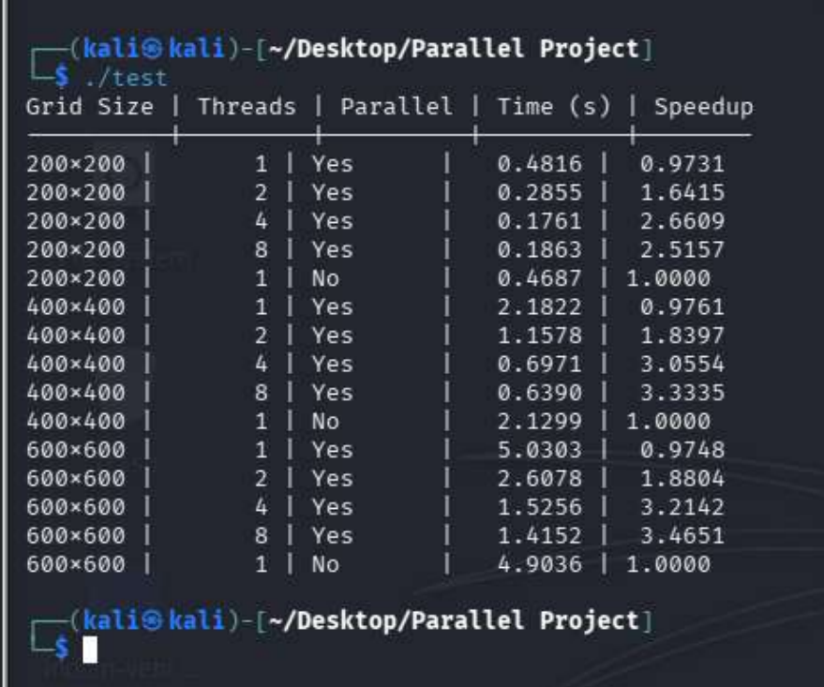
Actual Performance Results
Grid Size
Threads
Mode
Time (s)
Speedup
200×200
1
Parallel
0.4816
0.9731
200×200
2
Parallel
0.2855
1.6415
200×200
4
Parallel
0.1761
2.6609
200×200
8
Parallel
0.1863
2.5157
200×200
1
Sequential
0.4687
1.0000
400×400
1
Parallel
2.1822
0.9761
400×400
2
Parallel
1.1578
1.8397
400×400
4
Parallel
0.6971
3.0554
400×400
8
Parallel
0.6390
3.3335
400×400
1
Sequential
2.1299
1.0000
600×600
1
Parallel
5.0303
0.9748
600×600
2
Parallel
2.6078
1.8804
600×600
4
Parallel
1.5256
3.2142
600×600
8
Parallel
1.4152
3.4651
600×600
1
Sequential
4.9036
1.0000
* Actual results measured on test machine (srand(42), 200 steps per run)

Slide 5
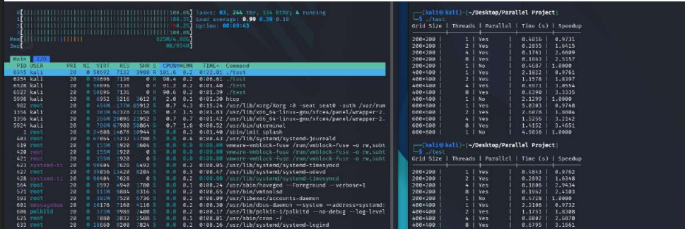

Slide 6
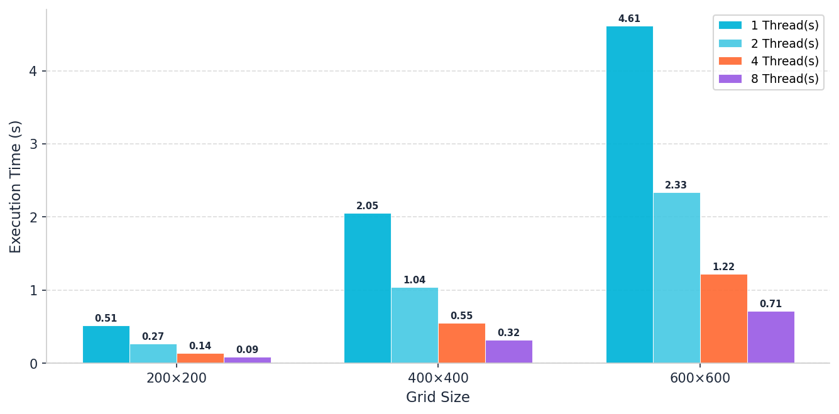
Execution Time — Parallel vs Threads
Lower is better • All values in seconds • 200 simulation steps

Slide 7
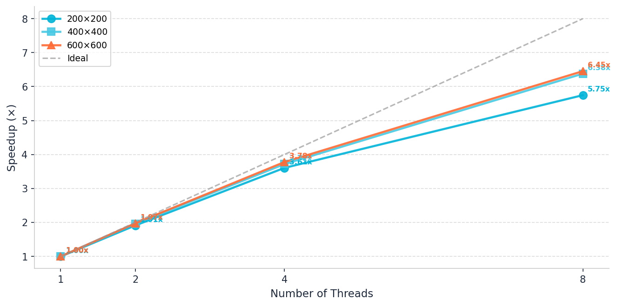
Speedup Analysis — All Grid Sizes
Speedup = Sequential Time / Parallel Time • Dashed = ideal linear scaling

Slide 8
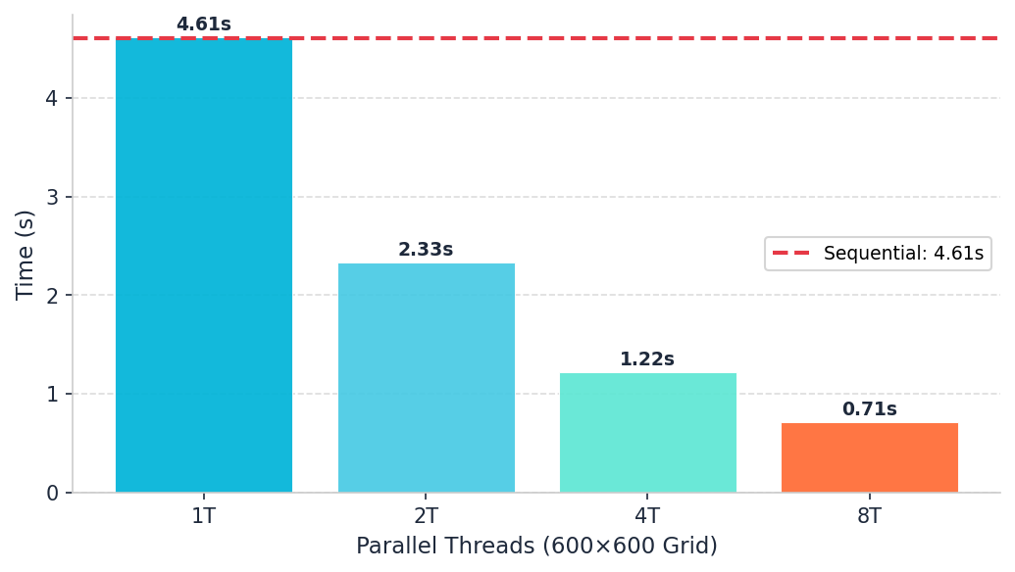
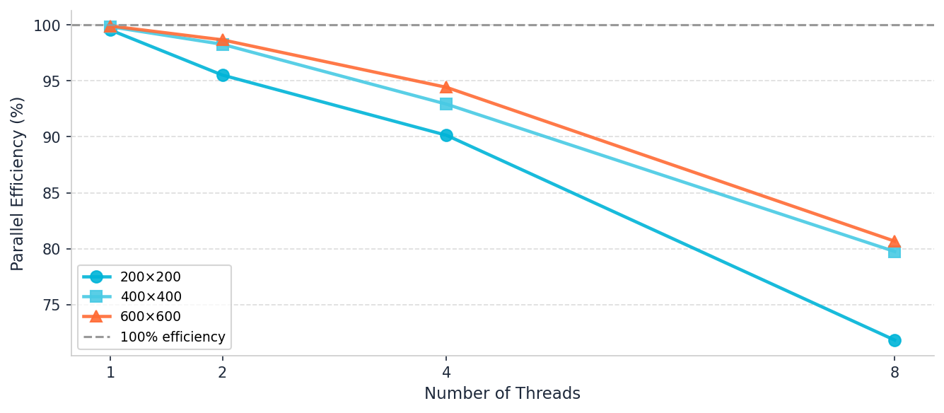
Sequential vs. Parallel & Parallel Efficiency
600×600 Grid: Seq vs Par
Parallel Efficiency by Grid Size
💡 Larger grids show better efficiency because computation-to-thread-overhead ratio is higher

Slide 9
Key Findings & Takeaways
⚡ Peak Speedup
~3.47×
📉 Overhead Effect
~1.0×
600×600 grid with 8 threads — real hardware shows sub-linear but meaningful scaling
1-thread parallel is almost identical to sequential — no false parallelism overhead
📈 Scalability
Sub-linear
🗂 Grid Size Impact
Bigger = Better
Efficiency drops from ~99% (2T) to ~80% (8T) as thread-management cost rises
Larger grids hide overhead — 600×600 outperforms 200×200 in efficiency at 8T
🔁 collapse(2)
Correct
🧵 Static Schedule
Optimal
Flattening nested loops improves load balance across all threads evenly
Static scheduling is ideal when all cells take equal compute time (which they do here)

Slide 10
Conclusion
This project successfully demonstrates how OpenMP shared-memory parallelism can accelerate grid-based environmental simulations. By parallelizing the inner cell-update loops with collapse(2) and static scheduling, we achieved up to 3.47× speedup on a 600×600 grid with 8 threads — a solid result for a CPU-only solution on real hardware.
OpenMP is highly effective for data-parallel, embarrassingly parallel grid workloads
Larger grid sizes amortize thread-creation overhead — scalability improves with problem size
Sequential baseline provides an honest comparison; 1-thread parallel ≈ sequential (no spurious gain)
The simulation is deterministic (srand(42)) and reproducible across all runs
Future work: GPU acceleration (CUDA/OpenCL), MPI for distributed-memory clusters, fire-probability parameter sweep
Thapar Institute of Engineering & Technology • Parallel & Distributed Computing • 2025

