Slide 1
Converting Adiabatic Equations Into Quantum Circuit Gates
Anushka Gupta-agupta35
Sreeraj Rajendran-srajen2
Varun Garg-vsgarg

Slide 2
Introduction
The main aim is to translate QUBO problems into gate circuits
This is done as gate models are more versatile and faster to compute classically
We create a code to take in a QUBO for a Boolean problem and output a quantum gate circuit corresponding to the inputs of the lowest energy states

Slide 3
Approach
Our code takes 2 (n,m) inputs initially (number of input bits and number of output bits). The code assumes that the first n bits are the input bits and the latter m bits are the output bits. It takes the weights of all the qubits and then the strengths of the couplers.
Receive input number of qubits, the QUBO and denote the output bit
Brute force all possible states in the QUBO
Sort the states as per the energy outputs of the QUBO
Build circuit for the lowest energy states

Slide 4
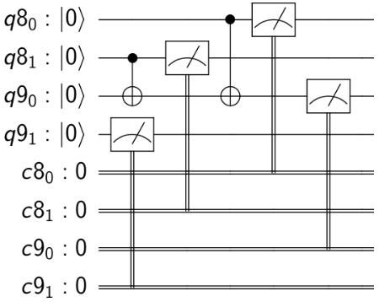
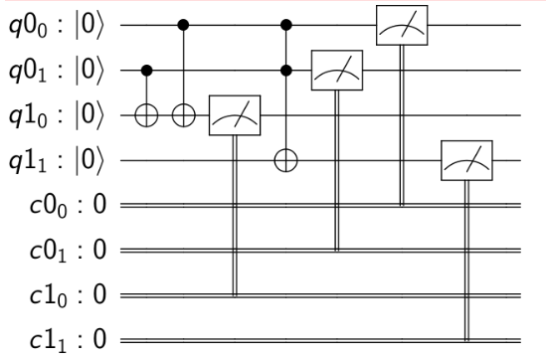
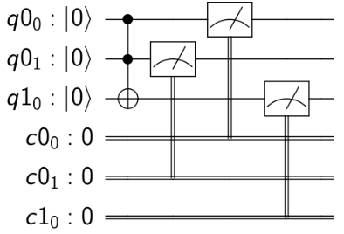
Sample Results
We try to create gates like AND, OR, NAND, NOR, XOR, half adder and full adder. Some example output results for AND,XOR and half adder are as below(left to right):

Slide 5
THANK YOU!

