Slide 1
Binary Heap
CSS 343: Data Structures, Algorithms, and Discrete Mathematics II
Version 2
Wooyoung Kim

Slide 2
Priority queue
A very common ADT: not FIFO. But determined by priority values
Usage
Schedule printing requests
Huffman coding
Primary operations
insert
findMin (or findMax)
deleteMin (or deleteMax)
Worst case complexity?
Unsorted collection
Sorted array
Binary search tree

Slide 3
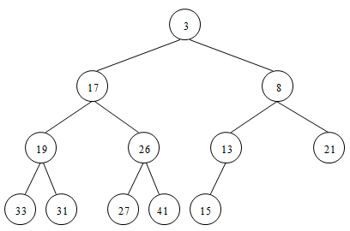
Binary Heap
Complete binary tree with heap property
Complete binary tree – every level is filled except possibly leaf level which is filled from left to right
Min heap property – a node is always no greater than its children
No other relationship otherwise between left and right subtrees

Slide 4

Binary Heap
Usually implemented in array
Start array at 1
For the n^{th} node
Parent index?
n/2
Left child index?
2n
Right child index?
2n + 1

Slide 5
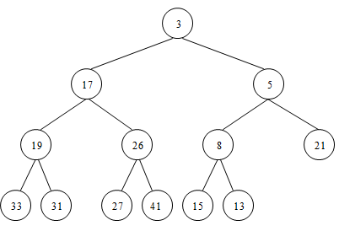
Insertion
Insert c (say priority 5)
Put to the end
Swap with parent if parent’s bigger
Group practice
Time complexity (worst case)?
O(log n)

Slide 6
Remove (min heap)
deleteMin
Root item is gone but not root (or no tree!)
Replace root item with last item then percolate down – pick small child to swap if child(ren) is smaller
Time complexity (worst case)?

Slide 7
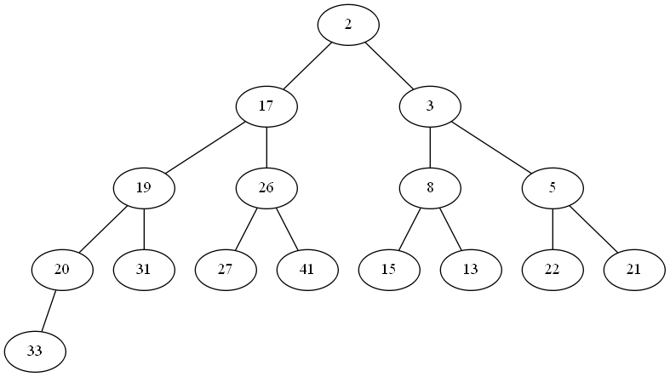
Practice
deleteMin (min heap)

Slide 8
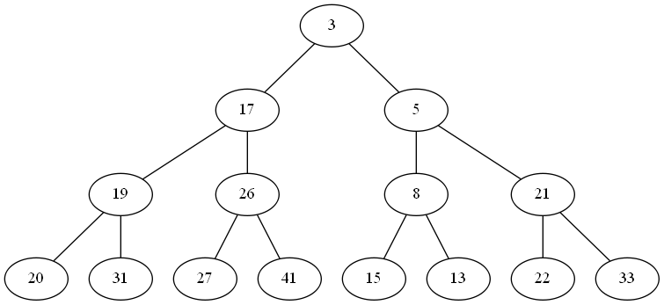
Practice
deleteMin (min heap)
Time complexity (worst case)?
-- O(log n)

Slide 9
Build a binary heap – O(nlogn)
E.g., 100, 80, 40, 90, 85, 60, 30, 45, 20, 95, 50, 10, 15, 120, 55
Insert by keeping complete binary tree
Percolate up
Repeat the two steps for each item
visualize
Group practice – final result?
Time complexity?
O(nlogn)

Slide 10
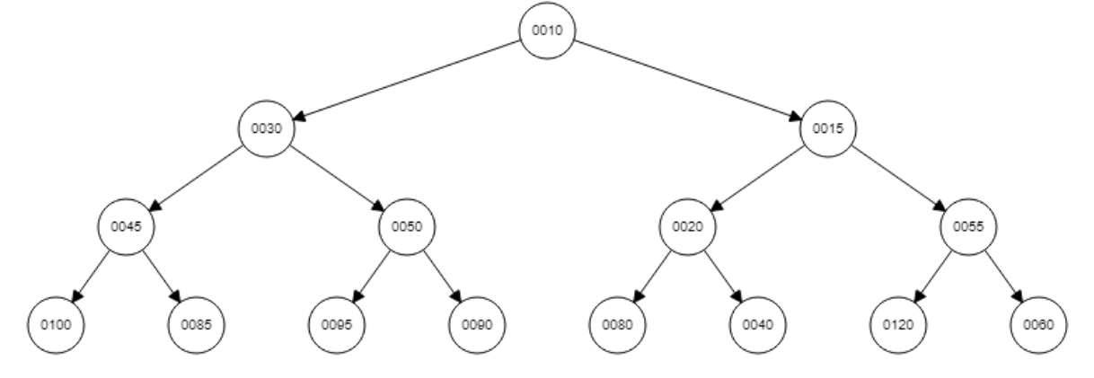
Build a binary heap-O(nlogn)
100, 80, 40, 90, 85, 60, 30, 45, 20, 95, 50, 10, 15, 120, 55

Slide 11
Build a binary heap –O(n)
O(nlogn) if add one node at a time.
Can we do better? Yes→ O(n)
What is a O(n) algorithm to build a binary heap, and why?

Slide 12
Build a binary heap –O(n)
Assumption: have data beforehand
E.g., 100, 80, 40, 90, 85, 60, 30, 45, 20, 95, 50, 10, 15, 120, 55
Build a complete binary tree: linear
Then make it a binary heap
For (int i = size/2; i>0; i--)
percolateDown(i);
Group practice:
Continue the process – final result?
Time complexity (worst case)?
O(n) (optionally see note 3 for more details)
Level 0 (root): 1 item, possible h swaps;
Level 1: 2 items, possible h-1 swaps;
So

Slide 13
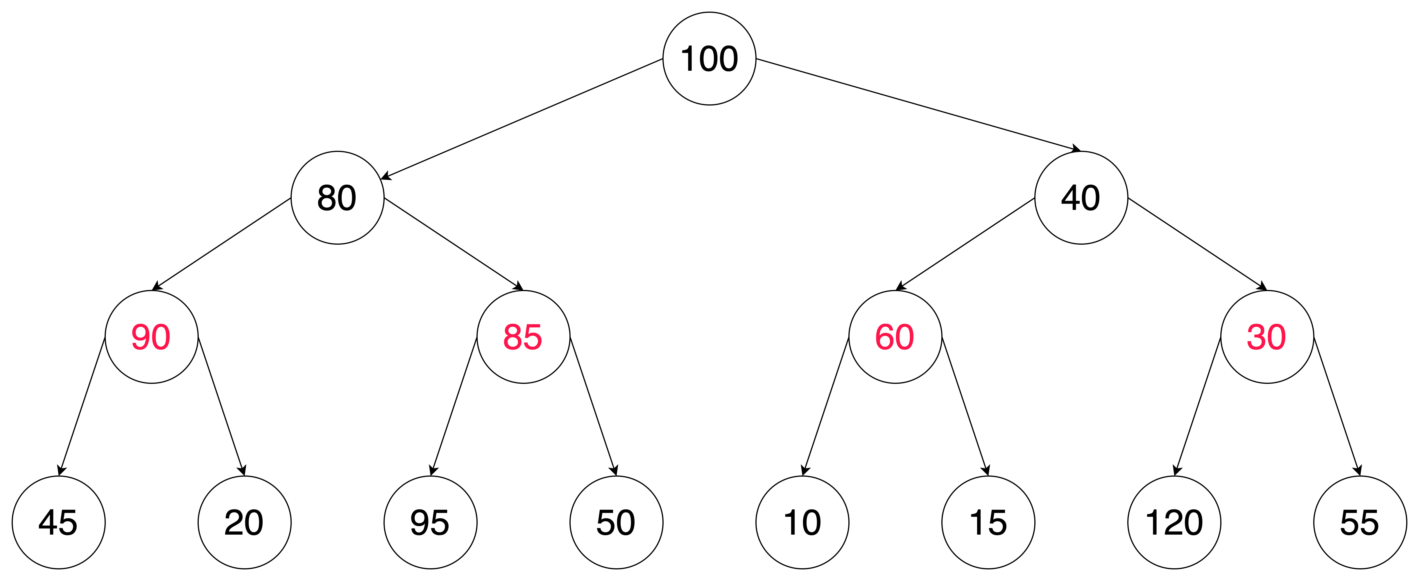
Build a binary heap-O(n)
100, 80, 40, 90, 85, 60, 30, 45, 20, 95, 50, 10, 15, 120, 55
Step1: Insert all to make complete binary tree

Slide 14
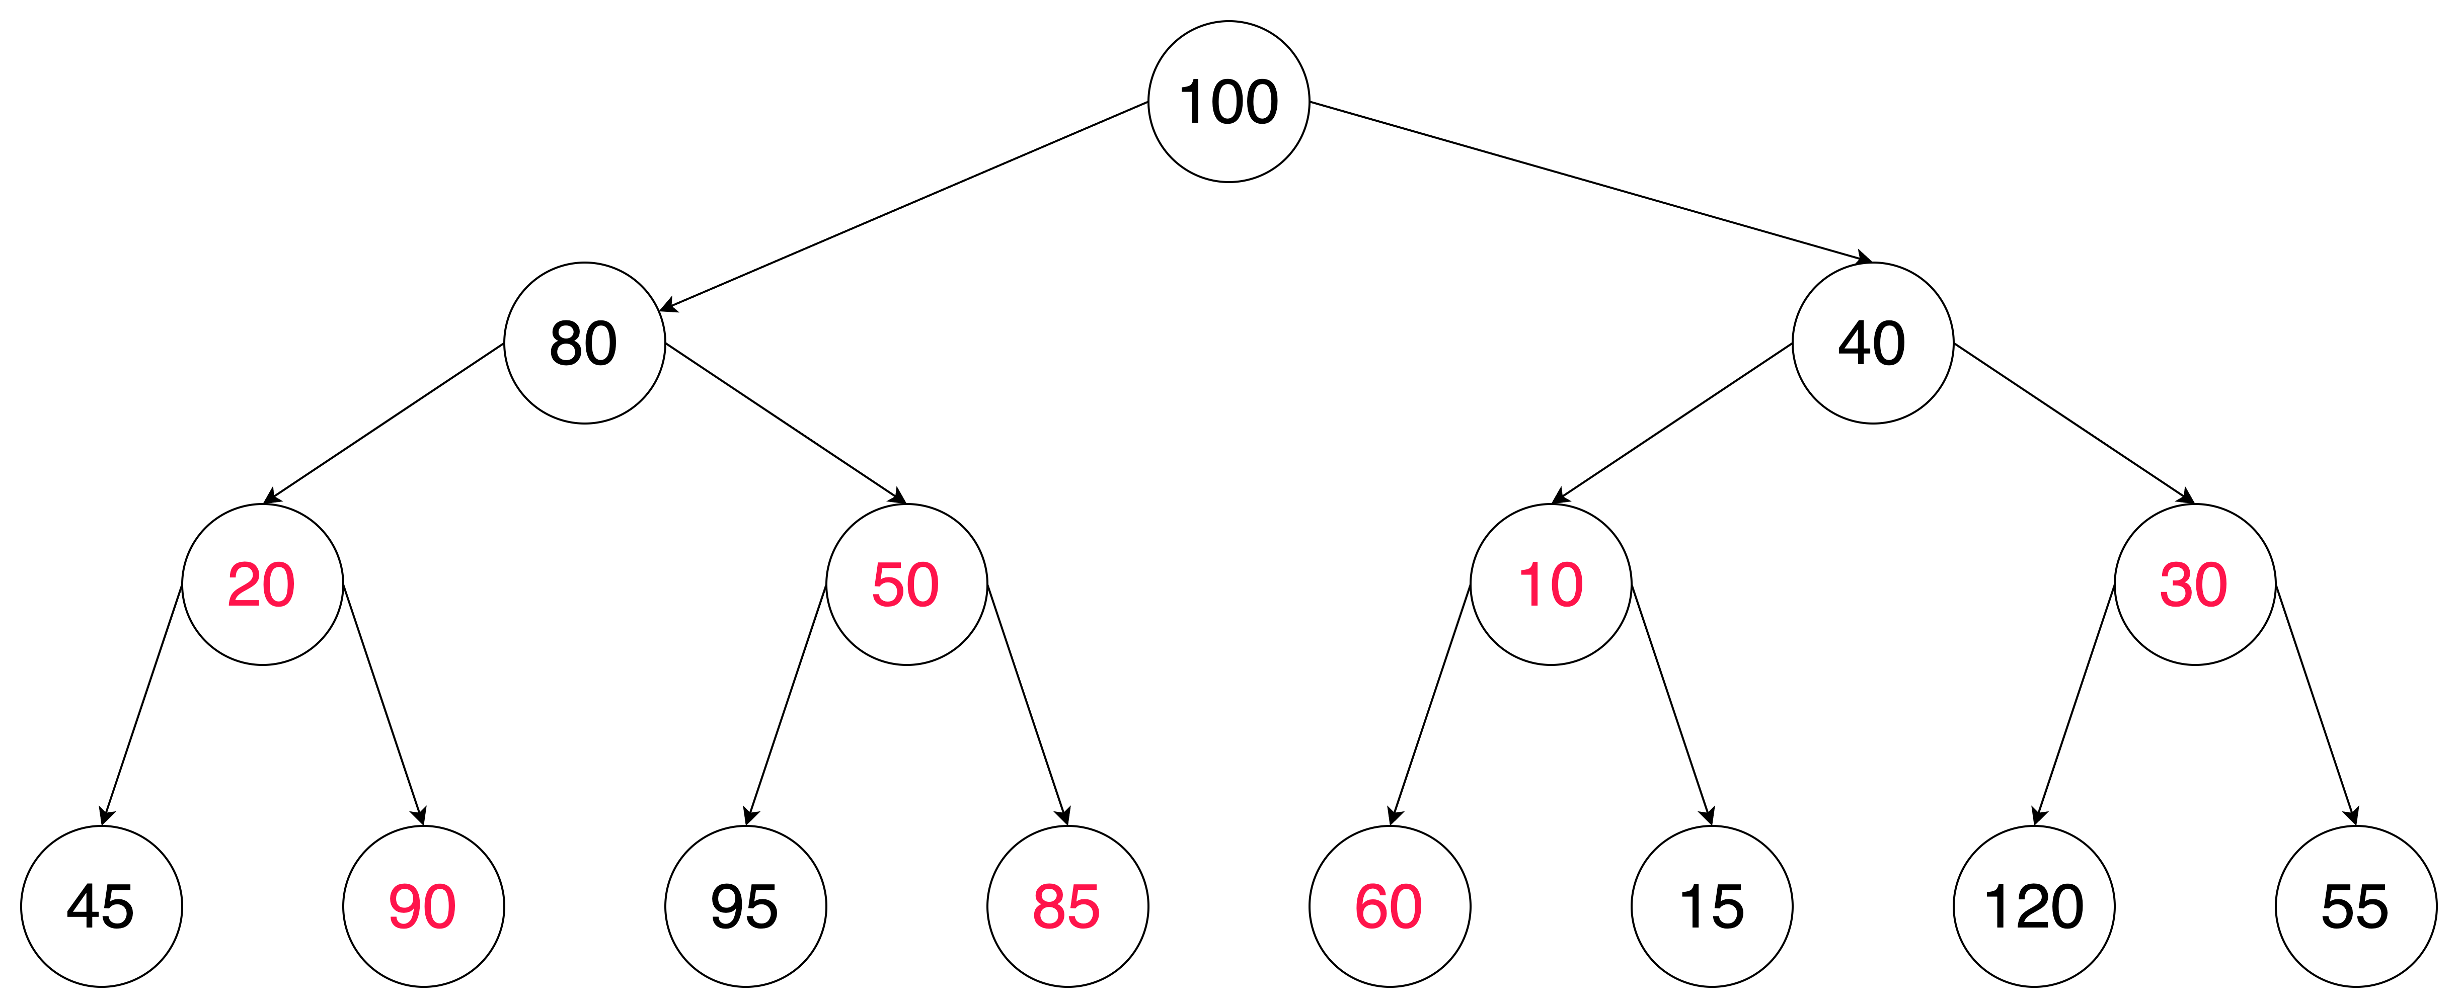
Build a binary heap-O(n)
100, 80, 40, 90, 85, 60, 30, 45, 20, 95, 50, 10, 15, 120, 55
Step2: Percolate down the nodes in level right above of the leaves, which is level 3

Slide 15
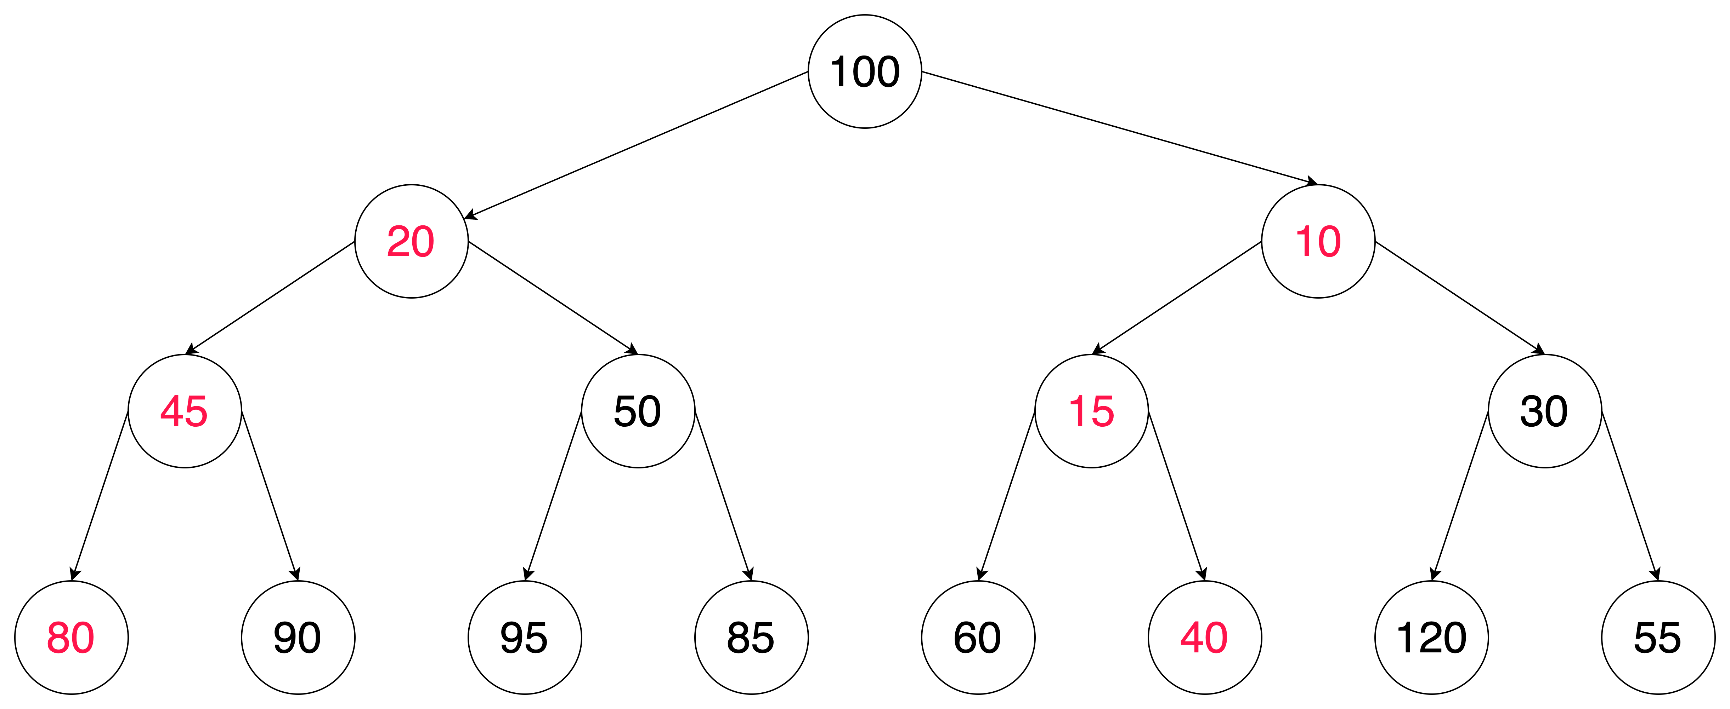
Build a binary heap-O(n)
100, 80, 40, 90, 85, 60, 30, 45, 20, 95, 50, 10, 15, 120, 55
Step3: Percolate down the nodes in level 2, until the leaf level.

Slide 16
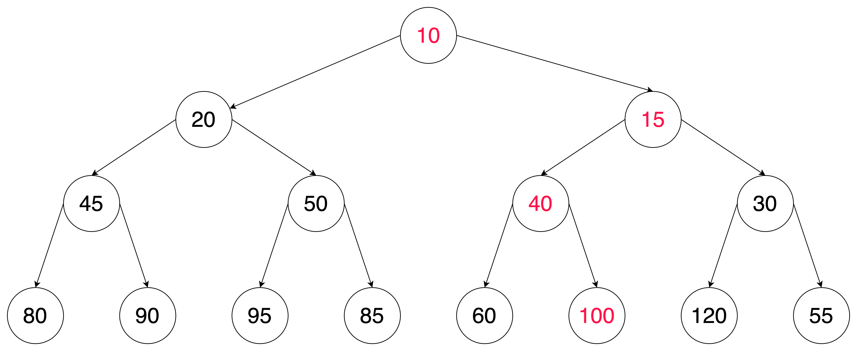
Build a binary heap-O(n)
100, 80, 40, 90, 85, 60, 30, 45, 20, 95, 50, 10, 15, 120, 55
Step4: Percolate down the root node until the level of leaves

Slide 17
Build a binary heap –O(n)
Time complexity (worst case)?
O(n) (optionally see note 3 for more details)
Level 0 (root): 1 item, possible h swaps;
Level 1: 2 items, possible h-1 swaps;
So

Slide 18
Build a binary heap – O(n)
Based on the assumption that data is given beforehand,
# of swap per height = # nodes * # swap per node
height | # nodes | # max. swap per node | remark
1 | 1=2⁰ | h | Swap top to leaf
2 | 2=2¹ | h-1 | Swap 1 to leaf
3 | 4=2² | h-2 | .
4 | 8=2³ | h-3 | .
… | … |  | .
h-1 | 2^{h-2} | 2 | Swap before leaf and leaf
h | 2^{h-1} | 1 | Swap only with leaf
h+1 | 2^{h} | 0 | Leaves do not have descendants

Slide 19


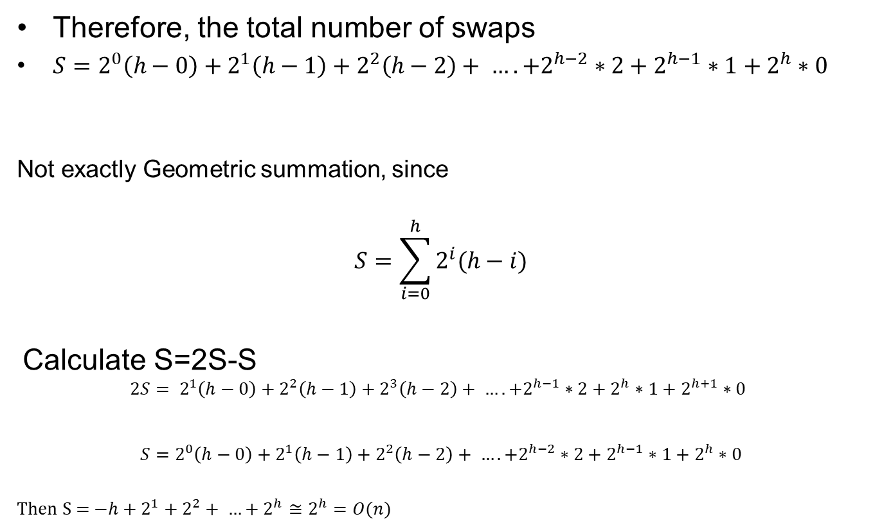




Build a binary heap –O(n)
Therefore, the total number of swaps
$S=2^{0}\left(h−0\right)+2^{1}\left(h−1\right)+2^{2}\left(h−2\right)+ …. +2^{h−2}∗2+2^{h−1}∗1+2^{h}∗0$
Not exactly Geometric summation, since
$$S=\sum_{i=0}^{h}{2^{i}(h−i)}$$
Calculate S=2S-S
$$2S= 2^{1}\left(h−0\right)+2^{2}\left(h−1\right)+2^{3}\left(h−2\right)+ …. +2^{h−1}∗2+2^{h}∗1+2^{h+1}∗0$$
$$S=2^{0}\left(h−0\right)+2^{1}\left(h−1\right)+2^{2}\left(h−2\right)+ …. +2^{h−2}∗2+2^{h−1}∗1+2^{h}∗0$$
Then S = ${−h+2}^{1}+2^{2}+ …+2^{h}≅2^{h}=O(n)$

Slide 20
Revisit: Huffman encoding efficiency
Building binary min heap: O(nlogn) or O(n)
Building Huffman tree using linked list: O(nlogn)
Do the following for n times
- Get 2 min. nodes from min heap and update
O(1)+O(logn)
- merge two nodes : O(1)
Time: O(nlogn)+O(nlogn) = O(nlogn)

