Slide 1
Graph
CSS 343: Data Structures, Algorithms, and Discrete Mathematics II
Version 2
Wooyoung Kim

Slide 2
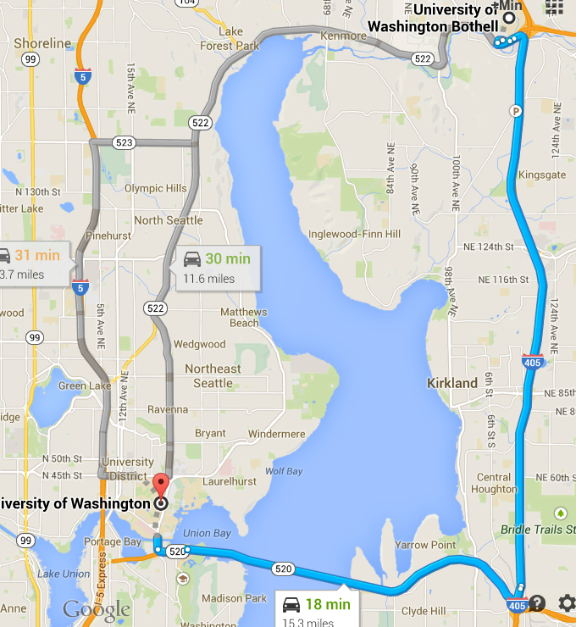
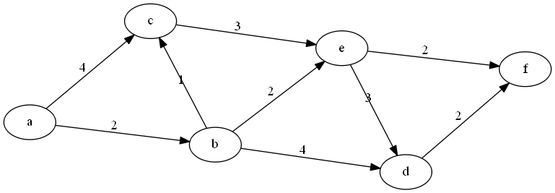
Graph ADT
Extremely common in CS applications
G = (V, E)
V: vertices, nodes, e.g., a, b, d, f
E: edges, e.g. edge (a, b)
Types
Directed: each edge is an ordered pair
Undirected
Weighted: each edge has a weight

Slide 3
Other basic concepts
Adjacent nodes: has an edge between them
Path: a sequence of edges to travel from one vertex to the other, e.g., from a to f
a, c, e, f
a, b, c, e, f
etc
Length of path (# of edges) vs. weight of path (sum of the edge weights)
destination
source

Slide 4
Graph Implementation
Arrays – adjacency matrix
an n x n array of weights
infinity (or a very large number, in practice) if there is no (directed) edge
Otherwise 1 (if non-weighted graph) or weight (if weighted graph)
How about this graph?
 | a | b | c | d | e | f
a | ∞ | 2 | 4 | ∞ | ∞ | ∞
b | ∞ | ∞ | 1 | 4 | 2 | ∞
c | ∞ | ∞ | ∞ | ∞ | 3 | ∞
d | ∞ | ∞ | ∞ | ∞ | ∞ | 2
e | ∞ | ∞ | ∞ | 3 | ∞ | 2
f | ∞ | ∞ | ∞ | ∞ | ∞ | ∞

Slide 5
Graph Implementation (cont.)
Pointers – adjacency list
one-dimensional array of linked-lists
each vertex: the set of vertices that are adjacent to it and the weights of the edges (if weighted graph)
How about this graph?
a
b
c
d
e
f
b | 2
c | 4
c | 1
d | 4
e | 2
e | 3
f | 2
d | 3
f | 2

Slide 6
Dijkstra’s Algorithm
Find the shortest path from a source (to a destination)
Implementation will be part of Program 3
Single-source shortest path problem
Both directed and undirected graphs
All edges must have nonnegative weights
Idea (dynamic programing)
Keep track of the best-known path to each vertex
Optimal Substructure
The subpath of any shortest path is itself a shortest path
destination
source

Slide 7
Pseudocode
for i = 1 to # vertices
find v; //not visited, shortest distance at this point
if v is destination
break;
mark v visited;
for each w adjacent to v
if (w is not visited)
T[w].dist=min(T[w].dist, T[v].dist+C[V][W])
destination
source

Slide 8
Follow the algorithm
4a
v=a
destination
source
2a
4a
3b
4b
v=b
destination
source
2a
6b

Slide 9
Follow the algorithm
3b
4b
6c
v=c
destination
source
2a
6b
3b
4b
v=e
6e
destination
source
2a
6b
7e

Slide 10
Follow the algorithm
3b
4b
8d
6e
destination
v=d
source
2a
6b
3b
4b
v=f: stop
6e
destination
source
a→b→e→f : dist=6
2a
6b

Slide 11
Solution
 | a | b | c | d | e | f
a | ∞ | 2 | 4 | ∞ | ∞ | ∞
b | ∞ | ∞ | 1 | 4 | 2 | ∞
c | ∞ | ∞ | ∞ | ∞ | 3 | ∞
d | ∞ | ∞ | ∞ | ∞ | ∞ | 2
e | ∞ | ∞ | ∞ | 3 | ∞ | 2
f | ∞ | ∞ | ∞ | ∞ | ∞ | ∞
 | b | c | d | e | f
Init, v=a | 2a | 4a | ∞ | ∞ | ∞
v=b, w=c,d,e | 2a | 2a+1=3b | 2+4=6b | 2+2=4b | ∞
v=c,w=e | 2a | 3b | 6b | 3b+3=6c 4b | ∞
v=e, w=d, f | 2a | 3b | 4b+3=7e 6b | 4b | 4b+2=6e
v=d, w=f | 2a | 3b | 6b | 4b | 6b+2=8d 6e
v=f, stop
a → b:2 → c:4
b → c:1→d:4→e:2
c →e:3
d → f:2
e → d:3 → f:2
dist=6
destination
source

Slide 12
Solution
 | a | b | c | d | e | f
a | ∞ | 2 | 4 | ∞ | ∞ | ∞
b | ∞ | ∞ | 1 | 4 | 2 | ∞
c | ∞ | ∞ | ∞ | ∞ | 3 | ∞
d | ∞ | ∞ | ∞ | ∞ | ∞ | 2
e | ∞ | ∞ | ∞ | 3 | ∞ | 2
f | ∞ | ∞ | ∞ | ∞ | ∞ | ∞
 | b | c | d | e | f
Init, v=a | 2a | 4a | ∞ | ∞ | ∞
v=b, w=c,d,e | 2a | 2a+1=3 | 2+4=6b | 2+2=4b | ∞
v=c,w=e | 2a | 3b | 6b | 3b+3=6c 4b | ∞
v=e, w=d, f | 2a | 3b | 4b+3=7e 6b | 4b | 4b+2=6e
v=d, w=f | 2a | 3b | 6b | 4b | 6b+2=8d 6e
v=f, stop
a → b:2 → c:4
b → c:1→d:4→e:2
c →e:3
d → f:2
e → d:3 → f:2
dist=6
3b
4b
6e
source
Backtrack from f to a
a→b→e→f : dist=6
2a
6b

Slide 13
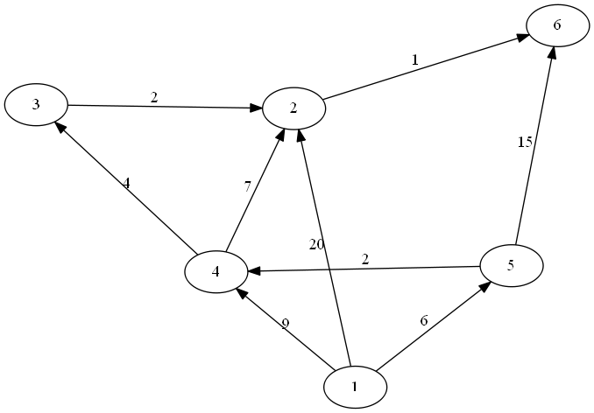
Watch Demo & Exercise
https://www.youtube.com/watch?v=UG7VmPWkJmA (demo starts at 35 second)
f
c
b
d
e
a

Slide 14
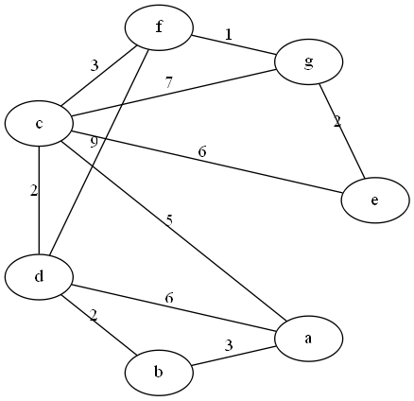
How about on undirected graph?

Slide 15
Review - Dijkstra’s Algorithm
Dijkstra Idea
Keep track of the best-known path to each vertex
Optimal Substructure
for i = 1 to # vertices
find v; //not visited, shortest distance at this point
if v is destination
break;
mark v visited;
for each w adjacent to v
if (w is not visited)
T[w].dist=min(T[w].dist, T[v].dist+C[V][W])

Slide 16
Example
 | b | c | d | e | f
Init, v=a | 2a | 4a | ∞ | ∞ | ∞
v=b, w=c,d,e | 2a | 2a+1=3 | 2+4=6b | 2+2=4b | ∞
v=c,w=e | 2a | 3b | 6b | 3b+3=6c 4b | ∞
v=e, w=d, f | 2a | 3b | 4b+3=7e 6b | 4b | 4b+2=6e
v=d, w=f | 2a | 3b | 6b | 4b | 6b+2=8d 6e
v=f, stop
How to reconstruct the path?
: going backwards from the destination until you get to the source
a→b→e→f : dist=6

Slide 17
Analysis of Dijkstra’s
for i = 1 to # vertices
find v; //not visited, shortest distance at this point
if v is destination
break;
mark v visited;
for each w adjacent to v
if (w is not visited)
T[w].dist=min(T[w].dist, T[v].dist+C[V][W])
Simple implementation with Adjacency matrix: O(V²) since
for each round with v, choosing shortest unvisited next v takes O(V)
Updating T(w) takes O(V) (at most V neighbors)
Therefore V*O(2V) = O(V²)
http://www.geeksforgeeks.org/greedy-algorithms-set-7-dijkstras-algorithm-for-adjacency-list-representation/
Improve: Using a min-hip: O(E log V) since
Choosing shortest unvisited next v takes O(1)
but updating min-hip takes O(log V)
Updating T(w) takes the number of edge of v, so total O(V+E)
logV * (V+E) = E*logV as (V+E)<=2E

Slide 18
More on graphs
Connected graphs
Depth First search/applications
Biconnected graphs and Articulation points
Breadth first review/applications
Euler tour and circuit

Slide 19
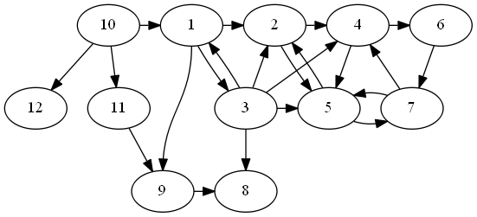
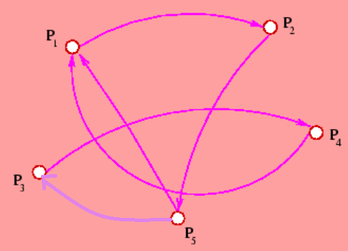
Connected vs. Unconnected
Connected vs. unconnected graph
A connected graph has a path from every vertex to every other vertex
How about these graphs?
How to determine?

Slide 20
Connected vs. Unconnected
Connected vs. unconnected graph
A connected graph has a path from every vertex to every other vertex
Find DFS (tree): If a graph is not connected, DFS from at V will not visit all the vertices.
Unconnected (Strongly) Connected
Weekly connected?

Slide 21
Note on connected graph
Connected graph: Usually associated with undirected graph. There is a path between every two nodes
Strongly connected: Usually associated with directed graph. There is a path between every two nodes (both direction)
Weakly connected: Usually associated with directed graph. If converted as undirected graph, then it is connected
When DFS from v does not visit all vertex, it is not (strongly) connected

Slide 22
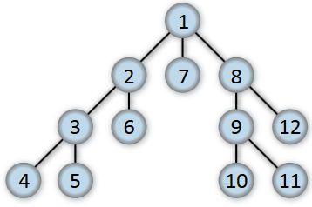
Depth-first algorithm
Part of your assignment 3
We’ve learned depth-first search on trees
pre-order traversal
Extend it to graph
Instead of “child” in tree, use "neighbor“ (adjacent)
For each vertex, need to decide in what order to visit the adjacent vertex – using vertex number to break ties

Slide 23
Depth-First Search code
Goes as far as possible from a vertex before backing up. Do this until visit all vertices.
Recursive algorithm
// traverses a graph beginning at v by using a DFS
dfs ( v: vertex)
Mark v as visited
for (each unvisited vertex u adjacent to v)
dfs(u)

Slide 24
Depth-First Search
Iterative algorithm, using a stack
// traverses a graph beginning at v by using a DFS
dfs ( v: vertex)
s = a new empty stack
// push v onto the stack and mark it
s.push(v)
Mark v as visited
while (!s.isEmpty()) {
if (!unvisited vertices adjacent to top of stack)
s.pop()
else{
select an unvisited u adjacent to top of stack)
s.push(u)
Mark u as visited
}
}

Slide 25
Example

Slide 26
Example
Adjacency list
1→2→3→9
2→4→5
3→1→2→4→5→8
4→5→6
5→2→7
6→7
7→4→5
8
9→8
10→1→11→12
11→9
12

Slide 27
Example
Adjacency list
1→2→3→9
2→4→5
3→1→2→4→5→8
4→5→6
5→2→7
6→7
7→4→5
8
9→8
10→1→11→12
11→9
12
s(stack): 1 2 4 5 7
DFS : 1 2 4 5 7
s(stack): 1 2 4 6
DFS : 1 2 4 5 7 6
s(stack): 1 2 4 5 7
DFS : 1 2 4 5 7
s(stack): 1
DFS : 1 2 4 5 7 6 3 8 9
s(stack): 1 2 4 5
DFS : 1 2 4 5 7
s(stack): 10 12
DFS : 1 2 4 5 7 6 3 8 9 10 11 12

Slide 28
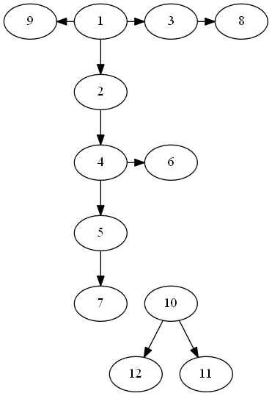
Example
DFS : 1 2 4 5 7 6 3 8 9 10 11 12
Draw DFS spanning tree
1, 2, 4, 5, 7, 6, 3, 8, 9, 10, 11, 12

Slide 29
DFS in a tree
DFS:
Preorder:

Slide 30
DFS in a tree
DFS: A B D H N O I E J K C F G L M
Preorder: A B D H N O I E J K C F G L M

Slide 31
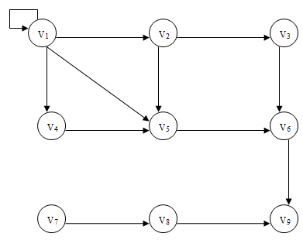
Exercise– depth first
Is it connected?

Slide 32
Time for DFS
// traverses a graph beginning at v by using a DFS
dfs ( v: vertex)
s = a new empty stack
// push v onto the stack and mark it
s.push(v)
Mark v as visited
while (!s.isEmpty()) {
if (!unvisited vertices adjacent to top of stack)
s.pop()
else{
select an unvisited u adjacent to top of stack)
s.push(u)
Mark u as visited
}
}
Each vertex is visited once, and each neighbor is visited at most once in directed graph, twice in undirected graph.
Therefore, O(V+E)

Slide 33
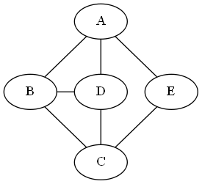
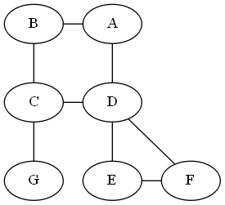
Biconnected
Biconnected:
A connected undirected graph where no vertex’s removal disconnects the rest of graph
Applications: Network, mass transit system
How to determine?
biconnected Not biconnected
Notes:
Biconnected graph: connected, non-separable graph

Slide 34
Biconnected
Biconnected:
A connected undirected graph where no vertex’s removal disconnects the rest of graph
Applications: Network, mass transit system
If graph is not biconnected:
articulation point: its removal disconnects the graph
biconnected Not biconnected

Slide 35
Articulation points
articulation point: its removal disconnects the graph
Can you find articulation points on these two graphs?

Slide 36
Articulation points
articulation point: how to find?

Slide 37
Articulation points
articulation point: how to find?
For all vertex,
a) remove v
b) see if it disconnects graph (DFS or BFS)
c) add v back to graph
Time complexity O(V*(V+E)) → Can we do better?

Slide 38
Articulation points
articulation point: how to find?
For all vertex,
a) remove v
b) see if it disconnects graph (DFS or BFS)
c) add v back to graph
Time complexity O(V*(V+E)) → Can we do better? → O(V+E) algorithm

Slide 39
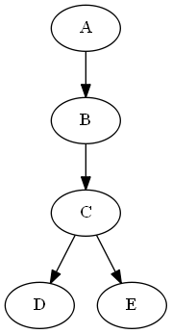
Articulation point detection
Check DFS spanning tree
Back edge: from descendant to ancestor, not part of tree edge
articulation point
Root is articulation iff it has at least two children
Other node v is articulation if it has a child w such that no vertex in subtree rooted with w has a back edge to one of the ancestors of v.
B is not articulation since D→A and E→A
C is not articulation since D→ A and E→A and D→B
Leaf is never an articulation point

Slide 40
Articulation point detection
Check DFS spanning tree
Define (seq, low)
seq (sequence #): order in the spanning tree (preorder number) DFS order
low (Lowest reachable #): the lowest sequence # node that the current node can reach by taking 0 or more tree edges and then (possibly) one back edge
low(B) = 1 since, B →C→D→A
low can be found efficiently using post-order traversal
(1,1)
(2,1)
(3,1)
(4,1)
(5,1)

Slide 41
Articulation point detection
O(V+E) algorithm to detect articulation points
Check DFS spanning tree
articulation point if
Root is articulation iff it has more than one child
Other node v is articulation iff its one of the child w has low(w)>=seq(v)
(w can only reach to v or below. So if v is removed, w cannot reach above v, so it is disconnected→ v is articulation point)
Leaf is never an articulation point
(1,1)
(2,1)
(3,1)
(4,1)
(5,1)

Slide 42
Computing low #
Get postorder in the DFS : O(V+E)
For each vertex v as in postorder, compute
seq(v),
low(v) = min seq(w) where v→w is backedge
low(w) where v→ w is tree edge (recursive)
Note that the third method is a recursive call. Since we need to evaluate low for all the children of v before we can evaluate low(v), this is a postorder traversal. For any edge (v,w), we can tell whether it is a tree edge or a back edge mearly by checking seq(v) and seq(w).
(1, )
postorder | D | E | C | B | A
seq(v) | 4 | 5 | 3 | 2 | 1
v→w | back(A) | back(A) | tree(D) | tree(C) | tree(B)
seq(w) | seq(A)=1 | 1
low(w) |  |  | low(D)=1 | low(C)=1 | low(B)=1
low(v) | 1 | 1 | 1 | 1 | 1
(2, )
(3, )
(4, )
(5, )
Notes:
Compute low (v) in postorder

Slide 43
Example

Slide 44
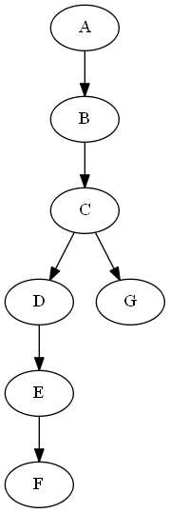
Example-seq
(1, )
(2, )
(3, )
low (Lowest reachable #): the lowest sequence # node that the current node can reach by taking 0 or more tree edges and then (possibly) one back edge
(4, )
(7, )
(5, )
(6, )

Slide 45
Example-low
(1,1)
(2,1)
(3,1)
low (Lowest reachable #): the lowest sequence # node that the current node can reach by taking 0 or more tree edges and then (possibly) one back edge
(4,1)
(7,7)
(5,4)
(6,4)

Slide 46
Using post-order
Get postorder in the DFS : O(V+E)
For each vertex v,
seq(v),
low(v) = min seq(w) where v→w is backedge
low(w) where v→ w is tree edge (w is child of v)
(1, )
post | F | E | D | G | C | B | A
seq(v) | 6 | 5 | 4 | 7 | 3 | 2 | 1
v→w | back(D) | tree(F) | back(A) | no | tree(D,G) | tree(C) | tree(B)
seq(w) | seq(D)=4 |  | seq(A)=1
low(w) |  | low(F)=4 |  |  | low(D)=1 | low(C)=1
low(v) | 4 | 4 | 1 | 7 | 1 | 1 | 1
(2, )
(3, )
(4, )
(7, )
(5, )
(6, )

Slide 47
Example
(1,1)
(2,1)
(3,1)
Articulation points low(w)>=seq(v) where w is one of v’s child
C and D are articulation points
C (seq(C) = 3, its child G has low(G) = 7)
D (seq(D) = 4, its child E has low(E) = 4)
(4,1)
(7,7)
(5,4)
(6,4)

Slide 48
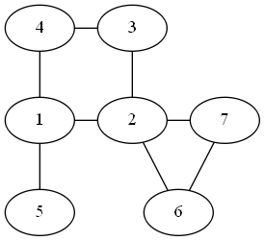
Articulation Points Exercise
What about the following graph?

Slide 49
Analysis
Time for DFS?
Question) in a binary tree, what is the complexity of preorder?
Time for finding articulation points?

Slide 50
Analysis
DFS: O(V+E)
Question) in a binary tree, what is the complexity of preorder? O(V+V-1) = O(V), since E = V-1 in a binary tree
Finding articulation points:
DFS ordering and find seq# : O(V+E)
Compute low#: O(V)
Get postorder in the DFS : O(V)
For each vertex v,
seq(v),
low(v) = min seq(w) where v→w is backedge
low(w) where v→ w is tree edge (w is child of v)

Slide 51
Applications of Depth first search
Minimum spanning trees in unweighted graphs
Cycle detection (using back edges)
Path finding
Topological Sorting
Puzzles with only one solution (e.g., mazes)

Slide 52



Euler(ian) tour
Puzzles:
reconstruct the figures using a pen (without being lifted from the paper), draw each line exactly once – Euler tour
Euler tour: a path that visits every edge exactly once

Slide 53
Euler path and Euler circuit
Open Euler tour (Euler path):
Start with an empty stack and an empty circuit.
If all vertices have even degree - choose any of them.
If there are exactly 2 vertices having an odd degree - choose one of them.
Otherwise no Euler circuit or path exists.
Closed Euler tour (Euler circuit):
Do a DFS from a vertex until you are back at this vertex
Pick a vertex on this path with an unused edge and repeat 1
Splice all these paths into an Euler circuit

Slide 54
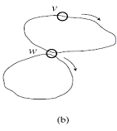
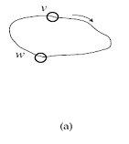
Algorithm for an Eulerian Circuit
Do a DFS from v until you are back at v. Mark edge (not vertex) as visited.
Pick a vertex on the path a with an unused edge and repeat a.
Splice all these paths into an Euler circuit.
(a)

Slide 55
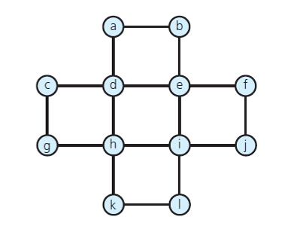
Finding Euler circuit
Adjacency list
a→b→d
b→a→e
c→d→g
d→a→c→e→h
e→b→d→f→i
f→e→j
g→c→h
h→d→g→i→k
i→e→h→j→l
j→f→i
k→h→l
l→i→k

Slide 56
Finding Euler circuit
DFS1: a b e d a
DFS2: e f j i e
DFS3: i h d c g h k l i
Combine the cycles:
a b e f j i h d c g h k l i e d a
Important note: Euler tour must visit each edge only once. Therefore, each DFSs should visit each edge only once. Whenever you visit an edge, mark it clearly so that you won’t visit again. Especially it is undirected graph, make sure to mark both direction if it is visited.

Slide 57
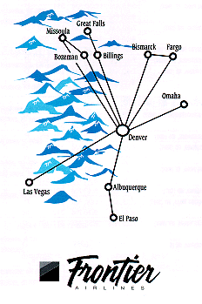
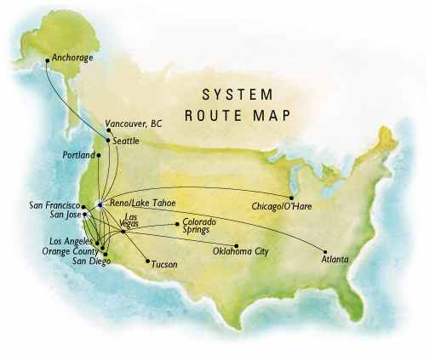
Applications of Euler tour
Networking
Navigation
Route maps
Base for harder problems:
Hamiltonian circuit (TSP)
These are examples of actual route maps from Frontier Airlines.
http://www.geom.uiuc.edu/~doty/pilot.html
Practice: redraw the graph with the cities more spread out. Is the route map an Euler circuit, tour, or neither?

Slide 58
Topological Sort
For a Directed Acyclic graph (DAG), topological sorting is a linear ordering of vertices s.t. for every edge u-v, u comes before v in the ordering
If Not DAG, topological sorting is unavailable.
From the graph below, it has a cycle 1→3→1, topological sorting is unavailable.

Slide 59
Topological Sort - steps
You need two stacks for the topological sorting.
Call DFS for the graph using a stack S.
Have an additional stack T, and whenever a node is popped from S, push it to T
After finishing DFS, pop the nodes from T one at a time, which is a topological sorting
Make sure that the arrows always go to right, to confirm it is a topological sorting.

Slide 60
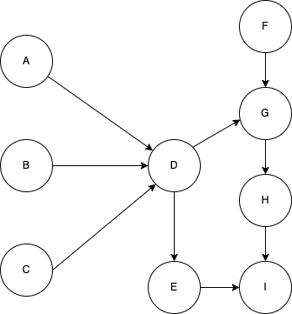
Topological Sort – Example (1)
Adjacency List
A→D
B→D
C→D
D→E→G
E→I
F→G
G→H
H→I
I
Stack | A D G H I E F B C
DFS | A D E I G H B C F
T stack | I E H G D A B C F
Topological sorting (pop T stack) : F C B A D G H E I
Like you can have other DFS, there are other topological sorting available.

Slide 61
Topological Sort – Example (2)
Adjacency List
A→D
B→D
C→D
D→E→G
E→I
F→G
G→H
H→I
I
Stack | A D G H I E F B C
DFS | A D G H I E B C F
T stack | I H G E D A B C F
Topological sorting (pop T stack) : F C B A D E G H I
Like you can have other DFS, there are other topological sorting available.

Slide 62
Topological Sort – Example (3)
Adjacency List
A→D
B→D
C→D
D→E→G
E→I
F→G
G→H
H→I
I
Stack | A D G H I E F B C
DFS | A D G H I E F B C
T stack | I H G E D A F B C
Topological sorting (pop T stack) : C B F A D E G H I
Like you can have other DFS, there are other topological sorting available.

Slide 63
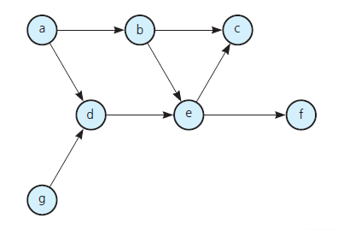
Topological Sorting - Exercise
Adjacency list
a→b→d
b→c→e
c
d→e
e→f
f
g→d

Slide 64
Breadth first algorithm
Breadth-first search on trees
Level-order traversal
Extend it to graph
Instead of “child” in tree, use "neighbor“ (adjacent)
Keep track of paths
Find BFS ordering in those graphs

Slide 65
Breadth first algorithm
Breadth-first search on trees
Level-order traversal
Extend it to graph
Instead of “child” in tree, use "neighbor“ (adjacent)
Keep track of paths
Find BFS ordering in those graphs
1,2,7,8,3,6,9,12,4,5,10,11

Slide 66
Breadth first
Level-order traversal: process vertices closest to the start first, and the most distant last
Keep track of paths
Use queue
start_bfs(){
Q← a queue
for v=1 to n
if (v is not visited)
bfs(v, Q);
}
bfs(v, Q){
mark v visited
Q.enqueue(v);
while (Q is not empty){
u=Q.dequeue()
for each w adjacent to u {
if (w is not visited){
mark w visited;
Q.enqueue(w)
}
}
}
}
1→2→3→9
2→4→5
3→1→2→4→5→8
4→5→6
5→2→7
6→7
7→4→5
8
9→8
10→1→11→12
11→9
12

Slide 67
Breadth first
1→2→3→9
2→4→5
3→1→2→4→5→8
4→5→6
5→2→7
6→7
7→4→5
8
9→8
10→1→11→12
11→9
12
start_bfs(){
Q← a queue
for v=1 to n
if (v is not visited)
bfs(v, Q);
}
bfs(v, Q){
mark v visited
Q.enqueue(v);
while (Q is not empty){
u=Q.dequeue()
for each w adjacent to u {
if (w is not visited){
mark w visited;
Q.enqueue(w)
}
}
}
}
1, 2, 3, 9, 4, 5, 8, 6, 7, 10, 11, 12

Slide 68
Breadth first
1→2→3→9
2→4→5
3→1→2→4→5→8
4→5→6
5→2→7
6→7
7→4→5
8
9→8
10→1→11→12
11→9
12
BFS tree:
Whenever dequeue v, the neighbors are added as children
1
2
3
9
4
5
8
10
6
7
11
12
1, 2, 3, 9, 4, 5, 8, 6, 7, 10, 11, 12

Slide 69
Exercise – Breadth first

Slide 70
Shortest path and BFS
BFS can only be used to find shortest path in a graph if
There are no loops
All edges have same weight or no weight
Start from the source and perform a BFS
Along with BFS order, keep the shortest paths for each vertex

Slide 71
Shortest path and BFS
BFS can only be used to find shortest path in a graph if
There are no loops
All edges have same weight or no weight
Start from the source and perform a BFS
Along with BFS order, keep the shortest paths for each vertex
Along with the BFS order, update the neighbor’s distance (yourself +1) if unvisited
BFS | 1 | 2 | 7 | 8 | 3 | 6 | 9 | 12 | 4 | 5 | 10 | 11
Prev |  | 1 | 1 | 1 | 2 | 2 | 8 | 8 | 3 | 3 | 9 | 9
Path | 0 | 1 | 1 | 1 | 2 | 2 | 2 | 2 | 3 | 3 | 3 | 3

Slide 72
Shortest path and BFS
Start from the source and perform a BFS
Along with BFS order, keep the shortest paths for each vertex
1→2→3→9
2→4→5
3→1→2→4→5→8
4→5→6
5→2→7
6→7
7→4→5
8
9→8
10→1→11→12
11→9
12
1
Along with the BFS order, update the neighbor’s distance (yourself +1) if unvisited
2
3
9
BFS | 1 | 2 | 3 | 9 | 4 | 5 | 8 | 6 | 7 | 10 | 11 | 12
Prev |  | 1 | 1 | 1 | 2 | 2 | 3 | 4 | 5 |  | 10 | 10
Path | 0 | 1 | 1 | 1 | 2 | 2 | 2 | 3 | 3 | Inf | Inf | inf
4
5
8
10
6
7
11
12

Slide 73
Applications of BFS
Graphs
Shortest path(BFS + Dijkstra’s algorithm)
Minimum spanning trees
Cycle detection
Search Engines: index building for visited links (crawlers)
Social Networks: find people with a given distance from someone
Networking and broadcasting: find neighboring nodes
Garbage collectors: better locality of reference

