Slide 1
CSS 422 Hardware and Computer Organization
Combinational Circuit
CPU Components and ALU Design
Ver. 2
Professor: Munehiro Fukuda

Slide 2
Topics
Karnaugh Map: more simplification techniques
Digital Components
Multiplexer
Decoder
Comparator
ALU Design
Half/Full Adders and Subtraction
Multiplier
ALU
Berger: Ch 1, 2, and 3
Null: Ch3

Slide 3
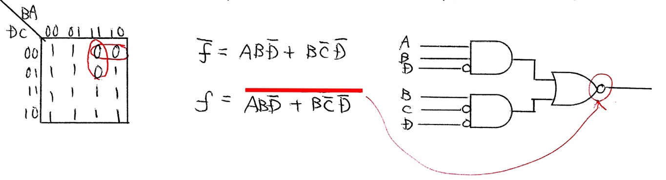
More Karnaugh Map Technique Use of Negation
If you find many 1s, group 0s.
Add a negation of the sum (= OR)

Slide 4

More Karnaugh Map Technique Exclusive OR
If a Kmap shows a latice with 0 at the upper left cell, use an exclusive OR.
truth table
A | B | F
0 | 0 | 0
0 | 1 | 1
1 | 0 | 1
1 | 1 | 0
B 0 1
B 0 1
BC 00 01 11 10
CD 00 01 11 10
A
0
1
A
0
1
A
0
1
AB
00
01
11
10
0 | 1
1 | 0
1 | 0
0 | 1
0 | 1 | 0 | 1
1 | 0 | 1 | 0
0 | 1 | 0 | 1
1 | 0 | 1 | 0
0 | 1 | 0 | 1
1 | 0 | 1 | 0
Kmap
Kmap
Kmap
F₁ = A~B + ~A B
= A B
F₂ = ~F
= ~(A B)
F₃ = A B C
Kmap
F₄ = A B C D

Slide 5
More Karnaugh Map Technique Don’t Care Terms
If some products can be either 0 or 1, you can choose 0 or 1 as you create larger groups.
A | B | C | D | P
0 | 0 | 0 | 0 | 0
0 | 0 | 0 | 1 | 0
0 | 0 | 1 | 0 | X
0 | 0 | 1 | 1 | 0
0 | 1 | 0 | 0 | 0
0 | 1 | 0 | 1 | 1
0 | 1 | 1 | 0 | 0
0 | 1 | 1 | 1 | X
1 | 0 | 0 | 0 | 0
1 | 0 | 0 | 1 | 0
1 | 0 | 1 | 0 | 0
1 | 0 | 1 | 1 | 0
1 | 1 | 0 | 0 | X
1 | 1 | 0 | 1 | X
1 | 1 | 1 | 0 | 1
1 | 1 | 1 | 1 | 1
CD 00 01 11 10
CD 00 01 11 10
AB
00
01
11
10
AB
00
01
11
10
0 | 0 | 0 | X
0 | 1 | X | 0
X | X | 1 | 1
0 | 0 | 0 | 0
0 | 0 | 0 | 0
0 | 1 | 1 | 0
1 | 1 | 1 | 1
0 | 0 | 0 | 0
Kmap
Kmap
F = AB + BD

Slide 6
Product of Sums
Simplification Steps
Negate a given product-of-sums form.
Apply De Morgan’s law to the negation.
Draw the corresponding truth table and Kmap.
Get a simplified logic.
Re-negate it back.
Example
F = (A + B + C)(B + ~C)
~F = ~{(A + B + C)(B + ~C)}
= ~(A + B + C) +~(B + ~C)
= ~A~B~C + ~BC
Truth table and Kmap
~ F = ~A~B +~BC
F = ~(~A~B + ~BC)
= ~(~A~B)~(~BC)
= (A + B)(B + ~C)
A | B | C | P
0 | 0 | 0 | 1
0 | 0 | 1 | 1
0 | 1 | 0 | 0
0 | 1 | 1 | 0
1 | 0 | 0 | 0
1 | 0 | 1 | 1
1 | 1 | 0 | 0
1 | 1 | 1 | 0
BC 00 01 11 10
A
0
1
1 | 1 | 0 | 0
0 | 1 | 0 | 0

Slide 7
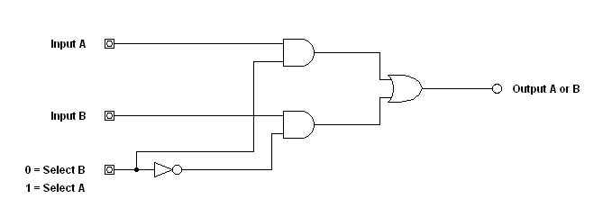
Simple Multiplexer (MUX)
Bus Selection
ALU Design
The MUX circuit allows one of two ( or more ) logical signals to be selected

Slide 8
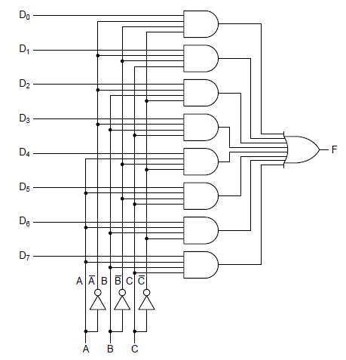
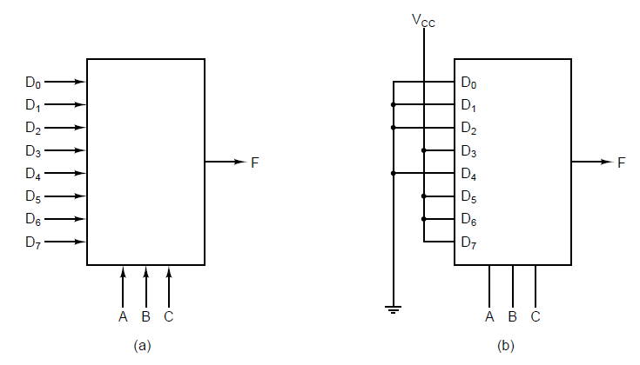
Multiplexers
Bus Selection
ALU Design
(a) An eight-input multiplexer. (b) The same multiplexer wired to compute the majority function.
A, B, C is control lines so that which of the eight input lines to be gated.

Slide 9
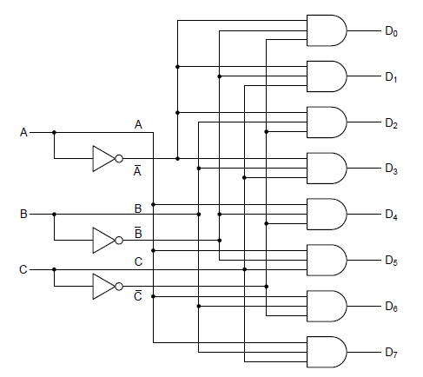
Decoder
Interrupt Control Hardware
A 3-to-8 decoder circuit: Depending on the inputs, only one of eight outputs is 1.

Slide 10
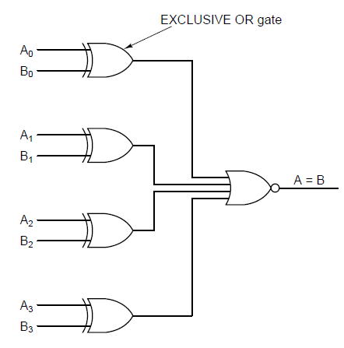
Comparator
ALU Design
A simple 4-bit comparator.

Slide 11
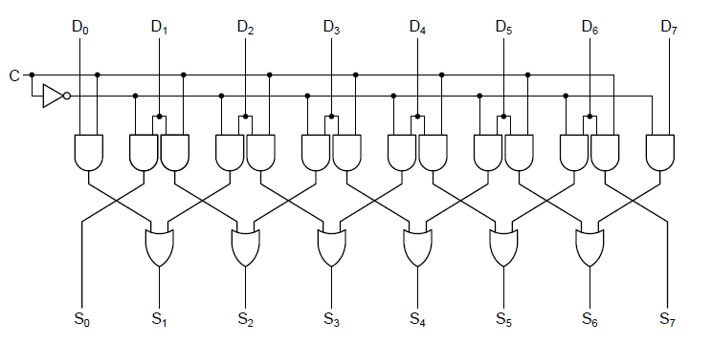
1-Bit Left/Right Shift Register
ALU Design

Slide 12
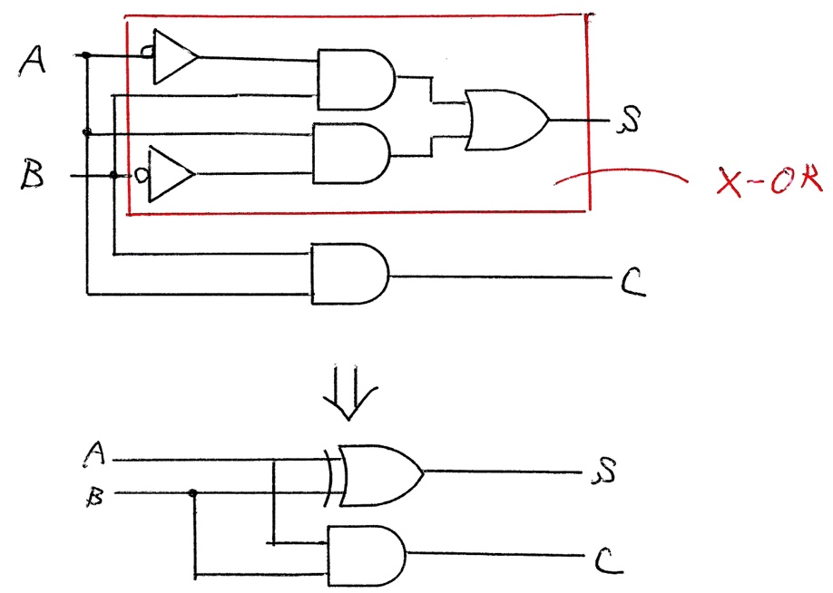
Half Adder
ALU Design
Truth Table
1-bit addition
A + B = Sum
0 + 0 = 0
0 + 1 = 1
1 + 0 = 1
1 + 1 = 1 0
A | B | Carry | Sum
0 | 0 | 0 | 0
0 | 1 | 0 | 1
1 | 0 | 0 | 1
1 | 1 | 1 | 0
~AB
A~B
S = ~AB + A~B = A + B
C = AB

Slide 13
Full Adder (1)
ALU Design
Truth Table
AB 00 01 11 10
Can’t simplify the logic at all:
S = ~A~BC_{in} + ~AB~C_{in} + A~B~C_{in} + ABC_{in}
Use the algebrical laws:
S = (~AB + A~B) ~C_{in} + (~A~B + AB) C_{in}
= (A B)~C_{in} + (~(A+B) + ~(~A + ~B))C_{in}
= (A B)~C_{in} + ~((A+B)(~A + ~B))C_{in}
= (A B)~C_{in} + ~(A~A +A~B+~AB +B~B)C_{in}
= (A B)~C_{in} + ~(A~B+~AB)C_{in}
= (A B)~C_{in} + ~(A B)C_{in}
= A B C_{in}
A | B | Cin | Cout | S
0 | 0 | 0 | 0 | 0
0 | 0 | 1 | 0 | 1
0 | 1 | 0 | 0 | 1
0 | 1 | 1 | 1 | 0
1 | 0 | 0 | 0 | 1
1 | 0 | 1 | 1 | 0
1 | 1 | 0 | 1 | 0
1 | 1 | 1 | 1 | 1
Cin
0
1
0 | 1 | 0 | 1
1 | 0 | 1 | 0
Kmap for S
If a Kmap became a lattice,
It means exclusiv ORs
AB 00 01 11 10
C_{out} = AB + BC_{cin} + C_{in}A
Use the algebrical laws:
C_{out} = AB(C_{in} + ~C_{in}) + (A +~A)BC_{in} + A(B + ~B)C_{in}
= ABC_{in} +AB~C_{in} + ABC_{in} +~ABC_{in} + ABC_{in} + A~BC_{in}
= ABCin + AB~Cin + (~AB + A~B)Cin
= AB(Cin + ~Cin) + (A B)Cin
= AB + (A B)Cin
Cin
0
1
0 | 0 | 1 | 0
0 | 1 | 1 | 1
Kmap for Cout

Slide 14
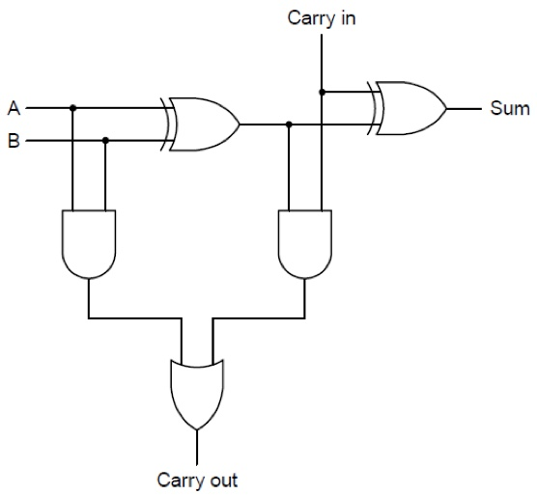
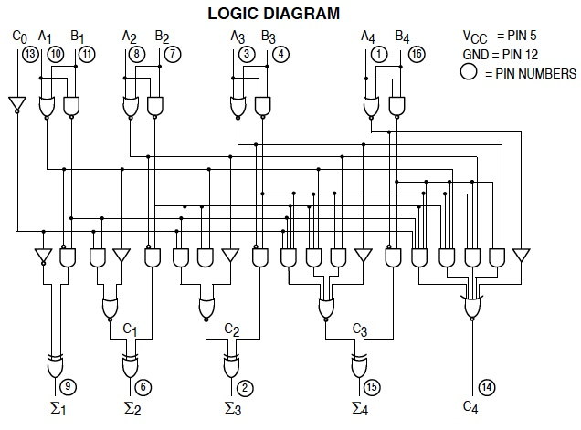
Full Adder (2)
ALU Design
C_{in}
A0
B0
A
B
Sum
GND
Carry look ahead
1-bit full addr
4-bit full addr
7483 4-bit full addr
C_{out}
C_{in}
A1
B1
A
B
Sum
C_{out}
C_{in}
A2
B2
A
B
Sum
C_{out}
C_{in}
A3
B3
A
B
Sum
Propagation Delay (with ripple carry)
C_{out}

Slide 15
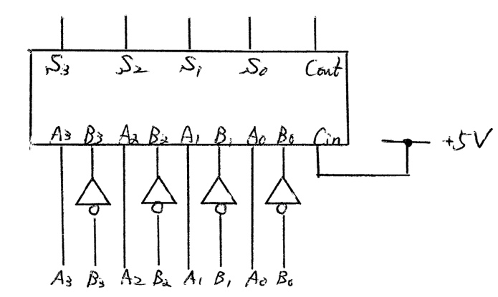
Subtraction
ALU Design
A – B = A + (–B) = A + (~B + 1)
2’s complement

Slide 16
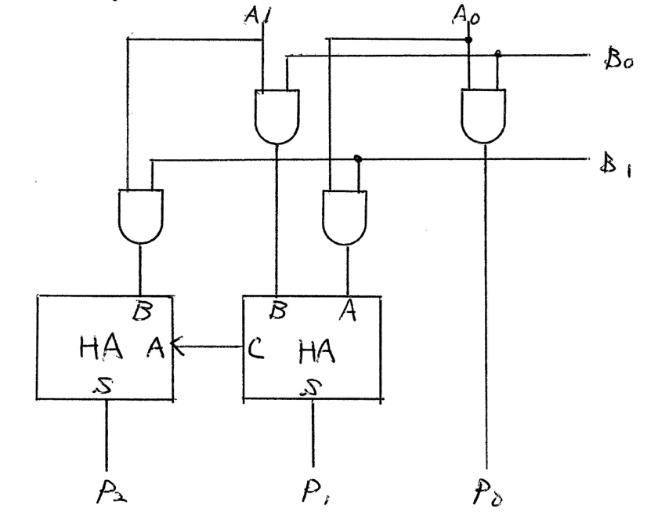
Multiplier
ALU Design
A₁ A₀
x) B₁ B₀
C₁ A₁B₀ A₀B₀
+ +
+) A₁B₁ A₀B₁
P₂ P₁ P₀
Full Addr
Half Addr

Slide 17
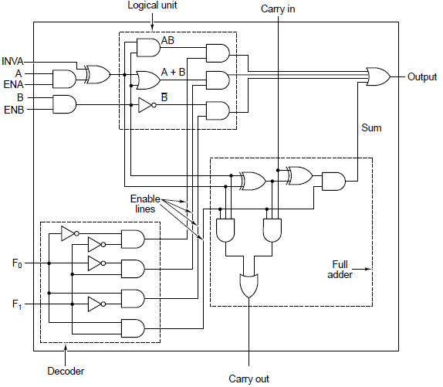
ALU
ALU Design
F₀ | F₁ | Operations
0 | 0 | AB
0 | 1 | A + B
1 | 0 | ~B
1 | 1 | A plus B

Slide 18
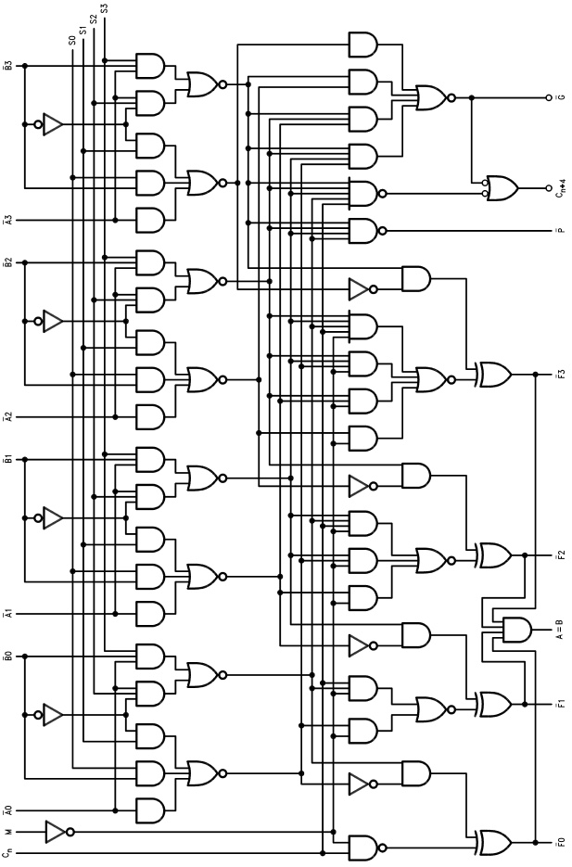
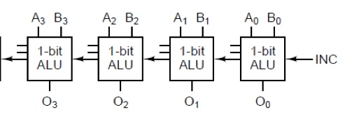
4-bit ALU
ALU Design
74181: Carry Look Ahead
Ripple Carry
F₀
F₁
C_{out}
C_{in}

Slide 19
Summary
More Kmap Techniques
Use the negation, XORs and “don’t care” terms
Digital Components
Multiplexer: choosing a data line from memory chips
Decoder: choosing a memory chip
Design of ALU
Comparator and shift register
Half/Full adder
Subtraction using a full adder (with ~B + Cin)
Multiplication with two half adders
Ripple carry versus carry look ahead Adder/ALU

