Slide 1
CSS 422 Hardware and Computer Organization
Project Overview
Ver. 1
Professor: Munehiro Fukuda

Slide 2
Objective
Implementing C Standard Library’s functions in ARM, through which you’ll understand
CPU operating modes: user and supervisor modes
System-call and interrupt handling procedures
C to assembler argument passing (APCS: ARM Procedure Call Standard)
Stack operations to impelment recursions at the assembly language level
Buddy memory allocation

Slide 3
ARM Implementation of C Standard Lib Functions
C standard lib functions | In stdlib.s ^{*1} | SVC ^{*2}
bzero( void *s, size_t n ) writes n zeroed bytes to the setring s. If n is zero, bzero( ) does nothing. | Yes
strncpy(char *dst, const char *src, size_t len) copies at most len characters from src into dst. It returns dst. | Yes
malloc( size_t size ) allocates size bytes of memory and returns a pointer to the allocated memory. If successful, it returns a pointer to allocated memory. Otherwise, it returns a NULL pointer. |  | Yes
free( void *ptr ) Deallocates the memory allocation pointed to by ptr. If ptr is a NULL pointer, no operation is performed. If successful, it returns a pointer to allocated memory. Otherwise, it returns a NULL pointer. |  | Yes
void (*signal( int sig, void (*func)(int))))(int); Invokes the func procedure upon receipt of a signal. Our implementation focuses only on SIGALRM, (whose system call number is 14.) |  | Yes
unsigned alarm( unsigned seconds ) sets a timer to deliver the signal SIGALRM to the calling process after the specified number of seconds. It returns the amount of time left on the timer from a previous call to alarm( ). If no alarm is currently set, the return value is 0. |  | Yes
*1: To be implemented in stdlib.s in the unprivileged thread mode
*2: To be passed as an SVC to SVC_Hander in the privileged handler mode

Slide 4
Software Organization
driver.c
int* alarmed;
void sig_handler1( int signum ) {
*alarmed = 2;
}
int main( ) {
char stringA[10] = "123456789\0";
char stringB[10];
_strncpy( stringB, stringA, 10 );
_bzero( stringA, 10 );
void* mem1 = _malloc( 1024 );
_free( mem6 );
alarmed = (int *)_malloc( 4 );
*alarmed = 1;
_signal( SIG_ALRM, sig_handler1 );
_alarm( 2 )
}
stdlib.s
_bzero
...
MOV pc, lr ; return to main( )
_strncpy
...
MOV pc, lr ; return to main( )
_malloc
....
MOV pc, lr ; return to main( )
_free
...
MOV pc, lr ; return to main( )
_signal
MOV pc, lr ; return to main( )
_alarm
MOV pc, lr ; return to main( )
User Mode
SysTick interrupt
starup_TM4C129.s
Reset_Handler
LDR R0, =__main
BX R0
SVC_Handler
PUSH {lr}
LDR R11, =_systemcall_table_jump
BLX R11
POP {pc}
SysTick_Handler
PUSH {lr}
LDR R11, =_timer_update
BLX R11
POP {pc}
svc.s
_systemcall_table_jump
PUSH {lr}
...
LDR R11, =_kinit, _kalloc, kfree, etc
BLX R11
POP {pc}
heap.s
_kinit
PUSH {lr}
...
POP {pc}
_kalloc
PUSH {r0-r12, lr}
...
LDR R11, =_ralloc
BLX R11
POP {r0-r12, pc}
_kfree
PUSH {r0-r12, lr}
...
LDR R11, =_rfree
BLX R11
POP {r0-r12, pc}
timer.s
_timer_init
PUSH {lr}
...
POP {pc}
_timer_start
PUSH {lr}
...
POP {pc}
_timer_update
...
_signal_handler
...
Supervisor (OS) Mode

Slide 5
Memory Map
Address | Size (hex) | Size (B) | Usage
0x400F.E600 – 0x400F.F028 | 0x0000.0A28 | 2.6KB | uDMA registers (memory mapped IO)
0x2000.7C00 – 0x2000.7FFF | 0x0000.0400 | 1KB | uDMA memory map (ch 30)
0x2000.7B80 – 0x2000.7BFF | 0x0000.0080 | 128B | System variables used by timer.s
0x2000.7B00 – 0x2000.7B7F | 0x0000.0080 | 128B | System call table used by svc.s
0x2000.6C00 – 0x2000.7AFF | 0x0000.0F00 | 3.8KB | Not used for now
0x2000.6800 – 0x2000.6BFF | 0x0000.0400 | 1KB | Memory control block to manage in heap.s
0x2000.6000 – 0x2000.67FF | 0x0000.0800 | 2KB | Not used for now.
0x2000.5800 – 0x2000.5FFF | 0x0000.0800 | 2KB | SVC (handler) stack: used by all the others
0x2000.5000 – 0x2000.57FF | 0x0000.0800 | 2KB | User (thread) stack: used by driver.c stdlib.s
0x2000.1000 – 0x2000.4FFF | 0x0000.4000 | 16KB | Heap space controlled by malloc/free
0x2000.0000 – 0x2000.0FFF | 0x0000.1000 | 4KB | Keil C compiler-reserved global data
0x0000.0000 – 0x1FFF.FFFF | 0x2000.0000 | 512MB | ROM Space: all code mapped to this space

Slide 6
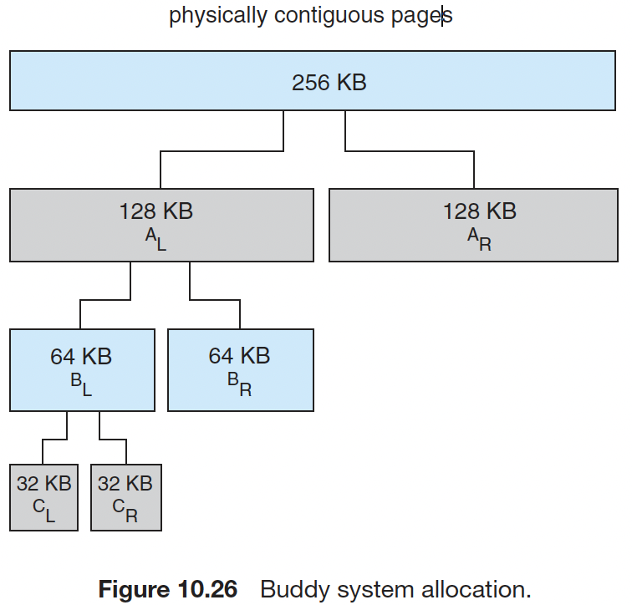
Buddy Memory Allocation

Slide 7
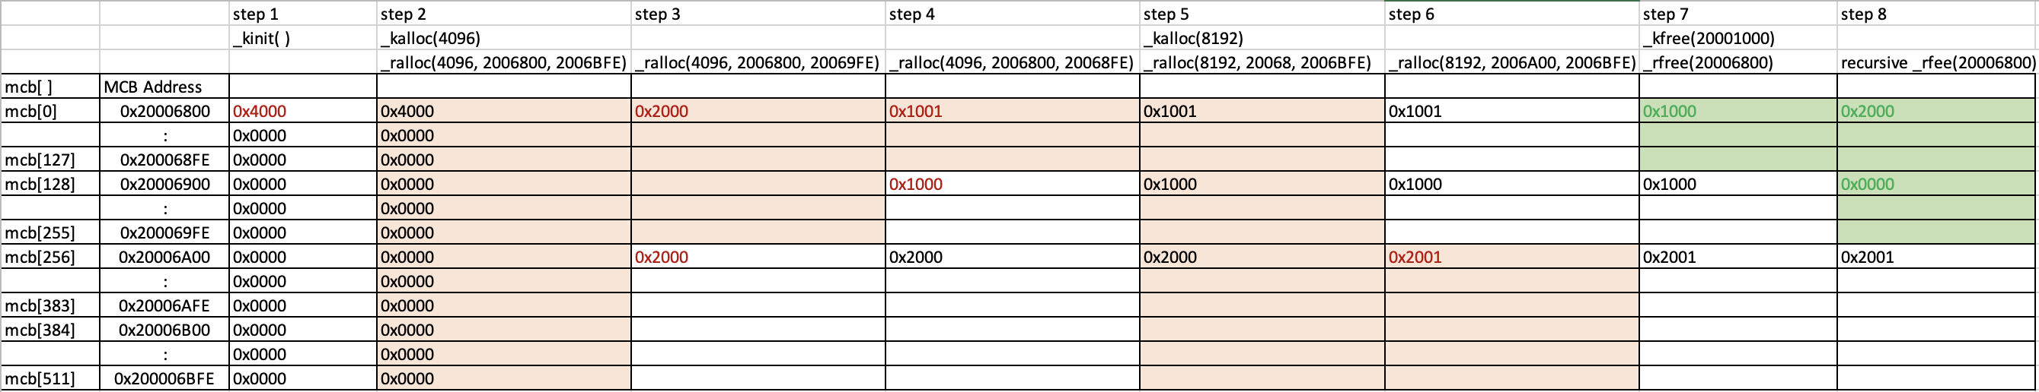
Memory Control Block (MCB)
MCB entry
bits | descriptions
#15 – #4 | The heap size this mcb entry is currently managing
#3 – #1 | Reserved
#0 | 0: available, 1: in use
SRAM (0x2000.1000 – 0x2000.3FFF) usage example and MCB entries
 | Heap Address | Memory Availability |  | MCB | MCB Address | Contents
0x20001000 – 0x20001FFF |  | 4KB in use |  | mcb[0] | 0x20006800 | 4097₁₀ (0x1001)
0x20002000 – 0x20002FFF |  | 4KB available |  | mcb[128] | 0x20006900 | 4096₁₀ (0x1000)
0x20003000 – 0x20003FFF |  | 8KB in use |  | mcb[256] | 0x20006A00 | 8193₁₀ (0x2001)
Buddy memory allocation
Deallocating 0x2000.6800
Allocating 4KB
Allocating 8KB

Slide 8
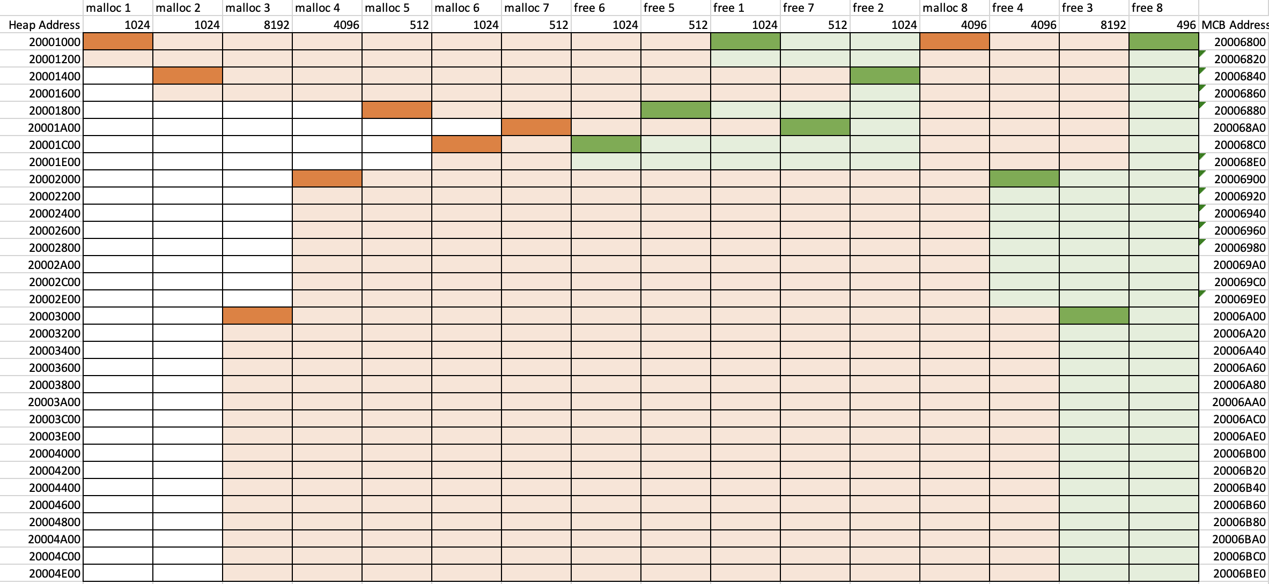
Test Scenario and Mem Allocation
driver.c
ARM SRAM (0x2000.1000 – 0x2000.4EFF)
int main( ) {
void* mem1 = malloc( 1024 );
void* mem2 = malloc( 1024 );
void* mem3 = malloc( 8192 );
void* mem4 = malloc( 4096 );
void* mem5 = malloc( 512 );
void* mem6 = malloc( 1024 );
void* mem7 = malloc( 512 );
free( mem6 );
free( mem5 );
free( mem1 );
free( mem7 );
free( mem2 );
void* mem8 = malloc( 4096 );
free( mem4 );
free( mem3 );
free( mem8 );
}

Slide 9
Signal and Alarm
int* alarmed;
void sig_handler1( int signum ) {
*alarmed = 2;
}
int main( ) {
signal( SIGALRM, sig_handler1 );
alarm( 2 );
while ( *alarmed != 2 ) {
void* mem9 = malloc( 4 );
free( mem9 );
}
}
Memory address | Parameters to store
0x2000.7B84 | *func
0x2000.7B80 | seconds
= sig_handler1
= 2
(2)
// Set a timer interrupt to invoke sig_handler1
// Let the timer count down from 2 seconds
Retrieve the seconds parameter from memory address 0x20007B80, which is the previous time value and should be returned to main( ).
Save a new seconds parameter from alarm( ) to memory address 0x20007B80.
Enable SysTick:
Set SYST_CSR’s Bit 2 (CLK_SRC) = 1, Bit 1 (INT_EN) = 1, Bit 0 (ENABLE) = 1
Clear SYST_CVR:
Set 0x00000000 in SYST_CVR.
(1)
(3)

Slide 10
Your Work
Step 1: Midpoint Report (Wk8)
Step 2: Final Report (Wk 11)
Materials | Remarks | Grade points (out of 25pts)
startup_tm4c129.s | From your Keil uVersion project | 2pts
stdlib.s | From your Keil uVersion project | 5pts
Two memory snapshots: stringA and stringB | From your Keil uVersion project | 4pts
heap.c | From your Linux C program | 10pts
a.out execution results | From your Linux C execution | 4pts
Materials | Remarks | Grade points (out of 75pts)
Your zipped Keil uVersion project (35pts) | startup_tm4c129.s Reset_Handler SVC_Handler SysTick_Handler | 5pts
 | driver_keil.c
 | stdlib.s | 6pts
 | svc.s | 3pts
 | heap.s | 16pts
 | timer.s | 5pts
Execution snapshots |  | 26pts
Documentation | A two-page summary of your implementation Narratives What you implemented. What was missing. Any Diagrams (at least one) | 6pts 6pts 2pts
Extra credits | If you implemented additional stdlib functions in ARM/THUMB-2, please write about them and highlight your narratives in our documentation. | 5pts

