Slide 1
CSS 422 Hardware and Computer Organization
Combinational Circuit
Logical Gates and Karnaugh Map
Ver. 2
Professor: Munehiro Fukuda

Slide 2
Topics
Logic and Gates
From circuit to logic
From logic to circuit
Canonical Forms
Sum of products
Product of sums
Karnaugh Maps and Boolean Equation
Berger: Ch 1, 2, and 3
Null: Ch 3

Slide 3

Analog vs Digital Circuits
Analog
Digital
Values: Any level probably between 0 and 5 volts
Signal Transmission
Example
Values: Two states
5V = H = 1 = On, 0V = L = Off
Signal Transmission
Example
circuit
circuit
1 1 0 1
Vcc (5V)
Input
High = 2.0 ~ 5V
Low = 0 ~ 0.7V
Collector
Output
Base
Emitter
GND

Slide 4
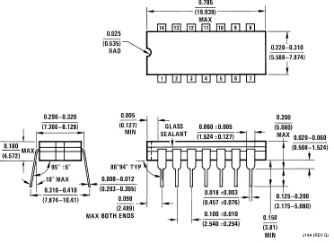



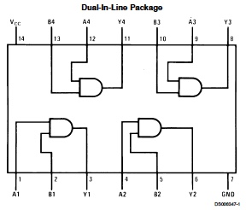
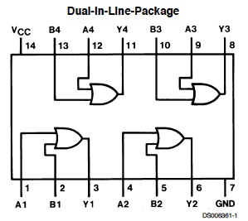
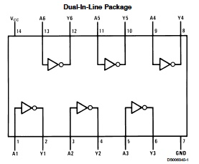
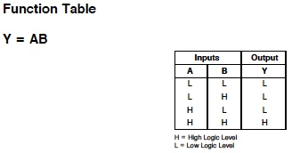
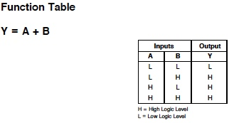
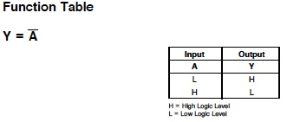
Logical Gates
AND | OR | NOT

Slide 5
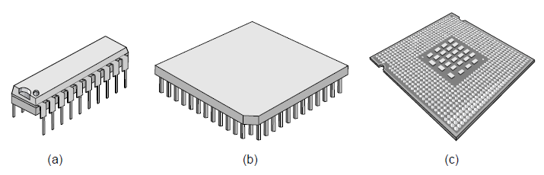
More Logical Gates
74 series
7408
7432
7402
7400
7402
7486
In general, integrated circuits consist of these basic logical gates.

Slide 6
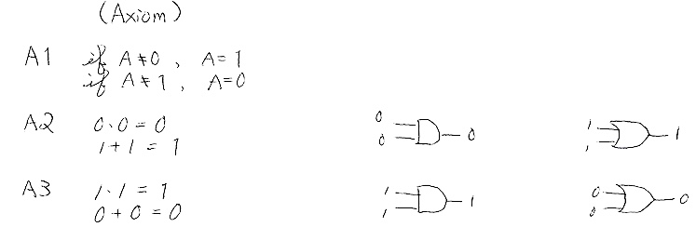
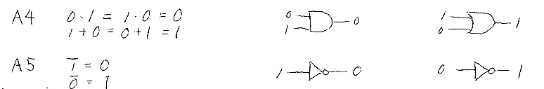
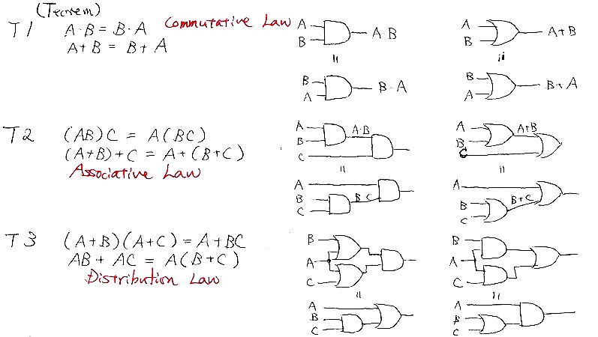
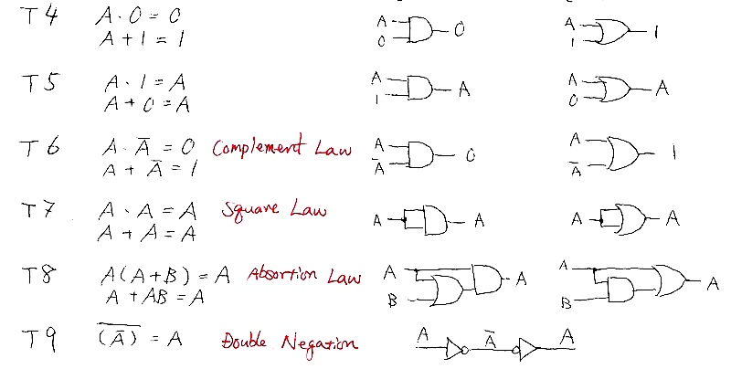
Boolean Algebra and Logical Gates
Axiom
Theorem

Slide 7
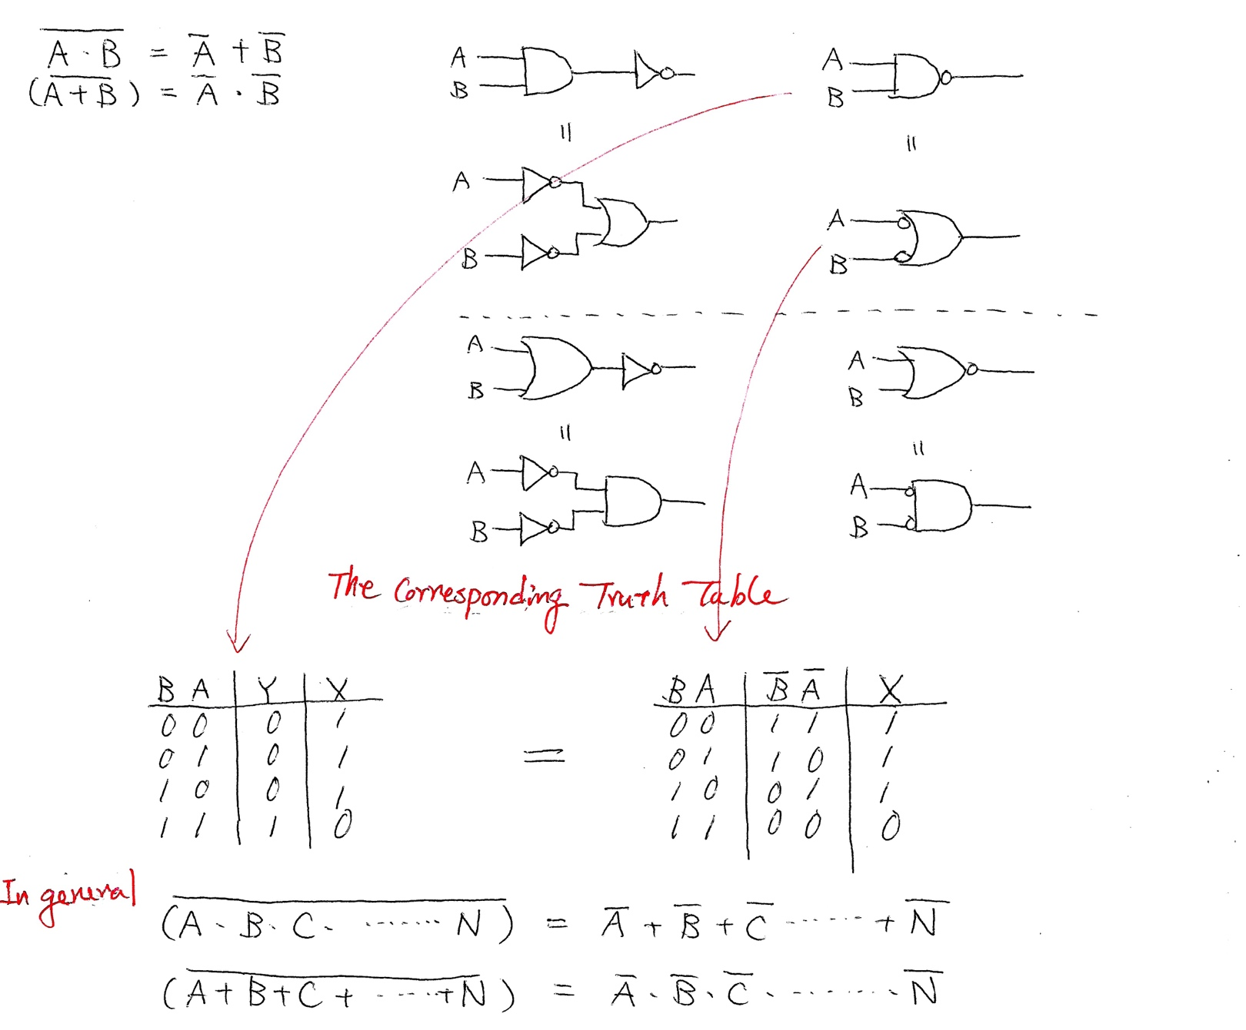
De Morgan’s Law

Slide 8
From circuit to Boolean Logic
We can easily interpret the function of a given circuit.
Ex)
A
A
A*
B
B
C
A
B
B
A *
+
A *
A *
B
B
B
C = A + B

Slide 9
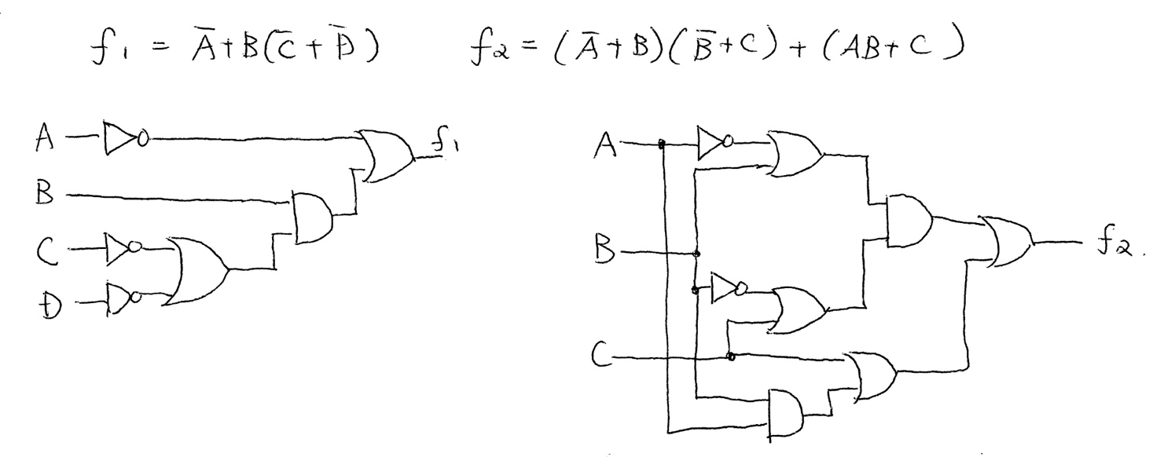
From Boolean to Circuit

Slide 10
3 x 8 Line Decoder (2)
a | b | c | D0 | D1 | D2 | D3 | D4 | D5 | D6 | D7
0 | 0 | 0 | 1 | 0 | 0 | 0 | 0 | 0 | 0 | 0
0 | 0 | 1 | 0 | 1 | 0 | 0 | 0 | 0 | 0 | 0
0 | 1 | 0 | 0 | 0 | 1 | 0 | 0 | 0 | 0 | 0
0 | 1 | 1 | 0 | 0 | 0 | 1 | 0 | 0 | 0 | 0
1 | 0 | 0 | 0 | 0 | 0 | 0 | 1 | 0 | 0 | 0
1 | 0 | 1 | 0 | 0 | 0 | 0 | 0 | 1 | 0 | 0
1 | 1 | 0 | 0 | 0 | 0 | 0 | 0 | 0 | 1 | 0
1 | 1 | 1 | 0 | 0 | 0 | 0 | 0 | 0 | 0 | 1
abc = 000 ---→ D0 =1
abc = 001 ---→ D1 =1
abc = 010 ---→ D2= 1
abc = 011 ---→ D3= 1
abc = 100 ---→ D4 =1
abc = 101 ---→ D5 =1
abc = 110 ---→ D6= 1
abc = 111 ---→ D7= 1

Slide 11
3 x 8 Line Decoder (3)
D0 = ~a ~b ~c
D1 = ~a ~b c
D2 = ~a b ~c
D3 = ~a b c
D4 = a ~b ~c
D5 = a ~b c
D6 = a b ~c
D7 = a b c

Slide 12
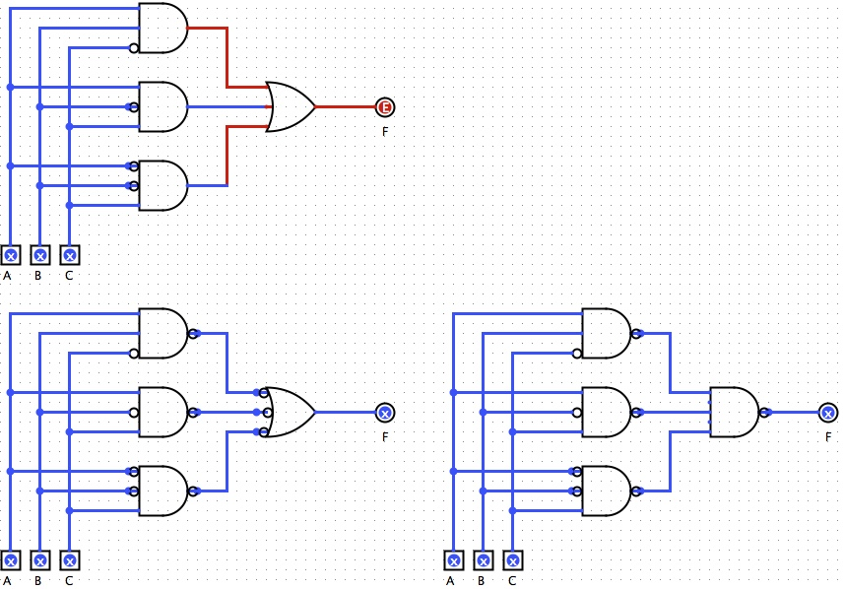
Canonical Form: Sum of Products
product
F = AB~C + A~BC + ~ABC
(where ~ = NOT)
sum
Through De Morgan’s Law, the circuit can consist
of ony NANDs (with Nots)

Slide 13
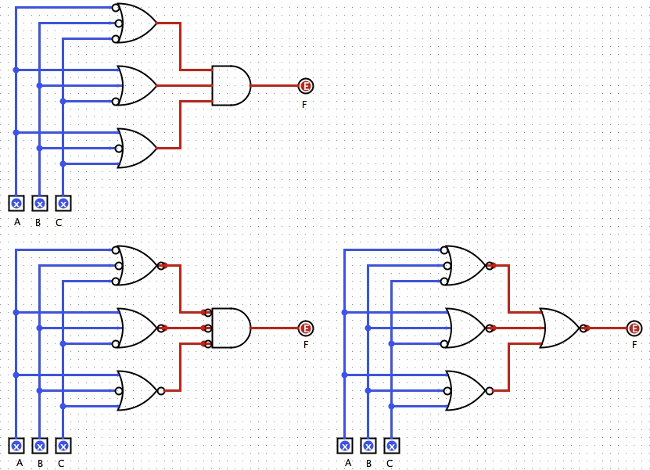
Canonical Form: Product of Sums
sum
F = (~A+~B+~C)(A+B+~C)(A+~B+C)
(where ~ = NOT)
product
Through De Morgan’s Law, the circuit can consist
of ony NORs (with Nots)

Slide 14
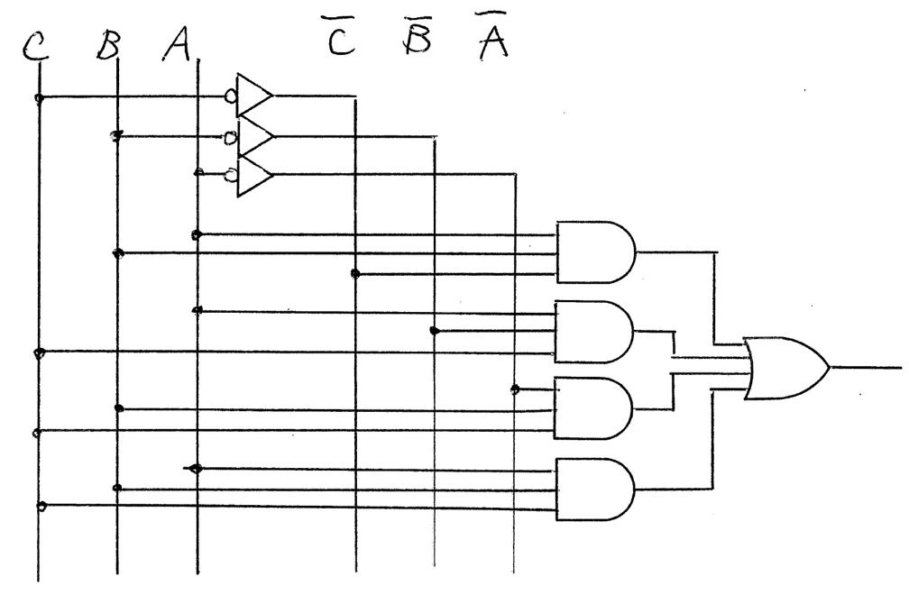
Circuit Design: Sum of Products
Circuit Design Steps
Create a truth table.
Identify all products that output “H” or 1.
Create a sum-of-products form.
Design the corresponding logical circuit with ANDs and ORs.
Disadvantages
Many ANDs
Many inputs to the OR
Logic Simplification
Convert a truth table into a Karnough map.
Group neighboring products.
Design a 3-input majority circuit.
C | B | A | F
0 | 0 | 0 | 0
0 | 0 | 1 | 0
0 | 1 | 0 | 0
0 | 1 | 1 | 1
1 | 0 | 0 | 0
1 | 0 | 1 | 1
1 | 1 | 0 | 1
1 | 1 | 1 | 1
AB~C
A~BC
~ABC
ABC
F = AB~C + A~BC + ~ABC + ABC

Slide 15
Karnaugh Map - Creation
How to convert a truth table (w/ 2-4 inputs) into a Karnaugh map
2 inputs
B 0 1
3 inputs
BC 00 01 11 10
4 inputs
CD 00 01 11 10
A
0
1
A
0
1
AB
00
01
11
10
A | B | P
0 | 0 | 1
0 | 1 | 0
1 | 0 | 1
1 | 1 | 0
1 | 0
1 | 0
A | B | C | P
0 | 0 | 0 | 0
0 | 0 | 1 | 1
0 | 1 | 0 | 0
0 | 1 | 1 | 0
1 | 0 | 0 | 1
1 | 0 | 1 | 1
1 | 1 | 0 | 1
1 | 1 | 1 | 1
0 | 1 | 0 | 0
1 | 1 | 1 | 1
A | B | C | D | P
0 | 0 | 0 | 0 | 0
0 | 0 | 0 | 1 | 1
0 | 0 | 1 | 0 | 0
0 | 0 | 1 | 1 | 0
0 | 1 | 0 | 0 | 0
0 | 1 | 0 | 1 | 0
0 | 1 | 1 | 0 | 1
0 | 1 | 1 | 1 | 1
1 | 0 | 0 | 0 | 1
1 | 0 | 0 | 1 | 1
1 | 0 | 1 | 0 | 0
1 | 0 | 1 | 1 | 0
1 | 1 | 0 | 0 | 1
1 | 1 | 0 | 1 | 0
1 | 1 | 1 | 0 | 0
1 | 1 | 1 | 1 | 1
0 | 1 | 0 | 0
0 | 0 | 1 | 1
1 | 1 | 0 | 0
1 | 0 | 1 | 0
Kmap
Kmap
truth table
Kmap
truth table
Examples
truth table

Slide 16
Karnaugh Map - Simplification
Simplification Steps
Group neighboring products.
Assign AND to each group.
Create a sum-of-products form.
Design the corresponding logical circuit.
1 x 2 or 2 x 1 rectangular group | 1 x 4 or 4 x 1 rectangular group
2 x 4 or 4 x 2 rectangular group | 2 x 2 square group
CD 00 01 11 10
CD 00 01 11 10
AB
00
01
11
10
AB
00
01
11
10
~A~B(~C~D+~CD+CD+C~D)
=~A~B{~C(~D+D)+C(D+~D)}
=~A~B(~C+C)
=~A~B
1 |  |  | 1
 |  | 1
 |  | 1
1 | 1 | 1 | 1
1
1
1
~AB~D(C+~C)=~AB~D
A(B+~B)CD=ACD
~C~D
CD 00 01 11 10
CD 00 01 11 10
AB
00
01
11
10
AB
00
01
11
10
1 |  |  | 1
1 |  |  | 1
1 | 1 | 1 | 1
1 | 1 | 1 | 1
1 |  |  | 1
 | 1 | 1
 | 1 | 1
1 |  |  | 1
~B~D
~D
BD
~A
Key 1: Get a larger group – reducing #inputs of the AND gate
Key 2: Reduce # groups – reduing # AND gates

Slide 17
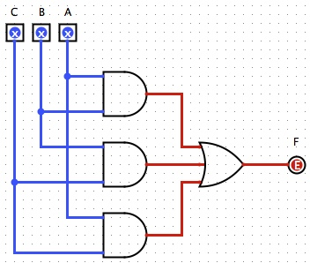
Eg 1: 3-Input Majority Circuit
truth table
C | B | A | F
0 | 0 | 0 | 0
0 | 0 | 1 | 0
0 | 1 | 0 | 0
0 | 1 | 1 | 1
1 | 0 | 0 | 0
1 | 0 | 1 | 1
1 | 1 | 0 | 1
1 | 1 | 1 | 1
Kmap
BA 00 01 11 10
AB
C
0
1
 |  | 1
 | 1 | 1 | 1
AB~C
AC
BC
A~BC
~ABC
F = AB + BC + CA
ABC
F = AB~C + A~BC + ~ABC + ABC

Slide 18
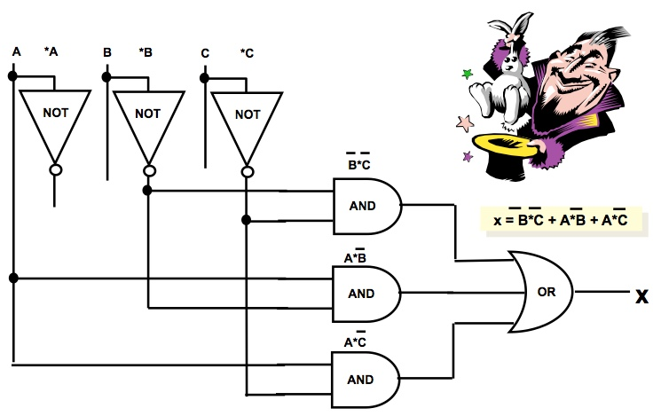
Eg 2: Boolean Simplification with K-Map versus Algebraic Laws
A B C x
Kmap
0 | 0 | 0 | 1
0 | 0 | 1 | 0
0 | 1 | 0 | 0
0 | 1 | 1 | 0
1 | 0 | 0 | 1
1 | 0 | 1 | 1
1 | 1 | 0 | 1
1 | 1 | 1 | 0
BC 00 01 11 10
A
0
1
1
1 | 1 | 0 | 1
~B~C
A~B
A~C
x = B*C + A*B + A*C
Simplified equation

Slide 19
Eg 3: 4-Input Circuit Simplification with K-Map versus Algebrical Laws
A B C D X
1. X = A*B*~C*~D + A*~B*C*~D + A*B*C*~D + ~A*~B*~C*D + ~A*B*~C*D + ~A*~B*C*D + ~A*B*C*D
2. X = A*B*~D*( ~C + C ) + A*~B*C*~D + ~A*~C*D* ( ~B+ B )
+ ~A*C*D*( B + ~B )
3. X = A*B*~D + A*~B*C*~D + ~A*D*( C + ~C )
4. X = A*B*~D + A*~B*C*~D + ~A*D
5. X = A*~D*(B + ~B*C) + ~A*D
6. X = A*~D*(C + B) + ~A*D //Second law of Dist.
0 0 0 0 0
1 0 0 0 0
0 1 0 0 0
1 1 0 0 1
0 0 1 0 0
1 0 1 0 1
0 1 1 0 0
Kmap
1 1 1 0 1
0 0 0 1 1
1 0 0 1 0
BA 00 01 11 10
AB~D
DC
00
01
11
10
0 1 0 1 1
 |  | 1
 | 1 | 1
1 |  |  | 1
1 |  |  | 1
1 1 0 1 0
AC~D
0 0 1 1 1
X = ~A*D + A*B*~D +A*C*~D
1 0 1 1 0
Kmap
~AD
0 1 1 1 1
1 1 1 1 0

Slide 20
Summary
Gate is a fundamental building block of all digital systems.
Logic gates are expressed with Boolean equation.
K-maps are used to derive Boolean equations from a truth table.
Design a digital system (combinational circuit)
Draw a truth table.
Draw K-maps to derive Boolean equations.
Draw a circuit diagram based on the equations.

