Slide 1
CSS 422 Hardware and Computer Organization
Sequential Circuit
Flip Flops / Memory Components
Ver. 2
Professor: Munehiro Fukuda

Slide 2
Topics
1-Bit Memory Devices
Latches (event-driven devices)
SR Latch
JK Latch
D Latch
Flip-Flops (clock-driven devices)
JK Flip-Flop
D Flip-Flop
T Flip-Flop
Burger Ch4 and 5.
Null Ch 3.

Slide 3
Combinational vs Sequential Circuit
Combinational
Sequential
No state and time
Maintaining states
States transiting along time with inputs and the current states
Inputs
F
Outputs
Inputs
F
Outputs
O = f( In, Qt )
Qt+1 = G(In, Qt)
Out = f( In )
G
State
Q

Slide 4
Asynchronous versus Synchronous Logic
Event-driven (Asynchronous)
Clock-driven (Synchronous)
States and outputs change with random events.
1-bit memory device: Latch
SR Latch
D Latch
States and outputs change with periodic clock signals.
1-bit memory device: Flip-Flop
D Flip-Flop
JK Flip-Flop
T Flip-Flop

Slide 5
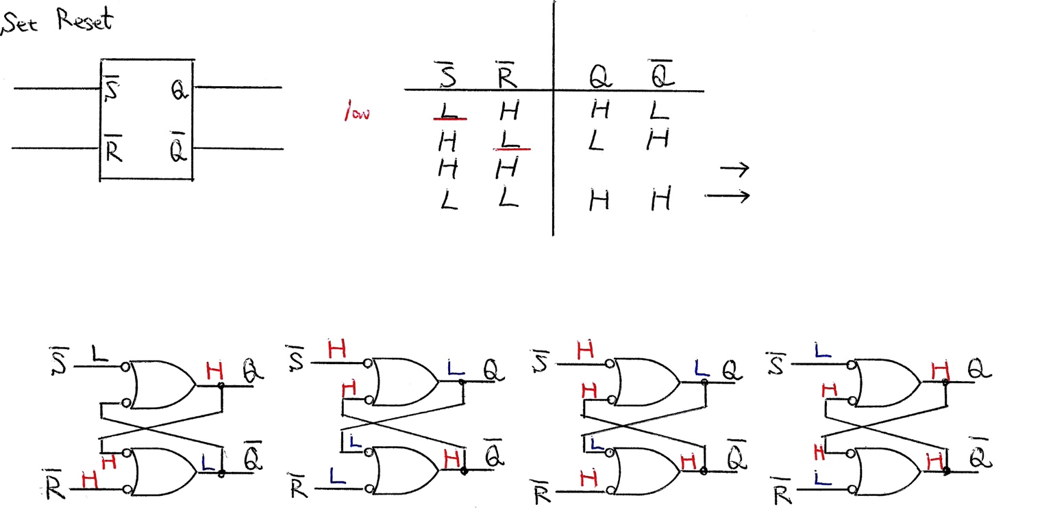
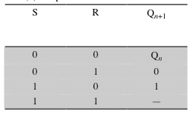
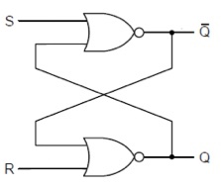
SR Latch
Active Low
Active High
(Textbook Spec.)
S R
Inputs
Outputs
active
Set
Reset
No change
Undefined
Q_{n-1} Q_{n-1}

Slide 6
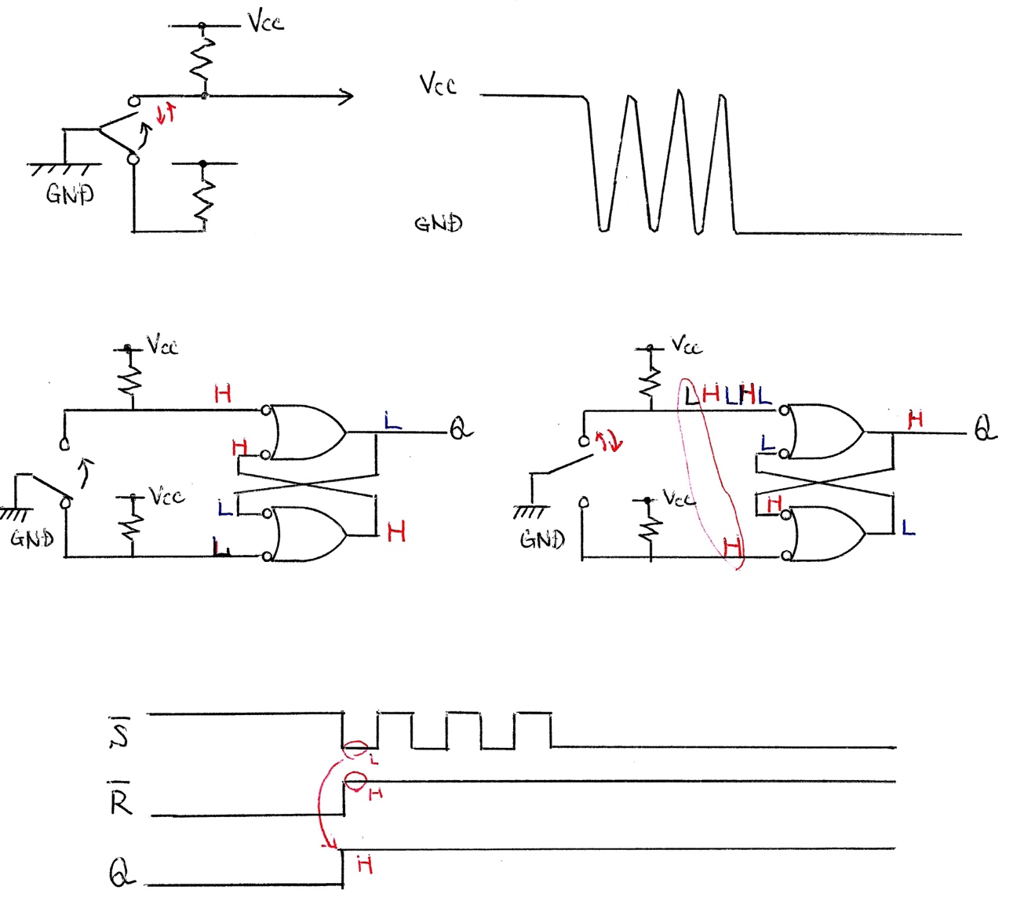
Switch Debouncer
Bouncing by a switch
Once a state is set, bouncing repeats no change and set in Q
Timing chart

Slide 7
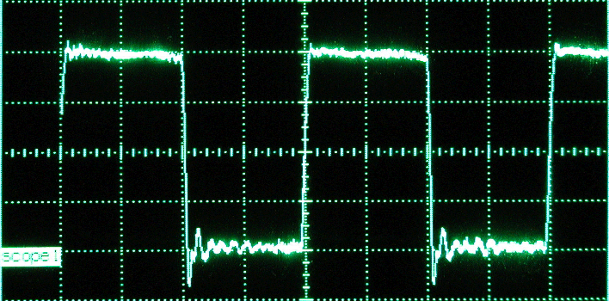
Clocks and Time
The clock in a digital system is an electronic analog of the pendulum which synchronizes the circuits in a computer system
The master control signal
Changes occur on the rising or falling edges of a clock pulse
Frequencies are the inverse of time (speed)
Frequency |  | Speed | Time
1 kilohertz | KHz | 10³ Hz | 1msec
1 megahertz | MHz | 10⁶ Hz | 1μsec
IBM PC (with Intel 486) | 50 MHz |  | 20nsec
1gigahertz | GHz | 10⁹ Hz | 1nsec
Dell Precision T550 (Intel Zeon X5698) | 4.4 GHz
1 terahertz | THz | 10¹² Hz | 1psec
This is the TTL (74 series) level.
Logic 1
1V
Not Defined
Logic 0

Slide 8
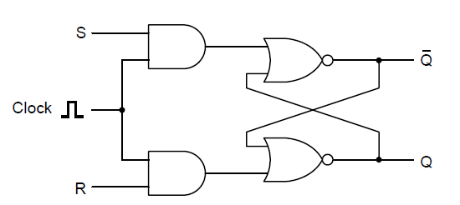
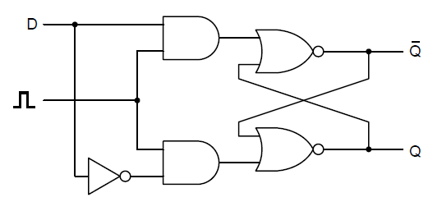
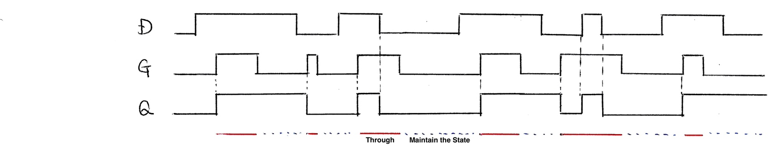
Clocked SR Latch and D Latch
Clocked SR Latch
Prevent the latch from changing state except at certain specific time.
When clock is 1, the latch is sensitive to S or R.
D Latch
Avoid the SR latch’s instability by giving R as the inverse of S.
Stored value is available at Q
To load the current value of D, give a positie pulse on the clock line.

Slide 9
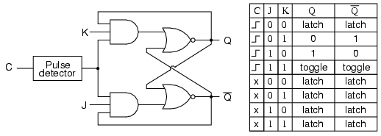
Clocked JK Latch
Avoid the SR latch’s instability by preventing the inputs being 1 at the same time.
In this case all possible combinations of input values are valid
Notes:
Another useful flip-flop is the J–K flip-flop. Like the S–R flip-flop, it has two inputs. However, in this case all possible combinations of input values are valid. Figure 11.26 shows a gate implementation of the J–K flip-flop.

Slide 10
Latch versus Flip-Flop
 | Latch | Flip-Flop
Similarities | Basic components for sequential circuit design They are bi-state devices. It is in one of two states. Without inputs, they remain in that state. They have two outputs which are always the complements of each other.
Differences | Level triggered: State changes when the clock is active. | Edge triggered: State transition occurs when the clock transition from 0 to 1 or from 1 to 0.

Slide 11
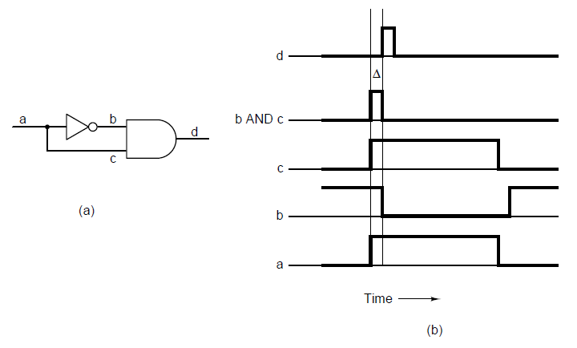
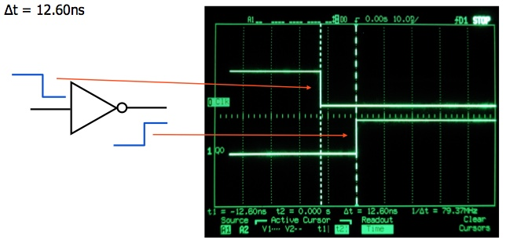
How to Create an Edge
Delay in the inverter makes the circuit work.

Slide 12
JK Flip Flop
Clocked JK Latch
CLK
J
K
Qt-1
Qt-1
Q
Which?
CLK
Ss
J
J
K
CLK
Qm
K
Qm
Ss
Master
Slave
CLK
Q

Slide 13
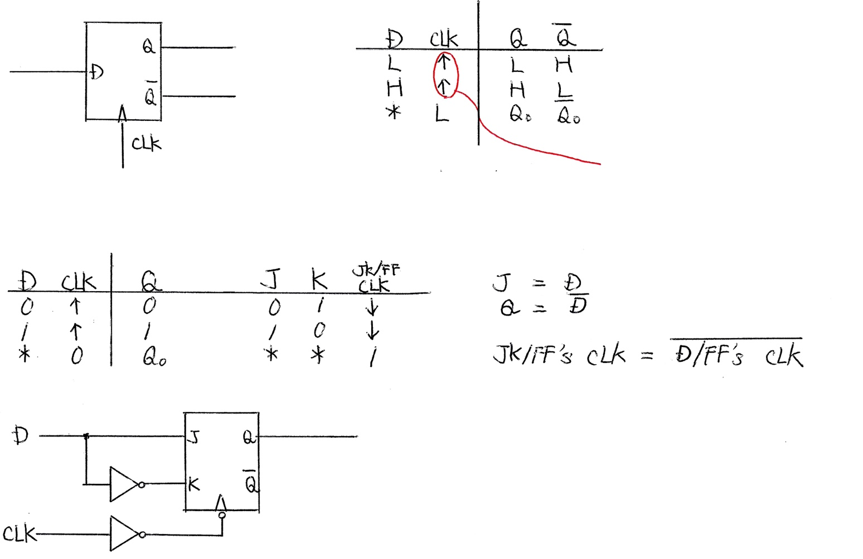
D Flip Flop
Outputs
Input
Set upon an up edge of the clock
State
Reset
Set
No Change

Slide 14
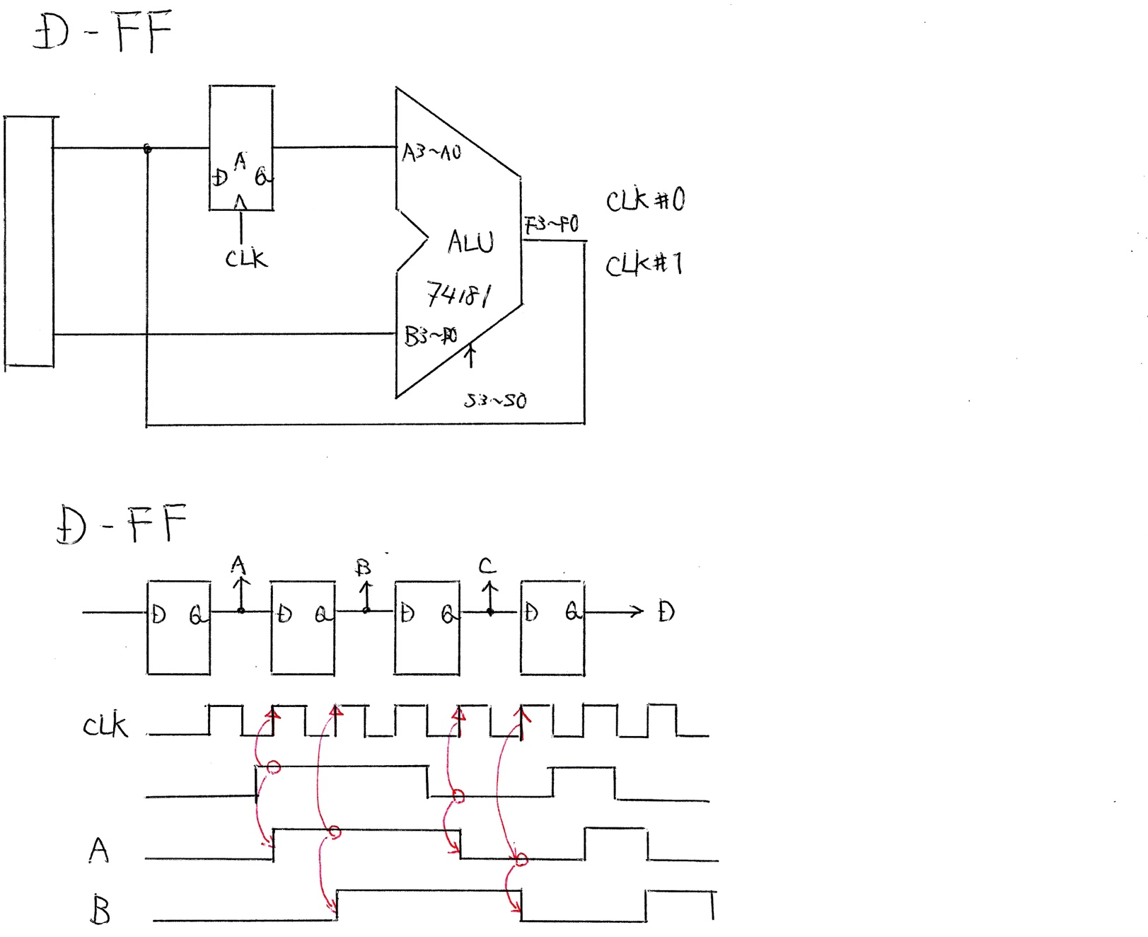
D Flip Flop Application
Application 1: Data Register
D0
MOVE.B Mem10, D0
ADD.B Mem20, D0
Application 2: Shift Register
input

Slide 15
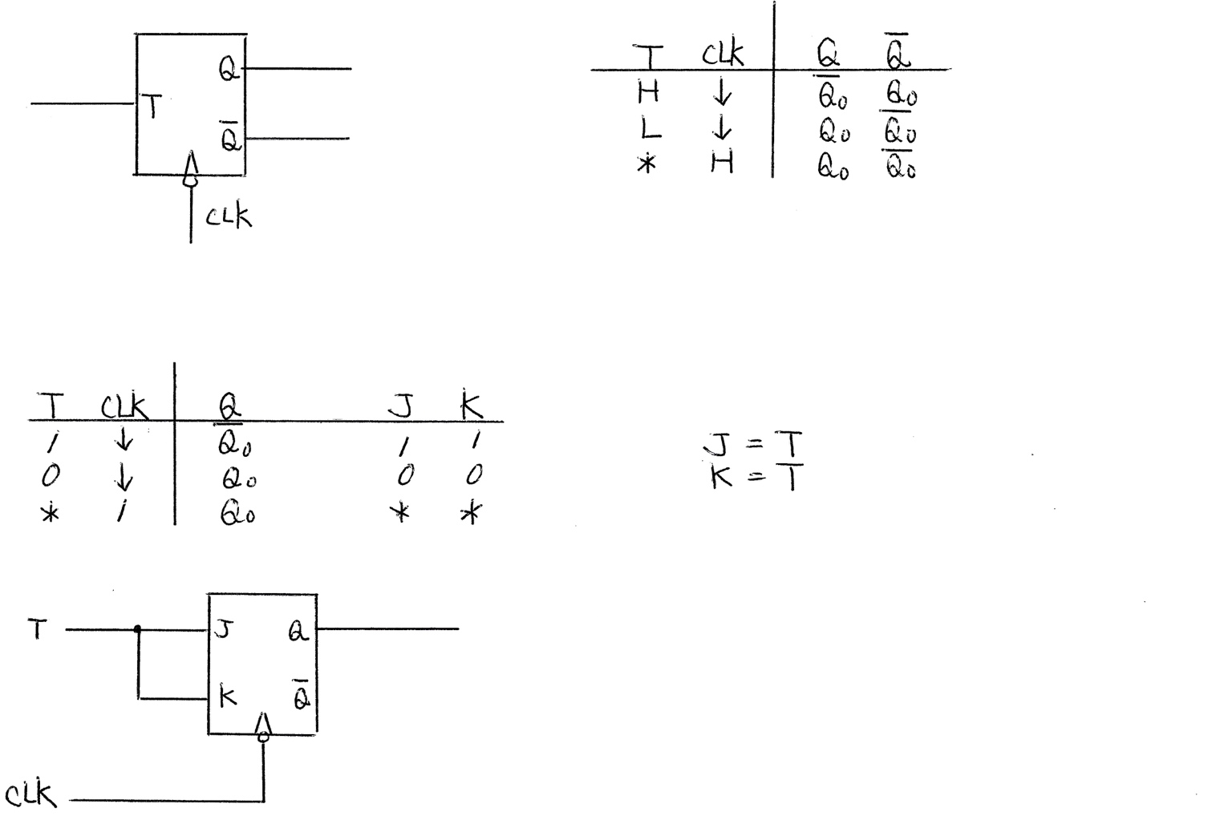
T Flip Flop
T flip-flop diagram
Inputs
Outputs
Toggle
No Change
No Change
State Transition Table
Emulate a T flip-flop with a JK flip-flop

Slide 16
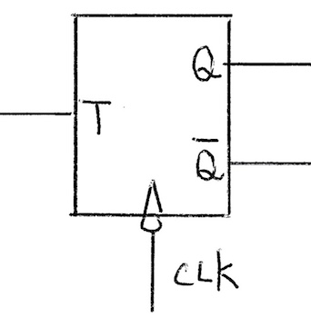
T Flip Flop Application
Clock divisors
Vcc (5V)
Vcc (5V)
Vcc (5V)
Q1
Q2
Q3
2.5MHz
20MHz
10MHz
5MHz
20 MHz CLK
Q1
Q2

Slide 17
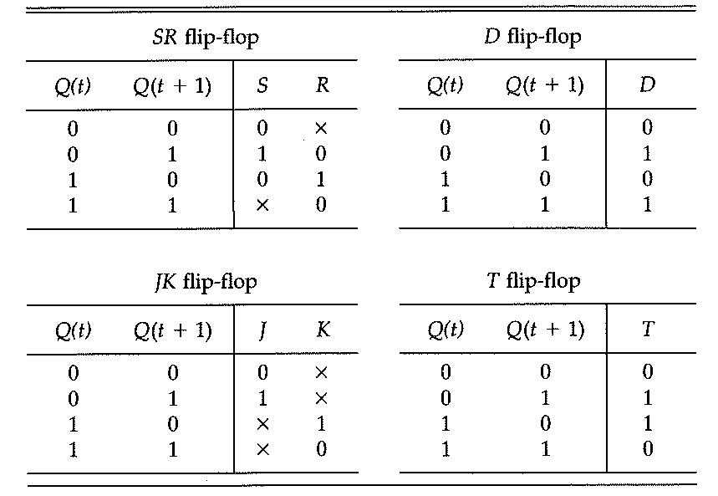
Flip Flops and Their Transition Tables

Slide 18
Summary
Understand the difference between latches and flip-flops.
Understand the reason why:
Transiting from SR to JK latches
Transiting from JK latch to master-slave JK flip-flop
Understand what applications use SR latch, D flip-flop, and T flip-flop

