Slide 1
CSS 422 Hardware and Computer Organization
Sequential Circuit
State Machines and Registers
Ver. 2
Professor: Munehiro Fukuda

Slide 2
Topics
Designing Finite State Machines
Example 1: Two-bit binary counter
Example 2: Three-bit sequential circuit
Looking at Typical Sequential Circuits
Ripple counter
Shift register
Storage register
Null Ch3.7

Slide 3
Design of Finite State Machines
Timer and Sequencer Design
5 Steps
Draw a state transition diagram.
Draw a state transition table.
Simplify redundant states.
Allocate flip-flops to the states.
Draw Kmaps to design combinational logics that generates state transitions and outputs.

Slide 4
Example 1: 2-Bit Binary Counter
Timer and Sequencer Design
An input is a binary number.
Count the number of 1s from 0 to 3, (i.e., 00 to 11) and thereafter reset to 0, (i.e., 00)
Design this sequential circuit.
Step 1: State Diagram
X=0/A=0, B=0
S0
X=1/A=0, B=1
X=1/A=0, B=0
X=0/A=0, B=1
X
A
S1
S3
1 0 1 1 0 0 1 0
Sequential Circuit
0 1 1 1 0 0 0 0
X=0/A=1, B=1
B
X=1/A=1, B=0
X=1/A=1, B=1
0 1 1 0 1 1 1 0
S2
CLK
X=0/A=1, B=0

Slide 5
Step 2: State Transition Table
Timer and Sequencer Design
 | Input X = 0 |  |  | Input X = 1
Current State | Next State | Output A | Output B | Next State | Output A | Output B
S0 | S0 | 0 | 0 | S1 | 0 | 1
S1 | S1 | 0 | 1 | S2 | 1 | 0
S2 | S2 | 1 | 0 | S3 | 1 | 1
S3 | S3 | 1 | 1 | S0 | 0 | 0
Step 3: Simplification Skipped
No States to Merge

Slide 6
Step 4: State Allocation
Timer and Sequencer Design
State allocation to JK FF A and B
JK FF State Transition Table
State | AB
S0 | 00
S1 | 01
S2 | 10
S3 | 11
Qt | Qt+1 | J | K
0 | 0 | 0 | *
0 | 1 | 1 | *
1 | 0 | * | 1
1 | 1 | * | 0
State Transition Table with JK FF A and B
 | Input X = 0 |  | Input X = 1 |  | Input X=0 |  | Input X=1 |  | Input X=0 |  | Input X=1
Current State | Next State | Output | Next State | Output | Inputs to JK FF-A |  |  |  | Inputs to JK FF-B
AB | AB | AB | AB | AB | JA | KA | JA | KA | JB | KB | JB | KB
00 | 00 | 00 | 01 | 01 | 0 | * | 0 | * | 0 | * | 1 | *
01 | 01 | 01 | 10 | 10 | 0 | * | 1 | * | * | 0 | * | 1
10 | 10 | 10 | 11 | 11 | * | 0 | * | 0 | 0 | * | 1 | *
11 | 11 | 11 | 00 | 00 | * | 0 | * | 1 | * | 0 | * | 1

Slide 7
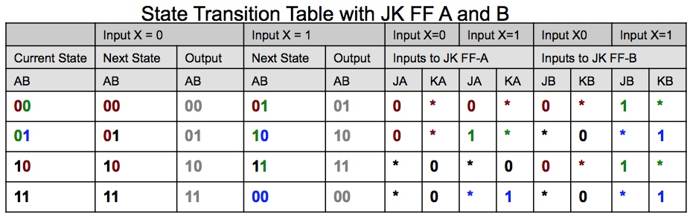
Step 5: Karnaugh Maps
Timer and Sequencer Design
J_{A} = BX | J_{B} = X
K_{A} = BX | K_{B} = X
AB 00 01 11 10
AB 00 01 11 10
X
0
1
X
0
1
0 | 0 | * | *
0 | 1 | * | *
0 | * | * | 0
1 | * | * | 1
Kmap
Kmap
AB 00 01 11 10
AB 00 01 11 10
X
0
1
X
0
1
* | * | 0 | 0
* | * | 1 | 0
* | 0 | 0 | *
* | 1 | 1 | *
Kmap
Kmap

Slide 8
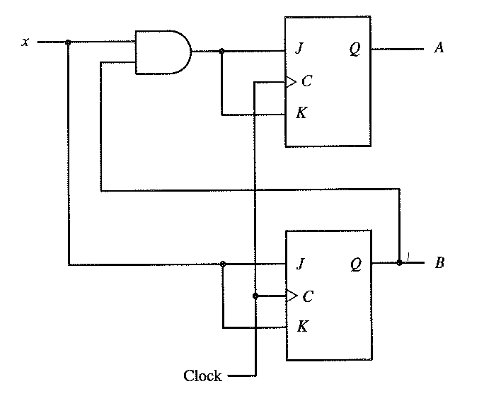
Logic of 2-bit Binary Counter
Timer and Sequencer Design

Slide 9
Example 2: 3-bit Sequential Circuit
An input is a sequence of 3-bit binary numbers.
If it is a 010, 011, 110, or 111 sequence, the circuit should emit 1 as its output.
Desgin this sequential circuit.
Step 1: State Diagram
S0
X=1/Z=0
X=0/Z=0
X
S1
S2
111 000 010
Sequential Circuit
Z
1 0 1
X=1/Z=0
X=0/Z=0
X=1/Z=0
X=0/Z=0
CLK
S3
S4
S5
S6
X=0/Z=1
X=0/Z=0
X=0/Z=1
X=0/Z=0
X=1/Z=1
X=1/Z=0
X=1/Z=1
X=1/Z=0

Slide 10
Step 2: State Transition Diagram
 | Input X = 0 |  | Input X = 1
Current State | Next State | Output Z | Next State | Output Z
S0 () | S2 | 0 | S1 | 0
S1 (1) | S4 | 0 | S3 | 0
S2 (0) | S6 | 0 | S5 | 0
S3 (11) | S0 | 1 | S0 | 1
S4 (10) | S0 | 0 | S0 | 0
S5 (01) | S0 | 1 | S0 | 1
S6 (00) | S0 | 0 | S0 | 0

Slide 11
Step 3: Simplification
 | Input X = 0 |  | Input X = 1
Current State | Next State | Output Z | Next State | Output Z
S0 | S2 | 0 | S1 | 0
S1 | S4 | 0 | S3 | 0
S2 | S6 | 0 | S5 | 0
S3 | S0 | 1 | S0 | 1
S5 | S0 | 1 | S0 | 1
S4 | S0 | 0 | S0 | 0
S6 | S0 | 0 | S0 | 0
S46
S35
S46
S35
S35 | S0 | 1 | S0 | 0
S46 | S0 | 0 | S0 | 0
Coldwell’s merging rule:
States that transit to the same state and produces the same output can be merged

Slide 12
Step 4: State Allocation
State allocation to JK FF A and B
JK FF State Transition Table
State | AB
S0 | 00
S1 | 01
S2 | 11
S3 | 10
Qt | Qt+1 | J | K
0 | 0 | 0 | *
0 | 1 | 1 | *
1 | 0 | * | 1
1 | 1 | * | 0
State Transition Table with JK FF A and B
 | Input X = 0 |  | Input X = 1 |  | Input X=0 |  | Input X=1 |  | Input X0 |  | Input X=1
Current State | Next State | Output | Next State | Output | Inputs to JK FF-A |  |  |  | Inputs to JK FF-B
AB | AB | Z | AB | Z | JA | KA | JA | KA | JB | KB | JB | KB
00 | 01 | 0 | 01 | 0 | 0 | * | 0 | * | 1 | * | 1 | *
01 | 10 | 0 | 11 | 0 | 1 | * | 1 | * | * | 1 | * | 0
11 | 00 | 1 | 00 | 1 | * | 1 | * | 1 | * | 1 | * | 1
10 | 00 | 0 | 00 | 0 | * | 1 | * | 1 | 0 | * | 0 | *

Slide 13
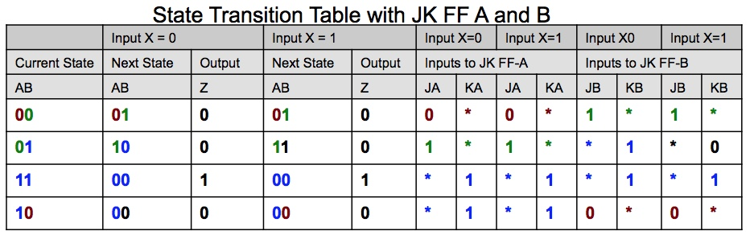
Step 5: Karnaugh Maps
J_{A} = B | J_{B} = ~A
K_{A} = 1 | K_{B} = ~X + A
AB 00 01 11 10
AB 00 01 11 10
X
0
1
X
0
1
0 | 1 | * | *
0 | 1 | * | *
1 | * | * | 0
1 | * | * | 0
Kmap
Kmap
AB 00 01 11 10
AB 00 01 11 10
X
0
1
X
0
1
* | * | 1 | 1
* | * | 1 | 1
* | 1 | 1 | *
* | 0 | 1 | *
Kmap
Kmap
Z = AB~X + ABX = AB(~X + X) = AB

Slide 14
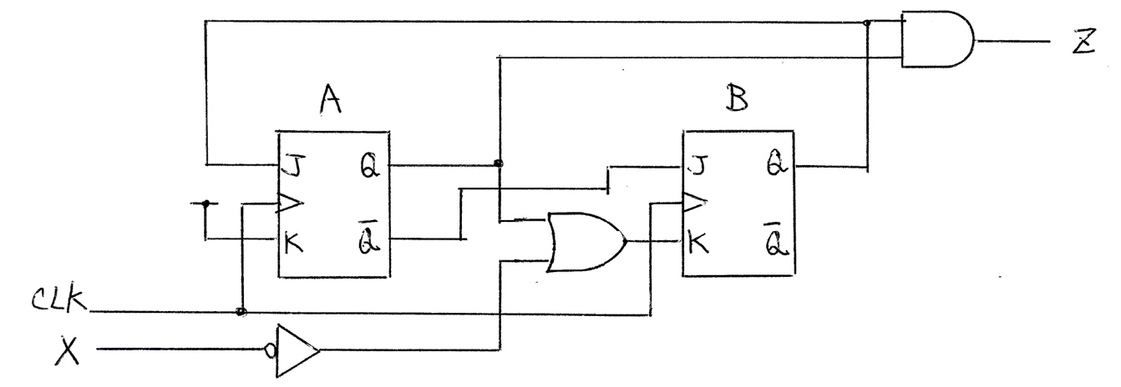
Example 2’s Sequential Circuit

Slide 15
How about Allocating D FF?
State allocation to D FF A and B
D FF State Transition Table
State | AB
S0 | 00
S1 | 01
S2 | 11
S3 | 10
Qt | Qt+1 | D
0 | 0 | 0
0 | 1 | 1
1 | 0 | 0
1 | 1 | 1
State Transition Table with D FF A and B
 | Input X = 0 |  | Input X = 1 |  | Input X = 0 | Input X = 1 | Input X = 0 | Input X = 1
Current State | Next State | Output | Next State | Output | Inputs to D FF-A |  | Inputs to D FF-B
AB | AB | Z | AB | Z | D_{A} | D_{A} | D_{B} | D_{B}
00 | 01 | 0 | 01 | 0 | 0 | 0 | 1 | 1
01 | 10 | 0 | 11 | 0 | 1 | 1 | 0 | 1
11 | 00 | 1 | 00 | 1 | 0 | 0 | 0 | 0
10 | 00 | 0 | 00 | 0 | 0 | 0 | 0 | 0

Slide 16
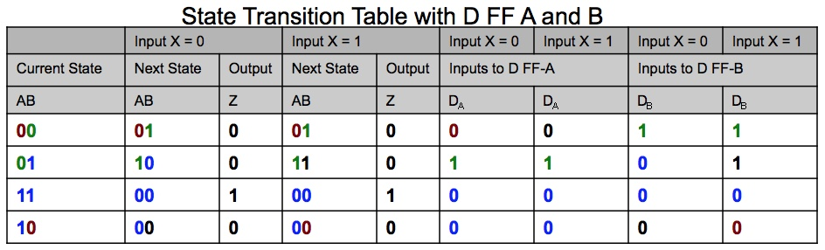
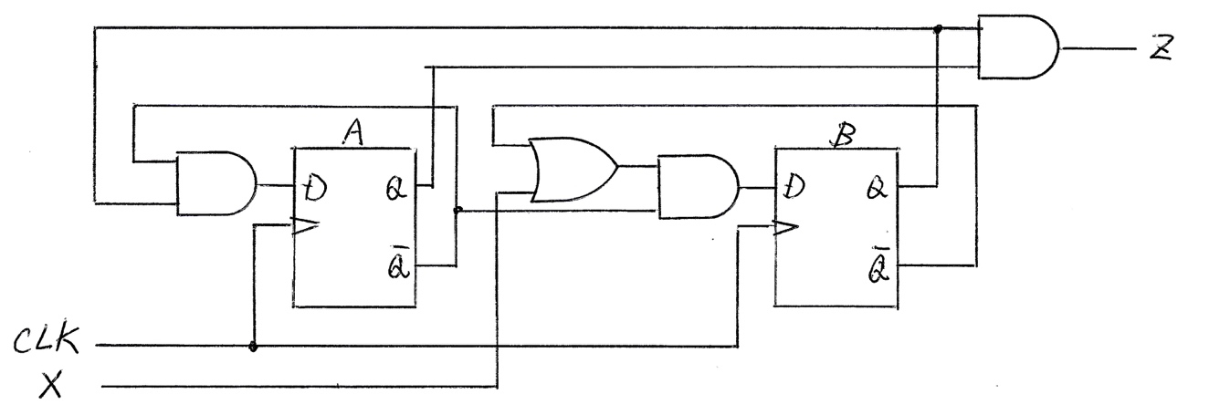
Kmap and D FF-based Circuit
D_{A} = ~AB | D_{B} = ~A~B + ~AX = ~A(~B + X)
AB 00 01 11 10
AB 00 01 11 10
X
0
1
X
0
1
0 | 1 | 0 | 0
0 | 1 | 0 | 0
1 | 0 | 0 | 0
1 | 1 | 0 | 0
Kmap
Kmap
Z = AB(~X + X) = AB

Slide 17
D Flip-Flops as a Ripple Counter
Timer and Sequencer Design
A 4-bit binary ripple counter
Given the name because the pulses “ripple” through the circuit
Q₀
Q₁
Q₂
Q₃
1
D
S
D
S
D
S
D
S
Q
Q
Q
Q
Clock in
CLK
Q
CLK
Q
CLK
Q
CLK
Q
R
R
R
R
RESET
Each “D” FF divides the incoming clock frequency by 2X
RESET sets all Q output to 0 without a clock signal (asynchronous)
Counts as fast as the first stage can toggle, but cannot be read until the count has rippled through to the last stage
Can build counter/dividers of any length, any binary divisor
Clock frequency at output Q₃ equals f_{Clock in} ÷ 16

Slide 18
D Flip-Flops as a Shift Register
Parallel In Serial Out Device
Q₀
Q₁
Q₂
Q₃
1
Shift data in
S
S
S
S
Shift data out
D
Q
D
Q
D
Q
D
Q
CLK
Q
CLK
Q
CLK
Q
CLK
Q
R
R
R
R
RESET
Clock in
Shift register moves data through successive stages on each clock pulse
Used for serial data communications, multiplication ( why ?), image processing
Basis for UART ( Universal Asynchronous Receiver/Transmitter )
Data can be read in serially and then read out in parallel
Serial data communications limits the number of signal wires needed to transmit bytewide
data ( Example shown here is a nibble )

Slide 19
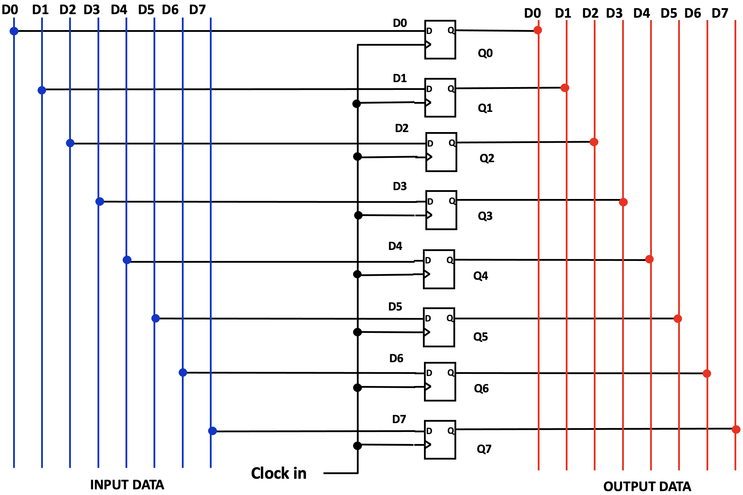
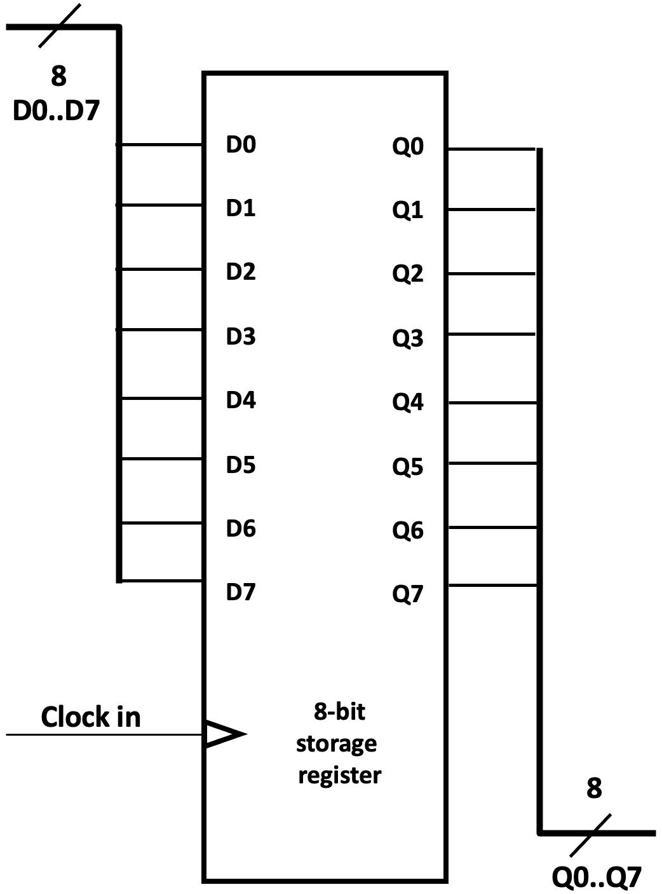
D Flip-Flops as A Storage Register
CPU Register / Memory Design
BUS: A grouping of “like” signals Here we have Data In bus ( D0..D7) and Data out bus ( Q0..Q7)
Busses are usually drawn with heavier lines to differentiate them from individual signal wires

Slide 20
Summary
Understand how to design and implement a finite state machine with flip-flops.
Review typical sequential circuits that are used in computer design.

