Slide 1
CSS 422 Hardware and Computer Organization
Bus and Memory Design
Ver. 1
Professor: Munehiro Fukuda

Slide 2
Topics
Memory Organization
How to increase the memory capacity
Memory Read/Write/Read modify write Bus Cycles
How CPU communicates with memory

Slide 3
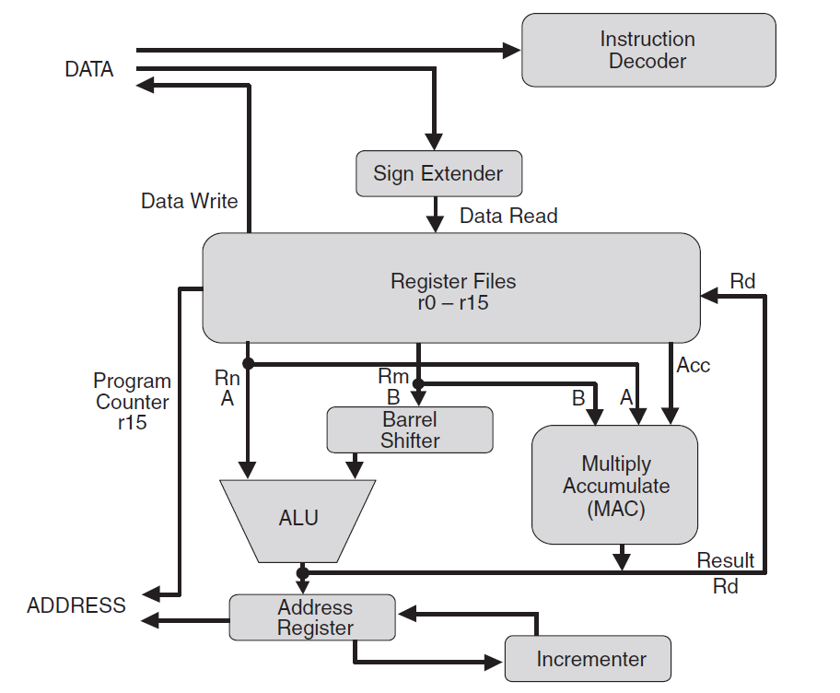
Microprocessor
This is what CPU does not include.
D0..D31
Memory
A0..A31
Peripherals

Slide 4
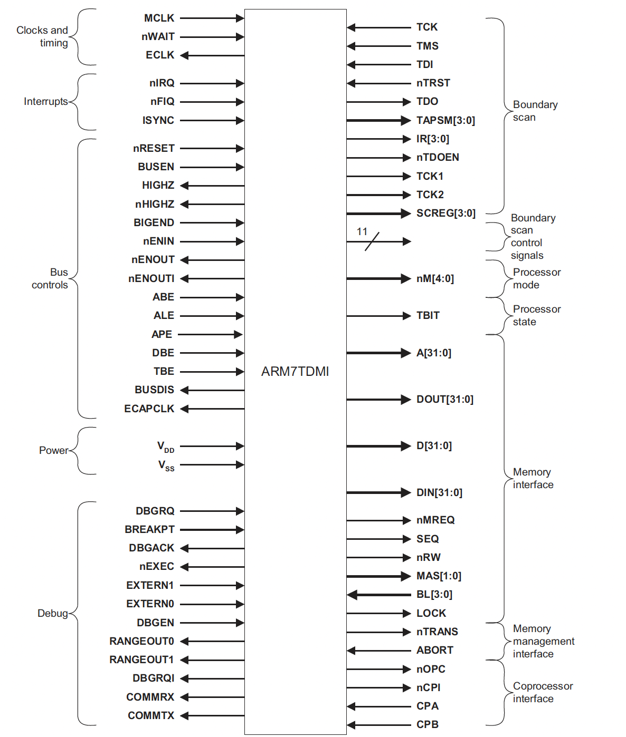
CPU and Memory
CPU has only temporary storage for computation
ARM7 has only R0-R16 registers to keep temporary data and addresses.
Most data should be maintained in external memory
ROM (Read-Only Memory): include boot strap routines.
RAM (Random Access Memory): can load your programs and data from hard disk.
CPU-memory communication takes place with address, data, and control signals.
nWAIT
Random Access Memory
RAM
address
data
nMREQ: ~mem req
nRW: ~read/write
MAS[1:0]: memory address strobe

Slide 5
Memory Organization
DB0
DB1
DB2
DB3
A0
D
Q
D
Q
D
Q
D
Q
CLK
OE
CLK
OE
CLK
OE
CLK
OE
A1
(W0)D0..D3
(OE0)D0..D3
CS
D
Q
D
Q
D
Q
D
Q
Memory decoding logic
CLK
OE
CLK
OE
CLK
OE
CLK
OE
(W1)D0..D3
R / W
(OE1)D0..D3
D
Q
D
Q
D
Q
D
Q
CLK
OE
CLK
OE
CLK
OE
CLK
OE
(W2)D0..D3
(OE2)D0..D3
D
Q
D
Q
D
Q
D
Q
CLK
OE
CLK
OE
CLK
OE
CLK
OE
(W3)D0..D3
(OE3)D0..D3
2² x 4 bits = 16 bits = 2 bytes

Slide 6
Memory Capacity
Memory capacity: 2^{k} X n
n data lines
k address lines
Memory Unit
2^{k} data
n bits per data
Suppose a memory chip has 16 address lines and 8 data lines
What is the capacity of the chip?
_____________ bits
_____________ bytes (8 bits)
_____________ words (16 bits)
Suppose a chip has a capacity of 2^{K} X 16, how many address bits and data bits?
_________ address bits
_________ data bits
Control lines (R/W)

Slide 7
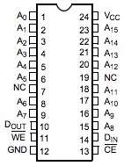
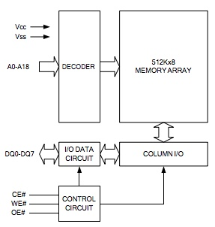
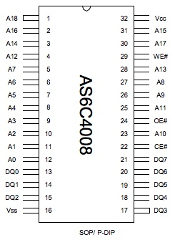
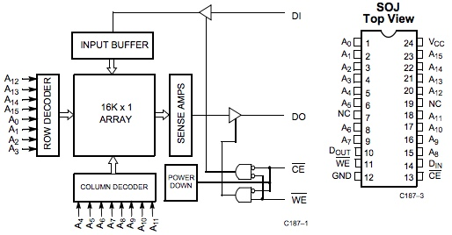
Memory extension
Large memory chip can be constructed with a number of smaller size of memory chips
AS6C4008 is an SRAM with the capacity of 19 x 8.
CY7C187 is an SRAM with the capacity of 16 x 1.
How to arrange CY7C187s for replacing an AS6C4008 with them?
3 more address lines
= decoded to 2³ different chip enables
D7
D6
D5
D4
D3
D2
D1
8 data lines
In total, (2¹⁹ x 8)/(2¹⁶ x 1) = 2³ x 8 = 64
D0

Slide 8
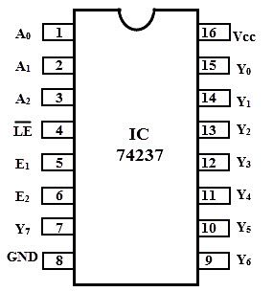
Increase Address Spaces
ADDR[21:19]
ADDR 19
ADDR[21:19]
ADDR[18:0]
ADDR 20
ADDR[18:0]
ADDR 21
Increase A[18:0] to A[21:0]
DATA[7:0]
Increase 512K spaces to 4096K
(=4M) spaces
3 to 8 decoder
ADDR[18:0]
DATA[7:0]

Slide 9
Increase Data Width
ADDR[18:0]
ADDR[18:0]
ADDR[18:0]
DATA[31:24]
DATA[31:24]
ADDR[18:0]
ADDR[18:0]
DATA[23:16]
DATA[23:16]
Increase D[7:0] to D[31:0]
ADDR[18:0]
DATA[15:8]
DATA[15:8]
Increase 512K spaces to 2048K
(=2M) spaces
Note that each address points to a long word instead of a byte
DATA[7:0]
DATA[7:0]

Slide 10
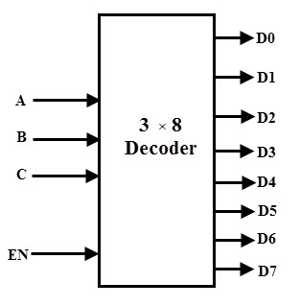
Increase Both
ADDR[23:0]
CE
ADDR 22
Increase the address length.
Increase the data width.
Exercise:
Build a 2²⁴ x 32 memory
Use 2¹⁹ x 8 memory chips (such as AS6C4008s).
How many 2¹⁹ x 8 memory chips should you have?
(2²⁴ x 32) / (2¹⁹ x 8 ) = 2⁵ x 4 = 128 chips
How many 3-to-8 decoders do you need to activate 128 CE lines?
Log₂ 128 / 4 = 5.
ADDR 23
GND
DATA[23:15]
DATA[7:0]
DATA[31:24]
DATA[15:8]
ADDR 19
ADDR 20
ADDR 21
ADDR[18:0]
CE

Slide 11
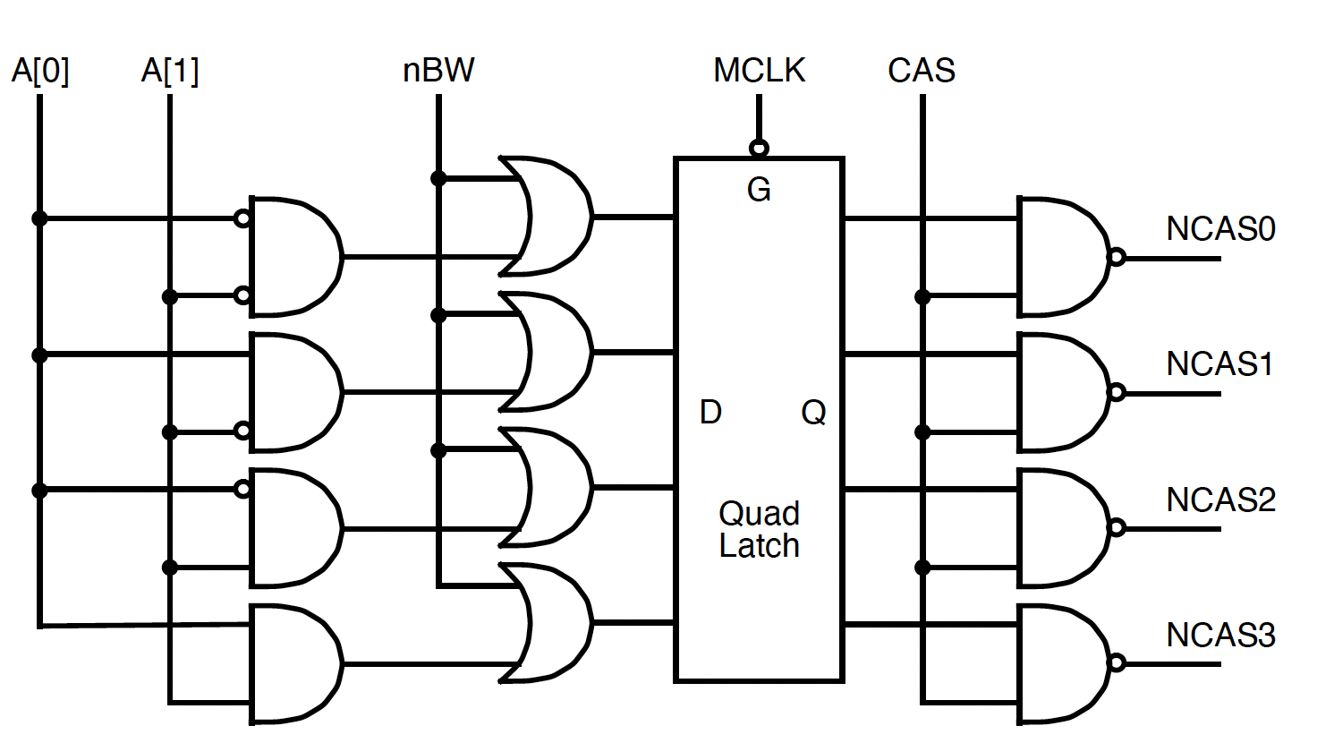
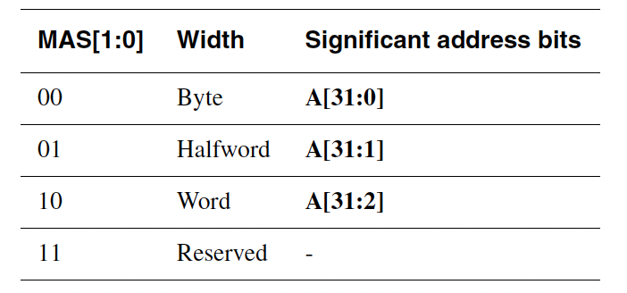
ARM7 Example
How to read a word, a high/low half word, or a selected byte
This example assumes DRAM with
RAS: Raw Address Strobe
CAS: Column Address Strobe
If we use SRAM, we should replace CAS with ~CS
Modified from ARM7 Data Sheet’s Figure 34
Its nBW is replaced with in ARM7TDI. MAS[1:0] is provided from CPU.

Slide 12
ARM7 Memory
nMREQ | SEQ | Cycle Type | Description
0 | 0 | Nonsequential cycle (N-cycle) | requests a transfer to or from an address which is unrelated to the address used in the preceding cycle.
0 | 1 | Sequential cycle (S-cycle) | requests a transfer to or from an address which is either the same, one word, or halfward
1 | 0 | Internal cycle (I-cycle) | does not require a transfer because it is performing an internal function, and no useful prefetching can be performed at the same time.
1 | 1 | Coprocessor register transfer (C-cycle) | uses the data bus to communicate with a coprocessor, but does not require any action by the memory system.

Slide 13
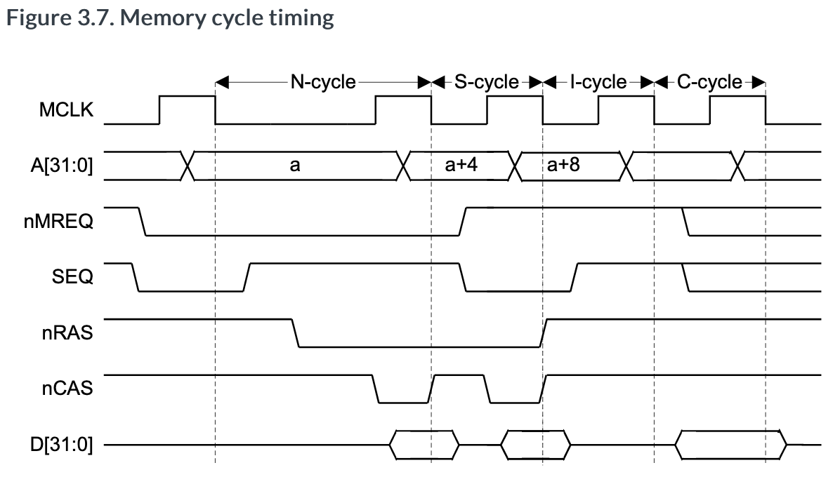
Memory Read Cycle
From ARM7TDMI Technical Reference Manual
https://developer.arm.com/documentation/ddi0210/c/Memory-Interface/Data-timed-signals/Byte-and-halfword-accesses?lang=en

Slide 14
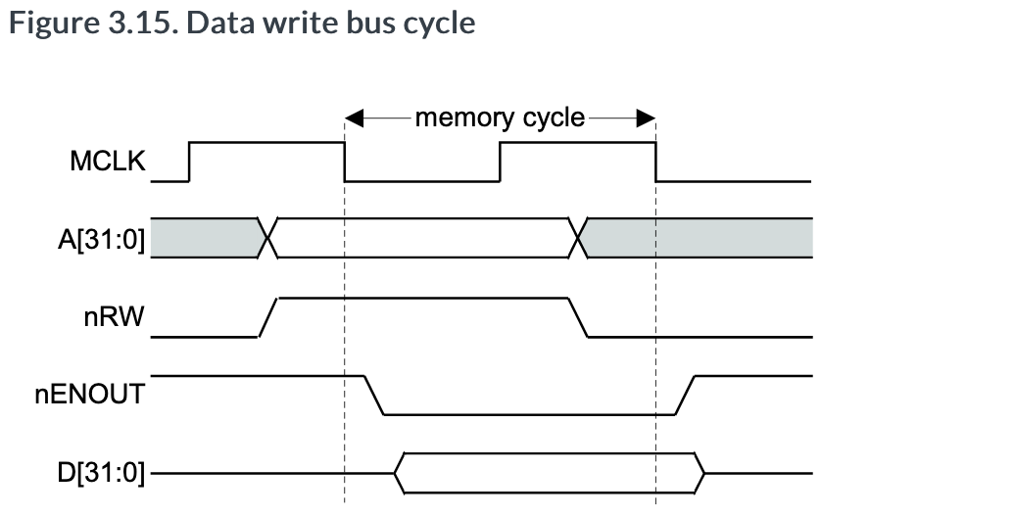
Memory Write Cycle
From ARM7TDMI Technical Reference Manual
https://developer.arm.com/documentation/ddi0210/c/Memory-Interface/Data-timed-signals/D-31-0---DOUT-31-0---and-DIN-31-0-?lang=en

Slide 15
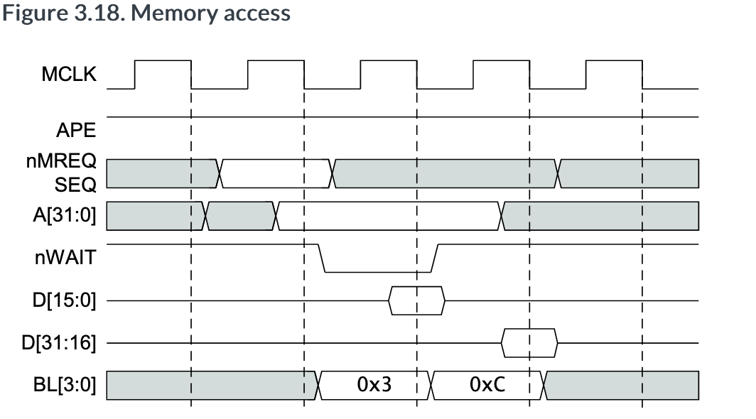
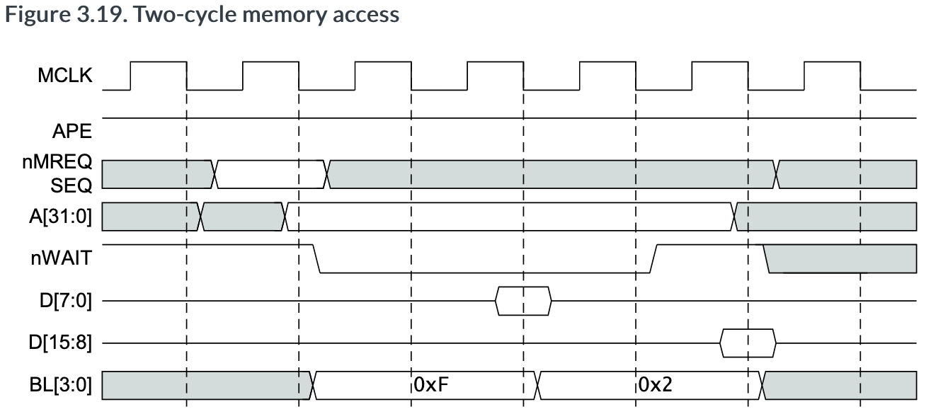
What if Memory Reacts Slow or needs to send half words or bytes?
BL[3:0] is provided from the memory system to CPU.
BL[3]: controls the latching of the data present on D[31:24].
BL[2]: controls the latching of the data present on D[23:16].
BL[1]: controls the latching of the data present on D[15:8].
BL[0]: controls the latching of the data present on D[7:0].
 | B[3],[2],[1],[0] | Data read into ARM7
0x3 | 0, 0, 1, 1 | D[15:0]
0xC | 1, 1, 0, 0 | D[31:16]
0X1 0XF | 0, 0, 0, 1 1, 1, 1, 1 | D[7:0] correct D[7:0] and garbage D[31:8]
0x2 | 0, 0, 1, 0 | D[15:8]
From ARM7TDMI Technical Reference Manual
https://developer.arm.com/documentation/ddi0210/c/Memory-Interface/Data-timed-signals/Byte-latch-enables?lang=en

Slide 16
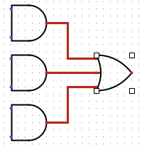
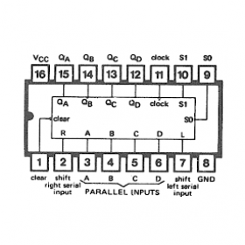
DTACK Generation
Who will generate DTACK?
Memory System but not memory chips
one cycle
No nWAIT from memory.
Memory chips are passive.
from address decoder
two cycles
more cycles
CY7C187
MCLK
74194
4-bit shift refister
MAS[1:0]
Vcc (5V)
GND

Slide 17
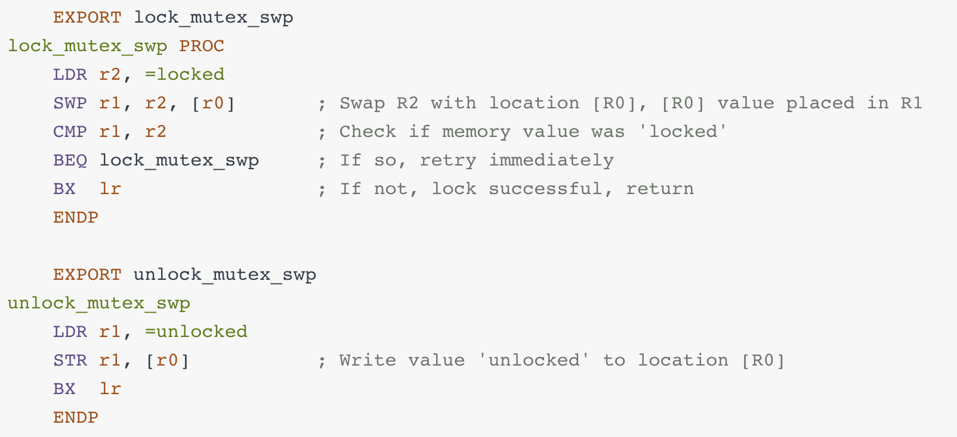
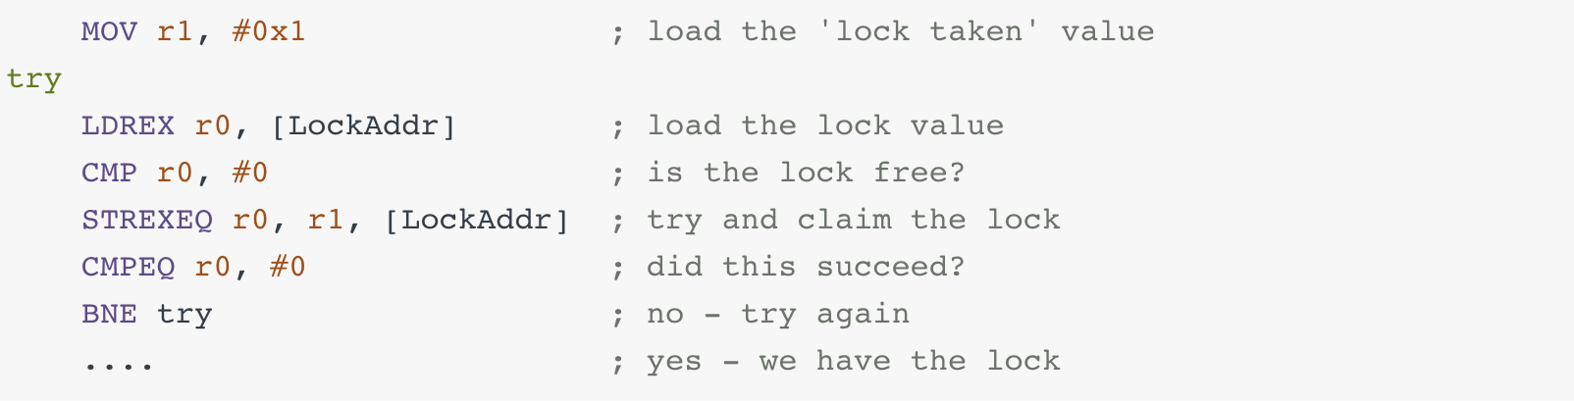
Exclusive Memory Access
SWP in ARM
LDREX/STREX in ARM
LOCK is asserted on the bus during SWP that needs
memory read
memory write
Instead of LOCK, the memory system remembers processor ID.

Slide 18
Summary
Memory extension
Can be done by increasing address spaces and data width.
Memory cycle
Must be delayed by a logic to activate nWAIT in accordance with memory response time
Read-modify-write cycle
Hardware support for a non-interruptible lock operation
Used in OS and parallel/concurrent computing

