Slide 1
CSS 422 Hardware and Computer Organization
RISC, Memory Hierarchy, and Cache Memory
Ver. 2
Professor: Munehiro Fukuda

Slide 2
Topics
Brief Explanation of CISC vs RISC
CISC: Complex Instruction Set Computer
RISC: Reduced Instruction Set Computer
Locality and Memory Hierarchy
Memory types and hierarchy
Spatial/temporal access locality
Cache Memory
Basic algorithm
Performance metrics
Direct mapping

Slide 3
CISC versus RISC in Assembly Code
CISC (MC68K)
MOVEI.W #10, D0
MOVEI.W #5, D1
MULS D0, D1
Total = 2 * 8 + 46 = 62 clocks
RISC (ARM)
MOV R0, #0
MOV R1, #10
MOV R2, #5
BEGIN:
ADD R0, R1
SUBS R2, #1
BNE BGEIN
Total = 3 + 5 * 4 + 3 = 26 clocks
MOVE: 8 clock
MULS: 46 clocks
MOV, AND, SUBS: 1 clock
BNE: 3 clock in true or 1 clock in false
The RISC idea is to simplify instructions and reduce #CPU cycles

Slide 4
CISC versus RISC
CISC | RISC
Single register set, typically 6 to 16 registers | Multiple register sets, often consisting of 256+ registers
1 or 2 register operands per instruction | 3 register operands per instruction
Parameter passing through off-chip memory | Parameter passing through on-chip register windows
Multiple-cycle instructions | Single-cycle instructions except load and store
Many complex instructions | Simple instructions
Variable-length instructions | Fixed-length instructions
Many instructions can access memory | Only load and store instructions can access memory
Many addressing modes | A few addressing modes
Microprogrammed control/less pipelined | Hardwired control/pipelined

Slide 5
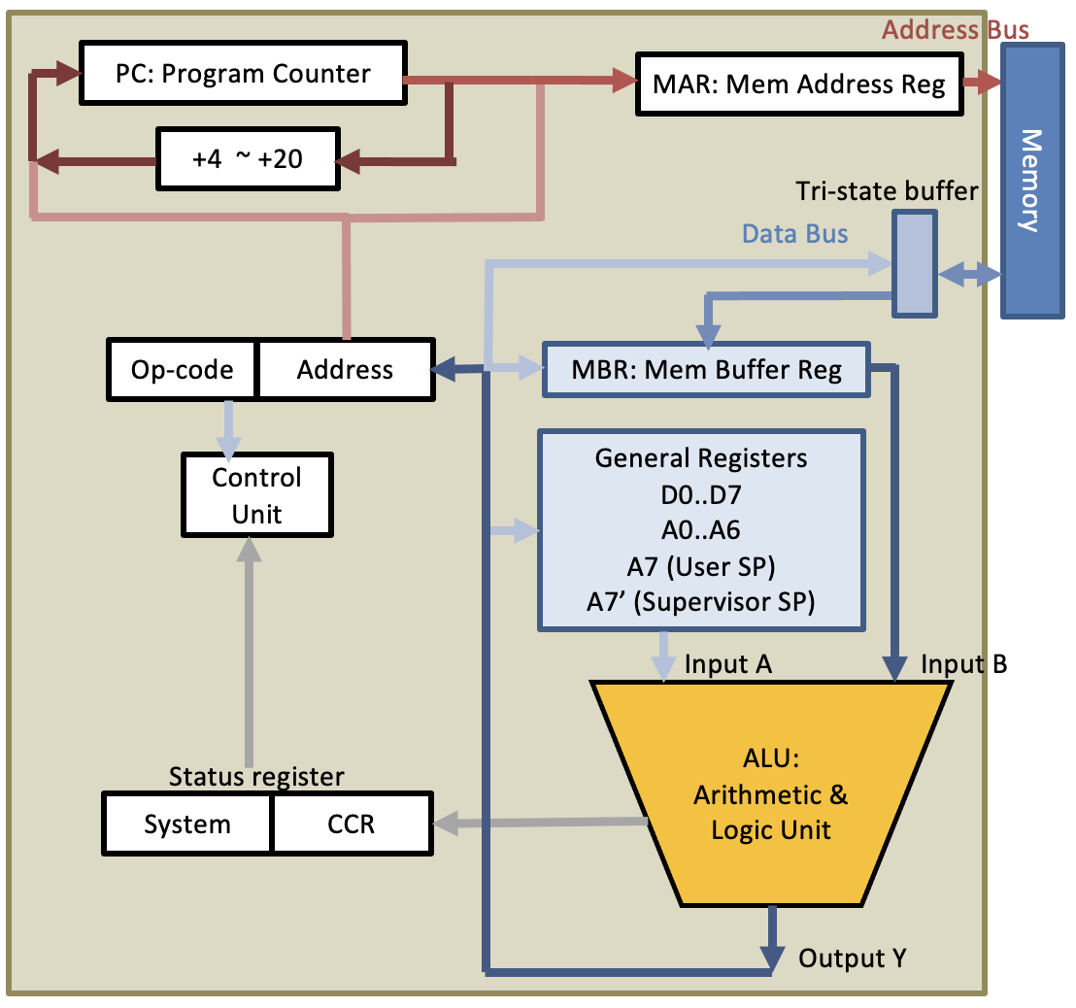
Micro-programmed vs Hardwired Control
Micro-programmed control
Hardwired control
Clock
Instr. Decoder
Instr. Decoder
Clock
move add sub clr
move add sub clr
Micro PC
Combinational
Logic
t0 t1 t2
Sequencer
move Instr t0
move Instr t1
move Instr t2
..
add Instr t0
add Instr t1
add Instr t2
Micro Intr. Reg
Control lines to PC, MAR, MBR, Regs, ALU, etc
Control lines to PC, MAR, MBR, Regs, ALU, etc
Pros and cons?

Slide 6
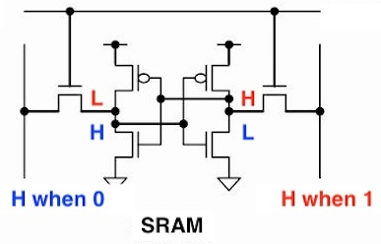
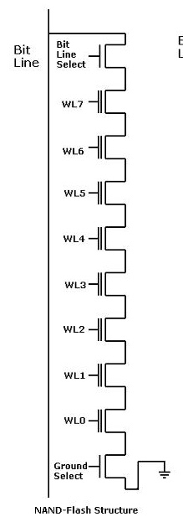
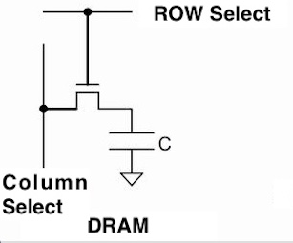
Storage
Storage Types | Pros | Cons | Viewpoints from Programs
SRAM | Fastest | Smallest capacity, Expensive | Frequent data
DRAM | Slow | Large, Cheap | Temporary data
SSD | Slower | Larger, Cheaper | Persistent data
HDD | Slowest | Largest, Cheapest | Big data
Cache memory
Main memory

Slide 7
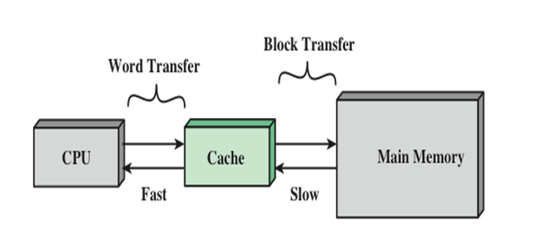
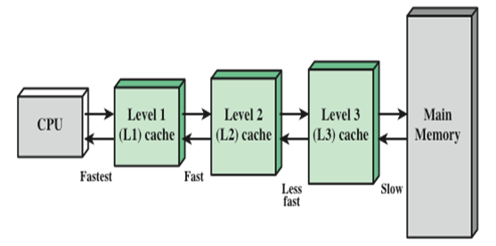
Locality
If an item is referenced:
Temporal locality: Examples in programming?
Spatial locality: Examples in programming?
Sequential Locality: Instructions tend to be accessed sequentially.
Cache: maintain instructions, data, and address information that will be accessed soon
Instruction Cache
Data Cache
Translation Lookahead Buffer

Slide 8
Cache Read Operation
RA – read address
Miss: requested data not in the cache
Hit: requested data in the cache

Slide 9
Effective Execution Time
Block: unit of data transfer (called refill line as well) (why?)
Hit rate: percentage of accesses found in cache
Miss rate: percentage of accesses not in cache (1 - hit rate)
Hit time: time to access cache
Miss penalty: time to replace block in cache with appropriate one (replace a block, not a data), tends to large. (100 times more than hit time)
Effective execution time (EET):
hit rate * hit time + miss rate * miss penalty
Goal is, as less EET as possible. (of course)
Decreasing miss rate (simultaneously increasing hit rate) is an important goal.

Slide 10
Class Exercise
A certain RISC processor has an on-chip cache with the following specifications (because its logic simple and thus has space for cache!):
Cache hit rate for the L1 cache is 98%
Instructions that are located in-cache execute in 1 clock cycle.
Instructions that are not found in the on-chip cache will cause the processor to stop program execution and refill a portion of the cache. This operation takes 100 clock cycles to execute.
Q) What is the EET in nanoseconds for this RISC processor if the clock frequency is 100 MHz?
Answer:
Clock cycle time = 1/100M = 10ns
EET = hit rate X hit time + miss rate X miss penalty
= 0.98 X 1 (clock cycle) X 10ns + 0.02 X 100 (clock cycle) X 10 ns
= 9.8 ns + 20 ns = 29.8 ns

Slide 11
Cache Organization
Cache memory consists of a number of cache entries.
LRU bits: used for replacing a victim cache line with a new entry (To be discussed in Lec. 16)
Valid bit: indicating if the cache line is valid.
Tag field: holding the memory address and determining if there is a match to a CPU request
Data field: Copies of the contents of main memory (instructions / data)
LRU bits | Valid | Tag | Data
Bit0: either set 0/1 or 2/3 accessed Bit1: either set 0 or 1 accessed Bit2: either set 2 or 3 accessed | 0 (invalid) 1 (valid) | Which column of memory stored | An actual copy of memory block

Slide 12
Cache Design
Goal: Increase the performance of computer using Caches.
Design Issues | In Details | Examples | Covered in
Cache Mapping Schemes | How to map the data in memory to the data in cache? | Direct cache mapping Associative cache mapping | Lec. 15
Write Policies | When to write back dirty data from cache to main memory | Write through Write back | Lec. 16
Replacement Algorithms | How to identify a victim cache line that should be written back to main memory | FIFO LRU: least recently use | Lec. 16
Cache Address | A program is running in a logical (virtual address always starting address 0x00000000) but we only have one physical address. | Physical or virtual address | Lec. 16
Cache Size | A long or short line? Which is efficient? | 32, 64, or 128 bytes | Lec. 15
# Caches | What is the optimal number of caches? | L1, L2, and L3 | Lec. 16

Slide 13
Mapping Function
How to map the address of memory to a data in a cache?
Direct Mapping
Set Associative Mapping
Associative Mapping
0
1
0
1
0
1
0
1
0
1
0
1
0
1
0
1
Set 0
Set 1
What’s the main drawback?
What’s the main drawback?

Slide 14


Metaphors of Mapping Functions
16 students are lined up to enter a tiered classroom. They are seated in the order of their student IDs.
Today is a self-studying class. Whenever a student has a question, s/he must go down to the special desk with 4 chairs, right in front of the professor.
Each student has the same textbook and ask the professor about a specific page# (i.e., offset)
Direct mapping: students on the same column compete the same chair. E.g. students 0, 4, 8, and 12 need to share chair A, but one at a time
Associative mapping: students can have any one of chairs A-D as far as it is unoccupied.
2-way set-associative mapping: Students on every other columns in the same color (red or blue) can choose one of the two same colored chairs AB or CD.
0
1
2
3
4
5
6
7
8
9
10
11
12
13
14
15
student ID except LS bits
→ tag#
LS bits of ID
→ set#
student ID → tag#
ID₁₀ → ID₂
1110
1010
0110
0010
1110
1010
0110
0010
1100
1000
0100
0000
1110
1010
0110
0010
1111
1011
0111
0011
row#
→ tag#
column#
→ block#
c
c
12
13
14
15
12
13
14
15
12
13
14
15
8
9
10
11
8
9
10
11
8
9
10
11
4
5
6
7
4
5
6
7
4
5
6
7
0
1
2
3
0
1
2
3
0
1
2
3
A 00 | B 01 | C 10 | D 11
A | B | C | D
A 0 | B 0 | C 1 | D 1
The professor can always identify each student with her/his tag on where s/he came from.

Slide 15
Direct Mapping
block #
offset in
each block
tag
block
0
1
2
3
offset
Bits in main memory address is divided into three fields
xx
xx
xx
xx
0000
0001
0010
0011
0100
0101
0110
0011
1000
1001
1010
1011
1100
1101
1110
1111
000000
000001
000010
000011
000100
000101
000110
000111
001000
001001
001010
001011
001100
001101
001110
001111
tag 0
010000
010001
010010
010011
010100
010101
010110
010111
011000
011001
011010
011011
011100
011101
011110
011111
 | Tag | Block | Offset
General description | Identify which column in memory | # blocks or #cache lines in cache | # bytes per block
Right example | 2 bit 4 columns | 2 bits 4 blocks | 2 bits 4 bytes per block
More practical example 512KB memory 32KB cache 64-byte / cache line | 4 bits 512KB / 32KB = 16 columns | 9 bits 32KB / 64B = 512 blocks | 6 bits 64 bytes per block
tag 1
100000
100001
100010
100011
100100
100101
100110
100111
101000
101001
101010
101011
101100
101101
101110
101111
tag 2
110000
110001
110010
110011
110100
110101
110110
110111
111000
111001
111010
111011
111100
111101
111110
111111
How to find the correspondence between memory and cache
1) Check the block.
2) Then, compare the tag.
tag 3

Slide 16
Direct Mapping
Divide the address into tag, block and offset bits
Memory size | M bytes
Cache size | C bytes
Cache block size | B bytes
Tag bits: log(M/C) | Block bits: log(C/B) | Offset bits: log B
Memory size | 64 bytes
Cache size | 16 bytes
Cache block size | 4 bytes
Memory size | 512KB
Cache size | 32KB
Cache block size | 64B
Memory size | 4GB
Cache size | 64KB
Cache block size | 64B
Tag (2) | Block (2) | Offset (2)
Tag (4) | Block (9) | Offset (6)
Tag (16) | Block (10) | Offset (6)
Compute address 47’s tag, block and offset
47₁₀ = 0x2F = 2_101111
10 11 11
Tag = 2, Block = 3, Offset = 3
Compute address 495412’s tag, block and offset
495412₁₀ = 0x43F87 = 2_100 0011 1111 1000 0111
1000 011111110 000111
Tag = 8, Block = 254, Offset = 7
#tags = 4G / 64KB = 2³²/ (2⁶ * 2¹⁰) = 2¹⁶
#blocks = 64K / 64 = 2¹⁶ / 2⁶ = 2¹⁰
#offset = 64B = 2⁶

Slide 17
Find Hit/Miss in Direct Mapping
block #
offset in
each block
tag
block
0
1
2
3
offset
Let’s assume that the cache tags are shown right.
Does address 001001 make a hit or miss?
Does address 100011 make a hit or miss?
3
0000
0001
0010
0011
0100
0101
0110
0111
1000
1001
1010
1011
1100
1101
1110
1111
000000
000001
000010
000011
000100
000101
000110
000111
001000
001001
001010
001011
001100
001101
001110
001111
2
tag 0
0
2
010000
010001
010010
010011
010100
010101
010110
010111
011000
011001
011010
011011
011100
011101
011110
011111
tag 1
How to find:
Check the block
Then, compare the tags.
Question:
How should tags be initialized?
The Valid bit!
100000
100001
100010
100011
100100
100101
100110
100111
101000
101001
101010
101011
101100
101101
101110
101111
tag 2
110000
110001
110010
110011
110100
110101
110110
110111
111000
111001
111010
111011
111100
111101
111110
111111
tag 3

Slide 18
Summary
RISC:
More memory needed and more dependent on compiler techniques but faster.
Memory Hierarchy:
Utilize locality of memory access.
Cache memory mapping
Direct mapping
Associative mapping
Set associative mapping
Study in the next lecture

