Slide 1
CSS 422 Hardware and Computer Organization
Associative Cache and Snoop Cache
Ver. 2
Professor: Munehiro Fukuda

Slide 2
Topics
Associative Mapping
Full associative
Set associative
Cache Write Policies
Write-through, Write-back, Write-around, and Write-allocate
Snoop Cache
Write invalidate and Write update
Elements of Cache Design
Replacement algorithms
Multi-level caches

Slide 3
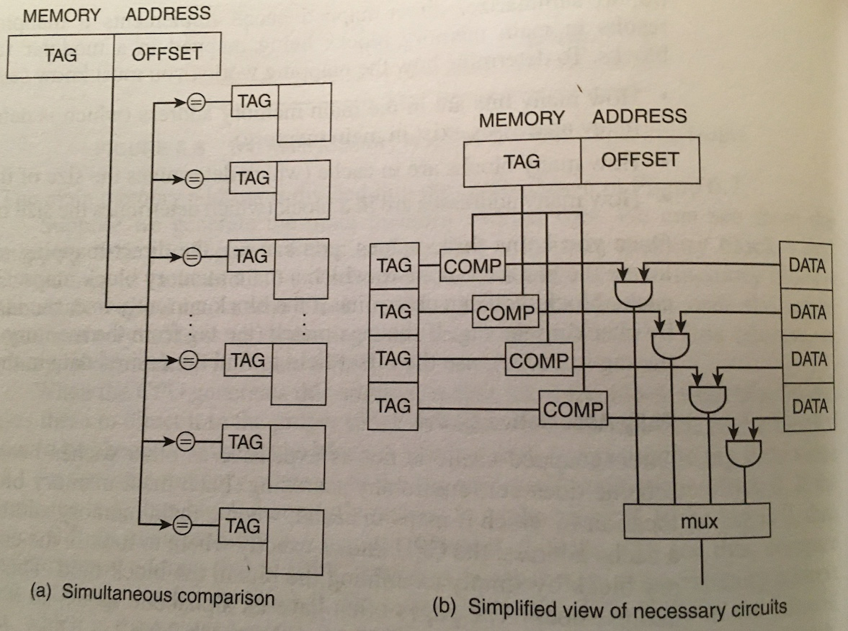
Associative Mapping
block #
= tag
offset in
each block
tag
offset
xxxx
xxxx
xxxx
xxxx
00
01
10
11
00
01
10
11
00
01
10
11
00
01
10
11
000000
000001
000010
000011
000100
000101
000110
000111
001000
001001
001010
001011
001100
001101
001110
001111
Tag (4) | Offset (2)
How to find the correspondence between memory and cache
Given a memory block, compare it with every single cache tag!
010000
010001
010010
010011
010100
010101
010110
010111
011000
011001
011010
011011
011100
011101
011110
011111
100000
100001
100010
100011
100100
100101
100110
100111
101000
101001
101010
101011
101100
101101
101110
101111
We need:
the valid bit in each tag.
110000
110001
110010
110011
110100
110101
110110
110111
111000
111001
111010
111011
111100
111101
111110
111111

Slide 4
Associative Mapping
Divide the address into tag, block and offset bits
Memory size | M bytes
Cache size | C bytes
Cache block size | B bytes
Tag bits: log(M/B) | Offset bits: log B
Memory size | 64 bytes
Cache size | 16 bytes
Cache block size | 4 bytes
Memory size | 512KB
Cache size | 32KB
Cache block size | 64B
Memory size | 4GB
Cache size | 64KB
Cache block size | 64B
Tag (4) | Offset (2)
Tag (13) | Offset (6)
Tag (16) | Offset (6)
Compute address 47’s tag and offset
47₁₀ = 0x2F = 2_101111
1011 11
Tag = 11, Offset = 3
Compute address 495412’s tag and offset
495412₁₀ = 0x43F87 = 2_100 0011 1111 1000 0111
1000011111110 000111
Tag = 0x10FE = 4350, Offset = 7
#tags = 4GB / 64B = 4 * 2³⁰ / 2⁶ = 2²⁶ = 2⁶
#offset = 32 – 26 = 6

Slide 5
Find hit/miss in an associative cache
block #
= tag
offset in
each block
tag
offset
00
01
10
11
00
01
10
11
00
01
10
11
00
01
10
11
000000
000001
000010
000011
000100
000101
000110
000111
001000
001001
001010
001011
001100
001101
001110
001111
Given a memory address, get its tag and offset.
Search the cache tag to find the block whose tag matches the memory address tag.
If found the matching tag (valid), then hit, otherwise miss.
When hit, then find the content in the cache block which is at the offset location.
Examples:
Ex1. Can memory address 011111 be found in the cache?
Ex2. How about 001001?
1011
0101
1100
0010
010000
010001
010010
010011
010100
010101
010110
010111
011000
011001
011010
011011
011100
011101
011110
011111
100000
100001
100010
100011
100100
100101
100110
100111
101000
101001
101010
101011
101100
101101
101110
101111
110000
110001
110010
110011
110100
110101
110110
110111
111000
111001
111010
111011
111100
111101
111110
111111

Slide 6
Problem on Associative Cache
Recall tag and offset bits calculation on p2:
Memory size 512KB.
Associative Cach size is 32KB.
The cache block size is 64 bytes.
➔ # Tags in a main memory : 512KB/64 =8K → # tag bit is log 2¹³ = 13
Block size in a main memory: 64 → offset bit is log 64 = 6
Tag (13) | Offset (6)
8196 comparators!
Should scan all the tags in a cache to find the matching tag (= the corresponding block).
Complex hardware is needed for address comparisons if main memory is large
When cache is full, what should be removed (victim block) when a new block should be loaded into cache?
Need replacement algorithm (will cover later)

Slide 7
Set-Associative Cache
Two-Way Set Associative Mapping
0
1
0
1
0
1
0
1
0
1
0
1
0
1
0
1
Or called N-way set associative cache.
Combines the properties of the direct-mapped and associative cache into one system
Direct mapped Cache is very restrictive
Associative Cache is very expensive (should search)
So, combine those two→ Set Associative Cache
Most commonly used in modern processors ( 4-way set associative cache )
The right example: 2-way set associative cache
Equivalent to a multiple-column direct mapping
The right example: a two-column direct mapping
N-way set associative: each set contains N number of blocks
The right example: each set contains 2 blocks.
Set 0
(2 ways)
Column 0
Set 1
(2 ways)
Column 1
Set 2
(2 ways)
Column 2
Set 3
(2 ways)
Column 3
Column 4
Column 5
Column 6
Column 7

Slide 8
2-way Set-associative cache
offset in
each block
Suppose a byte-addressable main memory system is 64 bytes capacity.
A 2-way set associative cache has 32 bytes capacity
A block (cache line) has 4 bytes
Offset bits in block: 2
How many sets does cache have?
Four sets: sets 0, 1, 2, and 3
Then, which bits in each memory address should indicate the corresponding set#?
Bit #3 and #2
Then, how many bits should be allocated to represent a tag or a cloumn #?
2 bits
Tag
00
0
1
0
1
0
1
0
1
0
1
0
1
0
1
0
1
000000
000001
000010
000011
000100
000101
000110
000111
001000
001001
001010
001011
001100
001101
001110
001111
Set 0
Column 0
01
Set 1
Column 1
11
Need to kick out one of these
010000
010001
010010
010011
010100
010101
010110
010111
011000
011001
011010
011011
011100
011101
011110
011111
Set 2
Column 2
01
Set 3
Column 3
11
100000
100001
100010
100011
100100
100101
100110
100111
101000
101001
101010
101011
101100
101101
101110
101111
Column 4
Column 5
110000
110001
110010
110011
110100
110101
110110
110111
111000
111001
111010
111011
111100
111101
111110
111111
Column 6
Column 7

Slide 9
2-way Set-associative cache
We want to bring data at
Address 7 (2_000111)
Address 58 (2_111010)
Address 24 (2_011000)
Address 37 (2_100101)
Tag
0
1
0
1
0
1
0
1
0
1
0
1
0
1
0
1
000000
000001
000010
000011
000100
000101
000110
000111
001000
001001
001010
001011
001100
001101
001110
001111
Set 0
Column 0
7
00
Set 1
10
Column 1
01
010000
010001
010010
010011
010100
010101
010110
010111
011000
011001
011010
011011
011100
011101
011110
011111
Set 2
Column 2
11
24
Set 3
Column 3
100000
100001
100010
100011
100100
100101
100110
100111
101000
101001
101010
101011
101100
101101
101110
101111
Column 4
37
Column 5
110000
110001
110010
110011
110100
110101
110110
110111
111000
111001
111010
111011
111100
111101
111110
111111
Column 6
58
Column 7

Slide 10
N-Way Set Associative Cache
Divide the address into tag, block and offset bits
Memory size | M bytes
Set associative cache size | W-way C bytes
Cache block size | B bytes
Tag bits: log(M/(C/W)) | Set bits: log((C/B)/W) | Offset bits: log B
Memory size | 64 bytes
Cache size 2 ways | 32 bytes
Cache block size | 4 bytes
Memory size | 512KB
Cache size 2 ways | 32KB
Cache block size | 64B
Memory size | 4GB
Cache size 4 ways | 64KB
Cache block size | 64B
Tag (2) | Set (2) | Offset (2)
Tag (5) | Set (8) | Offset (6)
Tag (18) | Set (8) | Offset (6)
#tags: 64 / (32 / 2) = 4 = 2²
#sets: (32/4)/2 = 4 = 2²
#offset: 4 = 2²
Compute address 47’s tag, block and offset
47₁₀ = 0x2F = 2_101111
10 11 11
Tag = 2, Block = 3, Offset = 3
#tags: 512 * 2¹⁰ / (32 * 2¹⁰ / 2) = 512 / 16 = 32 = 2⁵
#sets: (32K/64)/2 = 512 / 2 = 256 = 2⁸
#offset: 64 = 2⁶
Compute address 495412’s tag, block and offset
495412₁₀ = 0x43F87 = 2_100 0011 1111 1000 0111
10000 11111110 000111
Tag = 16, Block = 254, Offset = 7
#tags = 4G / (64KB / 4) = 2³² / (2¹⁶ / 4)
= 2³² / 2¹⁴ = 2¹⁸
#sets = (64KB / 64) / 4) = (2¹⁶ / 2⁶) / 4
= 2¹⁰ / 4 = 2⁸
#offset = 64B = 2⁶

Slide 11
Find Hit/Miss in Set Associative Cache
Given a memory address (57 = 2_111001)
Get tag(11), set(10), offset(01)
Go to the set 2 in the cache, search for tag (11).
If the tag matches, then hit, retreive data in offset(01 = 1)
Given a memory address (14 = 2_0001110)
Get tag(00), set(01), offset(10)
Go to the set 1 in the cache, search for tag (00).
If the tag matches, then hit, retrieve data in offset(10 = 2)
Given a memory address (43 = 2_101011)
Get tag(10), set(10), offset(11)
Go to the set 2 in the cache, search for tag (10)
If the tag does not match, then miss, bring data from memory address 43.
HOW!? → Cache line replacement
Tag
0
1
0
1
0
1
0
1
0
1
0
1
0
1
0
1
000000
000001
000010
000011
000100
000101
000110
000111
001000
001001
001010
001011
001100
001101
001110
001111
Set 0
Column 0
00
Set 1
Column 1
14
01
010000
010001
010010
010011
010100
010101
010110
010111
011000
011001
011010
011011
011100
011101
011110
011111
11
Set 2
?
Column 2
24
Set 3
10
Column 3
100000
100001
100010
100011
100100
100101
100110
100111
101000
101001
101010
101011
101100
101101
101110
101111
Column 4
43
Column 5
110000
110001
110010
110011
110100
110101
110110
110111
111000
111001
111010
111011
111100
111101
111110
111111
Column 6
57
Column 7

Slide 12
Cache Block Replacement
Replacement Algorithm
FIFO
Random
LRU
LRU: the most popular
Need a timestamp on when the corresponding cache block was accessed.
Choose a victim whose timestamp is oldest.
Very expensive:
To provide each cache block with a time stamp
To compare these time stamps: O(N) in N-way set associative
LRU bits in O( log N )
2 way: 1 bit
4 way: 2 bits
https://www.sciencedirect.com/topics/computer-science/set-associative-cache
LRU bit | LRU block
0 | 0th
1 | 1st
LRU bit0 | LRU bit1 | LRU block
0 | 0 | 0th
0 | 1 | 1st
1 | 0 | 2nd
1 | 1 | 3rd

Slide 13
In-Class Exercise
A certain RISC processor has an on-chip cache with the following specifications:
32-bit wide address and data busses
On-chip instruction cache is 64K bytes, organized as a 4-way set associative
Cache line (block size) = 64 bytes
Average cache hit rate = 95%
Instructions located in cache execute in 1 clock cycle
For this memory design burst accesses from main memory requires an address set-up time of 5 clock cycles, and then all subsequent burst fetches from main memory require 2 clock cycles per memory fetch.
What is the effective execution time in nanoseconds for this RISC processor if the clock frequency is 100 MHz?
From the lecture notes we recall that:
1 clock cycle = 1/100MHz = 10 ns
Effective execution time = hit rate * hit time + miss rate * miss penalty
Hit rate: 0.95: Miss rate: 0.05
Hit time = 1 clock cycle * 10 ns
Miss time = (burst memory access + read all 64 bytes (in a block))*10ns
= (5 + 2* (64/4))*10 ns = 370 ns
Note: If we have a cache miss, then the processor must refill one line in the cache. Since this is a 32-bit processor, we can read 4 bytes at once. Thus, we must read main memory 64/4 or 16 times. Since each external memory fetch requires 2 cycles, the memory read requires 16x2 = 32 clock cycles. However, we also have the overhead of setting up the address. This takes 5 clock cycles. Each clock cycle is 10 ns, so the miss penalty causes a total time delay of:
Effective execution time = 0.95*10 + 0.05*370 = 9.5 + 18.5 = 28 ns

Slide 14
Cache Write Strategies
MOV R0, #0xCD
LDR R1, =#2_10
MOV R0, [R1]
MOV R0, #0xEF
LDR R1, =#2_01
MOV R0, [R1]
Initial Cache and Memory
tag
Cache
tag
Cache
tag
Cache
tag
Cache
tag
Cache
10
01
AB
10
01
AB → CD
10
01
AB → CD
10
01
AB
10
01
AB
Dirty cache line
EF
Main
Main
Main
Post-write
Main
Main
00
01
10
11
00
01
10
11
00
01
10
11
00
01
10
11
00
01
10
11
EF
EF
AB
AB → CD
AB
AB
AB
Write-through
Write-back
Write-around
Write-allocate
Write-through
Post-write happens
Upon a flush or a victim replacement
Write-back

Slide 15
Multi-Processor System
Processor Chip
Processor Chip
CPU core
CPU core
CPU core
CPU core
H/W thread
H/W thread
H/W thread
H/W thread
H/W thread
H/W thread
H/W thread
H/W thread
reg0
…
reg0
reg0
…
reg0
reg0
…
reg0
reg0
…
reg0
1
1
…
1
1
…
1
1
…
1
1
…
…
…
…
…
…
…
…
sp
sp
sp
sp
sp
sp
sp
sp
ALU
FPU
ALU
FPU
ALU
FPU
ALU
FPU
L1 cache
L1 cache
L1 cache
L1 cache
L2 cache
L2 cache
Besides taking advantage of locality, why do we need cache for multi bus master (multi-processor) system?
System Memory
Cache coherency problems
Coherency protocols
Inclusion properties

Slide 16
Snoop Cache
 | Write-through | Write-back
CPU Cache
CPU Cache
CPU Cache
CPU Cache
CPU Cache
CPU Cache
→ y
x
→
→
x
z*
→ y
x
→
→
x
z*
Write-invalidate
Shared Memory
Shared Memory
→ y
x
→ z
x
CPU Cache
CPU Cache
CPU Cache
CPU Cache
CPU Cache
CPU Cache
→ y
x
→ z
→ y
x
→ z
z*
→ y
x
→z
→ y
x
→z
z*
Write-update
Shared Memory
Shared Memory
→ y
x
→ z
x
z*) For more accuracy, note that y is read in CPU3 and updated with z

Slide 17
Elements of Cache Design
Cache Address:
Logical
Physical – Now L1, L2, and L3
Cache Size
Line Size – 64B~128B
Number of Caches
Single or two level – L1, L2, and L3
Unified or split
Snoop cache
Write invalidate
Inclusive cache
Mapping function
Direct
Associative
Set Associative
Write Policy
Write through – Previously L1
Write back – Now L1, L2, and L3
Replacement Algorithm
Least recently used (LRU)
First in first out (FIFO)
Least frequently used (LFU)
Random

Slide 18
Summary
Two types of locality: spatial and temporal
Cache contents include data, tags, and attribute bits (valid and LRU)
Spatial locality demands larger block sizes (but may cause thrashing in multi cores.)
Because miss penalty is increasing (processors getting faster than memory), modern processors use set-associative caches
Separate I and D caches
Multi-level caches used to reduce miss penalty (1st level on-chip)
Memory system should be designed to support caches

