Slide 1
CSS 422 Hardware and Computer Organization
Computer Arithmetic
Ver. 3
Professor: Munehiro Fukuda

Slide 2
Topics
Nagative binary numbers and their arithmetic (Null Ch2.4)
Signed magnitude
One’s complement
Two’s complement
Multiplication/Division by shifts
Real numbers (Null ZCh2.5)
Binary
Fixed point
Floating point

Slide 3
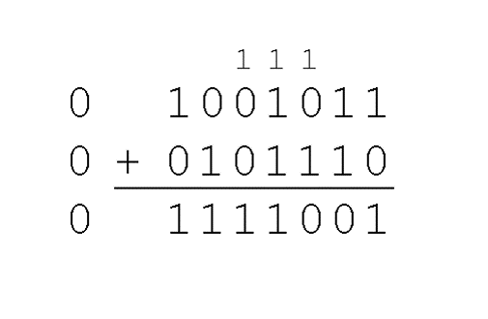
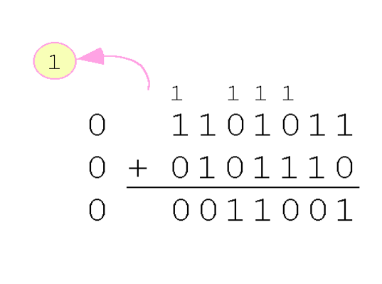
Signed Magnitude
Sign
If positive, then MSB is 0
If negative, then MSB is 1
Examples
in 8-bit system: 7 = 0 0 0 0 0 1 1 1 -7 = 1 0 0 0 0 1 1 1
in 4-bit system: 7 = 0 1 1 1 -7 = 1 1 1 1
Integer Arithmetic
75 + 46 = 121
107 + 46 = 25 (overflow)
How about -43 – (-24)
= -43 + 24 = -19?
1 0 1 0 1 0 1 1
+ 0 0 0 1 1 0 0 0
------------------------
1 1 0 0 0 0 1 1 = -67

Slide 4
Signed Magnitude
Question (in 4-bit system (nibble))
How to represent zero? 0000 or 1000 ?
Both of them are zero. So we have two zeros.
How many unsigned numbers you can have in a nibble system?
unsigned: 0000 to 1111 (sixteen numbers from 0 to 15),
How many signed numbers you can have in a nibble system?
signed: 0001 to 0111 (positive: 1 to 7), 1111 to 1001 (-7 to -1) , so fifteen numbers including zero. What are we missing?
With this representation in 4-bits sytem,
What is 7 – 5 in binary?
0111₂– 0101₂= 0010₂
What is 7+ (-5) in binary?
0111₂+ 1101₂= 1 0100₂
Need to distinguish A + B, -A + B, A + (-B), and -A + (-B)

Slide 5
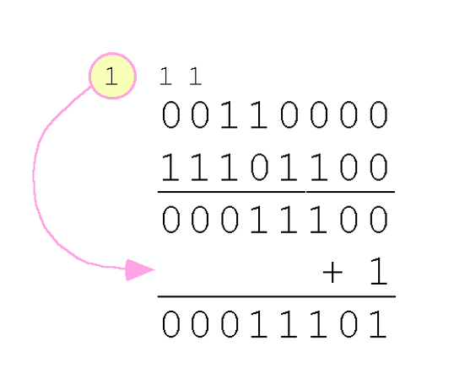
One’s Complement
Sign
If positive, then MSB is 0
If negative, then MSB is 1
But a given positive number and its negative are in a dual representation
+3 = 0000 0011
–3 = 1111 1100
Integer arithmetic
48 + (-19) = 29
Arithmetic is simpler with 1 carried around
But:
two zeros: positive zero 00000000
negative zero 11111111
carried around

Slide 6
Two’s Complement
Sign
If positive, then MSB is 0
If negative, then MSB is 1
But, given a postitive number, its negative number is 1’s complement + 1.
+3 = 0000 0011
–3 = 1111 1100 + 1 = 1111 1101
Example: In 8-bit system, compute the 2’s complement of 0x5E in ARM (or $5E in 68K)
Step 1: Convert to binary: 0x5E = 2_0101 1110 in ARM (or %0101 1110 or 0b01011110 in68K)
Step 2: Complement bits→ 1010 0001
Step 3: add 1→ = 1010 0001 + 1 = 1010 0010
Step 4: Convert to hex again: 2_1010 0010 → 0xA2
Example: In 2-hexa bit system, compute the 16’s complement of 0x5E in ARM (or $5E in 68K)
Step 1: Complement bits→ 0xA1 (= $A1)
Step 2: add 1→ = 0xA1 + 1 = 0xA2 (= $A2)

Slide 7
Two’s Complement
Question (in 4-bit system (nibble))
How to represent zero? 0000 or 1000 ?
The first one is zero, the second one is -8
How many unsigned numbers you can have in a nibble system?
unsigned: 0000 to 1111 (0 to 15),
How many signed numbers (in 2’s complement) you can have in a nibble system?
Positive: 0000 to 0111 ( 0 to 7)
Negative: 1000 to 1 111 (-8 to -1): So, total 16 numbers
With this representation in 4-bits system,
What is 7 – 5 in binary?
0111₂– 0101₂= 0010₂
What is 7+ (-5) in binary?
0111₂+ 1011₂= 1 0010₂
(Since it is 4-bit system, the carry bit won’t appear, so 0010₂=2₁₀)

Slide 8
Two’s complement arithmetic
Arithmetic overflow:
Adding two positive number results in a negative number
Adding two negative number results in a positive number
How this can be possible?
If the result is out of range, then the computer results in an incorrect answer
For example, in 4-bit system (range is -8 to 7)
7+ 7 = 0 1 1 1 + 0 1 1 1 = 1 1 1 0 (It is not 14, it is -2)→ incorrect result, negative
(-7)+(-8) = 1 0 0 1 + 1 0 0 0 = 1 0 0 0 1 (it has a carry bit and the result is 1)→ incorrect, positive
How the process detect the overflow? It has special bits to check. (Will cover later)

Slide 9
Multiplication/Division w/ Shifts
Multiplication by shifting left
Division by shifting right
1 left shift = x 2
00001011 (11₁₀) -> 00010110 (22₁₀)
2 left shifts = x 4
00001100 (12₁₀) -> 00110000 (48₁₀)
3 left shifts = x 8
00001100 (12₁₀) -> 01100000 (96₁₀)
1 right shift = / 2
00001100 (12₁₀) -> 00000110 (6₁₀)
2 right shifts = / 4 ->
00001100 (12₁₀) -> 00000011 (3₁₀)
Then, how about:
5 / 2 = ?
-7 / 2 = ?

Slide 10
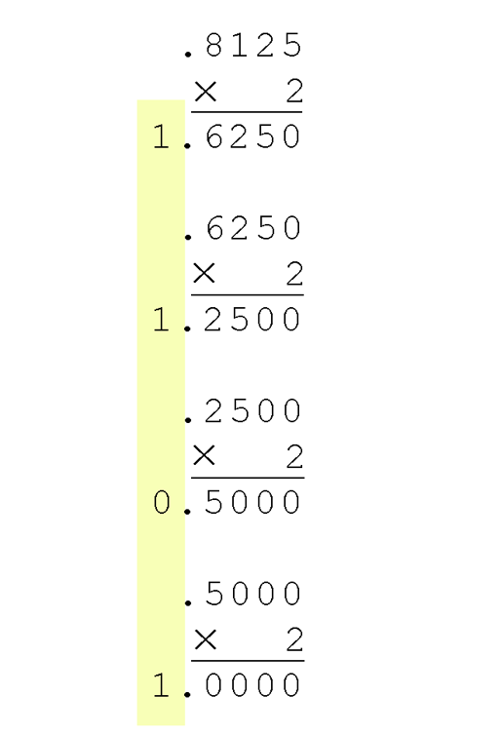
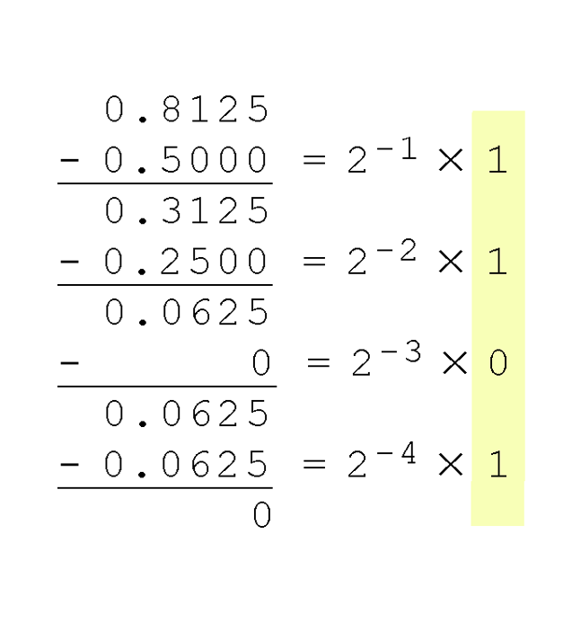
Real Numbers in Binary
Subtraction Method
Multiplication Method
Means larger than 0.5
Means larger than 0.05
Means less than 0.05
0.8125₁₀ = 0.1101₂
Means equal to 0.05

Slide 11
Real Numbers and Recurring Fractions
Many fractions are repeating
Ex) convert 0.6 to binary, using the multiplication method
0.6 * 2 = 0.2 ---- 1
0.2 * 2 = 0.4 -----0
0.4 * 2 = 0.8 -----0
0.8 * 2 = 0.6 -----1
0.6 * 2 = 0.2 ---- 1
0.2 * 2 = 0.4 -----0
0.4 * 2 = 0.8 -----0
0.8 * 2 = 0.6 -----1
So, 0.6 → 0.1001100110011001….. (will be repeated infinitely)
Solution:
Truncation : The simplest technique. Drop unwanted bits
Ex) 0.1101101 → 0.1101
Rounding : Better technique, but complicated
Ex) 0.1101101 = 0. 1101 + ( 0.0000101 = 2⁻⁵+2⁻⁷> 2⁻⁶)
= 0.1101 + 0.0001 = 0.1110

Slide 12
Real Number in Computers
How to represent a real number in a computer system?
Real number = integer part + fraction part
Can we represent an irrational number in binary?
No, since we have a fixed number of bits, and irrational numbers are irregularly infinite number.
If we approximate, then we can represent in bits.
Limited precision
Overflow/underflow is unavoidable

Slide 13
Real Number Formats
Two main approaches: Fixed vs. Floating
Fixed-point representation
Divide the bits for integer part and fraction part
Point is fixed
Easier but less flexible
Floating-point representation
Divide the bits for sign, exponent and mantissa part
Match with scientific notation
Point is floating
Flexible but more complex
Floating-point is now a standard

Slide 14
Fixed-Point Representation
Fixed-point representation
Divide the bits for integer part and fraction part
For example, 3.625₁₀ = 11.101₂
Not flexible.
What if you really need to represent 3.625 * 10⁽⁻¹⁸⁾ in computer?
How many bits will be needed?
10¹⁸ = Exa = Giga * 10³ * 10³ * 10³= 2³⁰ * 2¹⁰ * 2¹⁰ * 2¹⁰= 2⁶⁰
60 bits
0 | 0 | 1 | 1 | 1 | 0 | 1 | 0
Integer part
Fractional part

Slide 15
Floating-Point Representation
Floating point representation
Divide the bits for sign, exponent and mantissa
IEEE floating-point format
IEEE short real or single precision : 32-bits
IEEE long real or double precision: 64 bits
Sign (1) | Exponent (8) | Mantissa(23)
Sign (1) | Exponent (11) | Mantissa(52)

Slide 16
Floating-Point Representation
We will mostly use 32-bit (single precision) format.
Let’s represent a real number to floating-point format
Ex) - 3.8125₁₀
= - 11.1101₂ (note that the integer part is not 2’s complement)
=-1.11101*2¹ (normalize: scientific notation)
Sign bit = 1, since negative
Exponent = 1 + 127 (biased) = 128 = 10000000₂
Mantissa: 11101
Therefore in floating-point representation,
1 100 0000 0 111 01 00 0000 0000 0000 0000₂ = 0xC0740000 in ARM(or $C0740000 in 68K)
Sign (1) | Exponent (8) | Mantissa(23)

Slide 17
Normalization and Bias Exponent
Normalization: Always 1 appears as an integer part
So, we do not have to represent this 1 in the format, therefore save one bit
Biased exponent:
The exponent has 8 bits, meaning it can range from -127 to 127 (Here we assume that -128 will never happen)
Therefore if we add 127 to the exponent, it will be always non-negative number.
So, let’s assume that in the representation, 0~255 is available for exponent filed

Slide 18
Summary
Why don't computers use signed magnitude?
Why do we want to use two's complement rather than one's complement?
How will shift-based divisions truncate data?
How to convert a real number into binary.
What are the pros and cons of fixed point numbers?
Explain the normalization, the exponent, and the mantisa of IEEE floating-point numbers.

