Slide 1
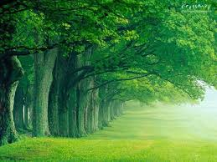




TITLE : ANUVRUDDHI (grow your self, grow the earth)
Presented by:
ANUSHKA DINESH SARODE .
(Founder, Visionary, and Developer)
Theme: Tree growing from a digital root.

Slide 2
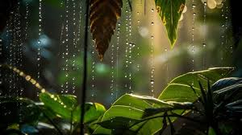
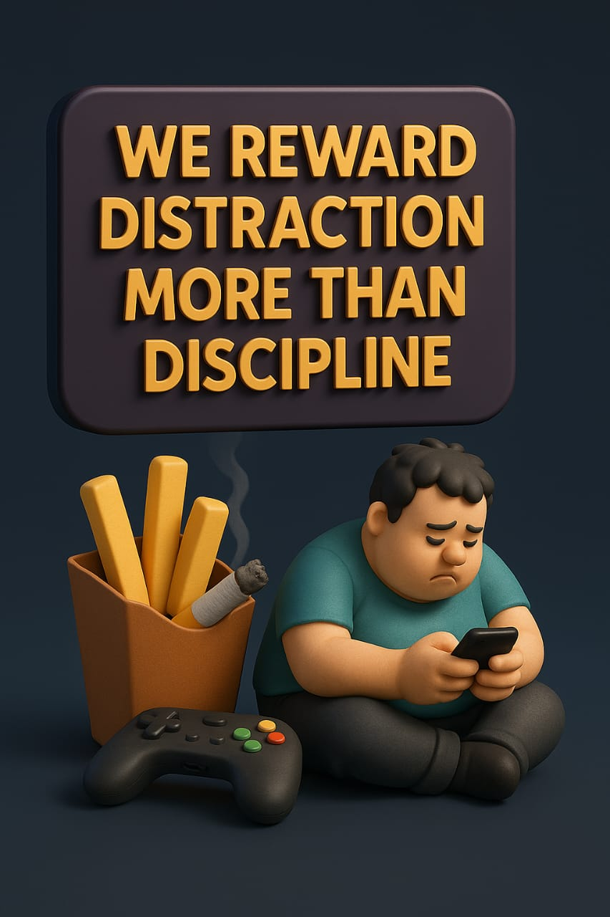
THE PROBLEM WE FACE: “WE REWARD DISTRACTION MORE THAN DISCIPLINE.”
“In today’s world , we reward distraction more than discipline.”
“Climate action feels boring. Habit-building feels like punishment.”
“We want growth-but we get no motivation, no reward, and no real-world result.”

Slide 3
OUR SOLUTION: A SYSTEM THAT GROWS YOU + our PLANET
Anuvruddhi means Sustainable Growth in Sanskrit.
(Embodies Tree Growth, Personal Growth, and Planet Healing.
This app is a gamified life system that transforms every day’s actions into personal growth, community impact, and environment healing.

Slide 4
KARMA XP SYSTEM – MOTIVATION THAT MATTERS (INSERT XP BADGE VISUAL WITH TREE LEAF ICON)
CORE FEATURES:
Gamified Habit Tracking-
( mediation, study, workout, eco-tasks)
Real Trees Planted in User’s Name-
As a reward for user plant a tree with their name in local area.
Karma XP & Tree Growth Rewards
Lifeclock prediction
(health + habit = lifespan)
It predicts the lifespan of user acccording their good habits.
Cultural theme Support
(Vedic, Sufi, Zen, Universal)
It relax the mind of user and connecting them with their culture.
Reflection Prompts for Emotional Growth

Slide 5
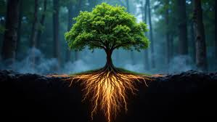

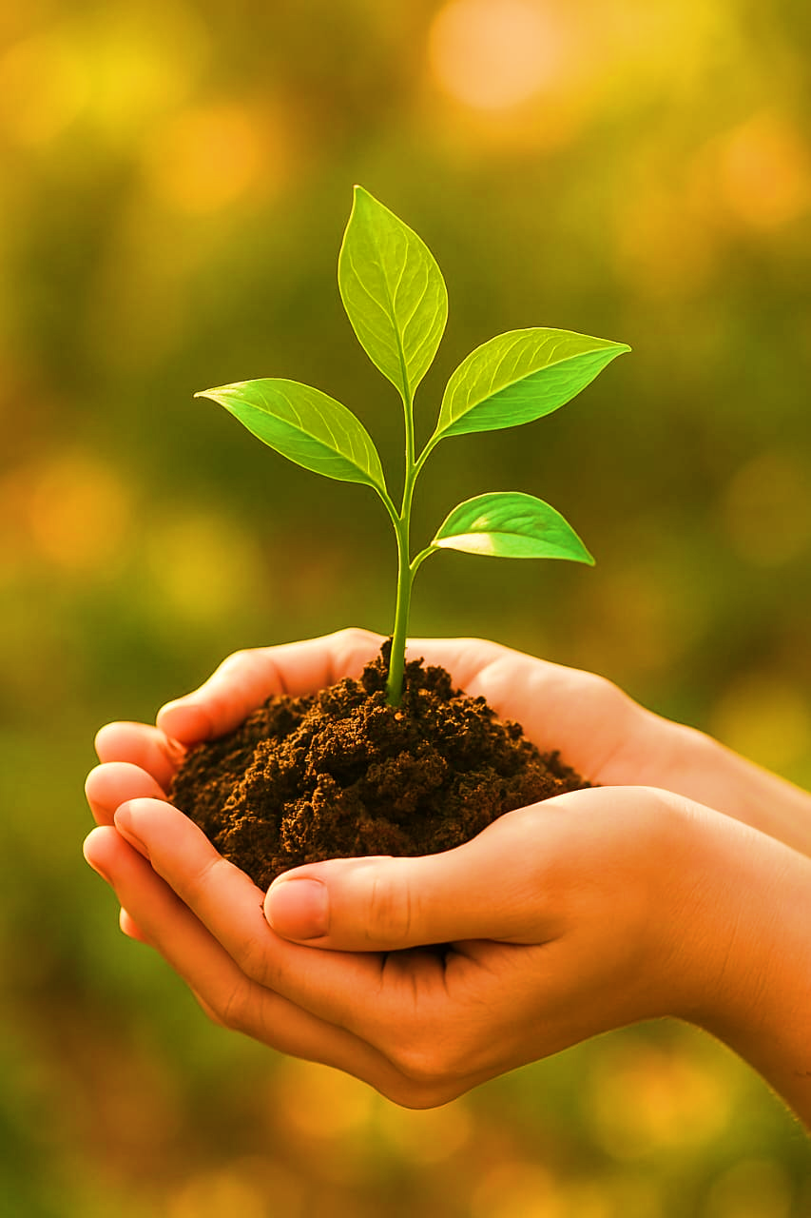
Green Sevaks: Jobs With Diginity.
Volunteer System with School, College and University students as a physical activity which gives credits to them in their curriculum.
Tree Certificates & eco-trips for winners.
Naturefeed for users to post eco-actions.
Green Sevak Jobs for the unemployed to care for trees
NGO Collaboration for tree tracking, impact reports.
School, Colleges and Universities those conduct this type of protocols will also give badges and certificates as a reward.

Slide 6

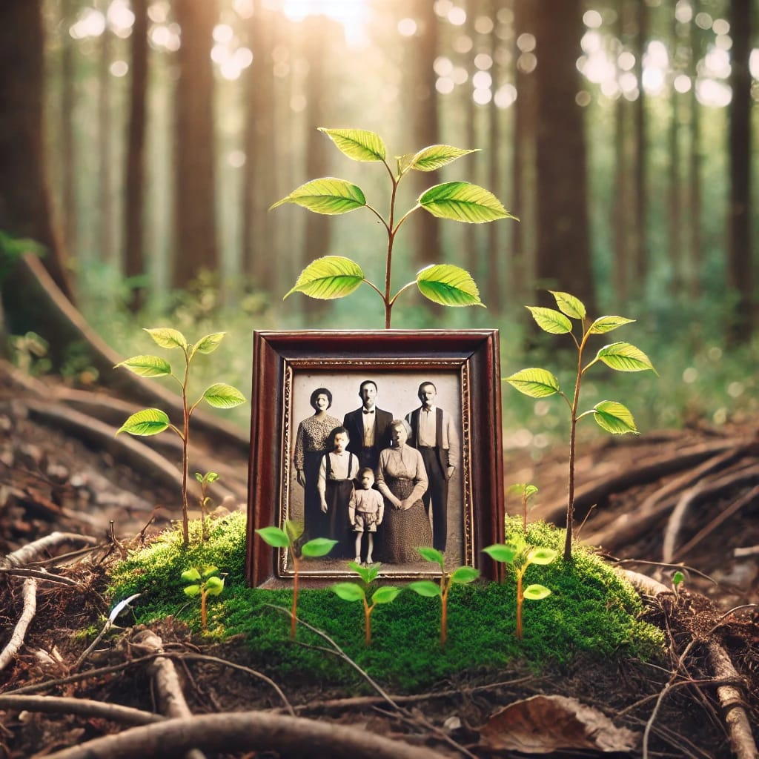
ECO-LEGACY MODE- YOUR FOREST FOR THE FUTURE generation.
INNOVATION FEATURES:
Eco-legacy Mode: Create a legacy forest for the future generations.
Culture-Aware Personalization: Holidays, languages, themes.
Steak Chains: Bonus rewards for chain reactions.
Tree Tracker Map: See where your trees are planted.
Sponsor/Investor Panel: Transparent reports & branding options.

Slide 7
Benefits for everyone with this project
STAKEHOLDER | BENEFITS
Users | Better habits, Mental clarity, Nature reward
Students | Credits, Leadership badges, Exposure ,and Connectivity with Nature.
Unemployed persons | Jobs as Green Sevaks.
NGOs | Volunteers, Support, Measurable Rports.
Sponsors | Branding, CSR, Emotional visibility.
Founder(As me Anushka) | Recognition, Growth, impact-driven startup.
Nature | Trees, healing, awareness, respect and love of everyone.

Slide 8
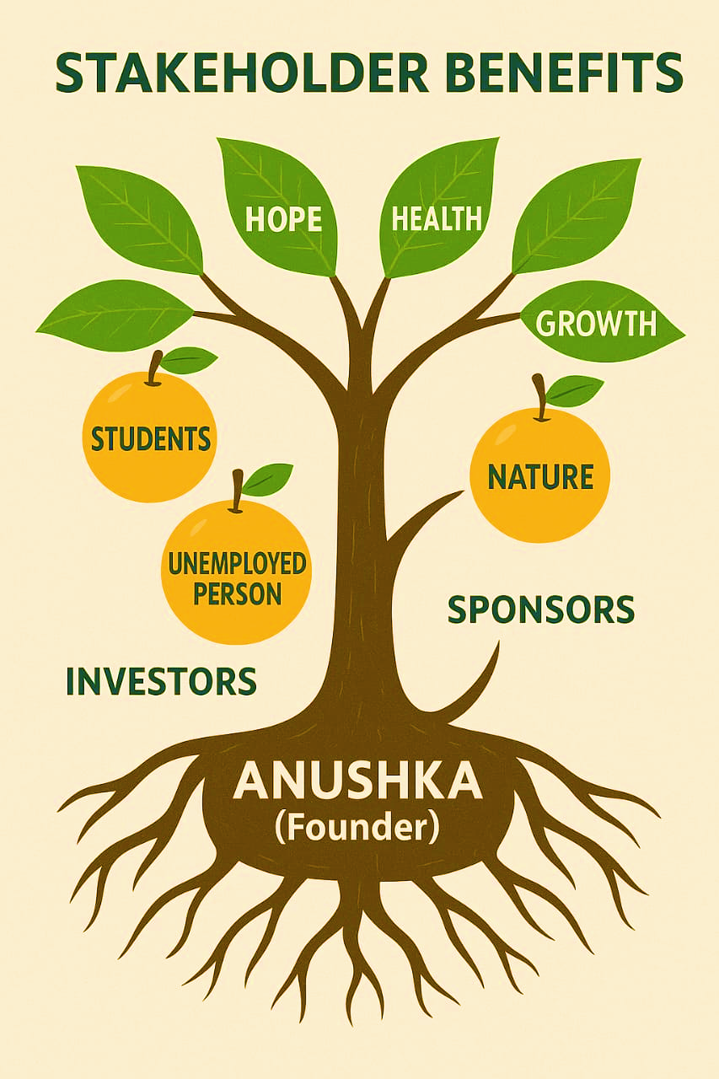

Stakeholders Tree

Slide 9

“This project exceeds the hackathon’s goal: We didn’t gamify habits. We Connected them to the real world through trees, emotions, community, and legacy.” “I named this Project Anuvruddhi – because growth is not just personal. It’s emotional, environmental, and eternal.” Thank you for listening. I’m Anushka – and I hope this idea grows in your heart too.
Hackathon challenge alignment
THANK YOU. LET’S GROW TOGETHER.

Slide 10
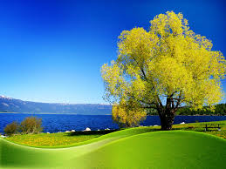
Thank you everyone
This is ANUVRUDDHI BY ANUSHKA

