Slide 1
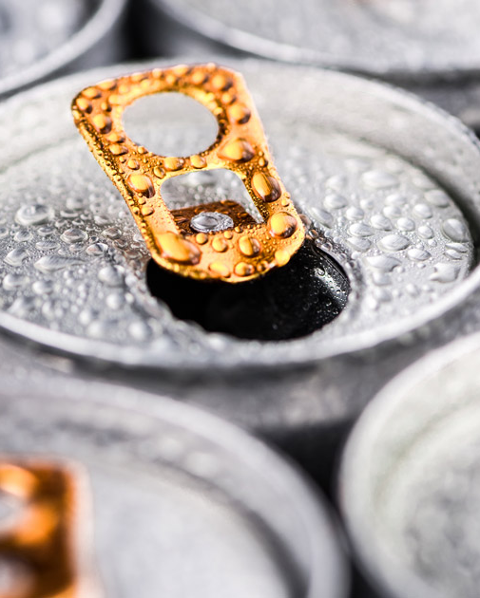
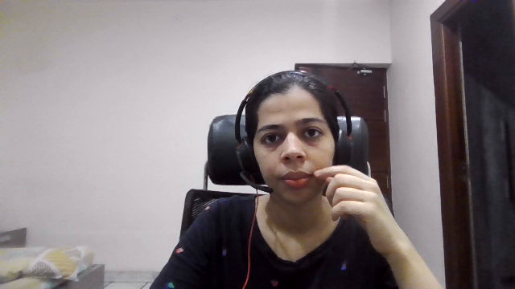
CODEX CODEX CODEX CODEX CODEX CODEX
Provide insights to the Marketing Team in Food and Beverage Industry

Slide 2
agenda
a
About the company
Primary & Secondary Insights
Recommendations
Additional Research
Domain Survey
Demographic Insights
Consumer Preferences
Competition Analysis
Marketing Channels and Brand Awareness
Brand Penetration
Purchase Behavior
Product Development
Product Pricing​ Marketing Plan​ Product Launch Plan​
Red Bull strategy

Slide 3
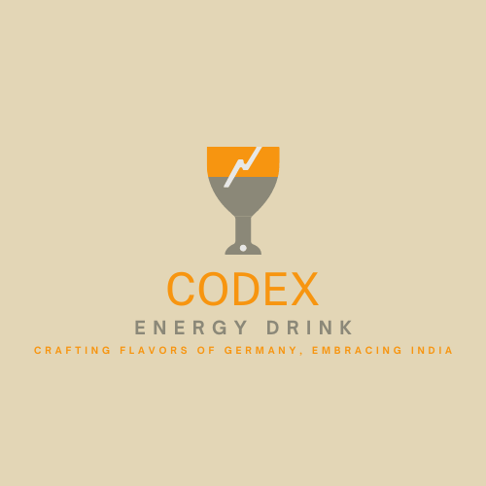

COMPANY
CodeX is a German beverage company that is aiming to make its mark in the Indian market.
A few months ago, they launched their energy drink in 10 cities in India.
Their Marketing team is responsible for increasing :
Market share
Product development
Brand awareness
They conducted a survey in those 10 cities and received results from 10k respondents.
overview

Slide 4
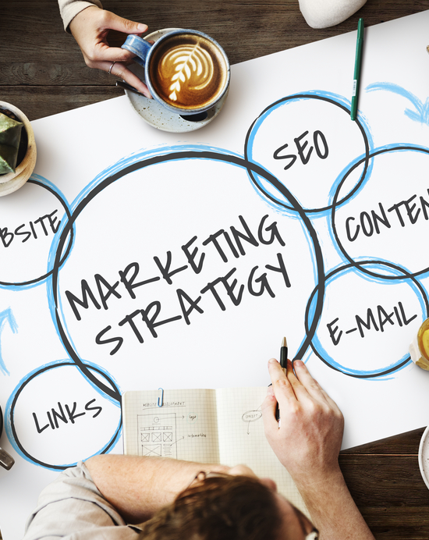
Marketing strategies
Product Packaging
Brand Positioning
Social Media Marketing
Blogging
Email Marketing
Seasonal Deals and Special Offers
Partner With Other Successful Brands
Don’t be Afraid to Re-evaluate and Re-Invent Your Brand.
The market size of Energy drinks in India is estimated at Rs 2,400 crores.
Growing at a CAGR of 45-50%
The market should be touching a minimum of Rs 10,000 crore by 2027

Slide 5

THE SURVEY
The survey conducted across the 10 cities, recorded the response from 10k respondents.
Following are some of the survey questions which had to be answered from the options given for each of them.
What is your age group?
Which energy drink brands do you currently consume or prefer?
. Which city in India do you reside in?
How often do you consume energy drinks?
What ingredients do you expect in an energy drink?
What are the main reasons for consuming energy drinks?
Which marketing channels or platforms do you often come across energy drink advertisements?
Have you heard of our energy drink before today?
What do you think of the brand name/logo/design?
What is your perception of energy drinks in general?
Have you ever tried our energy drink before?
If yes, how would you rate the taste, flavor, and overall experience?
What price range do you consider reasonable for an energy drink?
AIM : to convert these survey results to meaningful insights which the team can use to drive actions.

Slide 6
Primary & secondary insights
DATA CLEANING
Since all the respondents might not have answered all the questions properly, the data has been cleaned using the following steps
If a Respondent has not heard about CodeX before, then it is implied that he must have not tried it before, that means if Heard_before = No, then Tried_before has to be No.
If a respondent has not Tried our energy drink before, then he cannot rate the taste and the flavor of our product, that is, if Tried_before = No, then Taste_experience is Not Applicable.
If a person has tried out energy drink, then he cannot give an answers for the reasons which are preventing trying our energy drink, that is if Tried_before = Yes, then Reasons_preventing_trying is Not Applicable.
Following insights can be derived from the survey responses, which can help the Marketing Team in Food & Beverage Industry
Demographic Insights
Consumer Preferences
Competition Analysis
Marketing Channels and Brand Awareness
Brand Penetration
Purchase Behavior
Product Development

Slide 7
DEMOGRAPHIC DEMOGRAPHIC DEMOGRAPHIC INSIGHTS INSIGHTS INSIGHTS

Slide 8
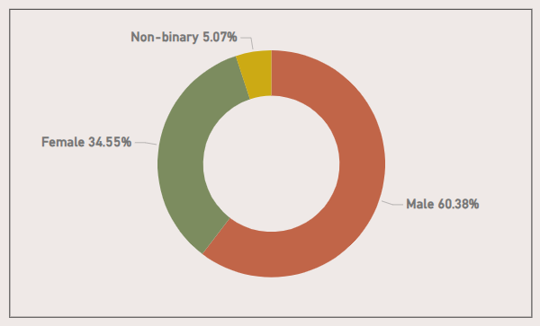
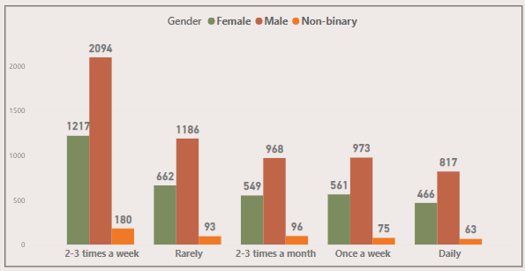
Who prefers energy drink more?
More than 60% of the consumers of energy drinks in India are Male, followed by Female (34.5%) and then by Non-binary (5.07%)
Consume Frequency : Male consumers form a major portion among each Consume Frequency.
The higher prevalence of male consumers of energy drinks in India may be attributed to social and cultural factors, such as targeted marketing and gender-specific perceptions of energy drinks.

Slide 9
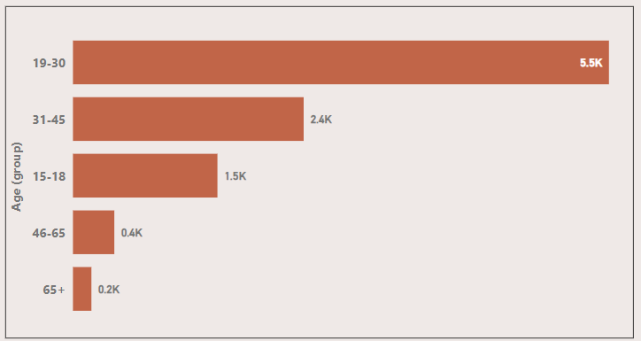
Which age group prefers energy drinks more?
The age group 19-30, which constitutes the young adults prefers Energy drinks the most. They constitute more than half of the consumers of energy drinks.
Reason : The reason that young adults are the target audience of Energy drinks is their active and fast-paced lifestyles which seeks a boost in energy and alertness.

Slide 10
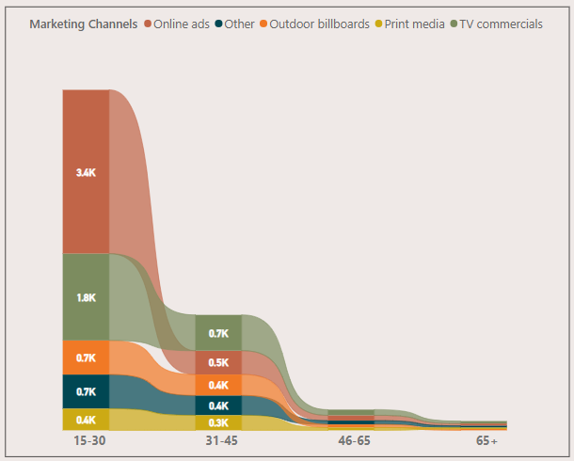
. Which type of marketing reaches the most Youth (15-30)?
Online ads reaches the most to the age group 15-30 (Youth).
Reason : Due to heavy internet usage and targeted marketing strategies.
However, this is not the case with other age groups, TV commercials is the top source of getting information about energy drinks to all other age groups.

Slide 11
CONSUMER CONSUMER CONSUMER PREFERENCES PREFERENCES PREFERENCES

Slide 12
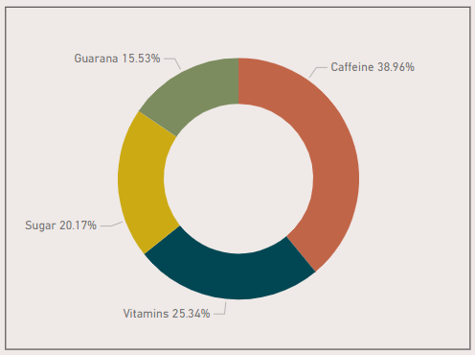
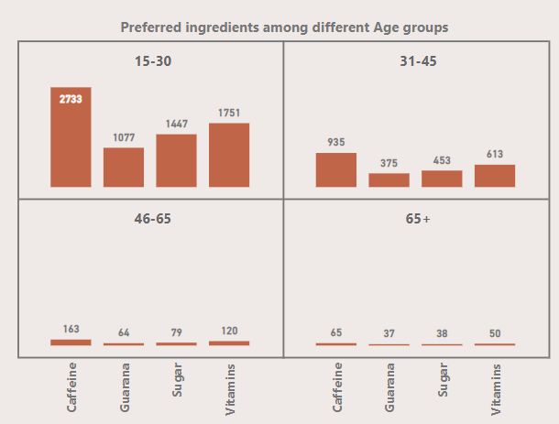
What are the preferred ingredients of energy drinks among respondents?
Caffeine is the most preferred ingredient of energy drinks not just overall but among all the age groups, followed by Vitamins, Sugar and Guarana.
Reason : Caffeine is the most preferred ingredient due to its stimulating effect on the central nervous system, providing a quick boost of energy, while Vitamins bring a healthy perspective among the consumers is at 2nd spot.

Slide 13
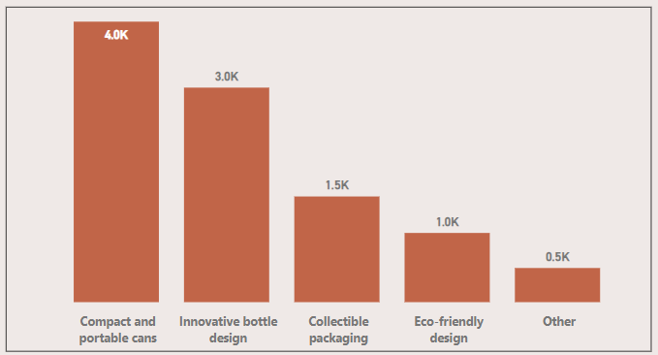
What packaging preferences do respondents have for energy drinks?
Around 40% of the consumers prefer Compact and portable cans whereas a huge majority (30%) of the consumers also like Innovative bottle designs.
Reason : Compact and portable cans are preferred due to convenience and on-the-go consumption.
For example : cans can easily be carried to gyms and also be provided during breaks in sports.

Slide 14
CONSUMER CONSUMER COMPETITION ANALYSIS ANALYSIS ANALYSIS

Slide 15
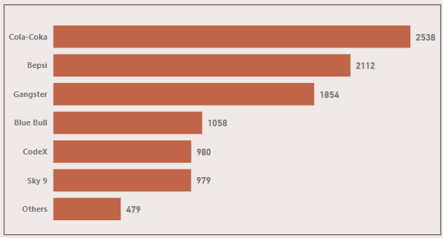
Who are the current market leaders?
Cola-Coka acquires 1/4th (25.38%) of the energy drinks market in India, followed by Bepsi which has more than 20% of the market share.
CodeX stands at 5th position in the market which is a positive sign that it is emerging as a brand in Indian Energy drinks market.
CodeX can emulate the marketing strategies of the leading brands.

Slide 16
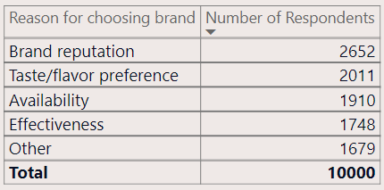
What are the primary reasons consumers prefer those brands over ours?
Consumers always trust brand, which is depicted in the above table.
Brand reputation is the primary reason for customers to choose a brand (26.5% of the customers rely on brand reputation for choosing a particular brand).
Taste/flavor preference and Availability are also major contributors of a customer choosing a brand over others.
CodeX should focus on the Taste/flavor and the Availability.

Slide 17
MARKETING CHANNELS MARKETING CHANNELS MARKETING CHANNELS MARKETING CHANNELS MARKETING CHANNELS & BRAND AWARENESS & BRAND AWARENESS & BRAND AWARENESS & BRAND AWARENESS & BRAND AWARENESS

Slide 18
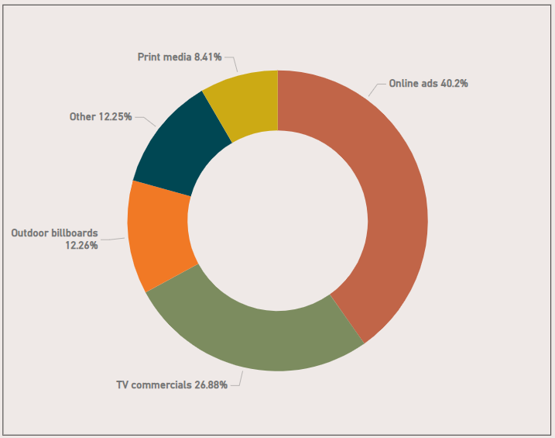
Which marketing channel can be used to reach more customers?
40% of the consumers get to know about energy drinks through Online ads, followed by TV commercials (26.8%).
Online ads is the most reachable marketing channel due to heavy internet usage across all the age groups.
CodeX should focus on increasing their online visibility to reach wider audience.

Slide 19
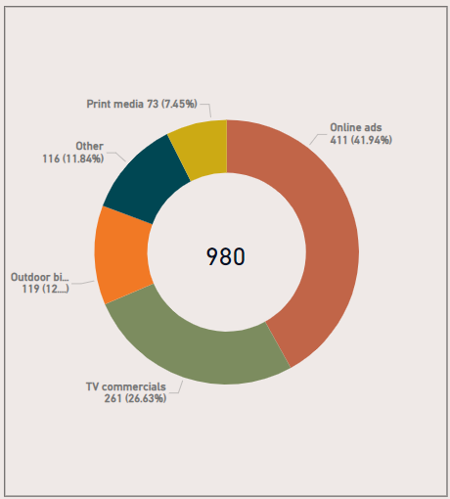
How effective are different marketing strategies and channels in reaching our customers?
Total CodeX customer – 980
Around 42% of our customers got to know about our energy drink through Online ads (411 out of 980).
26.63% of consumers get to know about our energy drink through TV commercials.

Slide 20
BRAND BRAND BRAND PENETRATION PENETRATION PENETRATION

Slide 21
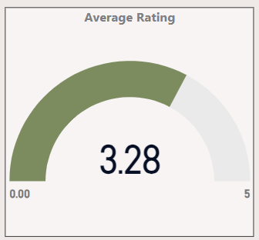
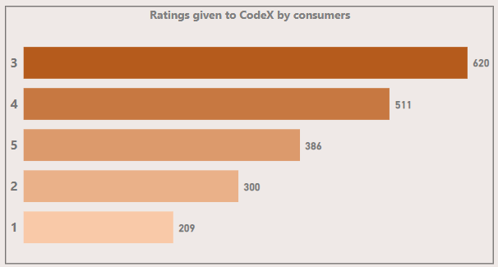
What do people think about our brand?
The consumers who have already tried our energy drink gave and average overall rating of 3.28.
This shows that the taste experience of the drink is average or slightly above average.
CodeX should work on the taste of its energy drinks as it is a very important factor that decides whether a consumer of energy drink will choose our brand or not.

Slide 22
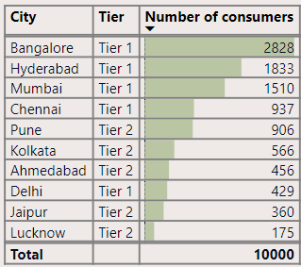
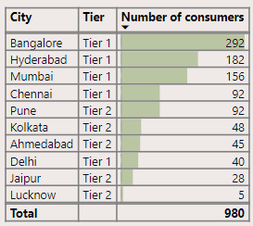
Which cities do we need to focus more on?
Citywise consumers (all brands)
CITYWISE CONSUMERS
(CODEX CONSUMERS)
Bangalore has the highest number of Energy drinks consumers (28.3%) and also highest number of CodeX consumers.
CodeX should focus more on Tier 1 cities including Bangalore, Hyderabad, Mumbai and Chennai since more than half of the consumers are coming from these cities.

Slide 23
PURCHASE PURCHASE PURCHASE BEHAVIOR BEHAVIOR BEHAVIOR

Slide 24
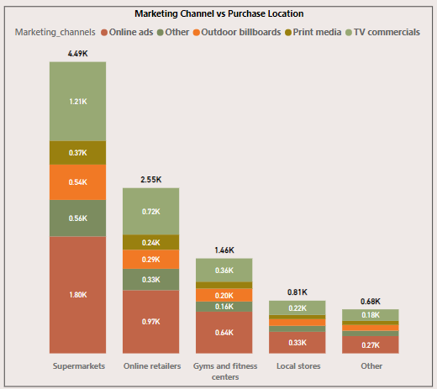
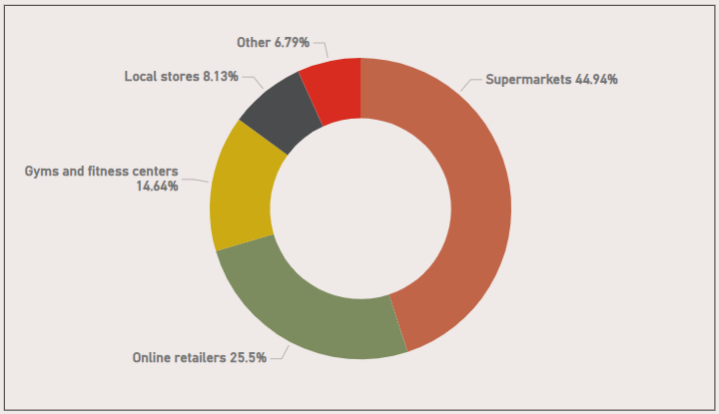
Where do respondents prefer to purchase energy drinks?
Approximately 45% of the respondents prefer to purchase energy drinks from Supermarkets, followed by Online retailers (25.5%).
Gym and fitness centers are also a big proportion of purchase location for energy drinks.
Even though respondents get to learn about energy drinks through online ads, many of them do not prefer to buy them through Online retailers.

Slide 25
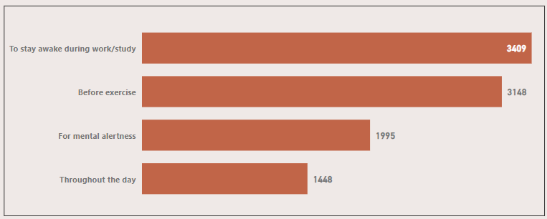
What are the typical consumption situations for energy drinks among respondents?
Respondents typically consumer energy drinks to stay awake during work/study (around 34%)
31% of the consumers prefer to consume them before exercise to boost up energy.
Around 20% respondents consume for mental alertness and only 14.4% of the consumers consume energy drinks throughout the day.

Slide 26
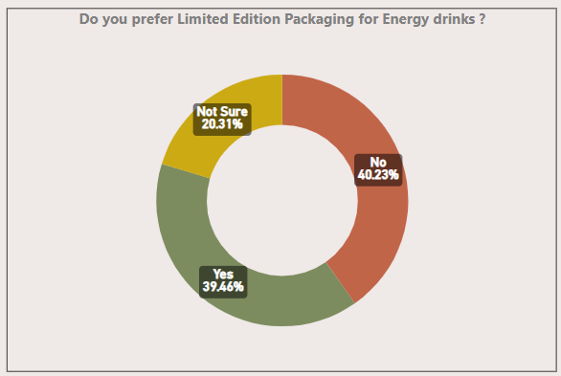
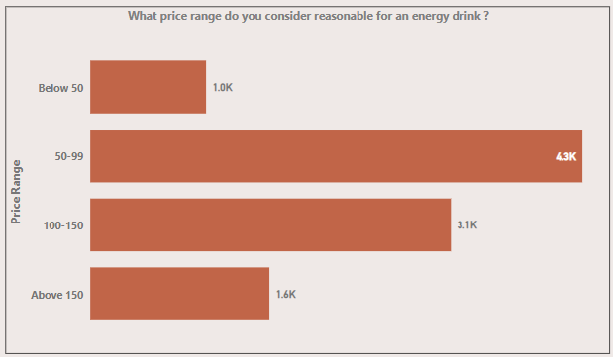
What factors influence respondents' purchase decisions?
1. LIMITED EDITION PACKAGING
2. PRICE
Around 40% of the consumers say that limited edition packaging influence purchase decisions.
Approximately same number of consumers do not consider limited edition packaging to be a factor.
4,300 respondents prefer price of the energy drinks to be between Rs 50 to Rs99.
Very less consumers prefer price below 50 and above 150.
Affordable energy drinks are preferred in India.

Slide 27
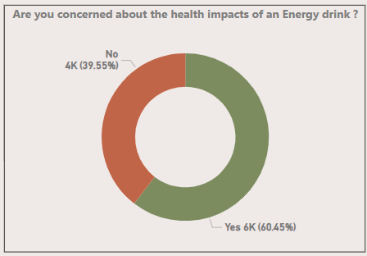
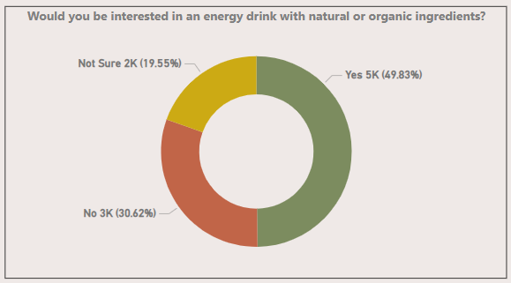
What factors influence respondents' purchase decisions?
3. HEALTH IMPACTS
4. INGREDIENTS
Half of the consumers are interested in energy drinks with natural or organic ingredients.
Nowadays, people are interested in buying things with natural or organic ingredients. Hence, this has a huge impact on buying decisions.
60% of the consumers are concerned about the health impacts of energy drinks
This shows that whether the energy drink is healthy or not is a very important factor in making purchase decision.

Slide 28
PRODUCT PRODUCT PRODUCT DEVELOPMENT DEVELOPMENT DEVELOPMENT

Slide 29
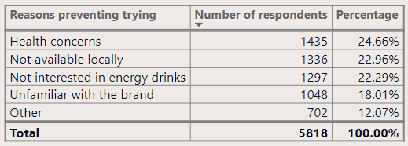
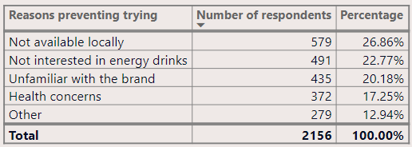
Which area of business should we focus more on our product development?
1. Reasons preventing trying
TIER 1 CITIES
TIER 2 CITIES
By looking at the reasons which are preventing the consumers to try our product, we can do huge improvements to our product.
For Tier 1 city, we should focus making an energy drink variant which is healthy as a huge population is not trying our energy drinks due to health concerns.
We should also try to make our Energy drinks locally available in both Tier 1 and Tier 2 cities, for example we can make them available in 24*7 stores so that they are available in all cities.

Slide 30
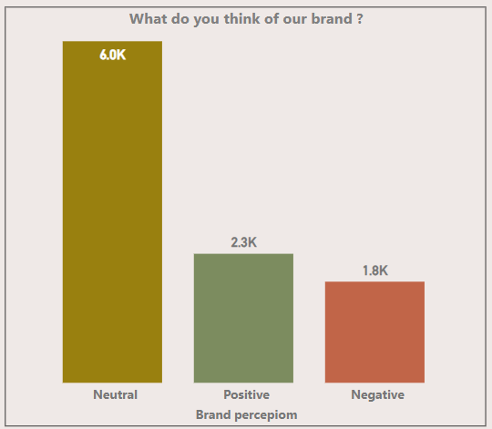
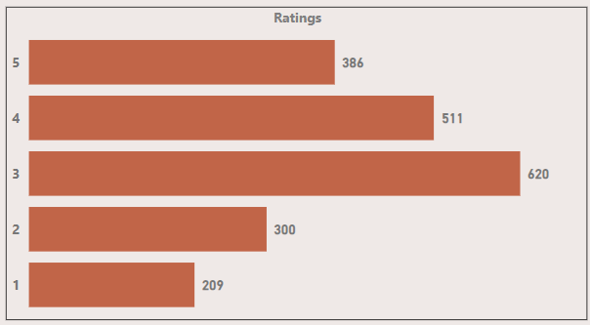
Which area of business should we focus more on our product development?
2. BRAND PERCEPTION
3. TASTE
Taste is another important factor influencing the choice of customers of energy drinks.
We must focus on making our energy drinks of good flavor and taste, to make it preferred over other energy drinks.
Brand image plays a very important role to make our brand, a preferred brand for consumer.
Only 23% of respondents have a positive image of our brand.

Slide 31
RECOMMENDATIONS RECOMMENDATIONS RECOMMENDATIONS RECOMMENDATIONS RECOMMENDATIONS RECOMMENDATIONS RECOMMENDATIONS

Slide 32




Marketing plan
Price
Product
Place
Promotion
The ideal price of our energy drink for Indian market should be between Rs 50 and Rs 150.
Indian consumers do not prefer a price of Rs 150 and above.
Compact and portable cans
Good taste and flavor
Healthy
Natural and organic ingredients.
Locally available
Available at all Supermarkets
Online advertisements
TV commercials

Slide 33
What immediate improvements can we bring to the product?
1. packaging
CodeX should focus on making Energy drinks in Compact and portable cans and Innovative bottle designs packaging since more than 70% of the consumers prefers energy drinks in cans and bottles.
These two packaging will help in following ways and make our brand reach a wider audience:
Easy to carry
Easy to store
Cost effective

Slide 34
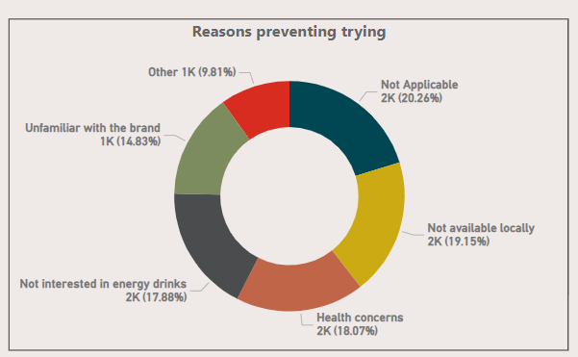
What immediate improvements can we bring to the product?
2. availability
The major reason in both Tier 1 and Tier 2 cities for the consumers for not trying our energy drink was Availability.
We should work on making our Energy drink locally available by making them available in Supermarkets ( leading purchase locations), making them available in 24*7 stores.
Availability helps in :
Increasing sales
Reaching a wider audience
Brand awareness
Build brand reputation

Slide 35
What immediate improvements can we bring to the product?
3. INGREDIENTS, TASTE & FLAVOR
Nowadays, people are Health conscious and are hence moving towards Energy drinks with Healthy ingredients.
CodeX should focus on increasing healthy ingredients in their energy drinks such as Vitamins.
Around 26% of the respondents have Vitamins as their preferred ingredient in Energy drinks.
We can also have a different variant of our energy drinks with Natural or organic ingredients
FLAVOR & TASTE
CodeX should focus on improving the taste of their energy drinks since taste is one of the major reason why consumers do not prefer a brand over other
Secondly, CodeX should provide its energy drink in different flavor variants.

Slide 36
What should be the ideal price of our product?
The ideal price of our energy drink should be between Rs 50 and Rs 150, as Indian consumers often prefer affordable products and more than 70% of the population prefer price between this range.
CodeX can launch a premium range for their energy drinks separately with higher price (Above Rs 150) and give it a separate name such as CodeX Premium for the consumers who prefer premium range of energy drinks.
Who should be our target audience, and why?
Our target audience should be the young adults between the age group of 19-30.
They constitute more than 50% of our consumers.
The young adults consume more energy drinks due to their lifestyle which demands instant energy and alertness to stay awake late night and during exercise.

Slide 37
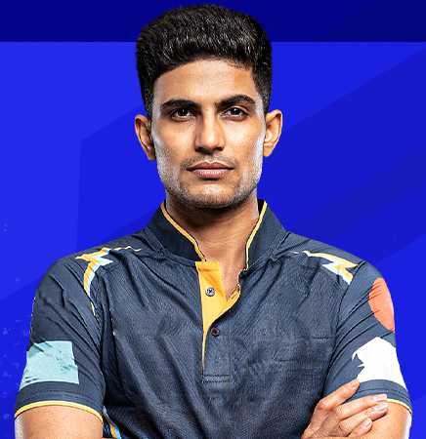
BRAND AMBASSADOR
SEASONAL DEALS AND SPECIAL OFFERS
A great marketing strategy is to offer deals and special offers on your products
Everyone likes to feel like they are getting a bargain.
CodeX could align their offerings with special parts of the year and seasonal celebrations to get the maximum interest, especially when you have a particular variation of your product pertinent to those celebrations.
A Brand Ambassador is someone who helps to promote a company's products, messaging, and image. Their purpose is to develop an efficient image by interacting with consumers.
Since, our energy drinks brand is an emerging brand, we can have an emerging sportsperson as our brand ambassador.
Hence, Shubhman Gill is an ideal candidate for our brand ambassador.
PARTNER WITH OTHER SUCCESSFUL BRANDS
Another way to build customer loyalty in your offerings is by partnering with existing brands that already have a strong customer base.
CodeX, can have a partnership in future with all the cult.fit gyms, since gyms and fitness centers are a major contributors to energy drink consumers. This will expand a huge market for our Energy drinks

Slide 38
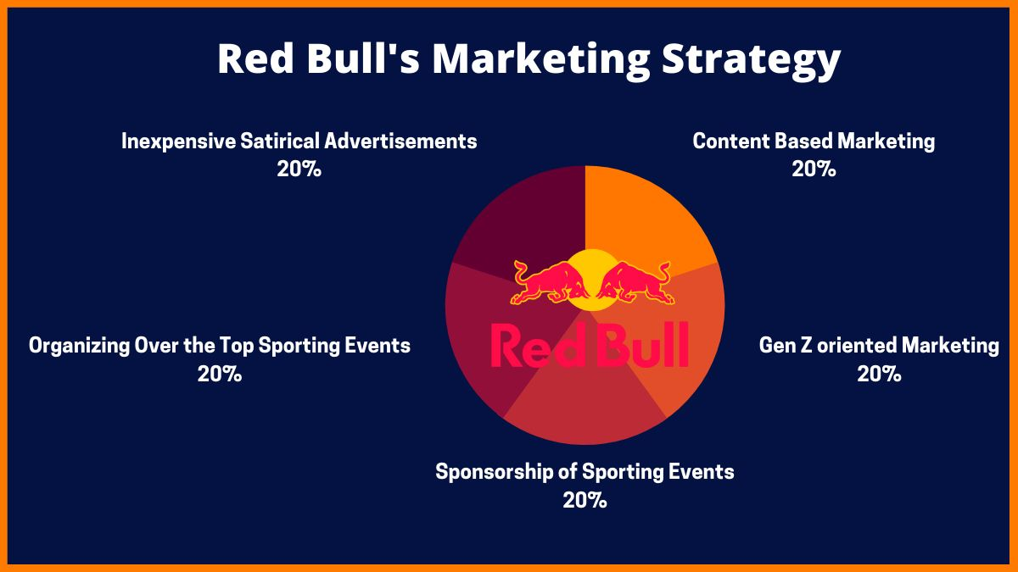
REdBULL’S MARKETING PLAN
The energy drinks market in India is dominated by Redbull which holds a 61% share
Red Bull is seen as more of a marketing company than a company that produces energy drinks.
A larger percentage of the company’s annual earnings is reinvested into its marketing campaigns
The purpose of making such a high budget for marketing is to maintain awareness with its consumers, thereby boosting its sales and securing its spot as a market leader. It also owns sports teams.
Red Bull has remained the leading brand for the longest time by having almost double the market share of its closest competitor. It owes its success and profitability to its robust marketing budget and strategy.
CodeX can emulate the marketing strategy followed by Redbull to make itself one of the biggest competitors in the energy drinks market.

Slide 39
Anushka Goyal anushkagoyal0198@gmail.com
Thank
thank
Thank
You
You
You
you
Thank you

