Slide 1
STEGANOGRAPHY - Hiding information in the image
CAPSTONE PROJECT
Presented By:
Student Name-Anushka Shree
College Name-Patna Science College(Patna University)
Department-Mater of Computer Application(MCA)

Slide 2
OUTLINE
Problem Statement
System Development Approach
Algorithm & Deployment
Result
Images used
Screenshots of Code
Conclusion
Future Scope
References

Slide 3
Problem Statement
In today's digital world, secure communication is essential. Steganography is a method that hides data within digital media such as images. This project aims to hide and retrieve secret messages inside images without altering the visual appearance. It demonstrates how messages can be embedded using Python and retrieved without data loss. The purpose is to ensure data confidentiality and prevent detection during transmission.

Slide 4
System Approach
Tools Used:
Python
jupyter Notebook
Libraries Required:
Pillow
NumPy (optional)

Slide 5
Algorithm & Deployment
Step-by-step process:
Load the original image using Pillow.
Convert the secret message to binary.
Hide bits of message into pixel RGB values (LSB technique).
Save the image with the hidden message.
Decode by reading LSB bits from image pixels.
Convert binary back to characters to retrieve the secret.

Slide 6
Result
Original Image (input-image.jpg)
Encoded Image (output-image.png)
Screenshot of Encoding Code
Screenshot of Decoding Code
Output: Decoded message: This is a secret message.
Observation: Both images look identical, which confirms successful steganography.
Github link
https://github.com/Anushka407

Slide 7
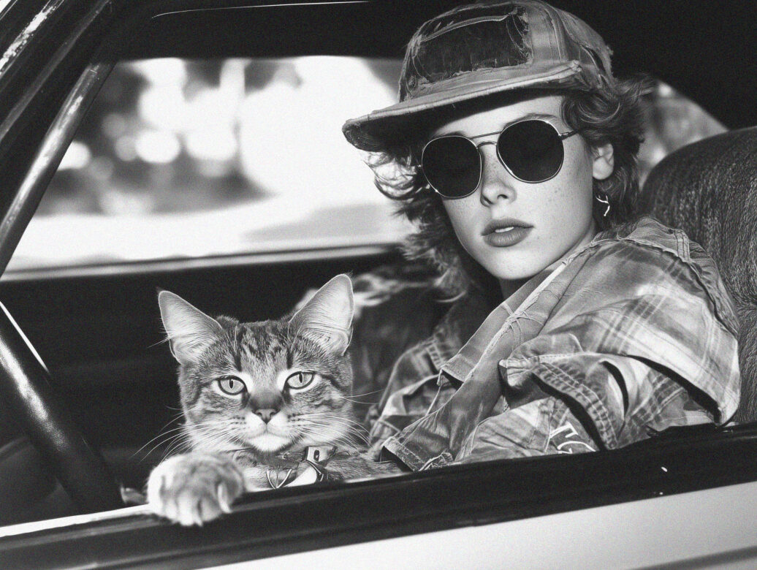

IMAGES USED IN THIS PROJECT
INPUT IMAGE/ORIGINAL IMAGE
OUTPUT IMAGE/ENCODED IMAGE
Decoded message: This is a secret message.
Observation: Both images look identical, which confirms successful steganography.

Slide 8
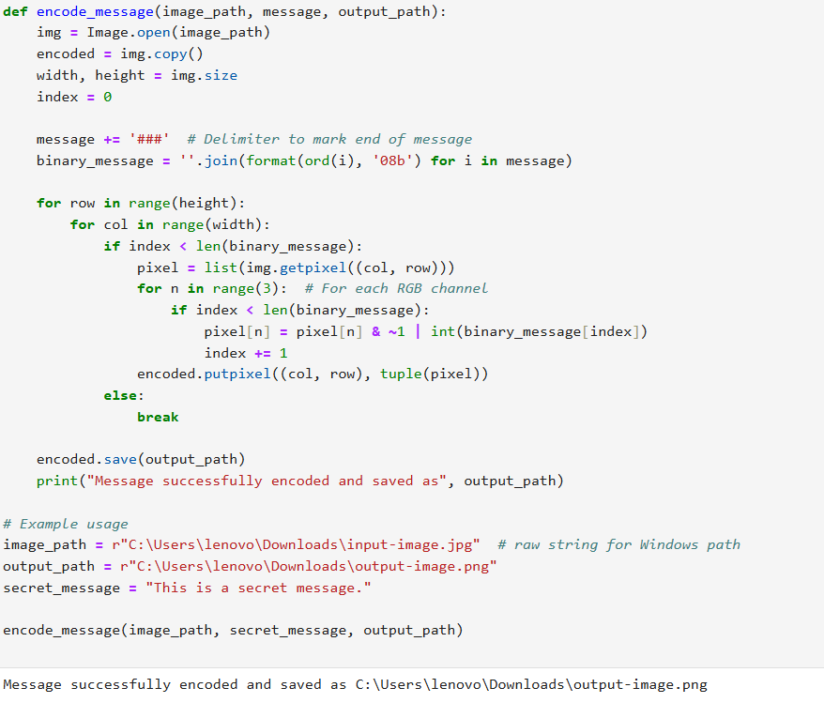
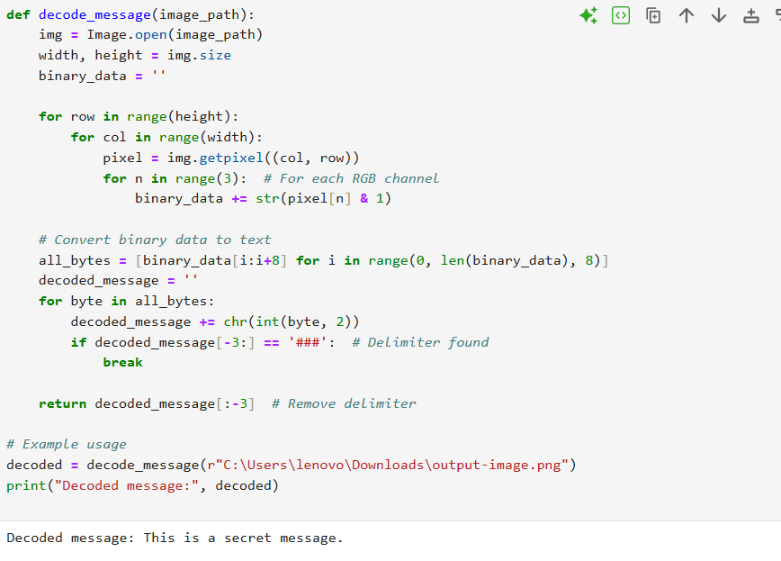
SCREENSHOTS OF ENCODING AND DECODING CODE
ENCODING IMAGE
DECODING IMAGE

Slide 9
Conclusion
The project successfully demonstrated text steganography using Python. The message was hidden in the image without changing its appearance. The decoding process was able to retrieve the message exactly. This project shows how data can be concealed securely and simply using the least significant bit method.

Slide 10
Future scope
Implement image encryption before embedding.
Extend support to audio/video steganography.
Add GUI for user-friendliness.
Use machine learning for steganalysis.

Slide 11
References
- https://pillow.readthedocs.io/
- https://www.geeksforgeeks.org/image-based-steganography-using-python/
- Python official documentation
- AICTE Cyber Security Internship Material

Slide 12
THANK YOU

