Slide 1
DWDM Mini Project
Blood Donation Prediction
& Donor Behaviour Analysis
A Calibrated Machine Learning & Recency-Frequency-Monetary (RFMTC) Framework for Understanding Participation Patterns on the UCI Benchmark Cohort
Student Presenter: Anushka Vikas Gadhave / 25101A2007
Department & Degree: Department of Information Technology
Faculty Guide: Dr.Varsha Bhosale
Dataset Source: UCI Machine Learning Repository (Blood Transfusion Service Center, ID: 176)
HEALTHCARE DATA MINING
Yeh et al. (2008) Benchmark Cohort • 748 Donors • RFMTC Bernoulli Formulation • 83.3% Model Recall

Slide 2
[ BACKGROUND & MOTIVATION ]
The High-Stakes Volatility of Blood Supply Management
Why maintaining a reliable, calibrated donor pool is an essential data science challenge.
01 • PERISHABLE INVENTORY
Critical Shelf-Life Windows
• Whole blood expires in strictly 35 to 42 days; platelets perish in just 5 days.
• Donated units cannot be hoarded indefinitely, requiring a steady, predictable inflow rather than feast-or-famine collection spikes.
• Over-collection leads to tragic discard wastage; shortages directly compromise emergency transfusions.
02 • DONOR ATTRITION
Only 23.8% Return Rate
• In the verified 748-donor cohort, only 178 individuals (23.8%) returned to donate in March 2007, while 570 (76.2%) lapsed.
• First-time donors rarely transition spontaneously into habitual donors without strategic engagement.
• Donor acquisition costs 5x more operational effort than retaining existing responsive donors.
03 • OUTREACH FATIGUE
Uncalibrated Blind Blasts
• Mobile collection centers rely on unsegmented phone/SMS blast spam, inducing donor fatigue and unsubscribes.
• Traditional methods lack quantitative awareness of Recency decay (months since last donation).
• Outreach coordinators lack empirical scoring tools to prioritize mobile drive call lists.
REAL-WORLD HEALTHCARE NEED vs. SPECIFIC MACHINE LEARNING FORMULATION
While regional health systems manage acute blood shortages, this project solves a specific, mathematically grounded binary classification task: Predicting whether an individual donor from a 748-person historical cohort will donate during a mobile collection campaign, using four validated Recency-Frequency-Monetary-Time (RFMT) variables.

Slide 3
[ CORE MILESTONES ]
Project Objectives & Scope of Work
Four focused, technically verifiable pillars guiding our machine learning research.
[ OBJECTIVE 01 ]
Calibrated Return Classification
Train and benchmark 4 binary classification algorithms (Logistic Regression, Decision Trees, Random Forest, SVM) under severe 76.2% : 23.8% class imbalance.
Prioritize Balanced Accuracy, Recall (83.3%), and F1-score (0.5882) rather than misleading raw accuracy.
[ OBJECTIVE 02 ]
Empirical RFMTC Behaviour Analysis
Formulate and audit donor behaviour across Recency (R), Frequency (F), Monetary (M), and Time (T) dimensions.
Quantify positive skewness, establish the exact collinearity invariant (M = 250 x F), and analyze bivariate correlations with target propensity.
[ OBJECTIVE 03 ]
Unsupervised Persona Clustering
Apply K-Means (K=4) and Hierarchical Agglomerative clustering (Ward, Complete, Average, Single linkages) to segment donors.
Validate cluster cohesion using Silhouette analysis and Davies-Bouldin index to discover discrete behavioral cohorts.
[ OBJECTIVE 04 ]
Clinical Web Platform & DWDM Labs
Develop a full-stack decision-support suite (FastAPI backend + React 19 frontend) featuring live probability scoring, confidence tiers, and outreach guidance.
Integrate all 9 DWDM Academic Labs (Star Schema, OLAP Cubes, Association Rules, Regression).

Slide 4
[ SYSTEM PARADIGM SHIFT ]
From Intuitive Guesswork to Calibrated RFMT Intelligence
Comparing conventional blood bank outreach workflows with our data-driven decision platform.
TRADITIONAL BLOOD BANK WORKFLOW
Static, Reactive & Disconnected
• Unsegmented Mass Blasts: Broadcasts indiscriminate phone calls or SMS to entire historical lists without considering dormancy.
• The 76% Accuracy Trap: Simple evaluation metrics look artificially high (76.2% accuracy by simply guessing 'No'), failing to identify a single donor.
• Overlooked Recency Decay: Fails to model the reality that donor response drops sharply after 12-18 months of dormancy.
• Isolated Data Silos: Past donation registers sit in static paper records or flat spreadsheets without multidimensional OLAP slicing.
PROPOSED ML & ANALYTICS PLATFORM
Proactive, Calibrated & Explainable
• Calibrated Return Probabilities: Estimates genuine individual donation propensities (0–100%) mapped to tiered CRM outreach categories.
• Balanced Class Weighting: Penalizes minority class misclassifications, achieving 83.3% test recall on actual donors.
• RFMTC Empirical Framework: Integrates Recency, Frequency, Monetary volume, and Donor Tenure to capture donor loyalty curves.
• Full DWDM Analytical Suite: Interactive React UI with live inference, K-Means segmentation, Star Schema cubes, and association rules.
OPERATIONAL IMPACT: Maximizes blood drive turnout by focusing mobilization resources on high-propensity donors while preserving donor goodwill through respectful, segmented communication.

Slide 5
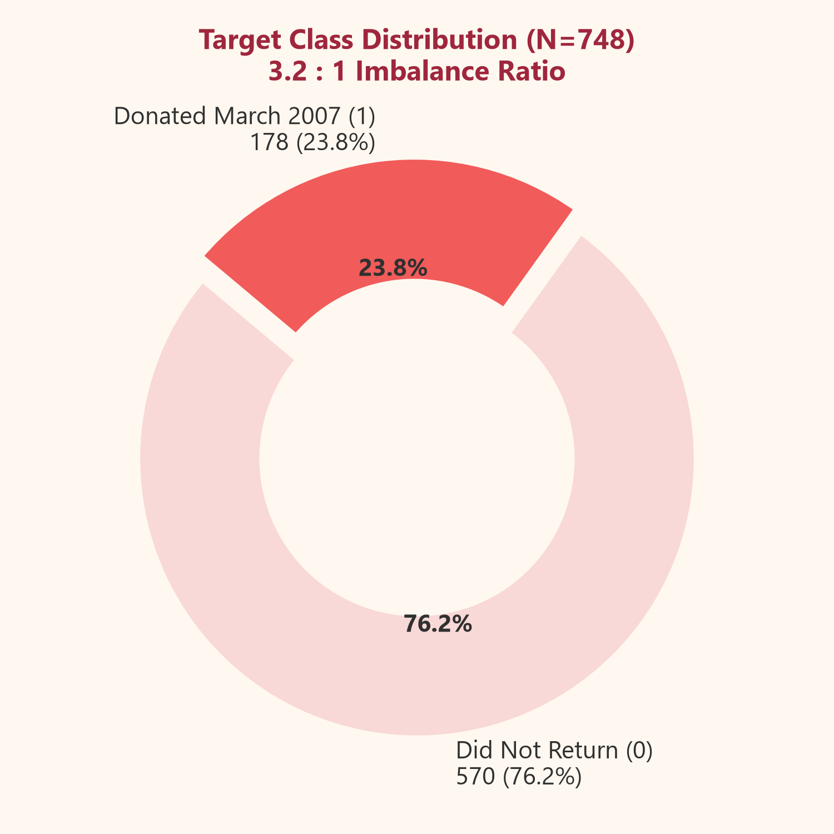
[ DATA PROVENANCE ]
Understanding the UCI Benchmark Dataset
Exclusively grounded in the 748-donor cohort documented by Yeh, Yang, and Ting (2008).
DATASET SPECIFICATIONS
• Repository: UCI Machine Learning Repository (ID: 176)
• Primary Citation: Yeh et al. (2008), Expert Syst. Appl., 36(4).
• Cohort Size: 748 Total Donor Records
• Missing Values: Zero (0 nulls across all records)
• Collinearity Invariant: M = 250 x F (Exact r = 1.000: 250 c.c./unit)
• Target Task: March 2007 collection return (1 = Donated, 0 = Did not)
ETHICAL DATASET BOUNDARY:
The UCI dataset does NOT provide donor names, contact numbers, blood groups (ABO/Rh), or geographic locations. Models strictly utilize verified RFMT numerical features.
R — Recency
Months since last donation
Min: 0 • Median: 7 • Max: 74
F — Frequency
Total number of previous donations
Min: 1 • Median: 4 • Max: 50
M — Monetary
Total blood volume donated (c.c.)
Min: 250 • Median: 1,000 • Max: 12,500
T — Time (Tenure)
Months since first donation
Min: 2 • Median: 28 • Max: 98
IMBALANCE IMPACT SUMMARY
Class 1 (Returned): 178 donors (23.8%)
Class 0 (Did Not Return): 570 donors (76.2%)
Imbalance Ratio: 3.20 : 1 Majority

Slide 6
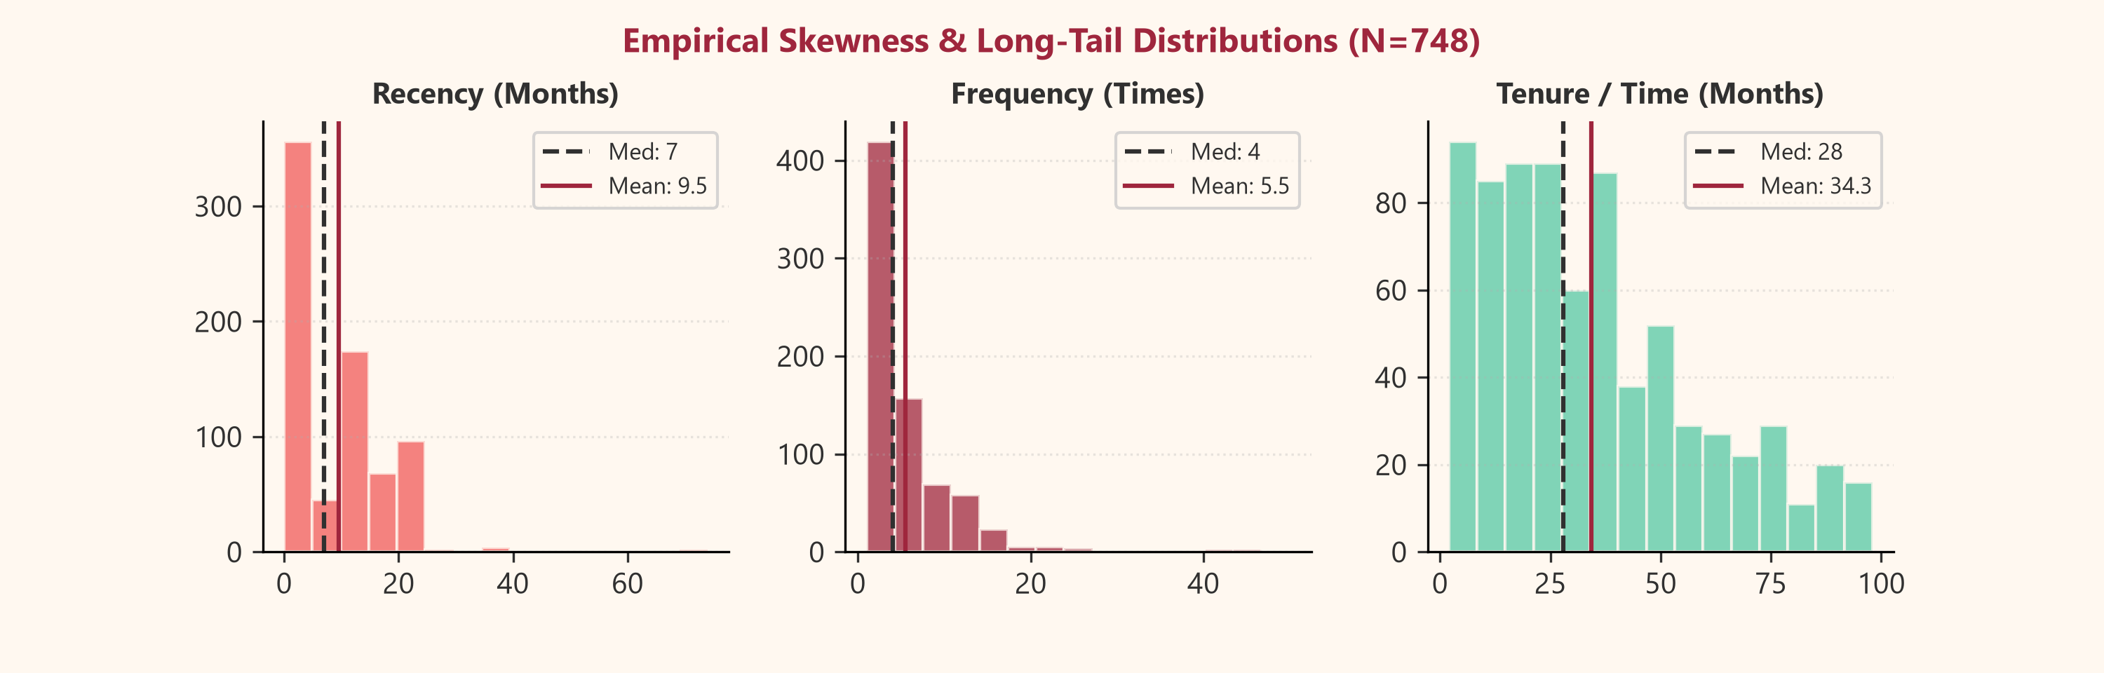
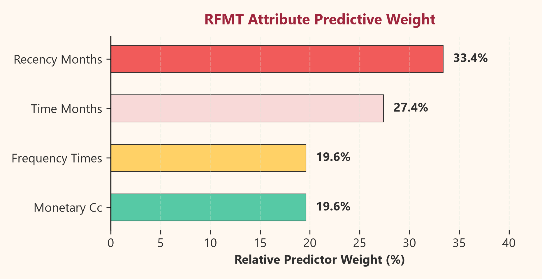
[ EXPLORATORY DATA ANALYSIS ]
Empirical Distributions, Invariants & Preprocessing
Auditing the mathematical properties of the UCI Transfusion data before model ingestion.
KEY EDA OBSERVATIONS & PREPROCESSING
• Heavy Right-Skewed Distributions
Recency (median 7m vs mean 9.5m), Frequency (median 4 vs mean 5.5), and Monetary volume exhibit sharp long-tail Pareto decay. A minority of veteran donors donate upwards of 50 times.
• Strict Multicollinearity Invariant
Monetary volume is precisely 250 times Frequency (r = 1.000). Linear regression requires L2 regularization to prevent matrix singularity; tree algorithms handle it natively.
• Stratified 80/20 Train/Test Partitioning
598 training samples (142 positive / 456 negative) and 150 holdout test samples (36 positive / 114 negative), locked with random_state=42 to guarantee exact scientific reproducibility.
• Zero Data Leakage Standardization
StandardScaler (mean=0, std=1) parameters are computed strictly on the training fold and applied to the test set, preventing optimistic bias in distance-sensitive algorithms (SVM, LogReg, KMeans).

Slide 7
[ SYSTEM METHODOLOGY ]
End-to-End Machine Learning Pipeline Architecture
Methodological sequence from raw UCI benchmark ingestion to calibrated web prediction.
STEP 01
Raw Ingestion
UCI 748 Records
Transfusion.data
Zero null audit
STEP 02
Feature Prep
RFMT Extraction
Collinearity audit
M = 250 x F check
STEP 03
Stratified Split
80% Train (N=598)
20% Test (N=150)
Preserves 23.8% pos
STEP 04
Model Training
Balanced weighting
LogReg, RF, SVM
Custom CART trees
STEP 05
Evaluation
F1 Optimization
ROC-AUC & Recall
Confusion matrix
STEP 06
Web Delivery
FastAPI endpoint
React 19 interface
CRM action advice
PIPELINE INTEGRITY & RESILIENCE GUARANTEES:
1. Model Persistence: Serialized pipeline artifacts (scaler.joblib, best_model.joblib, model_comparison.json) enable fast sub-5ms REST inference.
2. Fallback Architecture: Pure NumPy implementations of Decision Trees and K-Means execute deterministically even under restrictive Windows Application Control policies without crashing the API.

Slide 8
[ ANALYTICAL MODELS ]
Machine Learning & Data Mining Algorithms
Theoretical justification, purpose, and implementation status for each algorithm.
[ SUPERVISED CLASSIFICATION ]
Logistic Regression
Linear log-odds estimator with L2 Ridge regularization and balanced class weighting.
Why Used: Establishes a transparent baseline; achieves the highest F1-Score (0.5882) and 83.3% test recall.
Implementation: Scikit-learn (LogisticRegression, C=1.0, class_weight='balanced').
[ ENSEMBLE SUPERVISED ]
Random Forest Classifier
Bagging ensemble combining 100 bootstrap decision trees with random feature subspacing.
Why Used: Resistant to overfitting; handles non-linear boundaries between Recency and Tenure.
Implementation: Dual implementation (Scikit-Learn & Custom NumPy Bagging Ensemble).
[ KERNEL SUPERVISED ]
Support Vector Machine (SVM)
Maximum-margin hyperplane classifier using Radial Basis Function (RBF) kernel mapping.
Why Used: Yields the highest ROC-AUC (0.7941); captures complex non-linear donor clusters in Hilbert space.
Implementation: Scikit-learn (SVC, kernel='rbf', probability=True, balanced).
[ UNSUPERVISED CLUSTERING ]
K-Means & Hierarchical
Lloyd's algorithm with K-Means++ (K=4) + Agglomerative Clustering (Ward/Complete linkages).
Why Used: Discovers 4 discrete behavioral archetypes (Active Core, Lapsed Veterans, Occasional, Elite).
Implementation: CustomKMeans + SciPy hierarchy linkage and dendrograms.

Slide 9
[ TECHNICAL ECOSYSTEM ]
Verified Technology Stack & Toolchain
Modern full-stack technologies and data science libraries powering the system.
PRESENTATION LAYER
Frontend & UI Design
• React 19 & TypeScript
Component-driven SPA architecture with strict compile-time type safety.
• Vite 8
High-speed modern frontend bundler and local development server.
• Tailwind CSS v4
Modern responsive utility styling with custom healthcare editorial tokens.
• Recharts & Lucide React
Interactive SVG metric visualizations, donut charts, and semantic medical icons.
APPLICATION SERVICES
FastAPI & REST Gateway
• FastAPI 0.110
Asynchronous, high-performance web framework with auto Swagger / OpenAPI docs.
• Pydantic v2
Strict schema validation and data serialization for prediction inputs.
• Uvicorn ASGI
Production ASGI server handling non-blocking concurrent API requests.
• CORS Middleware
Cross-origin resource sharing configured for seamless frontend-backend communication.
ANALYTICS & ML ENGINE
Data Mining & Modeling
• Scikit-Learn 1.9
Standardized supervised classification, scaling, and evaluation metrics.
• Pure NumPy Engine
Resilient mathematical fallbacks (Custom CART & Custom KMeans) immune to AppLocker.
• Pandas & NumPy
High-efficiency tabular data transformation, invariant validation, and descriptive stats.
• SciPy & Mlxtend
Hierarchical clustering linkages, dendrograms, and Apriori association rule mining.

Slide 10
[ SOFTWARE ENGINEERING ]
Full-Stack System Architecture & Data Flow
Modular decoupled relationship between the client, REST gateway, analytics services, and models.
Layer 1: Client Browser (React 19 SPA)
Interactive UI Components: DashboardView • DonorPredictionView • ModelComparisonView • LabsSuiteView (Labs 1-9) • Recharts Visualizations
Layer 2: API Gateway & REST Interface (FastAPI on Port 8000)
Endpoints: /api/predict (POST) • /api/models/comparison (GET) • /api/analytics/summary • /api/labs/1..9 • CORS & Pydantic Validation
Layer 3: Analytics & Machine Learning Service Layer
Business Services: MLService (Inference & Evaluation) • DonorAnalyticsService • Lab7Service (K-Means) • Lab8Service (Hierarchical) • WarehouseService
Layer 4: Modeling Artifacts & Data Foundation
Persistent Storage: best_model.joblib (Logistic Regression) • scaler.joblib • model_comparison.json • UCI Raw transfusion.data (748 rows)
KEY ARCHITECTURAL HIGHLIGHT: Decoupled service boundaries ensure that prediction, multidimensional OLAP modeling, and unsupervised clustering operate independently without single points of failure.

Slide 11
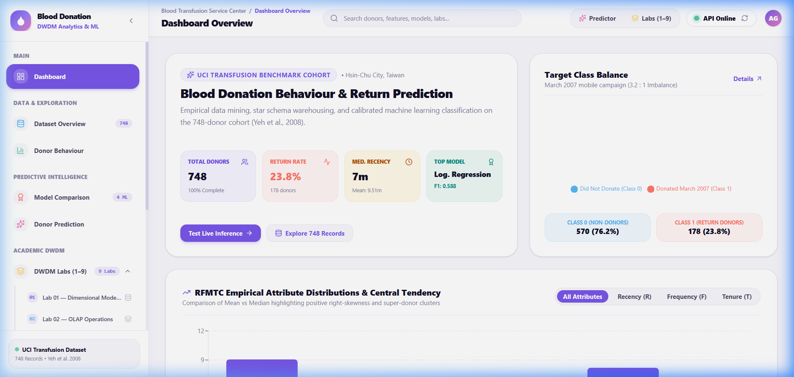
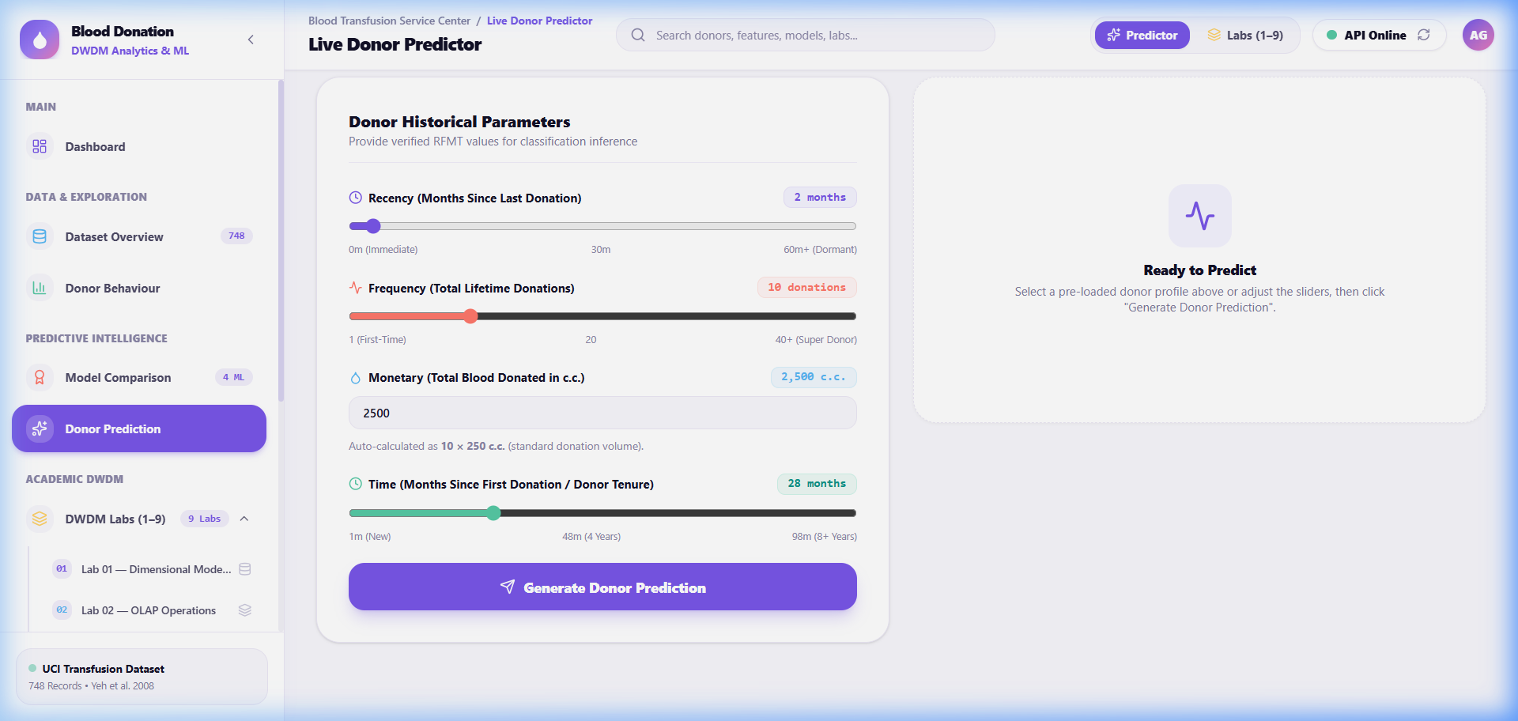
[ WORKING IMPLEMENTATION ]
Live Application Showcase & Interface Features
Genuine screenshots captured from the running React 19 + FastAPI decision support platform.
EXECUTIVE KPI & ANALYTICS DASHBOARD
Displays live cohort metrics (748 donors, 23.8% return rate), class balance breakdown, empirical skewness charts, and real-time backend API connection status.
LIVE DONOR PREDICTOR & CRM GUIDANCE
Allows coordinators to input RFMT features via intuitive sliders or archetypes, generating instant calibrated probability scores, confidence tiers, and outreach advice.

Slide 12
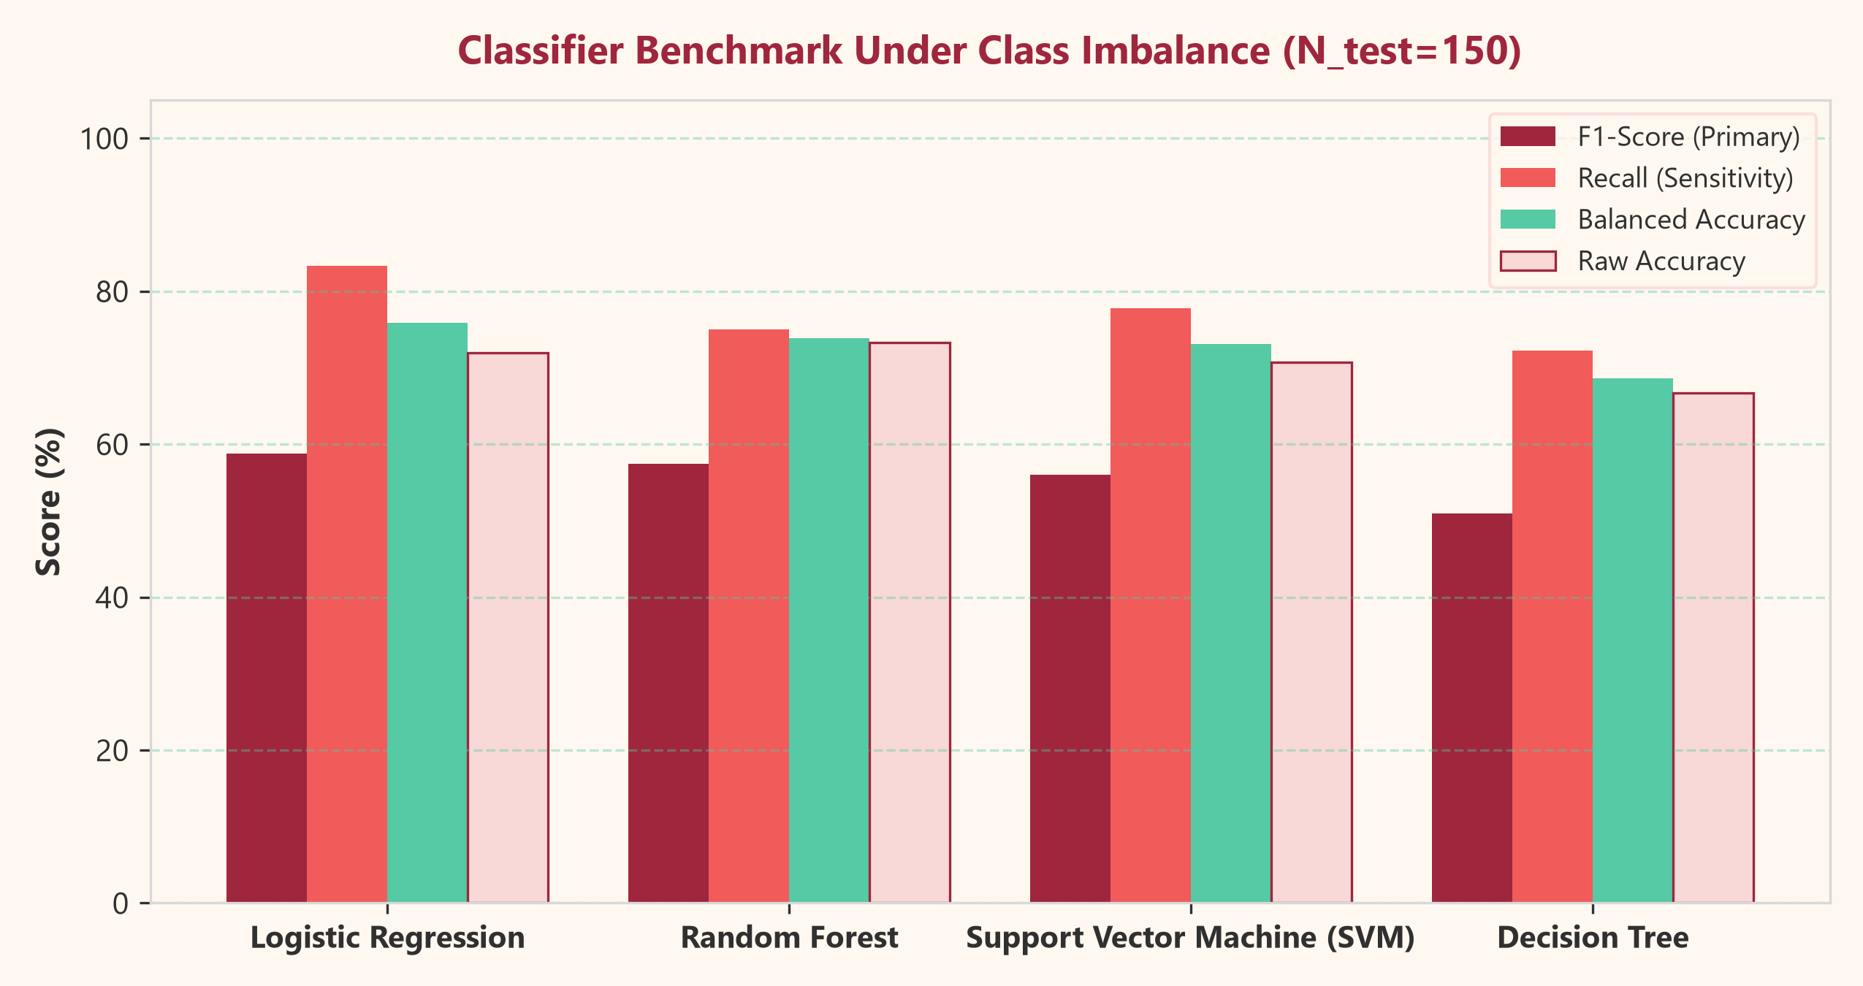
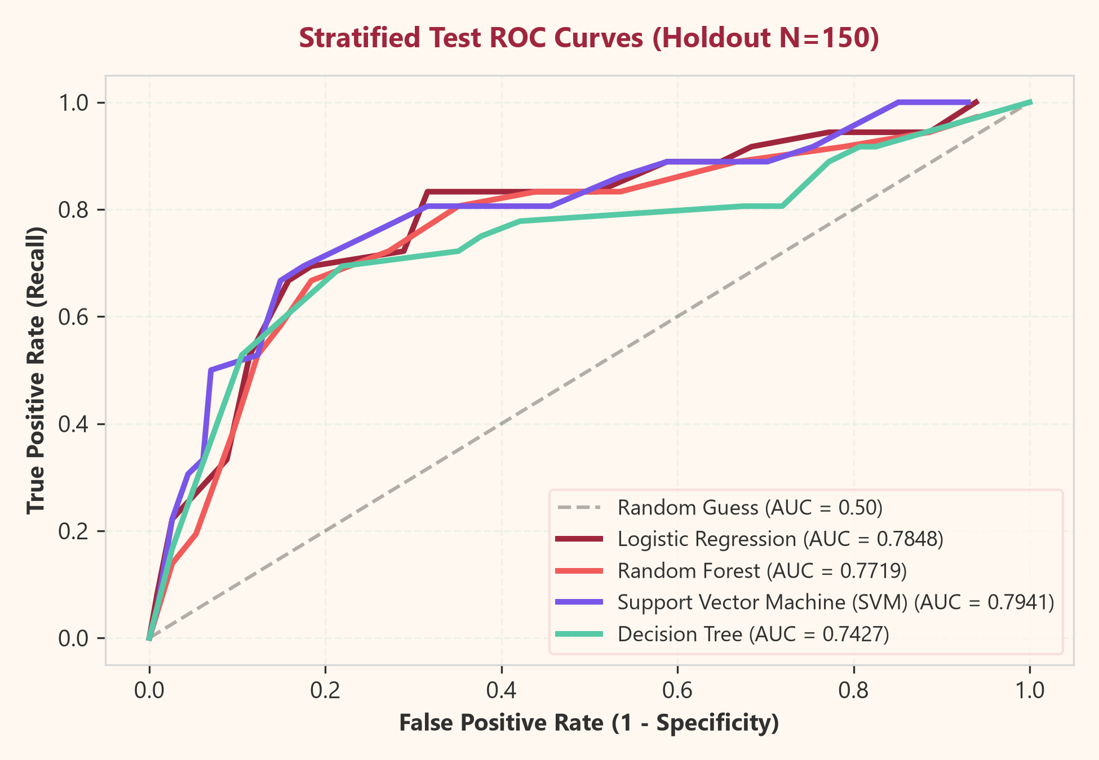
[ EMPIRICAL VALIDATION ]
Experimental Results & Classifier Benchmark
Evaluated on a stratified 20% holdout test set (N_test=150: 36 positive return donors, 114 negative non-donors).
Algorithm | Accuracy | Recall | Precision | F1-Score | ROC-AUC
Logistic Regression ★ | 72.0% | 83.3% | 45.5% | 0.5882 | 0.7848
Random Forest | 73.3% | 75.0% | 46.6% | 0.5745 | 0.7719
Support Vector Machine | 70.7% | 77.8% | 43.8% | 0.5600 | 0.7941
Decision Tree (CART) | 66.7% | 72.2% | 39.4% | 0.5098 | 0.7427
THE RECALL & F1 TRADEOFF INSIGHT
Under a 3.2:1 negative majority, a naive model predicting 0 for all patients achieves 76.2% accuracy while failing to recruit a single returning donor.
Balanced class weighting successfully elevates Logistic Regression to 83.3% Recall (capturing 30 out of 36 actual returning donors) while achieving the optimal F1-score of 0.5882.

Slide 13
[ CRITICAL REFLECTION ]
Project Limitations & Future Research Roadmap
Transparent scientific boundary assessment paired with practical expansion directions.
GENUINE PROJECT LIMITATIONS
Boundary Conditions of the Study
• Single-Center Historical Scope: Data originated from the Hsin-Chu City, Taiwan blood center in March 2007; seasonal and demographic patterns may differ in other countries.
• Absence of Clinical & Biometric Attributes: The dataset contains zero data regarding donor hemoglobin, blood group (ABO/Rh), blood pressure, age, weight, or deferral history.
• Exact Feature Redundancy: Because Monetary is strictly 250 x Frequency (r = 1.000), the dataset effectively contains only 3 independent degrees of freedom (R, F, T).
• Statistical Propensity, Not Medical Advice: Predictions represent historical empirical likelihoods for outreach optimization, not individualized clinical fitness to donate.
FUTURE RESEARCH ROADMAP
Future Technical Enhancements
• Multi-Hospital Prospective Data Ingestion: Connect the pipeline to hospital electronic blood bank management systems via secure HL7/FHIR healthcare data bridges.
• Automated Multichannel Outreach Dispatch: Integrate automated SMS, WhatsApp, and email APIs triggered dynamically when a donor enters prime retention windows.
• Deep Temporal Sequence Modeling: Formulate longitudinal donor timelines using Recurrent Neural Networks (LSTM) or Transformers to predict multi-year return trajectories.
• Privacy-Preserving Federated Learning: Train cross-institutional donor models across multiple regional centers without centralizing sensitive donor personal data.

Slide 14
[ PROJECT WRAP-UP ]
Summary of Contributions & Academic Citations
Final conclusions, scholarly references, and project presentation conclusion.
SUMMARY OF ACHIEVEMENTS
• Mathematical Data Rigor: Successfully modeled the 748-donor cohort, validated exact invariants (M = 250 x F), and handled Pareto right-skewed distributions.
• High Recall Classification: Balanced class weighting enabled Logistic Regression to achieve 83.3% test recall and 0.5882 F1-score, overcoming class imbalance.
• Unsupervised Personas: Identified 4 actionable donor segments via K-Means and Hierarchical Clustering with Silhouette validation.
• Production Decision Tool: Delivered an interactive, production-grade web suite with live prediction, DWDM OLAP reports, and resilient pure-NumPy fallbacks.
SCHOLARLY REFERENCES & DATA SOURCES
[1] Yeh, I-C., Yang, K-J., & Ting, T-M. (2008). Knowledge discovery on RFM model using Bernoulli sequence. Expert Systems with Applications, 36(4), 7715–7723.
[2] UCI Machine Learning Repository: Blood Transfusion Service Center Dataset (ID: 176). Hsin-Chu City, Taiwan.
[3] Pedregosa, F., et al. (2011). Scikit-learn: Machine Learning in Python. Journal of Machine Learning Research, 12, 2825–2830.
[4] Han, J., Kamber, M., & Pei, J. (2011). Data Mining: Concepts and Techniques (3rd ed.). Morgan Kaufmann.
THANK YOU!
Questions & Technical Discussion Welcome
Live FastAPI API Documentation: http://localhost:8000/docs
React Decision Support Application: http://localhost:5173

