Slide 1
Coupon usage prediction on In-Vehicle Recommendation systems
Anushka Hegde. Yanming Liu. Krishna Hemant

Slide 2
Problem Setting
Coupons are seen almost everywhere these days, from online clothing websites to travel agencies, food delivery apps and third party websites or applications hosting them.
Hosting coupons on another service can bring a lot of additional costs.
It is imperative to accurately recommend the most likely to be accepted coupons for the target group.
Research Objective:
Build a robust machine learning model to classify if the user will accept the given coupon or not.

Slide 3

Blueprint at a Glimpse

Slide 4
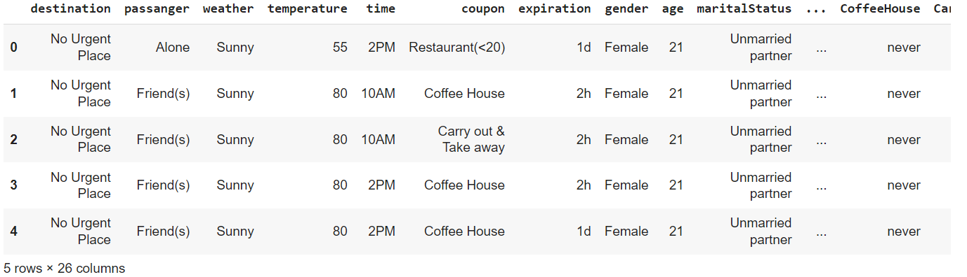
Data Source & Explanation
https://archive.ics.uci.edu/ml/datasets/in-vehicle+coupon+recommendation
12684 records, 26 attributes

Slide 5
EXPLORATORY DATA ANALYSIS
Data Cleaning
Drop car column with 99% null values
Impute other nan value in categorical feature with the most frequent category occurrence
Data Transformation
Set the data type for all features as category as expected
Data Analysis
Coupons acceptance vs. rejection
Counts for coupons accept or not among various categories of features
Counts for different coupon types
Independence between features and coupon acceptance

Slide 6
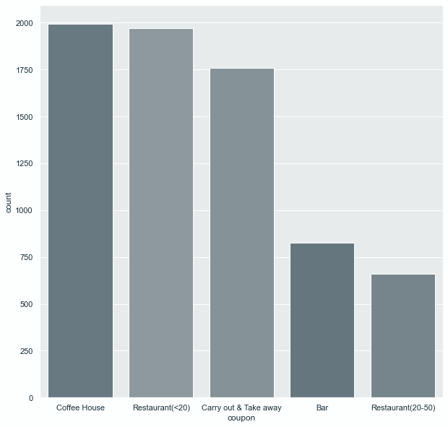
Coupons

Slide 7
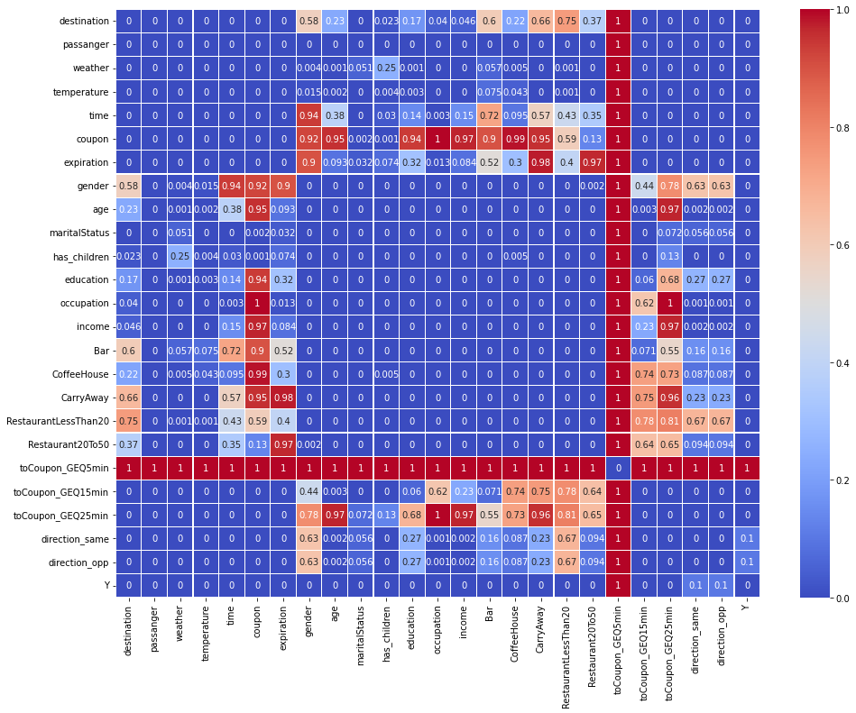
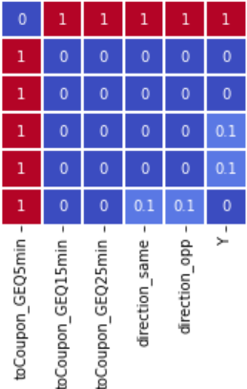
Correlation Analysis - Chi-square
Y

Slide 8
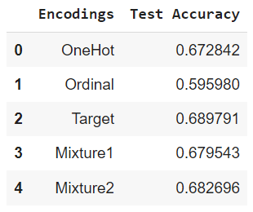
Feature Engineering
Feature Selection
Drop,
toCoupon_GEQ5min, direction_same, direction_opp
Feature Encoding
Five ways are conducted, and
mixture 2 style is picked for a
consideration of higher accuracy and robustness
for neural networks.

Slide 9
MACHINE LEARNING MODELS
Logistic Regression
Neural Networks
Support Vector Machines
Gaussian Naive Bayes

Slide 10
HYPER-PARAMETER TUNING WORKFLOW
Use the optimal value obtained from accuracy maximization for subsequent iterations
Select a new parameter to tune
ITERATE
Fix all
but one parameter
Baseline
FIX
TUNE
Run the model over a given set of values of the flexible parameter

Slide 11
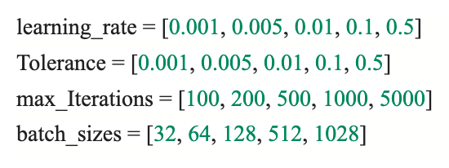
Logistic Regression
It is an extension of Linear Regression where the probability of class membership is analysed based on the sigmoid output.
Logistic Regression was implemented with Stochastic Gradient Descent to accelerate convergence.
Best parameters:
Learning rate = 0.001
Tolerance = 0.001
Maximum Iterations = 1000
Batch size = 128

Slide 12
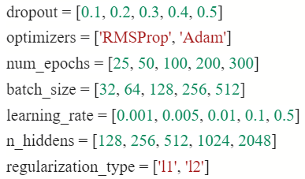
Neural Network
Neural Networks is implemented by Keras using optimizers to decrease the categorical cross entropy, and the model performance is obtained by test accuracy.
Baseline test accuracy with no hidden layer, no dropout value, no regularization , SGD optimizer is obtained for comparison with the one after parameter tuning.
Effect of hidden layer, and other parameters on validation accuracy is tested, and adopting the turning strategy as previous slide describe, we for loop the values on a model with 3 layers, in the graph and get the best parameters as below,
dropout = 0.3, optimizer = ‘Adam’, epoch = 50,
Batch size = 32, learning rate = 0.001,
number of hidden neurons = 2048,

Slide 13
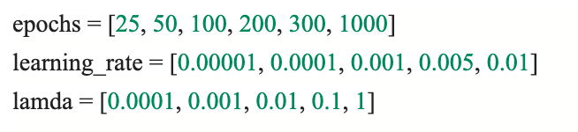
SVM (Hard Margin)
It maximises the minimum distance from the decision boundary to the training points with no leeway for misclassification.
Hard Margin SVM is implemented with l2 regularization.
Best parameters for Hard Margin SVM:
Learning rate = 0.00001
Lambda = -0.001
Maximum Iterations = 1000

Slide 14
Gaussian Naive Bayes
Gaussian NB supports continuous values or mixture encoded data and assumes an underlying Gaussian (normal) distribution with independent features.
Naive Bayes was also attempted on one-hot encoded data with laplace smoothing
However, no significant improved over the baseline was observed
Accuracy metrics on train, validation and test set:
Train = 0.6415
Validation = 0.6377
Test = 0.6357

Slide 15
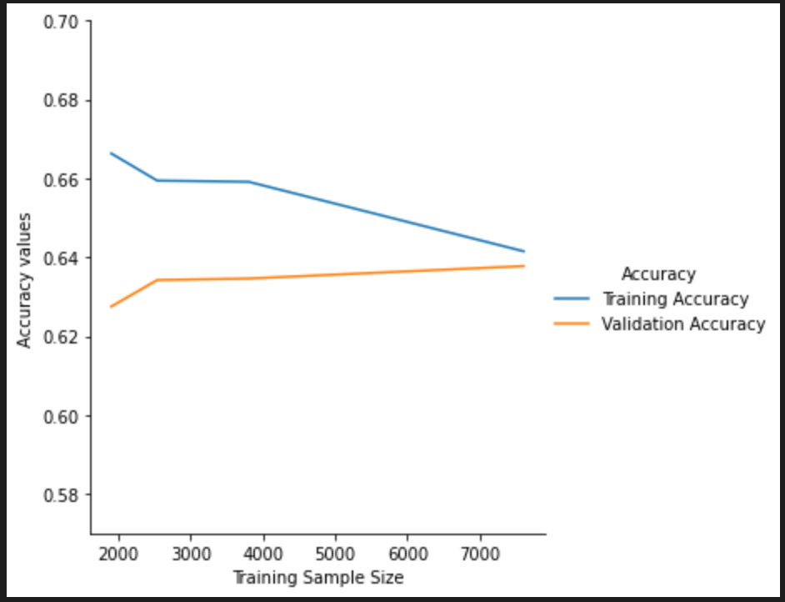
BIAS VARIANCE TRADEOFF (LEARNING CURVES)
A learning curve shows the validation and training accuracy of a model for varying numbers of training sample sizes.
In a high bias learning curve:
Low overall performance
Difference in convergence of training and test accuracies is small
Resolve: Increase the number of parameters or create new features.

Slide 16
Performance Evaluation
Accuracy
Time consumption
Space Usage

Slide 17
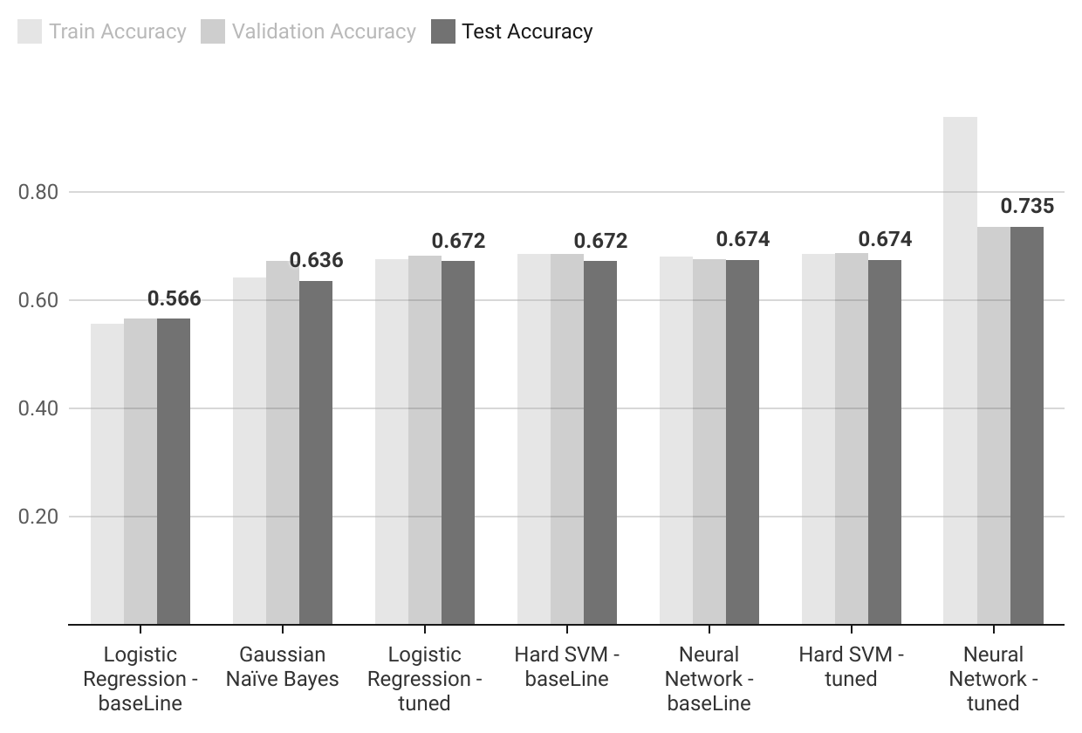
Accuracy for Models

Slide 18
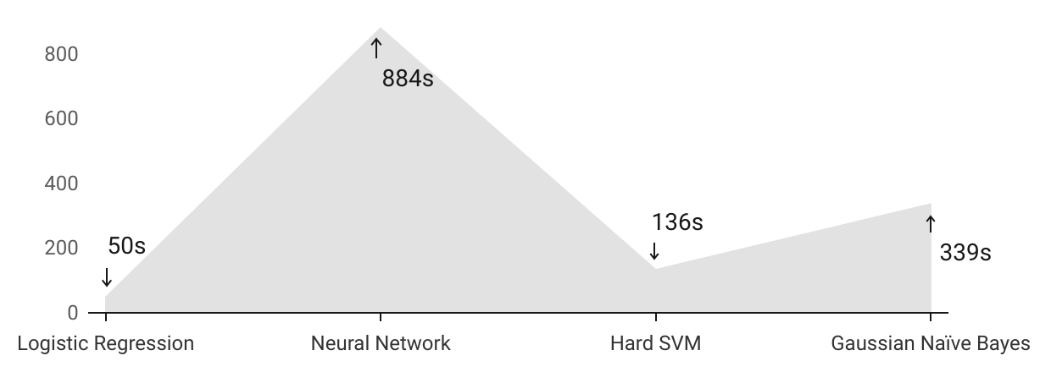
Processing Time

Slide 19
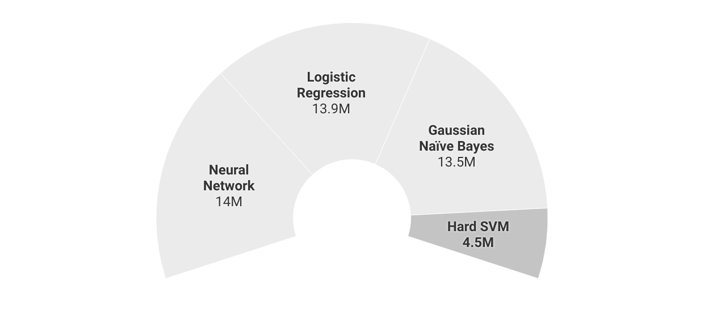
Peak Memory Usage (B)

Slide 20
Summary
Based on the model selection criteria, we can choose the optimal models according to our preference for accuracy or efficiency. Since the overall performance of the tuned Neural Networks model is approximately 6% higher than the next best, when prioritizing high accuracy, this model will work well. When computational efficiency may be an issue, particularly in the case of large datasets, it may be wiser to go with the Hard Margin SVM classifier.

Slide 21
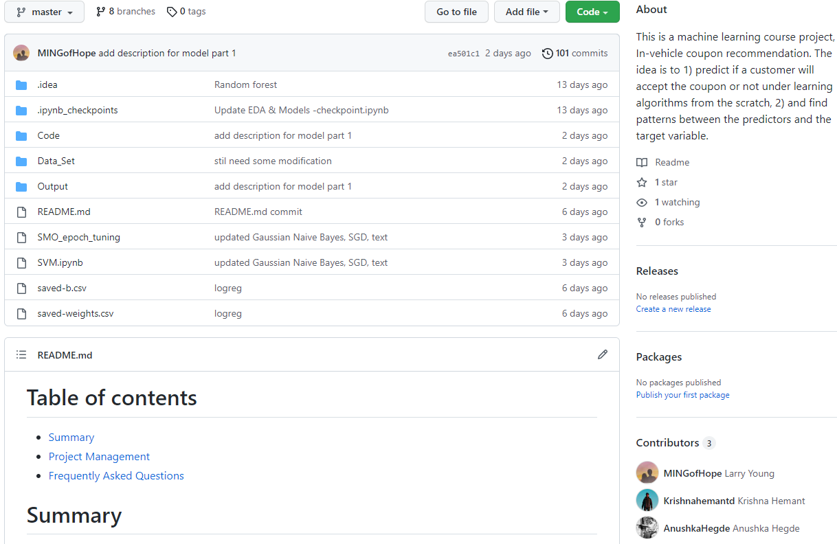
Thank you!
https://github.com/AnushkaHegde/In-Vehicle-Coupon-Recommendation-ML-Project

