Slide 1
🎉 Celebrating Our Employees

Slide 2
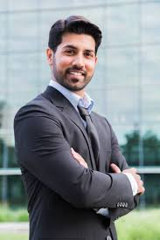

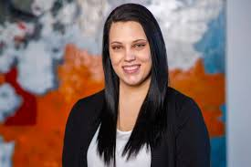
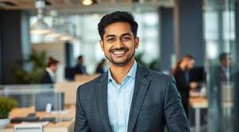
Anshul Singla
Aishvarya Sonpari
Saikumar Vakadari
Chaitanya Singla

Slide 3
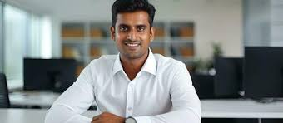
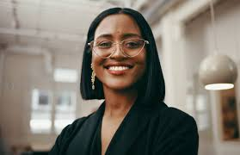
Gayatri Kumari Ojha
Bhanumati

