Slide 1
Unit-2 : Array and Linked List

Slide 2
Operations on List ADT – Create, Insert, Search, Delete, Display elements; Implementation of List ADT– Array, Cursor based Linked List; Types – Singly Linked List, Doubly Linked List, Circular Linked List; Applications - Sparse Matrix, Polynomial Arithmetic, Josephus Problem.

Slide 3
What is LIST ADT?
A List is a dynamic, ordered tuple of homogeneous elements.
List will be in the form: A1, A2, A3, .... An
First Element of the List: A1
Last Element of the List: An
ith Element of the List: Ai ,
Position of Element Ai :i ,
Position ranges from 0 to N
Size of the List: N
Empty List: If Size of the list is Zero (i.e N=0), it is Empty List.
Precedes and Succeeds: For any list except empty list, we say that Ai+1 follows (or succeeds) Ai (i<N) and that Ai-1 precedes Ai (i>1)

Slide 4
LIST Operations:
1. Add We can add new item/row in our list at first or at last or at any position.
2. Edit - If we entered wrong value for an item/row, don't worry we can edit/enter the right value at any point of time.
3. Search - If we want to search for a value in a big List, We can use CTRL+F to search and we can find the value which we need or position of row/item which contains the value which we need.
4. Insert (x,p,L)
Insert x at position p in list L
If p = END(L), insert x at the end
If L does not have position p, result is undefined
5. Locate(x,L)
returns position of x on L
returns END(L) if x does not appear
6. Retrieve (p, L)
returns element at position p on L
undefined if p does not exist or p = END(L)

Slide 5
7. Delete (p, L)
delete element at position p in L
undefined if p = END(L) or does not exist
8. Next (p, L)
returns the position immediately following position p
9. Prev (p, L)
returns the position previous to p
10. Makenull (L)
causes L to become an empty list and returns position END(L)
11. First (L)
returns the first position on L

Slide 6
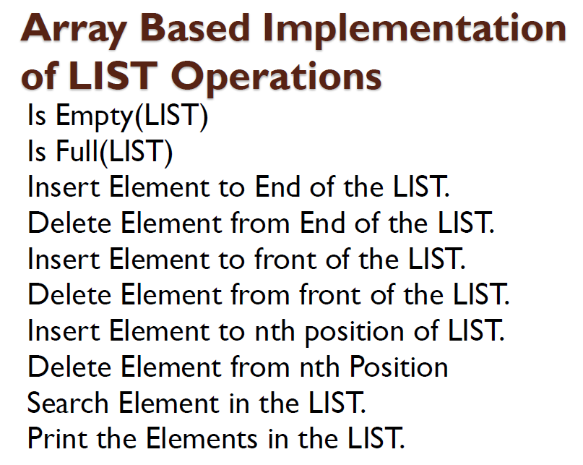

Slide 7
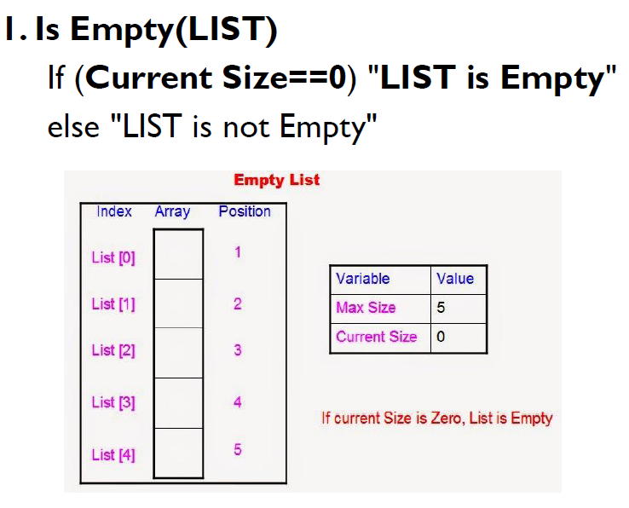

Slide 8
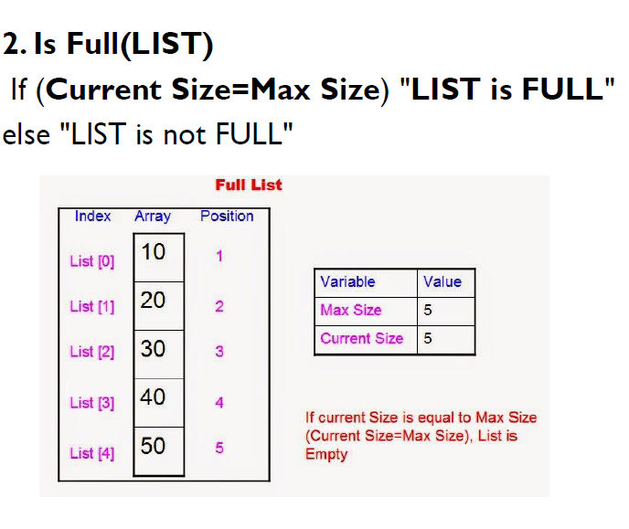

Slide 9
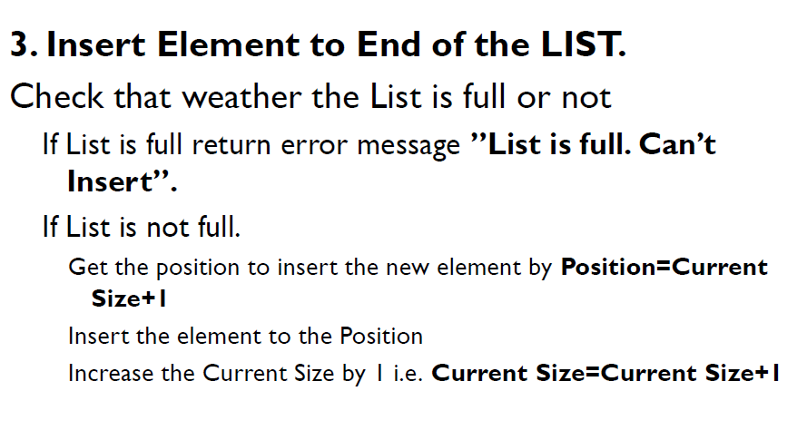

Slide 10
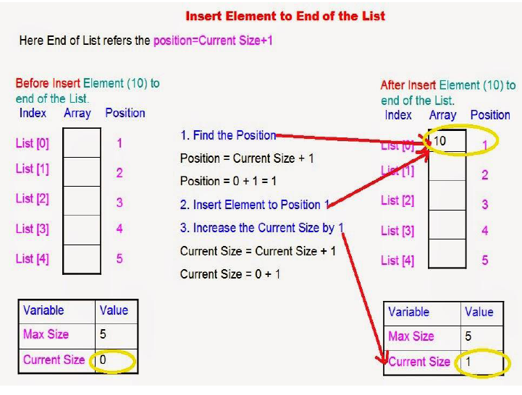

Slide 11
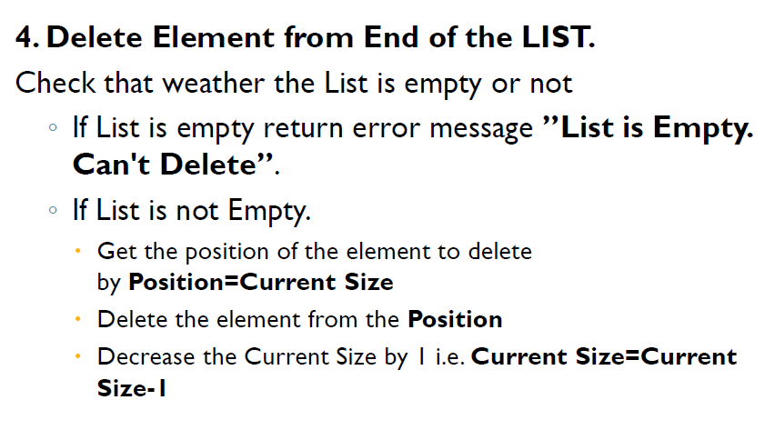

Slide 12
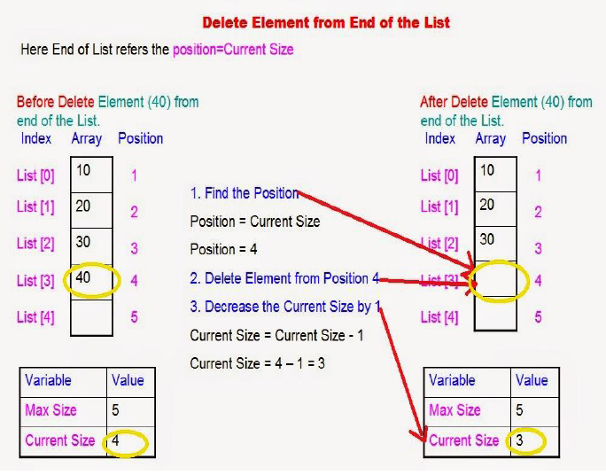

Slide 13
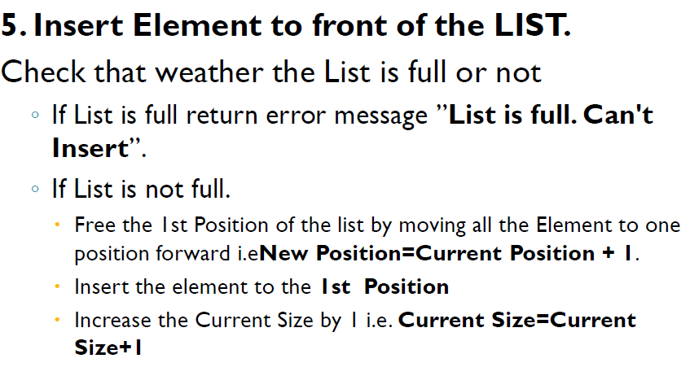

Slide 14
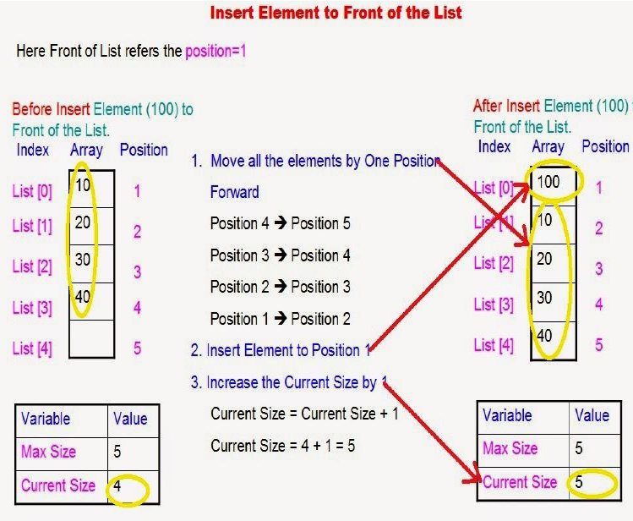

Slide 15
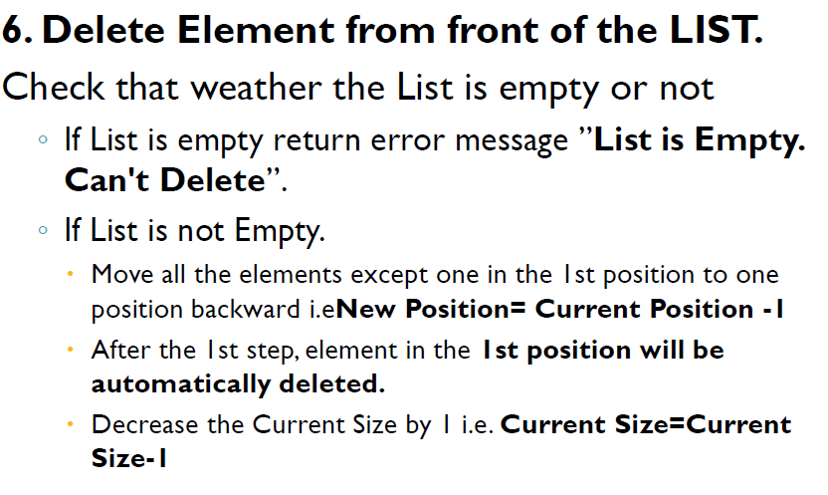

Slide 16
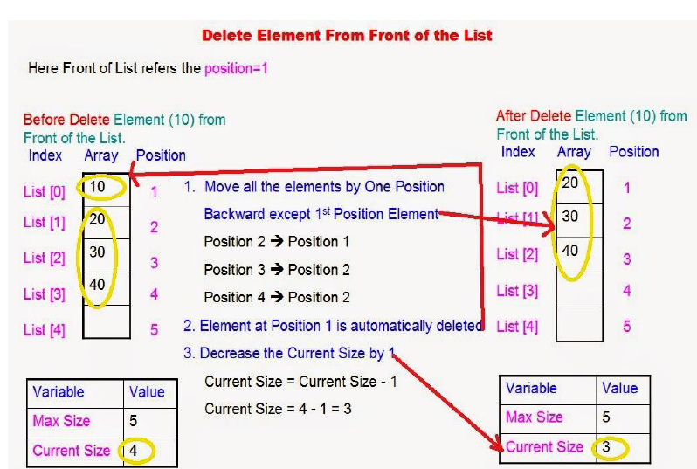

Slide 17
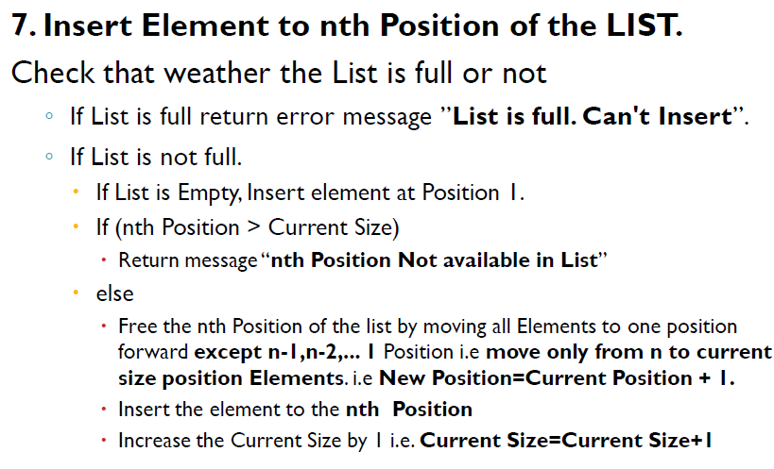

Slide 18
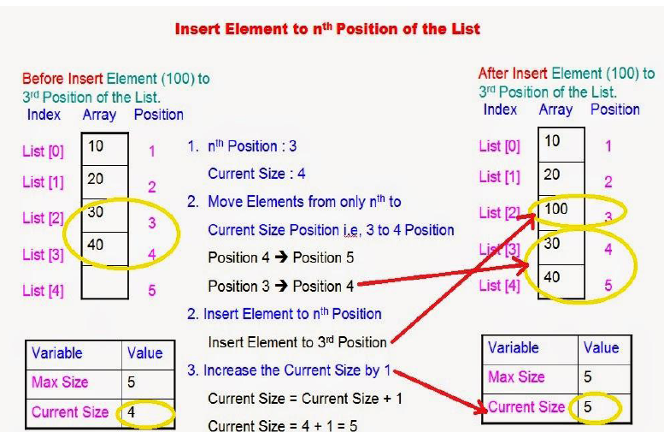

Slide 19
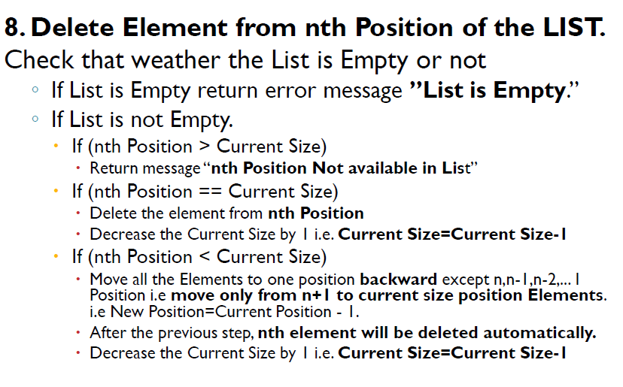

Slide 20
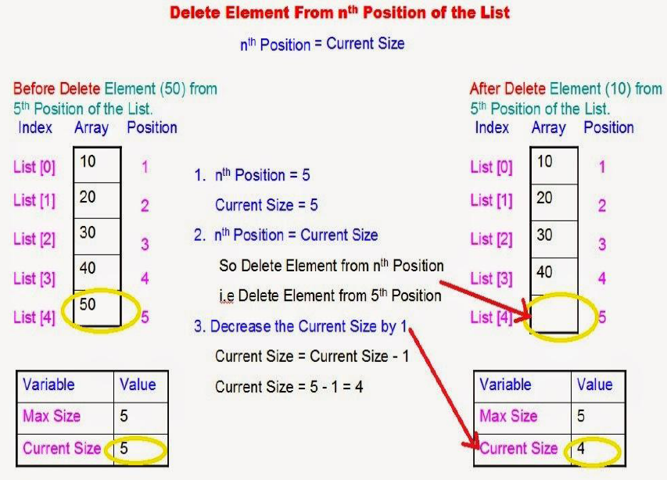

Slide 21
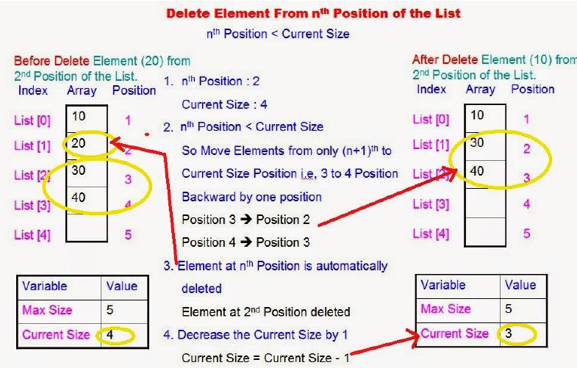

Slide 22
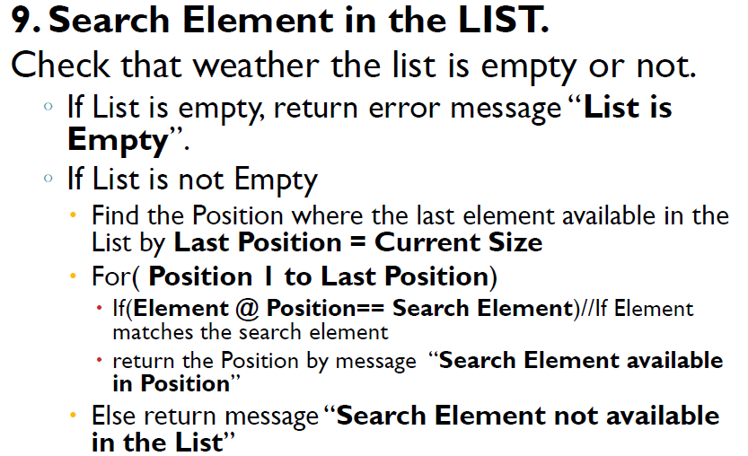

Slide 23
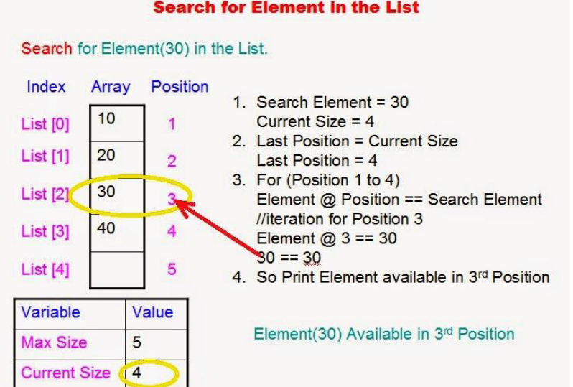

Slide 24
10. Print the Elements in the LIST.
Check that weather the list is empty or not.
If List is empty, return error message “List is Empty”.
If List is not Empty
Find the Position where the last element available in the List by Last Position = Current Size
For( Position 1 to Last Position)
Print the Position and Element available at the position of List.

Slide 25
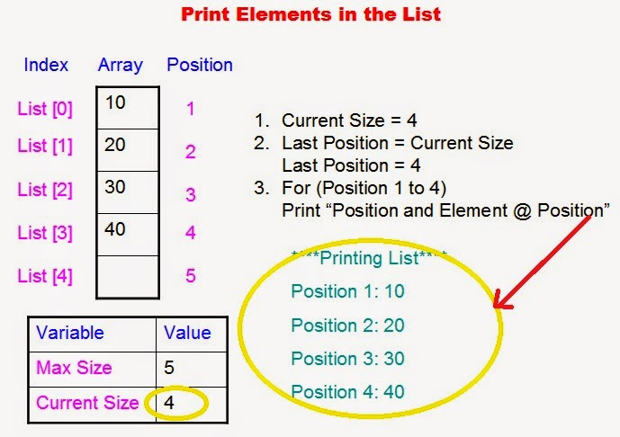

Slide 26
Advantages of Array Implementation of LIST:
No need to declare Large number of variables Individually
Variables are not scattered in Memory, they are stored in contiguous memory.
Ease the handling of large number of variables of same datatype.
Disadvantages of Array Implementation of LIST:
Rigid Structure
Can be hard to add/remove elements.
Cannot be dynamically re-sized in most Languages.
Memory Loss

Slide 27
Thank you

