Slide 1
Unit-2 : Array and Linked List

Slide 2
Operations on List ADT – Create, Insert, Search, Delete, Display elements; Implementation of List ADT– Array, Cursor based Linked List; Types – Singly Linked List, Doubly Linked List, Circular Linked List; Applications - Sparse Matrix, Polynomial Arithmetic, Josephus Problem.

Slide 3
Many languages, such as BASIC and FORTRAN, do not support pointers. If linked lists are required and pointers are not available, then an alternate implementation must be used. The alternate method we will describe is known as a cursor implementation.

Slide 4
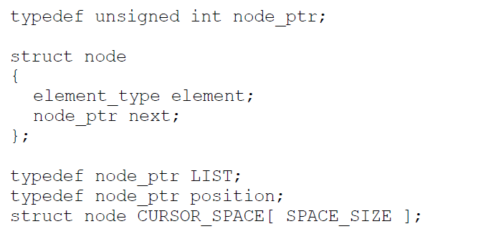
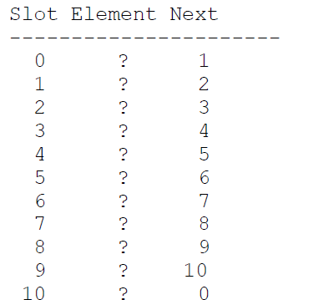
Declarations for cursor implementation of linked lists

Slide 5
The logical way to satisfy condition 1 is to have a global array of structures. For any cell in the array, its array index can be used in place of an address. Previous Figure gives the type declarations for a cursor implementation of linked lists.
We must now simulate condition 2 by allowing the equivalent of malloc and free for cells in the CURSOR_SPACE array. To do this, we will keep a list (the freelist) of cells that are not in any list. The list will use cell 0 as a header. The initial configuration is shown in previous slide
A value of 0 for next is the equivalent of a pointer. The initialization of CURSOR_SPACE is a straightforward loop, which we leave as an exercise. To perform an malloc, the first element (after the header) is removed from the freelist.

Slide 6
A linked list is a non-sequential collection of data items.
It is a dynamic data structure.
For every data item in a linked list, there is an associated pointer that would give the memory location of the next data item in the linked list.
The data items in the linked list are not in consecutive memory locations.

Slide 7
Advantages of linked lists:
1. Linked lists are dynamic data structures. i.e., they can grow or shrink during the execution of a program.
2. Linked lists have efficient memory utilization. Here, memory is not pre-allocated. Memory is allocated whenever it is required and it is de-allocated (removed) when it is no longer needed.
3. Insertion and Deletions are easier and efficient.

Slide 8
Disadvantages of linked lists:
1. It consumes more space because every node requires a additional pointer to store address of the next node.
2. Searching a particular element in list is difficult and also time consuming

Slide 9
Types of Linked Lists:
Basically we can put linked lists into the following four items:
1. Single Linked List.
2. Double Linked List.
3. Circular Linked List.
4. Circular Double Linked List

Slide 10
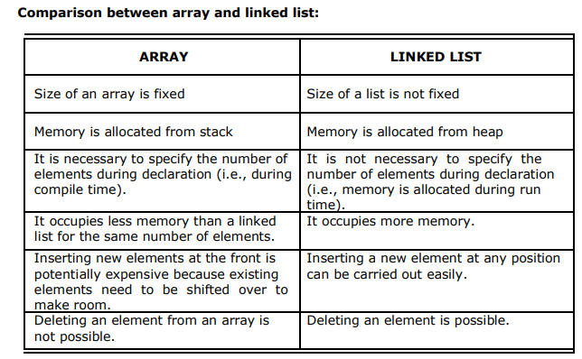

Slide 11
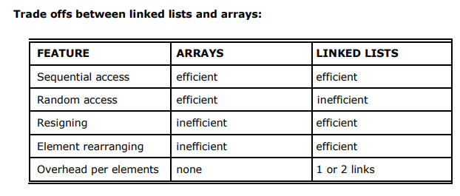

Slide 12
Single Linked List
A linked list allocates space for each element separately in its own block of memory called a "node".
The list gets an overall structure by using pointers to connect all its nodes together like the links in a chain.
Each node contains two fields; a "data" field to store whatever element, and a "next" field which is a pointer used to link to the next node.
Each node is allocated in the heap using malloc(),
The front of the list is a pointer to “start node”..

Slide 13
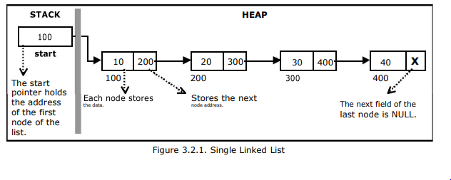

Slide 14
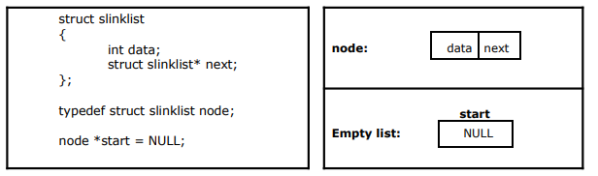
Implementation of Single Linked List
Creating a structure with one data item and a next pointer, which will be pointing to next node of the list.
This is called as self-referential structure.
Initialize the start pointer to be NUL

Slide 15
The basic operations in a single linked list are:
Creation.
Insertion.
Deletion.
Traversing.

Slide 16
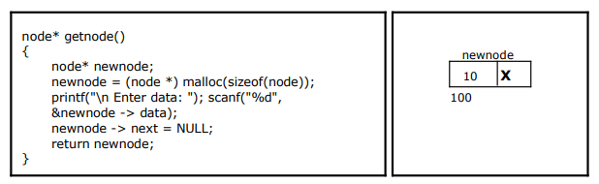
Creating a node for Single Linked List:
Creating a singly linked list starts with creating a node
The information is stored in the memory, allocated by using the malloc() function

Slide 17
Insertion of a Node:
The new node can then be inserted at three different places namely:
Inserting a node at the beginning.
Inserting a node at the end.
Inserting a node at intermediate position

Slide 18
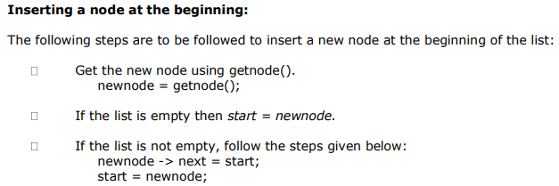

Slide 19
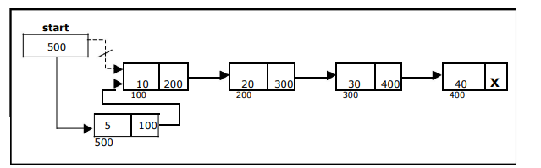
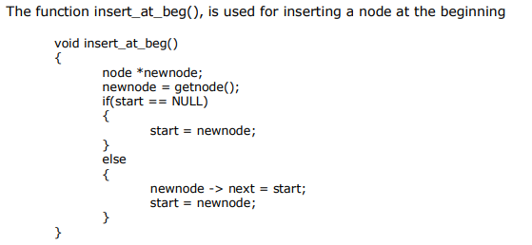

Slide 20
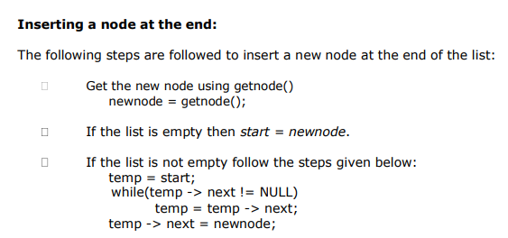

Slide 21
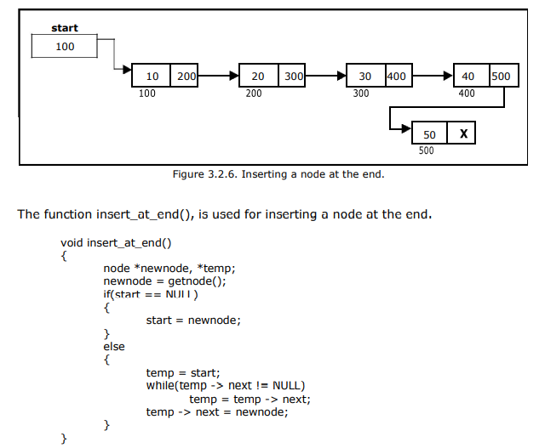

Slide 22
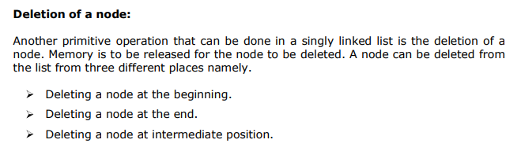

Slide 23
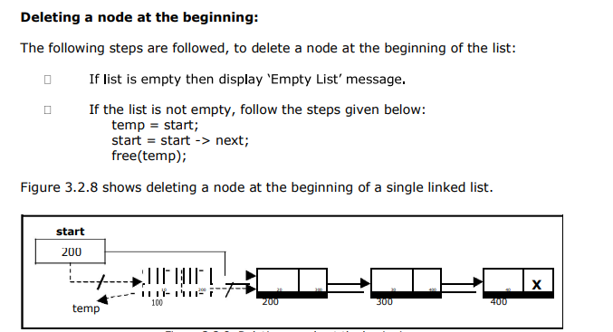

Slide 24
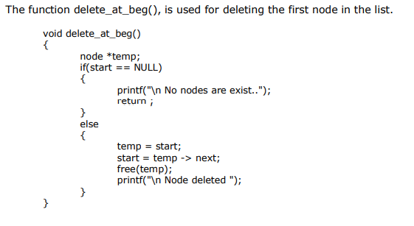

Slide 25
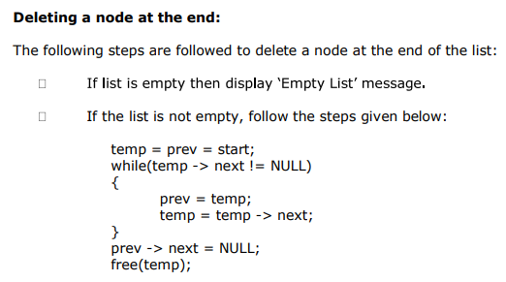
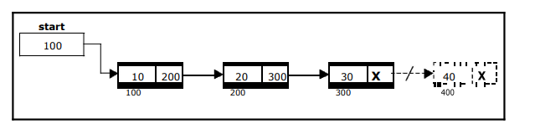

Slide 26
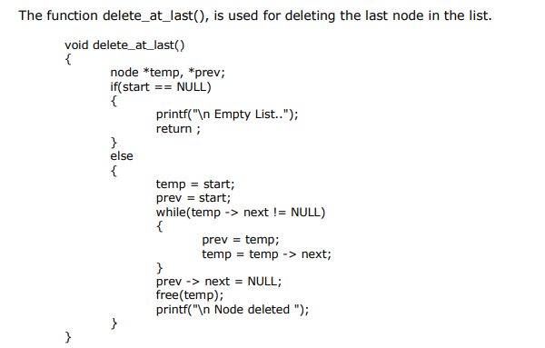

Slide 27
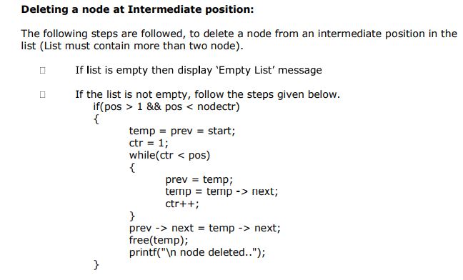
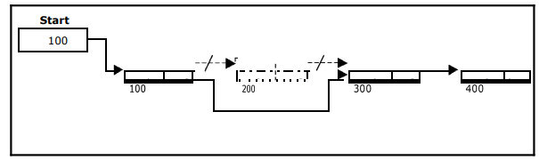

Slide 28
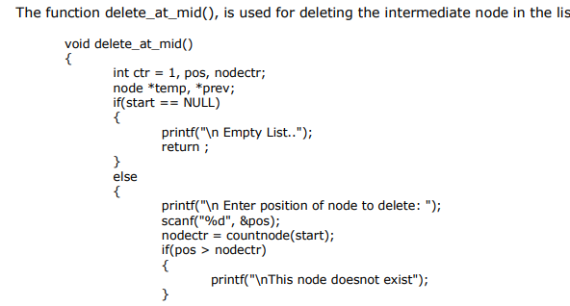
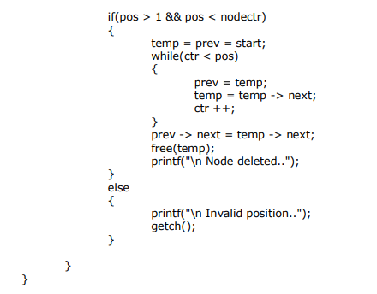

Slide 29
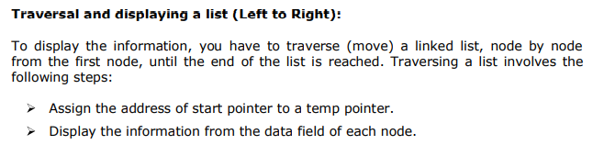
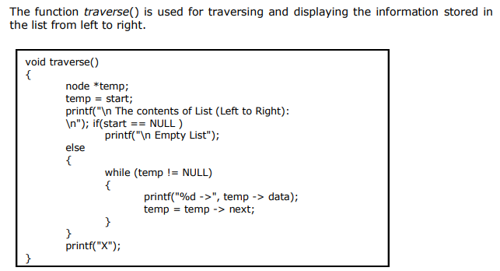

Slide 30
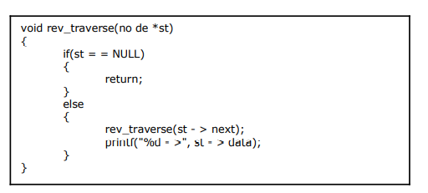
Alternatively there is another way to traverse and display the information. That is in reverse order. The function rev_traverse(), is used for traversing and displaying the information stored in the list from right to left

Slide 31
Application of linked list
Implementation of stacks and queues
Implementation of graphs : Adjacency list representation of graphs is most popular which is uses linked list to store adjacent vertices.
Dynamic memory allocation : We use linked list of free blocks.
Maintaining directory of names
Performing arithmetic operations on long integers
Manipulation of polynomials by storing constants in the node of linked list
representing sparse matrices

Slide 32
Thank you

