Slide 1
Unit-2 : Array and Linked List

Slide 2
Operations on List ADT – Create, Insert, Search, Delete, Display elements; Implementation of List ADT– Array, Cursor based Linked List; Types – Singly Linked List, Doubly Linked List, Circular Linked List; Applications - Sparse Matrix, Polynomial Arithmetic, Josephus Problem.

Slide 3
A double linked list is a two-way list in which all nodes will have two links.
This helps in accessing both successor node and predecessor node from the given node position.
It provides bi-directional traversing. Each node contains three fields
Left link.
Data.
Right link.

Slide 4
The left link points to the predecessor node and the right link points to the successor node.
The data field stores the required data.
Many applications require searching forward and backward thru nodes of a list.
For example searching for a name in a telephone directory would need forward and backward scanning thru a region of the whole list.

Slide 5
The basic operations in a double linked list are:
Creation.
Insertion.
Deletion.
Traversing.

Slide 6
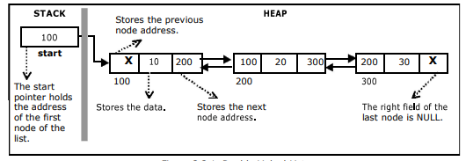
The beginning of the double linked list is stored in a "start" pointer which points to the first node.

Slide 7
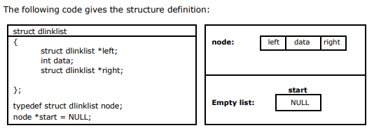

Slide 8
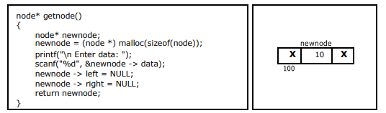
Creating a node for Double Linked List:
Creating a double linked list starts with creating a node.
The information is stored in the memory, allocated by using the malloc() function. The function getnode(), is used for creating a node, after allocating memory for the structure of type node, the information for the item (i.e., data) has to be read from the user and set left field to NULL and right field also set to NULL

Slide 9
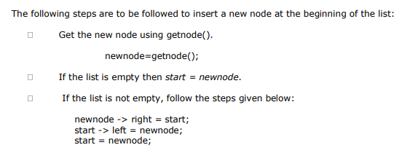
Inserting a node at the beginning:

Slide 10
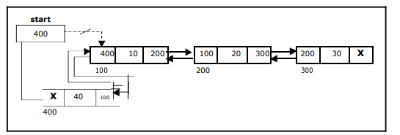

Slide 11
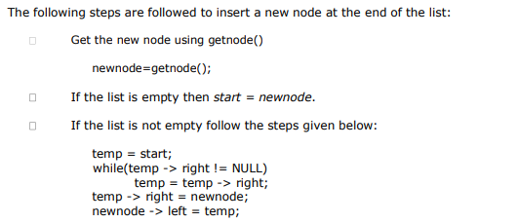
Inserting a node at the end:

Slide 12
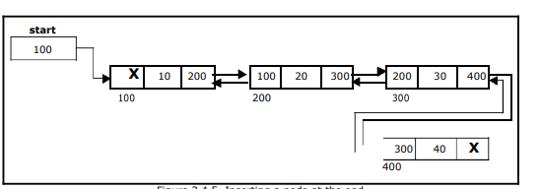

Slide 13
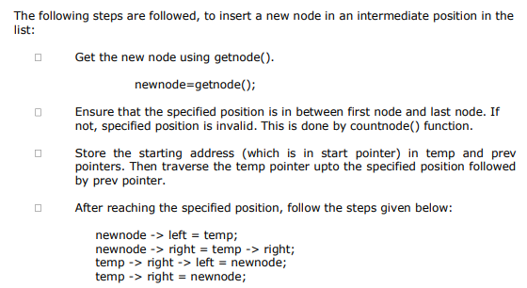
Inserting a node at an intermediate position

Slide 14
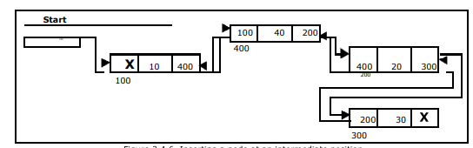

Slide 15
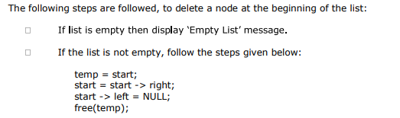
Deleting a node at the beginning

Slide 16
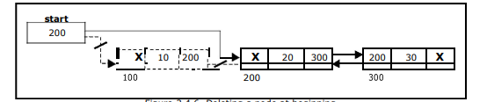

Slide 17
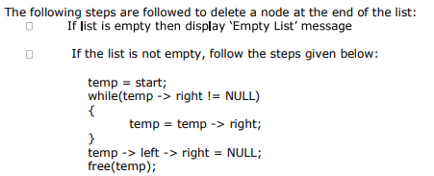
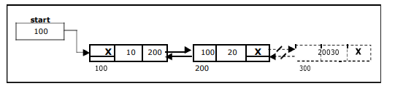
Deleting a node at the end

Slide 18
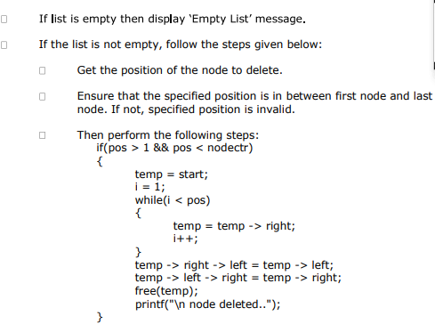
Deleting a node at Intermediate position:

Slide 19
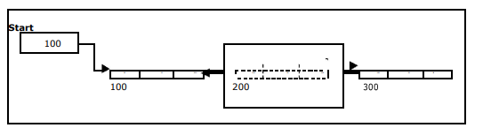

Slide 20

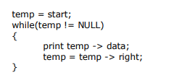
Traversal and displaying a list (Left to Right):

Slide 21
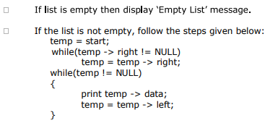
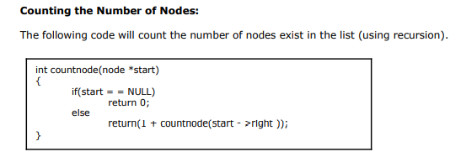
Traversal and displaying a list (Right to Left)

Slide 22
Thank you

