Slide 1
Unit-2 : Array and Linked List

Slide 2
Operations on List ADT – Create, Insert, Search, Delete, Display elements; Implementation of List ADT– Array, Cursor based Linked List; Types – Singly Linked List, Doubly Linked List, Circular Linked List; Applications - Sparse Matrix, Polynomial Arithmetic, Josephus Problem.

Slide 3
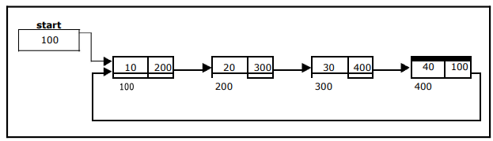
Circular linked list
the link field of the last node points back to the address of the first node
A circular linked list has no beginning and no end
In circular linked list no null pointers are used, hence all pointers contain valid address.

Slide 4
The basic operations in a circular single linked list are: Creation.
Insertion.
Deletion.
Traversing.

Slide 5
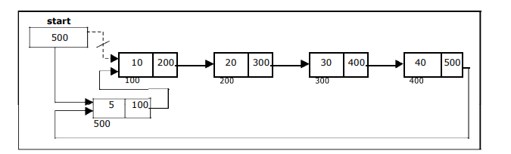
Inserting a node at the beginning

Slide 6
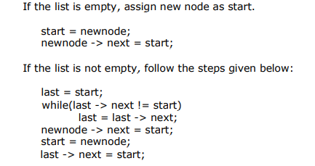

Slide 7
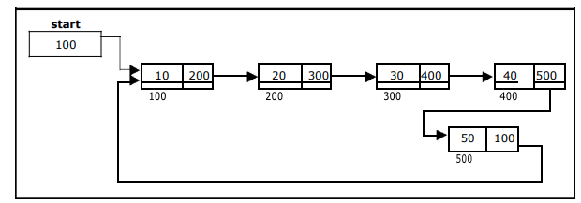
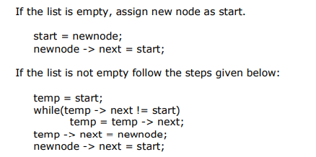
Inserting a node at the end

Slide 8
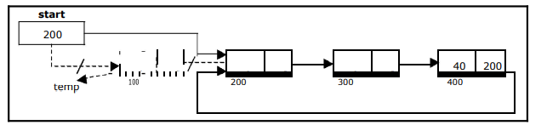
Deleting a node at the beginning:

Slide 9
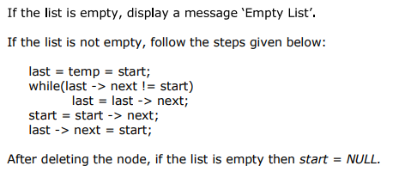

Slide 10
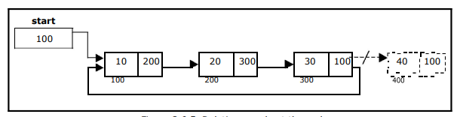
Deleting a node at the end

Slide 11
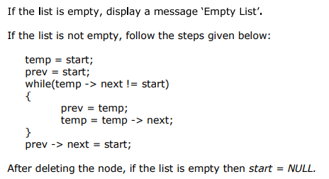

Slide 12
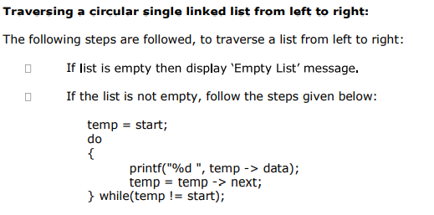

Slide 13
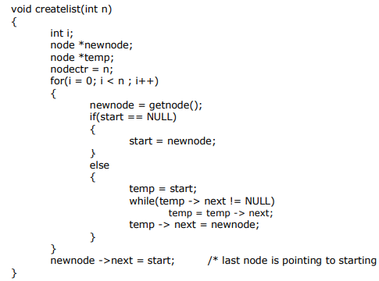
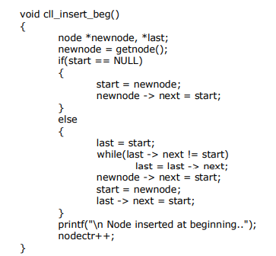
C code for circular linked list

Slide 14
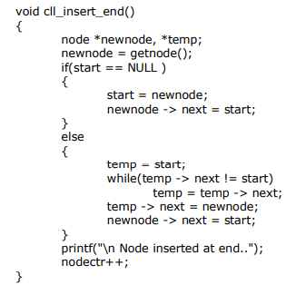
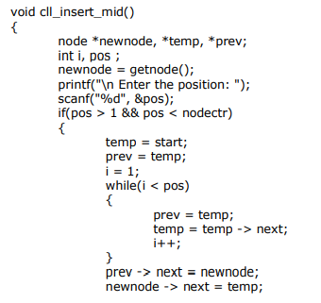
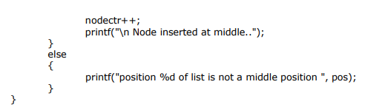

Slide 15
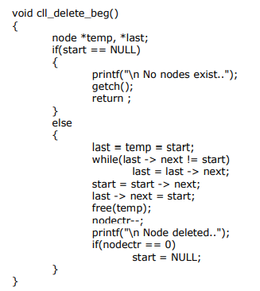
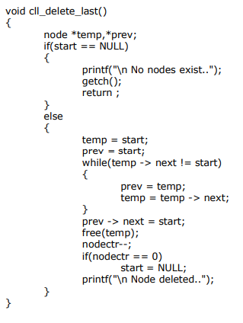

Slide 16
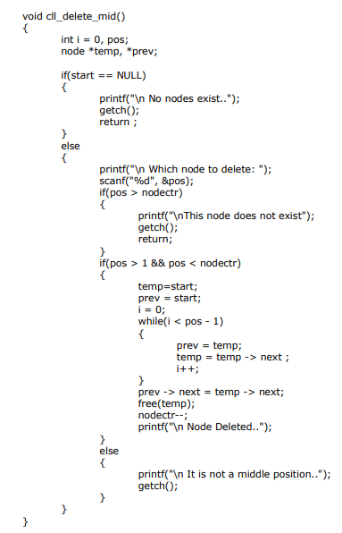

Slide 17
Application of Circular Linked List
Personal Computers, where multiple applications are running. All the running applications are kept in a circular linked list and the OS gives a fixed time slot to all for running. The Operating System keeps on iterating over the linked list until all the applications are completed.
Another example can be Multiplayer games. All the Players are kept in a Circular Linked List and the pointer keeps on moving forward as a player's chance ends.
Circular Linked List can also be used to create Circular Queue. In a Queue we have to keep two pointers, FRONT and REAR in memory all the time, where as in Circular Linked List, only one pointer is required

Slide 18
Application of circular linked list: Josephus problem
Josephus Problem talks about a problem where there are people standing in a circle waiting to be executed.
The counting out begins at some point in the circle and proceeds around the circle in a fixed direction.
In each step, a certain number of people are skipped and the next person is executed.
The elimination proceeds around the circle (which is becoming smaller and smaller as the executed people are removed), until only the last person remains, who is given freedom

Slide 19
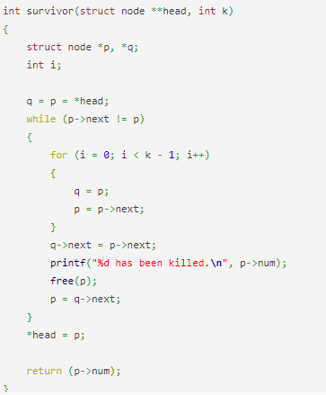

Slide 20
Thank you

