Slide 1
Unit-2 : Array and Linked List

Slide 2
Operations on List ADT – Create, Insert, Search, Delete, Display elements; Implementation of List ADT– Array, Cursor based Linked List; Types – Singly Linked List, Doubly Linked List, Circular Linked List; Applications - Sparse Matrix, Polynomial Arithmetic, Josephus Problem.

Slide 3
Polynomial Arithmetic

Slide 4
A polynomial is composed of different terms where each of them holds a coefficient and an exponent.
A polynomial p(x) is the expression in variable x which is in the form (ax^{n} + bx^{n-1} + …. + jx+ k), where a, b, c …., k fall in the category of real numbers and 'n' is non negative integer, which is called the degree of polynomial.
Example:
10x² + 26x, here 10 and 26 are coefficients and 2, 1 is its exponential value.

Slide 5
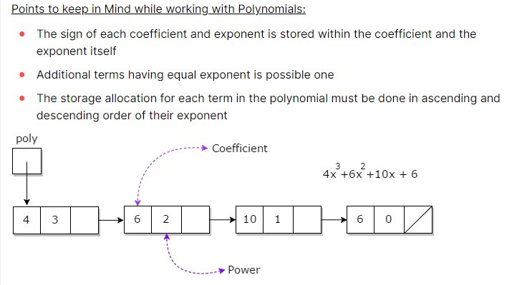

Slide 6
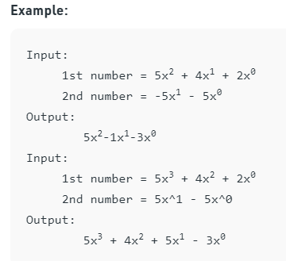
Given two polynomial numbers represented by a linked list. Write a function that add these lists means add the coefficients who have same variable powers

Slide 7
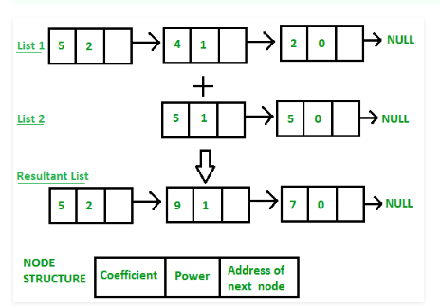

Slide 8
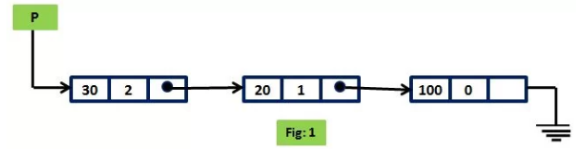
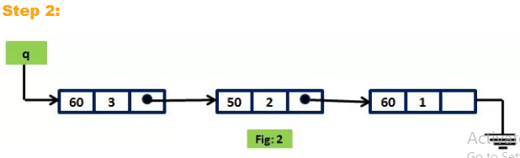
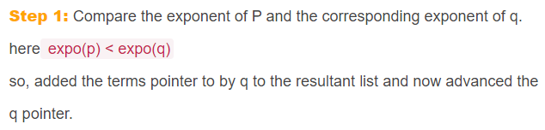

Slide 9
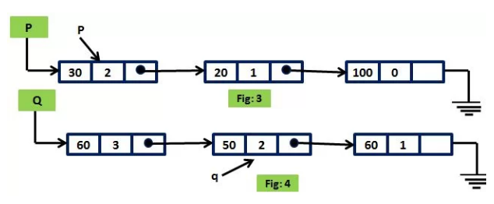
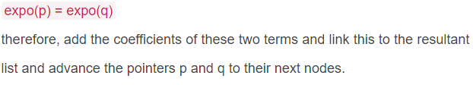

Slide 10
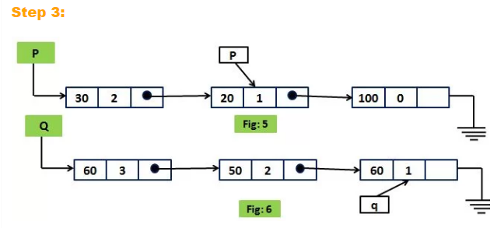
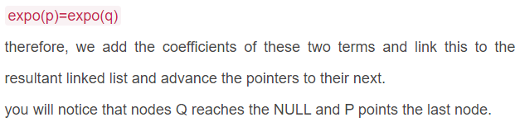

Slide 11
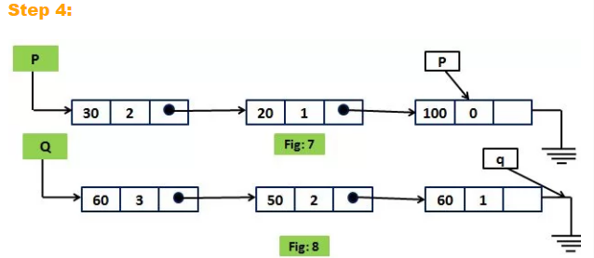
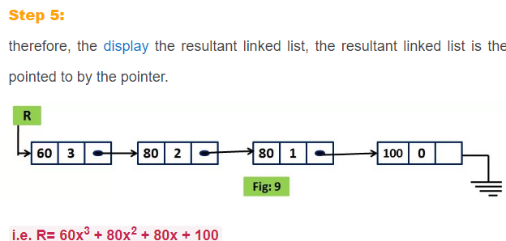

Slide 12
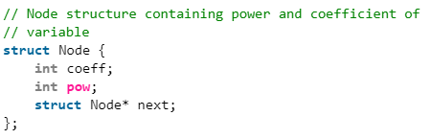

Slide 13
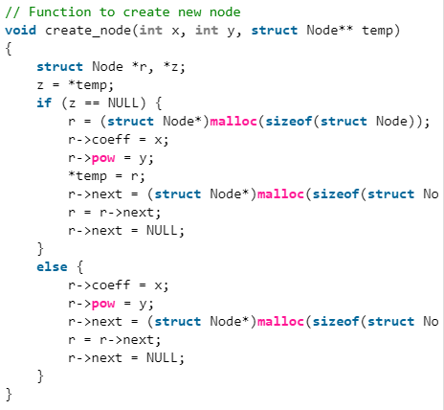

Slide 14
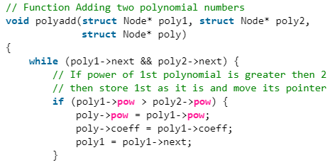
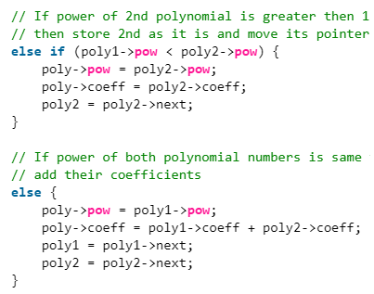

Slide 15
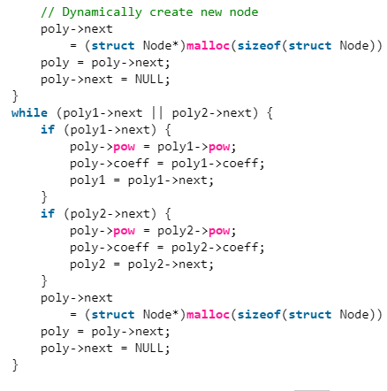

Slide 16
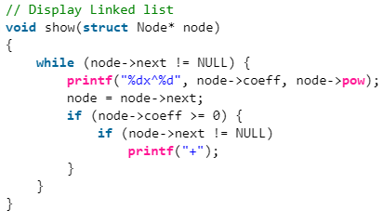

Slide 17
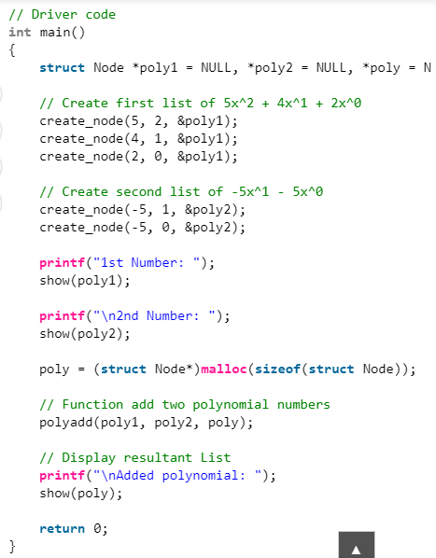

Slide 18
Thank you

