Slide 1
Unit-2 : Array and Linked List

Slide 2
Operations on List ADT – Create, Insert, Search, Delete, Display elements; Implementation of List ADT– Array, Cursor based Linked List; Types – Singly Linked List, Doubly Linked List, Circular Linked List; Applications - Sparse Matrix, Polynomial Arithmetic, Josephus Problem.

Slide 3
Sparse matrix
In computer programming, a matrix can be defined with a 2-dimensional array. Any array with 'm' columns and 'n' rows represents a mXn matrix. There may be a situation in which a matrix contains more number of ZERO values than NON-ZERO values. Such matrix is known as sparse matrix.
Sparse matrix is a matrix which contains very few non-zero elements

Slide 4
When a sparse matrix is represented with 2-dimensional array, we waste lot of space to represent that matrix. For example, consider a matrix of size 100 X 100 containing only 10 non-zero elements. In this matrix, only 10 spaces are filled with non-zero values and remaining spaces of matrix are filled with zero. That means, totally we allocate 100 X 100 X 2 = 20000 bytes of space to store this integer matrix. And to access these 10 non-zero elements we have to make scanning for 10000 times

Slide 5
A sparse matrix can be represented by using TWO representations, those are as follows...
Triplet Representation
Linked Representation
Triplet Representation
In this representation, we consider only non-zero values along with their row and column index values. In this representation, the 0th row stores total rows, total columns and total non-zero values in the matrix. For example, consider a matrix of size 5 X 6 containing 6 number of non-zero values. This matrix can be represented as shown in the image...

Slide 6
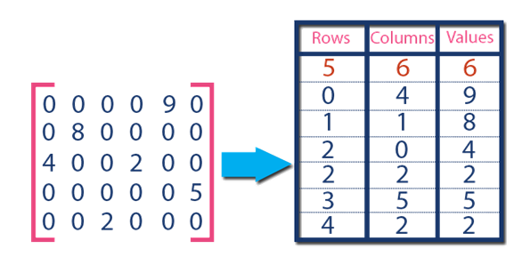
In above example matrix, there are only 6 non-zero elements ( those are 9, 8, 4, 2, 5 & 2) and matrix size is 5 X 6. We represent this matrix as shown in the above image. Here the first row in the right side table is filled with values 5, 6 & 6 which indicates that it is a sparse matrix with 5 rows, 6 columns & 6 non-zero values. Second row is filled with 0, 4, & 9 which indicates the value in the matrix at 0th row, 4th column is 9. In the same way the remaining non-zero values also follows the similar pattern.

Slide 7
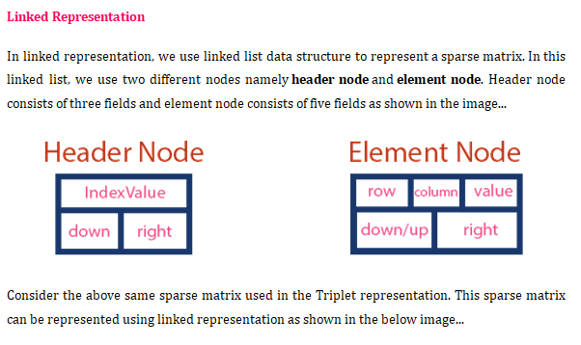

Slide 8
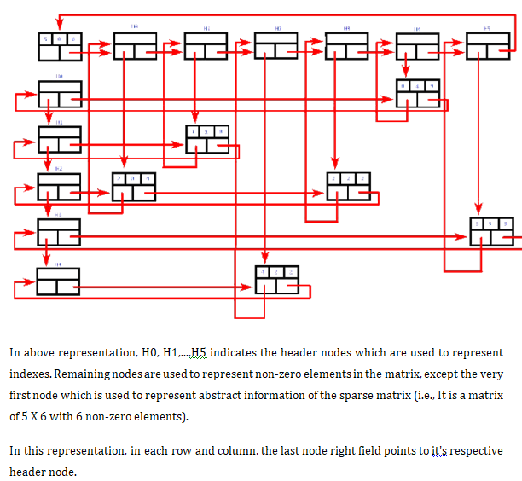

Slide 9
Thank you

