Slide 1
Data Structures and Algorithms 21CSC201J

Slide 2
Syllabus:
Unit 1: Primitive data types, Structures, Self-referential structures, Pointers, Dynamic memory allocation, Matrix multiplication, Data Structure – Definition, Types, ADT, Operations; Mathematical notations, Asymptotic Notations-Big O, Omega and Theta; Complexity – Time, Space, Trade off, Searching-Linear Search and Binary Search; Sorting-Insertion sort, Bubble sort.

Slide 3
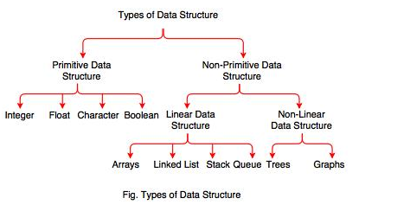
Introduction to Data Structures
A data structure is a particular way of organizing data in a computer so that it can be used effectively
It is a set of algorithms that we can use in any programming language to structure the data in the memory.

Slide 4
Applications of Data Structure
Different Data Structure is used in real life, such as the representation of an image in the form of a bit-map, implement printer spooler so that jobs can be printed in the order of their arrival, store information about the directories and files in a system, etc. Data Structure is used in various fields of
Computer Science, such as:
• Compiler Design
• Operating System
• Database Management System
• Statistical Analysis Package
• Numerical Analysis
• Graphics
• Artificial Intelligence

Slide 5
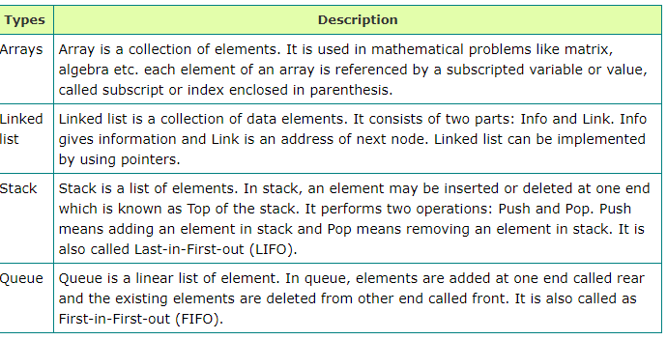
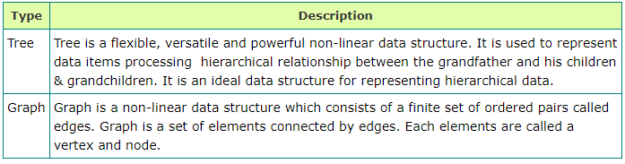
Linear Data Structure
Non-Linear Data Structure

Slide 6
Data structure operations:
The major or the common operations that can be performed on the data structures are:
Searching: We can search for any element in a data structure.
Sorting: We can sort the elements of a data structure either in an ascending or descending order.
Insertion: We can also insert the new element in a data structure.
Updation: We can also update the element, i.e., we can replace the element with another element.
Deletion: We can also perform the delete operation to remove the element from the data structure.

Slide 7
ADT- Abstract Data types
mentions what operations are to be performed but not how these operations will be implemented. It does not specify how data will be organized in memory and what algorithms will be used for implementing the operations
The user of datatype does not need to know how that data type is implemented, for example, we have been using Primitive values like int, float, char data types only with the knowledge that these data type can operate and be performed on without any idea of how they are implemented

Slide 8
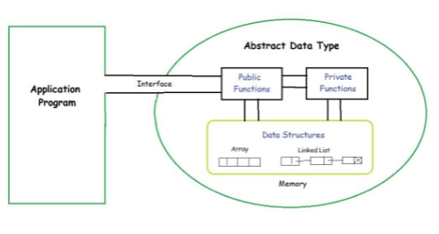
process of providing only the essentials and hiding the details is known as abstraction
ADT as a black box which hides the inner structure and design of the data type.

Slide 9
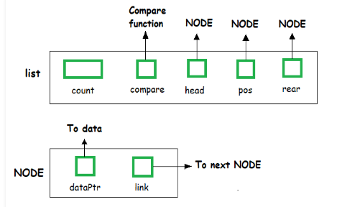
Examples of ADT are Stack, Queue, List etc
List ADT

Slide 10
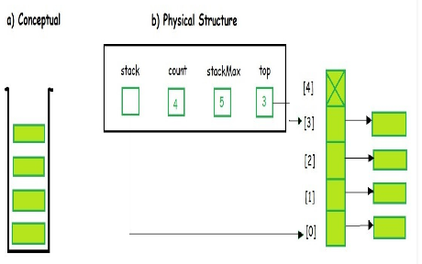
Stack ADT

Slide 11
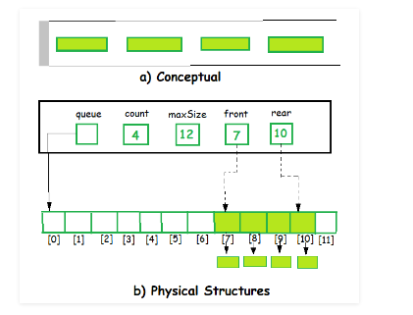
Queue ADT

Slide 12
Thank you

