Slide 1
Data Structures and Algorithms 21CSC201J

Slide 2
Syllabus:
Unit 1: Introduction to Data Structures
Data Structure Operations, ADT, Algorithms – Searching techniques, Complexity – Time , Space Trade off , Algorithms – Sorting, Complexity – Time , Space Trade off , Mathematical notations, Asymptotic notations-Big O, Omega, Theta, Data Structures and its Types, Linear and Non-Linear Data Structures, 1D, 2D Array Initialization, Accessing using Pointers, Declaring structures , Arrays of Structures and accessing

Slide 3
Sorting – The Task
Given an array
x[0], x[1], … , x[size-1]
reorder entries so that
x[0] <= x[1] <= . . . <= x[size-1]
Here, List is in non-decreasing order.
We can also sort a list of elements in non-increasing order.

Slide 4
Sorting – Example
Original list:
10, 30, 20, 80, 70, 10, 60, 40, 70
Sorted in non-decreasing order:
10, 10, 20, 30, 40, 60, 70, 70, 80
Sorted in non-increasing order:
80, 70, 70, 60, 40, 30, 20, 10, 10

Slide 5
Sorting Problem
What do we want :
- Data to be sorted in order
0
size-1
x:
Unsorted list
Sorted list

Slide 6
Issues in Sorting
Many issues are there in sorting techniques
How to rearrange a given set of data?
Which data structures are more suitable to store data prior to their sorting?
How fast the sorting can be achieved?
How sorting can be done in a memory constraint situation?
How to sort various types of data?

Slide 7
Sorting Algorithms
Basic operation involved in this type of sorting technique is comparison. A data item is compared with other items in the list of items in order to find its place in the sorted list.
Insertion
Bubble
Sorting by comparison – Insertion:
From a given list of items, one item is considered at a time. The item chosen is then inserted into an appropriate position relative to the previously sorted items. The item can be inserted into the same list or to a different list.
e.g.: Insertion sort

Slide 8
Sorting by comparison – Selection:
First the smallest (or largest) item is located and it is separated from the rest; then the next smallest (or next largest) is selected and so on until all item are separated.
e.g.: Selection sort, Heap sort
Sorting by comparison – Exchange:
If two items are found to be out of order, they are interchanged. The process is repeated until no more exchange is required.
e.g.: Bubble sort, Shell Sort, Quick Sort
Sorting by comparison – Enumeration:
Two or more input lists are merged into an output list and while merging the items, an input list is chosen following the required sorting order.
e.g.: Merge sort

Slide 9
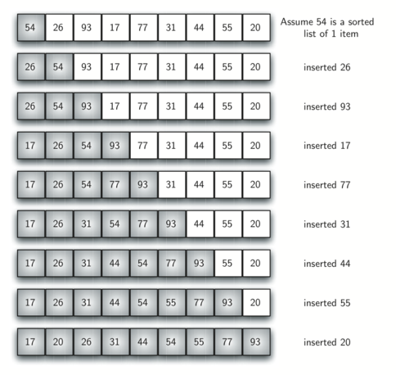
Insertion Sort - Example

Slide 10
Insertion Sort
General situation :
0
i
size-1
x:
smallest elements, sorted
remainder, unsorted
i
Compare and
Shift till x[i] is
larger.
i
0
j
size-1

Slide 11
Insertion Sort
Int ins_sort(int arr[])
{
Int n= arr.length;
Int key;
Int space;
For(int i=1; i<N; i++)
{
Key = arr[i];
Space = I;
For (int j= space-1; j>=0; j--)
{
If [arr[j] >key)
{
Arr[j+1] = arr[j]
Space = j;
Continue;
}
Break;
}
Arr[space] = key;
}
Return arr;
}

Slide 12
Insertion Sort: Complexity Analysis
Worst Case Time Coemplexity [ Big-O ]: O(n²)
Best Case Time Complexity [Big-omega]: O(n)
Average Time Complexity [Big-theta]: O(n²)

Slide 13
Worst Case Time Coemplexity analysis [ Big-O ]: O(n²)
Int ins_sort(int arr[])
{
Int n= arr.length; // 1 unit
Int key; // 1 unit
Int space; // 1 unit
For(int i=1; i<N; i++)// 1unit+ (N-1+1) +N-1
{
Key = arr[i]; // 2(N-1) – 2 operations
Space = I; // N-1
For (int j= space-1; j>=0; j--) //(N-1)+x+1+x
{
If [arr[j] >key) //2x
{
Arr[j+1] = arr[j] //3x
Space = j; //x
Continue; //x
}
Break;
}
Arr[space] = key; //2(N-1)
}
Return arr; //1 unit
}

Slide 14
Bubble Sort-
Bubble sort is the easiest sorting algorithm to implement.
It is an in-place sorting algorithm.
It uses no auxiliary data structures (extra space) while sorting
How Bubble Sort Works?
Bubble sort uses multiple passes (scans) through an array.
In each pass, bubble sort compares the adjacent elements of the array.
It then swaps the two elements if they are in the wrong order.
In each pass, bubble sort places the next largest element to its proper position.
In short, it bubbles down the largest element to its correct position.

Slide 15
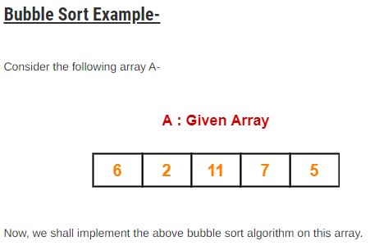
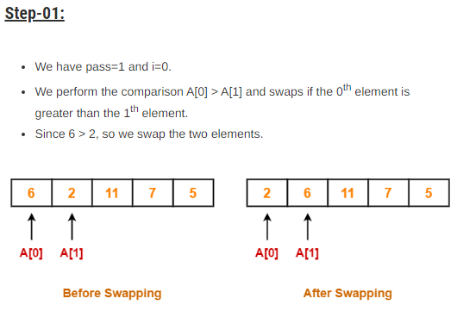

Slide 16
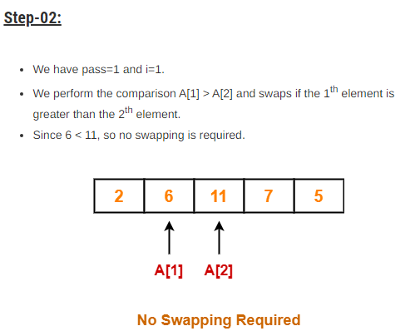
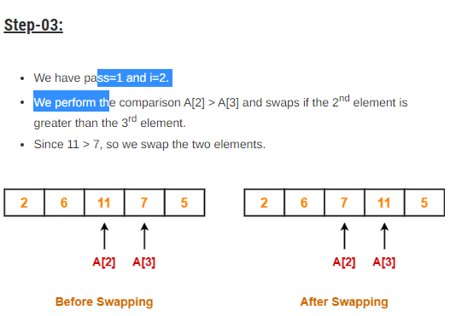

Slide 17
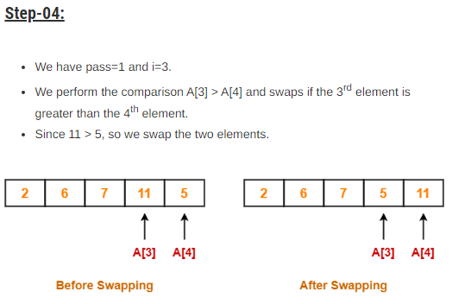
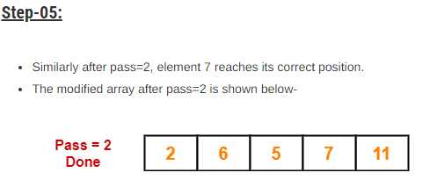

Slide 18
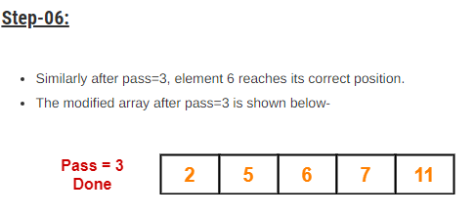
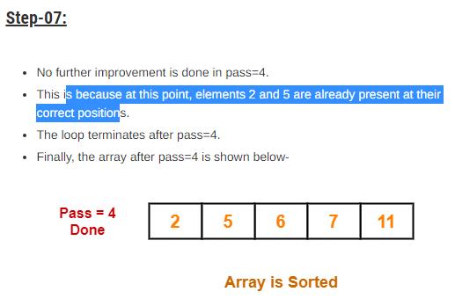

Slide 19
Algorithm 1
Int bubble_sort(int arr[])
{
Int n = arr.length;
Int temp;
For(int i=0;i<n-1;i++)
{
For(int j=0;j<n-1;j++)
{
If(arr[j]>arr[j+1])
{
Temp = arr[j];
Arr[j] = arr[j+1];
Arr[j+1]=temp;
}
}
}
Return arr;
}

Slide 20
Algorithm 2-modified
Int bubble_sort(int arr[])
{
Int n = arr.length;
Int temp;
For(int i=0; i<n-1; i++)
{
For(int j=0; j<n-1-I ;j++)
{
If(arr[j]>arr[j+1])
{
Temp = arr[j];
Arr[j] = arr[j+1];
Arr[j+1]=temp;
}
}
}
Return arr;
}

Slide 21
Complexity analysis of Algorithm 3- optimized code
Int bubble_sort(int arr[])
{
Int n = arr.length;
Int temp;
For(int i=0; i<n-1; i++) // 2N
{
Flag =0;
For(int j=0; j<n-1-I ;j++) //(N-1) +x+1+x
{
If(arr[j]>arr[j+1]) //3x
{
Temp = arr[j]; //2x
Arr[j] = arr[j+1]; //2x
Arr[j+1]=temp; //2x
flag =1;
}
}
}
if(flag ==0)
Break; summing them all gives O(N*N)
}

Slide 22
Thank you

