Slide 1
Data Structures and Algorithms 21CSC201J

Slide 2
Syllabus:
Unit 1: Introduction to Data Structures
Data Structure Operations, ADT, Algorithms – Searching techniques, Complexity – Time , Space Trade off , Algorithms – Sorting, Complexity – Time , Space Trade off , Mathematical notations, Asymptotic notations-Big O, Omega, Theta, Data Structures and its Types, Linear and Non-Linear Data Structures, 1D, 2D Array Initialization, Accessing using Pointers, Declaring structures , Arrays of Structures and accessing

Slide 3
Asymptotic Notations
The main idea of asymptotic analysis is to have a measure of efficiency of algorithms that doesn’t depend on machine specific constants, and doesn’t require algorithms to be implemented and time taken by programs to be compared. Asymptotic notations are mathematical tools to represent time complexity of algorithms for asymptotic analysis. The following 3 asymptotic notations are mostly used to represent time complexity of algorithms.
Big Oh (O)
omega (Ω)
theta (Θ)

Slide 4
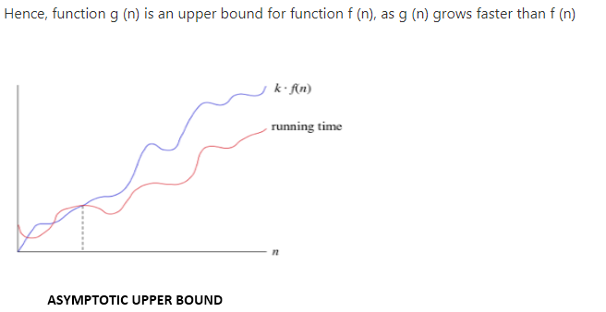
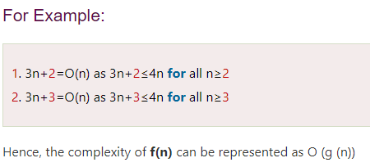
Big oh (O)
Big-oh notation: Big-oh is the formal method of expressing the upper bound of an algorithm's running time. It is the measure of the longest amount of time. The function f (n) = O (g (n)) [read as "f of n is big-oh of g of n"] if and only if exist positive constant c and such that
f (n) ⩽ k.g (n)f(n)⩽k.g(n) for n>n0n>n0 in all case

Slide 5
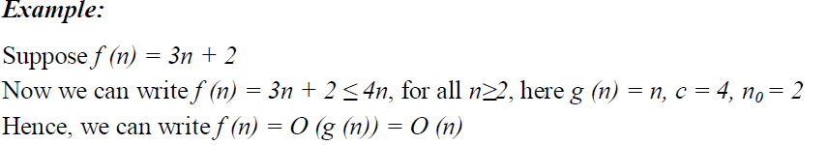
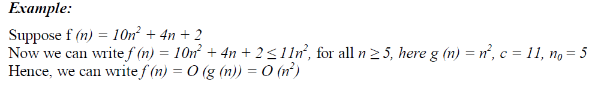
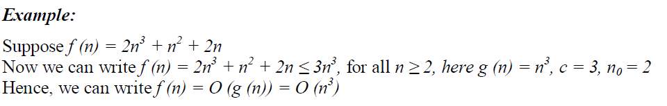
Examples:

Slide 6
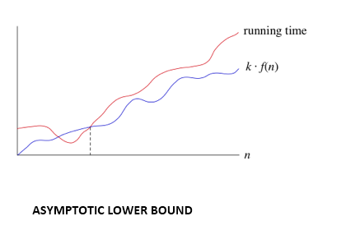
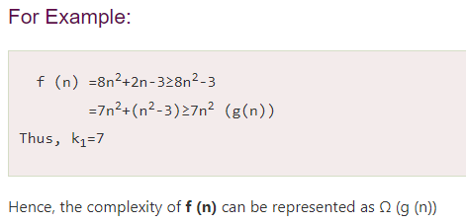
Omega () Notation: The function f (n) = Ω (g (n)) [read as "f of n is omega of g of n"] if and only if there exists positive constant c and n₀ such that
F (n) ≥ k* g (n) for all n, n≥ n₀

Slide 7
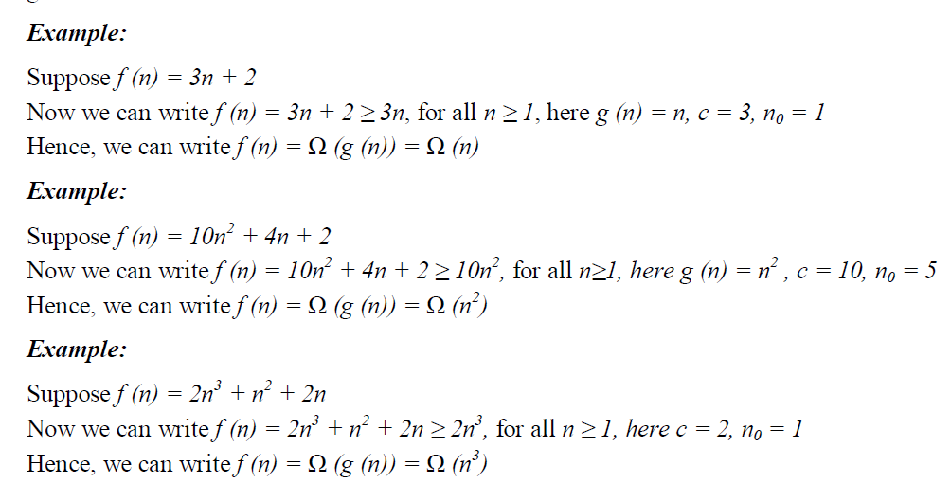

Slide 8
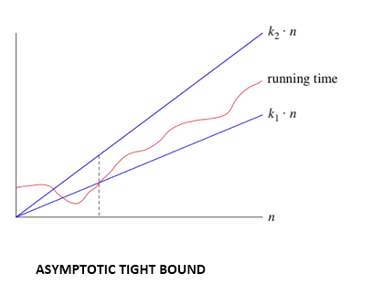
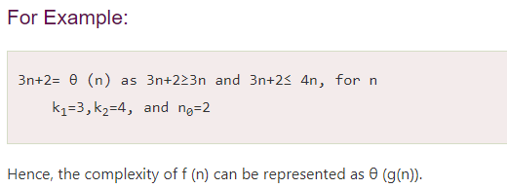
Theta (θ): The function f (n) = θ (g (n)) [read as "f is the theta of g of n"] if and only if there exists positive constant k₁, k₂ and k₀ such that
k₁ * g (n) ≤ f(n)≤ k₂ g(n)for all n, n≥ n₀

Slide 9
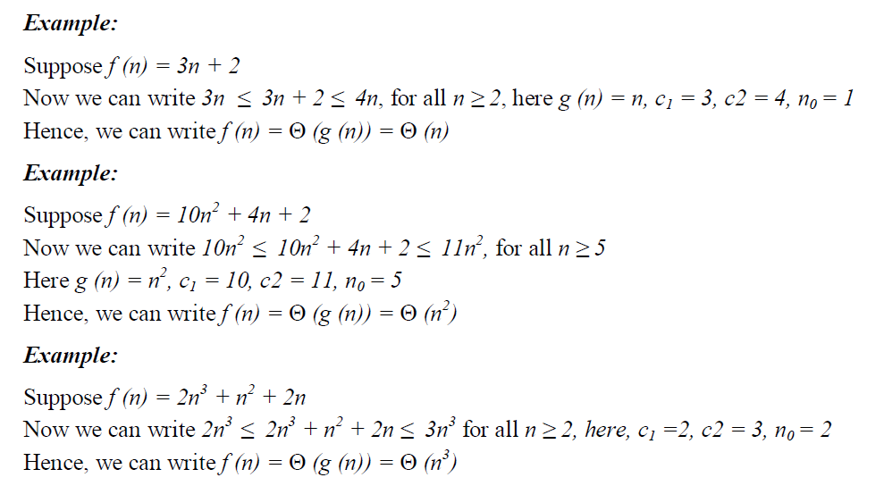

Slide 10
Growth Functions of Algorithm
The big-O notation is used to classify algorithms by how they respond in their processing time or working space requirements to changes in the input size.
Order of growth in algorithm means how the time or space for computation increases with input size, i.e. how the growth function grows with the input size.
Based on growth functions, the algorithm can be categorized as follows:
1. Constant time algorithms [ O(1) ]:
This means that the algorithm requires the same fixed number of steps regardless of the size of the task.
Example: Array access, Push and pop operations for a stack, enqueue and dequeue operations for a queue.

Slide 11
2. Logarithmic time algorithms [ O ( ) ]:
Logarithm time algorithms mean that T(n) is upper bounded by logarithmic of the input size, i.e. T(n) = logn.
Example: Binary search in a sorted list of n elements, Insert and Find operations for a binary search tree with n nodes, Insert and Remove operations for a heap with n nodes, etc
3. Linear time algorithms [ O (n) ]:
Linear time algorithm means that for large enough input sizes the running time increases linearly with the size of the input.
Example: Array traversal

Slide 12
4. Polynomial time algorithms [O (nk), for k > 1 ]:
i) Quadratic time (O (n2)) algorithm: The number of operations is proportional to the size of the task squared.
Example: Slow sorting algorithms, for example, selection sort of n elements.
ii) Cubic time (O (n3)) algorithm: The number of operations is proportional to the size of the task cubed.
Example: Matrix multiplication
5. Exponential time algorithms [ O (kn), for k>1 ]:
Exponential time algorithm means that T(n) is upper bounded by exponential expression of input size, i.e. T(n) = kn
Example: Towers of Hanoi, implementation of recursive Fibonacci, generating all permutations of n symbols.
The best time in the above list is obviously constant time, and the worst is exponential time

Slide 13
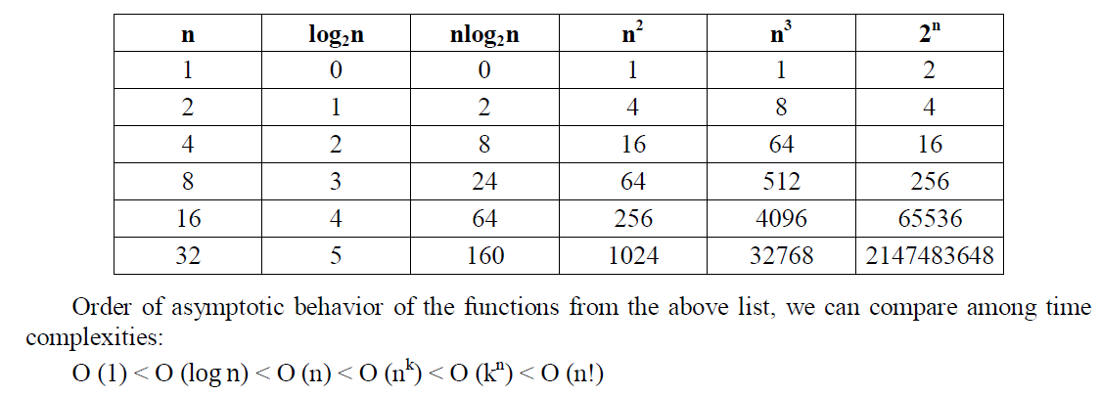
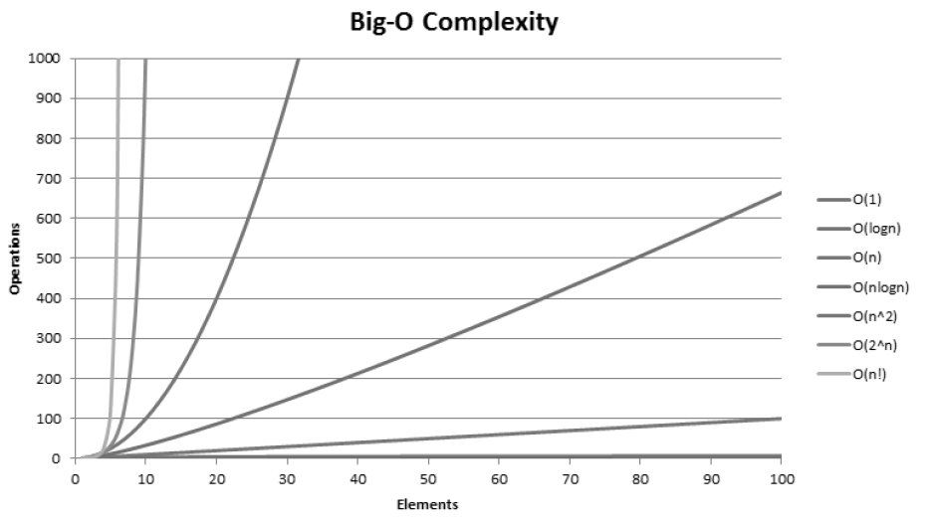
Values for different growth functions

Slide 14
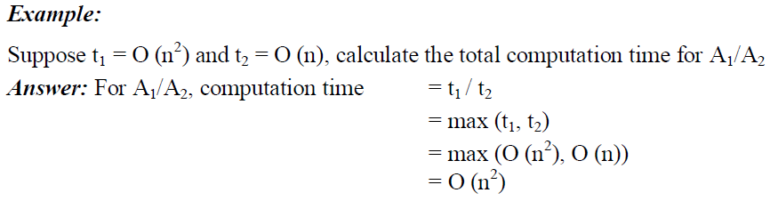
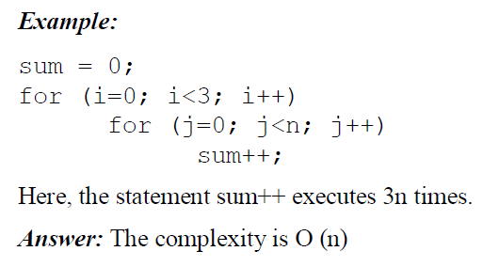
Complexity Examples:

Slide 15
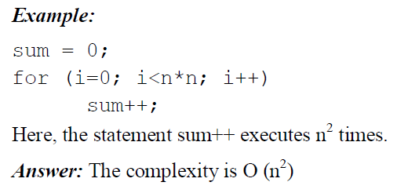
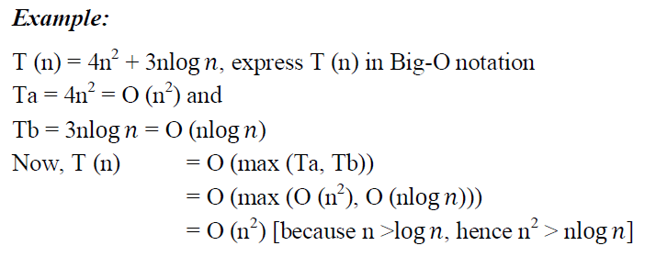

Slide 16
Thank you

