Slide 1
Data Structures and Algorithms 21CSC201J

Slide 2
Syllabus:
Unit 1: Introduction to Data Structures
Data Structure Operations, ADT, Algorithms – Searching techniques, Complexity – Time , Space Trade off , Algorithms – Sorting, Complexity – Time , Space Trade off , Mathematical notations, Asymptotic notations-Big O, Omega, Theta, Data Structures and its Types, Linear and Non-Linear Data Structures, 1D, 2D Array Initialization, Accessing using Pointers, Declaring structures , Arrays of Structures and accessing

Slide 3
Data structures are an integral part of computers used for the arrangement of data in memory. They are essential and responsible for organizing, processing, accessing, and storing data efficiently
Classification of Data Structure:
Data structure has many different uses in our daily life. There are many different data structures that are used to solve different mathematical and logical problems. By using data structure, one can organize and process a very large amount of data in a relatively short period

Slide 4
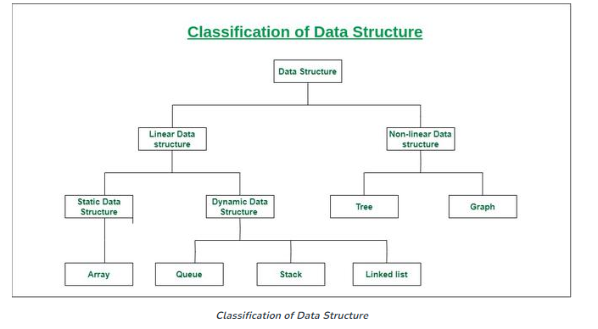

Slide 5
Linear data structure: Data structure in which data elements are arranged sequentially or linearly, where each element is attached to its previous and next adjacent elements, is called a linear data structure. Examples of linear data structures are array, stack, queue, linked list, etc.
Static data structure: Static data structure has a fixed memory size. It is easier to access the elements in a static data structure. An example of this data structure is an array.
Dynamic data structure: In the dynamic data structure, the size is not fixed. It can be randomly updated during the runtime which may be considered efficient concerning the memory (space) complexity of the code. Examples of this data structure are queue, stack, etc.
.

Slide 6
Non-linear data structure: Data structures where data elements are not placed sequentially or linearly are called non-linear data structures. In a non-linear data structure, we can’t traverse all the elements in a single run Examples of non-linear data structures are trees and graphs

Slide 7
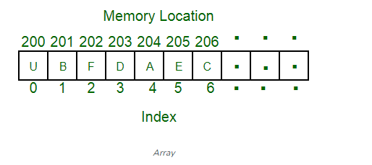
Arrays:
An array is a linear data structure and it is a collection of items stored at contiguous memory locations. The idea is to store multiple items of the same type together in one place. It allows the processing of a large amount of data in a relatively short period. The first element of the array is indexed by a subscript of 0. There are different operations possible in an array, like Searching, Sorting, Inserting, Traversing, Reversing, and Deleting.

Slide 8
Declaration of an array:-
We know that all the variables are declared before they are used in the program. Similarly, an array must be declared before it is used. During declaration, the size of the array has to be specified.
The size used during declaration of the array informs the compiler to allocate and reserve the specified memory locations.
Syntax:- data_type array_name[n]; where, n is the number of data items (or) index(or) dimension. 0 to (n-1) is the range of array.
Example:
int a[5];
float x[10];

Slide 9
Initialization of One-Dimensional Array in C
An array can be initialized at the following states:
At compiling time (static initialization)
Dynamic Initialization
Compiling time initialization:
The compile-time initialization means the array of the elements is initialized at the time the program is written or array declaration.
Syntax: data_type array_name [array_size]=(list of elements of an array); Example: int n[5]={0, 1, 2, 3, 4};
Run time initialization:
Run time initialization means the array can be initialized at runtime. That means array elements are initialized after the compilation of the program.

Slide 10
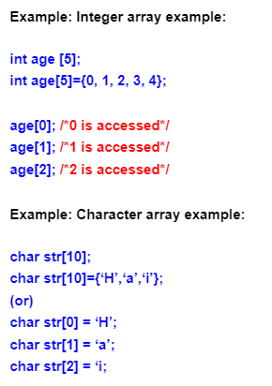
Array declaration, initialization, and accessing
Array declaration syntax: data_type arr_name [arr_size];
Array initialization syntax: data_type arr_name [arr_size]=(value1, value2, value3,….);
Array accessing syntax: arr_name[index];

Slide 11
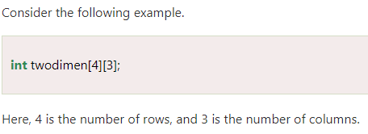
2D Array:
The two-dimensional array can be defined as an array of arrays. The 2D array is organized as matrices which can be represented as the collection of rows and columns. However, 2D arrays are created to implement a relational database lookalike data structure. It provides ease of holding the bulk of data at once which can be passed to any number of functions wherever required.
Syntax to declare the 2D array is given below.
data_type array_name[rows][columns];

Slide 12

Initialization of 2D Array in C
We will have to define at least the second dimension of the array. The two-dimensional array can be declared and defined in the following way.
We can also initialize a two-dimensional array in the form of a matrix as shown below:
int a[2][3]={ {0,0,0}, {1,1,1} };
When the array is completely initialized with all values, explicitly we need not specify the size of the first dimension.
Ex: int a[][3]={ {0,2,3}, {2,1,2} };
If the values are missing in an initializer, they are automatically set to zero

Slide 13
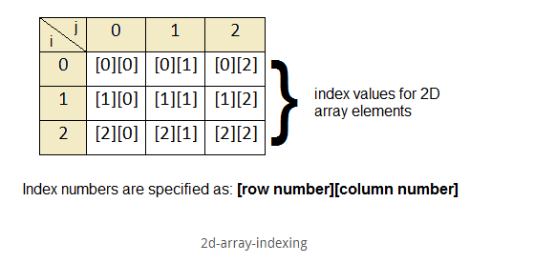
In case of 2D arrays, we use index numbers(like 1D arrays) in the subscript to access the array elements. The outer loop indicates the row index and the inner loop indicates the column index.
The following figure shows how the array elements are indexed:
We already see that the index format is [row number][column number].
Suppose we need to access the element in row 1 and column 2, we just need to write arrayName[1][2].

Slide 14
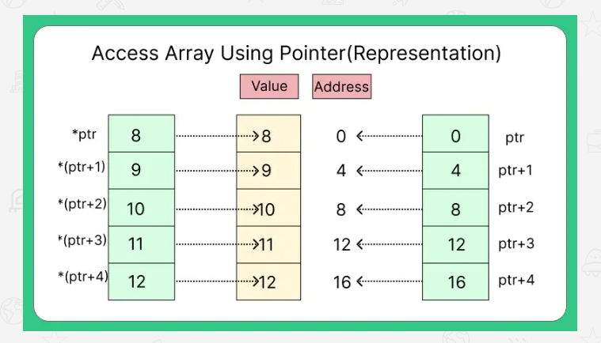
Access Array Using Pointer
Pointer to array means the pointer variable will hold the address to the first element of array of base element of array let’s say p[0] where a is an array.
If we use * before pointer variable it will return the value store at the address.

Slide 15
Thank you

