Slide 1
Data Structures and Algorithms 21CSC201J

Slide 2
Syllabus:
Unit 1: Introduction to Data Structures
Data Structure Operations, ADT, Algorithms – Searching techniques, Complexity – Time , Space Trade off , Algorithms – Sorting, Complexity – Time , Space Trade off , Mathematical notations, Asymptotic notations-Big O, Omega, Theta, Data Structures and its Types, Linear and Non-Linear Data Structures, 1D, 2D Array Initialization, Accessing using Pointers, Declaring structures , Arrays of Structures and accessing

Slide 3
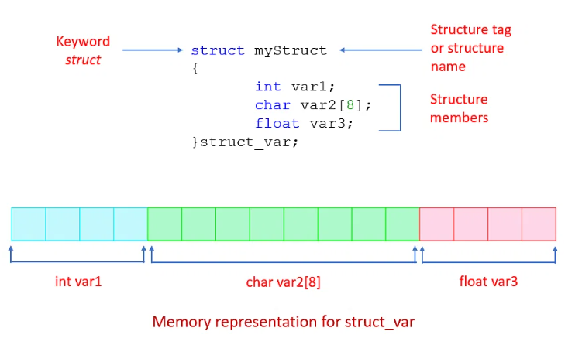
Declaring Structure and accessing
There is a need to store multiple logically related elements under one roof. For instance, an employee’s details like name, employee number, and designation need to be stored together. In such cases, the C language provides structures to do the job for us

Slide 4
A structure can be defined as a single entity holding variables of different data types that are logically related to each other. All the data members inside a structure are accessible to the functions defined outside the structure. To access the data members in the main function, you need to create a structure variable.
Syntax to Define a Structure in C
struct structName
{
// structure definition
Data_type1 member_name1;
Data_type2 member_name2;
Data_type2 member_name2;
};

Slide 5
Example
struct bookStore
{
// structure definition
char storeName
int totalBooks;
char storeLicense[20];
} storeA, storeB; // structure variables

Slide 6
Declaration of Structure Variables Separately
This way of creating structure variables is preferred when multiple variables are required to be declared. The structure variables are declared outside the structure.
Syntax:
struct structName
{
// structure definition
Data_type1 member_name1;
Data_type2 member_name2;
Data_type2 member_name2;
};
struct structName struct_var1, struct_var2;

Slide 7
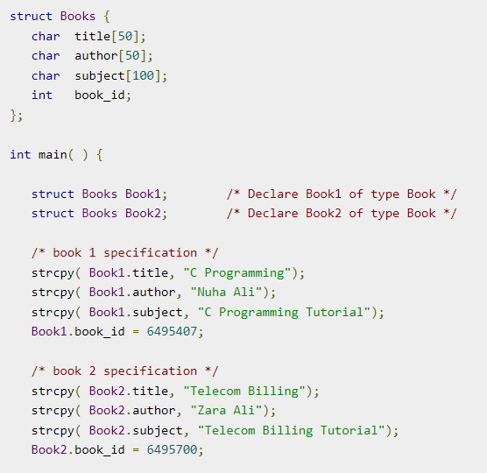
How to Access Structure Elements?
The members of a structure are accessed outside the structure by the structure variables using the dot operator (.). The following syntax is used to access any member of a structure by its variable:
Syntax
structVariable.structMember

Slide 8
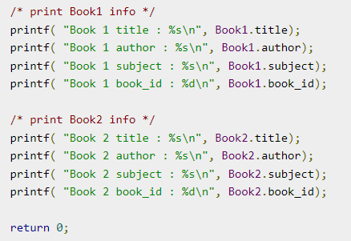
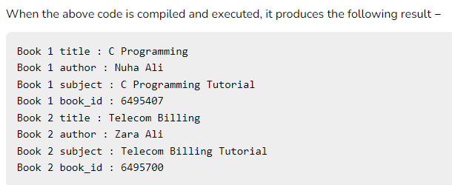

Slide 9
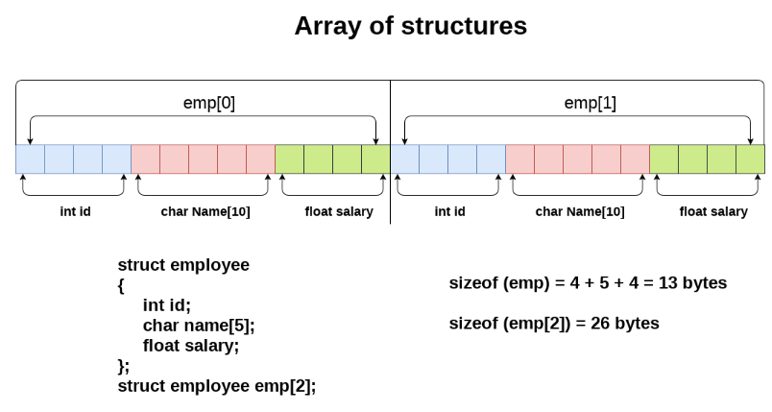
Array of Structures in C
An array of structures in C can be defined as the collection of multiple structures variables where each variable contains information about different entities. The array of structures in C are used to store information about multiple entities of different data types. The array of structures is also known as the collection of structures.

Slide 10
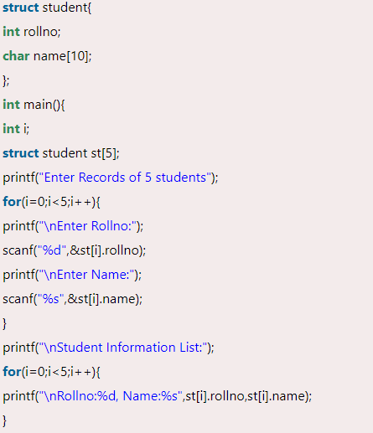
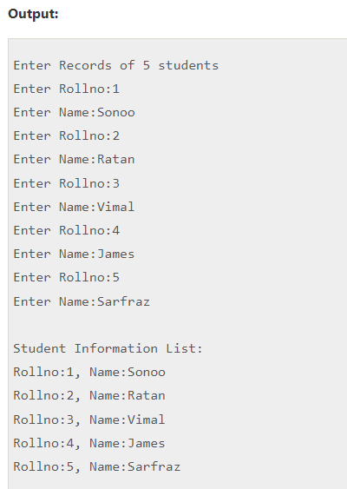
Let's see an example of an array of structures that stores information of 5 students and prints it.

Slide 11
Thank you

