Slide 1






Round 1 Idea Submission
Team Deadlock
(GitHub : https://github.com/AnushkaJha08/Deadlock-HackX)
Siddharth Nandan Lal(L), Anushka Jha, Ojasvi Padhiar & Swarna Jain
FinTech
AI-Driven Insider Trading
and
Market Manipulation Detection

Slide 2
Team Deadlock
AI-Driven Insider Trading and
Market Manipulation Detection
We propose a software-based system that monitors share selling patterns in real time, using AI to detect suspicious trading behaviors. It will generate alerts for anomalies, like unusually large purchases at low prices, and later identify the individuals responsible, when legal access to personal data is granted.
Detailed Explanation of proposed solution
1. Real-time Monitoring: Continuously tracks stock transactions and flags unusual trading behavior as it occurs.
2. AI Anomaly Detection: Uses machine learning to spot subtle deviations in trading patterns that may indicate insider trading.
3. Post-Event Identification: When legally allowed, it cross-references flagged trades with personal data to identify potential culprits.
How it addresses the problem
It improves detection by automating the monitoring process and identifying irregular trading in real time, reducing reliance on delayed, manual audits. The system adds another layer by enabling accountability once personal data access is legal.
Innovation and uniqueness in the problem
1. AI-Enhanced Accuracy: Detects hidden patterns that traditional methods often miss.
2. Immediate Alerts: Sends instant notifications for faster response to suspicious trades.
3. Future-Proof Identification: Links trade analysis with personal data, once legally permitted, for precise identification of insiders.

Slide 3



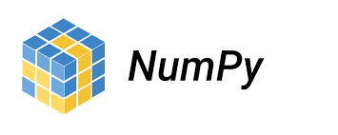



Team Deadlock
TECHNICAL APPROACH
API: AlphaVantage
Python libraries:
1. Numpy
2. Pandas
3. Matplotlib
4. Plotly
5. Datetime
6. Requests
7. Ipywidgets
8. Ipython.display
9. SciKit-Learn

Slide 4
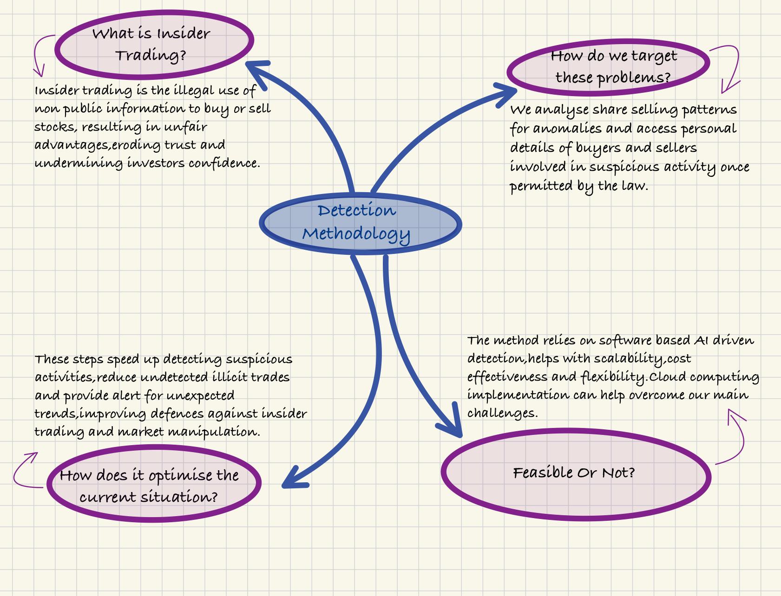
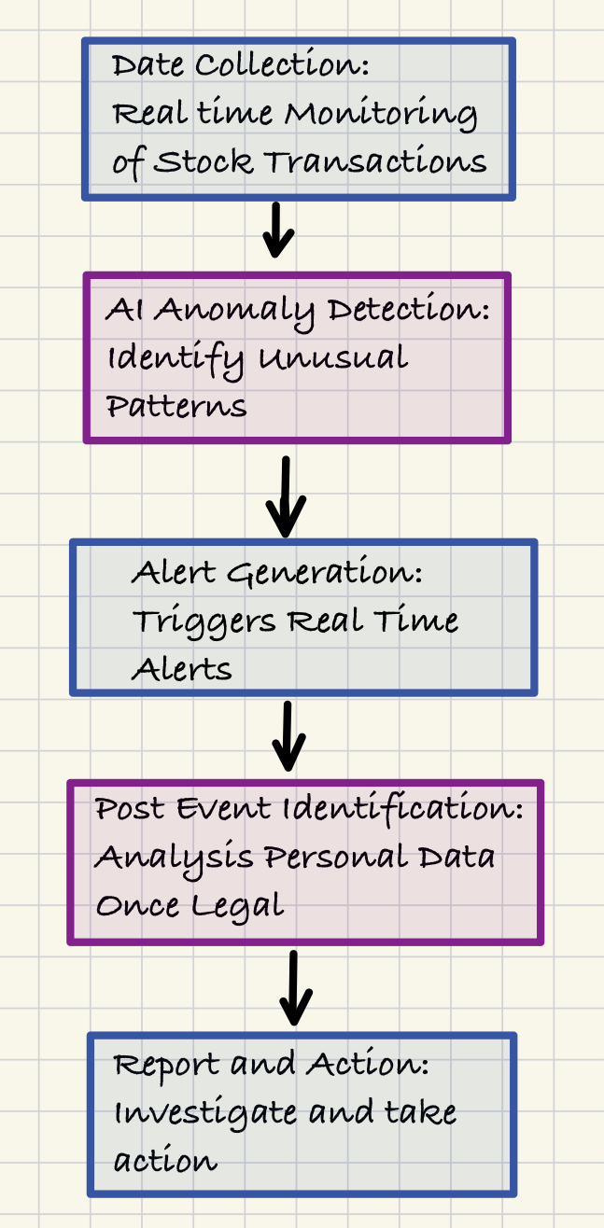
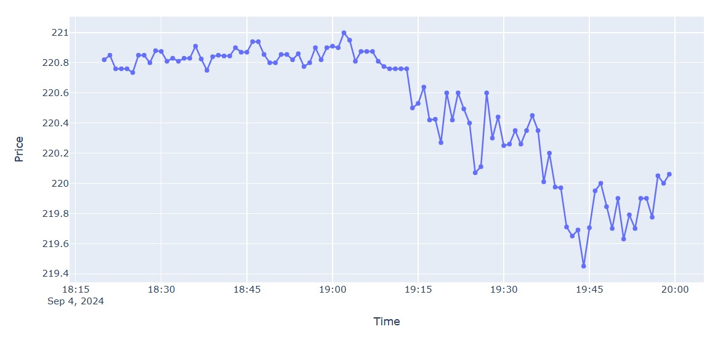
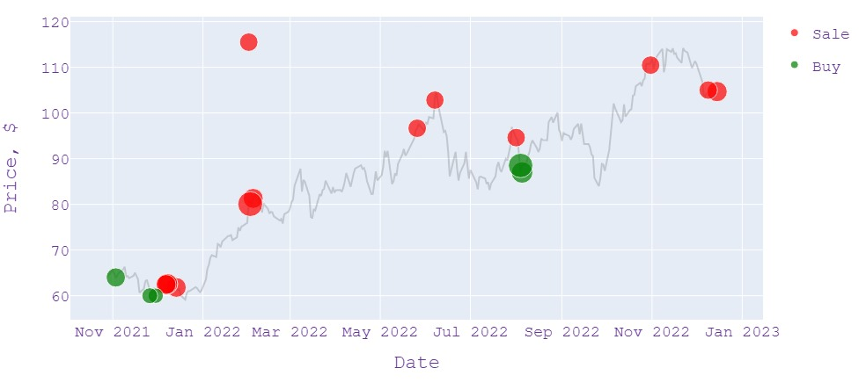
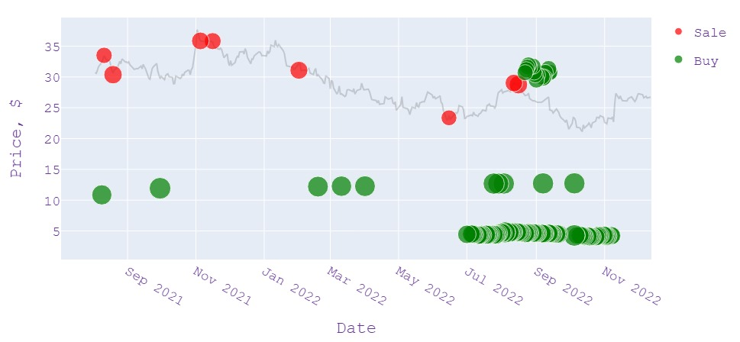
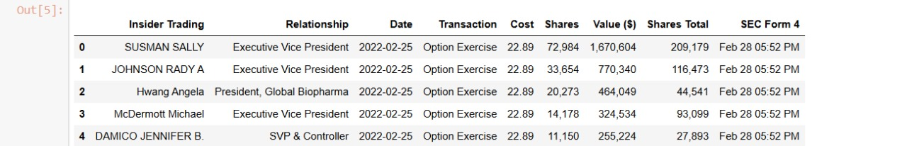
Team Deadlock
METHODOLOGY
Real-Time Data
No
Market
Manipulation
Sample Dataset
Market
Manipulation

Slide 5
Team Deadlock
FEASIBILITY AND VIABILITY
Our proposed solution is highly feasible as it leverages AI-driven, software-based anomaly detection without requiring additional hardware. Integration with existing stock exchange systems ensures smooth deployment, while AI models can be continuously updated, enhancing long-term adaptability.
Potential Challenges and Risks
1. Data Access and Privacy Regulations: Legal constraints may limit access to personal
data, hindering post-event identification of traders.
2. Limited Scalability Without Cloud: Without cloud connectivity, the system would struggle
to process large volumes of trading data in real-time.
Strategies for Overcoming These Challenges
1. Legal and Regulatory Compliance: Work closely with legal experts and regulatory bodies
to ensure your system aligns with evolving data privacy laws, accessing personal details
only when permissible.
2. Cloud-Based Scalability: Use cloud computing solutions to manage the computational
load, scaling resources as needed to handle large data volumes efficiently.

Slide 6
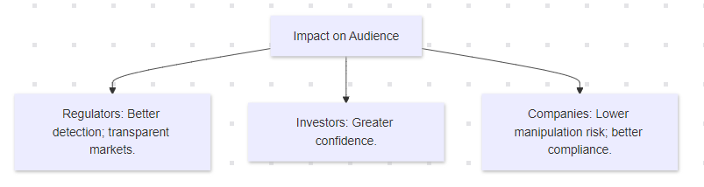
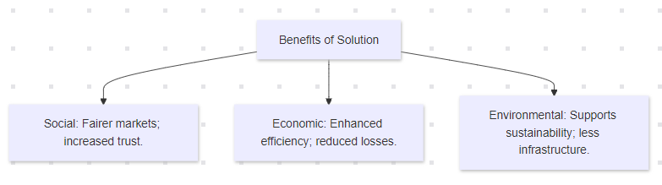
Team Deadlock
IMPACT AND BENEFITS
Potential Impact on Target Audience
Regulators and Exchanges: Enhanced ability to detect and address insider trading, leading to more transparent and fair markets.
Investors and Traders: Increased confidence in market integrity due to improved detection of illicit trading activities.
Companies: Reduced risk of market manipulation and improved compliance with regulations.
Benefits of the Solution
Social: Promotes fairness and transparency in financial markets, reducing opportunities for unethical behavior and increasing trust among investors.
Economic: Improves market efficiency by quickly identifying and addressing irregular trading, potentially reducing financial losses due to insider trading.
Environmental: Minimal direct environmental impact, but reduced need for physical infrastructure and paper-based processes support overall sustainability goals.

Slide 7
Team Deadlock
CONCLUSION
This project aims to detect potential insider trading by observing real-time stock price data and judging unusual activities like sudden spike/drop by a machine learning model. By improving detection capabilities for regulators, increasing investor confidence, and reducing manipulation risks for companies, it delivers substantial benefits across social, economic, and environmental dimensions. Given the negligence towards addressing insider trading, our solution becomes even more crucial. By providing a robust, proactive approach to detecting and addressing insider trading, we fill a critical gap and push for greater regulatory and enforcement action in the financial markets.

