Slide 1

Seasonal Agriculture Performance Analysis
Name – Anushka Chand
College Name – Babu Banarasi University
AICTE STU ID :STU681ddd65710601746787685

Slide 2

PROBLEM STATEMENT
Agricultural activities are influenced by seasonal variations in environmental conditions, farming practices, resource availability and market conditions. As a result, agricultural performance may differ from one season to another.
However, raw agricultural data does not clearly explain how agricultural performance changes across seasons or what patterns can be observed in different seasonal conditions.
The problem is to analyze the given agricultural dataset and investigate seasonal differences in agricultural performance by identifying meaningful patterns, trends, relationships and variations within the available data.

Slide 3
Project Description
This project analyzes a dataset of 4,000 farm records spanning multiple Indian states, crops and the three cropping seasons – Kharif, Rabi and Zaid.
Each record captures farming practices, environmental conditions (rainfall, temperature, humidity, soil), resource usage (fertilizer, pesticide, water, irrigation method) and economic outcomes (cost, revenue, profit).
The data is cleaned, explored and analyzed using Python to compare seasonal performance and identify patterns, relationships and differences in yield, profitability, resource use and risk.
Findings are translated into evidence-based insights and recommendations to support better seasonal agricultural planning.

Slide 4

WHO ARE THE END USERS?
Farmers & farm managers – plan sowing, irrigation and input use around seasonal performance trends.
Agricultural policymakers & planners – use seasonal evidence for resource allocation and planning.
Agri-business & market analysts – anticipate production and pricing patterns by season.
Banks & crop insurance providers – assess seasonal risk for credit and insurance decisions.
Researchers & students – use the findings as a base for further agricultural data studies.

Slide 5

Technology Used
Python – core language used for data cleaning and analysis.
Pandas & NumPy – data cleaning, aggregation and seasonal grouping.
Matplotlib & Seaborn – statistical charts and visual comparisons across seasons.
Jupyter Notebook – interactive environment for documenting the full analysis.
Descriptive statistics – means, correlations and group comparisons across seasons.
CSV dataset – 4,000-record seasonal agriculture performance dataset.

Slide 6
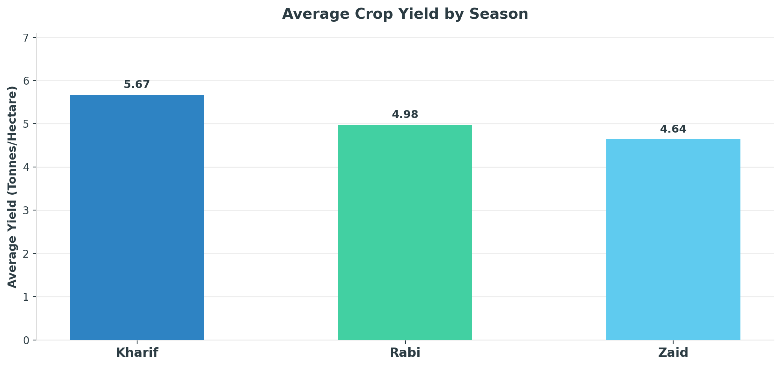
RESULTS
Result 1:Average Crop Yield by Season

Slide 7
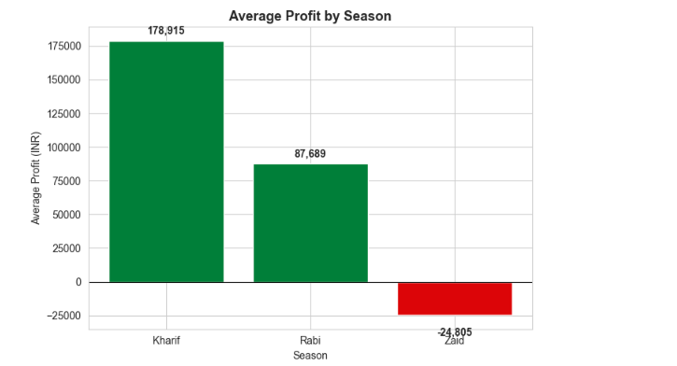
RESULTS
Result 2 Average Profit by Season

Slide 8
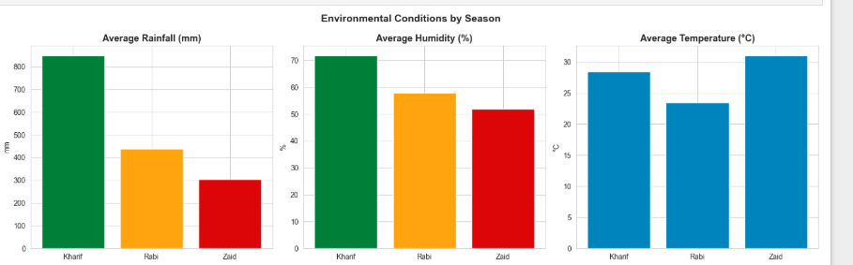
RESULTS
Result 3: Kharif is wetter and more humid; Zaid is hottest

Slide 9
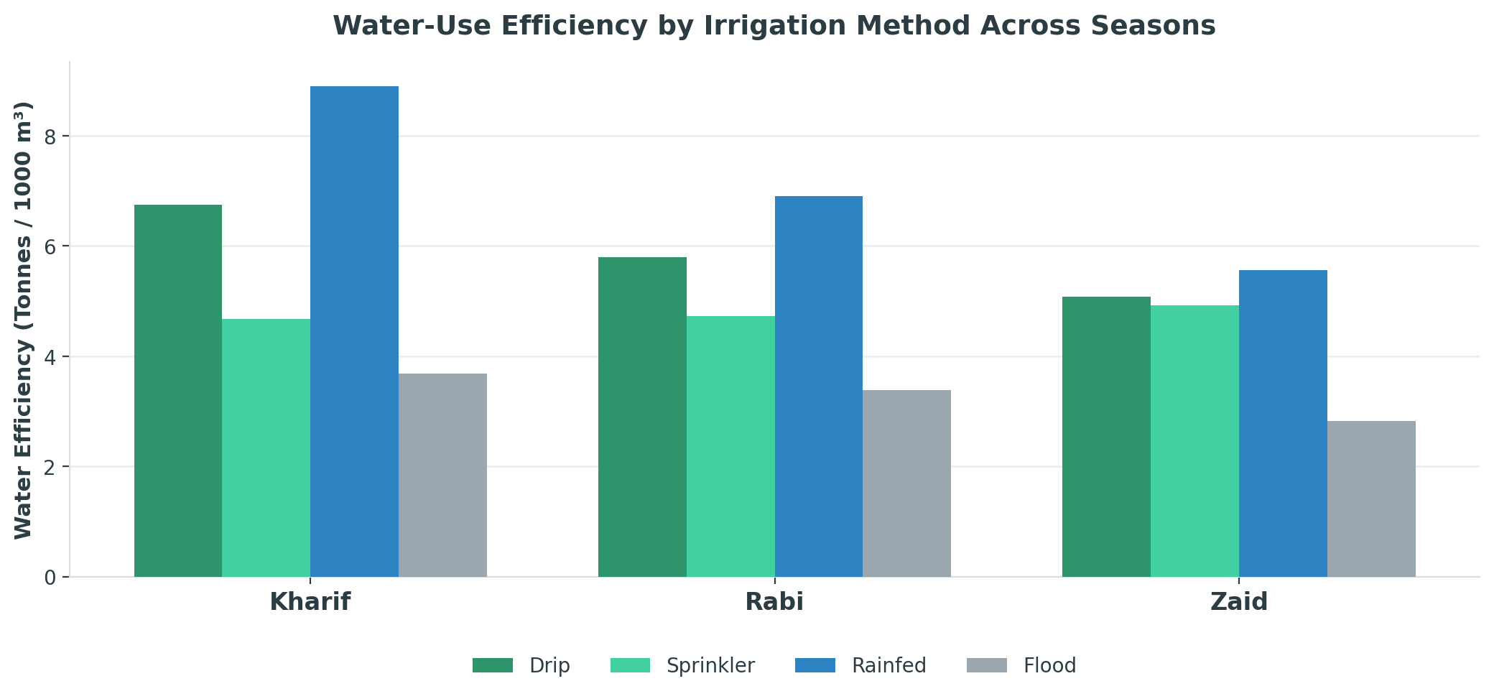
RESULTS
Result 4: Drip & rainfed irrigation are more water-efficient than flood

Slide 10
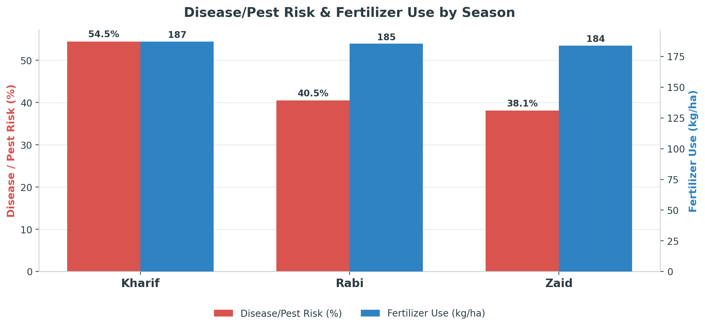
RESULTS
Result 5: Disease/pest risk is highest in Kharif despite similar fertilizer use

Slide 11
Future scope
Yield prediction models – apply machine learning to forecast season-wise yield and profit.
Real-time weather & soil integration – refine seasonal recommendations with live data feeds.
Zaid-season profitability study – investigate why Zaid runs at a loss and test mitigation strategies.
Wider geographic coverage – extend the dataset to more states, districts and crop varieties.
Interactive dashboard – build a live dashboard so farmers and planners can explore seasonal trends themselves.

Slide 12
GitHub Link
https://github.com/Anushkachand/SeaAgriculture_Performance_Analysis.git

Slide 13
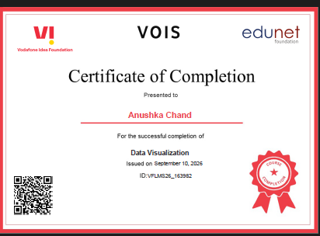
VOIS Course completion certificate -
Course name- Data Visualization

Slide 14
Thank you
.
.

