Slide 1
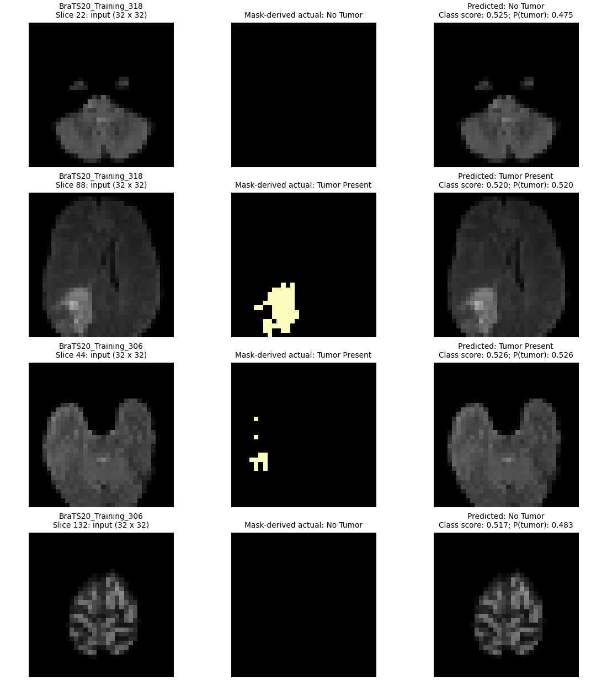
BRAIN + MRI RESEARCH PLATFORM
Brain Tumor Detection Using MRI Images
Brain + MRI Research Platform | Academic project presentation
Evidence-led biomedical imaging, tutorial delivery and experimental AI workflow
The project focuses on building an integrated biomedical imaging platform that combines MRI data inspection, preprocessing, image analysis and experimental deep learning.
It aims to simplify the process of exploring MRI datasets through an interactive interface rather than relying entirely on separate scripts and notebooks.
The platform brings together traditional image-processing techniques and CNN-based classification in one research environment.
01 | BRAIN + MRI RESEARCH PLATFORM
Research-only · not a clinical diagnosis

Slide 2
BRAIN + MRI RESEARCH PLATFORM
Platform architecture
Independent browser modules reuse validated MRI and analytics utilities.
• Browser: Dashboard, Tutorial Lab, Image Analysis Studio, MRI Research Studio.
• FastAPI: validation, data-URL image serialization, case discovery and reporting.
• Core: NIfTI I/O, preprocessing, SIFT/RANSAC, analytics and CNN inference.
The backend returns processed outputs and metrics to the frontend, allowing computational operations to remain separate from visual presentation.
Browser modules
FastAPI routes
her_core utilities
Models + artifacts
Data flow: validated local FLAIR/SEG → shared preprocessing → algorithm/checkpoint → compact PNG/metrics response → research UI.
02 | BRAIN + MRI RESEARCH PLATFORM
Research-only · not a clinical diagnosis

Slide 3
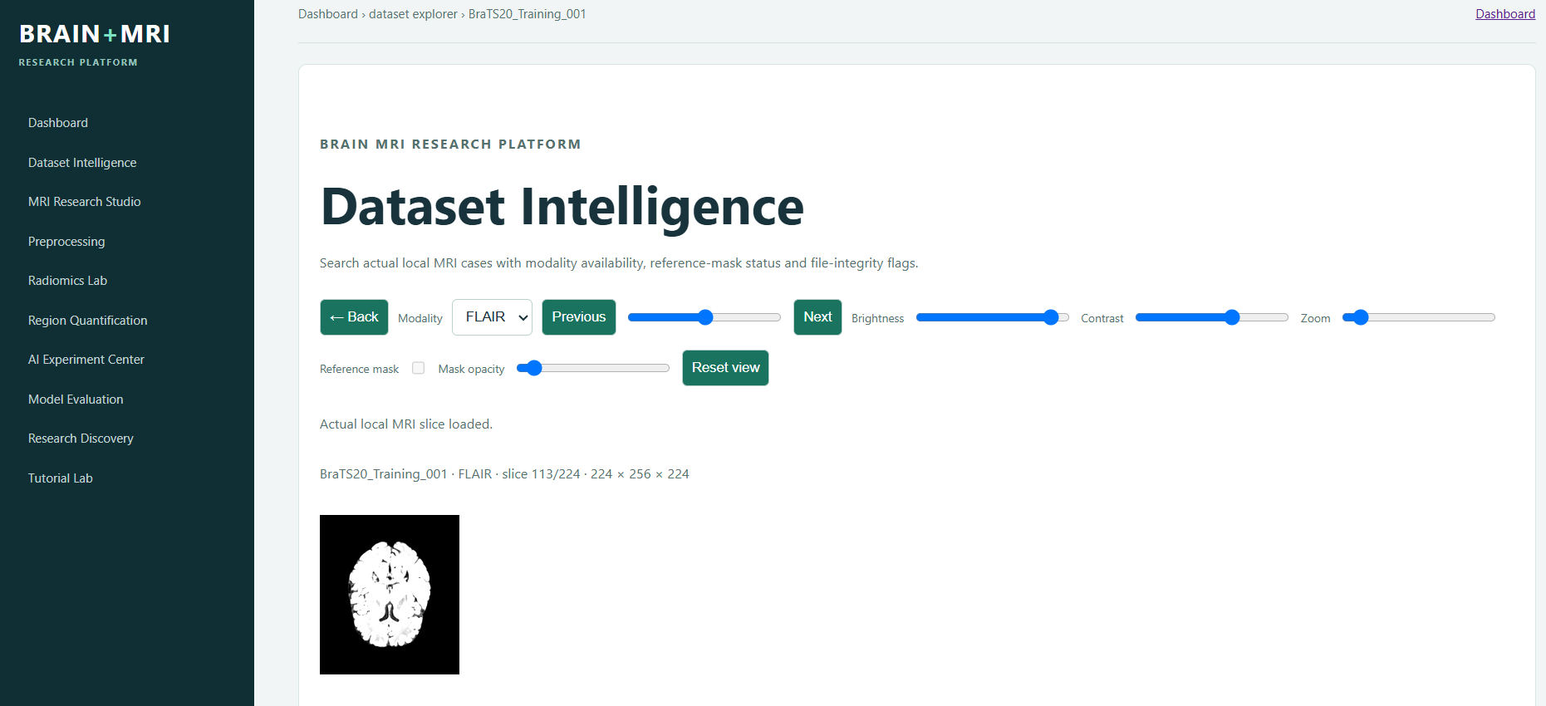
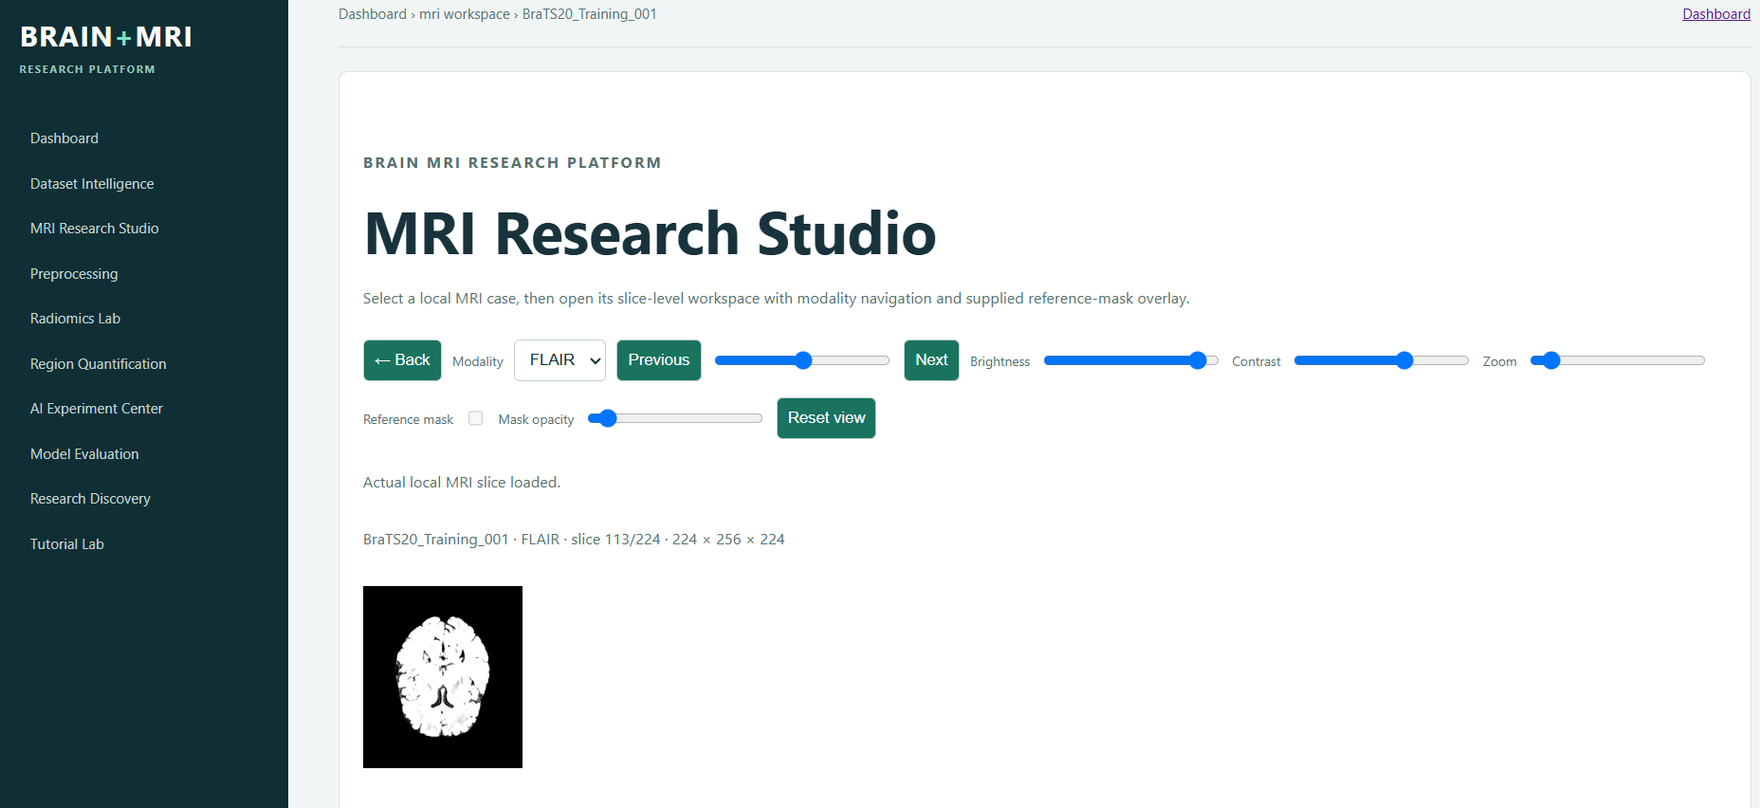
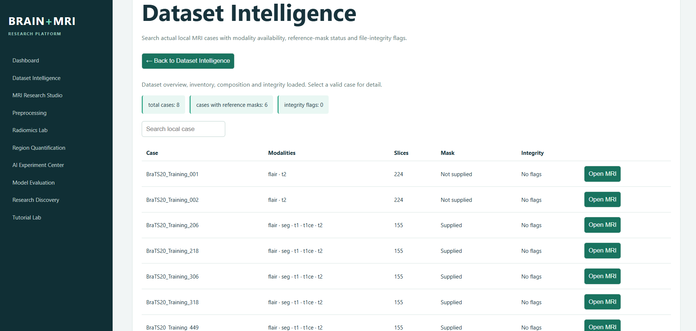
BRAIN + MRI RESEARCH PLATFORM
Frontend modules: contextual research workspace
Actual application screens show Dataset Intelligence and MRI Research Studio.
The application is organised around different research activities, allowing users to move between dataset exploration, image preprocessing and model-based analysis.
Dataset Intelligence provides an overview of available MRI cases and modalities.
MRI Research Studio provides a dedicated environment for selecting and executing research workflows.
The modular interface helps users understand each stage of the analysis process independently.
• Dataset Intelligence provides local case selection, modality context and actual slice preview.
• MRI Research Studio separates workflow selection from case-specific analysis and upload inference.
• The visible Back action follows contextual module hierarchy rather than always returning to Dashboard.
03 | BRAIN + MRI RESEARCH PLATFORM
Research-only · not a clinical diagnosis

Slide 4
BRAIN + MRI RESEARCH PLATFORM
Data lineage and safeguards
Every visible result has a traceable source and status.
• Local FLAIR/SEG → validate → preprocess → algorithm/checkpoint → PNG/metrics → UI.
• Missing masks stay missing; they are never converted to negative labels.
• The persistent checkpoint is reused; request handling never trains a new model.
FLAIR / SEG
VALIDATE
PREPROCESS
ALGORITHM
PNG / METRICS
UI
04 | BRAIN + MRI RESEARCH PLATFORM
Research-only · not a clinical diagnosis

Slide 5
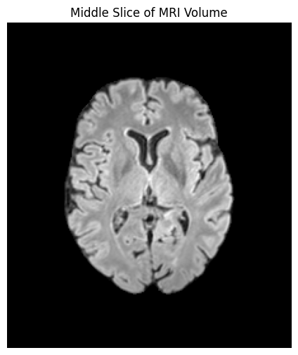
BRAIN + MRI RESEARCH PLATFORM
Dataset audit: local BraTS2020 evidence
Actual findings from CNN_DATASET_AUDIT.md.
• 8 case folders; FLAIR 8/8; SEG 6/8. Two unsegmented cases are excluded from supervision.
• Six FLAIR/SEG pairs are 240 × 240 × 155. Labels 0,1,2,3; y=1 iff mask > 0.
• All eligible labelled slices: 798 (355 negative, 443 positive).
The dataset audit establishes the availability and completeness of the local MRI data before model development.
FLAIR images are available for all eight cases, while segmentation annotations are available for only six.
Each eligible FLAIR/SEG pair contains a volume of 240 × 240 × 155 voxels.
Segmentation labels are converted into a binary slice-level target: a slice is considered positive when at least one voxel has a non-zero segmentation label.
This produces 798 eligible slices, consisting of 355 negative and 443 positive slices.
05 | BRAIN + MRI RESEARCH PLATFORM
Research-only · not a clinical diagnosis

Slide 6
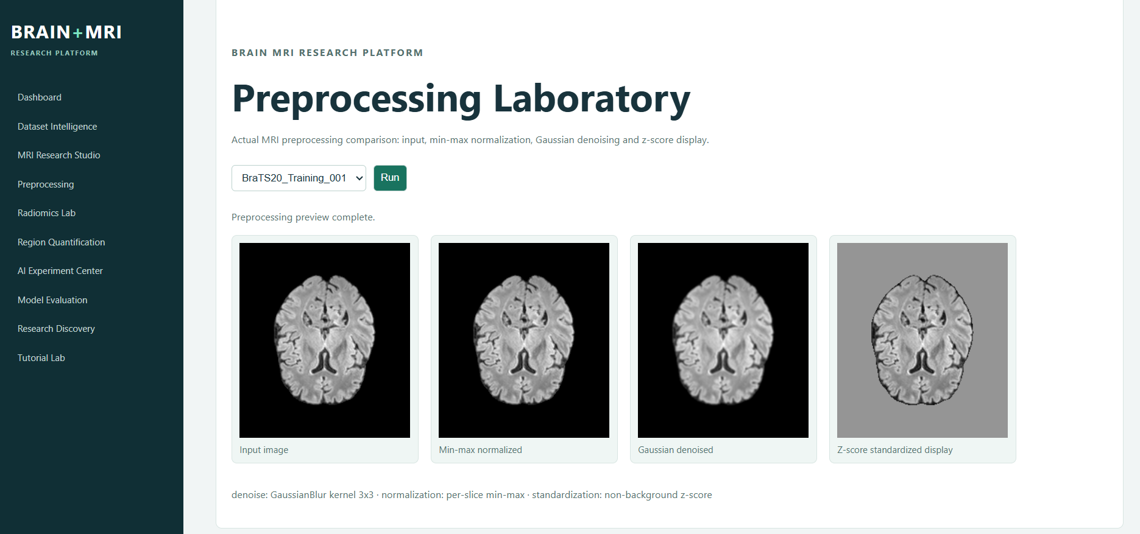
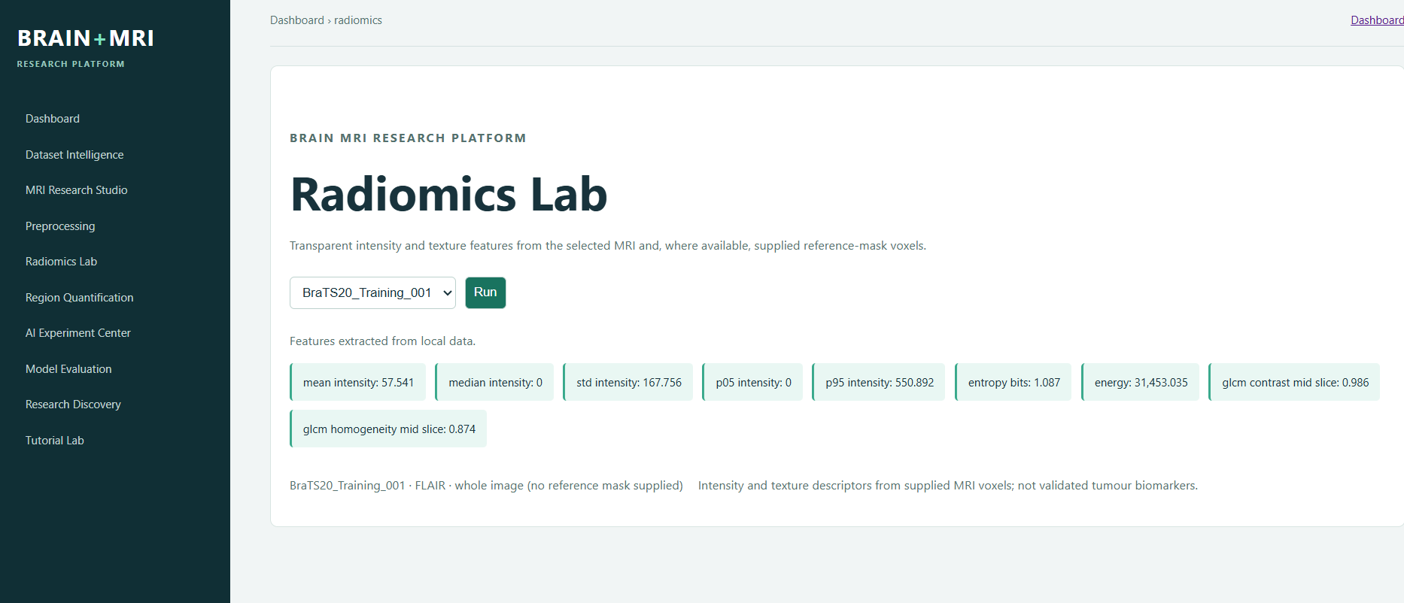
BRAIN + MRI RESEARCH PLATFORM
Implemented application analysis modules
Frontend outputs demonstrate that preprocessing and radiomics are separate functional modules.
• Preprocessing Laboratory renders original, cleaned, normalized and contrast-enhanced MRI stages.
The Preprocessing Laboratory allows users to observe how MRI images change after cleaning, normalization and contrast enhancement.
The Radiomics Lab provides a separate environment for extracting and exploring image-derived features.
Separating these operations makes it easier to understand the contribution of individual processing stages.
The application therefore supports both visual image inspection and quantitative feature exploration.
• Radiomics Lab selects a case/modality and exposes feature-analysis actions backed by actual local data.
• These modules are analysis tools; they do not report clinical diagnoses.
06 | BRAIN + MRI RESEARCH PLATFORM
Research-only · not a clinical diagnosis

Slide 7
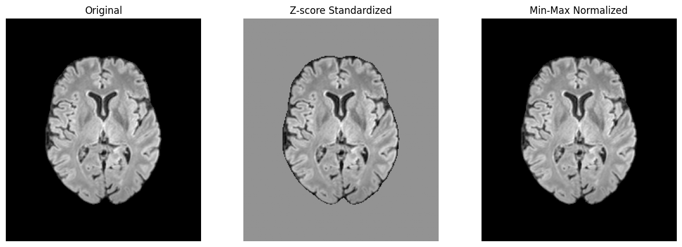
BRAIN + MRI RESEARCH PLATFORM
T1–T3: inspection, preprocessing and data quality
Foundational workflows establish data conditions before analysis.
• T1: discover local cases/modalities and show a middle slice.
• T2: clean invalid values; compare z-score and min–max transformations.
• T3: report missing modalities/duplicates without destructive assumptions.
07 | BRAIN + MRI RESEARCH PLATFORM
Research-only · not a clinical diagnosis

Slide 8
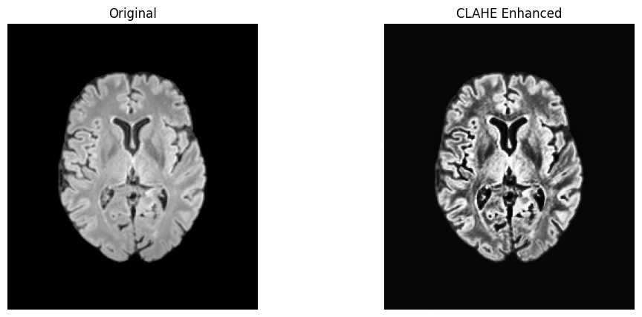
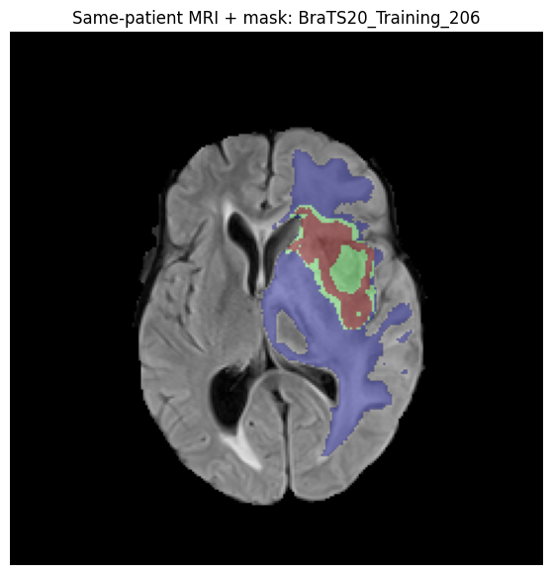
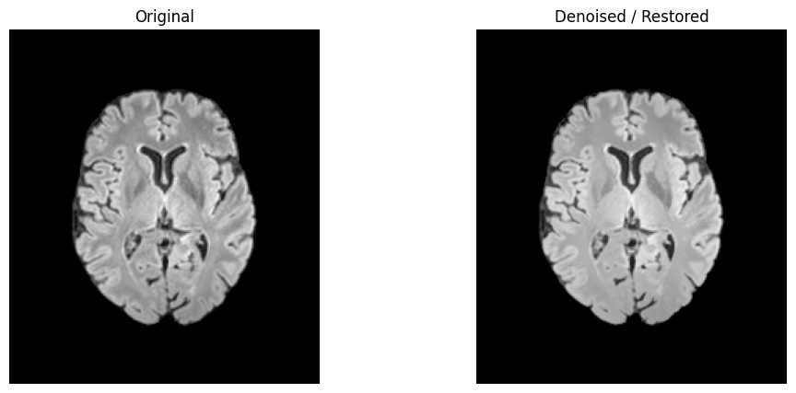
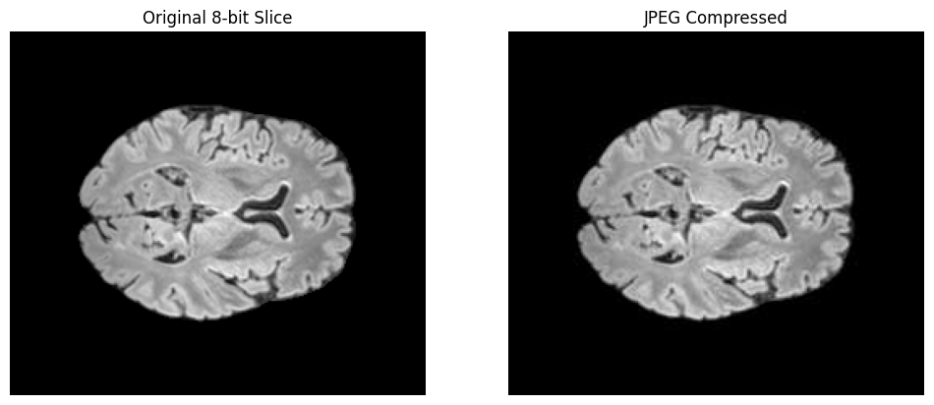
BRAIN + MRI RESEARCH PLATFORM
T4: biomedical image analysis
Aim: make enhancement and quality operations inspectable.
• Input: local MRI slice. CLAHE enhancement and bilateral denoising are displayed side by side.
• Interpretation: altered contrast is presentation support—not tumour segmentation/diagnosis.
• Implementation: notebook operations and reusable preprocessing helpers.
08 | BRAIN + MRI RESEARCH PLATFORM
Research-only · not a clinical diagnosis

Slide 9
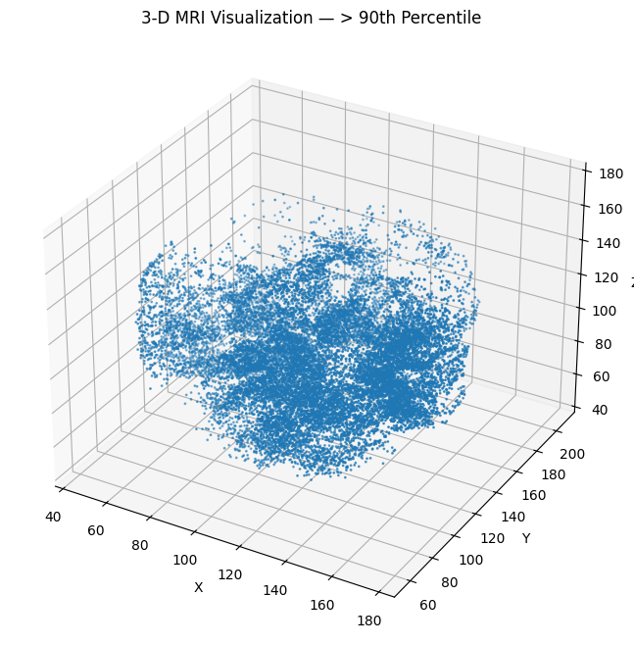
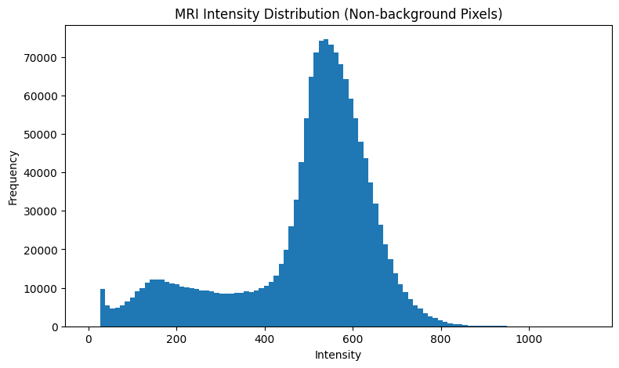
BRAIN + MRI RESEARCH PLATFORM
T4: intensity and 3-D context
Additional notebook evidence links slice-level work to volume context.
• Histogram uses non-background MRI intensity values, making intensity distribution explicit.
• 3-D threshold display is a visualisation of high-intensity voxels, not a tumour segmentation.
• These figures support inspection before feature extraction or classification.
09 | BRAIN + MRI RESEARCH PLATFORM
Research-only · not a clinical diagnosis

Slide 10
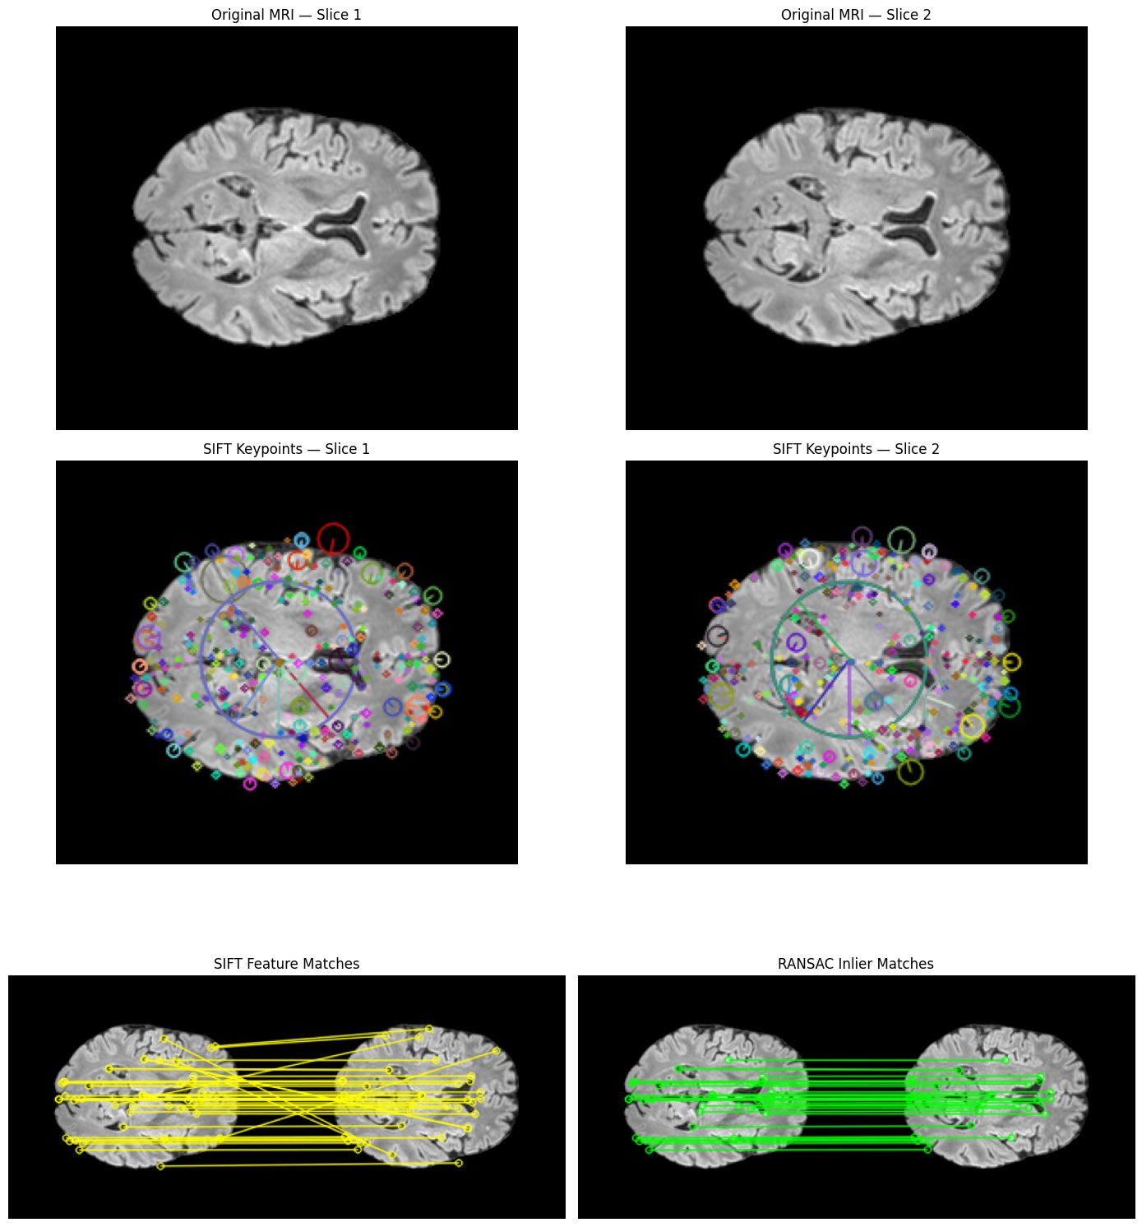
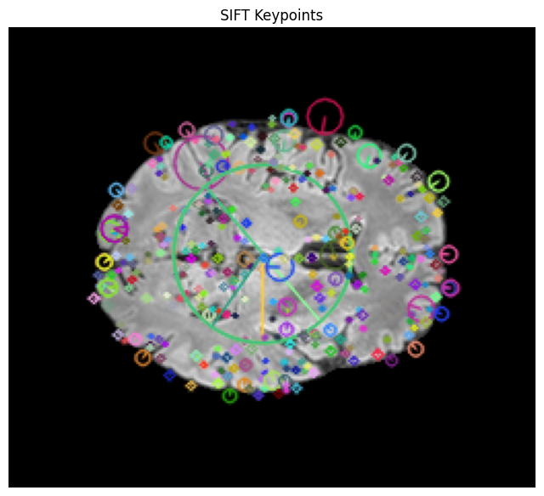
BRAIN + MRI RESEARCH PLATFORM
T5: SIFT + RANSAC
Aim: robust correspondence evidence between nearby MRI slices.
• SIFT detects scale-invariant keypoints and descriptors from normalized intensity.
• Descriptor matching proposes candidates; RANSAC estimates a robust transform/rejects outliers.
• Output supports image correspondence analysis, not tumour presence.
The CNN accepts a single-channel, 128 × 128 FLAIR image as input.
Three convolutional blocks progressively learn image features at different levels of abstraction.
Max pooling reduces spatial dimensions while retaining important learned features.
The fully connected layer combines extracted features to produce a final classification probability.
Dropout with a rate of 0.5 is included to reduce over-reliance on individual neurons during training.
10 | BRAIN + MRI RESEARCH PLATFORM
Research-only · not a clinical diagnosis

Slide 11
BRAIN + MRI RESEARCH PLATFORM
T5 CNN: target and leakage control
Binary slice labels derive only from reference-mask pixels.
Training accuracy measures how accurately the model classifies samples from the training partition.
Validation accuracy measures performance on a separate partition that is not used for gradient updates.
The training accuracy increased from 0.7197 to 0.9848.
Validation accuracy reached 0.8571 at the final recorded epoch.
The difference between training and validation performance indicates that the model may be learning patterns specific to the small training cohort.
• y = 1 if any(mask > 0), otherwise 0; unlabelled cases are excluded.
• Case separation: train 4 cases/132 slices; validation 1/35; held-out test 1/35.
• No patient contributes slices to more than one partition.
Training
4 cases · 132
Validation
1 case · 35
Held-out test
1 case · 35
11 | BRAIN + MRI RESEARCH PLATFORM
Research-only · not a clinical diagnosis

Slide 12
BRAIN + MRI RESEARCH PLATFORM
T5 CNN: architecture and experiment configuration
Saved model brats-flair-slice-cnn-v1 | input 128 × 128 × 1.
• Conv2D(32,3×3,ReLU,same) + pool → Conv2D(64) + pool → Conv2D(128) + pool.
• Flatten → Dense(128, ReLU) → Dropout(0.5) → Dense(1, sigmoid).
• Sigmoid is model-estimated P(tumour slice); evaluation threshold = 0.50.
Input
128²×1
Conv 32
Conv 64
Conv 128
Flatten
Dense 128
Input 128×128×1 FLAIR · Adam + binary cross-entropy · fixed seed 42 · 12 requested epochs · class weights 1.1786 / 0.8684
12 | BRAIN + MRI RESEARCH PLATFORM
Research-only · not a clinical diagnosis

Slide 13
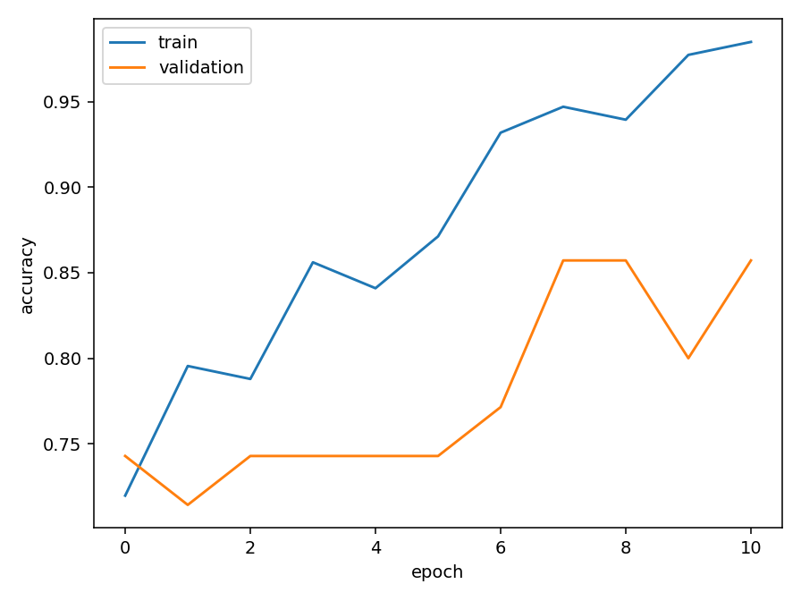
BRAIN + MRI RESEARCH PLATFORM
T5 CNN: training and validation accuracy
Actual persisted history; 11 recorded epochs.
• Training accuracy: 0.7197 → 0.9848. Validation ends at 0.8571.
• The gap is a small-cohort caution, not deployment evidence.
• Validation is for model selection; held-out reporting is separate.
Training accuracy
Training / validation loss
13 | BRAIN + MRI RESEARCH PLATFORM
Research-only · not a clinical diagnosis

Slide 14
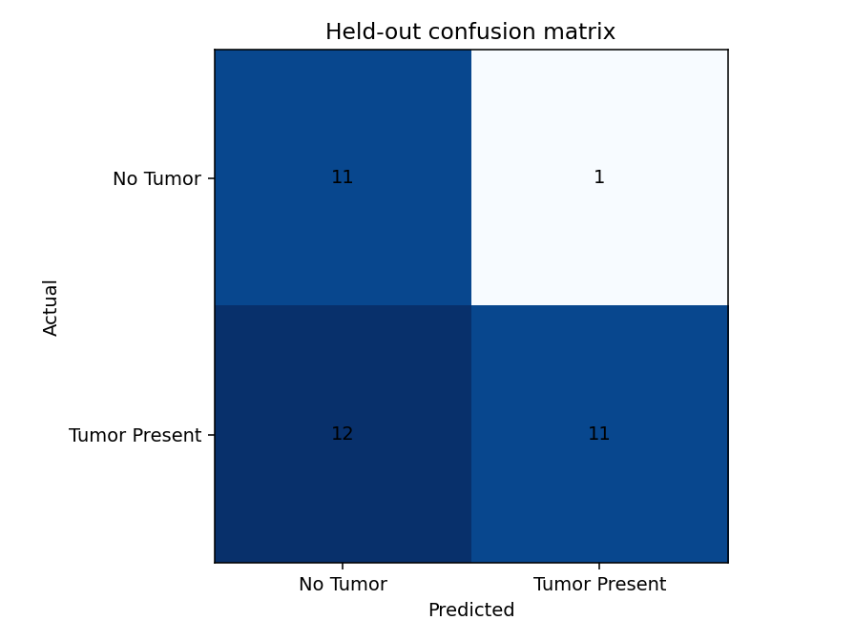
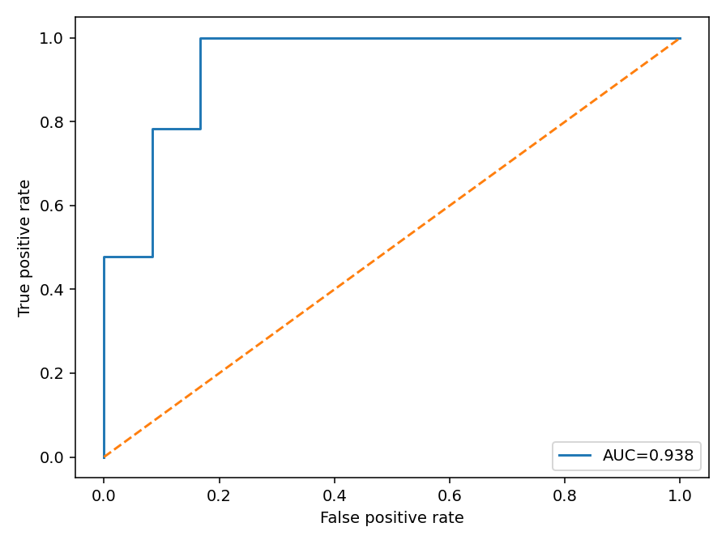
BRAIN + MRI RESEARCH PLATFORM
T5 CNN: held-out confusion matrix
Actual one-patient held-out test: 35 slices.
• [[11,1],[12,11]] = 11 TN, 1 FP, 12 FN, 11 TP.
• Tumour recall = 0.4783: 12/23 positive slices missed at threshold 0.50.
• Negative slice result cannot rule out tumour.
The CNN uses segmentation masks as reference annotations for generating binary slice-level labels.
A slice receives a positive label if any voxel in its corresponding segmentation mask has a value greater than zero.
The dataset is divided at the case level rather than randomly splitting individual slices.
This prevents slices originating from the same patient from appearing in multiple partitions.
ROC curve (AUC = 0.9384)
14 | BRAIN + MRI RESEARCH PLATFORM
Research-only · not a clinical diagnosis

Slide 15
BRAIN + MRI RESEARCH PLATFORM
T5 CNN: classification report
Actual held-out metrics (35 slices).
Class
Precision
Recall
F1
Support
No Tumor
0.4783
0.9167
0.6286
12
Tumor Present
0.9167
0.4783
0.6286
23
Macro average
0.6975
0.6975
0.6286
35
Weighted average
0.7664
0.6286
0.6286
35
15 | BRAIN + MRI RESEARCH PLATFORM
Research-only · not a clinical diagnosis

Slide 16
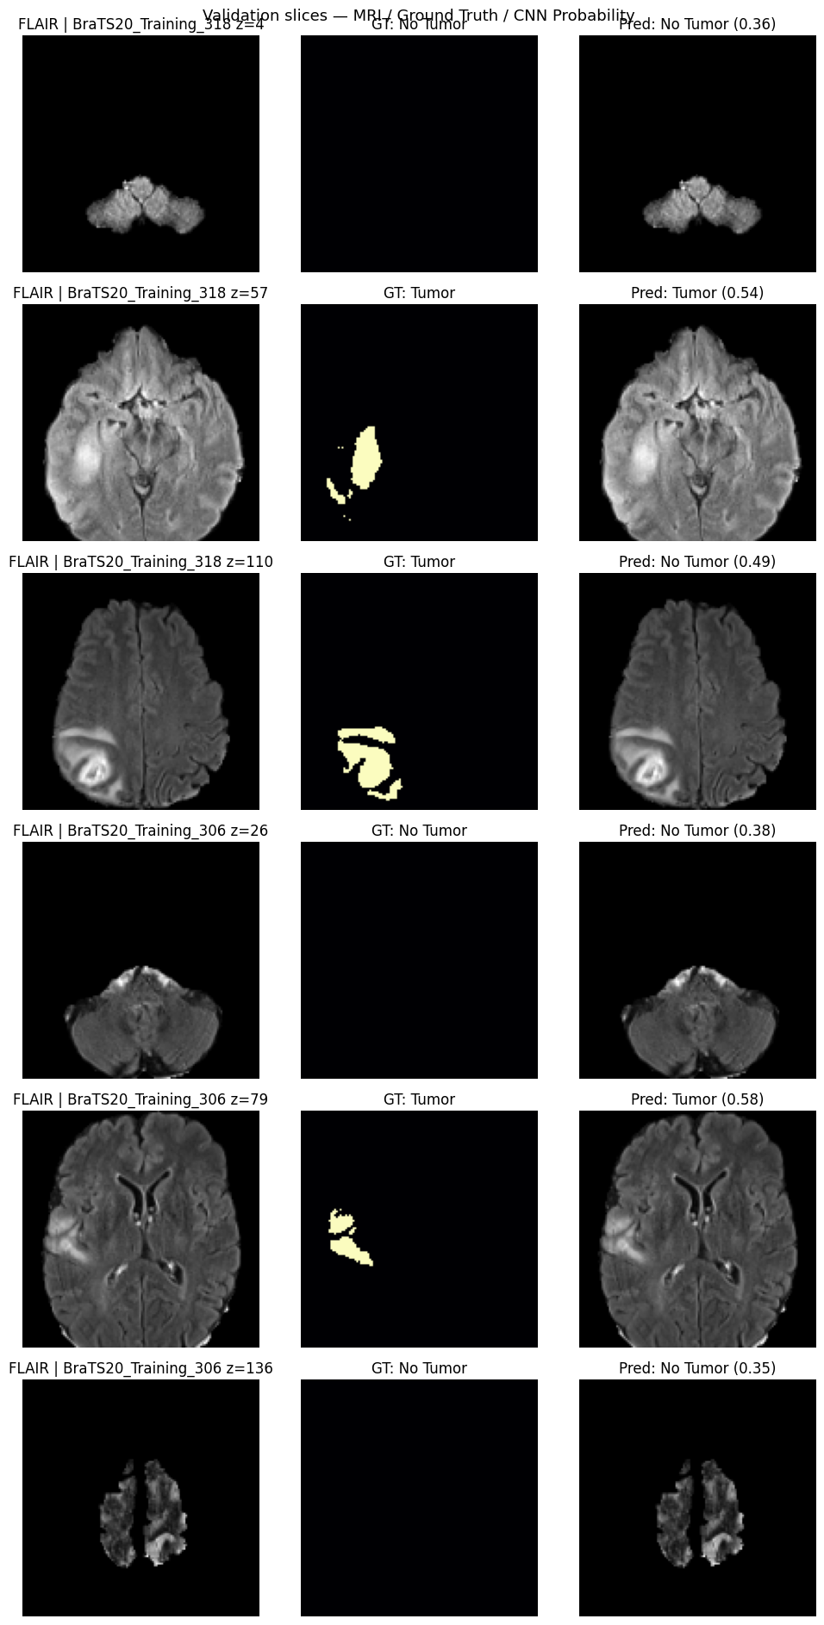
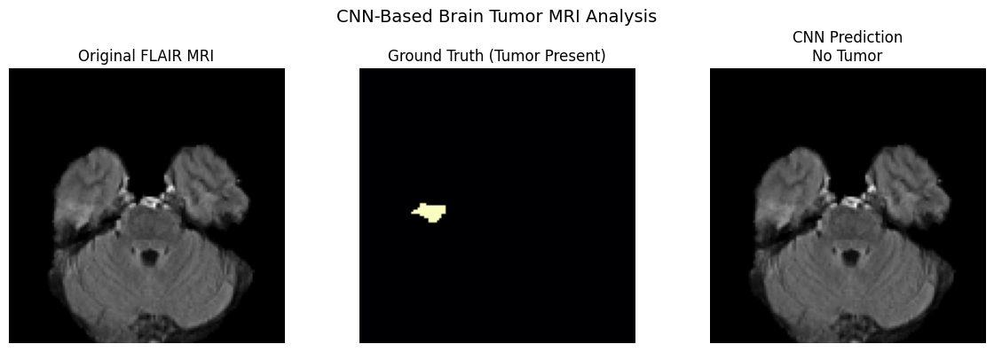
BRAIN + MRI RESEARCH PLATFORM
T5 CNN: actual inference visualization
Notebook evidence demonstrates genuine preprocessed-slice predictions.
• UI renders original MRI and exact 128 × 128 model input.
• Tutorial data can show actual label separately; arbitrary uploads do not have ground truth.
• Probabilities are model estimates, never diagnostic certainty.
16 | BRAIN + MRI RESEARCH PLATFORM
Research-only · not a clinical diagnosis

Slide 17
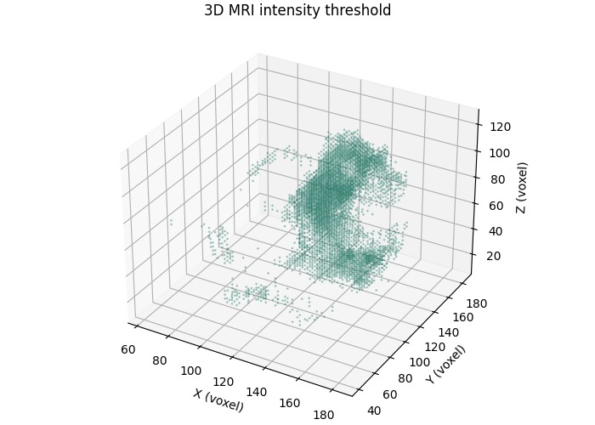
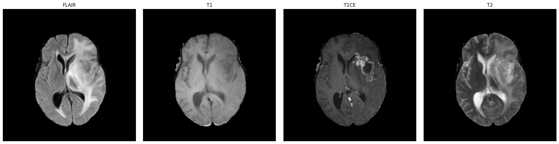
BRAIN + MRI RESEARCH PLATFORM
T6: multimodal MRI visualization
Aim: compare compatible modalities and supplied segmentation context.
• Same-case volumes are rendered with consistent orientation.
• SEG pane is supplied reference where present—not CNN output.
• Modality comparison precedes downstream interpretation.
Actual T6 notebook/project visualizations.
Actual project evidence · source images, notebook output or saved model artifact
17 | BRAIN + MRI RESEARCH PLATFORM
Research-only · not a clinical diagnosis

Slide 18
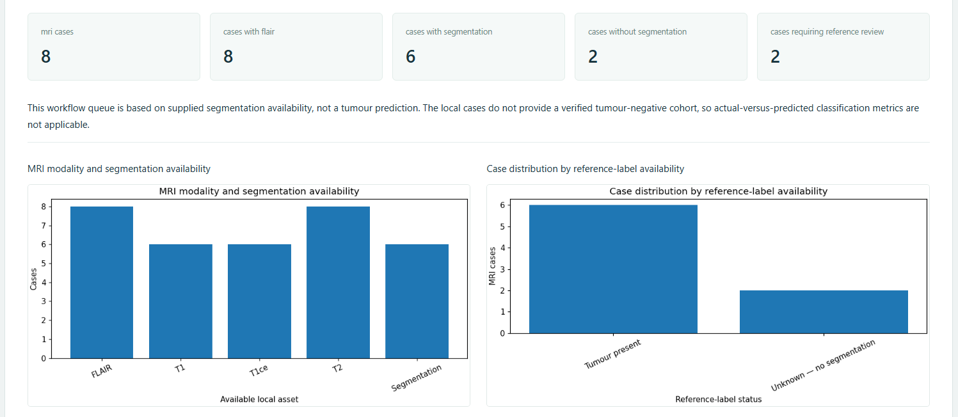
BRAIN + MRI RESEARCH PLATFORM
T7: MRI review queue
Aim: operational case review from actual data availability.
• Input: discovered local cases plus FLAIR/SEG availability.
• Output: review state and completeness status; T7–T9 do not request synthetic text examples.
• Availability is operational metadata, not a medical finding.
18 | BRAIN + MRI RESEARCH PLATFORM
Research-only · not a clinical diagnosis

Slide 19
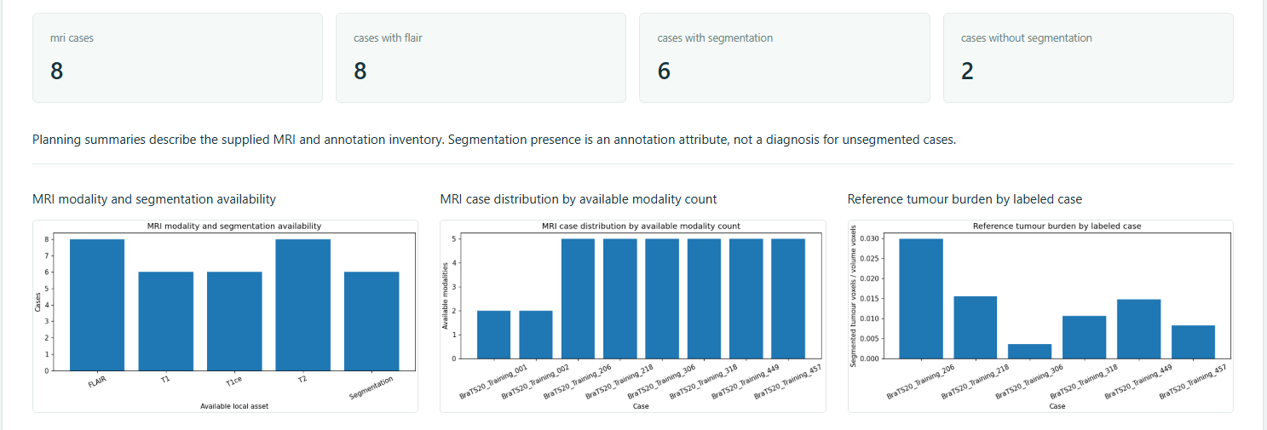
BRAIN + MRI RESEARCH PLATFORM
T8: healthcare data analysis
Aim: inspect dataset inventory and supplied tumour-burden information.
• Inputs: local metadata and SEG only where provided.
• Processing: counts, availability checks and volume-derived summaries.
• Small local summaries are repository descriptions—not epidemiological estimates.
19 | BRAIN + MRI RESEARCH PLATFORM
Research-only · not a clinical diagnosis

Slide 20
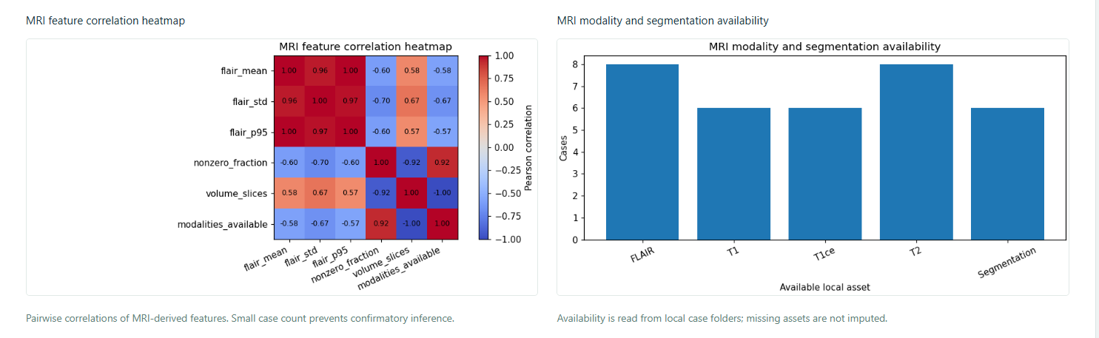
BRAIN + MRI RESEARCH PLATFORM
T9: feature exploration
Aim: derive MRI features for descriptive statistics.
• Normalized images/volumes yield intensity and simple morphology-derived exploration.
• Associations are descriptive; local cohort size limits inference and generalisation.
20 | BRAIN + MRI RESEARCH PLATFORM
Research-only · not a clinical diagnosis

Slide 21
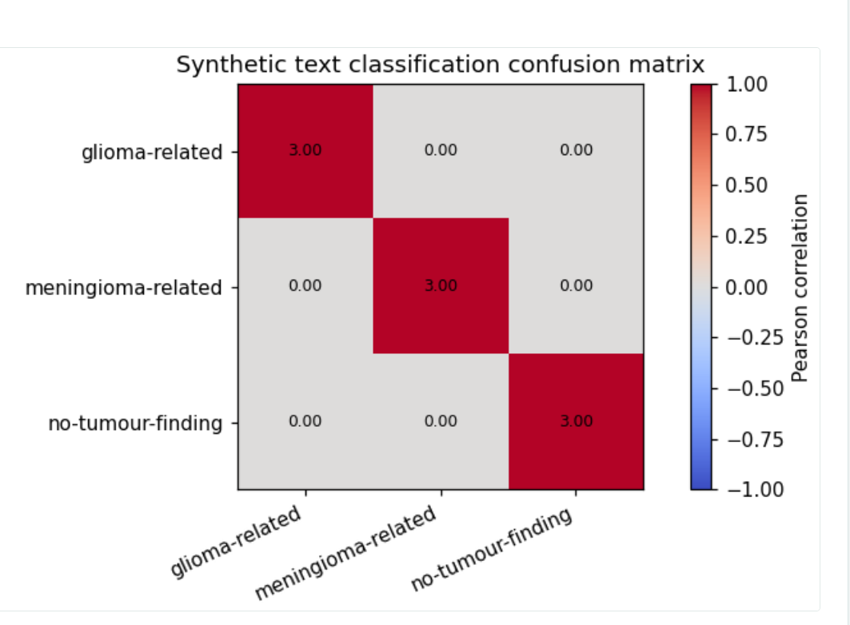
BRAIN + MRI RESEARCH PLATFORM
T10: text classification
A synthetic teaching-report workflow, distinct from MRI imaging.
• Supported synthetic CSV examples are restricted to T10–T12.
• TF–IDF features feed logistic classification and class-oriented tutorial outputs.
• No real patient reports, clinical NLP accuracy or diagnosis is claimed.
21 | BRAIN + MRI RESEARCH PLATFORM
Research-only · not a clinical diagnosis

Slide 22
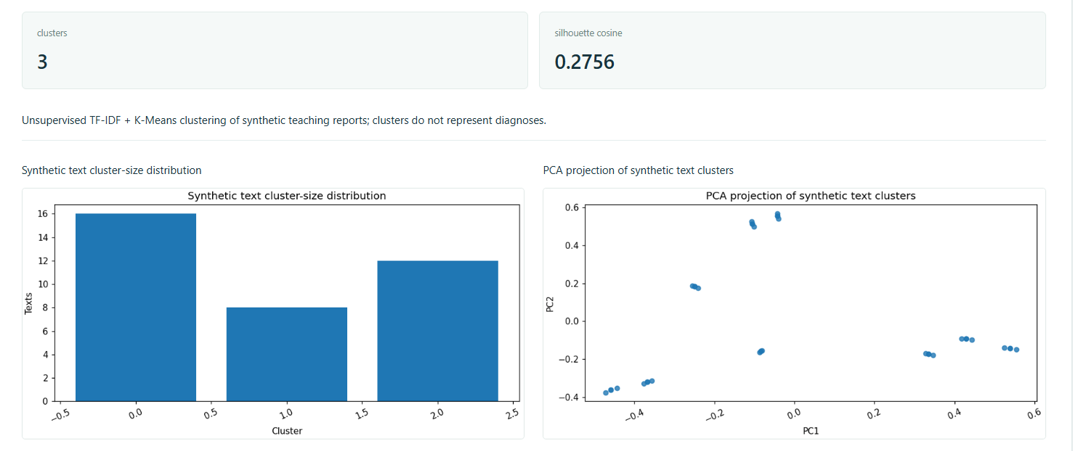
BRAIN + MRI RESEARCH PLATFORM
T10: clustering
Clustering remains independent from text classification.
• TF–IDF vectors feed K-Means; cluster IDs describe lexical similarity, not diagnoses.
• Separate UI controls preserve the difference between supervised and unsupervised workflows.
22 | BRAIN + MRI RESEARCH PLATFORM
Research-only · not a clinical diagnosis

Slide 23
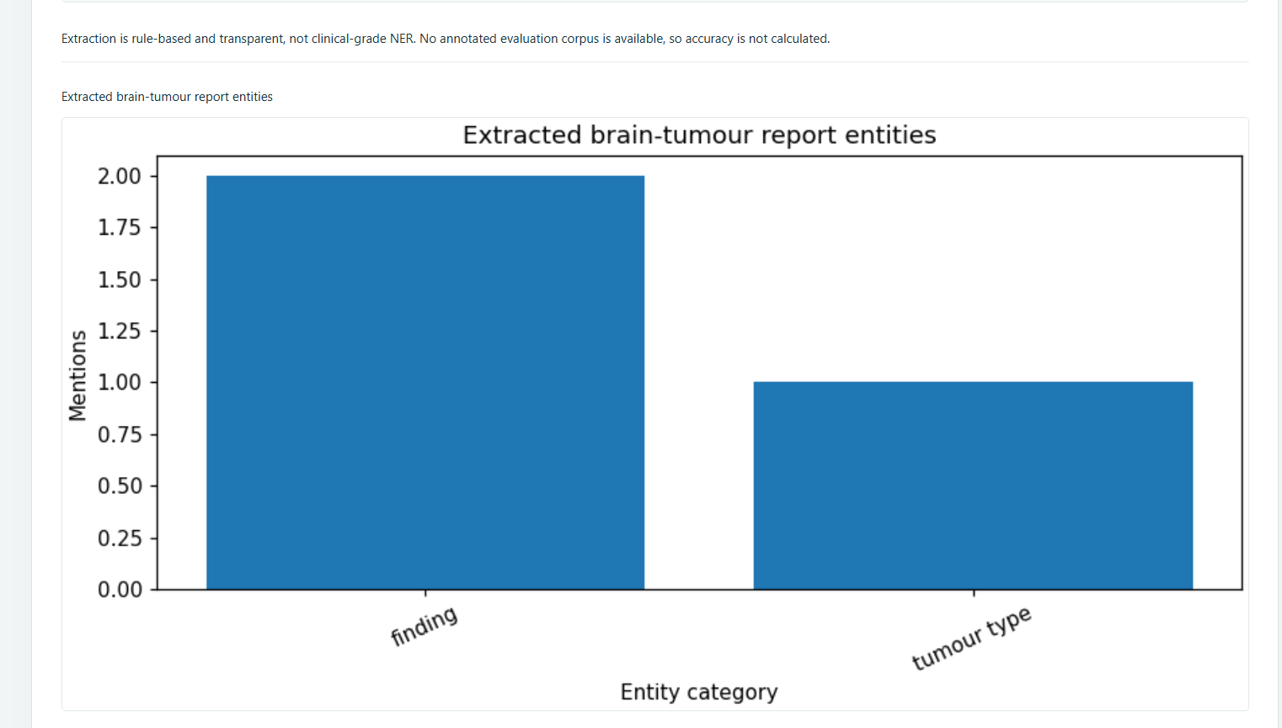
BRAIN + MRI RESEARCH PLATFORM
T11: entity extraction
Transparent lexicon and measurement-rule extraction.
• Synthetic text is processed with term and pattern matching.
• Output is structured teaching evidence, not a trained clinical NER system.
23 | BRAIN + MRI RESEARCH PLATFORM
Research-only · not a clinical diagnosis

Slide 24
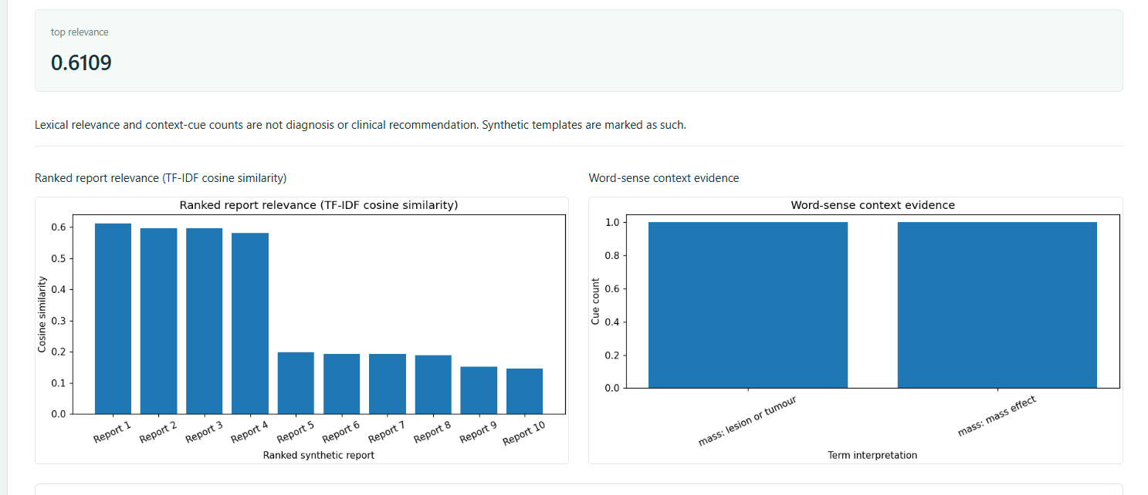
BRAIN + MRI RESEARCH PLATFORM
T12: ranking and disambiguation
TF–IDF cosine ranking of synthetic report passages.
• Query/corpus → vectorisation → cosine similarity → ranked result with ambiguity context.
• This demonstrates retrieval mechanics, not clinical decision support.
24 | BRAIN + MRI RESEARCH PLATFORM
Research-only · not a clinical diagnosis

Slide 25
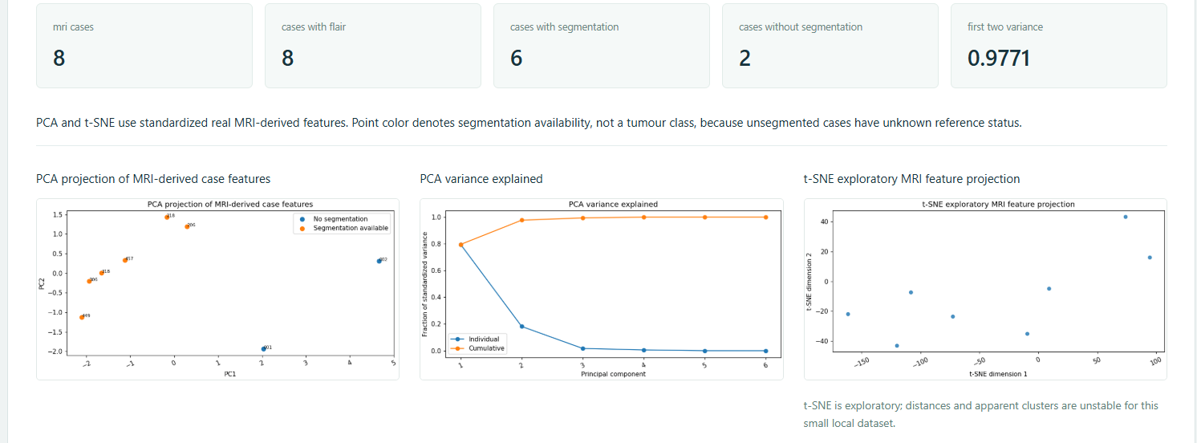
BRAIN + MRI RESEARCH PLATFORM
T13: PCA and t-SNE
Aim: lower-dimensional exploratory projections of standardised MRI features.
• PCA reports linear projection/explained-variance evidence; t-SNE offers nonlinear neighbourhoods.
• Visual clusters are hypothesis-generating, not validated biological subtypes.
25 | BRAIN + MRI RESEARCH PLATFORM
Research-only · not a clinical diagnosis

Slide 26
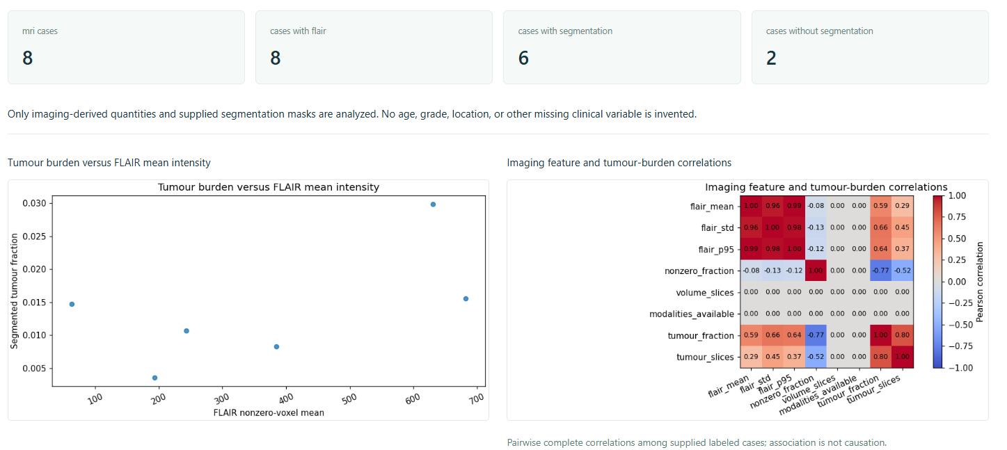
BRAIN + MRI RESEARCH PLATFORM
T14: tumour-burden associations
Aim: exploratory associations with supplied reference-mask burden.
• Feature summaries are paired with SEG-derived burden only when a reference mask exists.
• Association plots are non-causal and missing masks remain missing.
26 | BRAIN + MRI RESEARCH PLATFORM
Research-only · not a clinical diagnosis

Slide 27
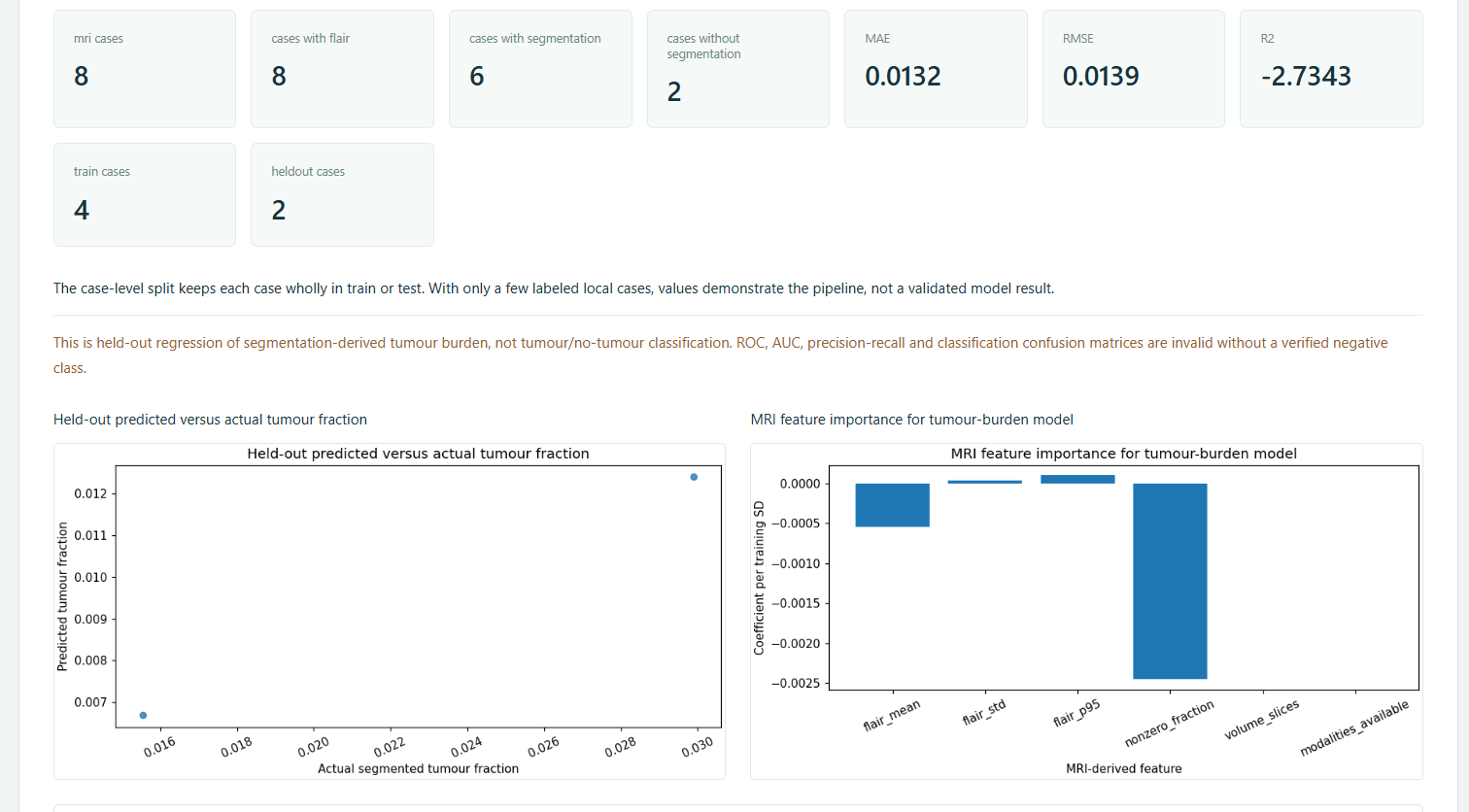
BRAIN + MRI RESEARCH PLATFORM
T15: held-out regression
Aim: estimate segmentation-derived tumour burden continuously.
• Task is regression, not tumour/no-tumour classification.
• Prediction-versus-reference visualisation requires regression metrics—not an invalid ROC claim.
• Local size limits confidence in generalisation.
27 | BRAIN + MRI RESEARCH PLATFORM
Research-only · not a clinical diagnosis

Slide 28
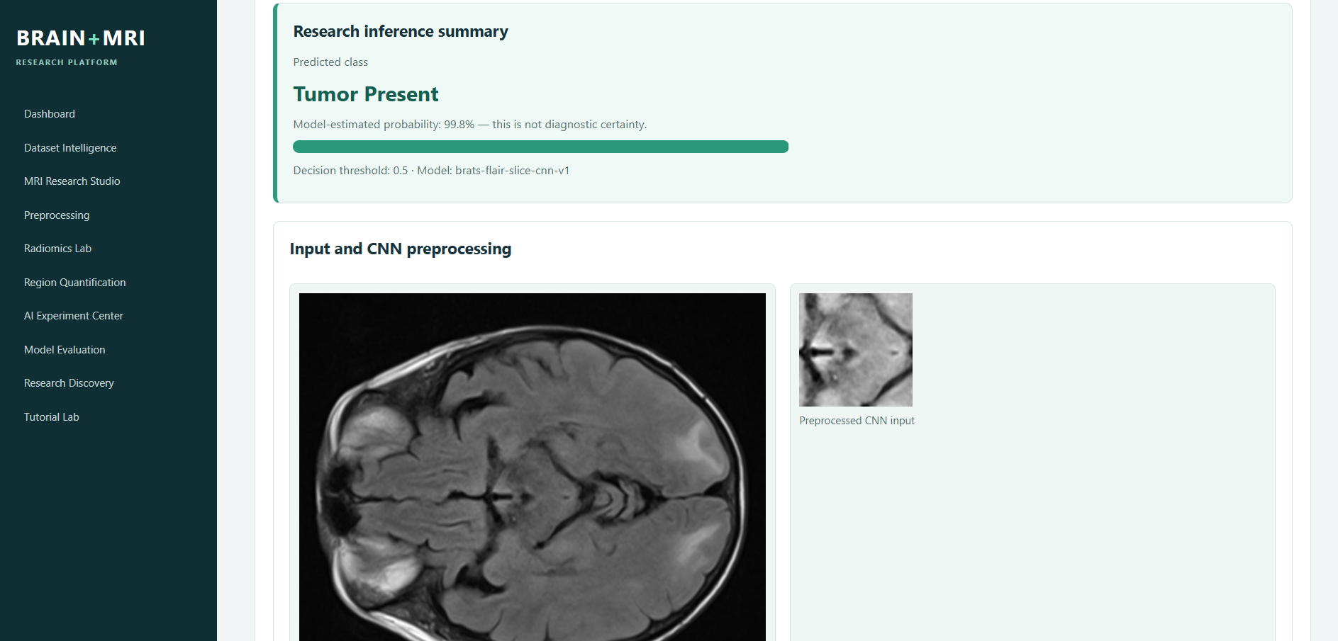
BRAIN + MRI RESEARCH PLATFORM
MRI Upload & AI Analysis
Persistent checkpoint inference is a separate application workflow.
• Compatible PNG/JPEG/NIfTI FLAIR inputs are server-validated (30 MB maximum).
• L/LA/RGB/RGBA images normalise safely to one grayscale channel, then reuse the unchanged FLAIR preprocessing.
• Response includes previews, slice probabilities/classes, duration and limitations.
28 | BRAIN + MRI RESEARCH PLATFORM
Research-only · not a clinical diagnosis

Slide 29
BRAIN + MRI RESEARCH PLATFORM
Limitations and safeguards
Transparency is a core technical requirement.
• Six labelled cases and one held-out test patient: experimental slice-level evidence only.
• No patient diagnosis, segmentation prediction, clinical confidence or arbitrary-upload accuracy is asserted.
• Raw BraTS data remains local/authorized; uploads are validated and not publicly exposed.
SMALL COHORT
METRICS
LIMITS
NO CLAIM
29 | BRAIN + MRI RESEARCH PLATFORM
Research-only · not a clinical diagnosis

Slide 30
BRAIN + MRI RESEARCH PLATFORM
Conclusion
A reproducible academic platform connecting MRI engineering, tutorials and transparent AI evidence.
• T1–T15 are represented through distinct aims, methods, actual output and limitations.
• The persistent FLAIR CNN is integrated but remains experimental and slice-level.
• Source-backed visuals and metrics make the work inspectable for an academic demonstration.
30 | BRAIN + MRI RESEARCH PLATFORM
Research-only · not a clinical diagnosis

