Slide 1
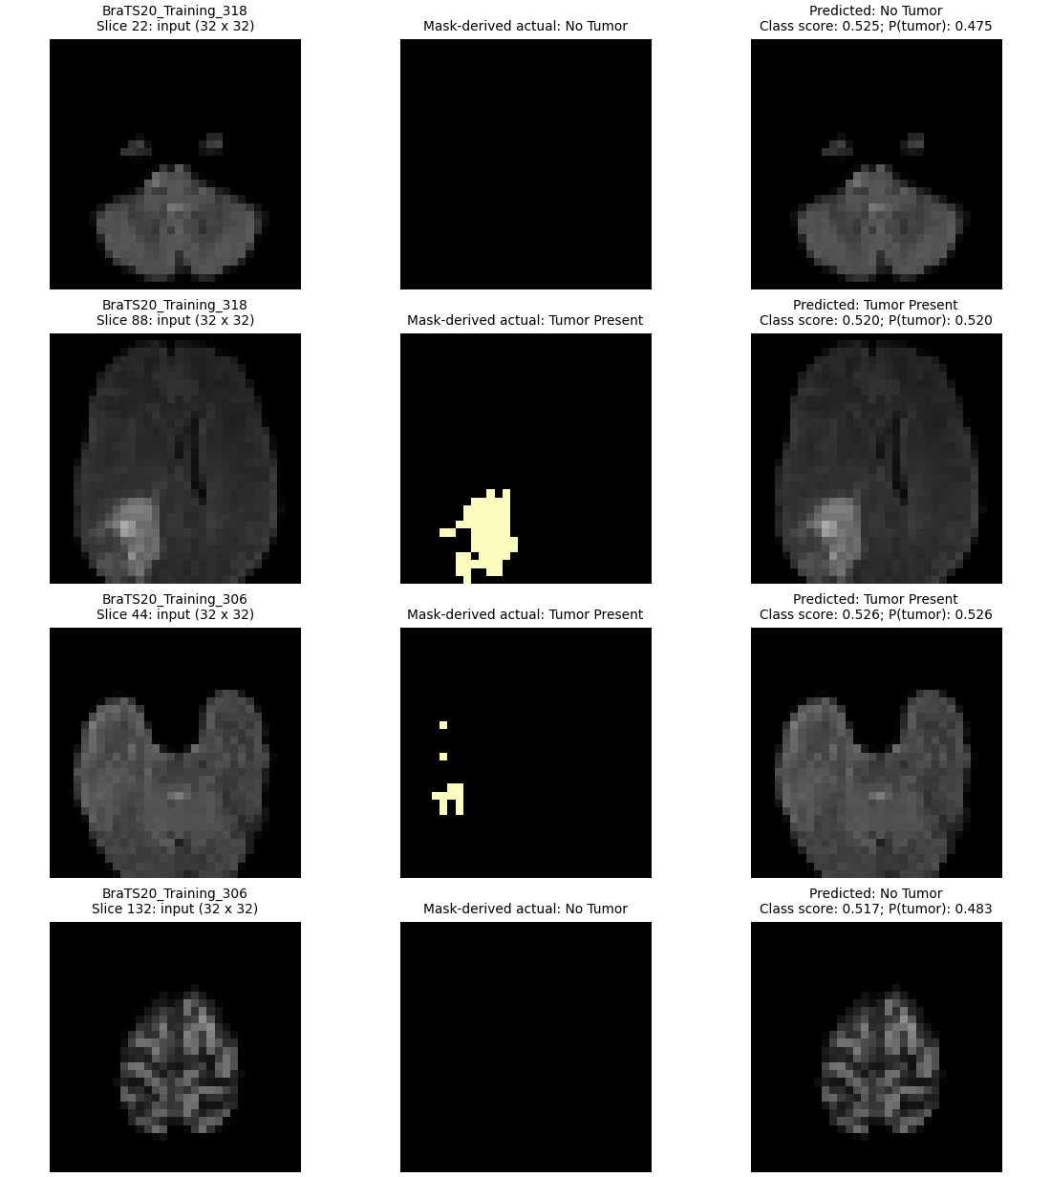
BRAIN + MRI RESEARCH PLATFORM
Brain Tumor Detection Using MRI Images
Brain + MRI Research Platform | Academic project presentation
• Evidence-led biomedical imaging, tutorial delivery and experimental AI workflow
• Research-only: no clinical diagnosis or patient-level claim
Actual CNN preview artifact.
01 | Healthcare project evidence deck
Research-only · not a clinical diagnosis

Slide 2
BRAIN + MRI RESEARCH PLATFORM
Presentation evidence audit
Revision checklist applied to the earlier sparse 33-slide deck.
• Expanded to technical diagrams, tables and source-backed metrics.
• Embedded saved plots, original notebook outputs and project visualizations.
• Expanded CNN to eleven methodology/evidence slides.
✓ Technical depth
→
✓ Original figures
→
✓ T1–T15 coverage
→
✓ Saved metrics
→
✓ Limits visible
→
✓ QA
• Covered T1–T15 with aim, inputs, processing, output and limitation.
02 | Healthcare project evidence deck
Research-only · not a clinical diagnosis

Slide 3
BRAIN + MRI RESEARCH PLATFORM
Problem definition
MRI analysis requires reproducible processing before output can be interpreted.
• MRI volumes may include invalid values, intensity variation and absent modalities.
• Supplied segmentation is reference ground truth—not a model prediction.
• Small local data supports teaching/pipeline validation, not clinical validation.
FLAIR / SEG
→
VALIDATE
→
PREPROCESS
→
ALGORITHM
→
PNG / METRICS
→
UI
03 | Healthcare project evidence deck
Research-only · not a clinical diagnosis

Slide 4
BRAIN + MRI RESEARCH PLATFORM
Platform architecture
Independent browser modules reuse validated MRI and analytics utilities.
• Browser: Dashboard, Tutorial Lab, Image Analysis Studio, MRI Research Studio.
• FastAPI: validation, data-URL image serialization, case discovery and reporting.
• Core: NIfTI I/O, preprocessing, SIFT/RANSAC, analytics and CNN inference.
Browser modules
→
FastAPI routes
→
her_core utilities
→
Models + artifacts
→
Rendered evidence
04 | Healthcare project evidence deck
Research-only · not a clinical diagnosis

Slide 5
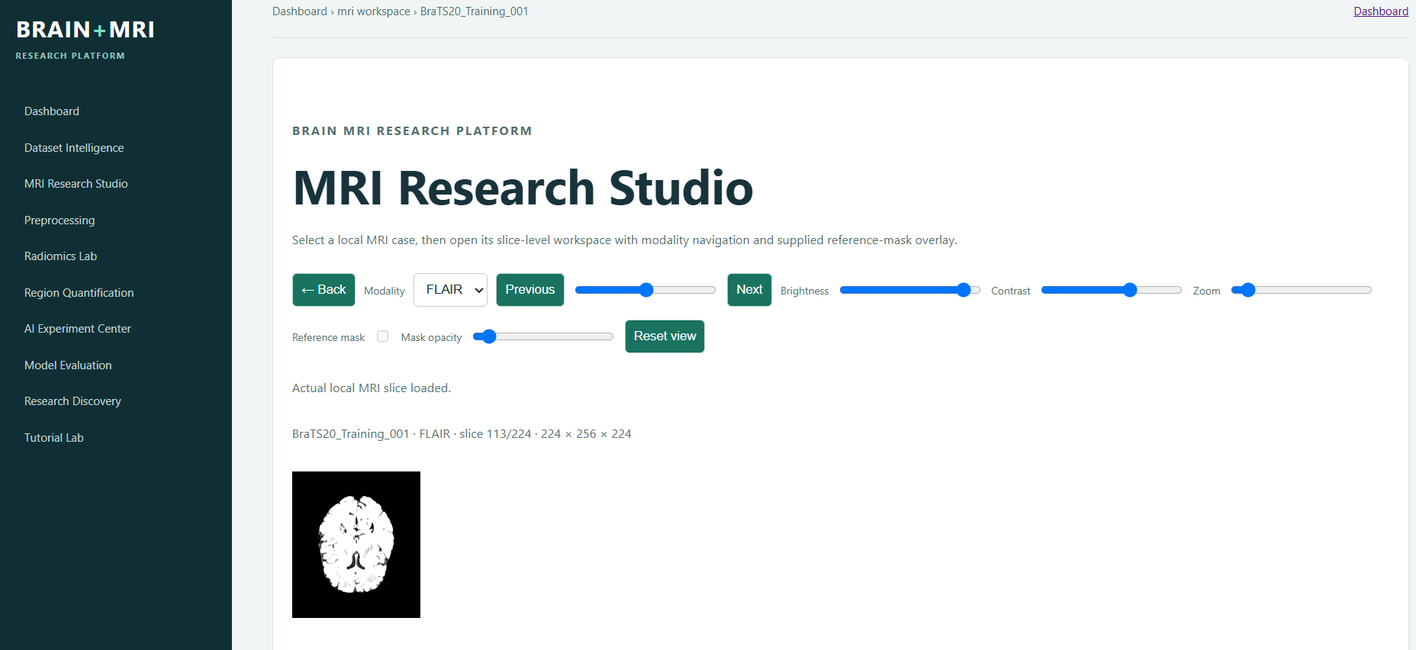
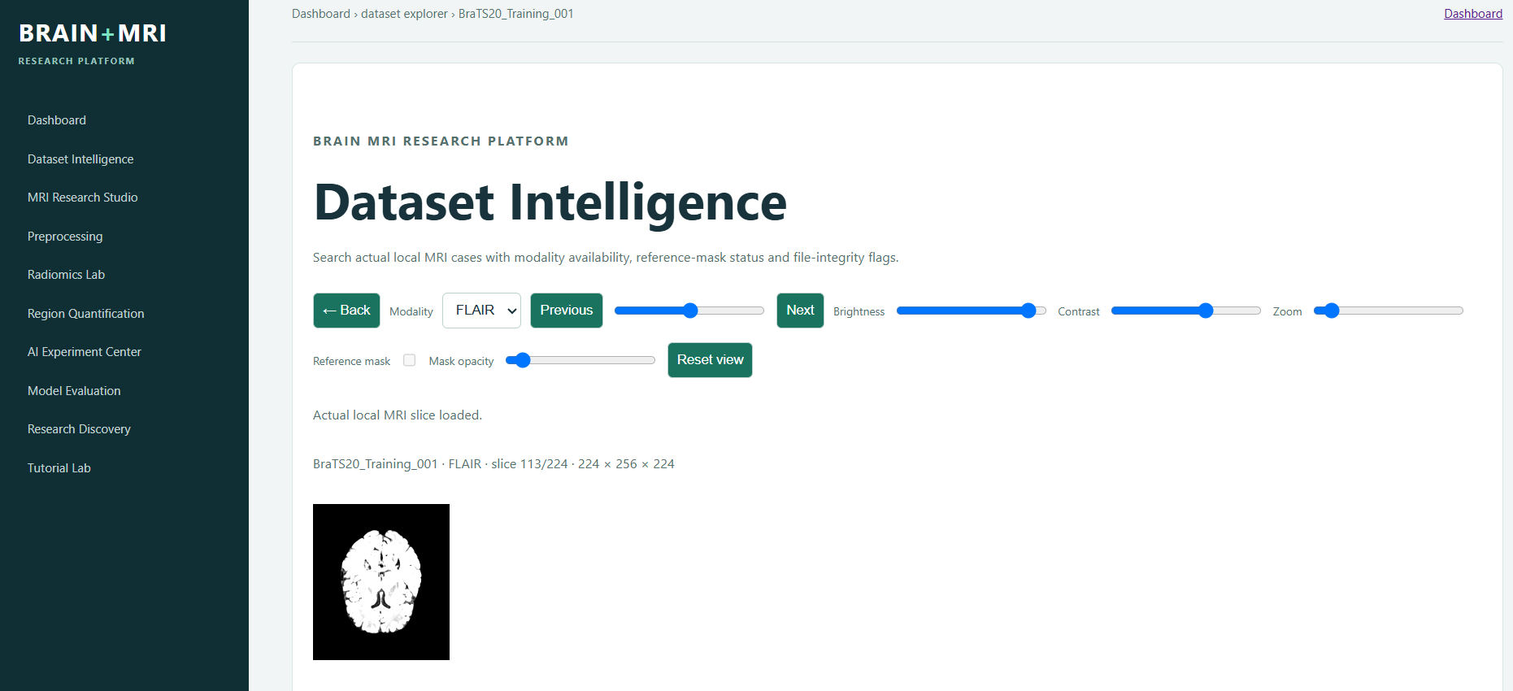
BRAIN + MRI RESEARCH PLATFORM
Frontend modules: contextual research workspace
Actual application screens show Dataset Intelligence and MRI Research Studio.
• Dataset Intelligence provides local case selection, modality context and actual slice preview.
• MRI Research Studio separates workflow selection from case-specific analysis and upload inference.
• The visible Back action follows contextual module hierarchy rather than always returning to Dashboard.
Actual frontend screenshots: Dataset Intelligence and MRI Research Studio.
05 | Healthcare project evidence deck
Research-only · not a clinical diagnosis

Slide 6
BRAIN + MRI RESEARCH PLATFORM
Data lineage and safeguards
Every visible result has a traceable source and status.
• Local FLAIR/SEG → validate → preprocess → algorithm/checkpoint → PNG/metrics → UI.
• Missing masks stay missing; they are never converted to negative labels.
• The persistent checkpoint is reused; request handling never trains a new model.
FLAIR / SEG
VALIDATE
PREPROCESS
ALGORITHM
PNG / METRICS
UI
06 | Healthcare project evidence deck
Research-only · not a clinical diagnosis

Slide 7
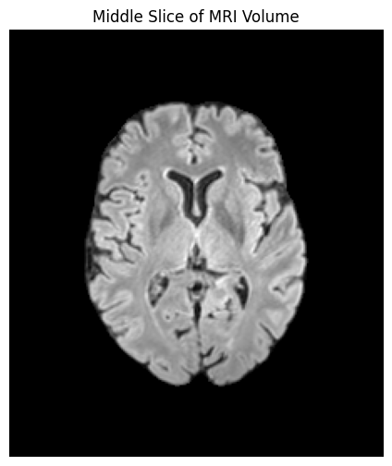
BRAIN + MRI RESEARCH PLATFORM
Dataset audit: local BraTS2020 evidence
Actual findings from CNN_DATASET_AUDIT.md.
• 8 case folders; FLAIR 8/8; SEG 6/8. Two unsegmented cases are excluded from supervision.
• Six FLAIR/SEG pairs are 240 × 240 × 155. Labels 0,1,2,3; y=1 iff mask > 0.
• All eligible labelled slices: 798 (355 negative, 443 positive).
Original notebook output: local MRI middle slice.
07 | Healthcare project evidence deck
Research-only · not a clinical diagnosis

Slide 8
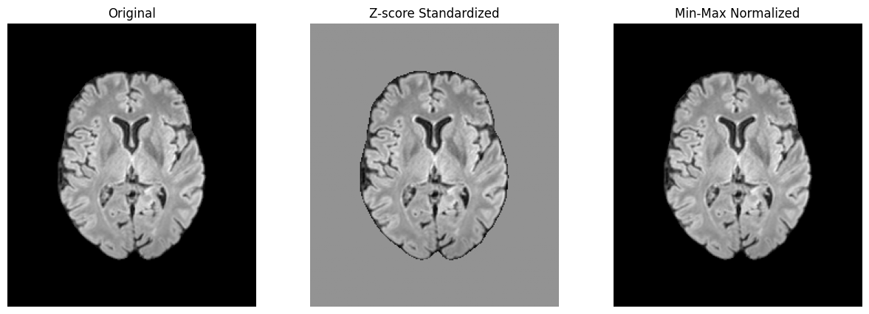
BRAIN + MRI RESEARCH PLATFORM
MRI preprocessing contract
The exact branch is shared by training, validation, test and upload inference.
• Clean NaN/Inf → 160 × 160 centre crop (when applicable) → per-slice min–max.
• x′ = (x − min(x)) / (max(x) − min(x)); resize to 128 × 128; one FLAIR channel.
• This contract is implemented in her_core/cnn.py, not recreated per endpoint.
Original notebook output: original, standardized, normalized.
08 | Healthcare project evidence deck
Research-only · not a clinical diagnosis

Slide 9
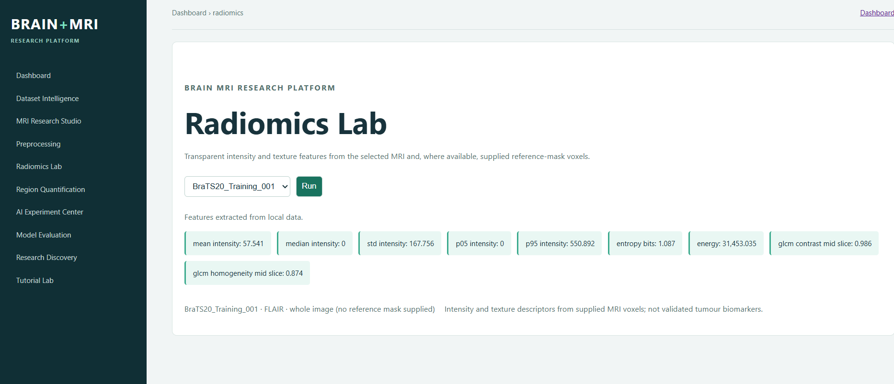
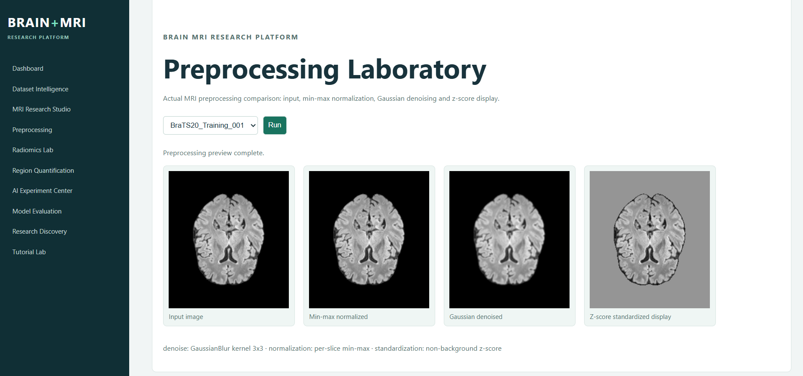
BRAIN + MRI RESEARCH PLATFORM
Implemented application analysis modules
Frontend outputs demonstrate that preprocessing and radiomics are separate functional modules.
• Preprocessing Laboratory renders original, cleaned, normalized and contrast-enhanced MRI stages.
• Radiomics Lab selects a case/modality and exposes feature-analysis actions backed by actual local data.
• These modules are analysis tools; they do not report clinical diagnoses.
Actual frontend screenshots: Preprocessing Laboratory and Radiomics Lab.
09 | Healthcare project evidence deck
Research-only · not a clinical diagnosis

Slide 10
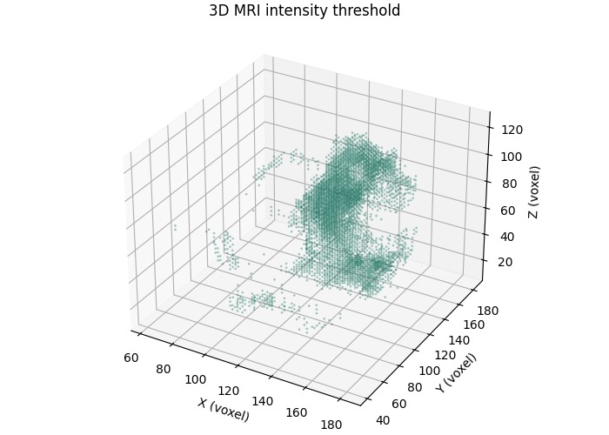
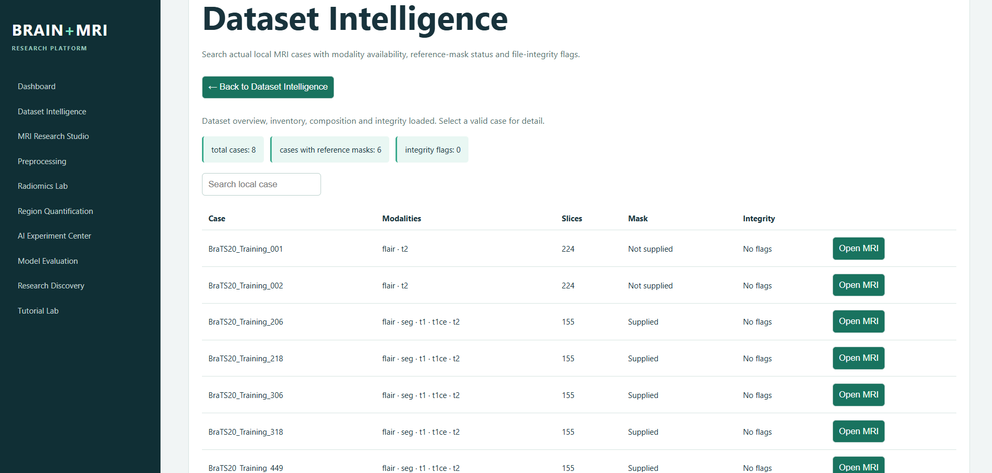
BRAIN + MRI RESEARCH PLATFORM
MRI Workspace and Dataset Explorer
Application modules render data rather than raw JSON.
• Case/modality/slice controls call the validated slice endpoint and return compact PNG data URLs.
• Brightness, contrast, zoom and reference-mask overlay apply only where the actual input exists.
• Dataset Explorer displays case inventory, modality availability, slice counts and integrity state.
Actual Dataset Intelligence interface and multimodal/reference-mask output.
10 | Healthcare project evidence deck
Research-only · not a clinical diagnosis

Slide 11
BRAIN + MRI RESEARCH PLATFORM
T1–T3: inspection, preprocessing and data quality
Foundational workflows establish data conditions before analysis.
• T1: discover local cases/modalities and show a middle slice.
• T2: clean invalid values; compare z-score and min–max transformations.
• T3: report missing modalities/duplicates without destructive assumptions.
Original notebook evidence for T1/T2.
11 | Healthcare project evidence deck
Research-only · not a clinical diagnosis

Slide 12
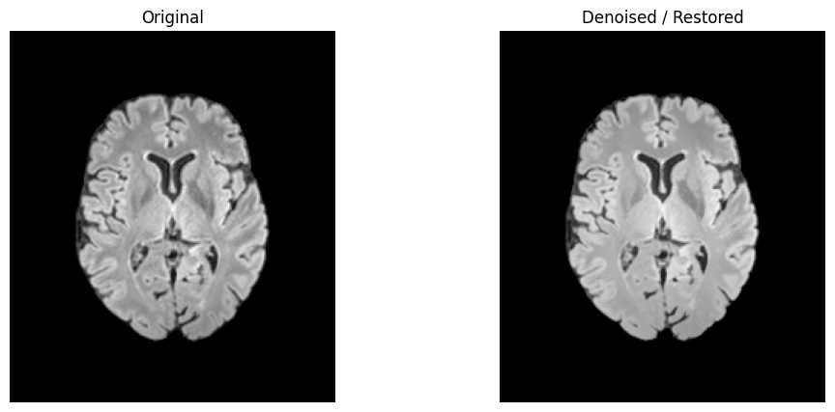
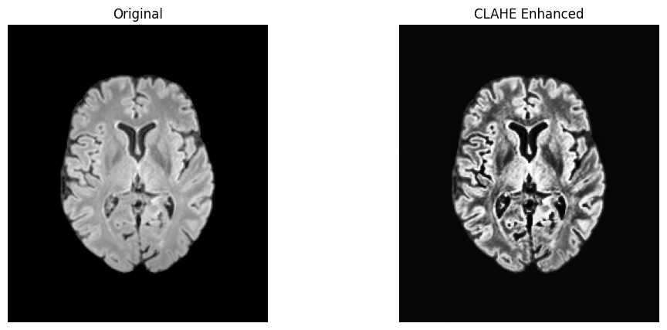
BRAIN + MRI RESEARCH PLATFORM
T4: biomedical image analysis
Aim: make enhancement and quality operations inspectable.
• Input: local MRI slice. CLAHE enhancement and bilateral denoising are displayed side by side.
• Interpretation: altered contrast is presentation support—not tumour segmentation/diagnosis.
• Implementation: notebook operations and reusable preprocessing helpers.
Actual T4 notebook outputs: enhancement and restoration.
12 | Healthcare project evidence deck
Research-only · not a clinical diagnosis

Slide 13
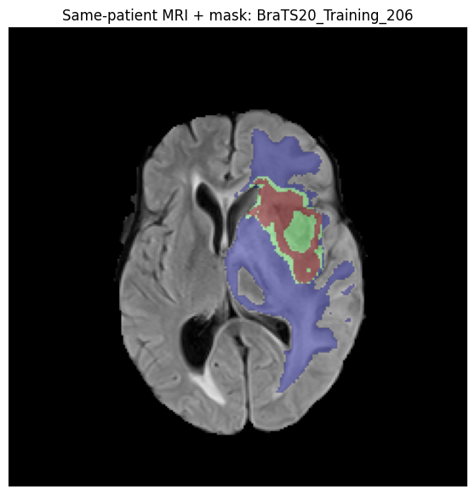
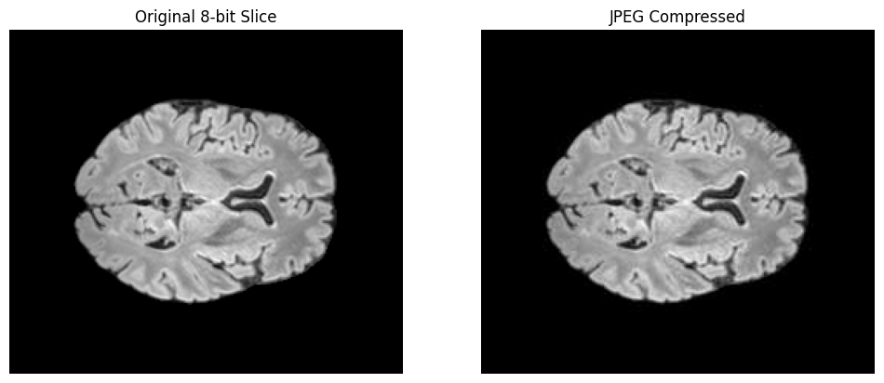
BRAIN + MRI RESEARCH PLATFORM
T4: reference overlay and compression
Reference masks remain distinct from processing effects.
• Same-case FLAIR + supplied SEG are overlaid as reference evidence.
• JPEG comparison demonstrates storage/artefact trade-offs for teaching.
• No predicted segmentation mask is claimed.
Actual T4 overlay and compression outputs.
13 | Healthcare project evidence deck
Research-only · not a clinical diagnosis

Slide 14
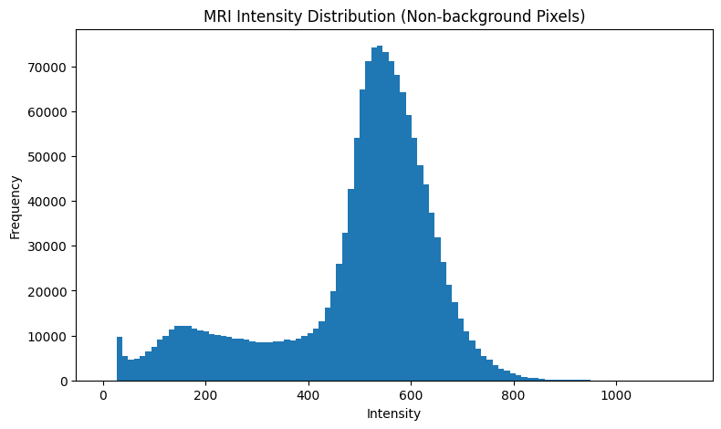
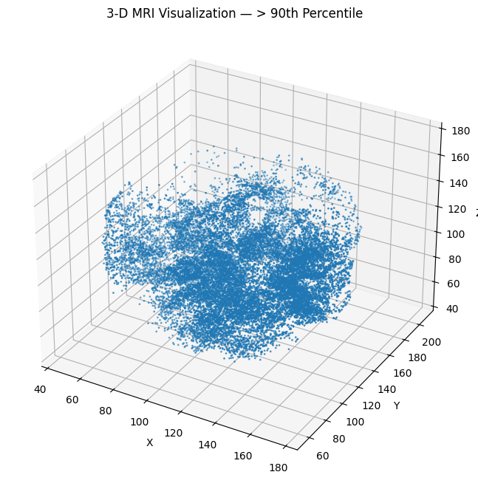
BRAIN + MRI RESEARCH PLATFORM
T4: intensity and 3-D context
Additional notebook evidence links slice-level work to volume context.
• Histogram uses non-background MRI intensity values, making intensity distribution explicit.
• 3-D threshold display is a visualisation of high-intensity voxels, not a tumour segmentation.
• These figures support inspection before feature extraction or classification.
Original notebook intensity and 3-D visualisation outputs.
14 | Healthcare project evidence deck
Research-only · not a clinical diagnosis

Slide 15
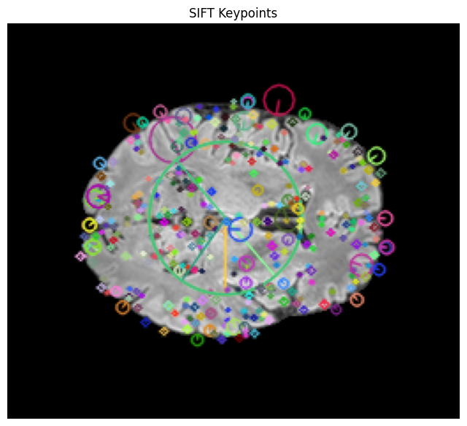
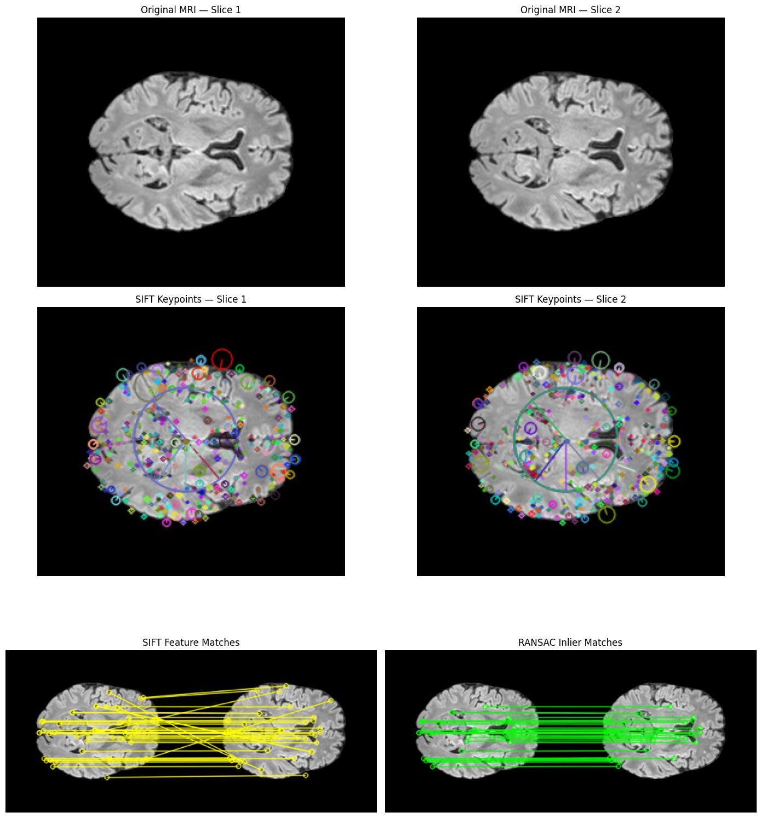
BRAIN + MRI RESEARCH PLATFORM
T5: SIFT + RANSAC
Aim: robust correspondence evidence between nearby MRI slices.
• SIFT detects scale-invariant keypoints and descriptors from normalized intensity.
• Descriptor matching proposes candidates; RANSAC estimates a robust transform/rejects outliers.
• Output supports image correspondence analysis, not tumour presence.
Actual T5 keypoint and RANSAC-match outputs.
15 | Healthcare project evidence deck
Research-only · not a clinical diagnosis

Slide 16
BRAIN + MRI RESEARCH PLATFORM
T5 CNN: target and leakage control
Binary slice labels derive only from reference-mask pixels.
• y = 1 if any(mask > 0), otherwise 0; unlabelled cases are excluded.
• Case separation: train 4 cases/132 slices; validation 1/35; held-out test 1/35.
• No patient contributes slices to more than one partition.
Training
4 cases · 132
→
Validation
1 case · 35
→
Held-out test
1 case · 35
16 | Healthcare project evidence deck
Research-only · not a clinical diagnosis

Slide 17
BRAIN + MRI RESEARCH PLATFORM
T5 CNN: layer-by-layer architecture
Saved model brats-flair-slice-cnn-v1 | input 128 × 128 × 1.
• Conv2D(32,3×3,ReLU,same) + pool → Conv2D(64) + pool → Conv2D(128) + pool.
• Flatten → Dense(128, ReLU) → Dropout(0.5) → Dense(1, sigmoid).
• Sigmoid is model-estimated P(tumour slice); evaluation threshold = 0.50.
Input
128²×1
→
Conv 32
→
Conv 64
→
Conv 128
→
Flatten
→
Dense 128
→
Sigmoid
17 | Healthcare project evidence deck
Research-only · not a clinical diagnosis

Slide 18
BRAIN + MRI RESEARCH PLATFORM
T5 CNN: experiment configuration
Persistent run from scripts/train_brain_tumor_cnn.py.
• Fixed seed 42; 12 requested epochs; best validation-loss checkpoint persisted.
Partition
Cases
Slices
Role
• Training-only weights: no-tumour 1.1786; tumour 0.8684.
Train
457,449,218,206
132
Optimisation
• Evenly spaced cap: 40 slices/case for the practical training run.
Validation
306
35
Selection
Held-out test
318
35
Experimental test
18 | Healthcare project evidence deck
Research-only · not a clinical diagnosis

Slide 19
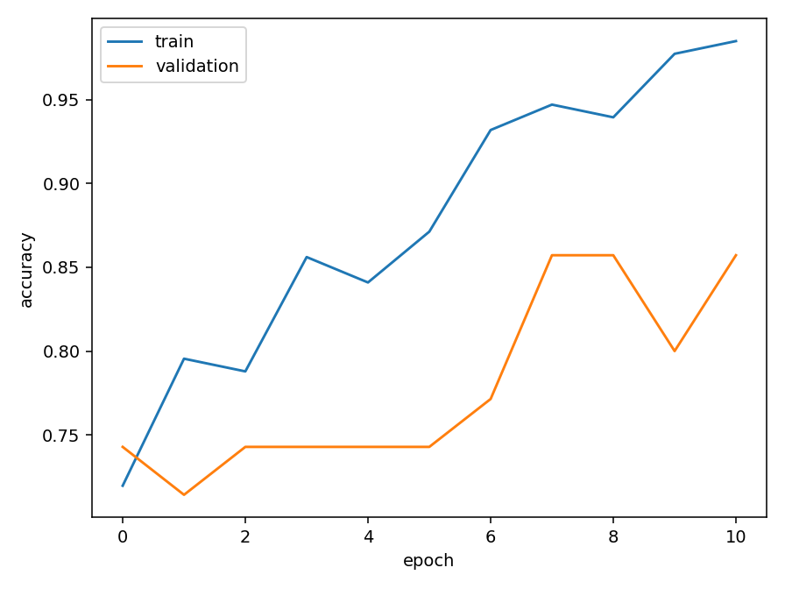
BRAIN + MRI RESEARCH PLATFORM
T5 CNN: training and validation accuracy
Actual persisted history; 11 recorded epochs.
• Training accuracy: 0.7197 → 0.9848. Validation ends at 0.8571.
• The gap is a small-cohort caution, not deployment evidence.
• Validation is for model selection; held-out reporting is separate.
models/training_accuracy.png
19 | Healthcare project evidence deck
Research-only · not a clinical diagnosis

Slide 20
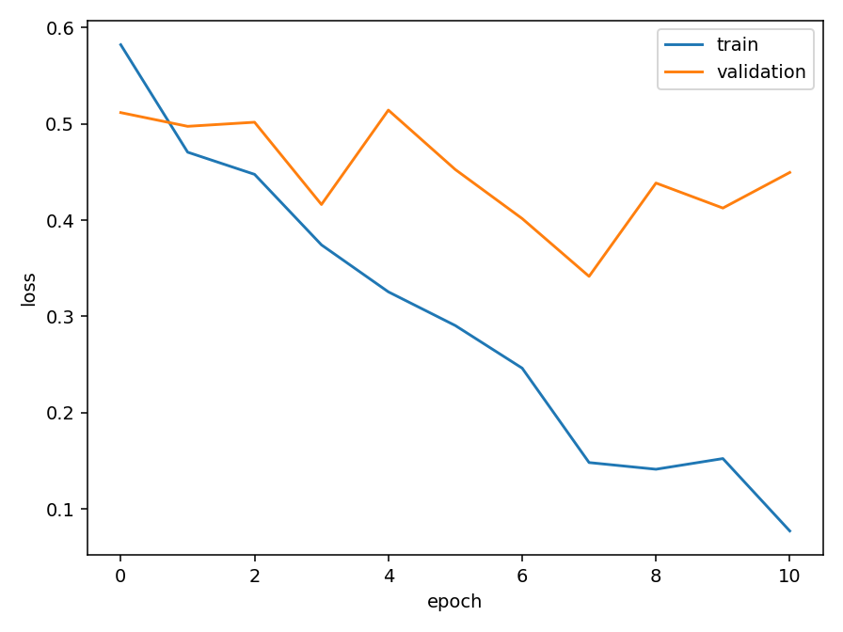
BRAIN + MRI RESEARCH PLATFORM
T5 CNN: training and validation loss
Actual persisted loss history; checkpoint selected by validation loss.
• Training loss: 0.5823 → 0.0772. Validation loss is non-monotonic and ends at 0.4496.
• The curves motivate independent patient-level evaluation; they do not prove generalisation.
models/training_loss.png
20 | Healthcare project evidence deck
Research-only · not a clinical diagnosis

Slide 21
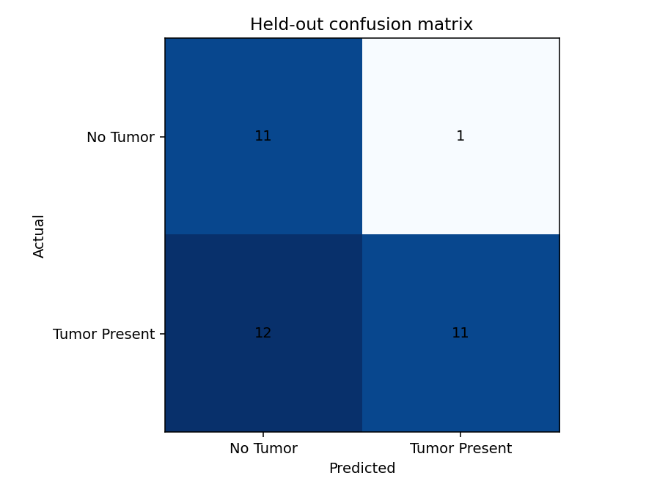
BRAIN + MRI RESEARCH PLATFORM
T5 CNN: held-out confusion matrix
Actual one-patient held-out test: 35 slices.
• [[11,1],[12,11]] = 11 TN, 1 FP, 12 FN, 11 TP.
• Tumour recall = 0.4783: 12/23 positive slices missed at threshold 0.50.
• Negative slice result cannot rule out tumour.
models/confusion_matrix.png
21 | Healthcare project evidence deck
Research-only · not a clinical diagnosis

Slide 22
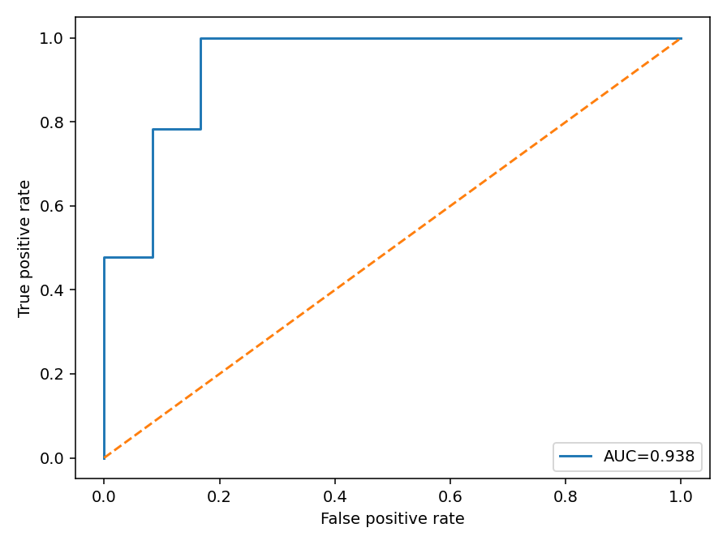
BRAIN + MRI RESEARCH PLATFORM
T5 CNN: ROC and threshold interpretation
Score ranking and thresholded classification answer different questions.
• Held-out ROC-AUC = 0.9384; thresholded accuracy = 0.6286; tumour recall = 0.4783.
• High AUC can coexist with modest recall at one fixed threshold.
• One held-out patient means neither statistic establishes clinical calibration.
models/roc_curve.png
22 | Healthcare project evidence deck
Research-only · not a clinical diagnosis

Slide 23
BRAIN + MRI RESEARCH PLATFORM
T5 CNN: classification report
Actual held-out metrics (35 slices).
Class
Precision
Recall
F1
Support
No Tumor
0.4783
0.9167
0.6286
12
Tumor Present
0.9167
0.4783
0.6286
23
Macro average
0.6975
0.6975
0.6286
35
Weighted average
0.7664
0.6286
0.6286
35
23 | Healthcare project evidence deck
Research-only · not a clinical diagnosis

Slide 24
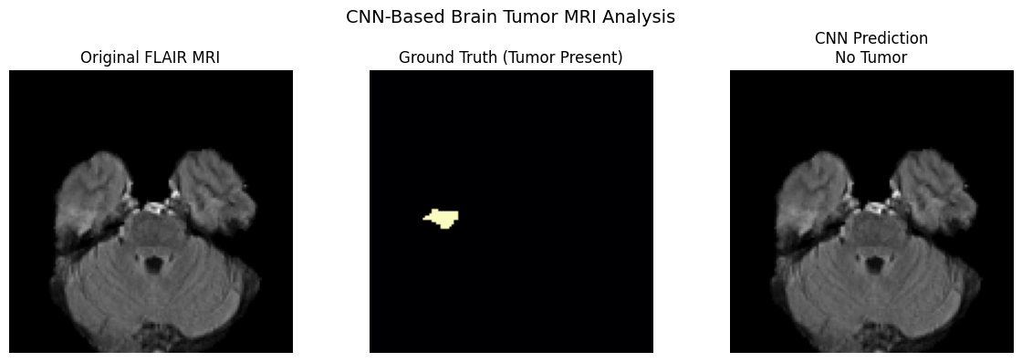
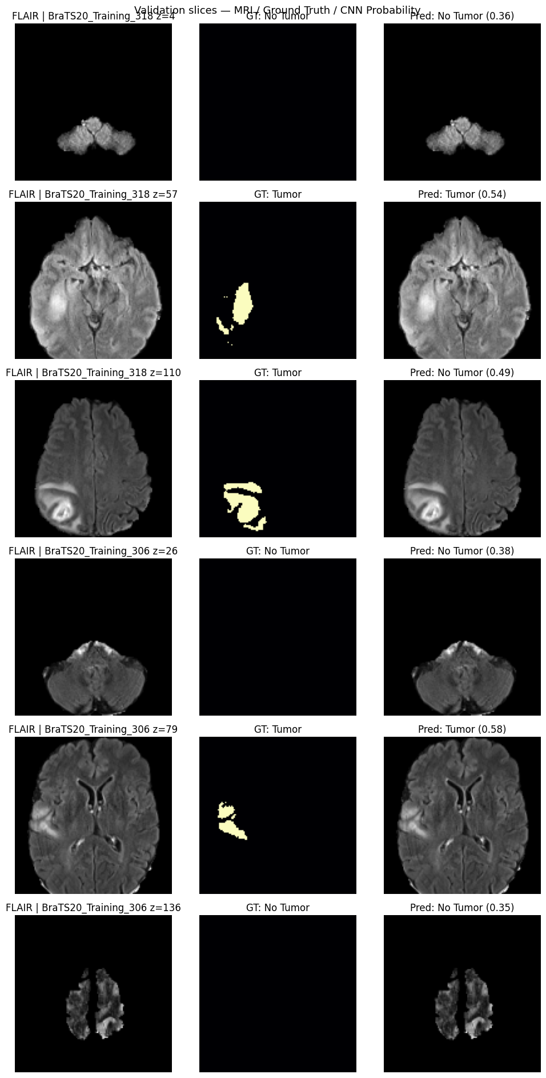
BRAIN + MRI RESEARCH PLATFORM
T5 CNN: actual inference visualization
Notebook evidence demonstrates genuine preprocessed-slice predictions.
• UI renders original MRI and exact 128 × 128 model input.
• Tutorial data can show actual label separately; arbitrary uploads do not have ground truth.
• Probabilities are model estimates, never diagnostic certainty.
Original notebook CNN prediction outputs.
24 | Healthcare project evidence deck
Research-only · not a clinical diagnosis

Slide 25
BRAIN + MRI RESEARCH PLATFORM
T5 CNN: result interpretation
Model output is technically useful only within its documented scope.
• A sigmoid probability ranks the uploaded/preprocessed slice under the trained experimental model.
• Thresholding at 0.50 creates a class label; it does not transform probability into clinical certainty.
• False negatives in the held-out matrix and one-patient test design require a conservative interpretation.
Actual integration preview and held-out confusion-matrix evidence.
25 | Healthcare project evidence deck
Research-only · not a clinical diagnosis

Slide 26
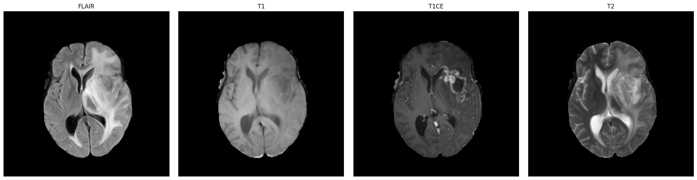
BRAIN + MRI RESEARCH PLATFORM
T6: multimodal MRI visualization
Aim: compare compatible modalities and supplied segmentation context.
• Same-case volumes are rendered with consistent orientation.
• SEG pane is supplied reference where present—not CNN output.
• Modality comparison precedes downstream interpretation.
Actual T6 notebook/project visualizations.
26 | Healthcare project evidence deck
Research-only · not a clinical diagnosis

Slide 27
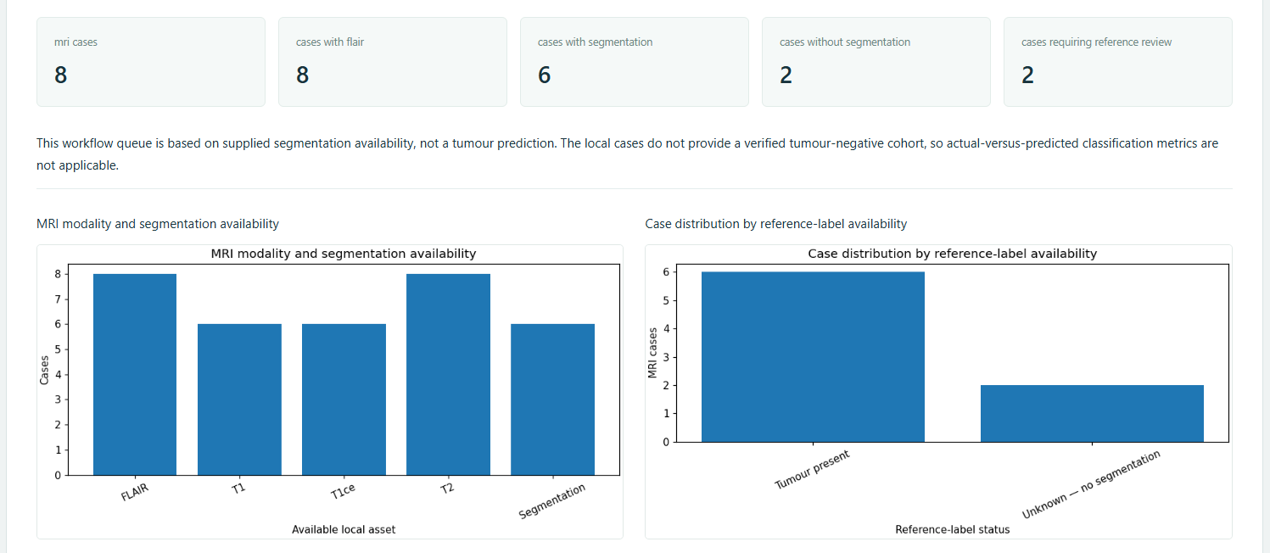
BRAIN + MRI RESEARCH PLATFORM
T7: MRI review queue
Aim: operational case review from actual data availability.
• Input: discovered local cases plus FLAIR/SEG availability.
• Output: review state and completeness status; T7–T9 do not request synthetic text examples.
• Availability is operational metadata, not a medical finding.
Actual T7 availability/completeness output.
27 | Healthcare project evidence deck
Research-only · not a clinical diagnosis

Slide 28
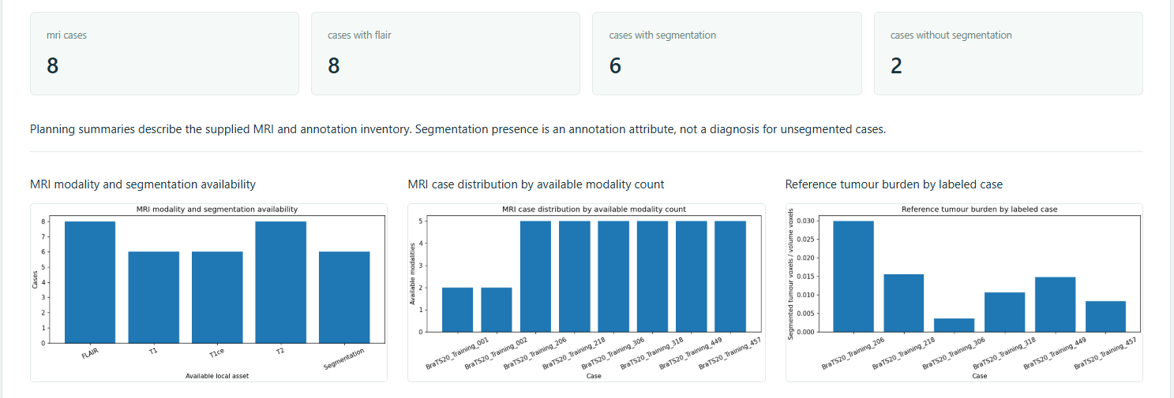
BRAIN + MRI RESEARCH PLATFORM
T8: healthcare data analysis
Aim: inspect dataset inventory and supplied tumour-burden information.
• Inputs: local metadata and SEG only where provided.
• Processing: counts, availability checks and volume-derived summaries.
• Small local summaries are repository descriptions—not epidemiological estimates.
Actual T8 inventory and distribution dashboard.
28 | Healthcare project evidence deck
Research-only · not a clinical diagnosis

Slide 29
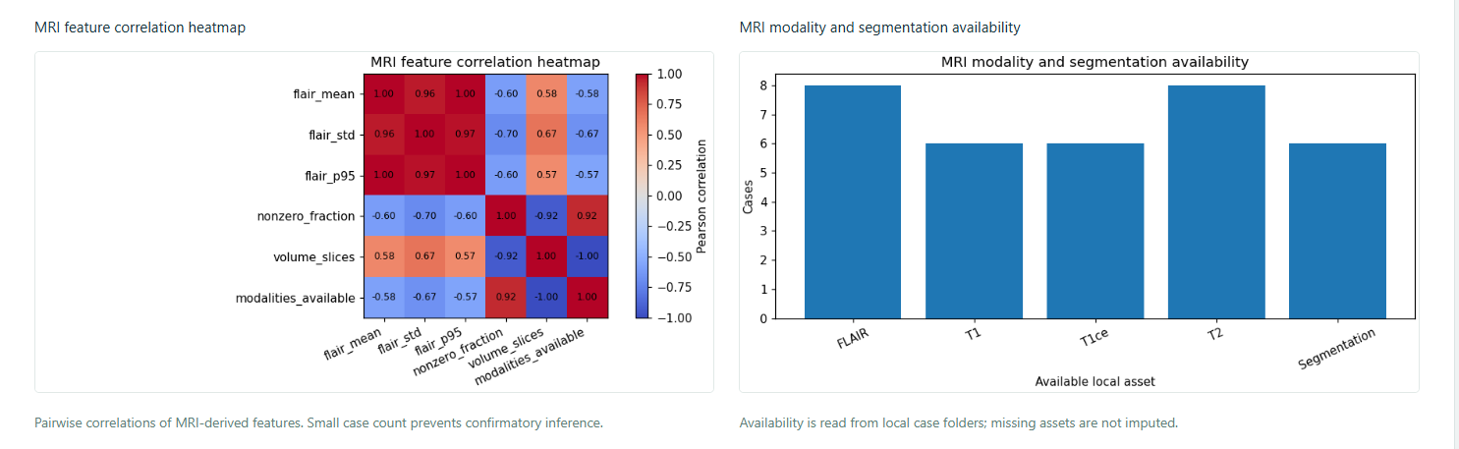
BRAIN + MRI RESEARCH PLATFORM
T9: feature exploration
Aim: derive MRI features for descriptive statistics.
• Normalized images/volumes yield intensity and simple morphology-derived exploration.
• Associations are descriptive; local cohort size limits inference and generalisation.
Actual T9 feature-correlation and availability output.
29 | Healthcare project evidence deck
Research-only · not a clinical diagnosis

Slide 30
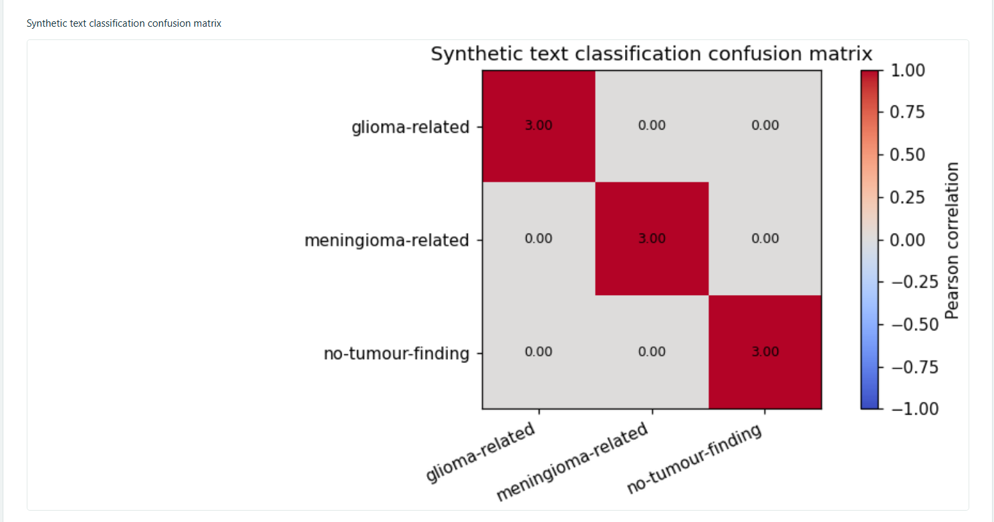
BRAIN + MRI RESEARCH PLATFORM
T10: text classification
A synthetic teaching-report workflow, distinct from MRI imaging.
• Supported synthetic CSV examples are restricted to T10–T12.
• TF–IDF features feed logistic classification and class-oriented tutorial outputs.
• No real patient reports, clinical NLP accuracy or diagnosis is claimed.
Actual T10 synthetic-text classification confusion matrix.
30 | Healthcare project evidence deck
Research-only · not a clinical diagnosis

Slide 31
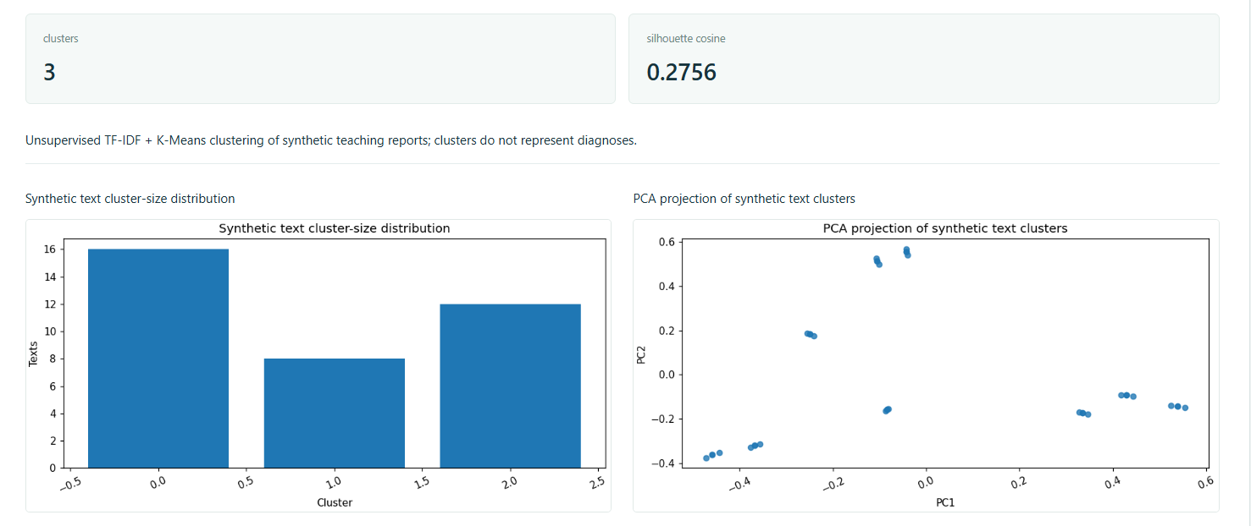
BRAIN + MRI RESEARCH PLATFORM
T10: clustering
Clustering remains independent from text classification.
• TF–IDF vectors feed K-Means; cluster IDs describe lexical similarity, not diagnoses.
• Separate UI controls preserve the difference between supervised and unsupervised workflows.
Actual T10 clustering distribution and PCA projection.
31 | Healthcare project evidence deck
Research-only · not a clinical diagnosis

Slide 32
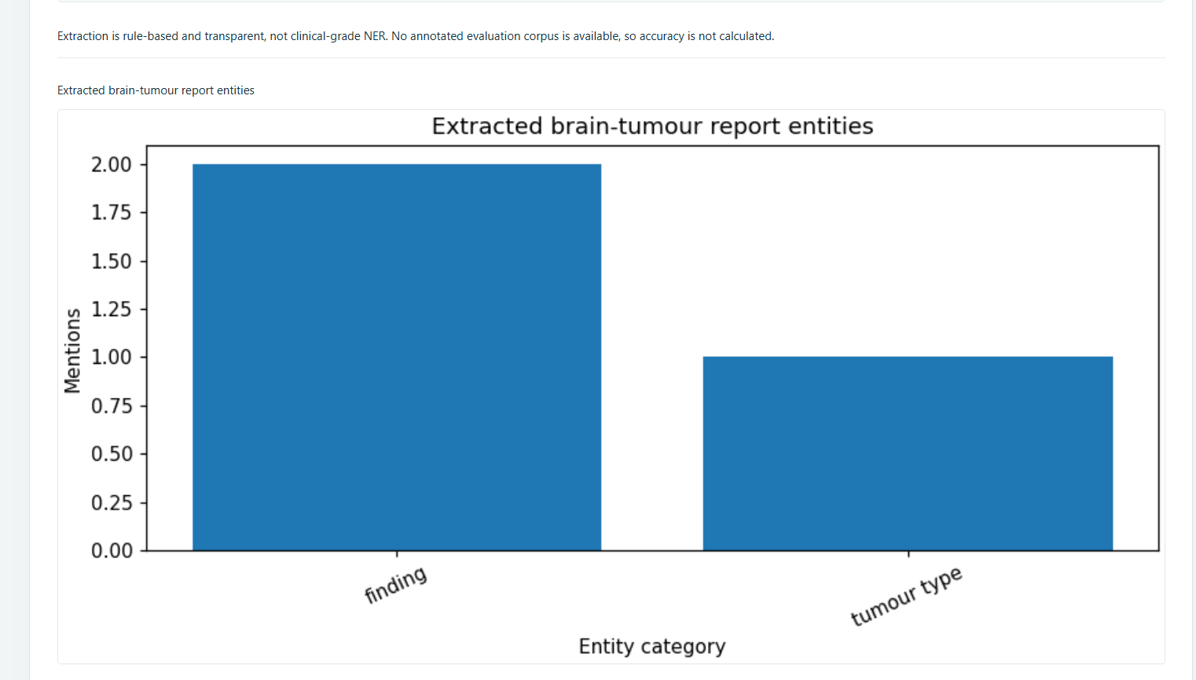
BRAIN + MRI RESEARCH PLATFORM
T11: entity extraction
Transparent lexicon and measurement-rule extraction.
• Synthetic text is processed with term and pattern matching.
• Output is structured teaching evidence, not a trained clinical NER system.
Actual T11 extracted-entity output.
32 | Healthcare project evidence deck
Research-only · not a clinical diagnosis

Slide 33
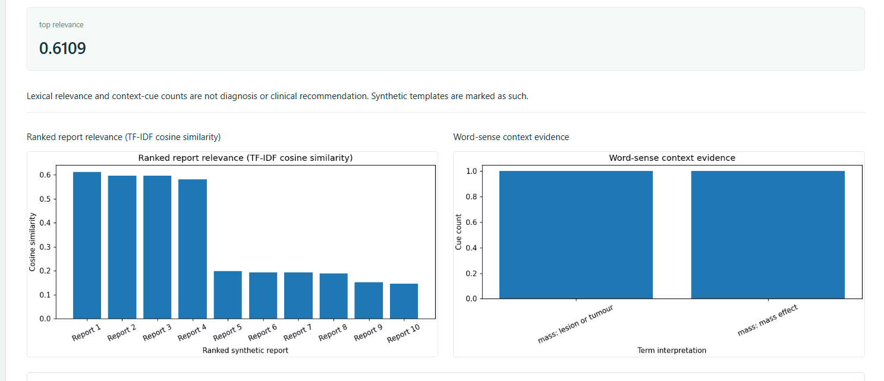
BRAIN + MRI RESEARCH PLATFORM
T12: ranking and disambiguation
TF–IDF cosine ranking of synthetic report passages.
• Query/corpus → vectorisation → cosine similarity → ranked result with ambiguity context.
• This demonstrates retrieval mechanics, not clinical decision support.
Actual T12 ranking and word-overlap output.
33 | Healthcare project evidence deck
Research-only · not a clinical diagnosis

Slide 34
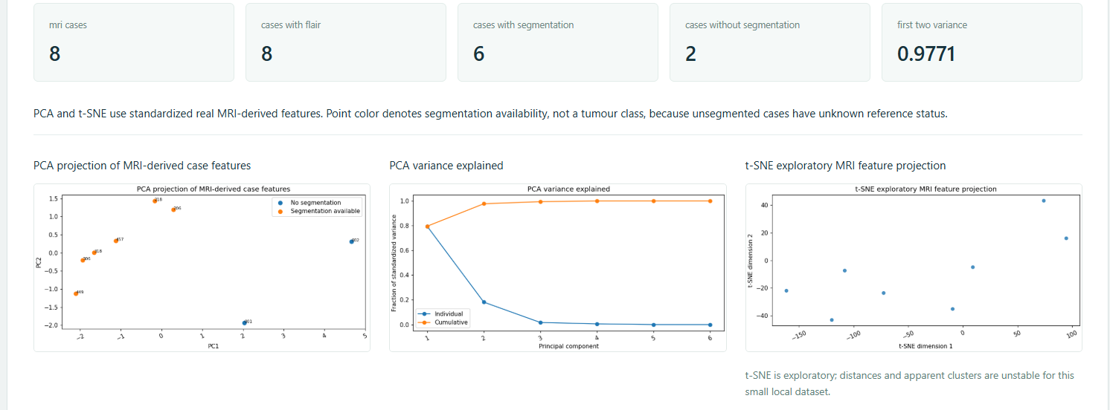
BRAIN + MRI RESEARCH PLATFORM
T13: PCA and t-SNE
Aim: lower-dimensional exploratory projections of standardised MRI features.
• PCA reports linear projection/explained-variance evidence; t-SNE offers nonlinear neighbourhoods.
• Visual clusters are hypothesis-generating, not validated biological subtypes.
Actual T13 PCA, t-SNE and feature-space output.
34 | Healthcare project evidence deck
Research-only · not a clinical diagnosis

Slide 35
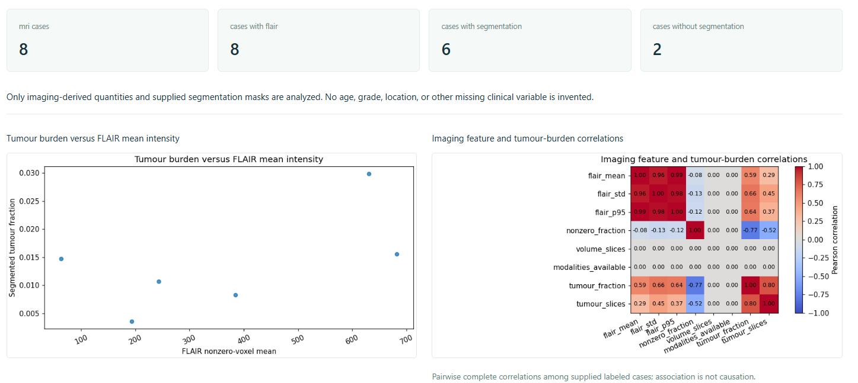
BRAIN + MRI RESEARCH PLATFORM
T14: tumour-burden associations
Aim: exploratory associations with supplied reference-mask burden.
• Feature summaries are paired with SEG-derived burden only when a reference mask exists.
• Association plots are non-causal and missing masks remain missing.
Actual T14 association/correlation output.
35 | Healthcare project evidence deck
Research-only · not a clinical diagnosis

Slide 36
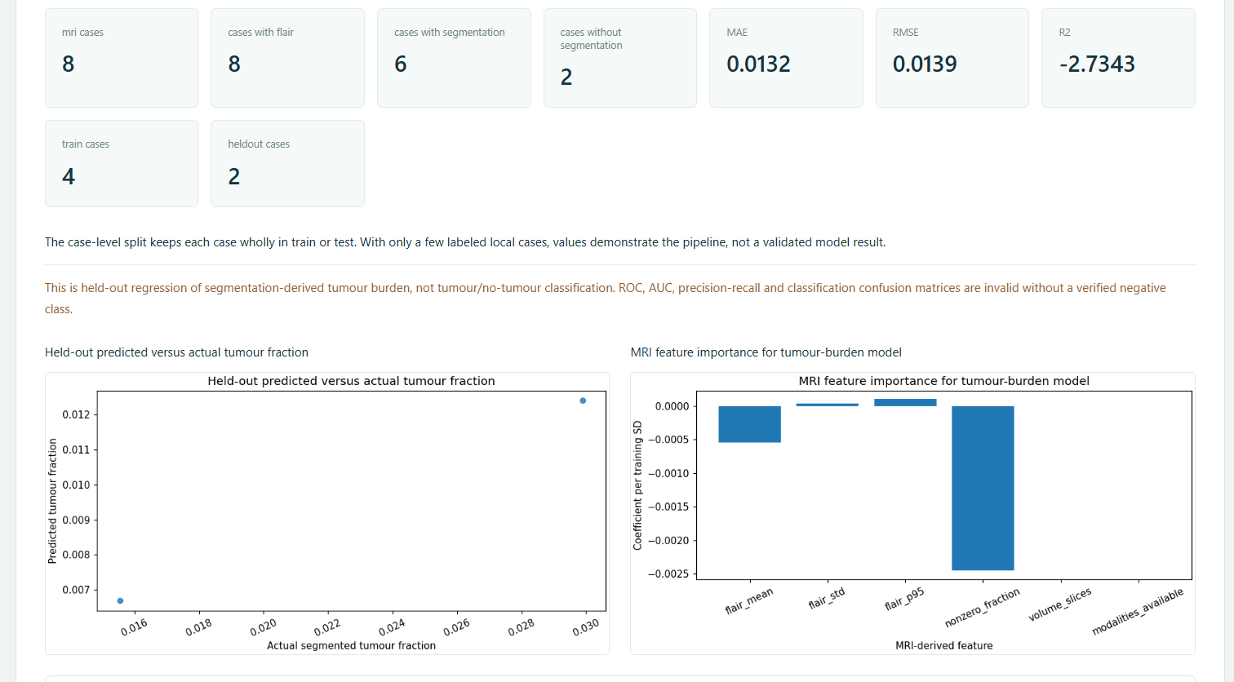
BRAIN + MRI RESEARCH PLATFORM
T15: held-out regression
Aim: estimate segmentation-derived tumour burden continuously.
• Task is regression, not tumour/no-tumour classification.
• Prediction-versus-reference visualisation requires regression metrics—not an invalid ROC claim.
• Local size limits confidence in generalisation.
Actual T15 held-out regression output.
36 | Healthcare project evidence deck
Research-only · not a clinical diagnosis

Slide 37
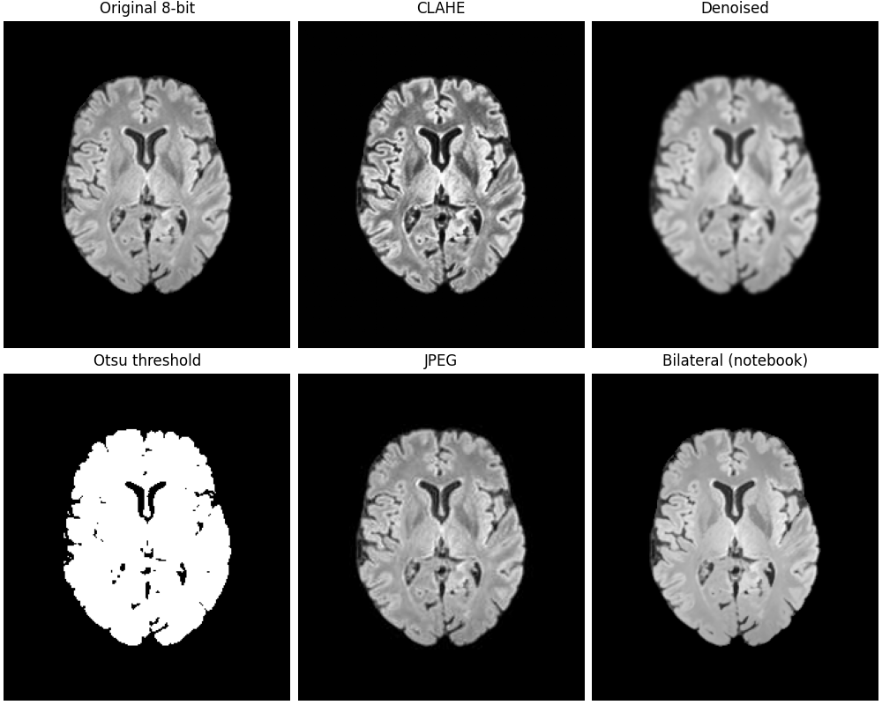
BRAIN + MRI RESEARCH PLATFORM
Image Analysis Studio
SIFT/RANSAC and CNN cards render actual serialized image results.
• Controls → endpoint → preprocess/model or feature algorithm → PNG/JPEG data URL → responsive cards.
• CNN cards present input, label only if available, probability/class and saved evaluation evidence.
• SIFT/RANSAC remains an independent working visual workflow.
Actual project visual assets.
37 | Healthcare project evidence deck
Research-only · not a clinical diagnosis

Slide 38
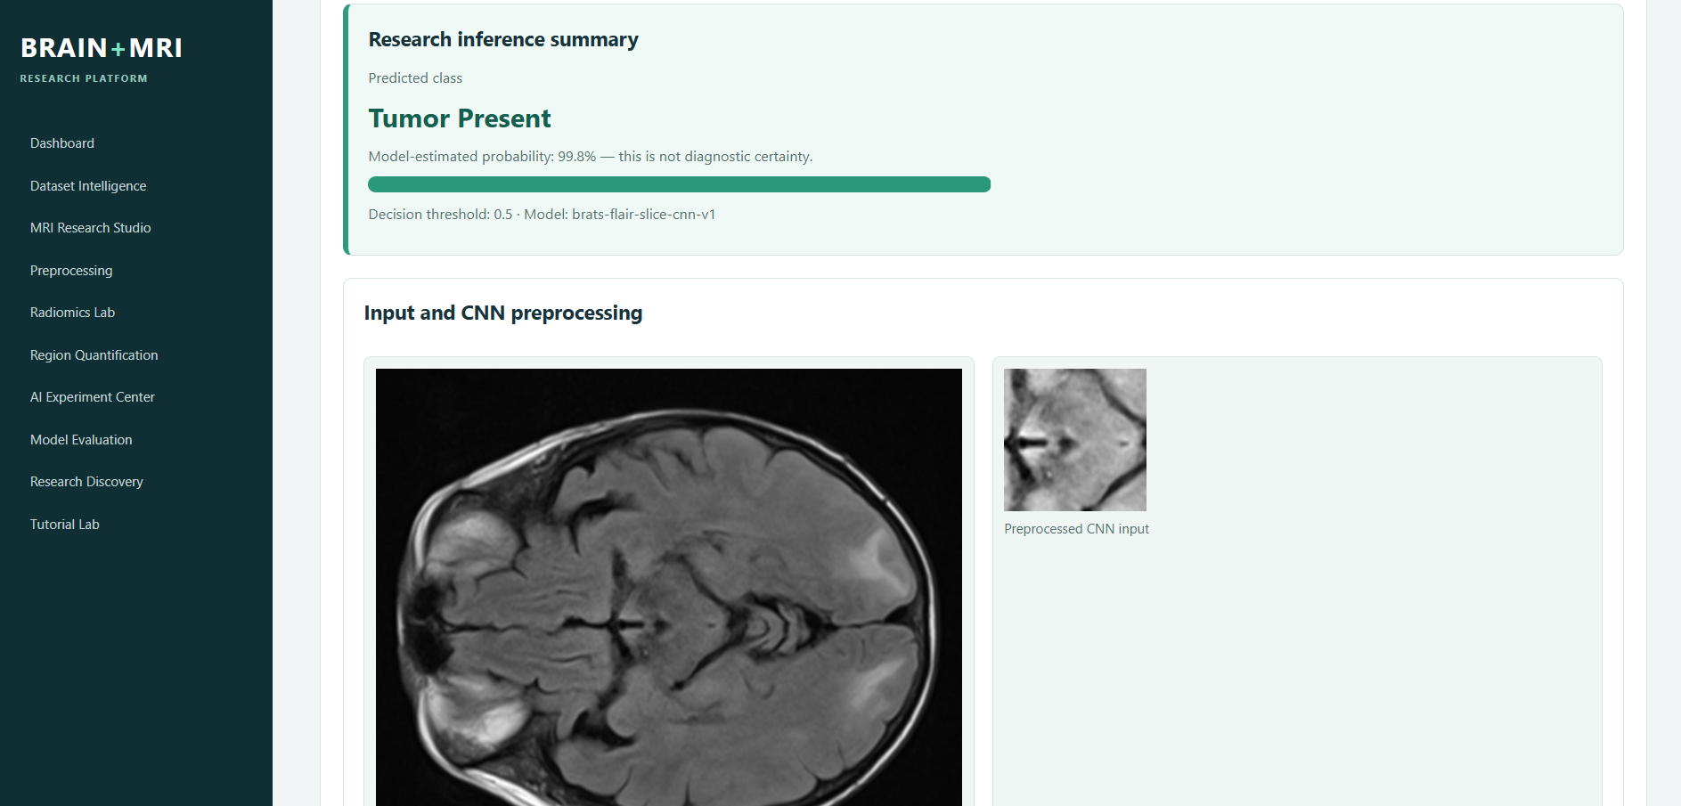
BRAIN + MRI RESEARCH PLATFORM
MRI Upload & AI Analysis
Persistent checkpoint inference is a separate application workflow.
• Compatible PNG/JPEG/NIfTI FLAIR inputs are server-validated (30 MB maximum).
• L/LA/RGB/RGBA images normalise safely to one grayscale channel, then reuse the unchanged FLAIR preprocessing.
• Response includes previews, slice probabilities/classes, duration and limitations.
Actual MRI Upload & AI Analysis inference interface.
38 | Healthcare project evidence deck
Research-only · not a clinical diagnosis

Slide 39
BRAIN + MRI RESEARCH PLATFORM
Research reporting and reproducibility
Reports retain actual response data and limitations.
• HTML/PDF reports contain metadata, model version, preprocessing, previews and returned slice predictions.
• No dataset reference mask is presented as an upload prediction; no synthetic metrics are generated.
• Artifacts: checkpoint, metadata, history, evaluation JSON, curves, ROC and matrix.
RESPONSE
→
REPORT
→
HTML / PDF
→
RECORD
39 | Healthcare project evidence deck
Research-only · not a clinical diagnosis

Slide 40
BRAIN + MRI RESEARCH PLATFORM
Implementation traceability
Source files map directly to visible project behaviour.
• `her_core/cnn.py`: exact preprocessing branch and saved CNN architecture.
• `scripts/train_brain_tumor_cnn.py`: patient-level experiment and persisted artifacts.
• `backend/main.py` / `backend/tutorials.py`: validated API routes; `frontend/*`: response rendering and contextual navigation.
INPUT
→
VALIDATE
→
COMPUTE
→
INTERPRET
40 | Healthcare project evidence deck
Research-only · not a clinical diagnosis

Slide 41
BRAIN + MRI RESEARCH PLATFORM
Implementation verification
Automated checks previously completed against this project.
• Python: 21 passed (39 subtests) in the recorded project verification run.
• Frontend integration covered T1–T15 and CNN visualization wiring; app integration checks completed.
• This delivery validates asset presence, PPTX package slide count and all rendered PDF pages.
✓ Technical depth
→
✓ Original figures
→
✓ T1–T15 coverage
→
✓ Saved metrics
→
✓ Limits visible
→
✓ QA
41 | Healthcare project evidence deck
Research-only · not a clinical diagnosis

Slide 42
BRAIN + MRI RESEARCH PLATFORM
Limitations and safeguards
Transparency is a core technical requirement.
• Six labelled cases and one held-out test patient: experimental slice-level evidence only.
• No patient diagnosis, segmentation prediction, clinical confidence or arbitrary-upload accuracy is asserted.
• Raw BraTS data remains local/authorized; uploads are validated and not publicly exposed.
SMALL COHORT
→
METRICS
→
LIMITS
→
NO CLAIM
42 | Healthcare project evidence deck
Research-only · not a clinical diagnosis

Slide 43
BRAIN + MRI RESEARCH PLATFORM
Future work
Substantive improvements require new data and validation.
• Multi-centre cohorts, prospective patient-level splits and independent test sets.
• Calibration/threshold selection within documented use cases and uncertainty analysis.
• Segmentation only after genuine segmentation-specific training/validation.
NEW DATA
→
VALIDATE
→
CALIBRATE
→
GOVERN
43 | Healthcare project evidence deck
Research-only · not a clinical diagnosis

Slide 44
BRAIN + MRI RESEARCH PLATFORM
Conclusion
A reproducible academic platform connecting MRI engineering, tutorials and transparent AI evidence.
• T1–T15 are represented through distinct aims, methods, actual output and limitations.
• The persistent FLAIR CNN is integrated but remains experimental and slice-level.
• Source-backed visuals and metrics make the work inspectable for an academic demonstration.
Actual inference and held-out evaluation artifacts.
44 | Healthcare project evidence deck
Research-only · not a clinical diagnosis

