Slide 1
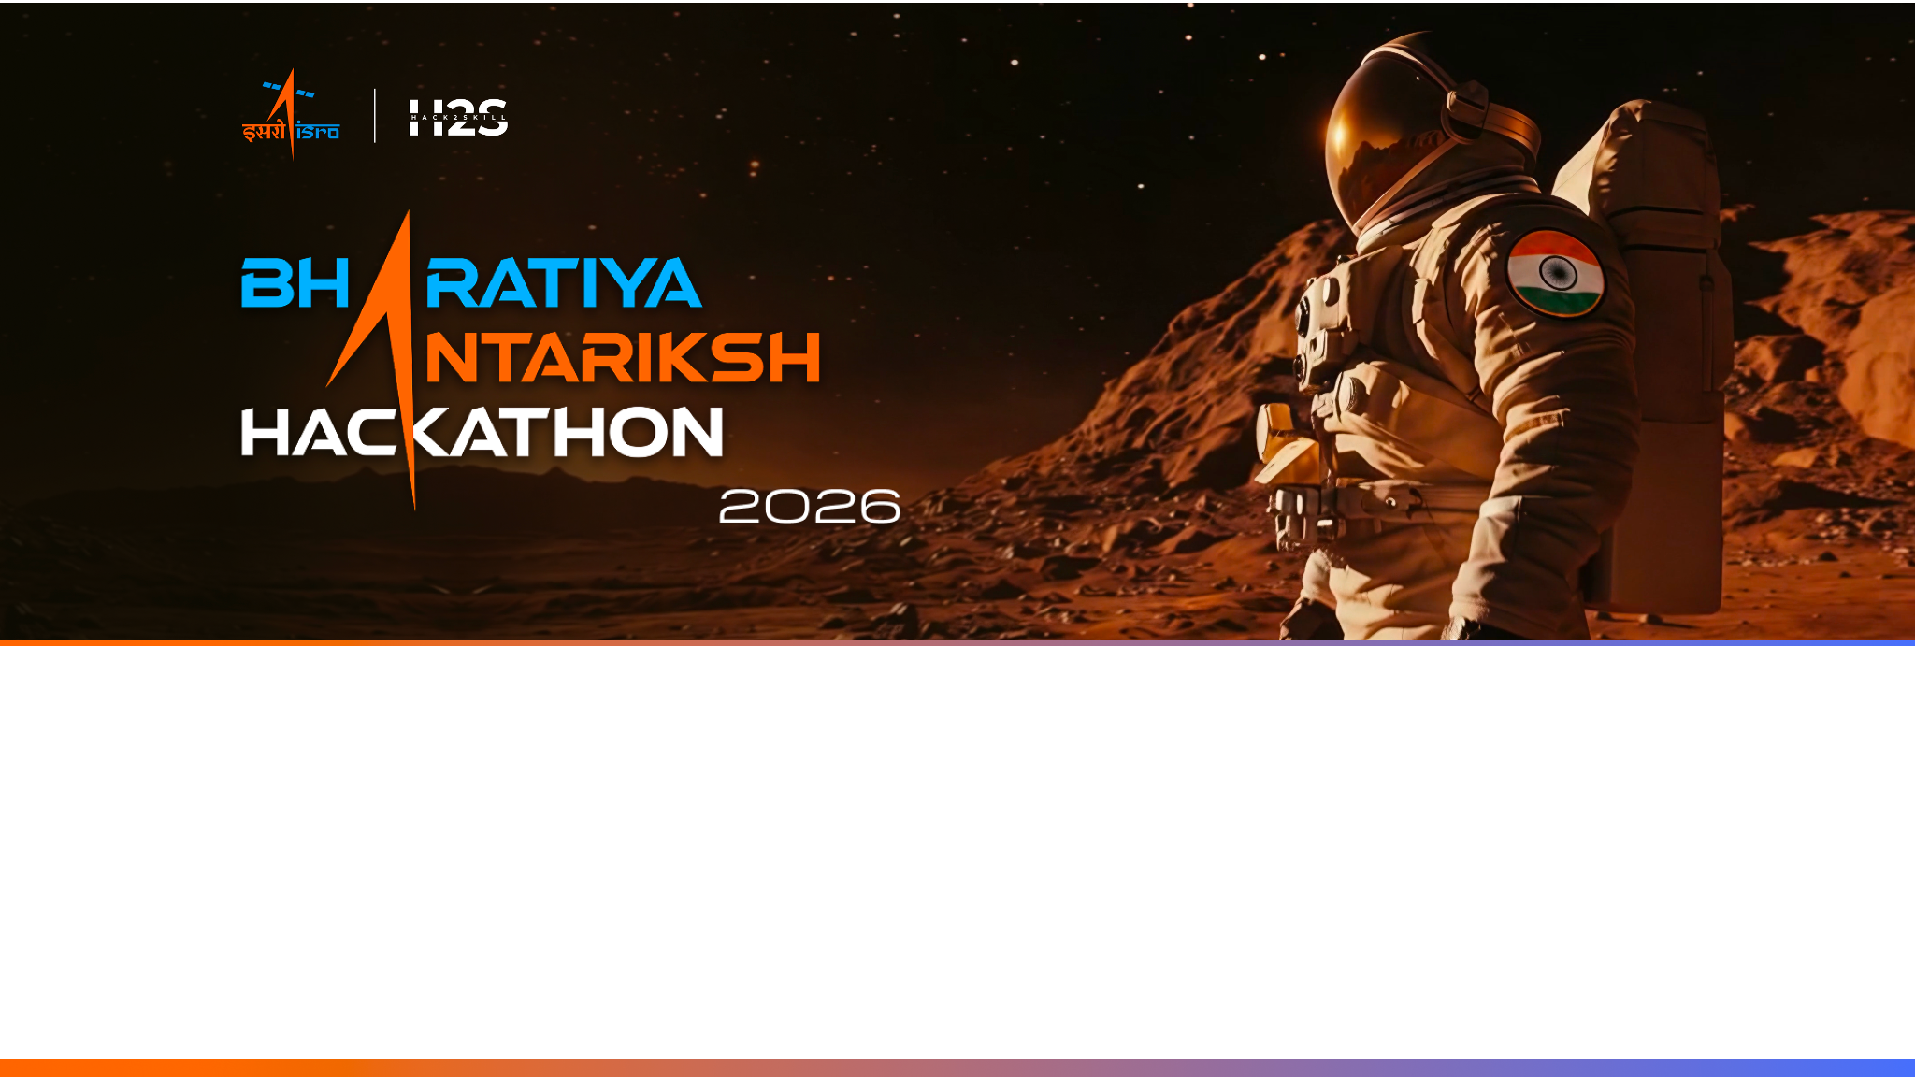
Team Name : Phoenix 🐦‍🔥
Team Leader Name : Anushka Dabhade
Problem Statement : PS 12 - Fill in the Frames Seamlessly - Enhancing Temporal
Resolution of Satellite Imagery using the techniques of AI/ML based on Optical Flow

Slide 2

Team Members
Team Leader: Name: Anushka Dabhade College: New LJ Institute of Engineering | Team Member-1: Name: Krithik Naidu College : New LJ Institute of Engineering
Team Member-2: Name: Deval Thakor College: New LJ Institute of Engineering | Team Member-3: Name: Fagun Soni College: New LJ Institute of Engineering

Slide 3
The Gap Nobody Else Closes
How our approach differs from every optical-flow and video-interpolation tool in use today.
WHAT'S OUT THERE TODAY
WHAT WE BUILT INSTEAD
1
Multi-Scale Optical Flow
Mesoscale drift + convective cells, modeled together
2
Cloud-Boundary Loss
Laplacian edge term keeps storm edges sharp
Traditional Optical Flow
Farneback / Lucas-Kanade break the moment a cloud rotates, forms, or dissolves.
3
Per-Pixel Confidence Maps
Know exactly what to trust in every frame
4
GOES/Himawari → INSAT Transfer Pretrain on 10-minute GOES/HIMAWARI satellite data, then fine-tune on INSAT data so the model can better adapt to regional weather conditions when applied.
5
Kelvin-Preserving Preprocessing
Physical meaning never sacrificed for convenience
6
Self-Supervised Training
Model learns temporal patterns directly from sequential satellite observations without manual labeling.
Generic Video Interpolation
RIFE / Super SloMo are cinema tools. single-scale, no physical meaning preserved.
7
Cloud Motion + Temporal Score
New metrics built for atmospheric motion
8
Generalizes Across Satellites
One pipeline : GOES, Himawari & INSAT alike

Slide 4
From Blind Spot to Trusted Forecast
INSAT-3DS photographs India every 30 minutes. A cyclone can jump Category 1 → 3 in 20 , invisible until now.
Ingest
.nc Frames
Dual-Scale
RAFT Flow
Modified
RIFE Synthesis
Confidence
Head
Fine-tune on
INSAT-3DS
Validation
Dashboard
Built for Satellites, Not Cinema
Two Scales, Fused
Confidence Maps That Operate
Existing video interpolation approaches are not optimized for satellite-specific atmospheric dynamics.Ours is designed from scratch for thermal infrared physics.
Our dual-scale architecture jointly models mesoscale drift and convective-scale cloud motion for improved atmospheric motion estimation.
A frame without a reliability score is a demo. Per-pixel confidence turns this into something IMD could actually deploy.
“We don't interpolate pixels , we model atmospheric physics at multiple scales, and tell you exactly how much to trust each frame.”
‘’Prototype will initially be trained on a smaller regional subset before scaling to full-disk satellite imagery.’’

Slide 5
What Our Solution Delivers (Features)
Frame A · t = 0
real INSAT frame
t = 15 ( AI fills this )
+ confidence map
Frame B · t = 30
real INSAT frame
1
Physics-Preserving Pipeline
2
Dual-Scale Flow Estimation
3
Satellite-Native Synthesis
Brightness temperature stays in Kelvin throughout , percentile-normalized, never flattened.
RAFT at two resolutions: coarse for system drift, fine for convective cells. Fused before synthesis.
Satellite-adapted RIFE interpolation preserves cloud boundaries and reduces blur artifacts during rapid cloud movement.
mesoscale (blue) + convective (orange)
4
Per-Pixel Confidence Maps
5
Pretrain → Fine-tune Transfer
6
Metrics-Rich Dashboard
Rapidly changing cloud regions are automatically flagged as uncertain, allowing forecasters to identify less reliable synthesized areas
Learns motion on GOES/Himawari (10-min truth), then fine-tunes natively on INSAT-3DS.
MSE, PSNR, SSIM, FSIM, plus novel Cloud Motion Score & Temporal Consistency Score.
stable
forming
GOES
HIMA
INSAT

Slide 6
How It Works-End to End (Process flow Diagram)
From raw satellite data to trusted synthetic frames.
Data Ingestion
GOES-19 · Himawari · INSAT : .nc files, Kelvin preserved
Preprocessing
Percentile clipping : physical meaning kept intact
Dual-Scale Optical Flow (RAFT)
Coarse: cyclone drift (1/8 res) · Fine: convective cells (1/2 res) → fused
Frame Synthesis (Modified RIFE)
Frame A + Frame B + fused flow → t = 15 min · Loss: L1 + perceptual + Laplacian edge
Confidence Map
Per-pixel reliability 0→1 , flags forming / dissipating clouds
Transfer Learning
Pretrain: GOES + Himawari · Fine-tune: INSAT-3DS sensor
Validation + Dashboard
MSE · PSNR · SSIM · FSIM · Cloud Motion Score · Temporal Consistency
Novel dual-scale optical flow architecture tailored for atmospheric motion
Confidence maps ( operational trust )
Our dual-scale architecture jointly models mesoscale drift and convective-scale cloud motion for improved atmospheric motion estimation.

Slide 7
What the Meteorologist Sees(Mock Diagram/Wireframes)
The dashboard : Real frames, synthetic frames, confidence, and metrics, all in one view.
Event: Cyclone Biparjoy (Gujarat) · 15 June 2023 · Channel: INSAT-3DS TIR1
Export .nc
t = 00:00
t = 00:30
t = 00:15 ← AI
Real frame
Real frame
Synthetic frame
High confidence
stable cloud core
Low confidence
forming edge cells
SSIM
PSNR
Cloud MS
0.91
34.2 dB
0.87
Temporal consistency:
0.93 / 1.00
00:00
00:15 ★
00:30
00:45 ★
01:00
★ = AI-synthesized frame
“Every synthetic frame ships with a confidence map , so forecasters know exactly what to trust.”

Slide 8
How the System Is Built (Architecture Diagram)
Four layers : Data, preprocessing, AI core, output.
GOES-19
AWS S3 · 10 min
INSAT-3DS
MOSDAC · 30 min
Himawari-8
JMA AWS · 10 min
Preprocessing Engine
NetCDF parser · Kelvin normalizer · Frame aligner · Pair sampler
AI CORE
RAFT Flow Estimator
Multi-resolution motion estimation for capturing both large-scale atmospheric movement and local cloud evolution.
Modified RIFE
Frame synthesizer + confidence head
Transfer Learning Controller
Pretrain weights (GOES/Himawari) → fine-tune pass (INSAT-3DS)
Web Dashboard
Timelapse · metrics · heatmap
Output .nc Store
Synthetic frames + metadata

Slide 9
Technologies Powering the Solution
Purpose-built stack — every tool chosen for a reason.
DATA LAYER
netCDF4
xarray
NumPy
Boto3
Sources: GOES-19 AWS S3 · MOSDAC INSAT-3DS · JMA Himawari-8
AI CORE
RAFT
RIFE (modified)
Confidence Head
Framework: PyTorch · Loss: L1 + perceptual + Laplacian edge
TRAINING
PyTorch Loop
W&B Tracking
Colab / Kaggle GPU
Free-tier compute, sufficient for initial fine-tuning
OUTPUT
React.js
Leaflet.js
Plotly
Flask API
Leaflet handles geospatial lat/lon overlays natively
EVALUATION
scikit-image
SSIM · PSNR · MSE
Cloud Motion Score
Temporal Consistency
Standard image metrics + two domain-specific scores
“No black boxes — every component is explainable, open-source, and reproducible.”

Slide 10
