Slide 1
LOANLENS
Loan risk
research findings
A reproducible ML pipeline and connected web application
Anushka Jain
LoanLens / Anushka Jain
01 / 21
Notes:
SLIDE 1: LoanLens: Loan-risk research findings
TIME BUDGET: 1.5 minutes
DELIVERY CUE: Make eye contact. Speak the first question slowly, pause for three seconds, and do not invite a long discussion yet.
Good morning everyone. I am Anushka Jain, and today I will present LoanLens, a loan-risk research project built around two supplied datasets.
Before we look at the pipeline, let me ask a quick question. Would you trust a model that catches every bad loan?
That sounds impressive. In this project, the selected model did catch all 65 bad loans in the final test set. But it also flagged 62 of the 64 good loans. That tradeoff is the main finding I want you to keep in mind throughout this presentation.
The assignment asked which future applicants should receive a loan. I approached that as an evidence problem: what can the historical data support, how should we evaluate the model, and where does the evidence stop?
I will explain the data relationship, the modeling workflow, the results, and the application. I will also cover the limitations and the additional information needed before this could influence real lending decisions.
My aim is to show a reproducible project and a clear recommendation grounded in its results. I will leave time at the end for questions.
Source: Verified project report, security/privacy audit and source at GitHub commit ab3f6d3fe2ac3c06b92680f3a1e7a551cc831cbe
https://github.com/Anushkajain-7/Loan-Risk-ML-Pipeline
See reports/project_report.md and reports/security_privacy_audit.md in the project repository.

Slide 2
PROBLEM DEFINITION
The business question and target
Can application-time data help estimate
the risk of a loan labeled Bad?
Bad = 1 Good = 0
The dataset does not define Bad or its observation horizon.
Every assessment requires human review. A score alone cannot authorize a loan.
LoanLens / Anushka Jain
02 / 21
Notes:
SLIDE 2: The business question and target
TIME BUDGET: 1.5 minutes
DELIVERY CUE: Explain the difference between predicting a supplied label and deciding whether to issue a loan. Do not call Bad a confirmed default definition.
The practical question is whether application-time information helps distinguish loans labeled Good from loans labeled Bad. I encoded Bad as one and Good as zero, so the positive class is the outcome we want to detect.
There is an important boundary here. The workbook supplies those labels, but it does not define exactly what Bad means. It does not tell us whether that means a missed payment, prolonged delinquency, a write-off, or another business rule. We also do not have a fixed observation horizon.
For that reason, I describe the output as estimated risk of the supplied Bad label. I do not claim it is a validated probability of default over a particular period.
An approval decision would also need affordability information, verified business rules, and the actual costs and benefits of lending. Those are incomplete here.
The project therefore produces a research risk assessment, with human review required for every application. A low score by itself never becomes permission to issue a loan. This boundary shapes both the evaluation and the interface.
Source: Verified project report, security/privacy audit and source at GitHub commit ab3f6d3fe2ac3c06b92680f3a1e7a551cc831cbe
https://github.com/Anushkajain-7/Loan-Risk-ML-Pipeline
See reports/project_report.md and reports/security_privacy_audit.md in the project repository.

Slide 3
DATA INGESTION AND INSPECTION
Two datasets with different coverage
Dataset | Rows | Original fields
Application Data | 647 | 31
Loan Performance | 1,285 | 2
1,269 distinct customer prefixes and 16 second-loan outcomes
Applications dated 16 Oct 2010 to 17 Apr 2011
Every application has Approved status: selection bias affects future use.
LoanLens / Anushka Jain
03 / 21
Notes:
SLIDE 3: Two datasets with different coverage
TIME BUDGET: 2 minutes
DELIVERY CUE: Point to the different row counts. Explain why more outcome rows do not automatically mean more usable training examples.
The workbook contains an application table and a loan-performance table. The application table has 647 rows and 31 original fields. The performance table has 1,285 loan rows with a loan identifier and a Good or Bad label.
The performance table covers 1,269 distinct customer prefixes, and 16 rows represent a second loan. The application dates run from October 2010 to April 2011. Although the period is roughly six months, it touches seven calendar months because the first and last months are partial.
The different row counts immediately raised a relationship question. We cannot treat every outcome row as an independent training example when we do not have the corresponding application information.
Every application also has status Approved. So this is a historical population of borrowers who already received loans. It does not represent everyone who applied, especially applicants the lender declined.
That creates selection bias. A model can learn patterns among approved borrowers while still giving unreliable assessments for the wider applicant population.
My first task was therefore to establish a defensible modeling population. The key step was validating the relationship between customer identifiers and loan identifiers before fitting anything.
Source: Verified project report, security/privacy audit and source at GitHub commit ab3f6d3fe2ac3c06b92680f3a1e7a551cc831cbe
https://github.com/Anushkajain-7/Loan-Risk-ML-Pipeline
See reports/project_report.md and reports/security_privacy_audit.md in the project repository.

Slide 4
DATA VALIDATION
Relationship validation produced 641 first loans
Application records | Count
Supplied application rows | 647
Malformed IDs excluded | 2
Valid but unmatched IDs excluded | 4
Matched first loans | 641
Join rule
Normalize identifier types and case
Match customer_id to the loan prefix
Use suffix -01 as the first-loan assumption
Owner confirmation of the first-loan mapping is still required.
LoanLens / Anushka Jain
04 / 21
Notes:
SLIDE 4: Relationship validation produced 641 first loans
TIME BUDGET: 2 minutes
DELIVERY CUE: Use only a clearly synthetic example, such as abc123def0 and ABC123DEF0-01. Say explicitly that the suffix interpretation needs source-owner confirmation.
The application table uses customer_id, while the performance table uses idLoan with a suffix. The working relationship is that the loan-ID prefix corresponds to the customer ID.
For a synthetic example, an application identifier abc123def0 would match a loan identifier ABC123DEF0-01 after case normalization. The example is illustrative and does not identify a real borrower.
A direct join would miss records because of uppercase and lowercase differences. Nine application IDs were also stored as integers. I therefore converted plausible identifiers to strings, normalized case, and padded shortened identifiers only where the documented length made that reasonable.
The pipeline checks duplicate identifiers and validates a one-to-one merge. It selects suffix -01 to represent the first loan, rather than attaching a later loan outcome to the initial application. That interpretation fits the structure, but the source owner still needs to confirm it.
The result is 641 matched first loans. Two malformed application identifiers and four valid unmatched applications are excluded. Another 628 first-loan outcomes have no matching application row, and the 16 repeat-loan outcomes do not enter this first-loan model.
These exclusions are reported explicitly. Missing relationships are never filled with guessed labels.
Source: Verified project report, security/privacy audit and source at GitHub commit ab3f6d3fe2ac3c06b92680f3a1e7a551cc831cbe
https://github.com/Anushkajain-7/Loan-Risk-ML-Pipeline
See reports/project_report.md and reports/security_privacy_audit.md in the project repository.

Slide 5
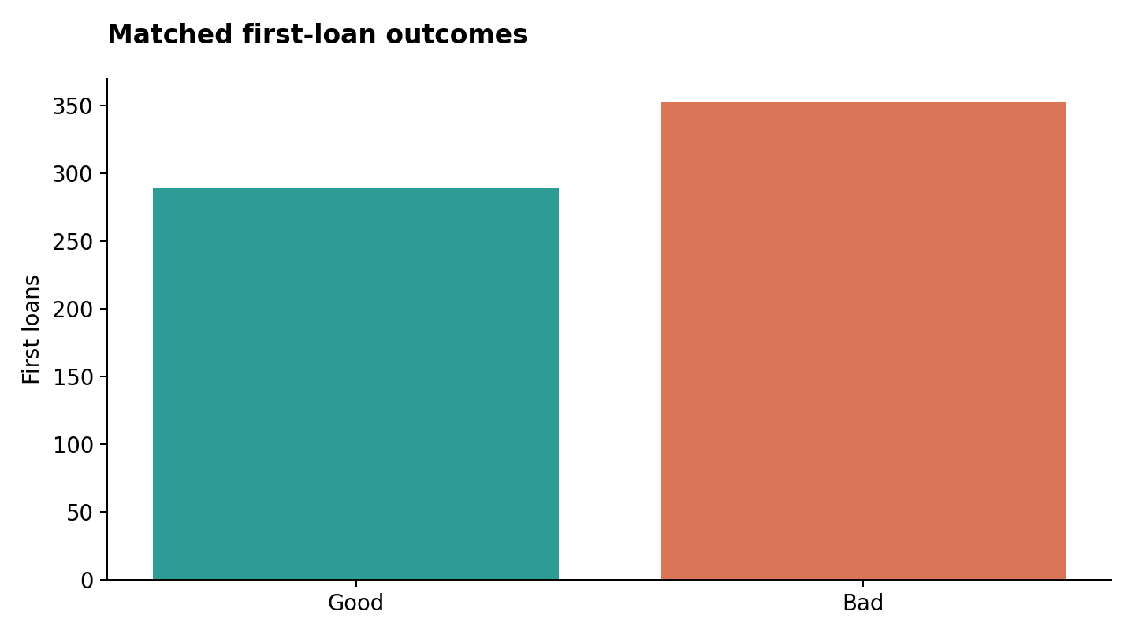
EXPLORATORY ANALYSIS
Data quality and the modeling population
641
matched first loans
289 Good / 352 Bad
Missing values and unusual score codes
Unconfirmed currency, duration units and outcome horizon
LoanLens / Anushka Jain
05 / 21
Notes:
SLIDE 5: Data quality and the modeling population
TIME BUDGET: 2 minutes
DELIVERY CUE: Point to the two bars. Keep the original loan table's population separate from the matched cohort.
Within the matched cohort, 352 loans are labeled Bad and 289 are labeled Good. That is roughly 55 percent Bad. This is the population used for modeling, and it differs from the full performance table.
That distribution matters because severe class imbalance is not the main challenge here. I did not apply SMOTE simply because the task involves lending. The model and evaluation should respond to the distribution we actually have.
There are missing values in several original fields. Some of those fields are excluded from the model, while retained missing values are handled inside the fitted preprocessing pipeline. Two matched records also report monthly rent greater than monthly income, which raises an affordability verification question.
Some score values are unusually low, including L2C values of 50 and FICO-family values of 222. I cannot assume they are errors. They may be valid observations or special codes. A source dictionary would determine how to treat them.
Finally, the dataset does not establish currency, duration units, or the meaning of the housing boolean. I avoid assuming these are rupees or that the model transfers directly to current Indian applicants. These gaps are part of the findings, rather than details to hide in an appendix.
Source: Verified project report, security/privacy audit and source at GitHub commit ab3f6d3fe2ac3c06b92680f3a1e7a551cc831cbe
https://github.com/Anushkajain-7/Loan-Risk-ML-Pipeline
See reports/project_report.md and reports/security_privacy_audit.md in the project repository.

Slide 6
DATA PROCESSING AND FEATURE ENGINEERING
Features and preprocessing
14 origination inputs
One saved pipeline
Requested amount and duration, income and rent
Median imputation with missing indicators
StandardScaler for numeric values
Five scores, payment frequency, deposit and ACH flags, coarse tenure
Category imputation and one-hot encoding
Two additional ratios: request/income and rent/income
Prediction features exclude identity, age and approval-time information.
LoanLens / Anushka Jain
06 / 21
Notes:
SLIDE 6: Features and preprocessing
TIME BUDGET: 2 minutes
DELIVERY CUE: Show feature groups rather than reading all 14 field names. Explain one ratio with synthetic numbers.
The model keeps 14 application-time inputs. These include requested amount and duration, monthly income and rent, five score fields, direct-deposit and ACH indicators, coarse tenure categories, and payment frequency.
I also added two ratios: requested amount divided by monthly income, and rent divided by monthly income. For a synthetic example, a request of 500 with income of 2,400 produces a request-to-income ratio of about 20.8 percent. These ratios describe relative financial burden using the available data. They do not establish complete affordability.
I excluded personal identifiers such as customer ID, email, date of birth, ZIP code, and bank routing number. Approval amounts and other approval-time information are also excluded because they may be unavailable or inappropriate when assessing a new application. Fields with unclear timing or semantics are treated conservatively.
Numeric preprocessing uses median imputation, missingness indicators, and StandardScaler. Categorical preprocessing uses imputation and one-hot encoding.
Crucially, all of this sits inside a scikit-learn pipeline. Each training fold learns its own transformations, and the same saved transformations handle future requests. That helps prevent leakage and keeps application behavior consistent with training.
Source: Verified project report, security/privacy audit and source at GitHub commit ab3f6d3fe2ac3c06b92680f3a1e7a551cc831cbe
https://github.com/Anushkajain-7/Loan-Risk-ML-Pipeline
See reports/project_report.md and reports/security_privacy_audit.md in the project repository.

Slide 7
EXPERIMENT DESIGN
A chronological evaluation design
Order in time | Records | Purpose
Earliest | 384 | Training and expanding-window CV
Next | 64 | Probability calibration
Next | 64 | Threshold selection
Latest | 129 | Untouched holdout test
Three expanding CV folds within the training subset. Later subsets remain separate.
LoanLens / Anushka Jain
07 / 21
Notes:
SLIDE 7: A chronological evaluation design
TIME BUDGET: 2 minutes
DELIVERY CUE: Use a four-row table. Follow the order with your pointer. Distinguish calibration from threshold tuning.
Future applications arrive after historical applications, so I used a chronological evaluation design. The earliest 384 matched records form the training block. Within that block, three expanding-window cross-validation folds compare the candidate models.
The next 64 records calibrate the selected, frozen model. A separate group of 64 records selects the operating threshold. The final 129 records form the untouched chronological test set.
Calibration and threshold selection answer different questions. Calibration asks whether a predicted probability is a reasonable reflection of observed outcomes. Threshold selection asks where to place an operational flag under a chosen cost assumption.
The test set takes part in neither step. I do not use its labels to select a model, fit preprocessing, calibrate probabilities, or choose the cutoff.
This design gives us a more relevant evaluation than a random shuffle for a future-request application. It still has a limit: we do not know when each historical outcome became observable. Chronological application dates cannot prove that all training labels would have matured before a later prediction.
So the split improves the experiment, while the missing outcome timestamps remain an unresolved data requirement.
Source: Verified project report, security/privacy audit and source at GitHub commit ab3f6d3fe2ac3c06b92680f3a1e7a551cc831cbe
https://github.com/Anushkajain-7/Loan-Risk-ML-Pipeline
See reports/project_report.md and reports/security_privacy_audit.md in the project repository.

Slide 8
EXPERIMENT TRACKING AND MODEL TRAINING
The random forest led cross-validation
Model | Average precision | ROC-AUC
Dummy baseline | 0.580 | 0.500
Logistic regression | 0.646 | 0.568
Random forest | 0.664 | 0.609
Histogram gradient boosting | 0.650 | 0.580
Selection used CV average precision. Sigmoid calibration used the separate 64 records.
LoanLens / Anushka Jain
08 / 21
Notes:
SLIDE 8: The random forest led cross-validation
TIME BUDGET: 2 minutes
DELIVERY CUE: Label all numbers as mean cross-validation average precision. Do not mix them with test results.
I compared four candidates using the same evaluation structure: a constant-prior dummy baseline, regularized logistic regression, a shallow random forest, and histogram gradient boosting.
The baseline is important because it tells us what performance looks like without useful individual risk ranking. Logistic regression gives an interpretable statistical benchmark. The tree models allow nonlinear relationships and interactions.
The selection criterion was mean cross-validation average precision for the Bad class. The baseline achieved about 0.580, logistic regression 0.646, the forest 0.664, and histogram gradient boosting 0.650.
The forest therefore became the selected candidate. That means it led this defined comparison. It does not mean it is universally the best algorithm for lending. The differences are fairly small, and the dataset is limited.
Experiment records capture the model parameters, fold metrics, fixed random seeds, and runtime versions. Model metadata also records the source fingerprint and split information. This makes the result inspectable and reproducible.
I avoided adding a complex neural network just to make the project look more advanced. With hundreds of matched records, careful validation and simple, well-controlled baselines deserve priority. The next test is whether the selected model holds up on later applications.
Source: Verified project report, security/privacy audit and source at GitHub commit ab3f6d3fe2ac3c06b92680f3a1e7a551cc831cbe
https://github.com/Anushkajain-7/Loan-Risk-ML-Pipeline
See reports/project_report.md and reports/security_privacy_audit.md in the project repository.

Slide 9
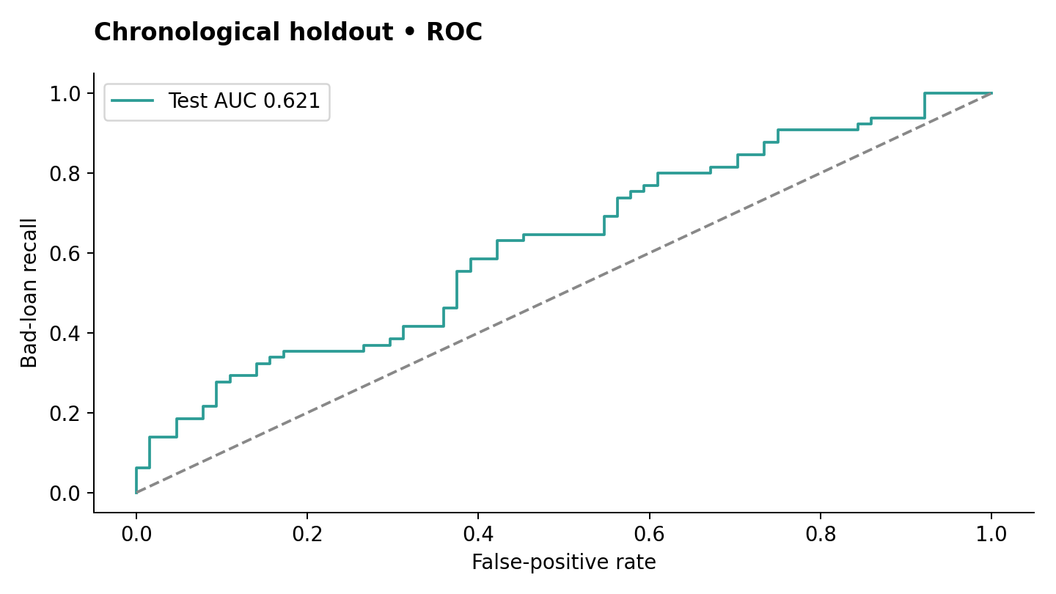
MODEL EVALUATION
Holdout ranking improved modestly
0.621
test ROC-AUC
Baseline: 0.500
129 holdout loans
Average precision: 0.650
Bootstrap AUC interval:
0.522–0.713
LoanLens / Anushka Jain
09 / 21
Notes:
SLIDE 9: Holdout ranking improved modestly over the baseline
TIME BUDGET: 2 minutes
DELIVERY CUE: Point to the diagonal and then the model curve. Say 'ranking performance' and never '62.1% accuracy.'
On the final chronological holdout, the selected model achieved ROC-AUC of approximately 0.621. The constant-prior baseline achieved 0.500. Average precision was about 0.650, compared with a baseline of 0.504.
ROC-AUC describes ranking across thresholds. Roughly speaking, an AUC of 0.621 means the model places a randomly selected Bad loan above a randomly selected Good loan about 62 percent of the time, accounting for tied scores in the metric. It does not mean the model is 62.1 percent accurate.
The result suggests some predictive signal in this sample. The improvement is modest, and the holdout contains only 129 loans.
The bootstrap AUC interval is approximately 0.522 to 0.713. That is a broad range. It reflects resampling uncertainty within this fixed sample and model. It does not cover every source of uncertainty, including historical selection bias, future population changes, or the missing target definition.
This is the point where I would be careful with the headline. Ranking above a baseline is useful research evidence. We still need to understand what the selected operating threshold does to actual borrowers. That is where the main limitation becomes very visible.
Source: Verified project report, security/privacy audit and source at GitHub commit ab3f6d3fe2ac3c06b92680f3a1e7a551cc831cbe
https://github.com/Anushkajain-7/Loan-Risk-ML-Pipeline
See reports/project_report.md and reports/security_privacy_audit.md in the project repository.

Slide 10
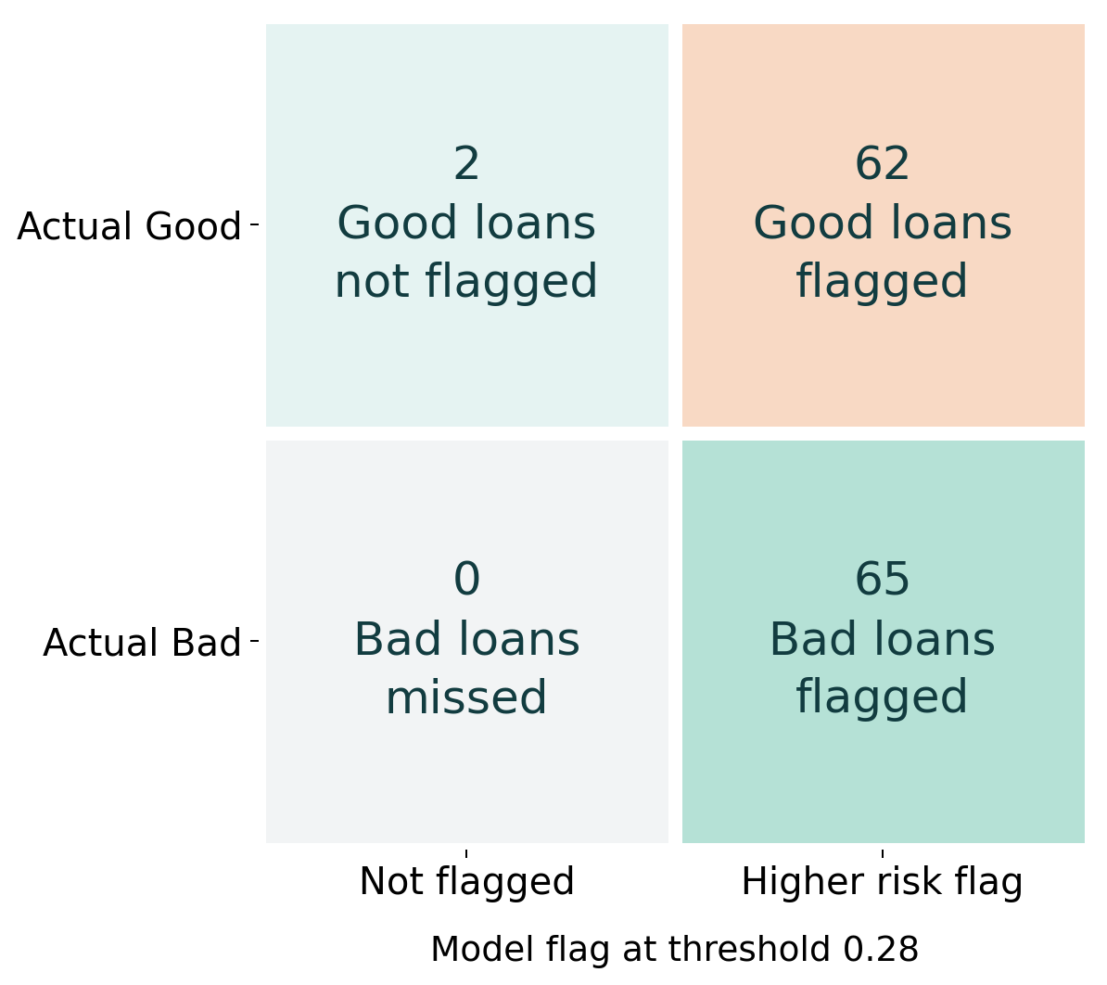
PREDICTION LOGIC AND BUSINESS TRADEOFF
The threshold flags almost every loan
127 / 129
loans receive a
higher risk flag
Threshold: 0.28
Bad recall: 100%
Good specificity: 3.1%
The assumed 5:1 cost ratio requires confirmation from the lender.
LoanLens / Anushka Jain
10 / 21
Notes:
SLIDE 10: The threshold flags almost every loan
TIME BUDGET: 3 minutes
DELIVERY CUE: Walk through all four cells. Pause after '62 good loans.' Ask the audience to consider the borrower impact for five seconds. This is the presentation's main result.
Here is the catch behind the 100 percent recall headline.
The operating threshold is approximately 0.28. I selected it using a separate validation block under an illustrative cost rule: missing a Bad loan receives five times the penalty of flagging a Good loan. That five-to-one ratio is an assumption for the experiment. It is not a cost estimate supplied by the lender.
Now look at the four cells. Among the 65 Bad loans, the model flags all 65 and misses none. Among the 64 Good loans, it flags 62 and leaves only two unflagged.
Take a moment to think about those 62 good borrowers. If someone converted every flag into a rejection, almost all the successful borrowers in this test set would receive a negative decision. If flags triggered review instead, the review team would still face a very large workload.
The model flags 127 of 129 test loans. Bad-loan precision is about 51.2 percent, so roughly half the flagged loans are actually Good. Specificity, which describes how many Good loans remain unflagged, is only 3.1 percent.
The baseline also achieves 100 percent Bad recall at this threshold by flagging every loan. That comparison prevents us from treating high recall as an automatic success.
My recommendation is clear: this operating point cannot justify automatic approval or denial. We need verified business costs, stronger representative data, and a validated policy before a risk score can affect loan issuance. Until then, the application keeps every assessment under human review.
Source: Verified project report, security/privacy audit and source at GitHub commit ab3f6d3fe2ac3c06b92680f3a1e7a551cc831cbe
https://github.com/Anushkajain-7/Loan-Risk-ML-Pipeline
See reports/project_report.md and reports/security_privacy_audit.md in the project repository.

Slide 11
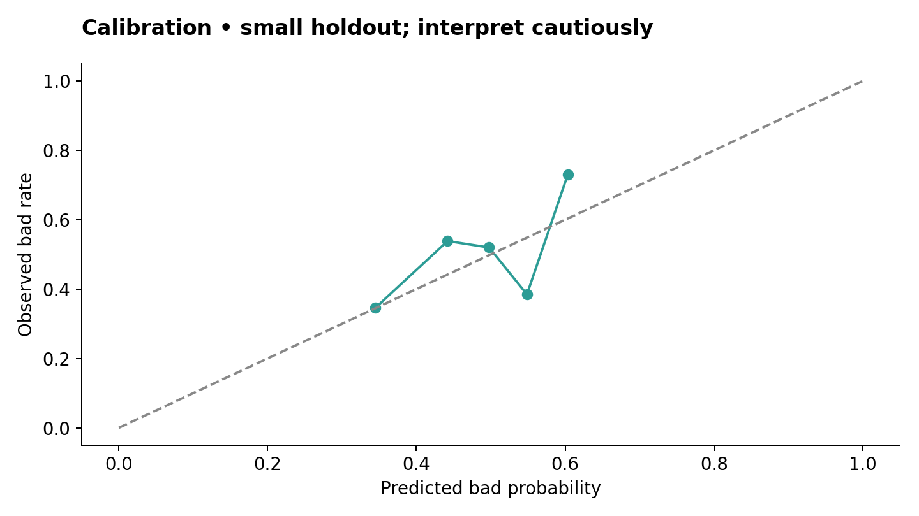
MODEL EVALUATION
Precision, recall and probability reliability
Bad precision: 0.512
Recall: 1.000
F1: 0.677
Baseline: 0.670
Brier: 0.239
Baseline: 0.259
Calibration used only 64 records. Probability reliability needs more evidence.
LoanLens / Anushka Jain
11 / 21
Notes:
SLIDE 11: Precision, recall and probability reliability
TIME BUDGET: 2 minutes
DELIVERY CUE: Explain the calibration diagonal simply. The precision-recall chart is included as a backup visual, not a second dense chart on this slide.
The other metrics help us understand why one percentage is not enough. At the selected threshold, Bad precision is about 0.512, recall is 1.000, and F1 is about 0.677. The baseline F1 is about 0.670, which is a very small difference at this operating point.
Average precision measures ranking quality across the precision-recall tradeoff. It is different from the 51.2 percent precision at one selected threshold. I keep those concepts separate when presenting the results.
I also calibrated the frozen forest with a sigmoid method on its own validation subset. Probability reliability matters because a risk score such as 70 percent carries an interpretation people may take literally.
On the holdout, the Brier score is 0.239 compared with 0.259 for the baseline. Lower is better for this measure, so that is an improvement. However, Brier reflects both calibration and discrimination, and this improvement alone does not establish reliable individual probabilities.
The calibration curve uses five quantile bins on a small holdout. Each bin has limited observations, and the calibration subset itself has only 64 records. I therefore describe the probabilities cautiously and make the uncertainty visible.
Source: Verified project report, security/privacy audit and source at GitHub commit ab3f6d3fe2ac3c06b92680f3a1e7a551cc831cbe
https://github.com/Anushkajain-7/Loan-Risk-ML-Pipeline
See reports/project_report.md and reports/security_privacy_audit.md in the project repository.

Slide 12
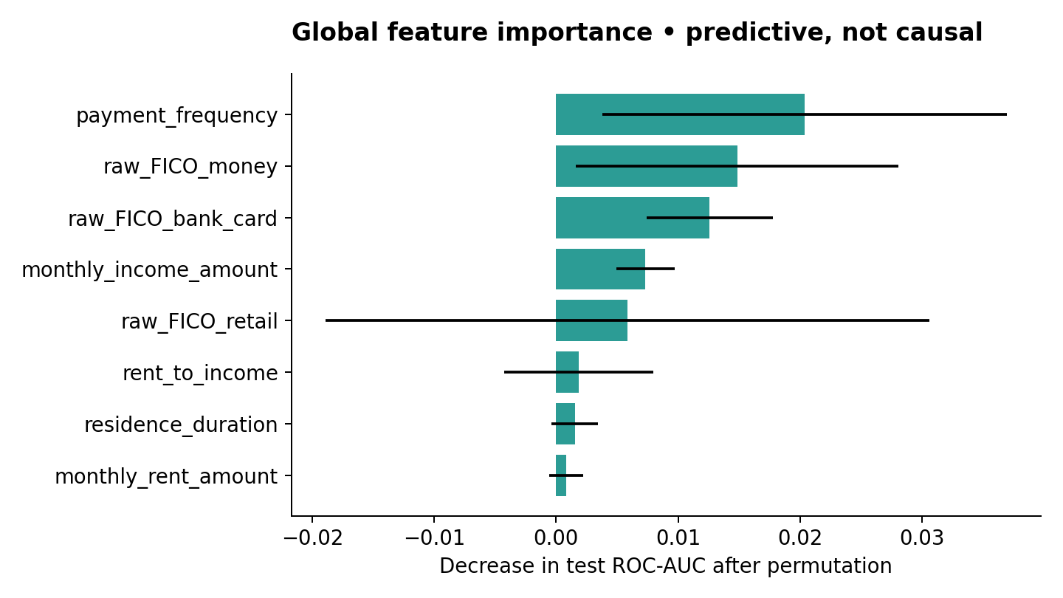
EXPLAINABILITY AND RESPONSIBLE AI
Explainability shows model sensitivity
Local sensitivity uses training medians. Associations do not establish causes.
LoanLens / Anushka Jain
12 / 21
Notes:
SLIDE 12: Explainability shows model sensitivity
TIME BUDGET: 2 minutes
DELIVERY CUE: Point to the largest few bars without declaring one predictor universally dominant. Say explicitly that this project does not implement SHAP.
The project includes two forms of explainability. For the global view, permutation importance measures how much holdout ROC-AUC changes when a feature is shuffled. The chart shows which inputs contribute to the fitted model's predictive behavior in this sample.
The larger mean importances include payment frequency and several score fields, but the values are small and uncertain. Correlated features can share information, so a low individual importance does not prove that a variable is irrelevant. The error bars show variation across repeated shuffles.
For an individual application, the interface performs reference comparisons. It replaces one numeric input with that feature's training median, reruns the model, and reports the probability difference.
For example, if replacing one reported amount with the training reference changes the score, that tells us the model is sensitive to that input around this example. It does not prove that changing the applicant's real financial situation would cause the same outcome.
I do not describe these comparisons as SHAP values, causal effects, or formal adverse-action reasons. Their purpose is to help a reviewer inspect the model's behavior. A responsible explanation needs clear boundaries as well as understandable language.
Source: Verified project report, security/privacy audit and source at GitHub commit ab3f6d3fe2ac3c06b92680f3a1e7a551cc831cbe
https://github.com/Anushkajain-7/Loan-Risk-ML-Pipeline
See reports/project_report.md and reports/security_privacy_audit.md in the project repository.

Slide 13
RESPONSIBLE AI
Fairness remains unresolved
Age at origination | Holdout records | ROC-AUC
25–39 | 44 | 0.439
40+ | 76 | 0.696
Under 25 | Below 20 | Suppressed
Age stays outside the prediction features and appears only in an offline audit.
Small, historically selected samples cannot certify fairness.
Other relevant groups and intersectional outcomes need appropriate audit data.
LoanLens / Anushka Jain
13 / 21
Notes:
SLIDE 13: Fairness remains unresolved
TIME BUDGET: 2 minutes
DELIVERY CUE: Use a small table with 44 and 76 observations. Keep the under-25 result suppressed. Do not imply age caused the performance difference.
Removing direct identifiers is an important privacy step, but it does not establish fairness. Other features can correlate with demographic characteristics, and different groups can experience different error rates.
I used date of birth only for a separate offline age-band audit, calculating age at the time of application. Age does not enter the prediction model.
On the chronological holdout, the age 25 to 39 group has 44 observations and an AUC of about 0.439. The age 40-plus group has 76 observations and an AUC of about 0.696. The under-25 estimate is suppressed because the subgroup is too small for the project's reporting rule.
These are descriptive differences in a limited sample. They warrant investigation, but they do not prove discriminatory causation or provide a fairness certificate. We also lack the broader demographic information needed for a comprehensive audit.
At the selected threshold, both reported groups have 100 percent Bad recall. That equality is not reassuring when the model flags almost everyone. We would need to examine false alarms, calibration, and other relevant outcomes with much better sample sizes.
The responsible next step is to collect governed audit information, keep it separate from prediction features, and validate group performance before considering a lending release.
Source: Verified project report, security/privacy audit and source at GitHub commit ab3f6d3fe2ac3c06b92680f3a1e7a551cc831cbe
https://github.com/Anushkajain-7/Loan-Risk-ML-Pipeline
See reports/project_report.md and reports/security_privacy_audit.md in the project repository.

Slide 14
PACKAGING, REGISTRY, API AND SECURITY
The application and privacy controls
Component | Data flow and controls
Frontend and FastAPI | Authenticated validation and record ownership
Saved ML pipeline | Local scoring from trusted artifacts and a version registry
Database | PostgreSQL support with a SQLite development/test adapter
Optional Hugging Face | Consented risk band and feature names only
Environment secrets, Argon2id hashing and secure production cookies
Filtered responses, safe logs and account deletion protect personal data.
LoanLens / Anushka Jain
14 / 21
Notes:
SLIDE 14: The connected application and privacy controls
TIME BUDGET: 2 minutes
DELIVERY CUE: Explain the request flow in words or a simple table. Do not display a credentials editor. Distinguish implemented controls from infrastructure verification.
The application connects the user interface to a FastAPI backend. A user signs in, submits the 14-field application contract, and receives a model-backed assessment. FastAPI serves the frontend and API from the same origin. The risk calculation does not live in browser code.
The backend loads the saved model once during application startup and reuses it across requests. It validates input fields, applies the packaged preprocessing, produces a score, and stores the assessment under the authenticated account. The design supports PostgreSQL, with SQLite available for local development and tests.
The privacy controls follow the data flow. The scoring form does not collect applicant names, emails, addresses, or bank account details. Passwords are stored as Argon2id hashes. Protected session cookies, CSRF checks, rate limits, and server-side ownership checks protect account operations. Users can delete an assessment or their live account data.
Secrets come from server environment variables. The public GitHub repository excludes the raw borrower dataset, model artifacts, .env, database files, and private certificates.
Hugging Face is optional. It can generate an explanation with consent, receiving only a coarse risk band and feature names. It does not make the loan-risk prediction. Live provider access and production infrastructure still require separate verification.
Source: Verified project report, security/privacy audit and source at GitHub commit ab3f6d3fe2ac3c06b92680f3a1e7a551cc831cbe
https://github.com/Anushkajain-7/Loan-Risk-ML-Pipeline
See reports/project_report.md and reports/security_privacy_audit.md in the project repository.

Slide 15
LIVE DEMO · THREE MINUTES
A synthetic application demonstration
01 Submit synthetic application values
02 Show the risk assessment and required human review
03 Open history and demonstrate outcome feedback
04 Show the outside-training-range warning
Fallback: use a prepared recording or screenshots from the actual app.
LoanLens / Anushka Jain
15 / 21
Notes:
SLIDE 15: A synthetic application demonstration
TIME BUDGET: 3 minutes
DELIVERY CUE: Switch to the already-running app. Narrate only what the screen actually shows. Return to slides at the three-minute mark. Use the fallback wording if the live demo is unavailable.
I will now walk through a synthetic application so you can see how the project handles a future request. These values do not describe a real borrower.
I am using a disposable account and loading the built-in synthetic example. The requested amount is 500, monthly income is 2,400, and monthly rent is 600, all expressed in the dataset's unconfirmed units.
When I select Assess application, the frontend sends the validated request to FastAPI. The backend uses the saved preprocessing and calibrated model. The result shows an estimated Bad-label probability, the model version, reference comparisons, and the review requirement. I will read the actual probability displayed rather than assume a value in advance.
Next, the history page shows this account's assessment. The outcome buttons let a user record later feedback, but that feedback is marked unverified and does not automatically retrain the model.
For a second assessment, I will change the requested amount to 9,000. This lies outside the training amount range of 250 to 800. The interface therefore gives an outside-training-range warning and continues to require human review.
This demonstrates the intended behavior: validate the request, assess with the deployed research version, preserve the account boundary, and expose limitations to the reviewer.
Source: Verified project report, security/privacy audit and source at GitHub commit ab3f6d3fe2ac3c06b92680f3a1e7a551cc831cbe
https://github.com/Anushkajain-7/Loan-Risk-ML-Pipeline
See reports/project_report.md and reports/security_privacy_audit.md in the project repository.
DEMO PREPARATION
{
"number": 15,
"title": "A synthetic application demonstration",
"seconds": 180,
"on_screen": [
"Synthetic values only",
"Assessment, history and outcome feedback",
"Outside-training-range warning",
"Human review remains required"
],
"cue": "Switch to the already-running app. Narrate only what the screen actually shows. Return to slides at the three-minute mark. Use the fallback wording if the live demo is unavailable.",
"script": "I will now walk through a synthetic application so you can see how the project handles a future request. These values do not describe a real borrower.\n\nI am using a disposable account and loading the built-in synthetic example. The requested amount is 500, monthly income is 2,400, and monthly rent is 600, all expressed in the dataset's unconfirmed units.\n\nWhen I select Assess application, the frontend sends the validated request to FastAPI. The backend uses the saved preprocessing and calibrated model. The result shows an estimated Bad-label probability, the model version, reference comparisons, and the review requirement. I will read the actual probability displayed rather than assume a value in advance.\n\nNext, the history page shows this account's assessment. The outcome buttons let a user record later feedback, but that feedback is marked unverified and does not automatically retrain the model.\n\nFor a second assessment, I will change the requested amount to 9,000. This lies outside the training amount range of 250 to 800. The interface therefore gives an outside-training-range warning and continues to require human review.\n\nThis demonstrates the intended behavior: validate the request, assess with the deployed research version, preserve the account boundary, and expose limitations to the reviewer.",
"demo_steps": [
"Before presenting: restore private artifacts, start the app, create a disposable account, and rehearse both assessments. Sign in before screen sharing. Leave .env and raw borrower files closed.",
"0:00-0:35: open Assess an application and click Load synthetic example. Explain that the input values are synthetic and the units are unconfirmed.",
"0:35-1:15: click Assess application. Point to the actual displayed probability, warning text, model version, and mandatory human-review message. Do not describe the result as approval or rejection.",
"1:15-1:55: open Outcomes & monitoring, locate the assessment, and demonstrate a Good/Bad feedback button only if appropriate for a synthetic record. Explain that the label is unverified. One record does not produce mature performance/drift estimates.",
"1:55-2:40: return to the form, change amount_requested to 9000, and assess again. Point out the outside_training_range band and warning. Other numbers stay unchanged so the audience sees the boundary clearly.",
"2:40-3:00: return to the slides. Explain that optional HF calls are not part of the core score. Skip the optional provider button unless you have tested it and intend to show it.",
"Do not demonstrate permanent deletion on an account you intend to keep. Deletion can be described on the security slide or shown with a separate disposable account after the main presentation."
],
"fallback": "The live interface is unavailable right now, so I will use the recording of my actual local run. The workflow shown is the same model-backed request, response, and input-range warning. I will keep the deployment limitation separate from the model findings. If no recording exists, say: I will describe the implemented request flow using the source and documented HTTP smoke test. I am not claiming a successful live demo today."
}

Slide 16
FUTURE REQUESTS, TESTING AND DEPLOYMENT
Monitoring and verification status
Monitoring
Verification
Account-only PSI after 20 predictions
43 documented tests and an HTTP smoke test passed with SQLite
Performance after 20 labels with both classes
Docker/PostgreSQL runtime and public TLS remain unverified
User feedback never triggers automatic retraining
Browser E2E and live Hugging Face calls remain unverified
Target infrastructure still needs validation before deployment.
LoanLens / Anushka Jain
16 / 21
Notes:
SLIDE 16: Monitoring and verification status
TIME BUDGET: 1.5 minutes
DELIVERY CUE: Describe thresholds as illustrative rules. Keep API correctness separate from model validity and production readiness.
Future requests create a monitoring record containing the model version, score, input features, and eventual account-owned feedback. After at least 20 predictions, the prototype calculates numeric-feature PSI against training bins. A PSI above 0.2 generates an illustrative alert.
With at least 20 labeled records and both outcome classes, it can calculate account-level AUC and Brier. These small-sample rules are implementation gates, not guarantees of stable population monitoring.
The feedback is user-reported and unverified. I therefore keep retraining offline and controlled, with reviewed labels and a new evaluation before any model release.
The documented verification includes 43 automated tests and a real-loopback HTTP smoke test using a disposable SQLite adapter. The tests cover ownership, authentication, input limits, deletion, error redaction, and model contracts, among other checks.
Those passes support application correctness in that environment. They do not prove production scalability, fairness, or dependable lending performance. PostgreSQL runtime, Docker deployment, public TLS, browser end-to-end behavior, and a live HF call require additional evidence.
Source: Verified project report, security/privacy audit and source at GitHub commit ab3f6d3fe2ac3c06b92680f3a1e7a551cc831cbe
https://github.com/Anushkajain-7/Loan-Risk-ML-Pipeline
See reports/project_report.md and reports/security_privacy_audit.md in the project repository.

Slide 17
DATA LIMITATIONS
Problems and limitations in the data
Approved borrowers only, from 2010–2011
Selection bias and an old sample limit relevance to current applicants.
Incomplete coverage and an assumed join
6 applications excluded, 628 first-loan outcomes unmatched and 16 repeat outcomes excluded.
Undefined outcome and timing
Bad, the performance horizon and label observation dates require confirmation.
Unclear field quality and meaning
Missing values, unusual score codes and unknown currency/duration units need a data dictionary.
LoanLens / Anushka Jain
17 / 21
Notes:
SLIDE 17: Problems and limitations in the data
TIME BUDGET: 1.5 minutes
DELIVERY CUE: Connect each data issue to the conclusion it limits. Do not describe rejected applicants as Bad.
Here is the catch with the dataset: every recorded application was already approved. That means the model learns about a selected group of borrowers, while our original question concerns future applicants more broadly.
The records also come from 2010 and 2011. We cannot assume the same patterns hold for a current lender or a different market.
Coverage is incomplete. Six application rows do not enter the matched cohort, and 628 first-loan outcomes lack application details. Sixteen repeat-loan outcomes remain outside this first-loan model. The customer-prefix join and first-loan suffix still need source-owner confirmation.
The target has another gap. Bad has no supplied definition or maturity horizon, and we do not know when each outcome became observable. Missing values and unusual score codes also need interpretation, rather than automatic correction.
These limitations reduce what we can conclude. They support a historical experiment, but they prevent a dependable policy for current applicants.
Source: LoanLens project report, sections 2–7 and 10. GitHub commit ab3f6d3fe2ac3c06b92680f3a1e7a551cc831cbe
https://github.com/Anushkajain-7/Loan-Risk-ML-Pipeline/blob/ab3f6d3fe2ac3c06b92680f3a1e7a551cc831cbe/reports/project_report.md

Slide 18
ANALYSIS LIMITATIONS
Shortcomings of the analysis
Small evaluation subsets
Only 129 test loans, 64 calibration records and 64 threshold-selection records.
An illustrative cost assumption
The assumed 5:1 cost ratio selects a threshold that flags 62 of 64 Good loans.
Incomplete evidence about future performance
Application-date splits cannot establish label maturity or performance in a new market.
Limited explanation and fairness checks
Model sensitivity is non-causal. Small age-group comparisons cannot establish fairness.
LoanLens / Anushka Jain
18 / 21
Notes:
SLIDE 18: Shortcomings of the analysis
TIME BUDGET: 1.5 minutes
DELIVERY CUE: Explain uncertainty plainly. Distinguish ROC-AUC from accuracy, and recall from lending usefulness.
The experiment has safeguards, including separate chronological subsets and preprocessing fitted inside the pipeline. Those safeguards do not remove every uncertainty.
The final test contains only 129 loans. Calibration and threshold selection each use 64 records. That makes the probability estimates, cutoff and subgroup comparisons unstable. The bootstrap AUC interval is 0.522 to 0.713, and it captures uncertainty conditional on this observed sample and fixed model. It does not cover selection bias, unknown target definitions or a changed lending environment.
The threshold also depends on an assumed five-to-one error cost. We do not have the lender's actual losses, recoveries or revenue. At that cutoff, catching every Bad loan comes with 62 false alarms among 64 Good loans.
Finally, feature importance and local sensitivity describe the model's associations. They do not establish causes or formal reasons for rejecting a borrower. Removing age and identifiers also does not eliminate proxy bias. Wider, prospective validation is still needed.
Source: LoanLens project report, sections 2–7 and 10. GitHub commit ab3f6d3fe2ac3c06b92680f3a1e7a551cc831cbe
https://github.com/Anushkajain-7/Loan-Risk-ML-Pipeline/blob/ab3f6d3fe2ac3c06b92680f3a1e7a551cc831cbe/reports/project_report.md

Slide 19
ADDITIONAL DATA
Additional data elements that would help
Data needed | What it would clarify
Outcomes and timestamps | Delinquency definition, observation dates, horizon and feature availability
Current applicant coverage | Applications, decisions and appropriately observable outcomes beyond approved loans
Affordability and economics | Verified income, debt obligations, employment, exposure, losses and recoveries
Definitions and governance | ID/score/unit dictionary, separate fairness audit fields and consent/retention rules
Actual interest, fees and funding costs would help justify the business threshold.
LoanLens / Anushka Jain
19 / 21
Notes:
SLIDE 19: Additional data elements that would help
TIME BUDGET: 1.5 minutes
DELIVERY CUE: Explain why each group helps. Treat extra data as a proposal, not as data already supplied.
The most useful next step is better evidence about the target and the applicant population. I would ask for a clear delinquency definition, a fixed performance horizon and dates showing when each outcome became observable. Feature timestamps would establish what information existed at application time.
I would then request recent applications and decision records covering the intended population. Rejected applicants do not have a repayment outcome for a loan they never received, so they must never receive guessed Good or Bad labels. Any alternative outcome information requires an appropriate, governed source.
For affordability, useful inputs include verified income, employment and existing debt obligations. For business value, we need loan exposure, realized losses, recoveries, interest, fees and funding costs. Those would support an economically justified threshold.
A source dictionary should confirm identifiers, score codes, currency and duration units. Appropriately governed demographic audit data should stay separate from prediction inputs. Acquisition channels and economic context could also help investigate changing populations. All additional collection should have a defined purpose and retention policy.
Source: LoanLens project report, sections 2–7 and 10. GitHub commit ab3f6d3fe2ac3c06b92680f3a1e7a551cc831cbe
https://github.com/Anushkajain-7/Loan-Risk-ML-Pipeline/blob/ab3f6d3fe2ac3c06b92680f3a1e7a551cc831cbe/reports/project_report.md

Slide 20
FINDINGS
Main findings and lending implications
Evidence | Observed result | Implication
Data join | 641 matched first loans | A limited, historically selected cohort
Test ranking | ROC-AUC 0.621 vs 0.500 baseline | Modest improvement in historical ranking
Threshold 0.28 | 65 Bad caught, 62 Good flagged | False alarms limit lending usefulness
Future use | Fairness and deployment checks incomplete | Controlled research with human review
The results cannot yet identify which future applicants should receive a loan.
LoanLens / Anushka Jain
20 / 21
Notes:
SLIDE 20: Main findings and lending implications
TIME BUDGET: 1.5 minutes
DELIVERY CUE: Use the table to explain the meaning of each result. End with the recommendation, not a promise of future accuracy.
My findings answer the assignment with a clear boundary. First, relationship validation creates 641 matched first-loan records. That gives us a reproducible modeling cohort, although it remains small and selected.
Second, the selected random forest achieves a test ROC-AUC of 0.621 against 0.500 for the constant baseline. This is modest ranking improvement. It is not 62.1 percent accuracy and it does not establish a dependable approval policy.
Third, the illustrative threshold catches all 65 Bad loans but flags 62 of the 64 Good loans. Overall, 127 of 129 test loans receive a higher risk flag. This would offer very little useful separation for a lending decision.
Finally, the connected application demonstrates how the pipeline serves future requests with human review, privacy controls and monitoring. It does not resolve the missing data or certify lending readiness.
My recommendation is controlled research use while confirming definitions, collecting recent representative data and completing prospective performance, fairness and infrastructure checks.
Source: LoanLens project report, sections 2–7 and 10. GitHub commit ab3f6d3fe2ac3c06b92680f3a1e7a551cc831cbe
https://github.com/Anushkajain-7/Loan-Risk-ML-Pipeline/blob/ab3f6d3fe2ac3c06b92680f3a1e7a551cc831cbe/reports/project_report.md

Slide 21
CONCLUSION
Recommendation and questions
Controlled research use
with mandatory human review
641 matched first loans support a reproducible analysis.
Holdout ranking is modest. The selected threshold creates serious false alarms.
Real lending use needs stronger data and prospective validation.
Questions
LoanLens / Anushka Jain
21 / 21
Notes:
SLIDE 21: Recommendation and questions
TIME BUDGET: 1 minutes
DELIVERY CUE: Slow down for the recommendation. Stop advancing slides and invite questions. Do not repeat the whole metric table.
To conclude, the project creates a reproducible workflow around 641 matched first loans and a connected application for future research assessments.
The selected model shows modest ranking performance on the chronological holdout, with an AUC of 0.621. The headline recall is 100 percent, but the threshold also flags 62 of 64 good loans. That makes the operating tradeoff unsuitable for automatic lending decisions.
My recommendation is to keep this as a research and controlled-review prototype, with an unconditional human-review requirement. A lending release needs current representative data, verified outcome definitions and business costs, followed by prospective and subgroup validation.
The main takeaway is that a model result becomes useful only when we can explain the population, the errors, and the limits of the decision it supports.
Thank you for your time. I am happy to take questions about the data relationship, evaluation choices, or application design.
Source: Verified project report, security/privacy audit and source at GitHub commit ab3f6d3fe2ac3c06b92680f3a1e7a551cc831cbe
https://github.com/Anushkajain-7/Loan-Risk-ML-Pipeline
See reports/project_report.md and reports/security_privacy_audit.md in the project repository.
Q&A ANSWER BANK
[
{
"question": "Which new applicants should actually receive a loan?",
"answer": "The supplied evidence cannot establish a reliable approval policy. The model provides limited historical risk ranking, and the selected threshold flags almost every loan. I would require affordability checks, verified business policy, current representative data, and prospective validation before using it to influence issuance. A low score alone is insufficient for approval."
},
{
"question": "Does AUC 0.621 mean 62.1 percent accuracy?",
"answer": "No. ROC-AUC measures ranking across thresholds. Accuracy depends on the chosen threshold and the actual class labels. At this threshold, 67 of 129 test loans are classified correctly, giving about 51.9 percent accuracy. The confusion matrix and operational tradeoffs are more informative here."
},
{
"question": "Why is 100 percent recall insufficient?",
"answer": "A model can achieve perfect Bad recall by flagging every loan. Our baseline does exactly that at this cutoff. The selected model flags 127 of 129 loans, including 62 Good loans. Recall must be assessed alongside false alarms, precision, specificity, and justified business costs."
},
{
"question": "Why did you choose random forest?",
"answer": "It achieved the highest mean cross-validation average precision among the four candidates: about 0.664. Selection took place within the training block, before evaluating the final test set. The margin over the alternatives was small, so I describe it as the best candidate in this experiment rather than a universally superior lending model."
},
{
"question": "Why did you use a chronological split?",
"answer": "The application is intended for future requests, so later records are the more relevant holdout. Preprocessing and selection use earlier data. However, missing outcome-observation dates prevent proof that earlier labels would have matured before each later application. A true point-in-time evaluation needs those dates."
},
{
"question": "Why did you not use SMOTE?",
"answer": "The matched modeling cohort contains 352 Bad and 289 Good loans, or roughly 55 percent Bad. Severe class imbalance is not the main problem. I focused on validation and threshold costs rather than introducing oversampling without a demonstrated need."
},
{
"question": "How did you determine that -01 is the correct target loan?",
"answer": "The suffix pattern is consistent with a first/second-loan structure, so -01 is the explicit modeling assumption. The pipeline checks the resulting one-to-one relationship and excludes -02 outcomes. I still need source-owner confirmation. If the suffix has another meaning, the target alignment and analysis must be revised."
},
{
"question": "How did you select threshold 0.28?",
"answer": "A separate threshold-validation block minimized five times missed Bad plus one times flagged Good. That cost ratio is illustrative. The lender did not supply actual losses, revenue, recoveries, or review costs, so I do not treat the threshold as a verified business optimum. The test results expose its excessive false alarms."
},
{
"question": "Could a higher threshold solve the problem?",
"answer": "It would change the precision-recall and false-alarm tradeoff, but I cannot choose a new cutoff using the test outcomes and present the same test as unbiased. I would define real costs, tune on validation or newly available historical data, then evaluate on a fresh holdout. A new threshold also cannot remove selection bias or create missing target definitions."
},
{
"question": "What is the difference between average precision and Bad precision?",
"answer": "Average precision summarizes ranking over the precision-recall curve. The reported test average precision is about 0.650. Bad precision at the selected threshold is about 0.512, meaning approximately half the flagged loans are actually Bad. They answer different questions and should not be presented interchangeably."
},
{
"question": "Is the probability calibrated and the model fair?",
"answer": "Neither claim is established strongly enough for lending. Sigmoid calibration uses a small validation subset, and the holdout calibration assessment is uncertain. The age audit shows descriptive performance differences, while other demographic information is absent. More representative data and stronger subgroup/prospective checks are required."
},
{
"question": "Did you use SHAP or causal explanations?",
"answer": "No. The project uses global permutation importance and local comparisons that replace one numeric feature with its training median. These explain model sensitivity and association. They do not establish causal effects, and they are not formal adverse-action explanations."
},
{
"question": "Why use Hugging Face if scikit-learn already predicts risk?",
"answer": "Hugging Face is an optional plain-language explanation layer. It does not select the model, change the risk score, or decide approval. The opt-in prompt contains a coarse band and feature names, not applicant values or identities. Core scoring works without it. The documented validation used a provider stub rather than a live account."
},
{
"question": "How do you prevent training/serving inconsistency?",
"answer": "The same packaged scikit-learn preprocessing and model handle serving. The backend validates a fixed input contract, loads the artifact once at startup, and checks the artifact checksum and runtime version. A checksum detects changes but does not authenticate an attacker-controlled artifact. Build/release access must still be protected."
},
{
"question": "What do the 43 passing tests actually prove?",
"answer": "They support the tested API, session, ownership, validation, deletion, privacy, and model-contract behavior in the disposable SQLite environment. They do not prove production throughput, PostgreSQL deployment correctness, clinical or financial validity, fairness, or robust generalization. Those require separate checks."
},
{
"question": "Is the app deployed and production-ready?",
"answer": "The verified project includes local API testing and deployment configuration. It does not establish a public live deployment or successful PostgreSQL/Docker/TLS production checks. I would update that statement only after verifying the target host. The research model would still need current data and prospective validation even if the infrastructure passed."
},
{
"question": "Why are model artifacts and the dataset absent from GitHub?",
"answer": "The raw workbook contains borrower identities, and the model artifacts derive from borrower data. The public repository contains reviewed source and aggregate reports, with strong ignore rules. Authorized users can restore private artifacts locally or train from their privately held workbook. Secrets and private data do not need to be public for reproducible source code to be inspectable."
},
{
"question": "What was your contribution, and did you use AI tools?",
"answer": "I developed and studied this project with AI-assisted coding support. I can explain the join assumptions, leakage exclusions, preprocessing contract, split design, evaluation, and security boundaries using the source and reports. AI helped produce implementation and documentation. I would not claim that I manually wrote every line or completed checks that I have not personally verified."
},
{
"question": "What would you improve first?",
"answer": "I would confirm the target horizon and data semantics, then obtain recent representative data with reliable application/outcome timestamps. Next I would define affordability and verified costs. Those changes improve the validity of the problem before trying more algorithms or tuning a threshold."
},
{
"question": "What if the model gives an unexpected result for an input outside its experience?",
"answer": "The backend rejects malformed or out-of-contract inputs. Values outside train-derived ranges receive a warning and an outside-training-range assessment band. The system still requires human review. This is a visible boundary check, not a guarantee that every unfamiliar real-world case has been detected."
}
]
"Reserve 15 minutes, but prepare all answers. Let the questioner finish, repeat the key question briefly, answer in 30-60 seconds, and offer further detail only when useful. If you do not know, say: I have not validated that yet. My next step would be to test [specific check] and report the evidence. At minute 48-50, take the last question so you can finish within the 55-minute plan."
REVISED SCHEDULE: Main slide budgets total 39.5 minutes, rounded to a 40-minute talk. Allow 15 minutes for Q&A and 4 minutes of buffer. Planned maximum: 59 minutes. Slides 17–20 each have a 90-second budget.

Slide 22
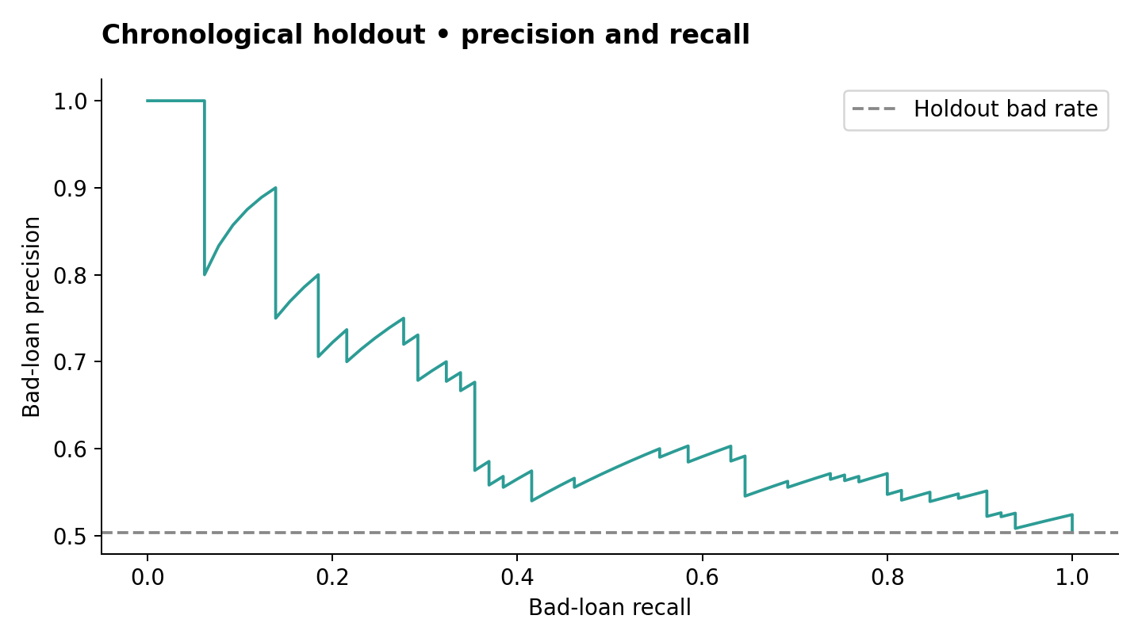
BACKUP CHART
Precision and recall on the holdout
LoanLens / Anushka Jain
Backup
Notes:
BACKUP ONLY. Show during Q&A if useful. Average precision 0.650 versus holdout prevalence baseline 0.504. Source: Verified project report, security/privacy audit and source at GitHub commit ab3f6d3fe2ac3c06b92680f3a1e7a551cc831cbe
https://github.com/Anushkajain-7/Loan-Risk-ML-Pipeline

