Slide 1

SpellSetu
LINGUAHACK
Enhancing Text Accuracy with Jaro-Winkler Similarity and XLM-RoBERTa
Team: Cyphers
Presenter: Anushka & Akshra Bansal
Course: B.Tech CS-AI III Year
Institution: Banasthali Vidyapith University

Slide 2
Table of contents
01
02
03
04
05
06
Problem Statement
Introduction
Key Features
How SpellSetu works?
Technology Stack
Prototype
01
02
03
Performance Evaluation
Key Applications/takeaways
Conclusion

Slide 3
PROBLEM STATEMENT
Spelling and word usage correction (English and
Hindi), Develop a model to identify and correct
spelling mistakes and inappropriate word usage
while understanding sentence context

Slide 4
INTRODUCTION
What is SpellSetu?
✔ SpellSetu is an AI-driven bilingual spell and context correction system that
enhances text accuracy in both English and Hindi.
✔ It goes beyond basic spell-checking by understanding the sentence structure and meaning to suggest the most appropriate corrections.
✔ Many of us rely on spell-checkers while writing but most fail to detect context-based errors.
Why is it important?
✔ In a multilingual country like India, users often switch between languages, making
context-aware spell correction crucial.
✔ Traditional spell-checkers focus only on basic dictionary matches, whereas
SpellSetu provides smarter, contextually relevant corrections.
✔ Helps students, writers, professionals, and businesses communicate more
effectively by eliminating spelling and grammatical mistakes.

Slide 5

KEY FEATURES
Bilingual Support
Works with both English and Hindi.
Hybrid Correction Approach
Combines dictionary-based and contextual AI models.
Performance Evaluation
Uses synthetic error generation for testing accuracy.

Slide 6
HOW SpellSetu WORKS?
Step-1: Dictionary-Based Correction
Identifies words using a predefined English-Hindi dictionary. Uses Jaro-Winkler similarity to find closest matching words.
Step-2: Context-Aware Refinement
Utilizes XLM-RoBERTa (multilingual deep learning model) to choose the best correction based on sentence context.
Step 3: Accuracy Evaluation
Compares corrected output with expected sentence
to measure word-level accuracy.

Slide 7
TECHNOLOGY STACK
Natural Language Processing (NLP): Enables semantic understanding of text for better corrections.
XLM-RoBERTa (Multilingual Model): Provides deep learning-based context correction across multiple languages.
Jaro-Winkler Similarity Algorithm: Helps identify and correct spelling errors based on character-level similarities.
Dictionary-Based Lookup: Ensures the system can recognize commonly used words and phrases for accurate spelling correction.
Streamlit (User Interface): Provides an interactive and user-friendly interface for real-time corrections.

Slide 8
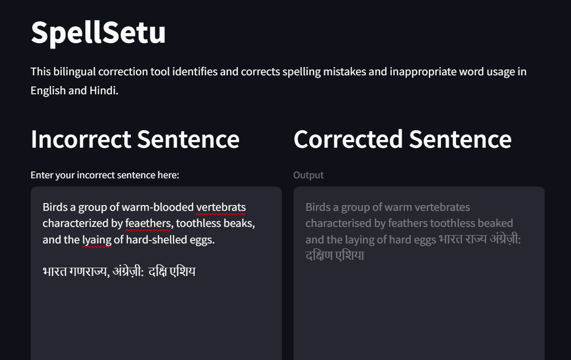
PROTOTYPE

Slide 9
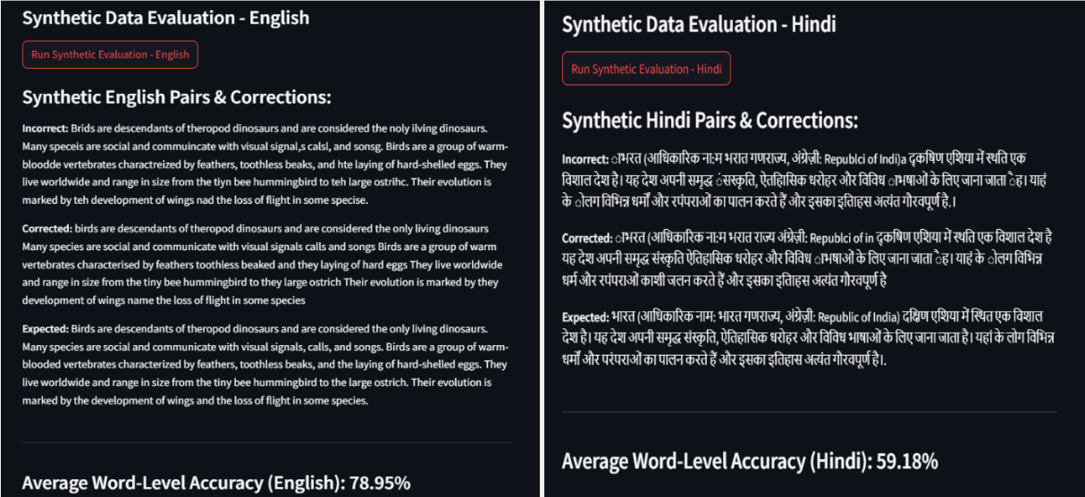
PROTOTYPE

Slide 10
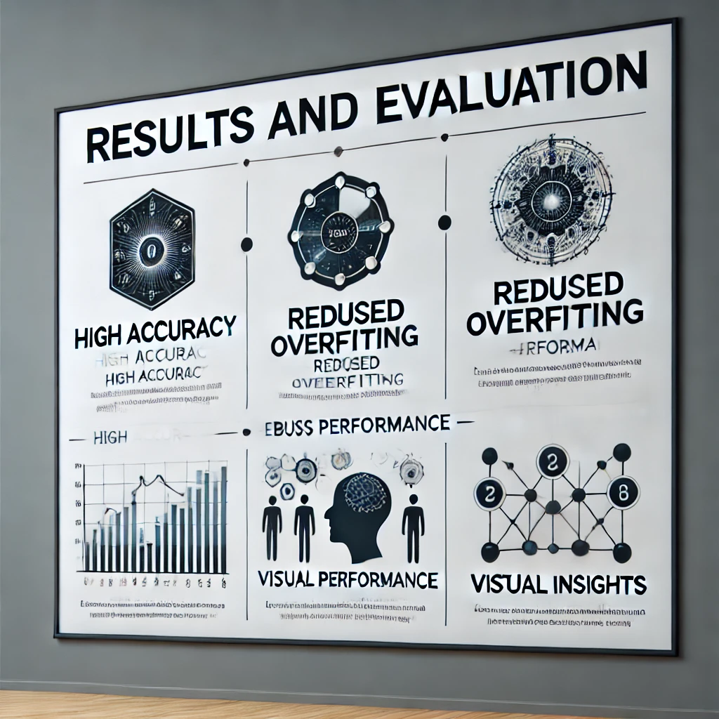
Performance Evaluation
Testing Methodology
✔ Uses synthetic error generation for evaluation.
✔ Measures correction accuracy using word-level comparison.
Results
✔ Improved correction accuracy compared to traditional spell-checkers.
✔ Efficient for both single-word errors and contextual corrections.

Slide 11
REAL-TIME APPLICATIONS
Educational Platforms Helps students improve writing skills by providing real-time spelling and grammar corrections.
Corporate Communication Ensures error-free emails, reports, and presentations.
Social Media & Blogging Provides instant correction for posts, tweets, and captions.
Content Creation & Journalism Helps writers, journalists, and bloggers produce polished, grammatically correct content.

Slide 12
Conlusion
SpellSetu revolutionizes spell and grammar correction by combining NLP, phonetic similarity, and linguistic rules.
Enhances text accuracy and readability through context-aware suggestions and multilingual support.
Bridges the gap between human communication and AI, ensuring seamless, intelligent text correction.
A step towards smarter, more adaptive language processing for diverse users and applications.

Slide 13
Thank You!

