Slide 1
IBM University Engagement Project Submission
“Exploring the Power of Agentic AI with IBM Cloud and Orchestrate”

Slide 2

Project Tile – [AccrediAI – AI Agent for NBA Accreditation]
Domain of Project – [ Education ]
Student Name | Recent Passport Photo | Email ID | Mobile number [WhatsApp]
Anushree Ramesh Jodangi |  | Shri.anii02@gmail.com | 8197609291

Slide 3
Problem Statement -
Problem Statement : AI Agent designed to assist faculty with NBA accreditation processes (RAG Based)
The Challenge
Faculty members spend significant time searching through NBA criteria, formats, guidelines and previous accreditation documents. Preparing SAR documents and performing CO–PO mapping can be complex, time-consuming and prone to inconsistency.
The Objective
Develop a RAG-based AI agent that:
Retrieves relevant NBA criteria and guidelines.
Provides context-aware answers to faculty queries.
Assists in SAR preparation.
Supports CO–PO mapping.
Retrieves relevant past documentation and formats.
Reduces manual effort and improves consistency.

Slide 4
Proposed Solution -
Proposed Solution: AccrediAI – NBA Accreditation Assistant
AccrediAI is a RAG-based Agentic AI assistant designed to help faculty with NBA accreditation activities.
The system retrieves relevant information from trusted NBA guidelines, accreditation documents, institutional records and previous documentation. The retrieved information is provided as context to IBM Granite, which generates grounded and relevant responses.
Key Functions:
NBA guideline and criteria retrieval
SAR preparation assistance
CO–PO mapping support
Document-based question answering
Relevant format/document retrieval
Context-aware AI responses

Slide 5
Technology Used
IBM Granite – Natural language understanding, reasoning and response generation
IBM Cloud – Cloud infrastructure for developing and deploying the AI solution
RAG (Retrieval-Augmented Generation) – Retrieves relevant NBA information before generating answers
Vector Database – Stores document embeddings for semantic search
LangFlow / Orchestrate – For designing and orchestrating the AI workflow
IBM watsonx.ai – AI model deployment and AI workflow support

Slide 6
Orchestrate component Used -
1) Chat Input
Faculty enters questions related to NBA criteria, SAR, CO–PO mapping or documentation.
2) IBM watsonx AI Agent
Processes the faculty query and coordinates the AI workflow.
3) IBM Granite Model
Generates context-aware responses using the retrieved NBA information.
4) RAG / Document Retrieval Component
Retrieves relevant information from uploaded NBA documents and institutional resources.
5) File Component
Stores and provides access to NBA guidelines, formats and supporting documents.
6) Chat Output
Displays the generated answer, guidance, relevant criteria and documentation suggestions.

Slide 7
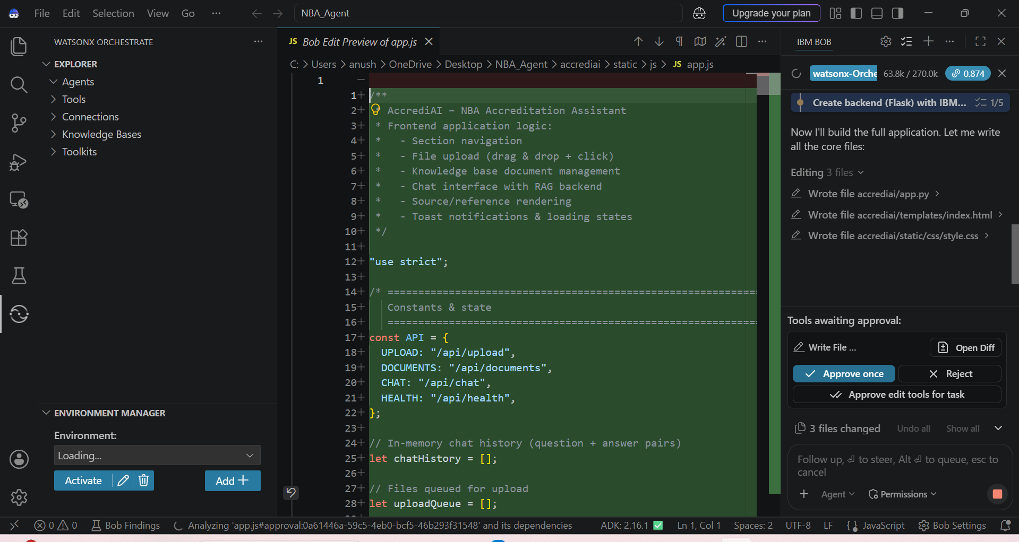
Agent Instructions Screenshot-

Slide 8
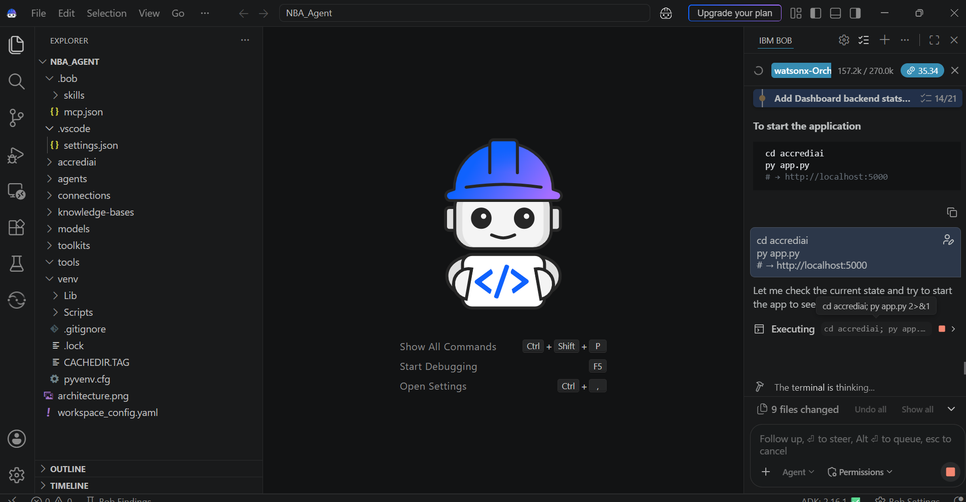

Slide 9
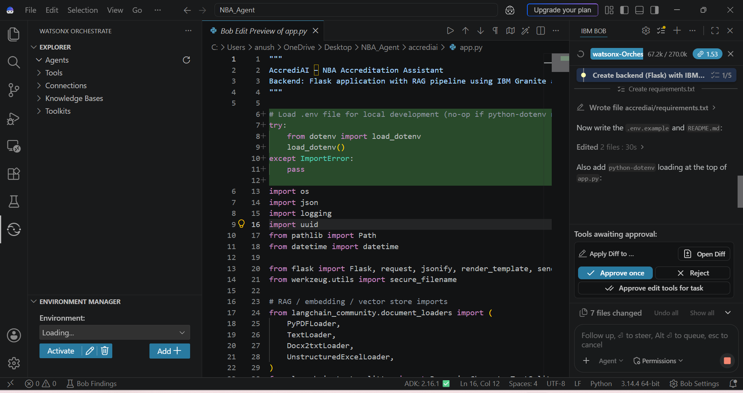

Slide 10
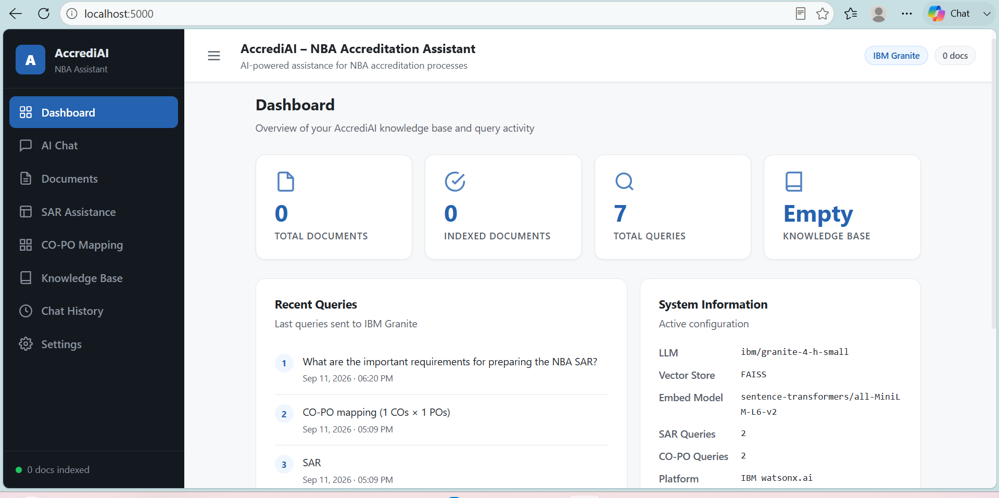
Prompt with output Screenshot:

Slide 11
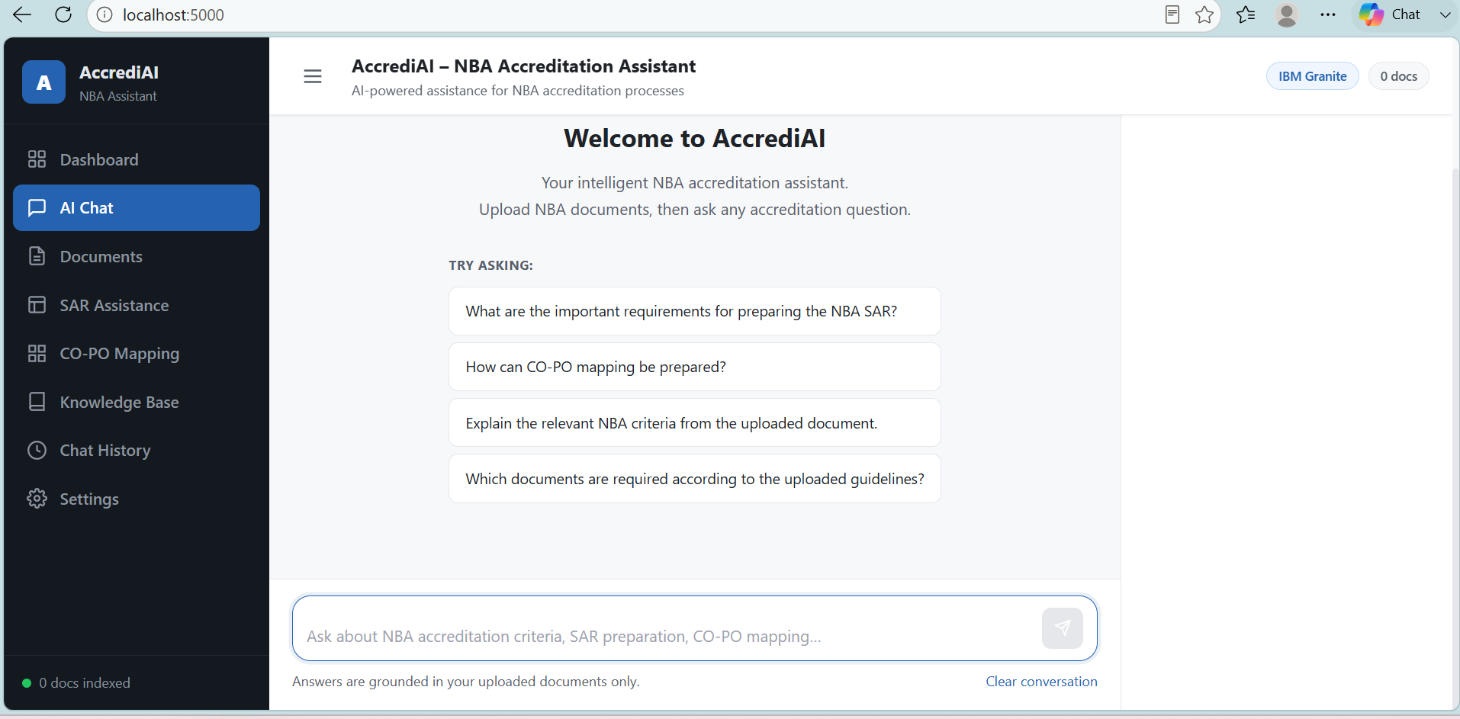
Other Applicable Screenshots:

Slide 12
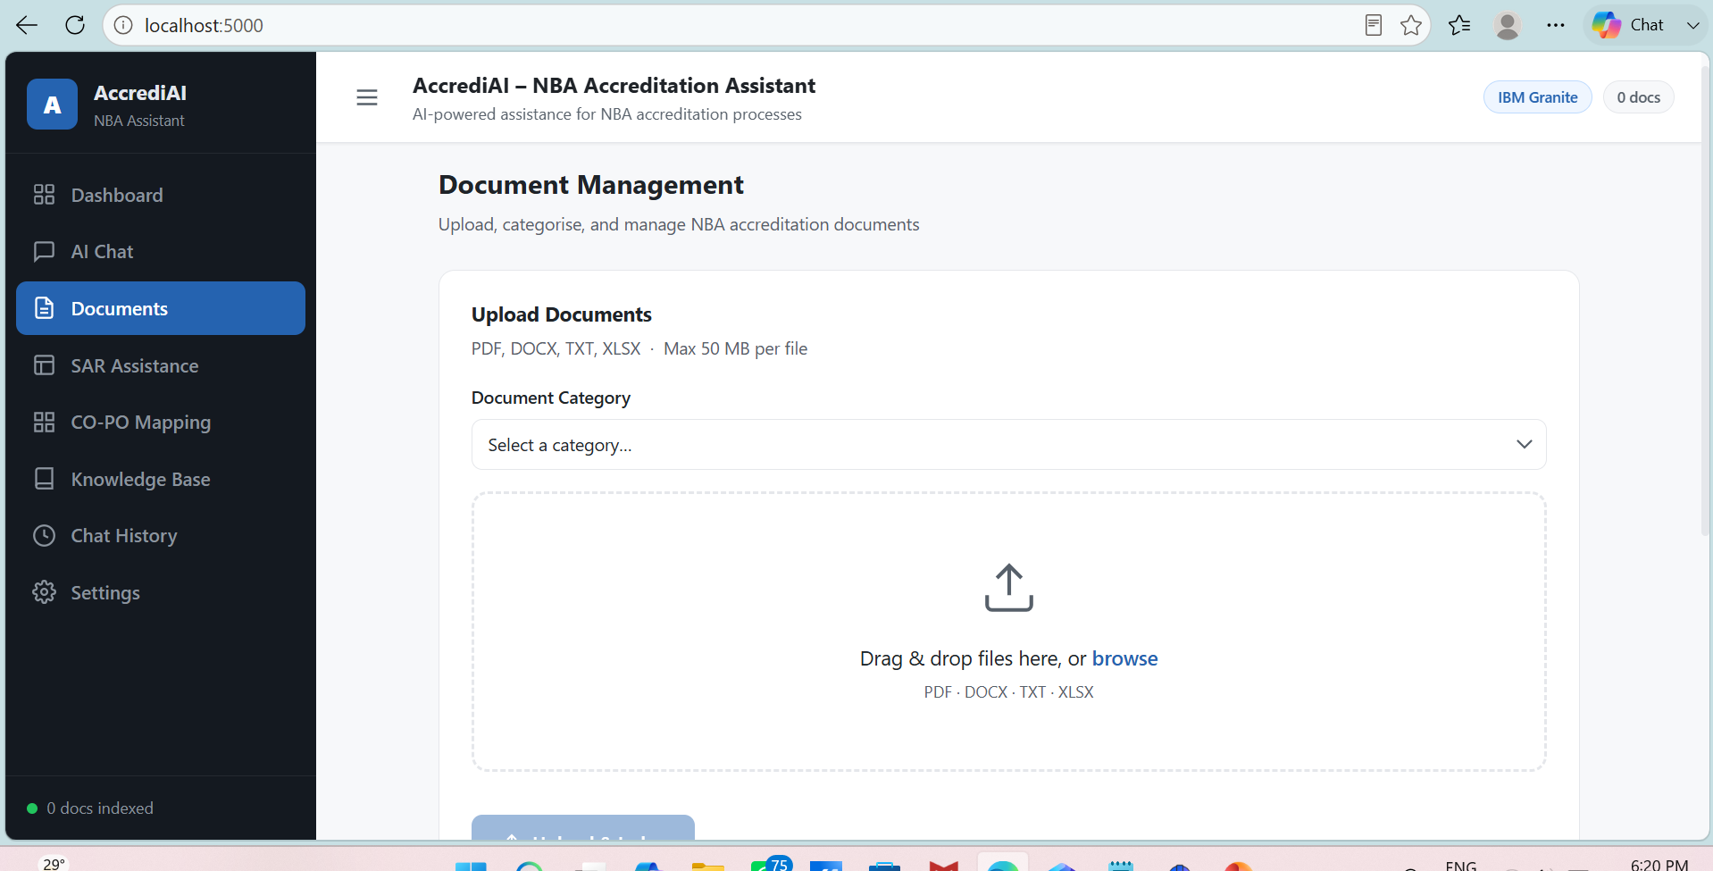

Slide 13
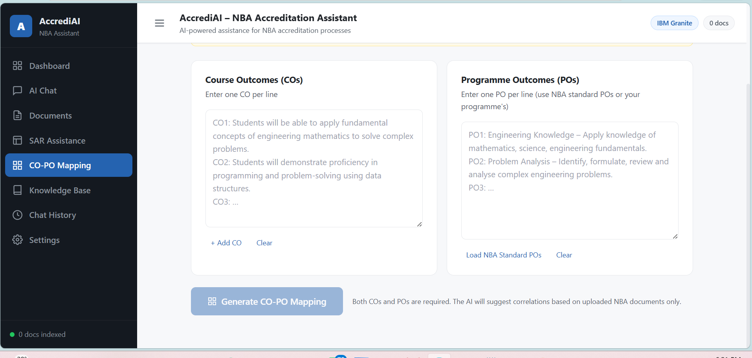

Slide 14
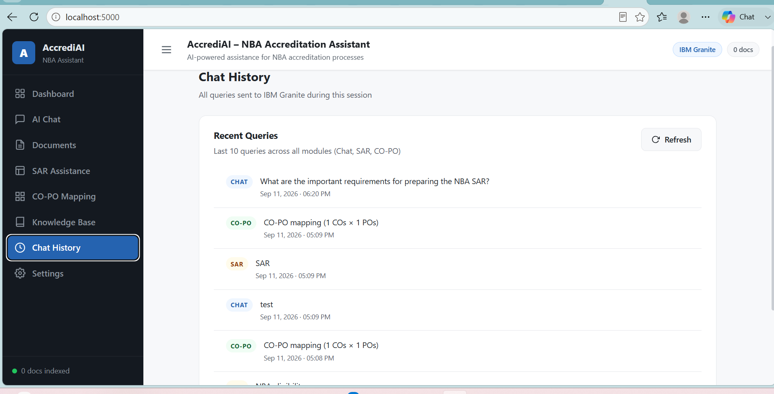

Slide 15
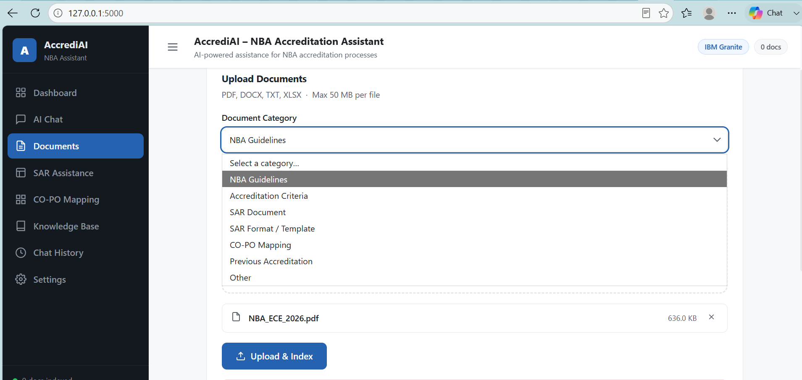

Slide 16
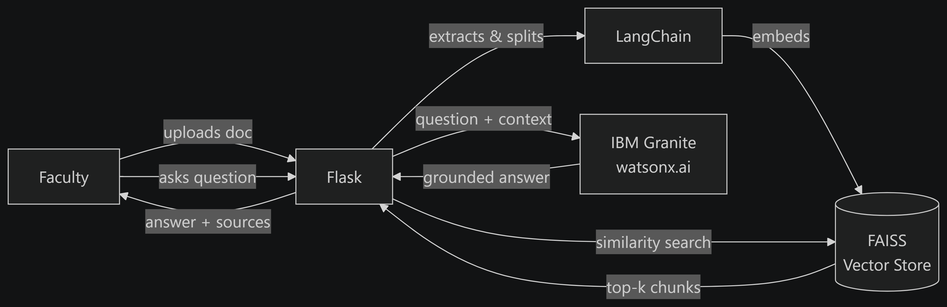
Orchestrate architecture blueprint

Slide 17

Role of Agentic AI in the solution
Role of Agentic AI in AccrediAI
Agentic AI enables the system to act as an intelligent accreditation assistant rather than a basic chatbot.
It:
Understands faculty queries.
Retrieves relevant NBA information.
Uses multiple sources of documentation.
Provides context-aware responses.
Assists with SAR preparation.
Supports CO–PO mapping.
Reduces repetitive manual document searching.

Slide 18
Novelty and Uniqueness
1. RAG-Based Accreditation Assistance
Uses retrieved NBA documents to provide grounded responses.
2. NBA-Specific Knowledge
Focused specifically on NBA accreditation requirements.
3. SAR Preparation Support
Helps faculty understand and prepare relevant SAR content.
4. CO–PO Mapping Assistance
Provides guidance for curriculum outcome mapping.
5. Document Intelligence
Allows faculty to interact with large accreditation documents using natural language.
6. Reduced Manual Effort
Reduces the time spent searching through multiple guidelines and documents.
7. IBM Granite + IBM Cloud
Uses IBM's AI and cloud technologies as required by the problem statement.

Slide 19
Git Hub Link
working Github URL – https://github.com/Anushree-RJ/IBM_NBA_Agent.git
Make sure you have Uploaded following three files into your github repository
1) app.json file ,
2) yourproblemstatement.pdf file
3) your projectpresntation.pptx file
4)any other files
·
·
·

Slide 20
Future Scope
1. Automated SAR Draft Generation
Generate initial SAR sections based on institutional data.
2. Advanced CO–PO Mapping
Automatically suggest mappings using course outcomes and program outcomes.
3. Multi-Agent Accreditation Assistant
Separate agents for NBA criteria, SAR, CO–PO mapping and document verification.
4. Institutional Knowledge Base
Integrate department-specific documents and previous accreditation records.
5. Multilingual Support
Allow faculty to interact with the system in multiple languages.
6. Continuous Knowledge Updates
Update the knowledge base when new NBA guidelines or formats become available.
·
·
·

Slide 21
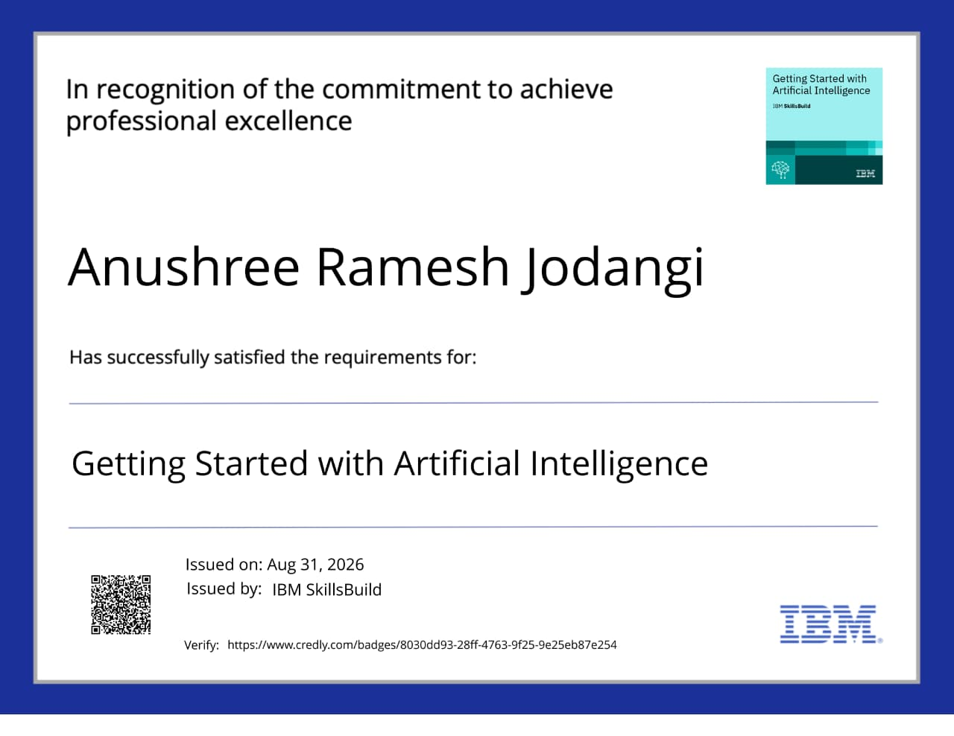
Certificates Earned:

Slide 22
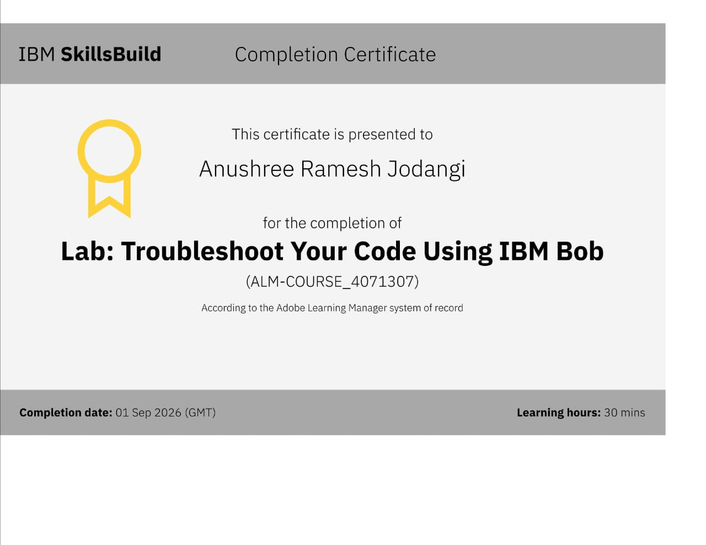
Certificates Earned:​

Slide 23


