Slide 1
Analysis and Early Prediction of Sepsis using Clinical Data
By Anushree Ankola
Advisor: Dr. Anand Panangadan
Reviewer : Prof. Tseng Chen James
Notes:
Thank you so much for attending my presentation. I welcome you both. If you have any questions during my presentation please stop me and ask and I will try my best to answer them.
My final year project is Analysis and Prediction of Sepsis using Clinical Data

Slide 2
Agenda
Sepsis – Affects and Symptoms
Objective
Challenge Dataset
Procedure
EDA – missing values
Feature Engineering
EDA – Dataset Imbalance
Choosing Accuracy metric
Decision Tree for prediction
Future Scope 1 - Using XGBoost for prediction
Further research and findings
Conclusion
Reference
Notes:
The agenda for today’s presentation is – first I will talk about sepsis, its statistics, affects and symptoms. The objective of the project, the challenge dataset, Procedure I took to solve the problem, Exploratory Data Analysis and my intuitions , findings and inferring the course of project, handling data imbalance and missingness, choosing the right accuracy metric. Then building prediction models, future scope of project and conclusion.

Slide 3
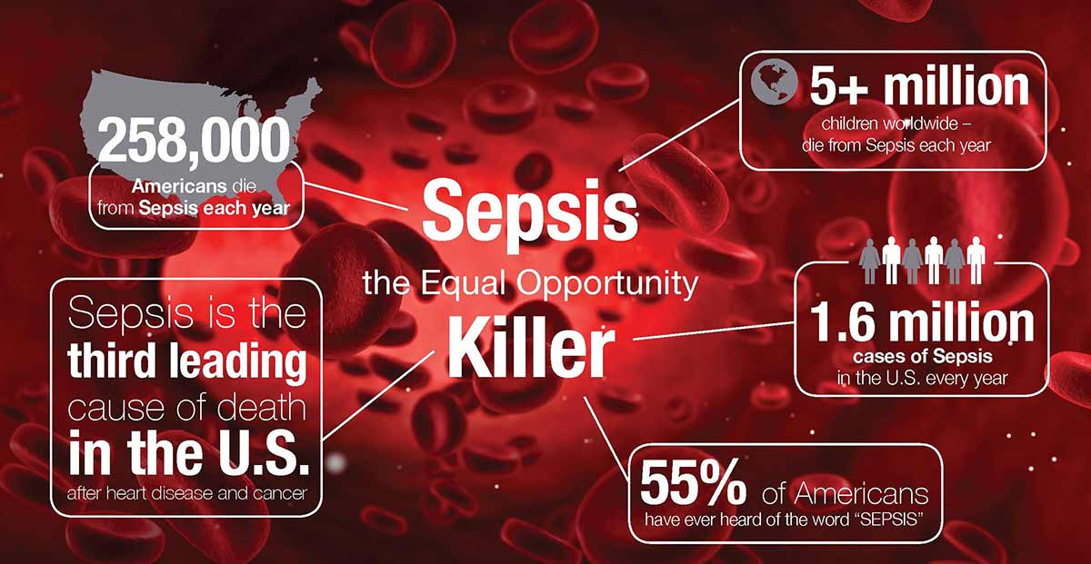
Sepsis - Statistics
Notes:
What is Sepsis ?
Sepsis is a potentially life-threatening condition caused by the body’s response to an infection. In a usual case, the body releases chemicals into bloodstream to neutralise an infection. Sepsis occurs when the body’s response to these chemicals is out of balance, triggering changes that can damage multiple organ systems.
Sepsis is caused by infection and can happen to anyone. Sepsis is most common and most dangerous in:
Older adults
Pregnant women
Children younger than 1
People who have chronic conditions, such as diabetes, kidney or lung disease, or cancer
People who have weakened immune systems
Statistics
In USA, 270,000 people die from sepsis each year
Internationally , 6 Million people die from sepsis each year
US hospitals spend 24 Billion each year on sepsis (13 % of Health Budget)
Each hour of delay in treatment can roughly increase mortality by 4–8 %
Source : https://www.mayoclinic.org/diseases-conditions/sepsis/symptoms-causes/syc-20351214

Slide 4
Sepsis - Affect and Symptoms
Affects:
very young children,
older adults,
people with chronic diseases,
and those with weakened immune system
Sepsis can be difficult to diagnose because it occurs quickly and can be confused with other conditions. Watch for a combination of the following symptoms.
S Shivering, fever, or very cold E Extreme pain or general discomfort (“worst ever”) P Pale or discolored skin S Sleepy, difficult to rouse, confused I “I feel like I might die!” S Short of breath

Slide 5
Objective
Goal of the analysis is the early detection of sepsis using physiological data.
The early prediction of sepsis is potentially life-saving, and we aim to predict sepsis 6 hours before the clinical prediction of sepsis.
Late prediction of sepsis is potentially life-threatening, and also consumes heavy hospital resources.
By predicting sepsis in non-sepsis patients or predicting sepsis very early in sepsis patients consumes limited resources and we can assume the risk of prediction to be minimal but revolutionary.

Slide 6
Challenge Dataset
Data used in the competition is sourced from ICU patients in two separate hospital systems and is obtained from Physionet.
The data will be split into 70% Training and 30 % testing set. The training set will be split for validating the training set.
The original data for each patient will be contained within a single pipe-delimited text file. Each file will have the same header and each row will represent a single hour's worth of data. Each hospital have 20,000 patients and hence 20,000 files.
Available patient co-variates consist of Demographics, Vital Signs, and Laboratory values
Features:
8 Vital Signs : Heart Rate, Temperature , Blood Pressure, Respiratory rate,
26 Laboratory Values : Platelet Count, Glucose , Calcium etc
6 Demographics : Age, Gender, Time in ICU , Hospital Admit time
1 Label :
0 (Non-sepsis) and 1 (Sepsis)
Notes:
The Challenge data repository contains one file per patient (e.g., training/p00101.psv ).
Each training data file provides a table with measurements over time. Each column of the table provides a sequence of measurements over time (e.g., heart rate over several hours), where the header of the column describes the measurement. Each row of the table provides a collection of measurements at the same time (e.g., heart rate and oxygen level at the same time).
Features:
Vital Signs : Heart Rate, Temperature , Blood Pressure, Respiratory rate, End tidal carbon dioxide
Laboratory Values : Platelet Count, Glucose , Calcium etc
Demographics : Age, Gender, Time in ICU , Hospital Admit time
Label :
0 (Non-sepsis) and 1 (Sepsis)
Hence we can see that this is a Binary Classification problem

Slide 7
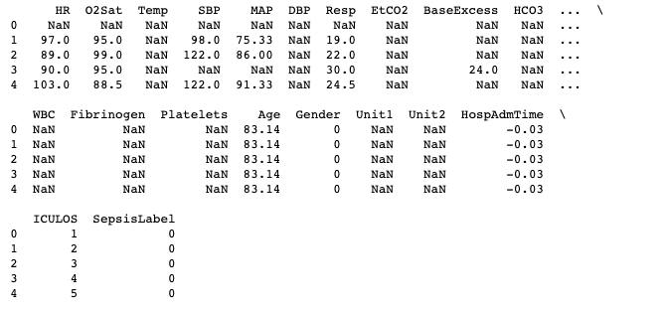
Sepsis Data
Notes:
I will explain the relevant features later

Slide 8
Assumptions
Combined dataset by appending all the patient files
Total files: 43,765 psv files
Shape of original file: (1552287 * 41)
The dataset is not time dependent.
2 approaches to solve it:
Add a time component and patient ID
Ignoring time component and consider each row independently
Following 2nd approach. Reason: Can predict sepsis without past patient data. More robust and need less resources.
Notes:
This approach would help in predicting Sepsis at each hour for any patient(with or without patient past data).
The data for the problem is an hourly time sequence record for each patient. But the records do not have a time-label associated with them, so that opens the scope of interpreting it as a non-temporal problem (ignoring the time component)
There are two ways in which one can approach this problem:
Temporal Approach : Take into the account the time component for the data. Sepsis is diagnosed for each patient at each hour using the past data.
Non-temporal Approach : Ignore the time component and treat record as independently and identically distributed. This approach would help in predicting Sepsis at each hour for any patient(with or without patient past data)

Slide 9
Procedure
Combine all Data
Non-time dependent approach
Handling Missing Values
Feature Engineering
Handling Data Imbalance
Baseline prediction
Notes:
Plan Of Action
The data for the problem is an hourly time sequence record for each patient. But the records do not have a time-label associated with them, so that opens the scope of interpreting it as a non-temporal problem (ignoring the time component)
There are two ways in which one can approach this problem:
Temporal Approach : Take into the account the time component for the data. Sepsis is diagnosed for each patient at each hour using the past data.
Non-temporal Approach : Ignore the time component and treat record as independently and identically distributed. This approach would help in predicting Sepsis at each hour for any patient(with or without patient past data)

Slide 10
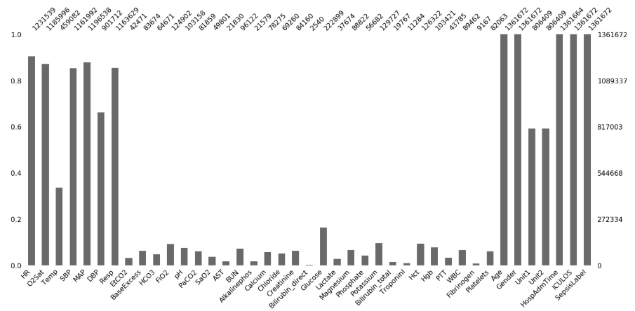
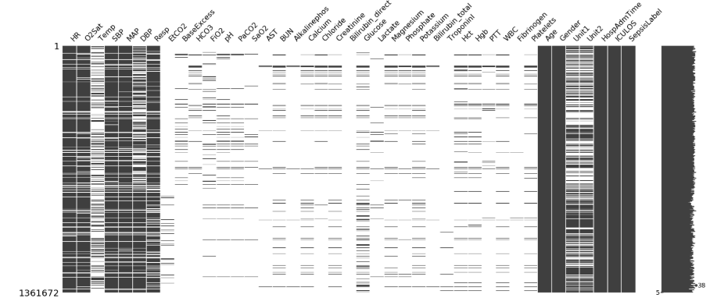
EDA - Handling Missing Values
Most of Laboratory Data are having missing values (Fig)
There are more than 90% of missingness in the dataset
2 steps to handle:
Remove features with missingness > 92%
Categorically encode features to handle missingness.

Slide 11
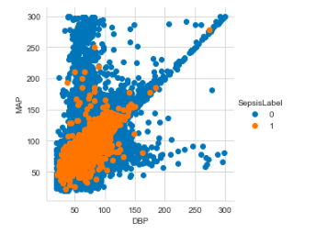
Feature Selection – Part 1
Two Approaches employed for Feature Selection:
Checked correlation of features contributing to the presence of Sepsis
Read health magazines and Research journals such as
US National Library of Medicine, National Institutes of Health
Centers for Disease Control and Prevention
Sepsis - The American Journal of Medicine
and filtered out the most named indicator of Sepsis
Outcome: Heart rate, Pulse Oximetry, Body temperature, Blood Pressure (SBP, DBP), Mean Arterial Pressure, Respiration rate, Frac of inspired oxygen, Age, Gender, Hospital Admission Time and ICU length of stay.

Slide 12
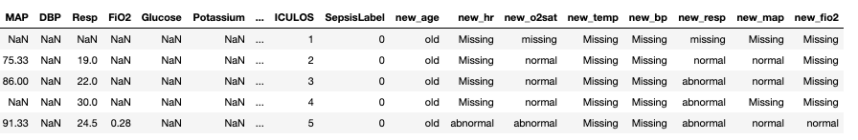
Feature Engineering & label encoding
Developed 8 new features and are described:
new_age : has 3 categorical values – old, young and adult
new_hr, new_temp, new_o2sat, new_bp, new_resp, new_map, new_fio2: has 3 categorical values – normal, abnormal and missing
Next, performed feature section again on them and selected all above features, plus Gender, Hospital Admission Time and ICU length of Stay for further processing as a training set
Notes:
1. Age¶
Three categories -
Child - Age less than 10 year
Adult - Age more than 10 year and less than 60 years
Senior - Age more than 60

Slide 13
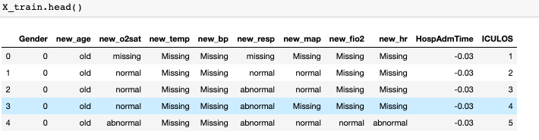
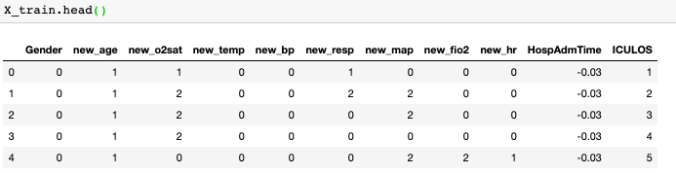
]
All these are categorically values. They are encoded so that it is easier to run a ML algorithm.

Slide 14
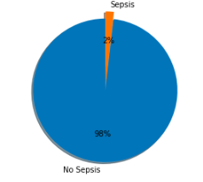
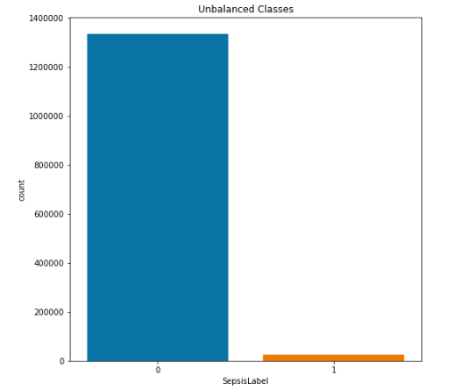
EDA – Handling Data Imbalance
98% of patients does not have sepsis and 2% have sepsis.
Problem with Accuracy
Ways to deal with Imbalance:
Under sampling
Oversampling
Using a good algorithm
Using Balanced Bagging Classifier
Which is better?
Balanced Bagging Classifier with Decision Trees
Notes:
Non-Temporal Approach
In this approach we ignore the time component associated with each patient hourly record and treat them as independently and identically distributed.
Train-Validation-Test -Split
The data repository has data from two hospitals and a total of 40 thousand patients. The actual number of records would be higher as a patient could have stayed in the hospital for a variable amount of time.
Splitting these records to train , validation and test. While splitting I have made sure that each patient is fully contained in exactly one of the splits.
Train : 30K Patients
Test : 5K Patients
Validation : 5K Patients
Note : The script to divide the data to train -test-validation split can be found here https://github.com/kskaran94/Sepsis_Identification
Exploratory Data Analysis
After performing descriptive data analysis on the train data, these were the concerns that highlighted
Concerns
Extremely Imbalance data : As we can see from the bar plot, the records are extremely imbalanced (Less than 1 % vs 99 %+) with the minority class being Sepsis (1).

Slide 15
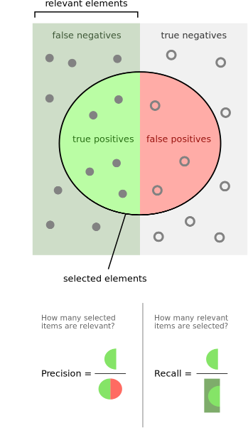
Training Data with Decision Trees
Pre-work:
Common classification Metrics are not useful as there is an imbalance in the data– accuracy score
Precision is defined as the fraction of relevant examples (true positives) among all of the examples which were predicted to belong in a certain class.
Precision = (true positives) / (true positives + false positives)
Recall is defined as the fraction of examples which were predicted to belong to a class with respect to all of the examples that truly belong in the class.
Recall = (true positives) / (true positives + false negatives)

Slide 16
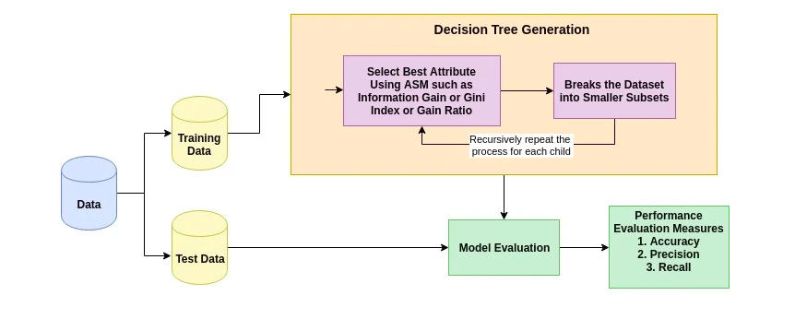
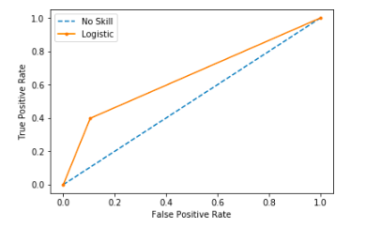
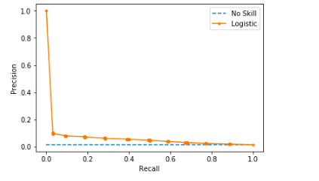
Training Data with Decision Trees
Using Balanced Bagging Classifier from imblearn library, which automatically create balanced samples of the input data.
has the parameter 'ratio' that should control how the data is sampled. I have used majority - resample the majority class
From Fig, although ROC curve seems promising, we can see that P-R curve is not great at classifying.
Notes:
Attribute Selection Measure:
Information Gain: which measures the impurity of the input set
Entropy: it refers to the impurity in a group of examples
Information gain computes the difference between entropy before split and average entropy after split of the dataset based on given attribute values
Gini Ratio: An extension to information gain known as the gain ratio. Gain ratio handles the issue of bias by normalizing the information gain using Split Info
Gini Index: Gini Index considers a binary split for each attribute. You can compute a weighted sum of the impurity of each partition
Attribute selection measure is a heuristic for selecting the splitting criterion that partition data into the best possible manner. It is also known as splitting rules because it helps us to determine breakpoints for tuples on a given node. ASM provides a rank to each feature(or attribute) by explaining the given dataset. Best score attribute will be selected as a splitting attribute (Source). In the case of a continuous-valued attribute, split points for branches also need to define. Most popular selection measures are Information Gain, Gain Ratio, and Gini Index.

Slide 17
Training the data with XGBoost
XGBoost - eXtreme Gradient Boosting
Boosting: Method converts
weak learners -> strong learners
Boosting algorithm like XGBoost adds iterations of the model sequentially, adjusting the weights of the weak-learners along the way. This reduces bias from the model and typically improves accuracy.
Benefits of XGBoost: Highly scalable/parallelizable, quick to execute, and typically out performs other algorithms.

Slide 18
Further Research and Findings
Time component Approach ; need domain expert
PCA for understanding variables better
Using SMOTE for handling Imbalance
Work further on XGBoost
Better Feature Engineering
Ways to reduce Hospital stay time
Learning Curve with the Project
Python – Object Oriented Structure and Programming
Libraries heavily used – Sklearn, Matplotlib
Built on Jupyter Notebook

Slide 19
Conclusion
We have handled the missing ness and imbalance in the large dataset
We removed missing values > 92%
Performed feature engineering (8 new features) and selected important features
We aimed to predict the onset of the sepsis by 6 hours and so far the Machine Learning model employed seem to classify it partially
The project has a scope of continuing with further research on the importance of the features, better model building and under the guidance of a good health science domain expert.

Slide 20
References
[1] https://www.physionet.org/content/challenge-2019/1.0.0/
[2] https://www.datacamp.com/community/tutorials/decision-tree-classification-python
[3] https://towardsdatascience.com/using-bagging-and-boosting-to-improve-classification-tree-accuracy-6d3bb6c95e5b
[4] https://towardsdatascience.com/early-detection-of-sepsis-using-physiological-data-78d5f31fab9d
[5] https://iopscience.iop.org/article/10.1088/1757-899X/428/1/012004
[6] https://machinelearningmastery.com/roc-curves-and-precision-recall-curves-for-classification-in-python/
[7] https://www.cdc.gov/
[8] https://www.ncbi.nlm.nih.gov/pmc/articles/PMC6429642/
[9] http://www.erogol.com/fighting-class-unbalance-supervised-ml-problem/

Slide 21

Thank You
I would like to thank my advisor Dr. Anand Panangadan for helping me with the project
I would like to thank my friends at Edward Life Sciences for advising me on ways to approach the problem
I would like my university for giving me the necessary skills to attempt and complete the project

