Slide 1
Data Report
Marketing Analytics Project Insights for the year 2024

Slide 2
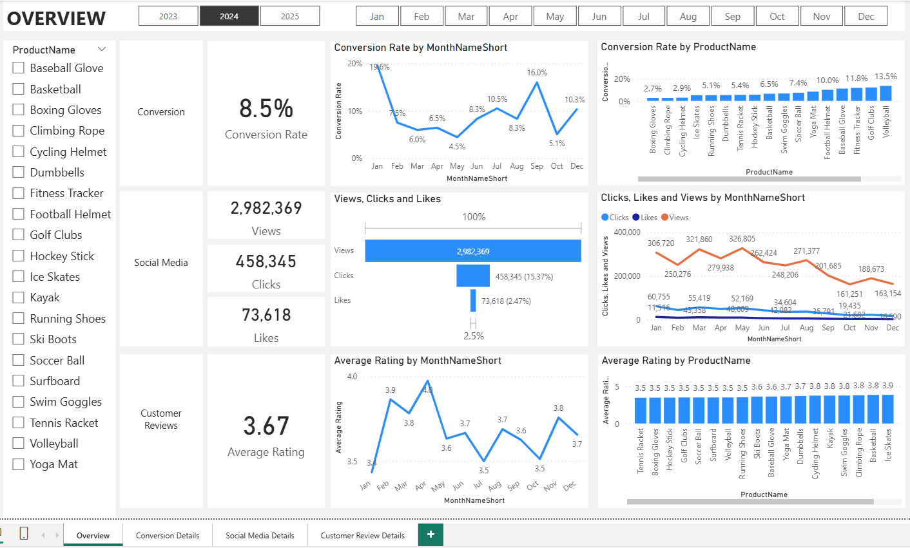
Overview
Reduced Customer Engagement:
Overall engagement, measured by views, declined throughout the year. This steady drop signals that we might need to rethink our content strategy to maintain and grow audience interest.
Decreased Conversion Rate:
Saw a significant recovery in December, hitting 10.3%, after a sharp drop to 5.1% in October. This suggests some seasonal factors at play, or perhaps specific campaigns that drove higher conversions at year-end.
Although clicks and likes were relatively low compared to the number of views, the click-through rate was solid at 15.37%. This suggests that while the broader audience isn’t engaging as much, the core group of engaged users are still highly interested.
Customer Feedback Analysis:
Ratings stayed steady, averaging around 3.7.
Although stable, the average rating is below the target of 4.0, suggesting a need for focused improvements in customer satisfaction for products below 3.5

Slide 3
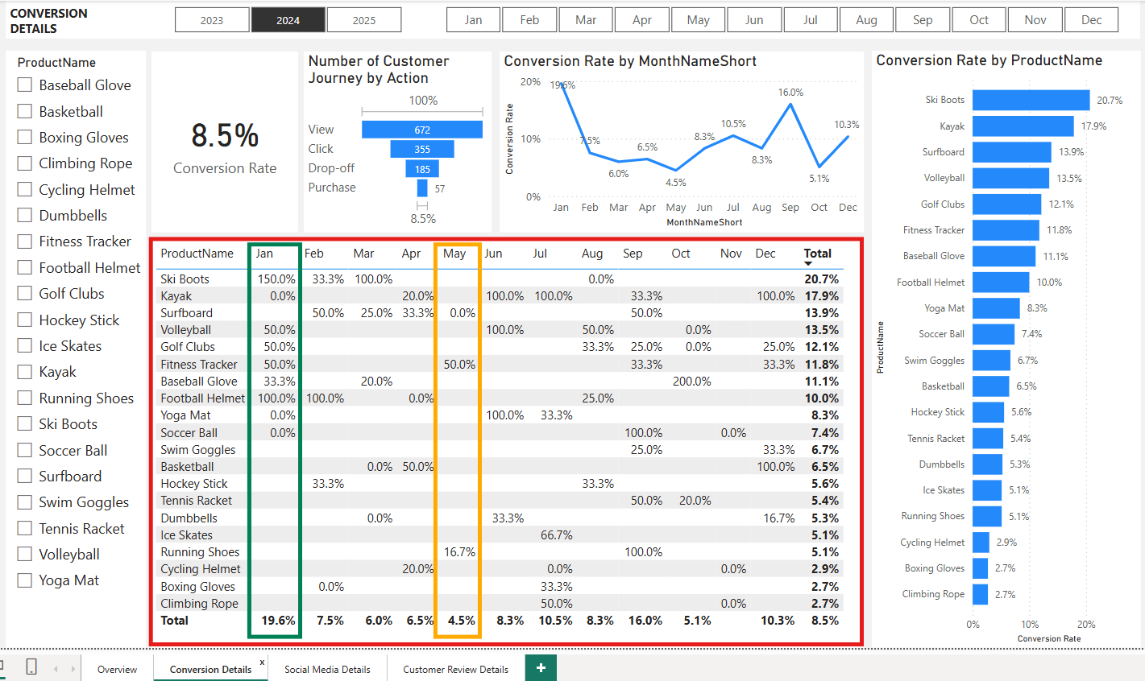
Deceased Conversion Rates
General Conversion Trend:
Throughout the year, conversion rates varied, with higher number of products converting successfully in few months like February and July. This suggests that while some products had strong peaks, there is a potential to improve conversions in lower-performing months throughout the targeted interventions.
Lowest Conversion Month:
May experienced the lowest overall conversion rate at 4.5% with no products standing out significantly in terms of conversion. This indicates a potential need to revisit marketing strategies or promotions during this period to boost the performance.
Highest Conversion Rates:
January recorded the highest overall conversion rate at 19.6% driven significantly by the Ski Boots with a remarkable 150.0% conversion. This indicates a strong start to the year, likely fueled by seasonal demand and effective marketing strategies.

Slide 4
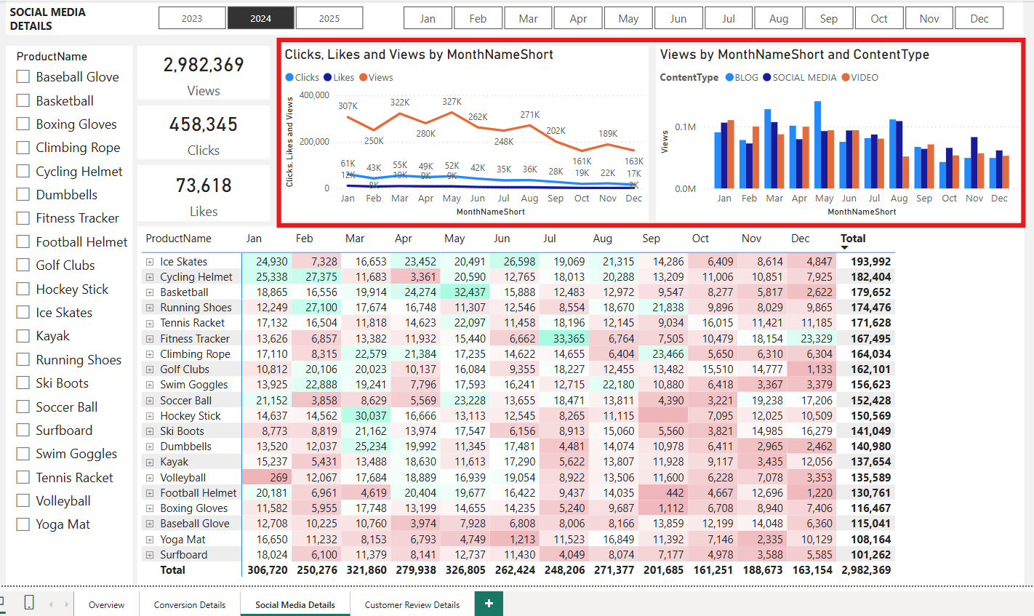
Reduced Customer Engagement
Declining Views:
Views peaked in February and July but declined from August onwards indicating reduced audience engagement in the later half of the year.
Low Interaction Rate:
Clicks and likes remained consistently low compared to views suggesting the need for more engaging content or stronger calls to action.
Content Type Performance:
Blog content drove the most views, specially in April and July, while social media and video content maintained a steady but slightly lower engagement.

Slide 5
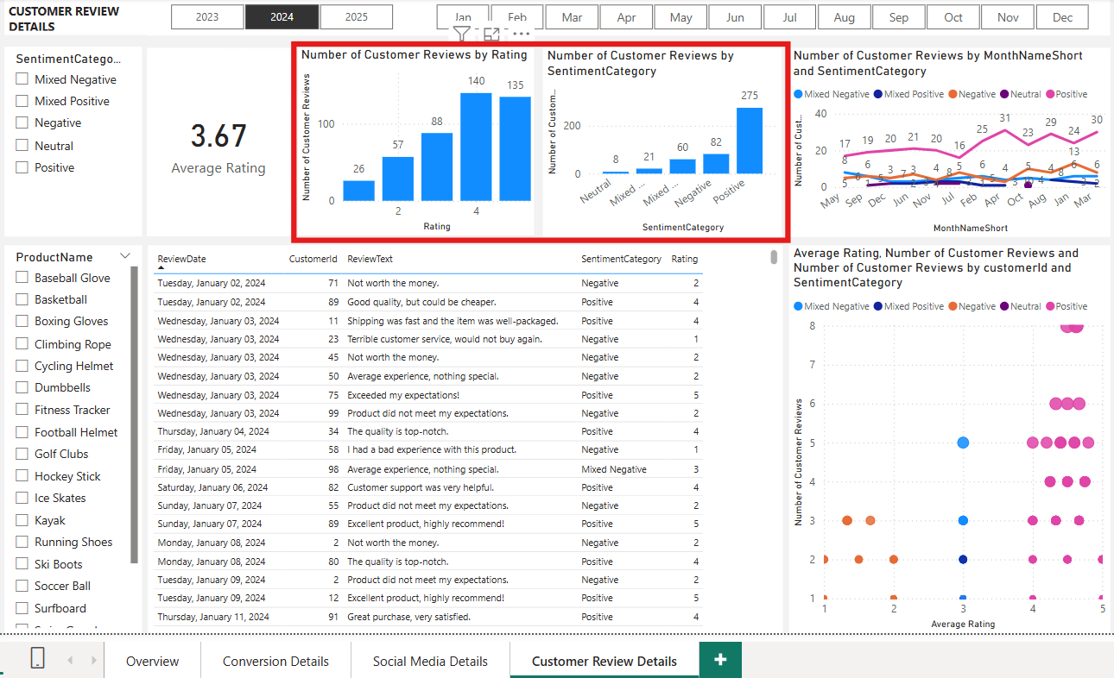
Customer Feedback Analysis
Customer Ratings Distribution:
The majority of customer reviews are in the higher ratings, with 140 reviews at 4 stars, 135 reviews at 5 stars, indicating overall positive feedback. Lower ratings (1 or 2 stars) account for a smaller proportion with 26 reviews at 1 star and 57 reviews at 2 stars.
Sentiment Analysis:
Positive sentiment dominates with 275 reviews, reflecting a generally satisfied customer base. Negative sentiment is present in 82 reviews with a similar number of mixed and neutral sentiments, suggesting areas for improvement, but overall strong customer approval.
Opportunity for improvement:
The presence of mixed positive and mixed negative suggests that there are opportunities to convert those mixed experiences into more clearly positive ones, potentially boosting overall ratings. Addressing the specific concerns in mixed reviews could elevate customer satisfaction.

Slide 6
Goals and Insights
Increase Conversion Rates:
Goal: Identify factors impacting conversion rates and provide recommendation to improve it.
Insight: Highlight key stages where visitors drop-off and suggest improvements to optimize the conversion funnel.
Enhance Customer Engagement:
Goal: Determine which type of content drive the highest engagement.
Impact: Analyze interaction levels with different types of marketing content to inform better content strategies.
Improve Customer Feedback Scores:
Goal: Understand common themes in the customer reviews and provide actionable insights.
Insight: Identify recuring positive and negative feedback to guide product and service improvements.

Slide 7
Actions
Increase Conversion Rates:
Target High-Performance Product Categories: Focus marketing efforts on products with demonstrated high conversion rates, such as Kayaks, Ski boots and Baseball Gloves. Implement seasonal promotions or personalized campaigns during peak months (e.g. January and September) to capitalize on these trends.
Enhance Customer Engagement:
Revitalize Content Strategies: To turn around declining views and low interaction rates, experiment with engaging content format such as interactive video or user-generated content. Additionally, boost engagement by optimizing call-to-action placement in social media and blog content, particularly during historically lower engagement months (September to December).
Improve Customer Feedback Scores:
Address Mixed and Negative Feedbacks: Implement a feedback loop when mixed and negative reviews are analyzed to identify common issues. Develop improvement plans to address these concerns. Consider following with dissatisfied customers to resolve issue and encourage re-rating, aiming to move average ratings closer to the 4.0 target.

