Slide 1

Student Performance Analysis

Slide 2

Introduction
This report presents an Exploratory Data Analysis (EDA) of the factors that influence student academic performance. By analyzing academic scores alongside study habits, demographic characteristics, and institutional variables, the study seeks to identify the key determinants of student success. The insights derived from this analysis can support educators, administrators, and policymakers in making informed, data-driven decisions related to resource allocation, targeted student interventions, and scholarship distribution, ultimately contributing to improved educational outcomes.

Slide 3

Project Objective
The primary objective of this analysis is to examine how student attendance and engagement influence academic performance and overall grading outcomes. It also aims to identify high-performing students and potential scholarship candidates while assessing the demand for advanced placement opportunities. Furthermore, the study evaluates the financial and operational value of academic courses by analyzing factors such as credit hours, faculty workload, and classroom utilization. By comparing departmental academic achievements with investments in faculty and facilities, the analysis provides insights to support effective resource allocation, strategic planning, and institutional budgeting decisions.

Slide 4

Research Questions
Q1: Do study hours positively impact overall performance?
Q2: Does internet access improve academic outcomes?
Q3: Does attendance have a strong positive relationship with scores?
Q4: Does parental education influence student achievement?
Q5: Are Math scores mostly concentrated around the average range?
Q6: Do certain study methods lead to better scores?
Q7: Does school type impact student performance?
Q8: Do students with shorter travel times perform better?
Q9: How can top performers be identified for scholarships?
Q10: Are English scores evenly distributed among students?
Q11: How can low-performing students be targeted for intervention?
Q12: Do Math, Science, and English scores strongly affect the overall score?
Q13: Do Science scores indicate moderate to strong academic performance?
Q14: How can top-performing students be targeted for rewards and recognition?
Q15: Are subject scores, attendance, and study hours the strongest predictors of overall
performance?

Slide 5

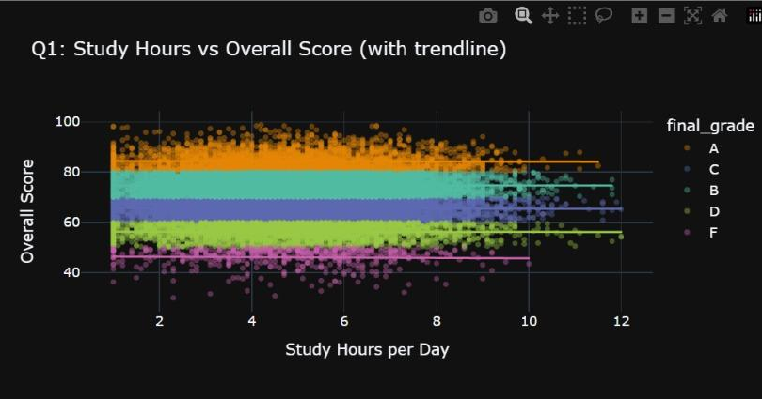
Do study hours positively impact overall performance?
The analysis suggests that student performance is driven more by the quality and effectiveness of studying than by the quantity of study hours alone. Institutions should therefore focus on improving student engagement, attendance, learning support programs, and study skills training rather than encouraging longer study hours as the sole strategy for academic improvement.

Slide 6

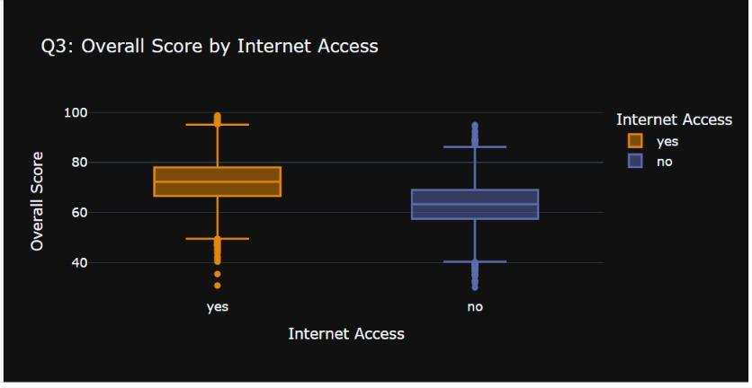
Does internet access improve academic outcomes?
The analysis suggests that internet access is associated with improved academic performance, making it an important factor in student success. Educational institutions should consider expanding digital infrastructure, providing affordable internet support, and ensuring equitable access to online learning resources. Such initiatives can help reduce academic disparities and improve overall student outcomes.

Slide 7

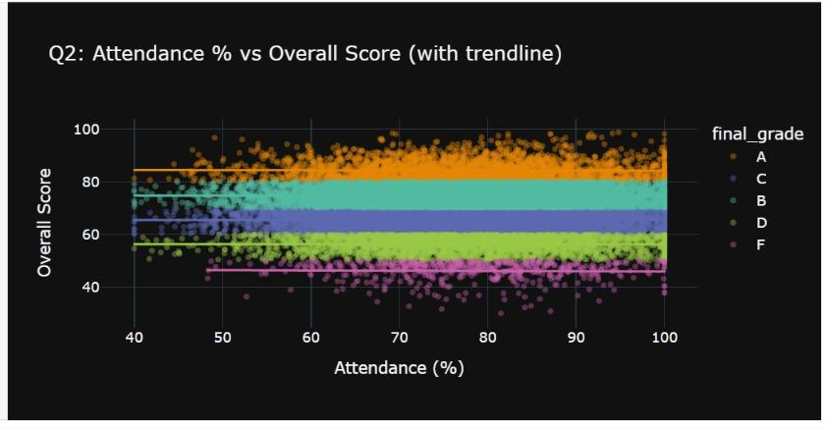
Does attendance have a strong positive relationship with scores?
The analysis indicates that consistent attendance is an important contributor to academic success, but it is not the sole determinant of performance. Institutions should prioritize attendance monitoring and early intervention programs for students with declining attendance, while also focusing on improving classroom engagement and learning support services. Encouraging regular attendance can help improve academic outcomes, particularly for students at risk of underperforming

Slide 8

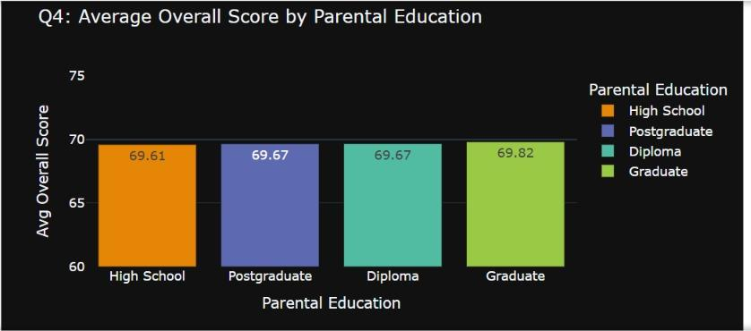
Does parental education influence student achievement?
The analysis indicates that parental education level has a very limited effect on student academic performance within this dataset. Academic success appears to be influenced more by student-specific and institutional factors than by parents' educational qualifications. This is a positive indicator of educational inclusiveness and equal learning opportunities.

Slide 9

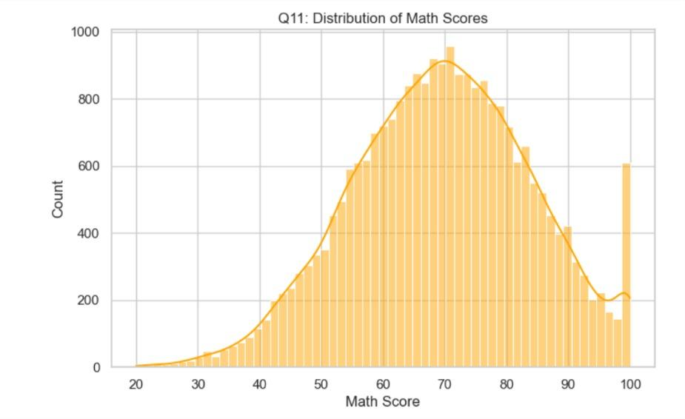
Are Math scores mostly concentrated around the average range?
A grading anomaly has created an unnatural spike of perfect scores. While the bulk of the class performed normally (averaging around a 70), there is a massive, disproportionate cluster of students who scored exactly 100. This highly irregular spike suggests that grades were either capped at 100, or heavy extra credit artificially pushed a large volume of top-performing students into the perfect score bracket.

Slide 10

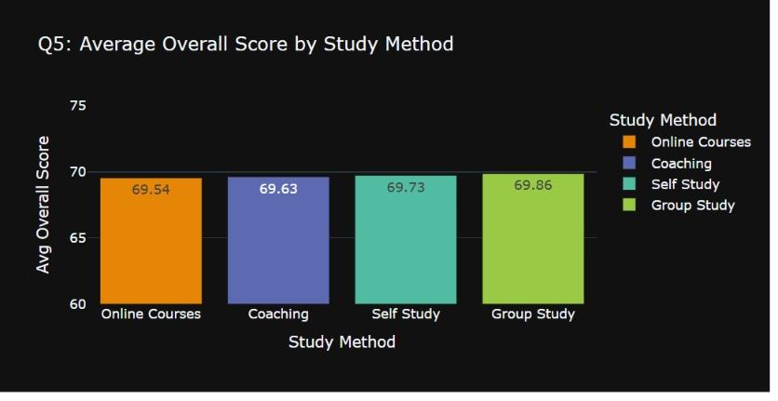
Do certain study methods lead to better scores?
The analysis suggests that students can achieve similar academic outcomes regardless of their preferred study method, provided they remain engaged and consistent in their learning. While Group Study shows a slight advantage, the differences are too small to indicate a substantial performance gap. Institutions should therefore focus on promoting effective learning strategies and student engagement rather than emphasizing a single study approach.

Slide 11

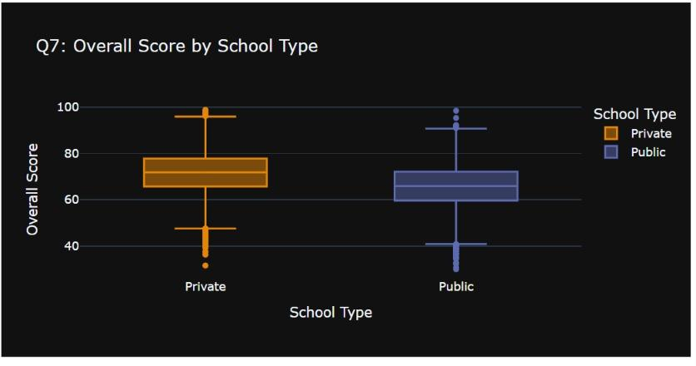
Does school type impact student performance?
Private schools tend to yield higher overall scores than Public schools.The median score and the middle 50% of the data are visibly higher for Private schools (median ~72) compared to Public schools (median ~65). While both school types have high and low outliers, the overall distribution suggests a general performance advantage associated with the Private school category.

Slide 12

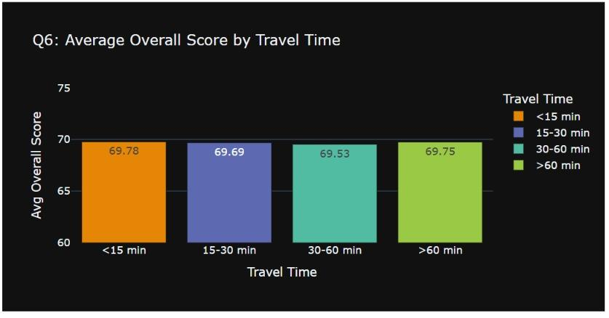
Do students with shorter travel times perform better?
Travel time does not impact the overall score.Regardless of whether the commute takes under 15 minutes or over an hour, the average score remains practically identical across all groups (averaging ~69.7), proving that travel duration is completely unrelated to the measured outcome.

Slide 13
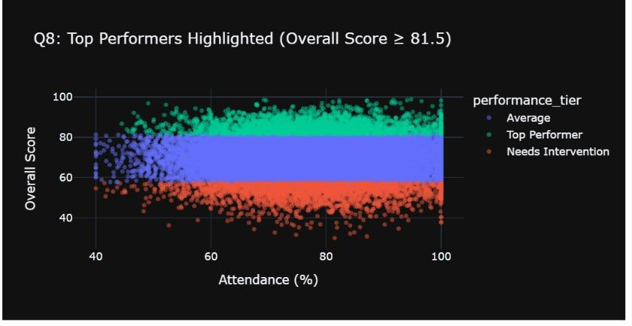
How can top performers be identified for scholarships?
The analysis suggests that students can achieve similar academic outcomes regardless of their preferred study method, provided they remain engaged and consistent in their learning. While Group Study shows a slight advantage, the differences are too small to indicate a substantial performance gap. Institutions should therefore focus on promoting effective learning strategies and student engagement rather than emphasizing a single study approach.

Slide 14

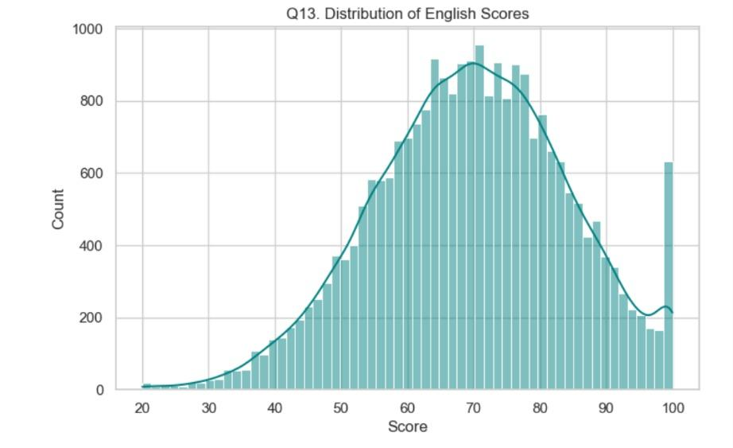
Are English scores evenly distributed among students
A grading cap or extra credit has caused an unnatural cluster of perfect scores. While the general class performance follows a natural curve (peaking around 70), there is a disproportionately massive cluster of students who scored exactly 100. This highly irregular spike suggests that grades were capped at 100, or heavy extra credit artificially pushed a large volume of top-performing students into the perfect score bracket.

Slide 15

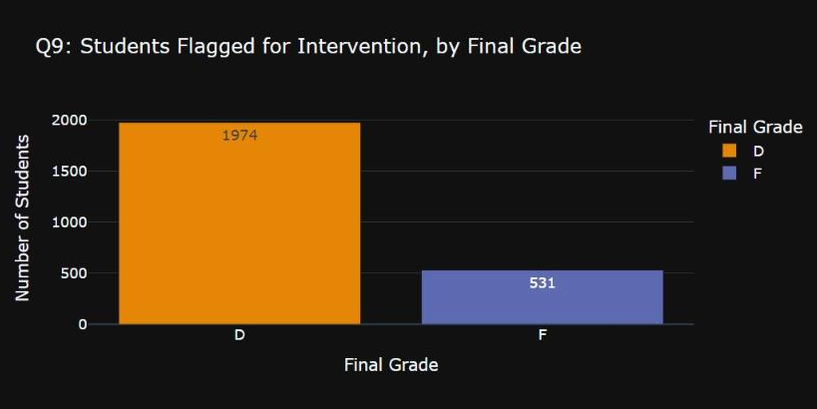
How can low-performing students be targeted for intervention?
Interventions overwhelmingly target borderline passing students.Nearly 80% of all students flagged for intervention finished with a 'D' grade (1,974 students), which is nearly four times the number of students who flagged and failed with an 'F' (531 students). This shows the flagging system is catching students who are struggling but still barely passing.

Slide 16

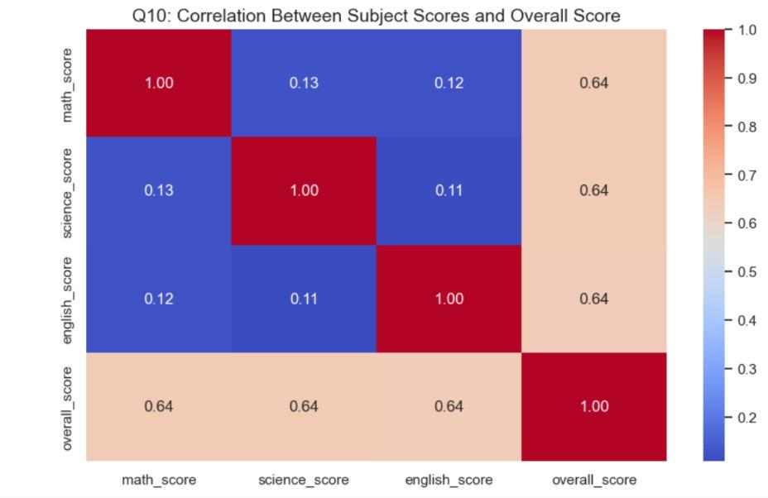
Do Math, Science, and English scores strongly affect the overall score?
All subjects matter equally, but skill sets do not overlap.Math, Science, and English contribute exactly the same amount to the overall score (all showing a 0.64 correlation). However, a student's score in one subject is essentially unrelated to their score in another (correlations of ~0.12), meaning students tend to have distinct strengths and weaknesses rather than sweeping, cross-subject academic proficiency.

Slide 17

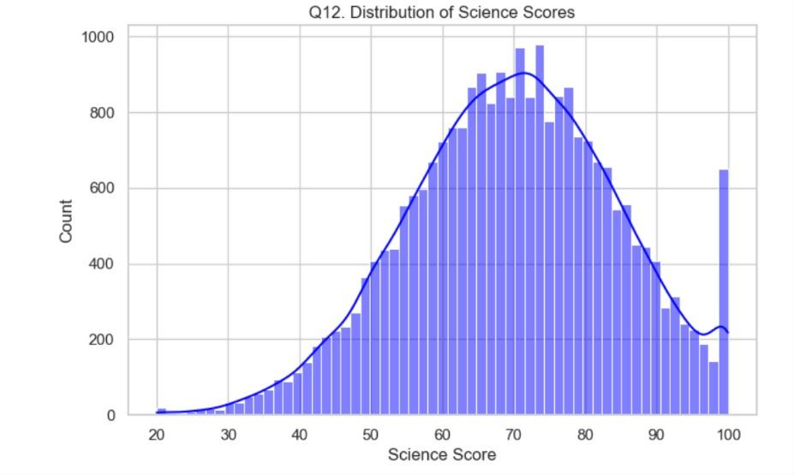
Do Science scores indicate moderate to strong academic performance?
A score cap or extra credit has created an unnatural cluster of perfect scores.While the general class performance follows a natural curve (peaking around 70–75), there is a massive, disproportionate cluster of students who scored exactly 100. This highly irregular spike suggests that grades were capped at 100, or heavy extra credit artificially pushed a large volume of high-performing students into the perfect score bracket.

Slide 18

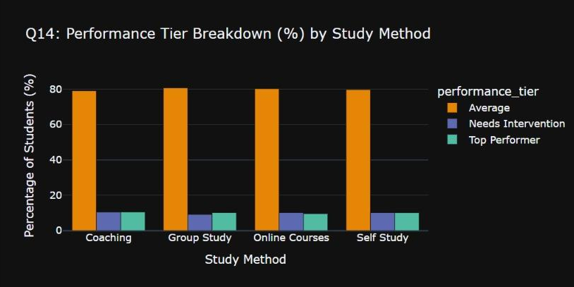
How can top-performing students be targeted for rewards and recognition?
Study method does not dictate performance outcomes. The percentage of Average students (~80%), Top Performers (~10%), and those Needing Intervention (~10%) is identical regardless of whether they use Coaching, Group Study, Online Courses, or Self Study. The medium a student chooses to study through has no measurable effect on which performance tier they ultimately fall into.

Slide 19

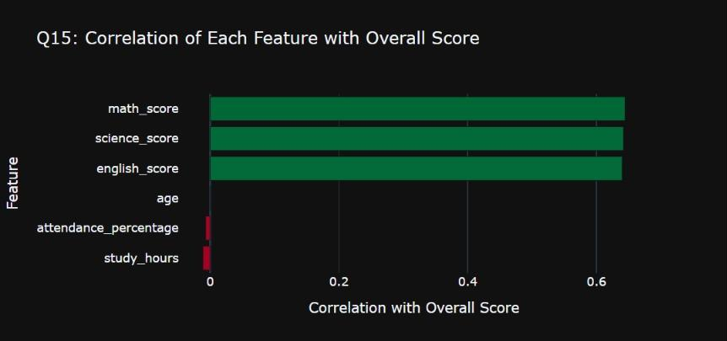
Are subject scores, attendance, and study hours the strongest predictors of overall performance?
Academic subjects drive the overall score, while student effort is irrelevant.A student's overall score is determined entirely and equally by their Math, Science, and English scores. Factors like age, attendance rate, and study hours have zero meaningful correlation to the final outcome, proving that the score measures test performance alone rather than rewarding study habits or participation

Slide 20
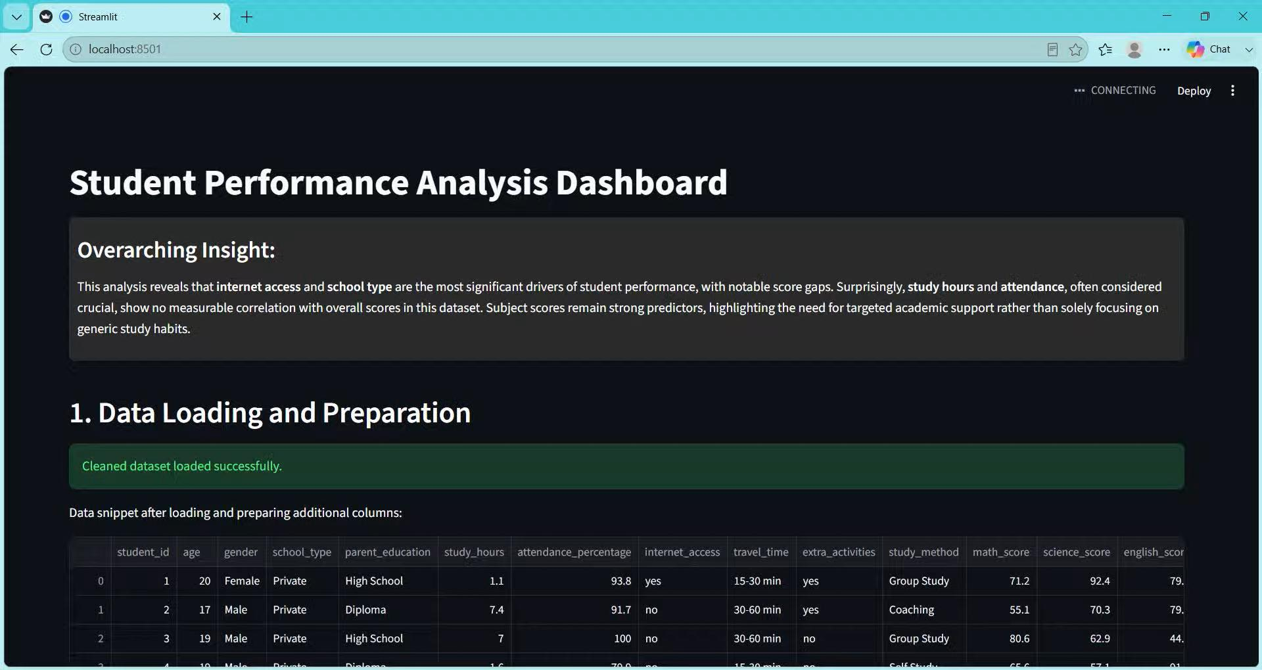
Created Dashboard by Using Streamlit

Slide 21

Conclusion
Standard behavioral metrics like attendance, study hours, and study methods show no statistical impact on student performance, which is instead driven entirely by core subject proficiency (Math, Science, English) and school type (Private vs. Public). To maximize institutional ROI, resources should be redirected from broad study programs toward subject-specific tutoring for at-risk 'D' students and closing the public-private performance gap. Furthermore, scholarships must be strictly merit-based using an overall score threshold of 81.5. Ultimately, educational investments must pivot away from attempting to optimize personal study habits and focus directly on targeted academic intervention and core subject mastery.

Slide 22
THANK YOU

