Slide 1
HAPPIEST HEALTH · DIGITAL TWIN CHALLENGE
VitalTwin
A personal digital twin for chronic-disease patients that monitors, predicts and simulates
Team: Nexon
Members: Anushree Kasturi
Institution: Amrita Vishwa Vidyapeetham, Bengaluru
Live demo: https://vitaltwin.streamlit.app/

Slide 2
PROBLEM STATEMENT
The problem: chronic disease is managed in snapshots
• India has 100M+ people with diabetes and ~315M with hypertension; many are undiagnosed or poorly controlled (ICMR-INDIAB, 2023).
• Care is episodic - a clinic visit every 3 months sees one BP reading and one HbA1c, while the disease evolves every day.
• Wearables & CGMs produce rich data, but nobody turns it into a personal, predictive model of the patient.
• Interventions are trial-and-error - doctors cannot test 'what if this patient walks 30 min and cuts salt?' before prescribing it.
Our question
Can we build a living virtual replica of each patient that
stays synced with their real data, flags deterioration early,
predicts long-term risk, and lets clinicians safely test
interventions on the twin first?
VitalTwin · Patient Digital Twin for Chronic Disease · Happiest Health Digital Twin Challenge
2

Slide 3
WHO USES IT AND HOW
Healthcare use case
👤 Patient
Sees their own twin
Understands what drives risk
Plans meals & activity on the
glucose twin before eating
🩺 Clinician
Remote monitoring dashboard
Prioritised critical alerts
Tests therapy plans on the twin
before prescribing
🏥 Care program
Population triage by risk
Preventive outreach for
pre-diabetic / hypertensive
members (e.g. corporate wellness)
Example journey - Ravi, 52, pre-diabetic, hypertensive smoker
• Twin syncs 48 h of smartwatch, CGM and BP-cuff data and calibrates his insulin sensitivity (−29 % vs population prior).
• Monitoring catches a tachycardia episode, a night-time SpO₂ dip and a hypoglycaemic event as critical alerts.
• Risk view shows 15 % diabetes / 19 % CVD 10-yr risk; smoking and systolic BP are the top modifiable drivers.
• What-if a realistic plan (300 kcal deficit, 150 min/wk exercise, 2.5 g salt, quit smoking, 80 % adherence) cuts CVD risk to ~6 % in 24 weeks.
VitalTwin · Patient Digital Twin for Chronic Disease · Happiest Health Digital Twin Challenge
3

Slide 4
WHAT WE BUILT
Solution: a hybrid physics + AI digital twin
Sync
Ingest multi-sensor streams
EWMA state estimation
Calibrate physiology to the
patient's CGM (least squares)
Monitor
Personal baselines
IsolationForest anomalies
Clinical hard limits
De-duplicated alert feed
Predict
10-yr T2D & CVD risk
Calibrated gradient boosting
Counterfactual explanations
of modifiable drivers
Simulate
Glucose-insulin ODE (24 h)
Lifestyle & medication
projection (12-52 wks)
Scenario vs. no-change
Why hybrid? Mechanistic models give physiologically plausible, explainable simulations with little data;
ML models capture population risk patterns that equations miss. Together they make a twin that can both explain and predict.
VitalTwin · Patient Digital Twin for Chronic Disease · Happiest Health Digital Twin Challenge
4

Slide 5
ARCHITECTURE
System architecture
1 · PHYSICAL PATIENT & DATA
2 · INGESTION & TWIN SYNC
3 · DIGITAL TWIN CORE
4 · APPLICATIONS (STREAMLIT)
⌚ Smartwatch
HR · SpO₂ · skin temp · steps (1 min)
Stream ingestion
Resample to 5-min windows
Interpolate gaps, de-noise
pandas pipeline (twin/data.py)
Twin state store
Patient profile + calibrated parameters
🧬 Twin state
Sync view & calibration fit
🩸 CGM sensor
Glucose every 5 min
Physiology engine (mechanistic)
Bergman minimal model: glucose-insulin,
meals, exercise, metformin (1-min ODE)
Lifestyle model: weight · BP · HR · LDL
· HbA1c (ADAG) week-by-week
📡 Live monitoring
Vitals replay + alert feed
State estimation
EWMA blend of EHR + sensors
Resting HR · BP · fasting glucose
(twin/sync.py)
🩺 BP cuff
Systolic / diastolic, 3×/day
⚠️ Risk drivers
Explainable 10-yr risk
AI / ML engine (data-driven)
Calibrated HistGradientBoosting:
10-yr T2D & CVD risk (AUC 0.87 / 0.82)
Counterfactual risk-driver explainer
IsolationForest + personal z-score
+ clinical limits → alerts
🔮 What-if simulator
Compare plans over 12-52 wks
📋 EHR & labs
HbA1c · lipids · history · meds
Physiological calibration
Fit insulin sensitivity SI and
basal glucose Gb to CGM
SciPy Nelder-Mead least squares
RMSE → sensor-noise level
🩸 Glucose twin
Plan a day: meals, walk, meds
📝 Patient log
Meals · exercise · sleep
Closed loop: clinician / patient chooses an intervention on the twin → applied to the real patient → new sensor data re-syncs and re-calibrates the twin
VitalTwin · Patient Digital Twin for Chronic Disease · Happiest Health Digital Twin Challenge
5

Slide 6
MODEL DETAILS
AI / ML models & frameworks
Component | Method | Framework | Result
10-yr T2D risk | HistGradientBoosting + isotonic calibration | scikit-learn | AUC 0.868 · Brier 0.030
10-yr CVD risk | HistGradientBoosting + isotonic calibration | scikit-learn | AUC 0.818 · Brier 0.046
Risk explanation | Counterfactual: factor → healthy target | custom | Per-patient ranked drivers
Anomaly detection | IsolationForest + personal z-score + limits | scikit-learn | All injected events caught
Glucose physiology | Bergman minimal model + gut absorption | NumPy (Euler, 1 min) | Est. HbA1c within 0.3 % of labs
Twin calibration | Nelder-Mead least squares on SI, Gb | SciPy | SI recovered within ~2 %
Lifestyle projection | Effect-size model, coupled to ODE | NumPy | Weight · BP · LDL · HbA1c
Trained on a 20,000-person synthetic cohort with FINDRISC / Framingham-inspired risk structure (80/20 stratified split). No real patient data is used; the pipeline is ready to retrain on NHANES, UK Biobank or hospital EHR data.
VitalTwin · Patient Digital Twin for Chronic Disease · Happiest Health Digital Twin Challenge
6

Slide 7
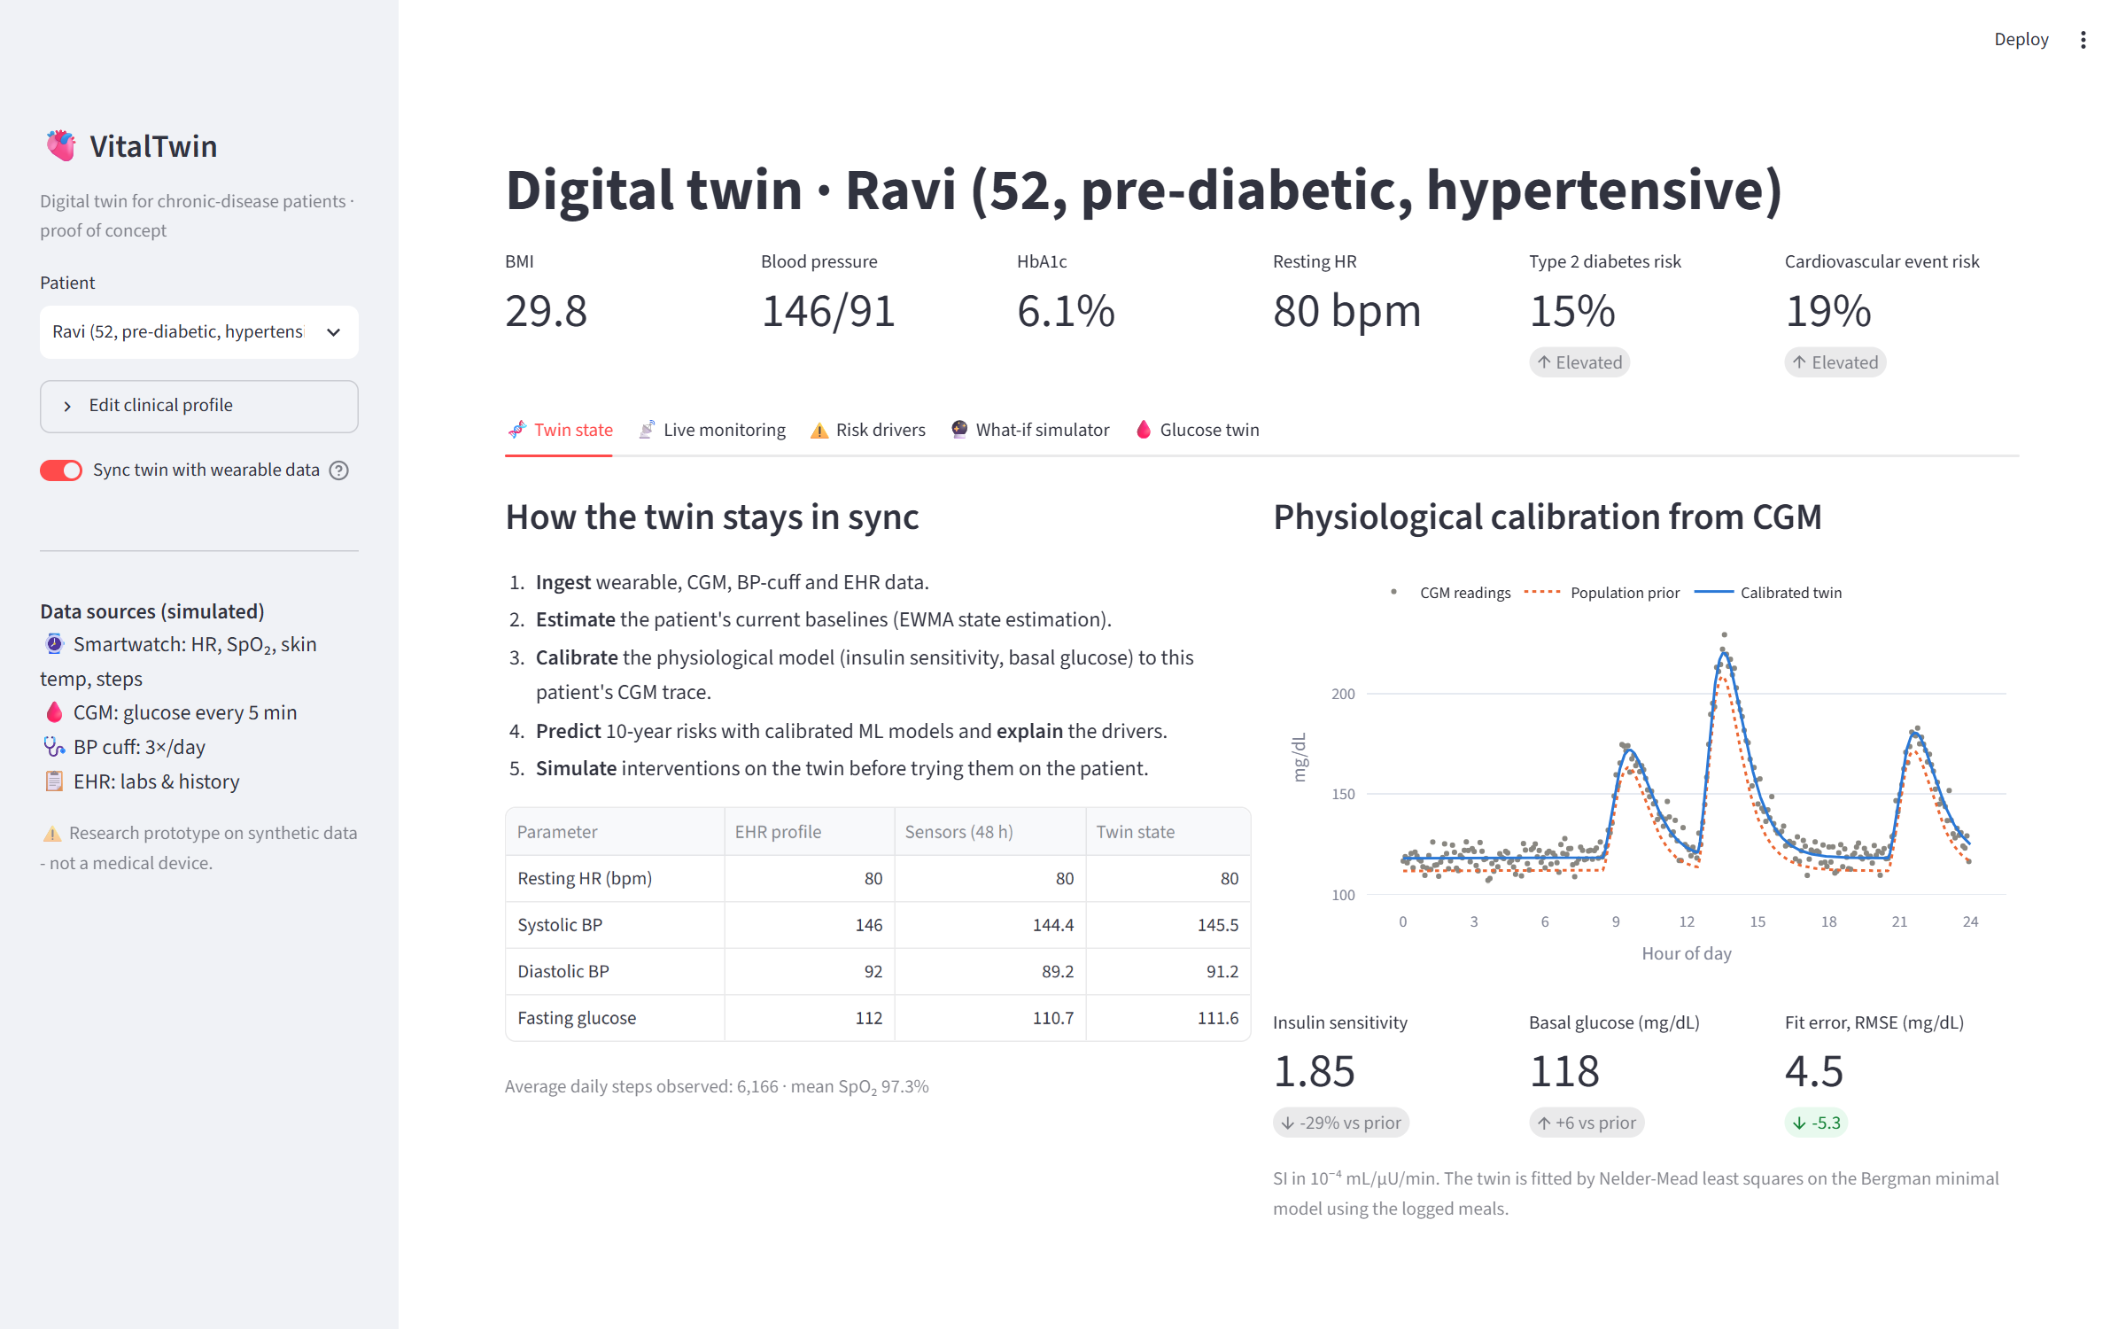
DEMO · SYNC
Twin state & physiological calibration
EHR values are blended with 48 h of sensor data; the glucose model is fitted to this patient's CGM trace.
VitalTwin · Patient Digital Twin for Chronic Disease · Happiest Health Digital Twin Challenge
7

Slide 8
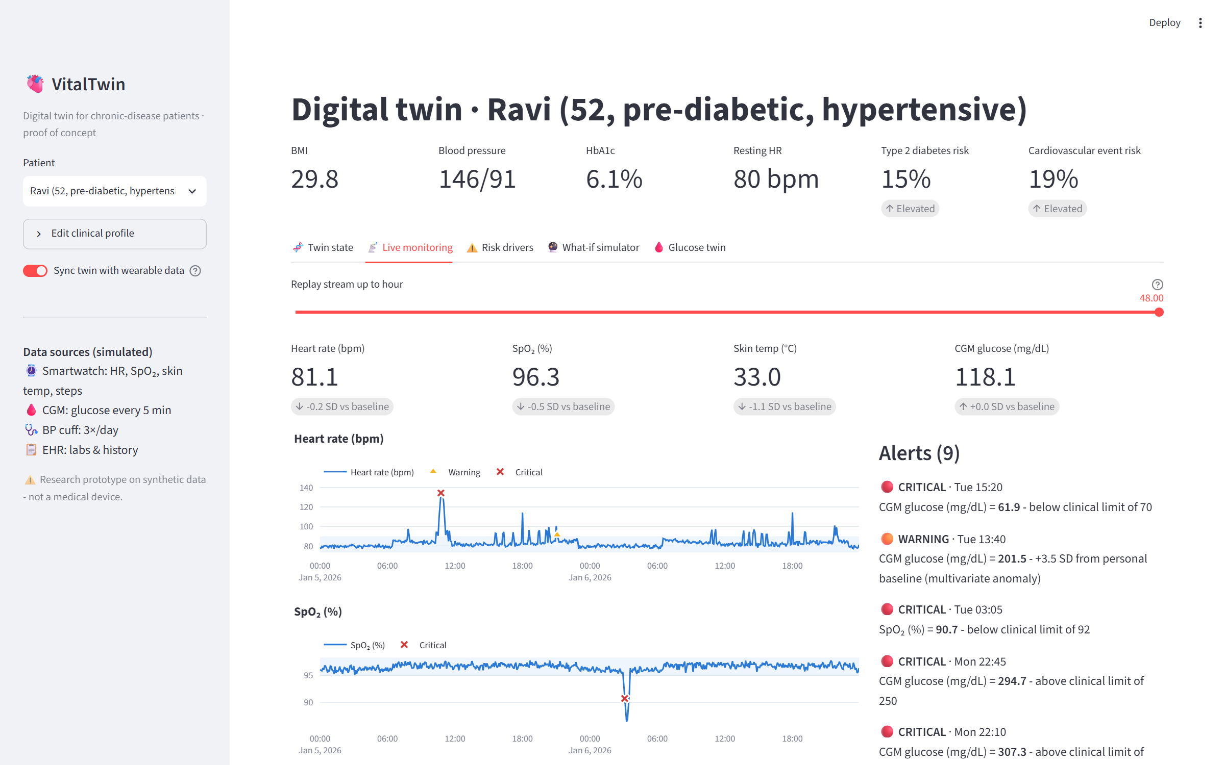
DEMO · MONITOR
Live monitoring & alerts
Personal ±3 SD baselines, multivariate anomalies and clinical limits produce a prioritised alert feed.
VitalTwin · Patient Digital Twin for Chronic Disease · Happiest Health Digital Twin Challenge
8

Slide 9
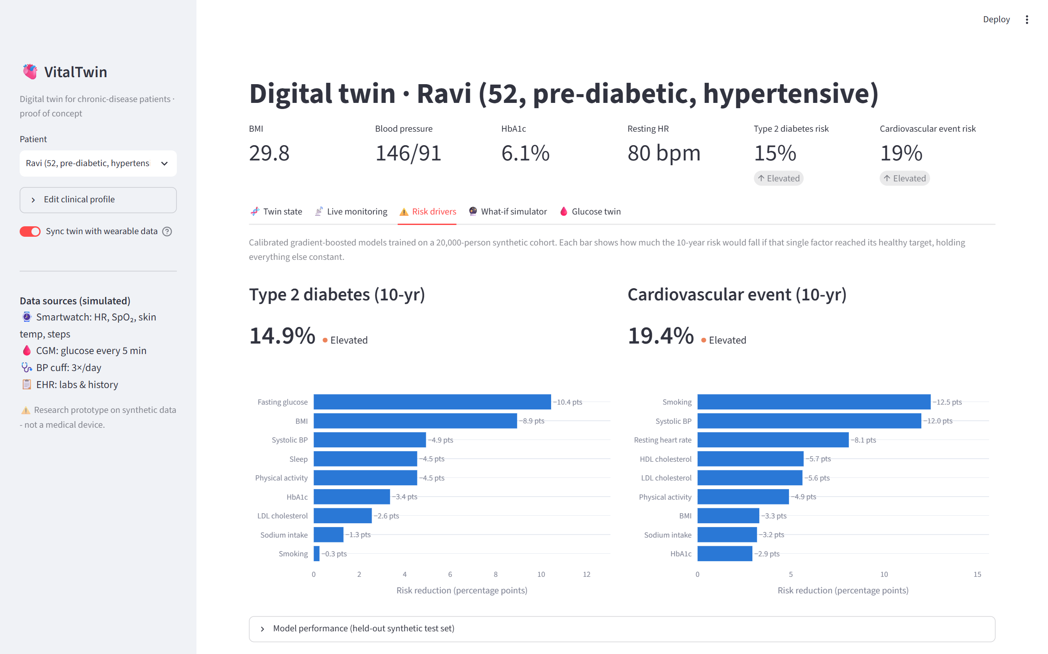
DEMO · PREDICT
Explainable risk drivers
Each bar = risk reduction if that one factor reached its healthy target - actionable, not just a score.
VitalTwin · Patient Digital Twin for Chronic Disease · Happiest Health Digital Twin Challenge
9

Slide 10
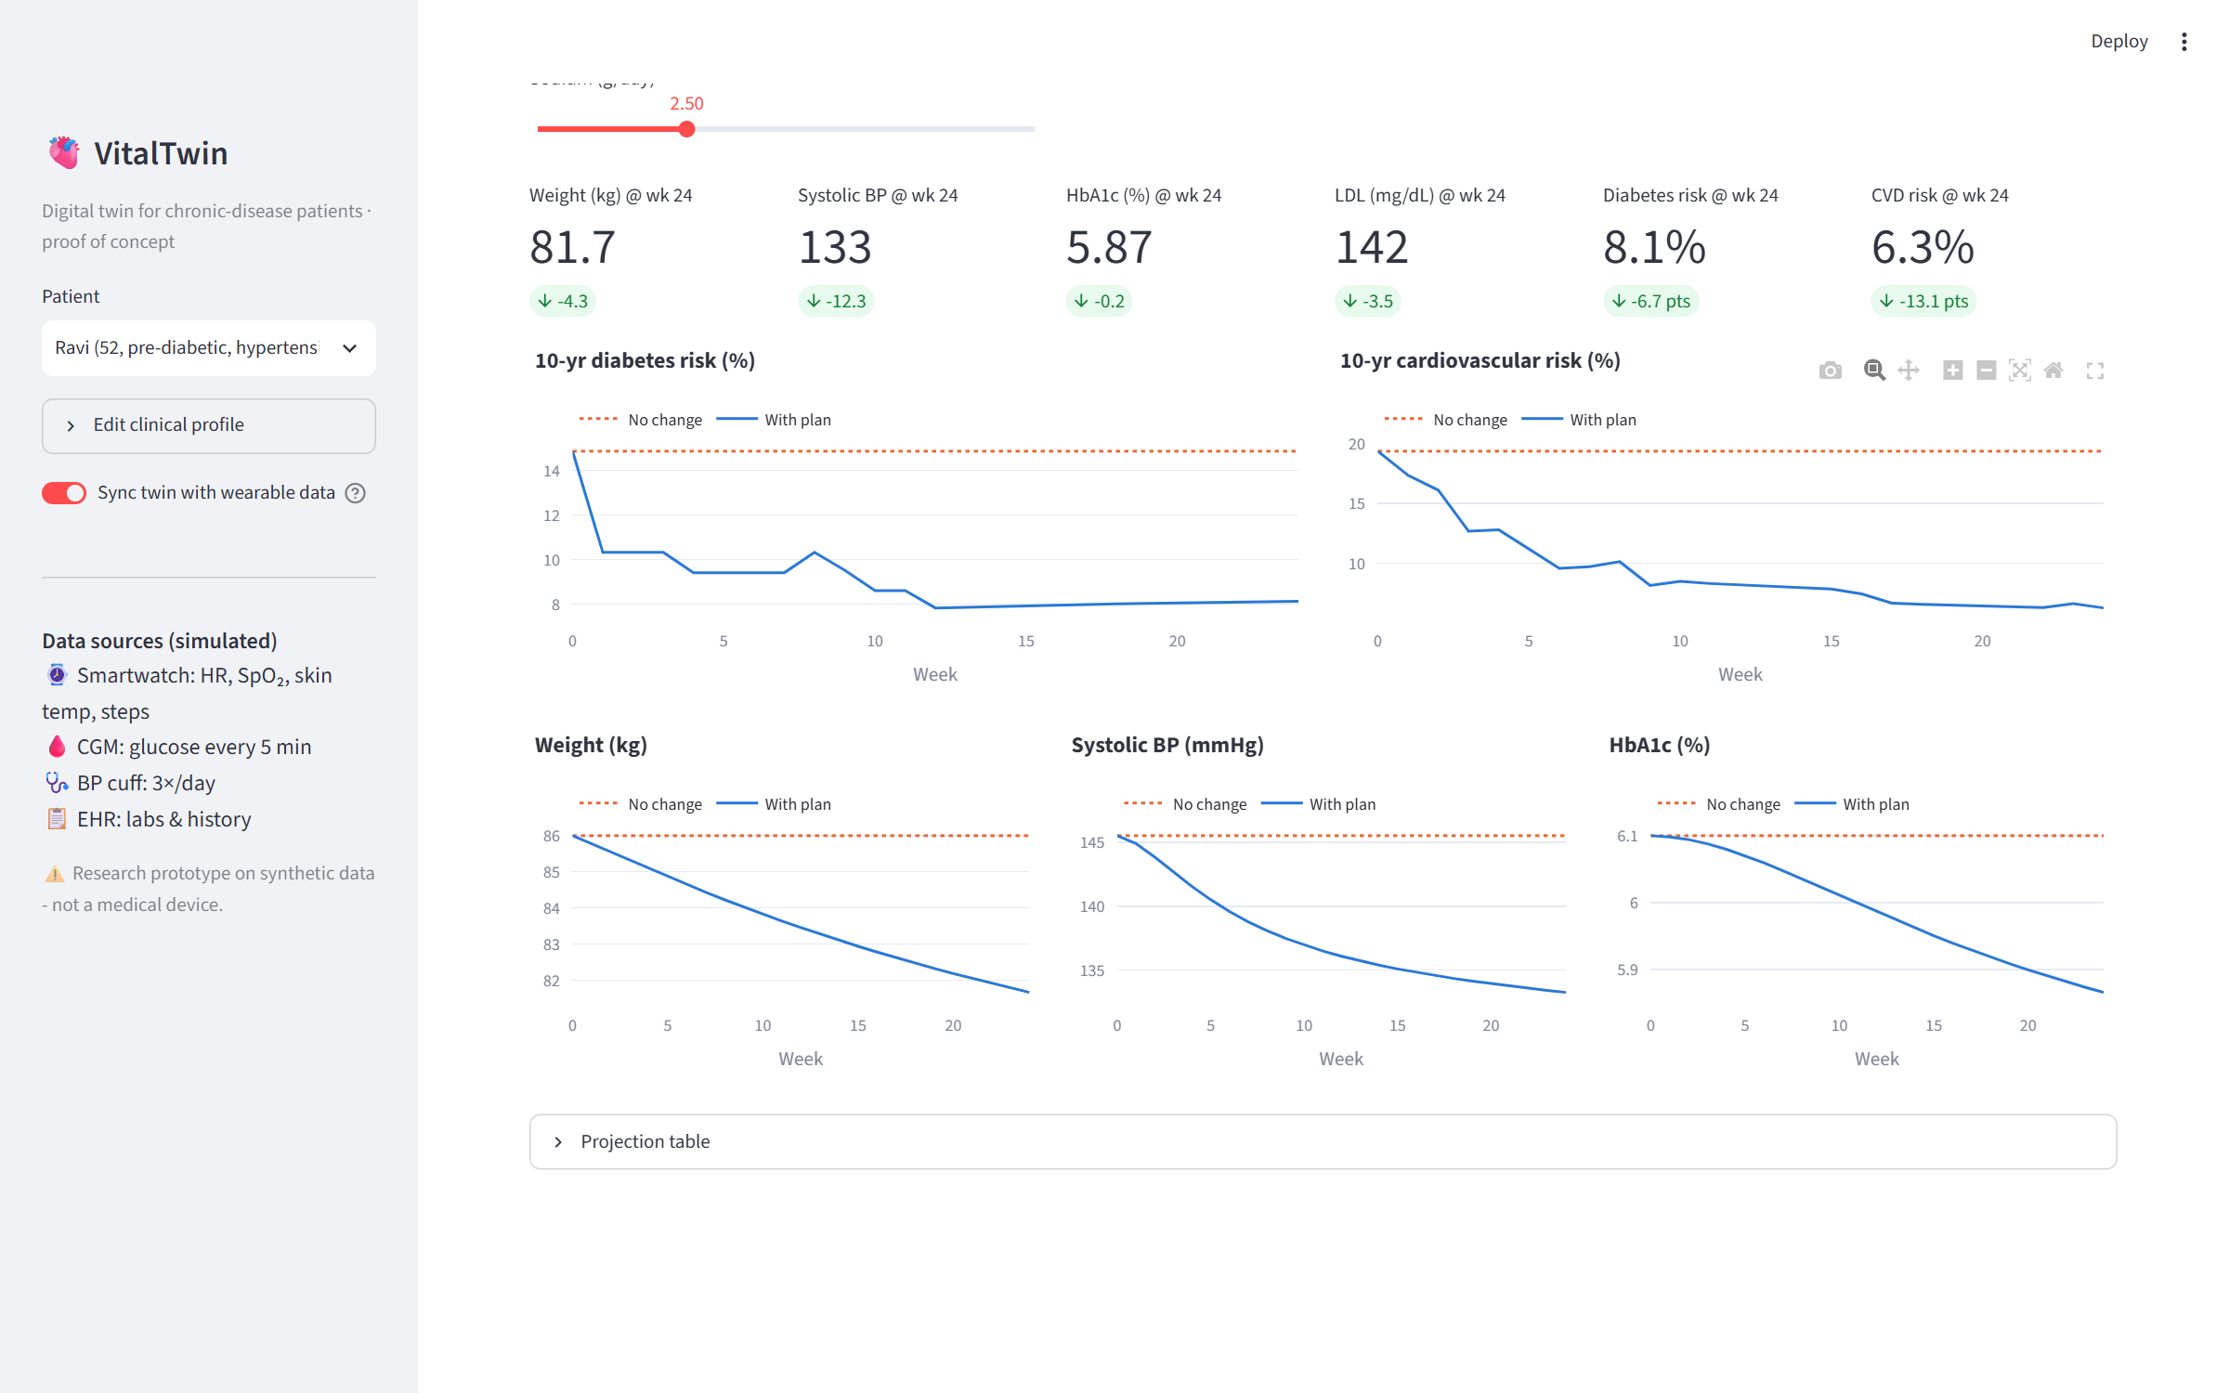
DEMO · SIMULATE
What-if intervention simulator
Compare a care plan against no change before the patient commits to it.
VitalTwin · Patient Digital Twin for Chronic Disease · Happiest Health Digital Twin Challenge
10

Slide 11
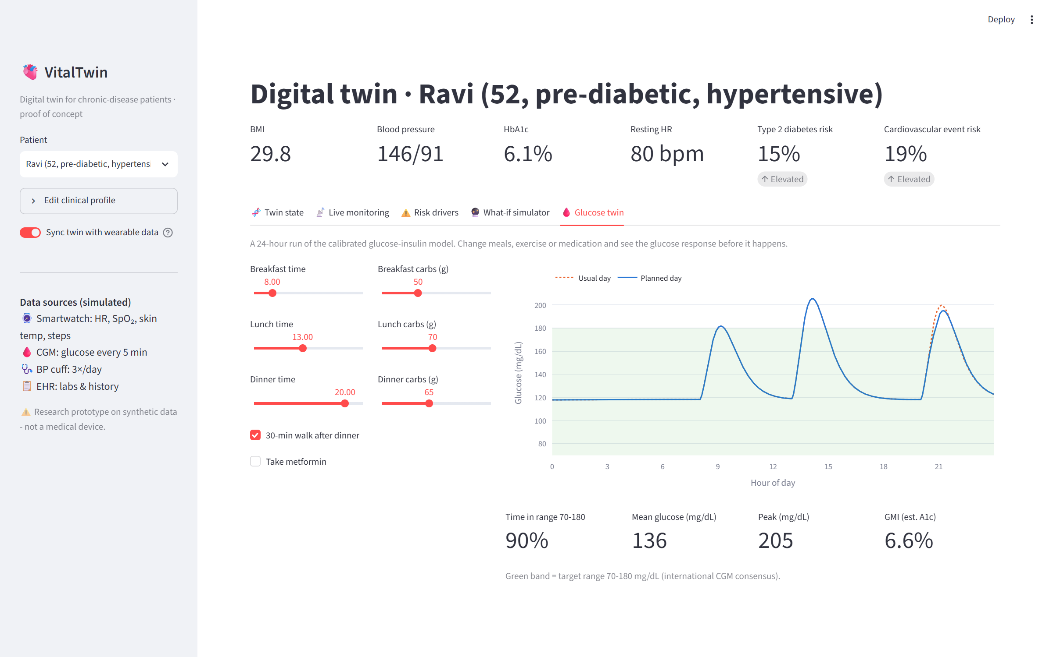
DEMO · SIMULATE
Glucose twin: plan a day
Move meals, change carbs, add a walk or metformin - see time-in-range before it happens.
VitalTwin · Patient Digital Twin for Chronic Disease · Happiest Health Digital Twin Challenge
11

Slide 12
RESULTS OF THE PROOF OF CONCEPT
Outcomes
0.87
0.82
~2 %
4 / 4
AUC · diabetes risk
AUC · CVD risk
error recovering hidden insulin sensitivity
injected clinical events detected
• Working end-to-end twin - sync, monitor, predict, explain and simulate in one interactive app.
• Physiologically grounded - simulated HbA1c within 0.3 % of each persona's lab value before any calibration.
• Actionable - for the demo patient a realistic plan lowers 10-yr CVD risk from 19 % to ~6 % and diabetes risk from 15 % to ~8 % in 24 weeks.
• Tested - 10 automated tests cover the physiology, calibration, ML ranking and anomaly detection.
VitalTwin · Patient Digital Twin for Chronic Disease · Happiest Health Digital Twin Challenge
12

Slide 13
NEXT STEPS
Limitations & roadmap
Current limitations
• Synthetic training cohort - risks are illustrative
• Effect sizes simplified from literature
• Simulated sensor streams, single-patient app
• Not clinically validated; not a medical device
Roadmap
• Retrain on real cohorts (NHANES, ICMR-INDIAB, EHR)
• Live device APIs: Health Connect, HealthKit, Libre
• FHIR integration & clinician multi-patient view
• Kalman / Bayesian twin updating with uncertainty bands
• Cardiac (HRV, ECG) and renal sub-models
• Prospective validation study with a partner hospital
VitalTwin · Patient Digital Twin for Chronic Disease · Happiest Health Digital Twin Challenge
13

Slide 14
VITALTWIN
Thank you
Team: Nexon
Members: Anushree Kasturi
Institution: Amrita Vishwa Vidyapeetham, Bengaluru
Live demo: https://vitaltwin.streamlit.app/
Code: https://github.com/AnushreeKasturi/health-digital-twin
Demo video: [Unlisted YouTube link]
Research prototype on synthetic data. Not intended for diagnosis or treatment decisions.
VitalTwin · Patient Digital Twin for Chronic Disease · Happiest Health Digital Twin Challenge
14

