Slide 1

Git
&
Github

Slide 2
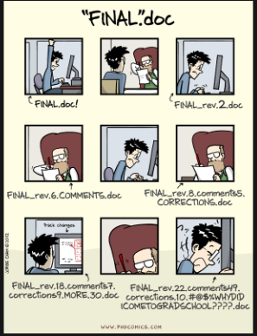
The Problem

Slide 3
Methods for tracking versions
Save numbered zip files
Formal version control

Slide 4
Why and What is version control ?
▶History of changes
▶Able to go back
▶No worries about breaking things that work
▶Merging changes from multiple people
Notes:
Version control is a system that records changes to a file or set of files over time so that you can recall spe-
cific versions later.

Slide 5
What’s git ?
Distributed Source control system
Tracks any content (but mostly plain text files)
–source code
–data analysis projects
–manuscripts
–websites
–presentation

Slide 6
Why ?
It's fast
You don't need access to a server
Amazingly good at merging simultaneous changes
Everyone's using it

Slide 7
What is GitHub ?
A tool build on top on git
Interface for exploring git repositories
Open source
–immediate, easy access to the code
Like facebook for programmers

Slide 8
Why use GitHub?
It takes care of the server aspects of git
Graphical user interface for git
–Exploring code and its history
–Tracking issues
Facilitates:
–Learning from others
–Seeing what people are up to
–Contributing to others' code
Lowers the barrier to collaboration
–"There's a typo in your documentation." vs.
"Here's a correction for your documentation."

Slide 9
Check if it’s installed
Setting up git
On Ubuntu linux – “sudo apt-get install git”
On Fedora – “dnf install git”
On Ubuntu linux – “git --version”
On Fedora – “git --version”

Slide 10
First time ?
Run – “git config --global user.name “Your name” ”
Run – “git config --global user.email <your email>”

Slide 11
What now ?(Cont.)
Login to github
Select “New Repository”
Set the repository name to <yourname>.github.io
Add a description
Make it a public repository
Initialize with a readme.md file
Copy the repository URL

Slide 12
In terminal
In the terminal, run – “git clone <your repository url>.git”.
This command will create a clone of the entire repository on your local system. It will create a folder with the same name as the repository insde the current directory.
This will take some time…
Once done, run – “cd <name of repository>”

Slide 13
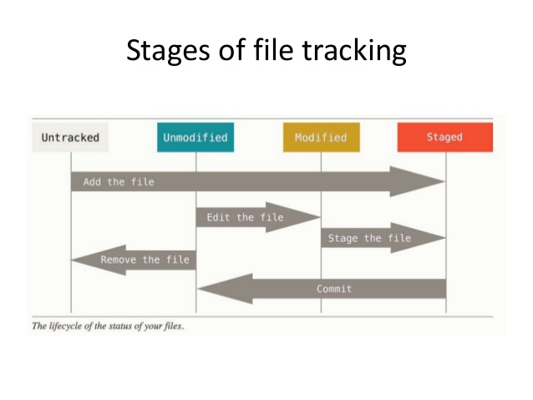
The 3 stages of a file in git

Slide 14
In the terminal
Run – “git status”
- This will show you all files that are yet to be committed. i.e new files that have been tracked or existing files that have been modified.

Slide 15
In the terminal(Cont.)
To stage ‘all’ tracked files, run – “git add .”
This will send ‘all’ tracked files to the staged area.
Now run – “git commit”
This will commit all your changes to the local .git repository
Then run – “git push” and then enter your github username and password at the prompt.
- This will push all your commited files from your local repository to your github repository.

Slide 16
Clone
Add files
commit the changes
Push the content

Slide 17
What else can you do ?
Open your friend’s Github profile
Go ahead and fork your friend’s repo
Fork? How ?Where?
How is it different from clone?

Slide 18
Contribute to other’s repo
Clone the fork
Suggest some changes, his repo looks dull, add some color to it.
Push the changes to your repo
Create a request to have your suggestions accepted. How? Why?

Slide 19
What did just happen???
You cannot directly push to other’s repo
Create your fork, and push changes there
link your changes, to the original repo
Wait for the decision
Accept-Merge and close :)
Reject-Closed without merge :(

Slide 20
Wanna learn more!
Codeschool
Udacity
Codecademy
Start contributing to open source projects
Invite us again for another session ;)

