Slide 1
Gremlin-Python
Overview + Demo
Sarah Masud, Red Hat

Slide 2
BUZZ WORDS
TinkerPop - Framework
Gremlin - DSL
Gremlin - Python - Wrapper

Slide 3
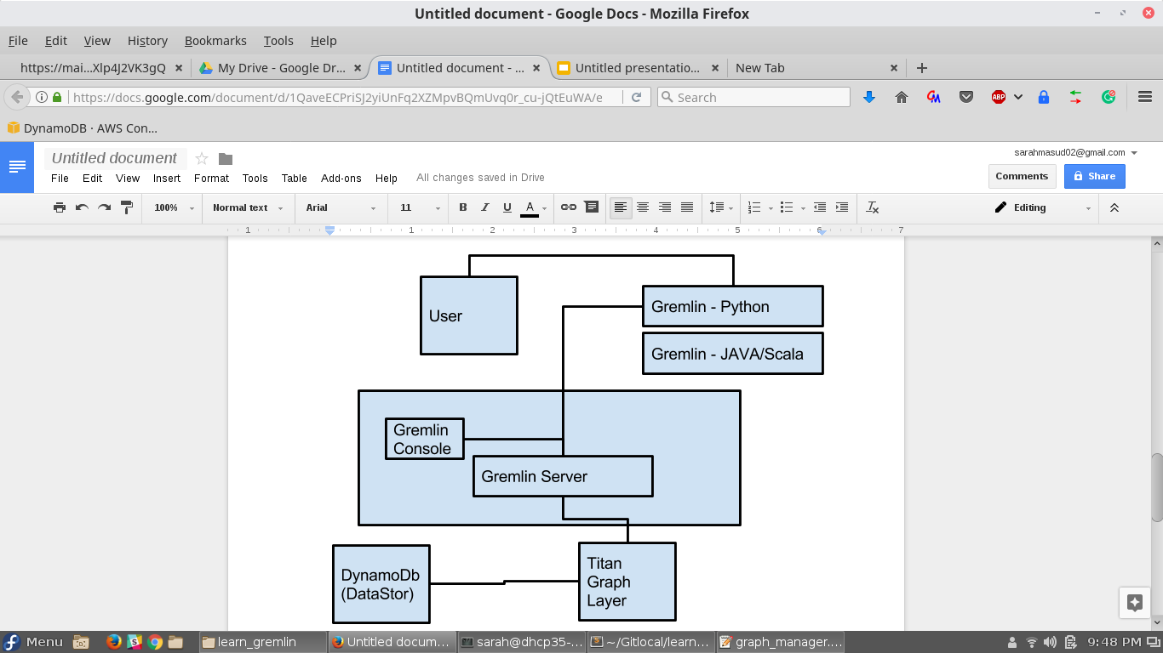
ARCHITECTURAL OVERVIEW (Used in demo)

Slide 4
FEATURES OF GREMLIN
Provides backend transparency BECAUSE
Does NOT provide schema management queries
Based out of functional programming
Return the result as an iterator
Default- Edges are directional
+many more

Slide 5
FUN TIME
(aka DEMO)

Slide 6
NUANCES OF GREMLIN-PYTHON
No REST interface
Interact with only the traversal object and it's feature.
Always end the query with toList() or toSet()
I/O Looping issues with Ipython
Works with only Titan 1.0.0 and above
No tryNext()- duplication logic to be written in python

Slide 7
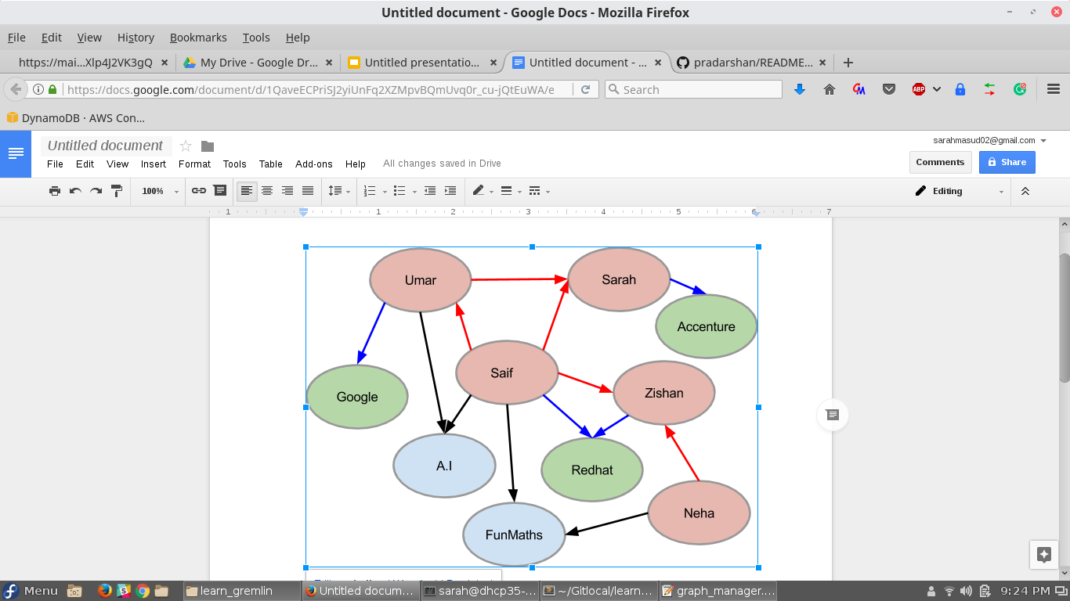
DUMMY GRAPH
Circles
Red- People
Green- Orgs
Blue- Groups
Arrows
Red- Knows
Blue- Works at
Black- Member of

Slide 8
MOST COMMON FUNCTIONS
g.V() / g.E ()
g.V().count() /E().count()
g.V().outE() / inE()/ inV()
g.V().out() /in()
Step modifiers
as(), where(), inject()

Slide 9
SAMPLE QUERY 1 - MAP FUNCTION
Whom does Saif Know as his 1st level of connection?
Involves all people node
Go to the person with name Saif
Find the out edges of Saif
Filter only those edges which connect people
Go the nodes pointed by the edge
List the names of the people in those nodes

Slide 10
SAMPLE QUERY 2 - FILTER FUNCTION
Who all are not working anywhere?
Involves all people node, as well as org node
Find the out edges of the people
Filter only those people who have an edge to an org
List the names of the people in those nodes

Slide 11
SAMPLE QUERY 3 - REDUCE FUNCTION
Number of working people?
Involves all org nodes
Find the in edges of the org
Filter only those edge which are org-person-works_at
Find the person at the other end of the edge
List all such people
Perform dedup to remove people working with multiple orgs from appearing multiple times.

Slide 12
FOOD FOR THOUGHT
List all the people in the 2nd level connection of Saif.
Who all the not members of any group, can this be used to generate user activity?
Finding all number of working people, why not use the people nodes instead of the org node?

Slide 13
References:
Tinkerpop -Gremlin Getting started
Gremlin-Titan-Dynamo Setup
Gremlin -Python
Demo Source Code

Slide 14
Q/A
Thank You

