Slide 1

Introduction to PyTorch and Its Applications
Anushree Raut Amandeep Singh Saran Titus Michael Masele Major
CS506 Winter 2026

Slide 2
Overview
Introduction to PyTorch​
Tensors​
Datasets and DataLoader​
Transforms​
Neural Networks​
Training with torch.autograd​

Slide 3
What is PyTorch?
Open-source deep learning framework​
Developed by Meta AI​
Python based ​
It is used for research and production​

Slide 4
Why PyTorch?
Easy to learn and use​
Dynamic computation and graph​
Flexible and intuitive​
Strong community support​

Slide 5
Applications of PyTorch
Natural Language Processing(NLP)​
Computer Vision​
Speech Recognition​
Healthcare AI​
Autonomous systems​

Slide 6
What are Tensors?
Multi-dimensional array​
Core data structure in PyTorch​
Similar to NumPy arrays​

Slide 7
Tensor Features:
Tensor Features
GPU acceleration
Supports mathematical operations
Efficient data handling

Slide 8
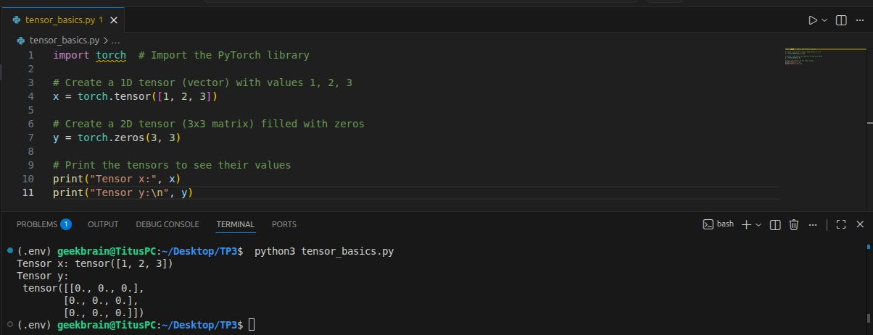
Tensor Example(Code)

Slide 9
Tensor Operations
Addition, multiplication
Reshaping tensors
Matrix operations

Slide 10
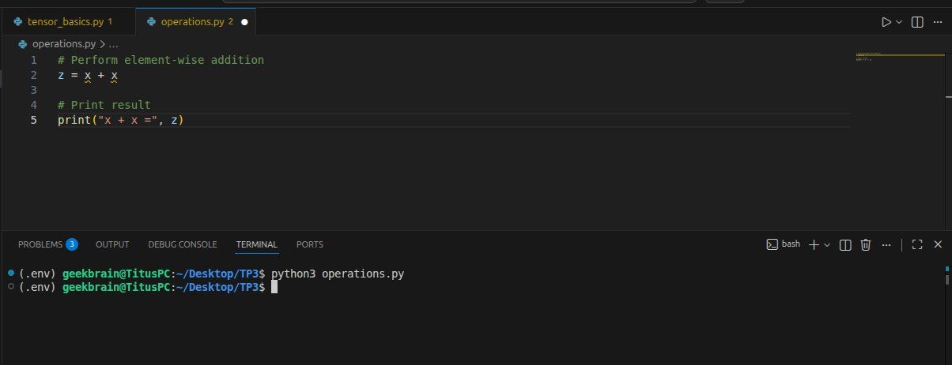
Tensor Operations

Slide 11
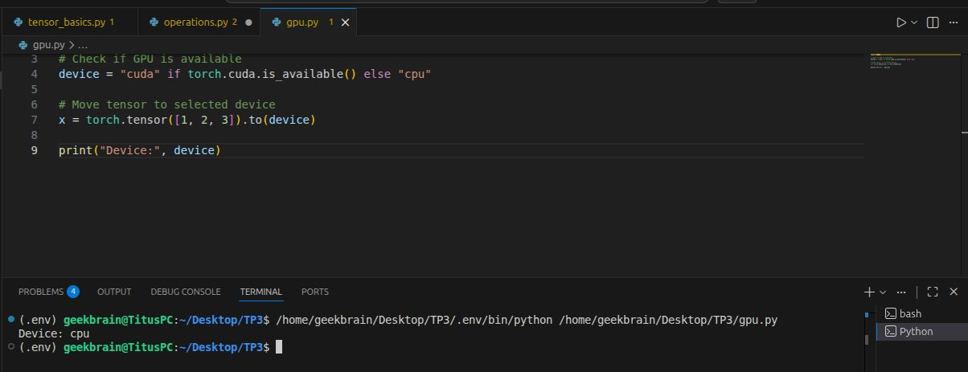
GPU Acceleration

Slide 12
Datasets in Pytorch
Used to store and manage data
Example: MNIST dataset

Slide 13
Why Data Handling Matters
Efficient training​
Handle large datasets​
Supports batching​

Slide 14
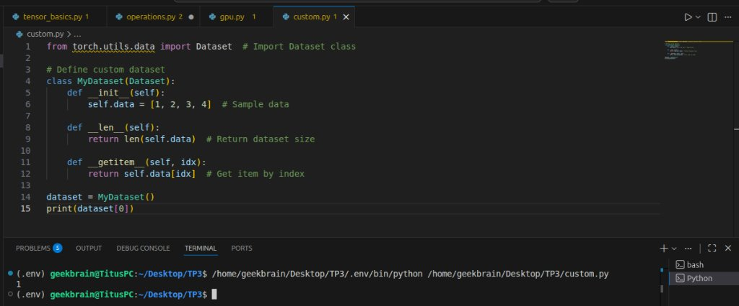
Custom Dataset

Slide 15
DataLoader
Loads data in batches
Supports shuffling
Improves training efficiency

Slide 16
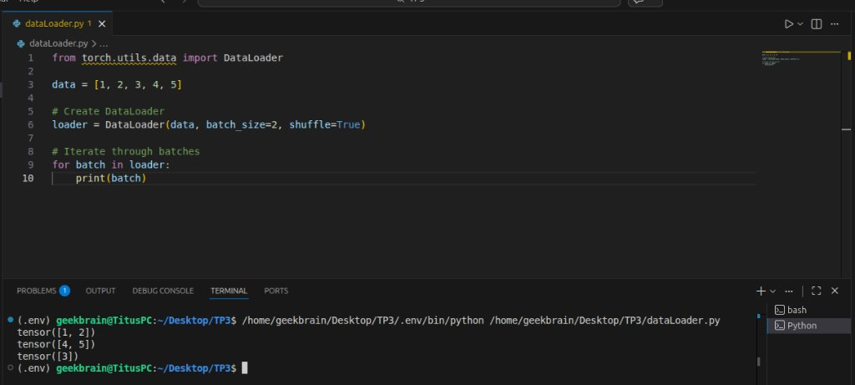
DataLoader Example

Slide 17
Data Pipeline Diagram
Raw Data => Dataset =>DataLoader => Batches => Model​

Slide 18
What are Transforms?
Modify and preprocess data
Convert images to tensors

Slide 19
Common Transforms
Normalize data
Resize images
Data augmentation

Slide 20
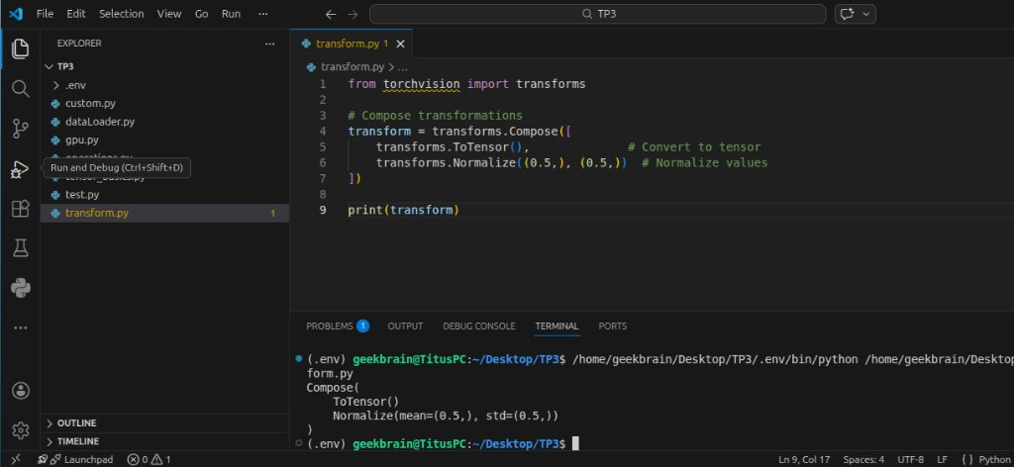
Transform Examples

Slide 21
Why Transforms Matter
Improve model accuracy​
Reduce overfitting​
Standardize input data​

Slide 22
Neural Networks Overview
Models inspired by the human brain
Learn patterns from data

Slide 23
Components of Neural Networks
Input layer
Hidden layers
Output layer

Slide 24
Neural Network Diagram
Input => Hidden layers => Output layer => Output​

Slide 25
Activation Functions
ReLU​
Sigmoid​
Softmax​
Introduce non-linearity​

Slide 26
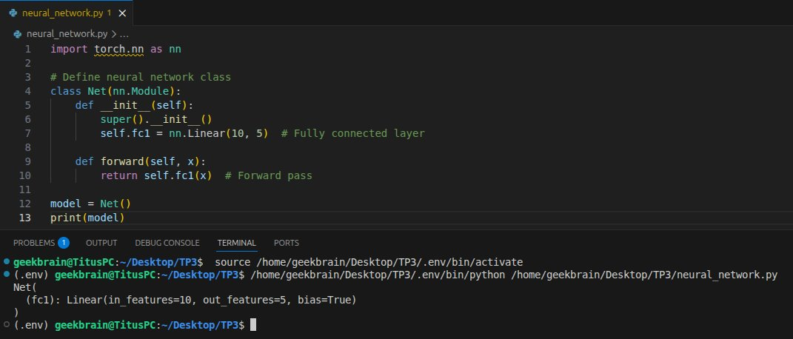
Build a Neural Network

Slide 27
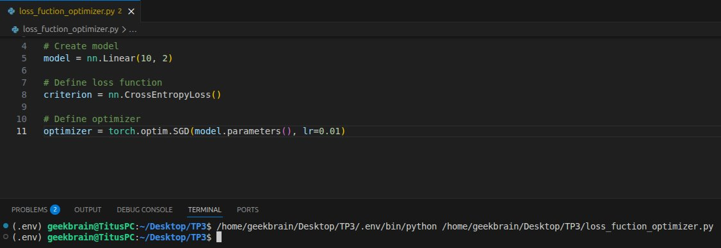
Loss Function and Optimizer

Slide 28
What is Autograd?
Automatic differentiation system
Computes gradients automatically

Slide 29
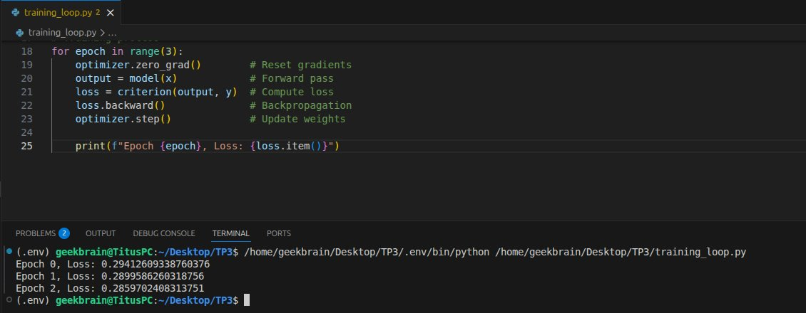
Training with Autograd

Slide 30
Training Process Diagram
Input => Model => Output => Loss=> Backpropagation => Update Weights => Repeat​

Slide 31
Advantages of PyTorch
Flexible and dynamic
Easy debugging
GPU support

Slide 32
Conclusion
PyTorch is powerful and beginner-friendly
Widely used in AI applications
Essential tool for deep learning

Slide 33
References
Chollet, F. (2018). Deep Learning with Python. Manning Publications. (ISBN 9781617294433)
Chapter 8: Generative Deep Learning
Microsoft. (n.d.). Introduction to generative AI concepts.
Machine Learning TV. (2018, July 27). Simple deep neural networks for text classification [Video]. YouTube.
Rasa. (2020, March 16). NLP for developers: Word embeddings | Rasa [Video]. YouTube.
The Coding Train. (2018, October 19). 12.1: What is word2vec? - Programming with text [Video]. YouTube.

Slide 34


Q&A

