Slide 1

Introduction to Scikit-learn and its applications
Anushree Raut Amandeep Singh Saran Titus Michael Masele Major
CS506 Spring 2025

Slide 2
Agenda
Overview of Scikit-learn
Basic Features
Supervised Learning (Linear Regression, SVM)
Unsupervised Learning (K-Means, GMM)
Model Selection &
Visualization Techniques Evaluation

Slide 3
What is Scikit-learn?
Open-source Python ML library
Built on NumPy, SciPy, matplotlib
Tools for data mining & analysis
Widely used in academia & industry

Slide 4
Key Advantages
User-friendly, consistent API
Wide range of algorithms
Preprocessing & feature selection
Strong community & documentation

Slide 5
Basic Features
Data preprocessing: scaling, normalization, encoding
Supervised learning
Unsupervised learning
Model evaluation & selection
Pipeline support

Slide 6
Scikit-learn Workflow
Load Data
Preprocess Data
Split Train/Test
Choose Model
Train Model
Evaluate Model
Predict / Deploy

Slide 7
Supervised Learning Overview
Learn from labeled data
Predict outputs from inputs
Regression → Continuous
Classification → Categorical

Slide 8
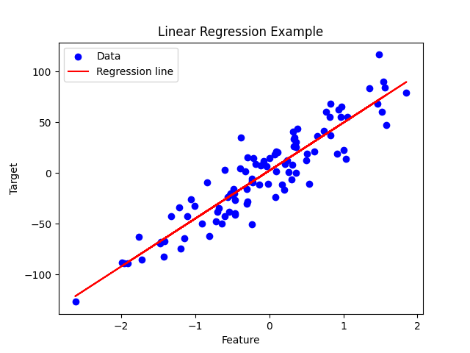
Example 1 – Linear Regression
Predict continuous values (e.g., house prices)

Slide 9
Linear Regression – Application Example
Metrics: R² score, Mean Squared Error Dataset: synthetic / Boston housing

Slide 10
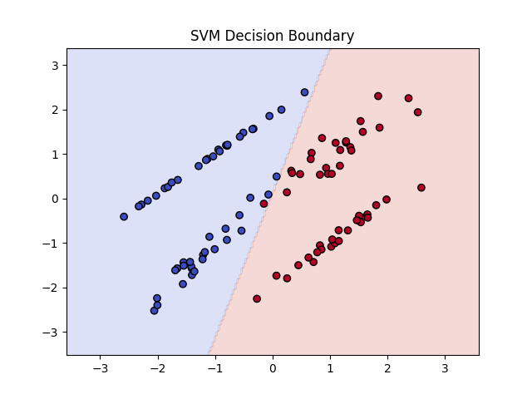
Example 2 – Support Vector Machine (SVM)
Used for classification tasks, finds optimal separating hyperplane.

Slide 11
SVM – Implementation Example
Code: SVC(kernel='linear') Visual: Decision boundary

Slide 12
Unsupervised Learning Overview
Learn from unlabeled data
Find patterns or clusters
Tasks: Clustering, Dimensionality Reduction

Slide 13
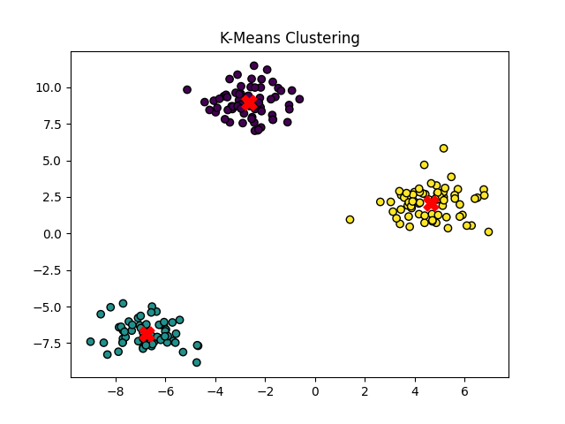
Example 1 – K-Means Clustering
Groups similar data points into clusters.

Slide 14
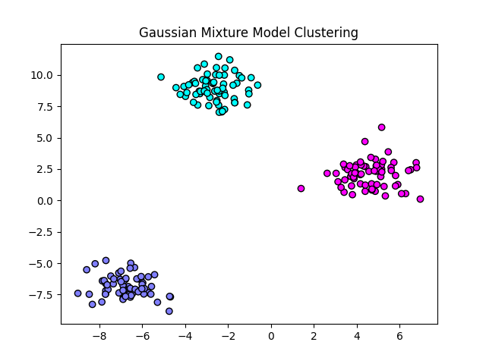
Example 2 – Gaussian Mixture Models
Probabilistic clustering using Gaussian distributions.

Slide 15
Model Selection & Evaluation
Train/Test split
Cross-validation
Grid search / Random search

Slide 16
Evaluation Metrics – Regression
Mean Squared Error (MSE)
Root Mean Squared Error (RMSE)
R² Score

Slide 17
Evaluation Metrics – Classification
Accuracy
Precision, Recall, F1-score
Confusion Matrix

Slide 18
Cross-validation
Split data into k folds
Train on k-1 folds, test on remaining
Ensures model generalization

Slide 19
Hyperparameter Tuning
Use GridSearchCV / RandomizedSearchCV to find optimal parameters

Slide 20
Visualization Techniques
Scatter plots, line plots
Decision boundaries (SVM)
Cluster plots (K-Means, GMM)
Learning curves

Slide 21
Example – Visualizing Clusters
See K-Means and GMM plots for actual visualization

Slide 22
Example – Model Performance
Regression: predicted vs actual values Classification: confusion matrix heatmap

Slide 23
Conclusion
Scikit-learn provides a comprehensive ML toolkit
Supports supervised & unsupervised learning
Enables model selection, evaluation, visualization
Widely used in industry & research

Slide 24


Q&A

