Slide 1


Air Quality Measurement
Using AIML

Slide 2

Learning Objectives
Understand data preprocessing for air quality datasets
Perform exploratory data analysis (EDA)
Apply Linear Regression and Random Forest models
Evaluate model performance using metrics
Optimize models using GridSearchCV
Goal
To predict air pollutant levels (CO concentrations) using machine learning models for better environmental monitoring.
GOAL
Source :
https://github.com/AnushreeS578/Air-Quality-Measurement

Slide 3
Tools and Technology used
Programming & Libraries: Python (Pandas, NumPy, Matplotlib, Seaborn, Scikit-learn)
Development Environment: Jupyter Notebook / Google Colab
Machine Learning Models: Linear Regression, Random Forest

Slide 4
Methodology
Data Preprocessing – Clean missing values, select relevant features
Exploratory Data Analysis (EDA) – Analyze distributions, correlations, trends
Model Training – Train Linear Regression & Random Forest models
Model Evaluation – Measure performance using MAE, MSE, and R²
Model Optimization – Tune Random Forest parameters using GridSearchCV

Slide 5
Problem Statement
Air pollution poses serious health risks and environmental damage.
Traditional monitoring is slow and cannot provide real-time predictions.
Accurate prediction of pollutant levels can help authorities take timely preventive actions.

Slide 6
Solution
Analyze historical air quality data using machine learning models.
Predict pollutant levels (CO concentrations) accurately in advance.
Support authorities and health organizations in making informed, timely decisions.

Slide 7
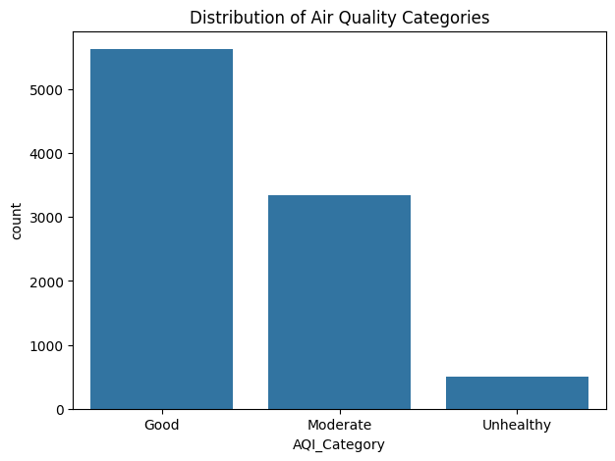
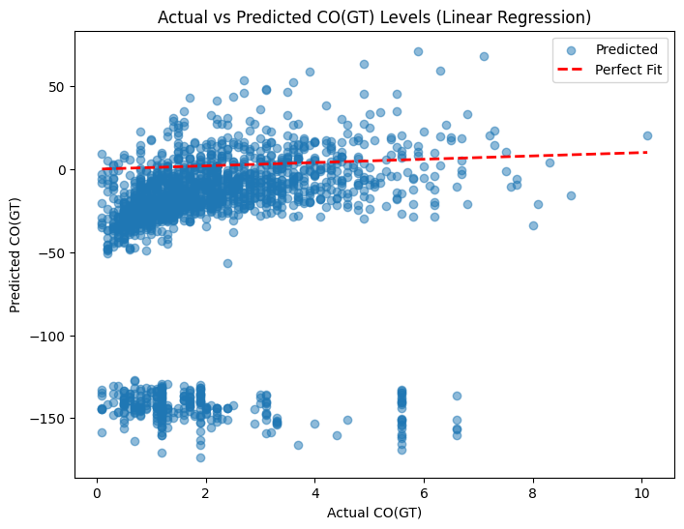
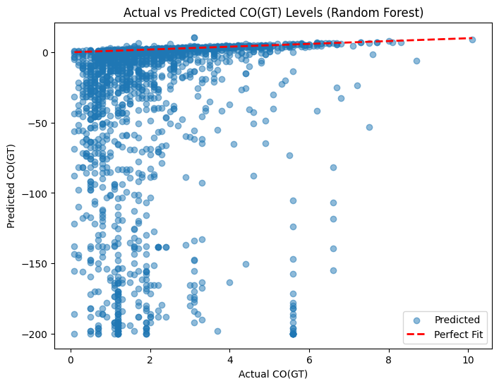
Screenshot of Output

Slide 8
Conclusion
Random Forest outperformed Linear Regression in predicting pollutant levels.
EDA revealed key feature correlations and pollutant distribution patterns.
GridSearchCV optimization improved Random Forest performance.
Predictive modeling can assist authorities in timely decision-making for air quality management.

