Slide 1
Signals and Systems
Classification of signal, systems, Continuous-time signals, continuous-time exponential signal

Slide 2
Classification of Signals
continuous-time or discrete-time
Periodic or non-periodic
energy or power
analog or digital
Real or complex, etc.

Slide 3
Continuous-time Signals
A signal x(t) that is defined at all instants of time is known as a continuous-time signal.
A continuous-time signal takes a value at every instant of time t.

Slide 4

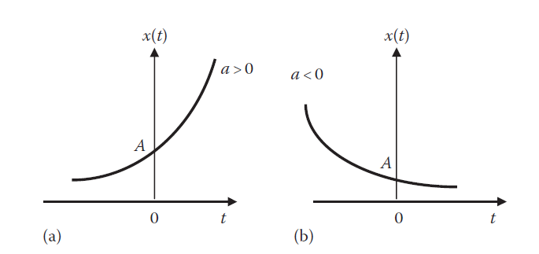
Continuous-time Exponential Signals

Slide 5
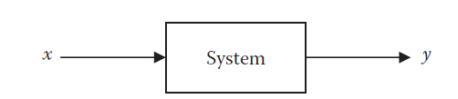
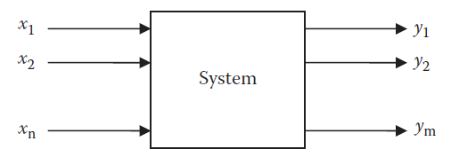
Classification of Systems
a system may be regarded as a mathematical model of a physical process that relates the input signal x(t) to the output signal y(t).

Slide 6
Interconnections of Systems
Series (cascade), parallel, and feedback

Slide 7
Continuous-Time and Discrete-Time Systems
A system is continuous-time if the input and output signals are continuous-time. In continuous time systems, time is measured continuously.
Some continuous-time systems are described by ordinary differential equations, algebraic equations (resistive circuits), polynomial equations (diodes), integral equations (op amp integrator circuits), etc.
It is discrete-time if the input and output signals are discrete-time. For discrete-time systems, time is defined only at discrete instants and the systems are described by difference equation and any other way the input–output properties of the system may be specified.

Slide 8
Causal and Non-Causal Systems
A causal system is one whose present response does not depend on the future values of the input.
A causal (or nonanticipatory) system is one whose output y(t) at the present time depends only on the present and past values of the input x(t).
Every physical system is causal.
Eg: The motion of a car is causal since it does not expect the future actions of the driver. Causality is a necessary condition for a system to be realized in the real world we live in.
Causal systems are physically realizable.

Slide 9
Linear and Nonlinear Systems
Linearity is the property of the system describing a linear relationship between input (cause) and output (effect).
The property is a combination of both homogeneity (scaling) property and the additivity property.
a system is linear if it satisfies homogeneity and additivity properties.

Slide 10
The homogeneity property requires that if the input is multiplied by any constant k, then the output is multiplied by the same constant, that is,
The additivity property requires that the response to a sum of inputs is the sum of the responses to each input applied separately.
If Tx1 = y1 and Tx2 = y2, then

Slide 11
A linear system may be regarded as one in which all the interrelationships among the quantities involved are expressed by linear equations, which may be algebraic, differential, or integral.
A very important consequence of linearity is that Superposition principle applies.
If an input consists of the weighted sum of several signals, then the output is the weighted sum of the responses of the system to each of those signals.

Slide 12
An example of a linear system is a circuit that contains resistors, capacitors, and inductors, since these are linear elements.
Devices such as rectifiers, diodes, and saturating magnetic devices are nonlinear.
A system having even one such device is treated as nonlinear.

Slide 13
Time-Varying and Time-Invariant Systems
A time-varying system is one whose parameters vary with time.
In a time-invariant system, a time shift (advance or delay) in the input signal leads to the time shift in the output signal.

Slide 14
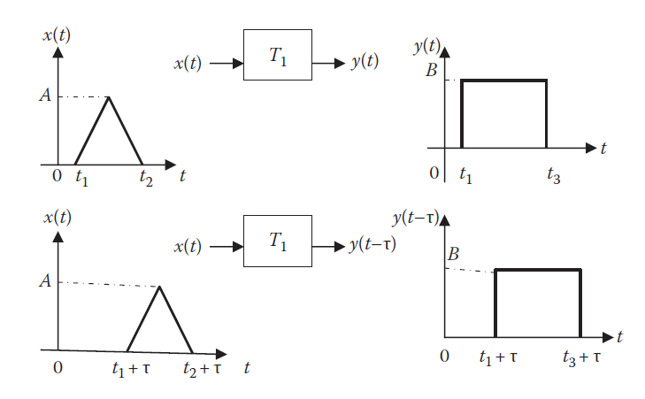
Example of TI systems

Slide 15
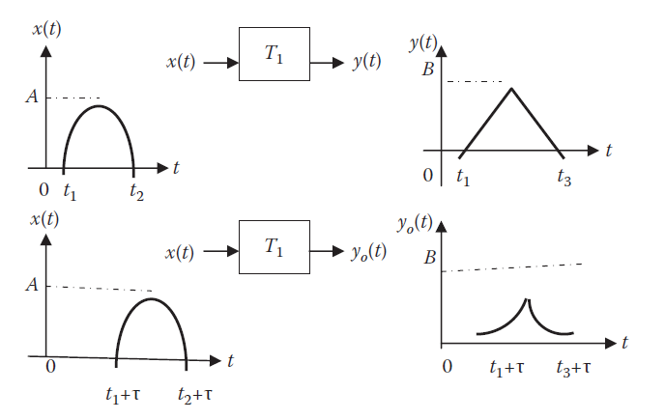
Example of time varying signal

Slide 16

Systems with and without Memory
When the output of a system depends on the past and/or future input, the system is said to have a memory.
A memoryless system is one in which the current output depends only on the current input; it does not depend on the past or future inputs.

Slide 17
A system with a memory is also called a dynamic system.
A memory-less system is called a static system.
Many practical systems such as resistive networks, amplifiers, operational amplifiers, and diodes are usually modeled as memory-less systems.

Slide 18
Invertibility and Inverse Systems

