Slide 1

SMART INDIA HACKATHON 2026
TITLE PAGE
Problem Statement ID – SIH26168
Problem Statement Title – AI-ML based Intelligent Dead Reckoning system for seamless navigation
Theme – Miscellaneous
PS Category – Software
Team ID – <Team ID from portal>
Team Name (Registered on portal) – KANABI
Organisation: Indian Space Research Organisation (ISRO) · Dept. of Space

Slide 2
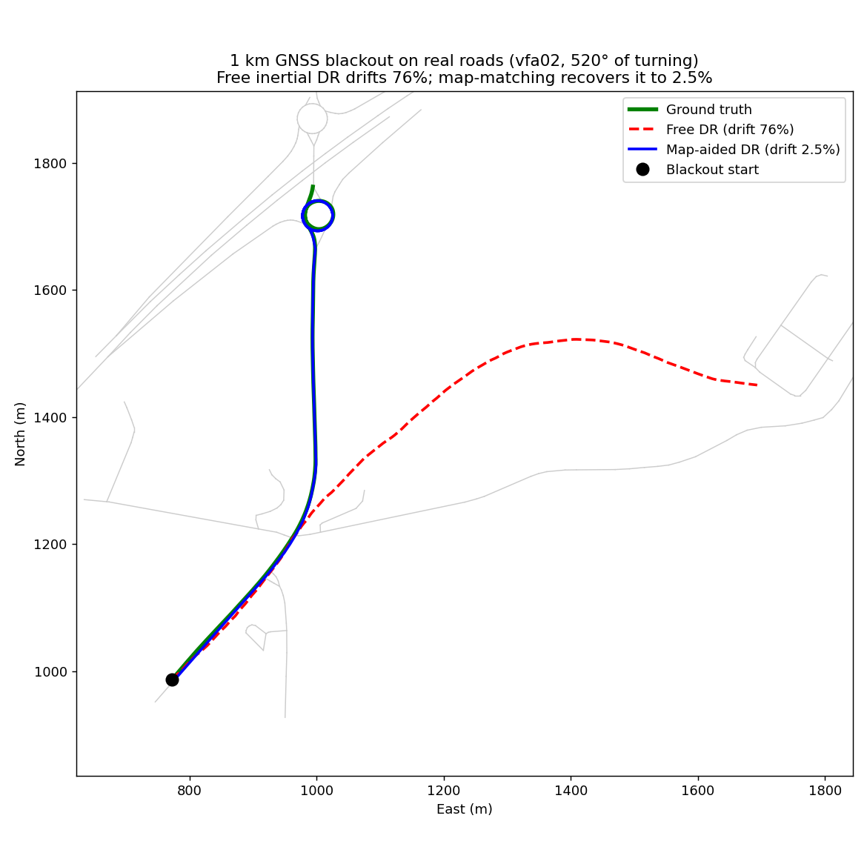
IDEA: Intelligent Dead Reckoning (IDR) + GNSS Fusion
KANABI
Proposed solution
Preliminary result on IO-VNBD (drive vfa02): 1 km GNSS blackout, 520° of turning
An edge-deployable engine + Android app that keeps lane-level position when GNSS is lost (tunnels, underpasses, parking, urban canyons, jamming) using only the phone's accelerometer, gyroscope, magnetometer and an offline OpenStreetMap graph. No OBD-II, no wheel sensor, no fixed mount.
Hybrid AI + physics pipeline: in-vehicle alignment & calibration → AI speed/vibration filter (1-D CNN) → bias-corrected INS → map-matching with non-holonomic constraints → AI-augmented error-state Kalman fusion with instant GNSS-deficit switching.
Training happens on desktop (IO-VNBD); the engine runs on the phone at sensor rate (pure Dart, no server) and the same core targets the edge engine at ~200 Hz for external/FOG IMUs; the 32 k-param CNN ships via ONNX/TFLite.
How it addresses the problem
GNSS drop → seamless switch to inertial tracking within ms; GNSS return → re-converge to GNSS+INS.
Speed without OBD: last-GNSS speed anchor + learned IMU corrections; vibration, potholes and idling filtered out.
Heading drift (the real killer of phone DR) is cancelled by snapping to the road graph on every edge.
Innovation and uniqueness
Data-driven design: on IO-VNBD we measured that speed holds to 1–2 % but gyro heading drifts 19–28° in 30–60 s, so we spend the AI budget where the error really is.
Mount-agnostic calibration (gravity + PCA of driving acceleration) and one shared core engine for phone and edge/FOG sensors.
Plain phone IMU drifts 76 % of distance; our map-aided IDR finishes 2.5 % off and tracks the roundabout. Benchmark: < 10 %.

Slide 3
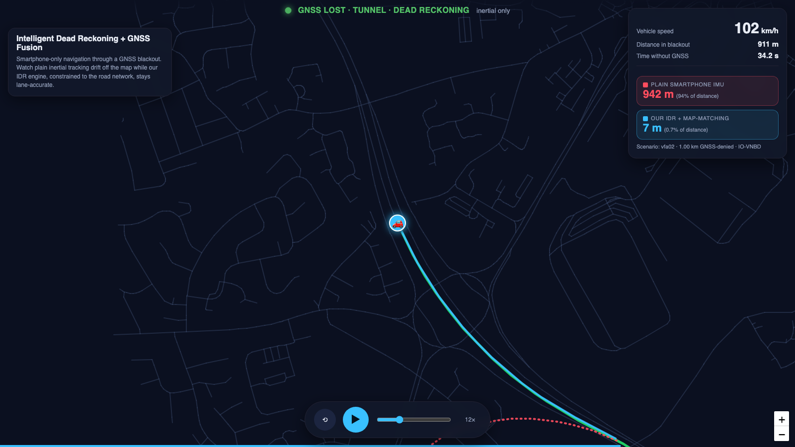
TECHNICAL APPROACH
KANABI
Technologies
Training
Python · PyTorch · NumPy/SciPy · CatBoost
Models
1-D CNN speed filter (32 k params) · LSTM IMU-error corrector · gated causal CNN Δv
Estimation
Error-state EKF/UKF · NHC & ZUPT · HMM map-matching (Newson–Krumm)
Maps
Offline OpenStreetMap graph (osmnx export, on-device)
Deployment
ONNX → TFLite · Flutter/Android app · Python edge engine (200 Hz FOG IMU)
Methodology: on-device pipeline (10 Hz on phone, ~200 Hz on edge engine)
1 Align & calibrate
Gravity → vertical axis; PCA of driving accel → forward axis. Phone-to-vehicle rotation + accel/gyro bias + compass offset from the pre-blackout window. Works on dash or holder.
2 AI speed & vibration filter
Mount-invariant IMU features → 1-D CNN / causal Δv model. Rejects engine idle, potholes, bumps; forward speed without OBD-II.
3 INS propagation
Bias-corrected gyro heading + speed integrate position at 10 Hz. Speed anchored to last GNSS fix (within 1–2 % of oracle).
4 Map-match + NHC
Odometry walks the offline OSM graph; gyro picks the branch at junctions; heading reset to road bearing. Zero lateral/vertical velocity pseudo-measurements.
5 AI fusion & deficit handler
Loosely coupled error-state EKF; LSTM learns residual IMU errors. GNSS graded GOOD / DEGRADED / DENIED (HDOP, sat count, C/N0) → mode switch in ms.
INPUT phone accelerometer · gyroscope · magnetometer · GNSS (when available) · offline OSM tiles
OUTPUT continuous position, velocity, heading @ 10 Hz + mode flag (GNSS+INS / Degraded / Dead reckoning) → smooth vehicle icon in the app
Workflow and current status
Phase 1 (desktop, done): IO-VNBD loader & synchronisation audit, feature engineering, speed-filter & LSTM training, simulated-blackout evaluation over 369 one-km blackouts, OSM map-matching, browser replay demo.
Phase 2 (on-device, working): Android app runs alignment, pre-blackout calibration, dead reckoning and OSM map-matching on the phone (unit-tested on synthetic drives; APK in repo), with a simulate-tunnel switch and live drift read-out on GNSS return. Next: on-device ES-EKF fusion, 200 Hz edge build, real tunnel test.

Slide 4
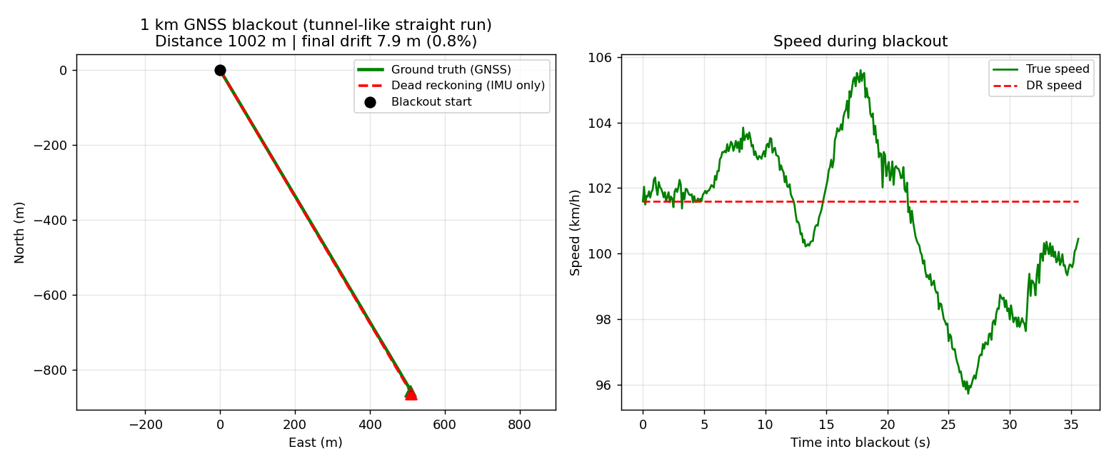
FEASIBILITY AND VIABILITY
KANABI
Feasibility: measured on IO-VNBD, smartphone IMU only
Challenges, risks and how we handle them
Scenario (simulated GNSS blackout on real drives) | PS benchmark | Achieved
50 m blackout, motorway (< 1 min) | < 5 m | 0.4 m (0.7 %)
1 km straight, tunnel-like run @ ~100 km/h | < 100 m | 7.9 m (0.8 %)
1 km real roads with turns, map-aided (median of 369) | < 10 % | 3.3 % hwy · 4.8–7.0 % urban
Share of 1 km blackouts under 10 % (free DR → map-aided) | — | 17 % → 74 %
Challenge / risk | Strategy
Gyro heading drifts 19–28° in 30–60 s → free DR > 10 % beyond ~200 m | Map-matching + NHC reset heading on every road edge; ZUPT at stops; magnetometer only as a weak prior
Absolute speed from 10 Hz vibration aliases (> 5 Hz Nyquist) | Anchor to last GNSS speed + learned Δv correction; 100–200 Hz sampling on phone/edge for the filter
Wrong branch at ambiguous junctions (remaining urban misses) | Multi-hypothesis HMM map-matching with gyro-turn likelihood; prune on GNSS return
Phone mount changes / hand-held, two-wheelers | Continuous re-alignment on detected mount change; vehicle-class model heads
Different IMUs (phone vs FOG) and finale datasets | Sensor-agnostic core; calibration stage absorbs bias/scale; same code path for edge engine
On-device latency and battery | Tiny CNN, TFLite int8, 10 Hz loop; heavy training stays on desktop
Viability
Zero hardware cost: runs on phones already on every dashboard; no OBD dongle, no vehicle integration.
Open data (IO-VNBD) + open maps (OSM) → no licensing barrier; models retrain as finale datasets arrive.
Working repo, reproducible pipeline, replay demo and Android APK already exist.
Position plot inferred from an IO-VNBD test drive: 1 km blackout, final drift 7.9 m. Trained within-vehicle (Driver E), tested on held-out drives vfa02 / vtb5 / vw2. Reproducible: python -m src.idr.evaluate / evaluate_mapmatch.
Compute: 32 k-parameter CNN + EKF runs comfortably at 10 Hz on a mid-range Android phone; OSM graph for a city fits in a few MB offline.

Slide 5
IMPACT AND BENEFITS
KANABI
Who it helps
Benefits
Delivery & ride-hailing riders
Two-wheelers and cabs with only a phone: no frozen map in flyovers, underpasses and metro tunnels.
Social / safety
No missed exits or erratic jumps in tunnels; safer lane guidance for two-wheelers; reliable emergency response in GNSS-denied places.
Trucks, fleets & older cars
Vehicles without factory INS or OBD feed get continuous tracking and correct turn-by-turn guidance.
Economic
Zero added hardware; fewer failed deliveries and detours; one engine for millions of existing phones and fleet devices.
Emergency responders
Ambulances and fire units keep position in parking decks and canyons where seconds matter.
Environmental
Fewer wrong turns and re-routing loops → less fuel and emissions per trip.
Navigation & telematics apps
Drop-in engine for MapmyIndia / fleet SDKs; edge engine for ISRO, defence and rail use with FOG IMUs.
Strategic
Resilience against jamming/spoofing and signal loss; complements NavIC; same AI core deploys on edge hardware for space, defence and rail.
Benchmark the judges set vs. what we already measure
Live replay demo + Android app
Real IO-VNBD drive through a 1 km blackout: plain IMU 942 m off, IDR + map-matching 7 m. App shows a smooth vehicle icon with an unmistakable GNSS / Dead-reckoning banner.
< 10 %
PS target drift
0.7 %
50 m blackout
0.8 %
1 km tunnel run
3.3–7 %
1 km real roads (median)

Slide 6
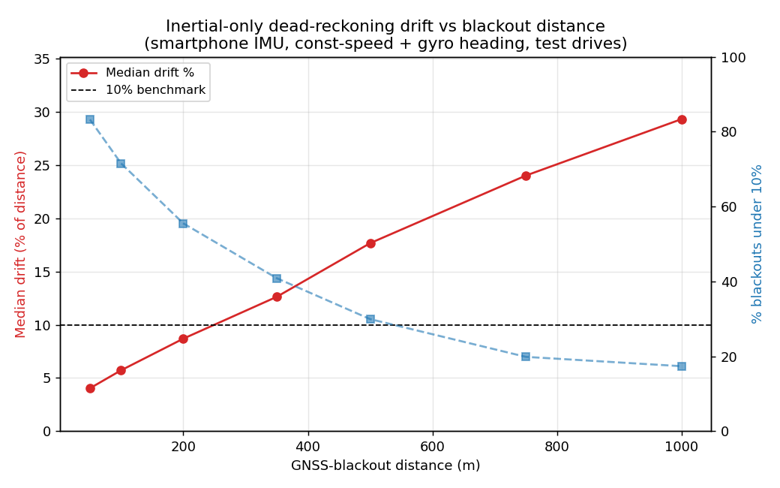
RESEARCH AND REFERENCES
KANABI
Our work (open for review)
Key findings from our IO-VNBD study
Code, models, results: https://github.com/AnushtupGhosh5/sih
Reproducible pipeline (requirements.txt / Docker): IO-VNBD loader → speed filter training → blackout evaluation → map-matching → figures; RESULTS.md holds every number on this deck.
Browser replay demo (demo/index.html) and Android APK (mobile_app/ui) included in the repository.
References
Onyekpe U., Palade V., Kanarachos S., et al. “IO-VNBD: Inertial and Odometry benchmark dataset for ground vehicle positioning.” Data in Brief, 2021. github.com/onyekpeu/IO-VNBD
Newson P., Krumm J. “Hidden Markov Map Matching Through Noise and Sparseness.” ACM SIGSPATIAL GIS, 2009.
Brossard M., Barrau A., Bonnabel S. “AI-IMU Dead-Reckoning.” IEEE Trans. Intelligent Vehicles, 2020.
Herath S., Yan H., Furukawa Y. “RoNIN: Robust Neural Inertial Navigation in the Wild.” ICRA, 2020.
Solà J. “Quaternion kinematics for the error-state Kalman filter.” arXiv:1711.02508, 2017.
Groves P. D. Principles of GNSS, Inertial, and Multisensor Integrated Navigation Systems, 2nd ed., Artech House, 2013 (NHC, ZUPT, loosely coupled INS/GNSS).
OpenStreetMap contributors, openstreetmap.org; Boeing G. “OSMnx” (Computers, Environment and Urban Systems, 2017).
TensorFlow Lite / ONNX Runtime documentation for on-device inference.
Inertial-only phone DR stays under 10 % only to ~150–200 m; map constraints extend this to 1 km (median 29.3 % → 3.3–7.0 %).
Holding the last GNSS speed is within 1–2 % of oracle speed over a tunnel; gyro heading, not speed, dominates error.
Inertial alignment of the dataset (phone vs ECU, 20 sessions) raised Δv correlation from 0.08 to 0.31, proving recoverable motion information in the phone IMU.
Dataset audit found and fixed a gyro/gravity axis-matching bug that corrupts heading in naive loaders.

