Slide 1
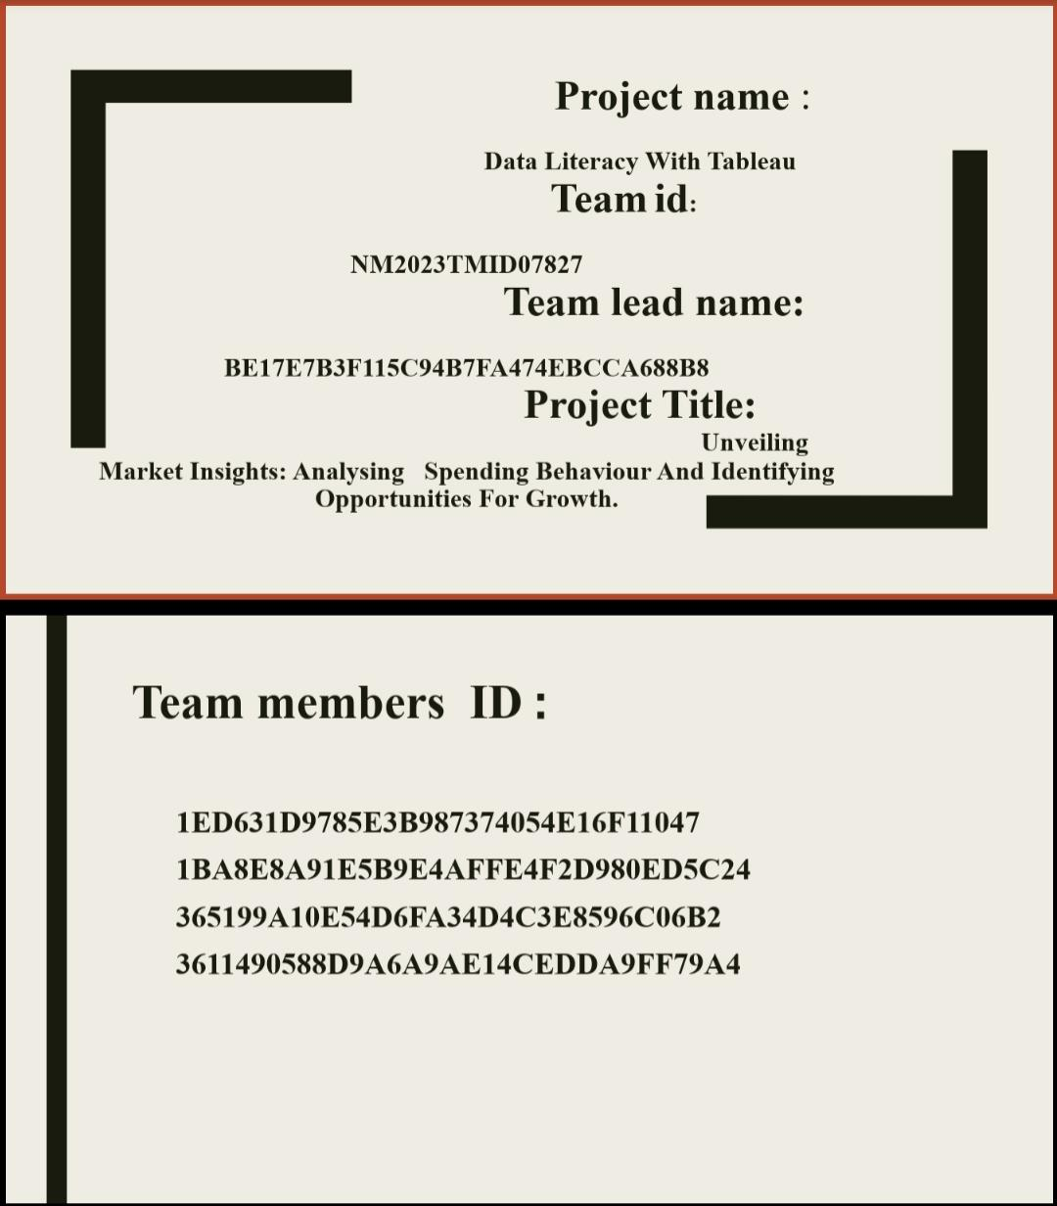

Slide 2
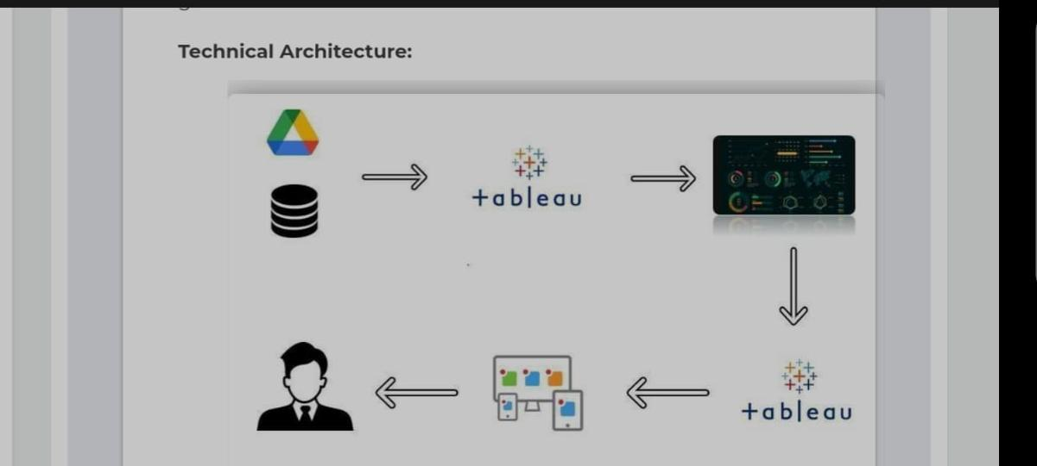

Slide 3
INTRODUCTION
Unveiling Market Insights: Analysing Spending Behaviour And Identifying Opportunities For Growth Wholesaling or distributing is the sale of goods to retailer to industrial, commercial, institutional or other professional businessman to other wholesalers (wholesale businesses) and related subordinated services. Wholesaling is buying goods in bulk quantity, usually directly from the manufacturer or source, at a discounted rate. The retailer then sells the goods to the end consumer at a higher price making a profit. The consumption and production of marketed food are spatially separated. Production is primarily in rural areas while consumption is mainly in urban areas. IN today’s highly competitive business landscape, gaining deep market insights is essential for businesses to thrive and grow. This project aims to analyse customer spending behaviour and identify opportunities for growth by leveraging data analytics and data-driven decision-making. The primary objective of this project is to understand customer spending patterns, preferences, and trends across various dimensions.. By conducting a comprehensive analysis, businesses can optimize their marketing strategies, improve product offerings, and enhance customer engagement to drive revenue growth.

Slide 4
Problem Defining

Slide 5
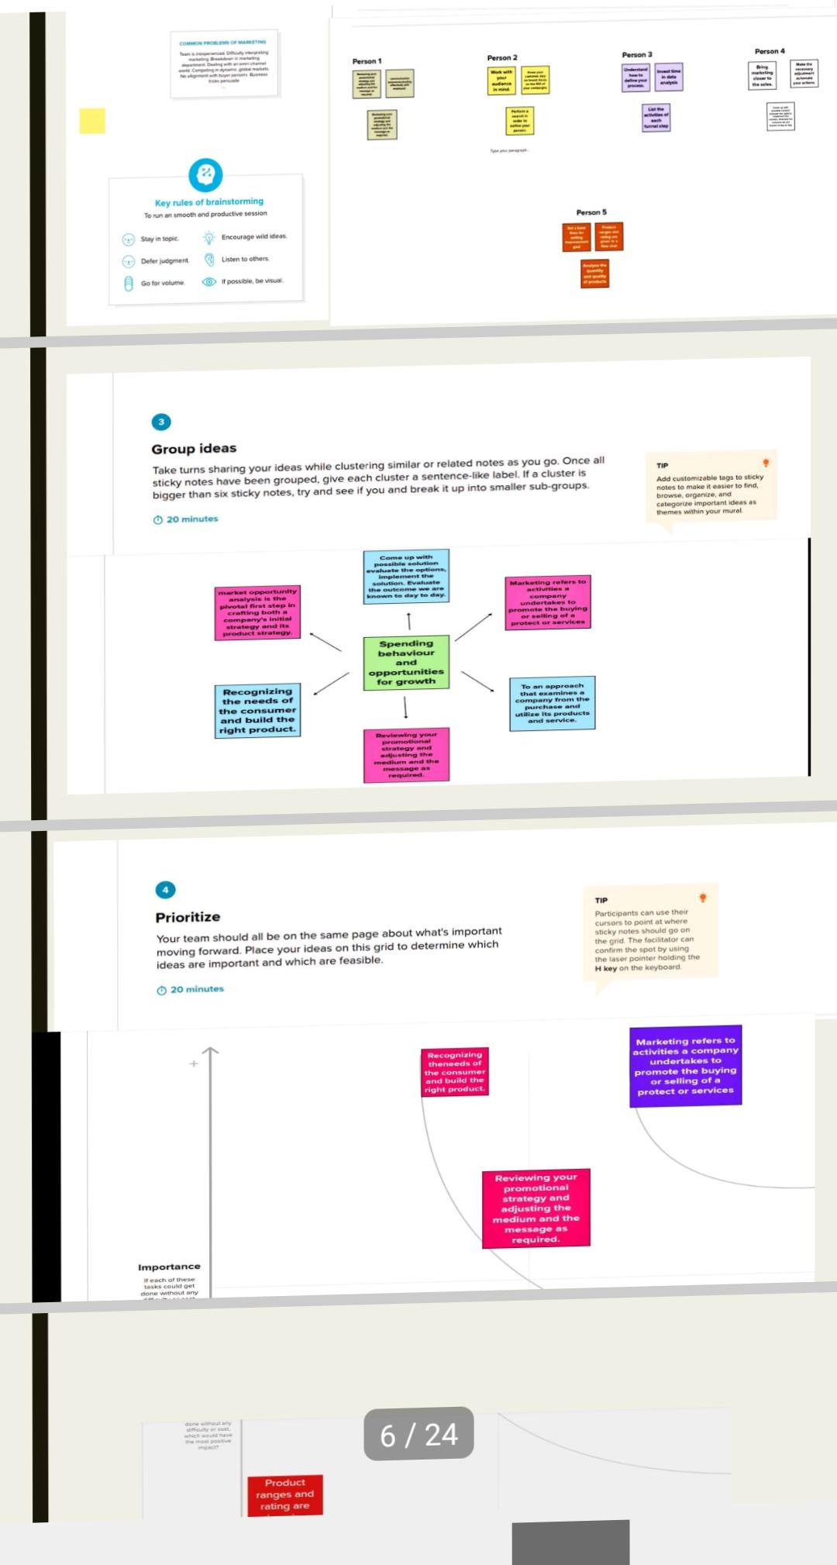
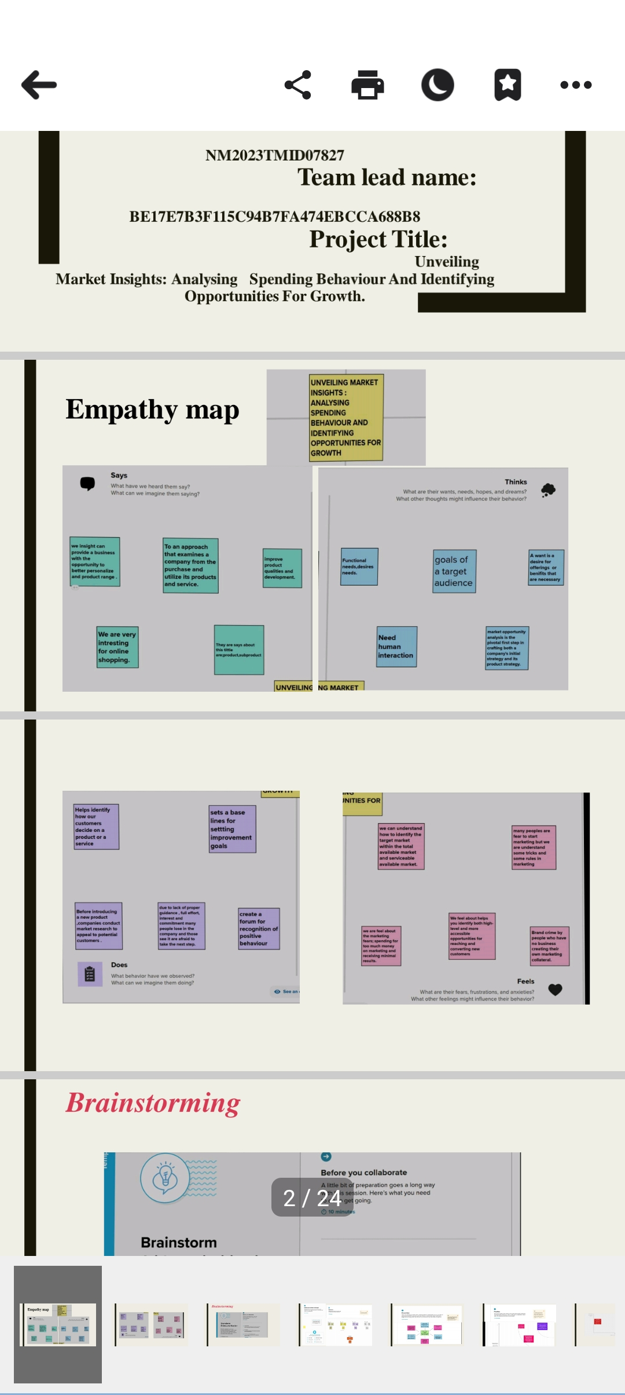
We are designed the empathy map and brainstorming for defining problems

Slide 6
DESIGN THINKING

Slide 7
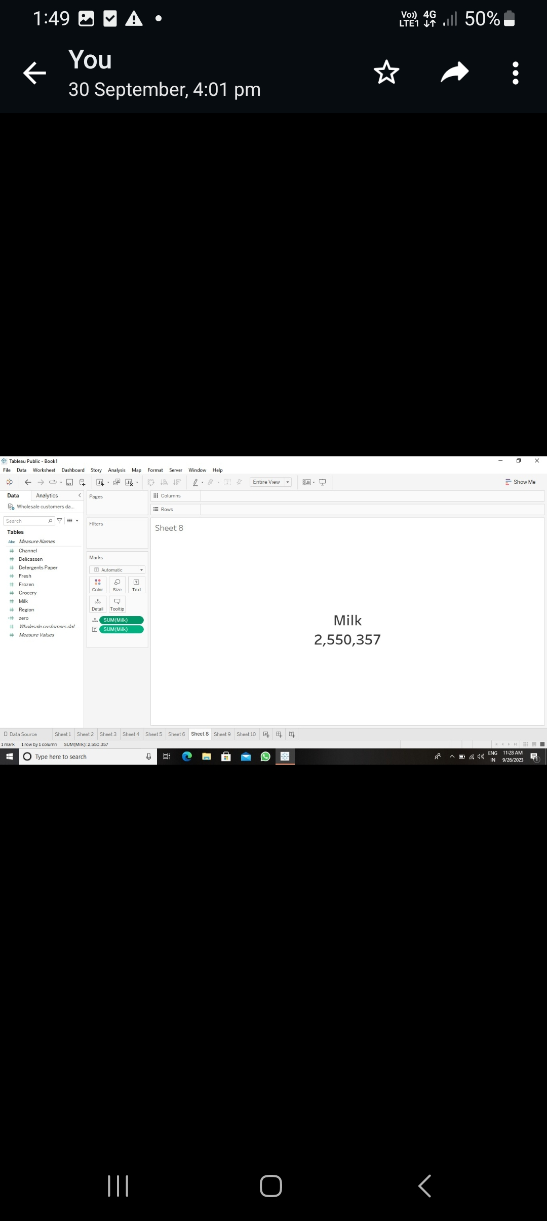
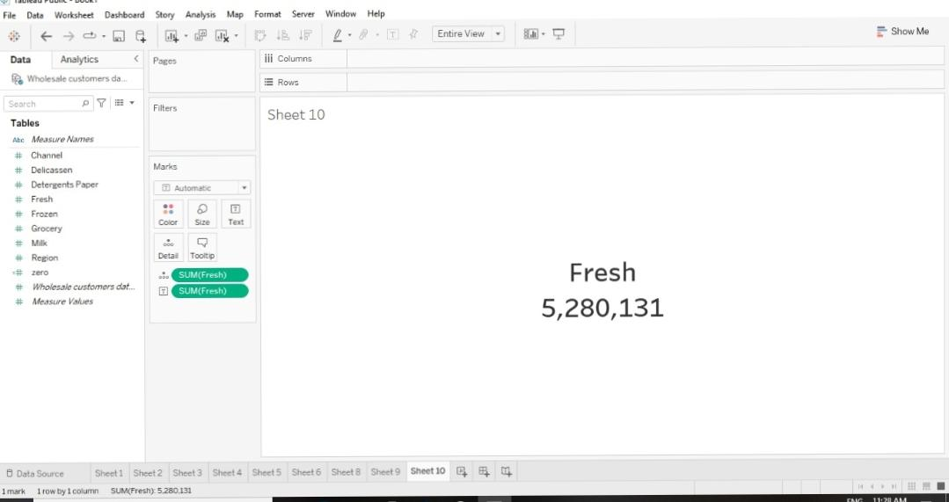
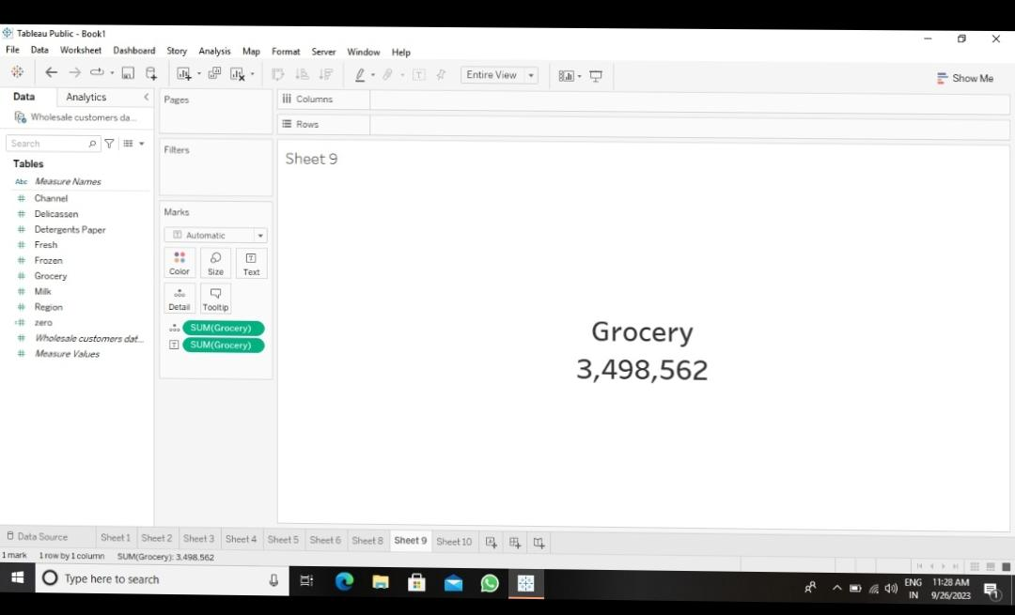
WE ARE MAKE THE DATA VISUALIZATION 1.KPI’S FOR MILK,GROCERY, FRESH

Slide 8
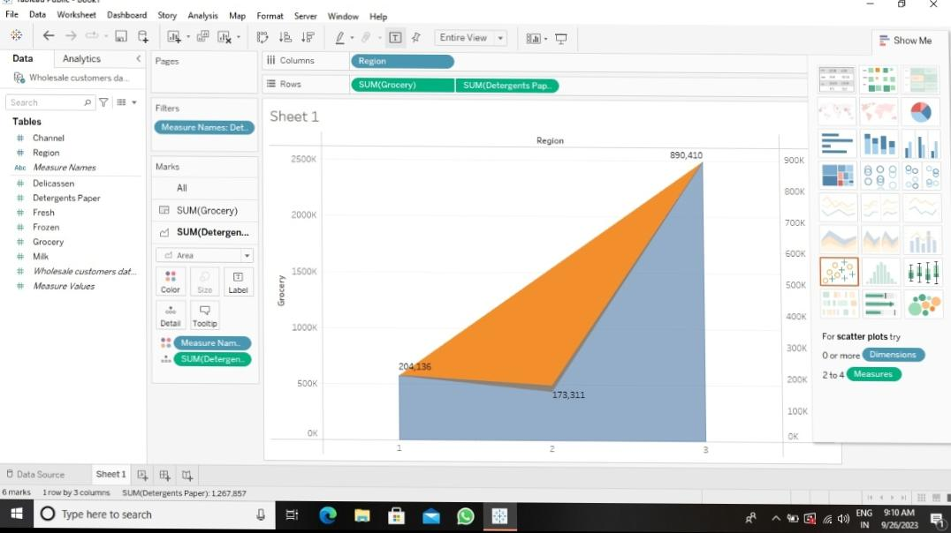
Region Wise Grocery and Detergent Paper

Slide 9
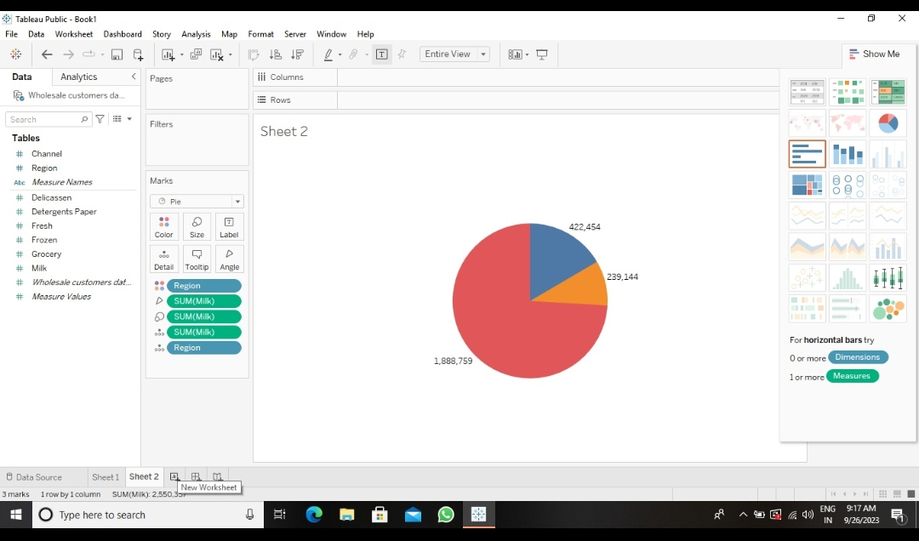
Region Wise Milk

Slide 10
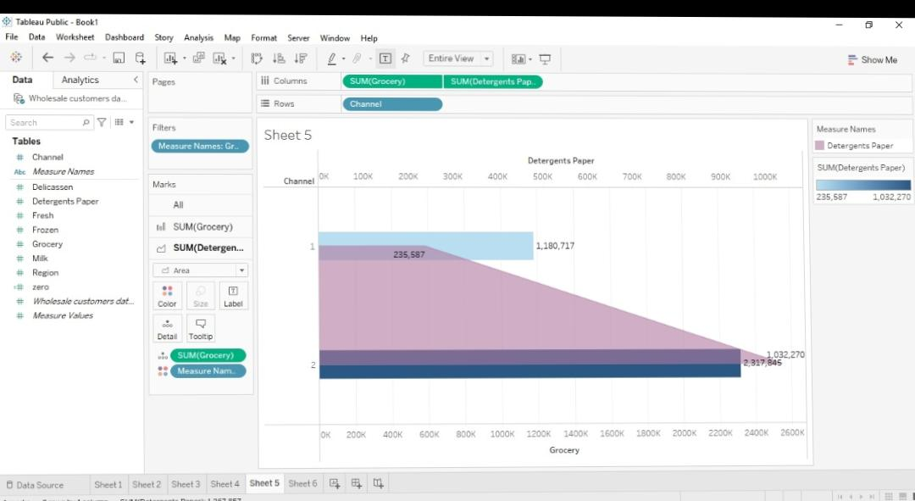
Channel Wise Grocery and Detergent Paper

Slide 11
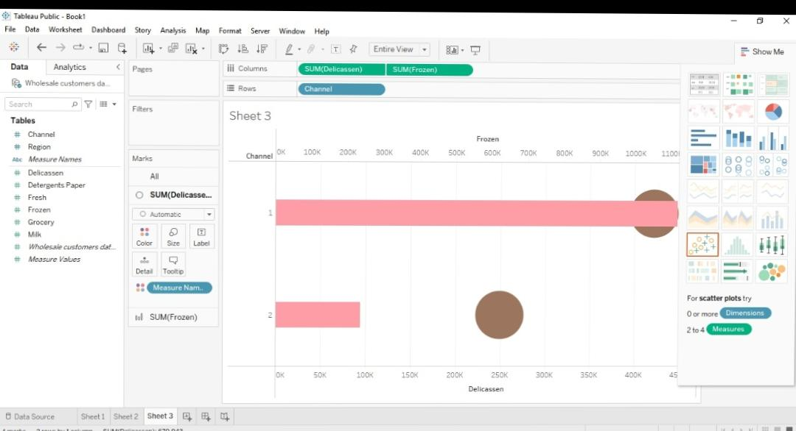
Channel Wise Delicatessen And Frozen

Slide 12
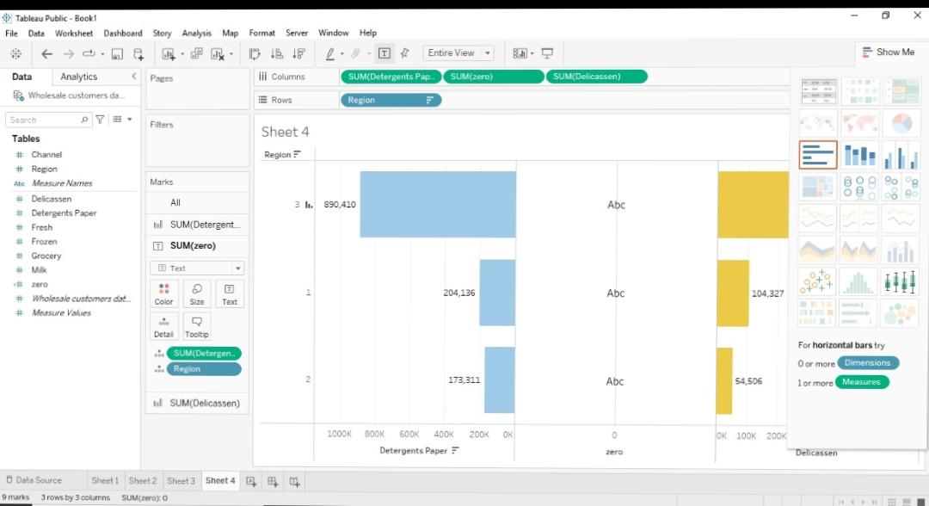
Region Wise Detergent Paper And Delicatessen

Slide 13
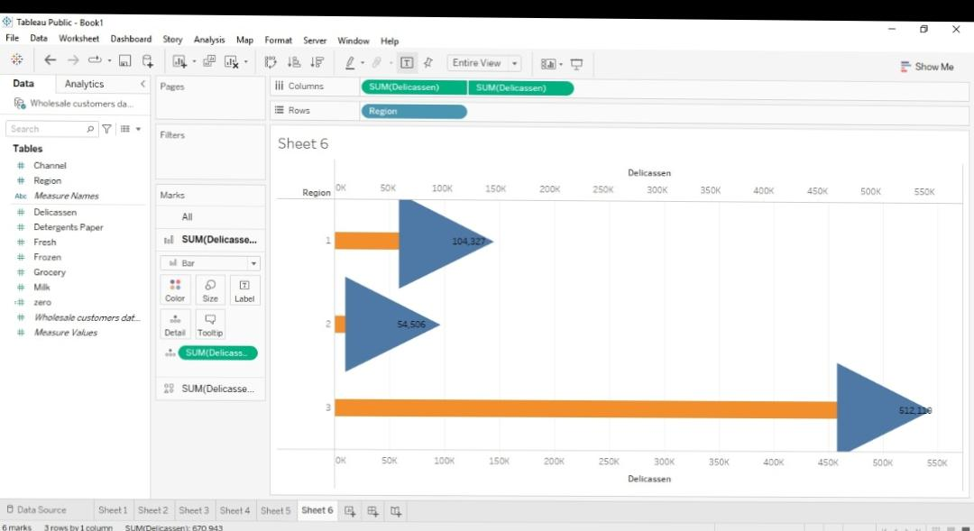
Region Wise Delicatessen

Slide 14
Result

Slide 15
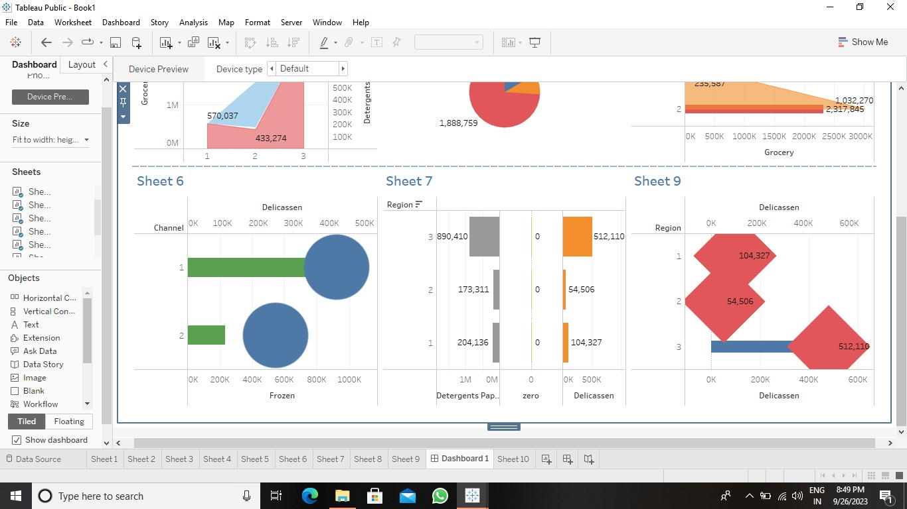
DASHBOARD

Slide 16
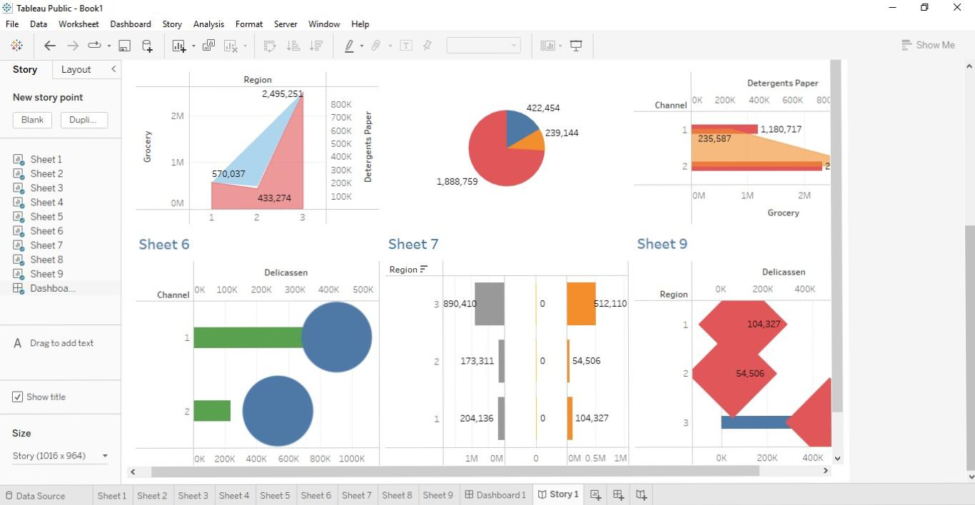
Story

Slide 17
UPLOADED LINK:
https://public.tableau.com/app/profile/anushya.selvam/viz/WholesalercustomerAnalysis/Dashboard1?publish=yes
This is the Dashboard published link.
https://github.com/Anushyaselvam/unveiling-market-insights-Analysing-spending-behaviour-and-identifying-opportunities-fop-growth.git
This is the Empathy map and brainstorming uploaded link.

Slide 18
ADVANTAGES AND DISADVANTAGES

Slide 19
ADVANTAGES
This project is very useful for understand the data base of wholesale customer analysis.
It is very useful to improve our technical knowledge.
DISADVANTAGES
But this 14 days trial is disappointment for our project.
Because our project is very long duration but trial is only 14 days.

Slide 20
CONCLUSION
Finally me and my team members are analysing the dataset for wholesale customers.
And we are learning how create the empathy map , brainstorming, data visualization, dashboard and create story of that data base.

Slide 21
Future scopes
This project is very useful for our future guidance.
We are hope this project is useful for our future workspace.
Because we are learn how to use tableau .
And how to create empathy ,brainstorming, data visualization, dashboard and story .

Slide 22
Appendix
Appendix was not used in our project.

Slide 23
Conclusion:
This project is used to analyse the wholesale customer data’s.
And this project is very useful in our future.

Slide 24
Thank you

